Slide 1
Machine Learning with Magnets
Kyle Lennon

Slide 2
Machine Learning
Learning patterns from data
Models include:
  Clustering algorithms
  Kernel methods (SVM)
  Bayesian networks
  Neural networks
Interacting “neurons”
  Commonly binary (0/1, +/- 1)
  Activated based on local environment

Slide 3



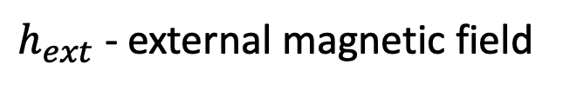


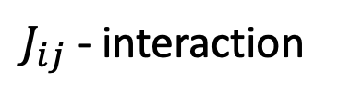

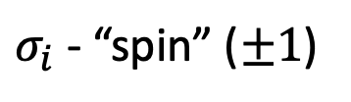


The Ising Model
Model for ferromagnetism in stat. mech.
Proposed by Wilhelm Lenz (1920)
Solved (1D) by his student, Ernest Ising (1925)
Lattice sites arranged in an undirected graph
$$J_{12}$$
$$J_{23}$$
$$J_{34}$$
$$σ_{1}$$
$$σ_{2}$$
$$σ_{3}$$
$$σ_{4}$$
$$h_{ext}$$
$σ_{i}$ - “spin” ($±1$)
$J_{ij}$ - interaction
$h_{ext}$ - external magnetic field

Slide 4

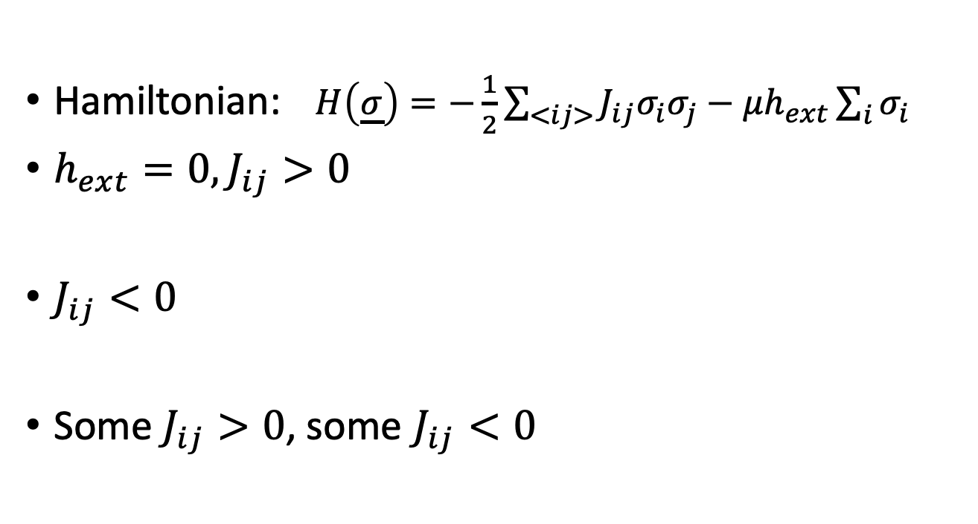







The Ising Model
$$J_{12}$$
$$J_{23}$$
$$J_{34}$$
$$σ_{1}$$
$$σ_{2}$$
$$σ_{3}$$
$$σ_{4}$$
$$h_{ext}$$
Hamiltonian: $H\left(\underline{σ}\right)=−\frac{1}{2}\sum_{<ij>}{J_{ij}σ_{i}σ_{j}}−μh_{ext}\sum_{i}{σ_{i}}$
$h_{ext}=0,J_{ij}>0$
$J_{ij}<0$
Some $J_{ij}>0$, some $J_{ij}<0$
or
(Many local min possible)

Slide 5
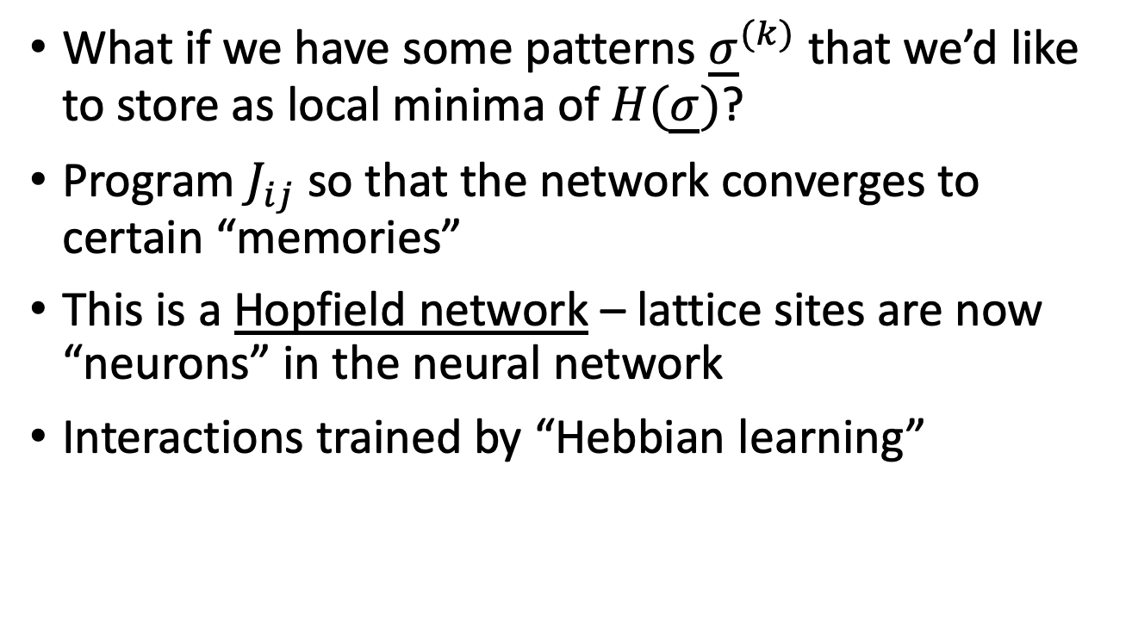
Ising Model
What if we have some patterns ${\underline{σ}}^{(k)}$ that we’d like to store as local minima of $H(\underline{σ})$?
Program $J_{ij}$ so that the network converges to certain “memories”
This is a Hopfield network – lattice sites are now “neurons” in the neural network
Interactions trained by “Hebbian learning”

Slide 6

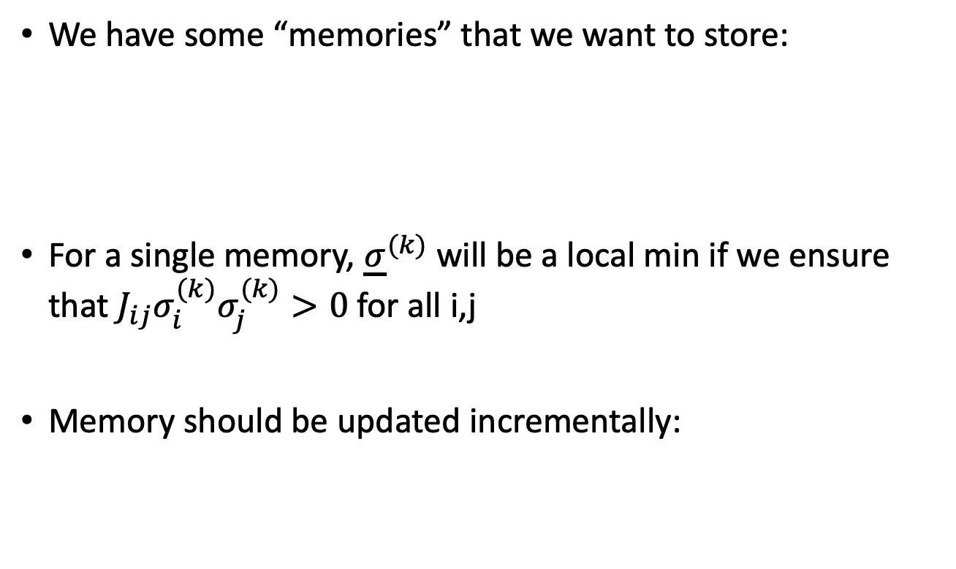
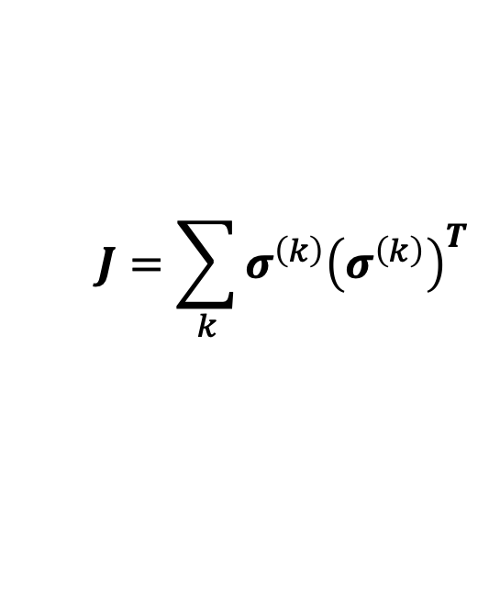
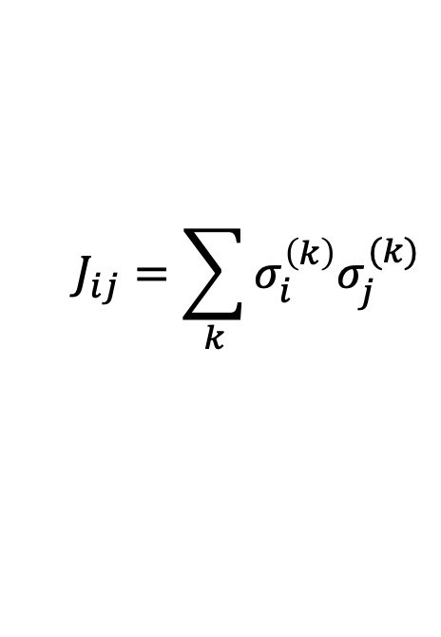
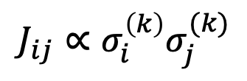
Hebbian Learning
We have some “memories” that we want to store:
For a single memory, ${\underline{σ}}^{(k)}$ will be a local min if we ensure that $J_{ij}σ_{i}^{(k)}σ_{j}^{(k)}>0$ for all i,j
Memory should be updated incrementally:
$${\underline{σ}}^{(k)}=\left(\begin{matrix}σ_{1}^{\left(k\right)} \\ … \\ σ_{n}^{\left(k\right)}\end{matrix}\right)$$
$$J_{ij}∝σ_{i}^{\left(k\right)}σ_{j}^{(k)}$$
$$J_{ij}=\sum_{k}{σ_{i}^{\left(k\right)}σ_{j}^{(k)}}$$
$$J=\sum_{k}{σ^{\left(k\right)}{\left(σ^{\left(k\right)}\right)}^{T}}$$

Slide 7

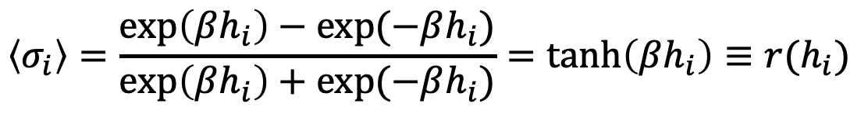


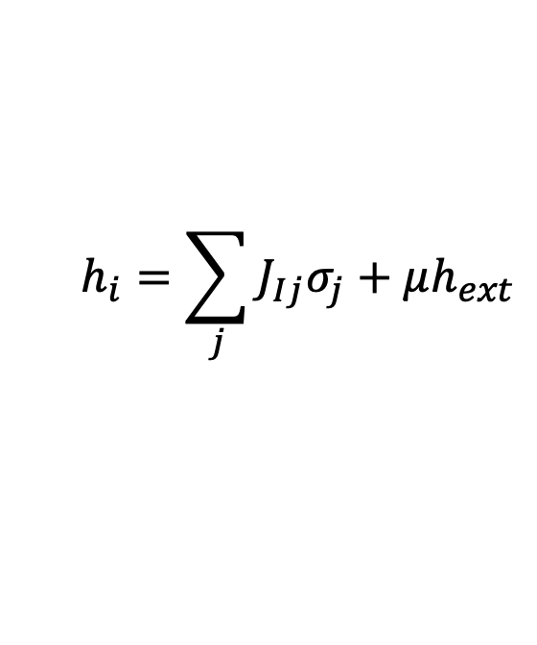
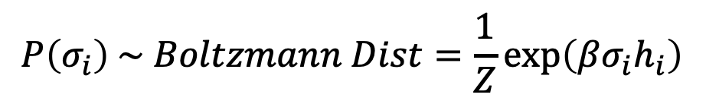
Hopfield Network
Given all $J_{ij}, h_{ext}$, what do we expect for $σ_{i}$?
$$\left\langle σ_{i}\right\rangle =\left(+1\right)P\left(+1\right)+\left(−1\right)P(−1)$$
$$P\left(σ_{i}\right) \sim Boltzmann Dist=\frac{1}{Z}\exp\left(βσ_{i}h_{i}\right)$$
$$h_{i}=\sum_{j}{J_{Ij}σ_{j}+μh_{ext}}$$
$$Z=\exp\left(βh_{i}\right)+exp⁡(−βh_{i})$$
$$\left\langle σ_{i}\right\rangle =\frac{\exp\left(βh_{i}\right)−\exp{(−βh_{i})}}{\exp\left(βh_{i}\right)+exp⁡(−βh_{i})}=\tanh\left(βh_{i}\right)≡r(h_{i})$$

Slide 8
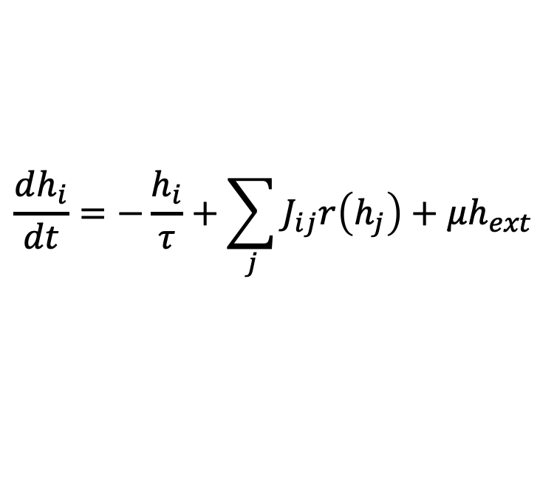
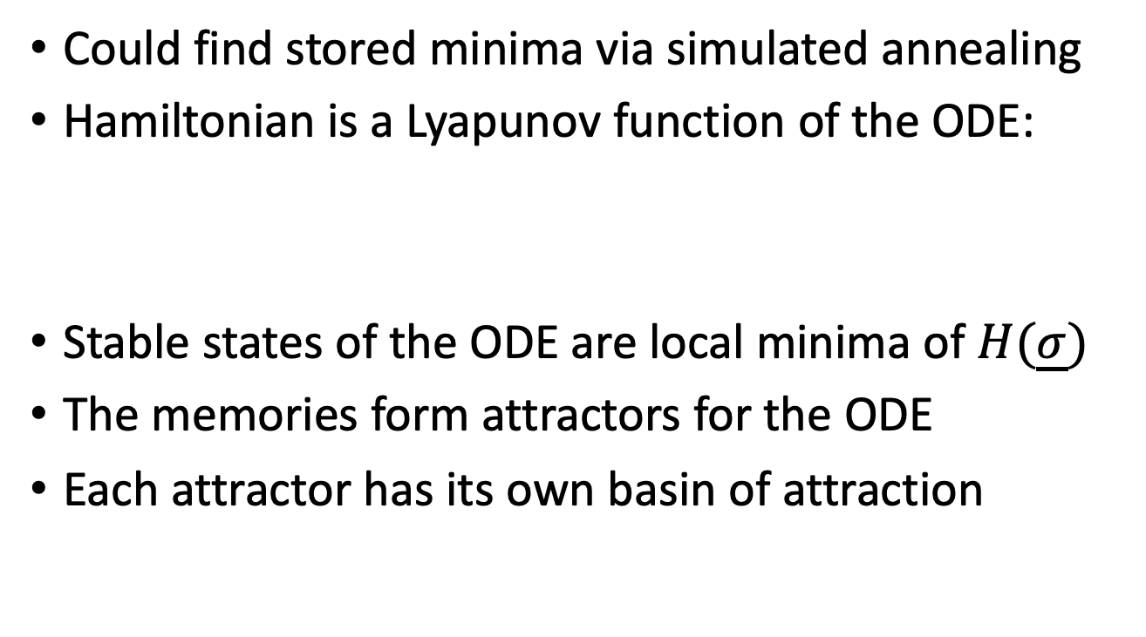
Hopfield Network
Could find stored minima via simulated annealing
Hamiltonian is a Lyapunov function of the ODE:
Stable states of the ODE are local minima of $H(\underline{σ})$
The memories form attractors for the ODE
Each attractor has its own basin of attraction
$$\frac{dh_{i}}{dt}=−\frac{h_{i}}{τ}+\sum_{j}{J_{ij}r\left(h_{j}\right)}+μh_{ext}$$

Slide 9
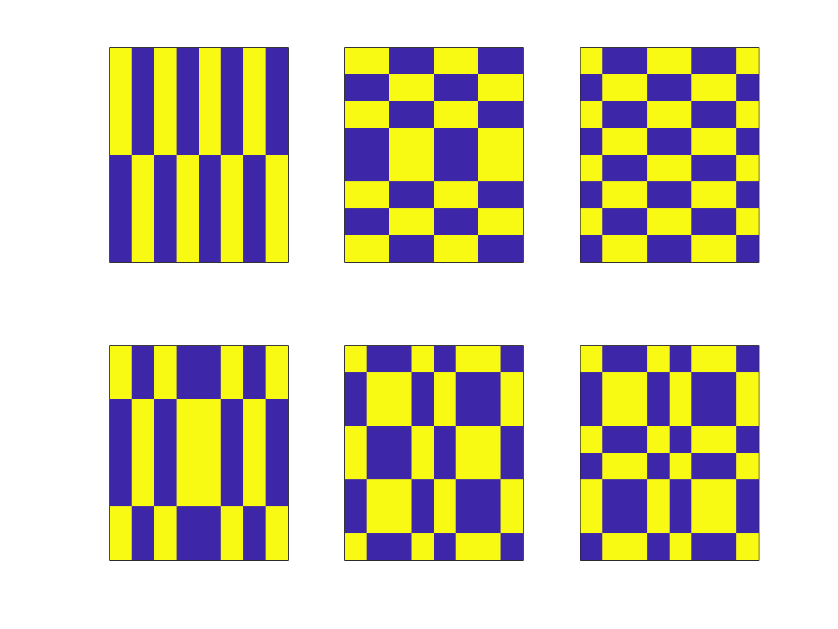
Hopfield Networks

Slide 10
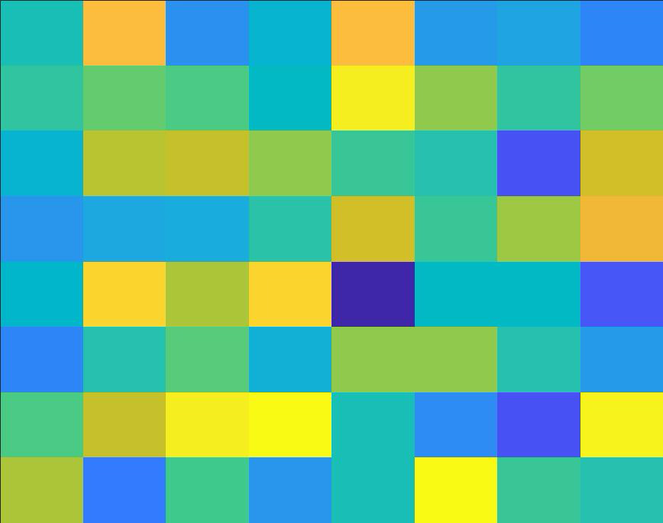
Hopfield Networks

Slide 11
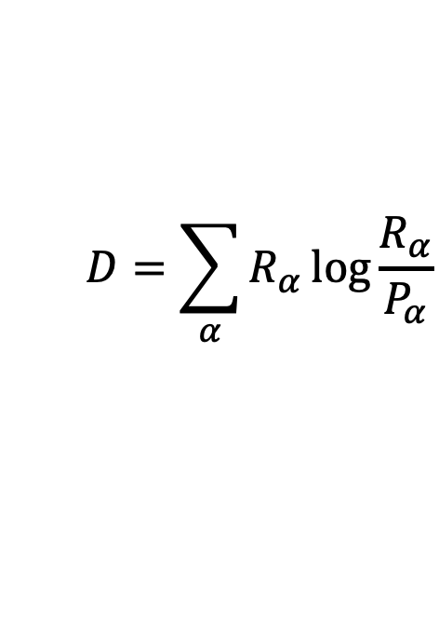
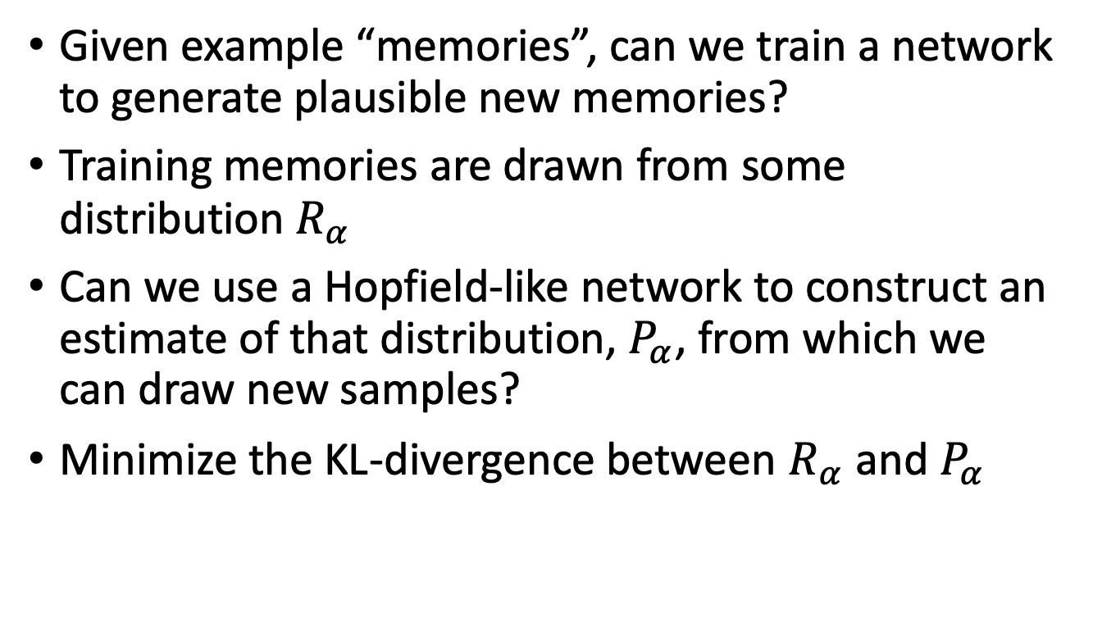
Generative Hopfield Network
Given example “memories”, can we train a network to generate plausible new memories?
Training memories are drawn from some distribution $R_{α}$
Can we use a Hopfield-like network to construct an estimate of that distribution, $P_{α}$, from which we can draw new samples?
Minimize the KL-divergence between $R_{α}$ and $P_{α}$
$$D=\sum_{α}{R_{α}\log{\frac{R_{α}}{P_{α}}}}$$

Slide 12
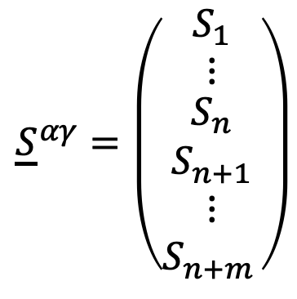
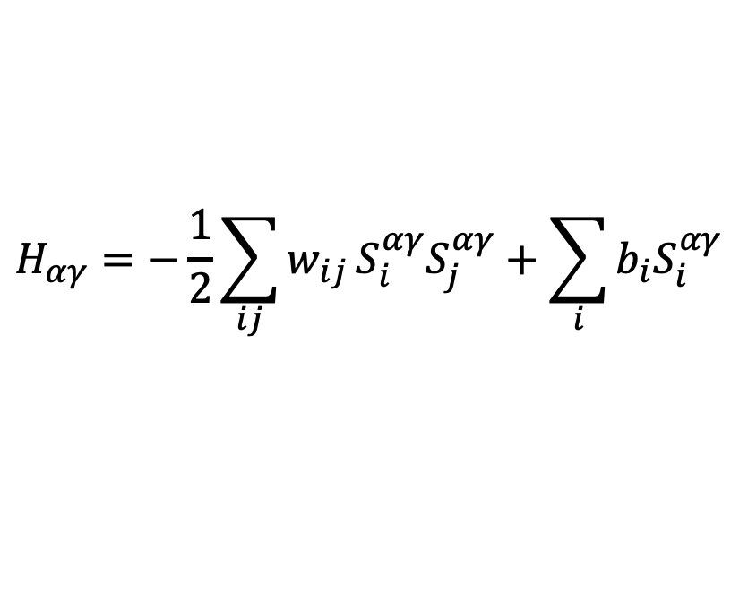


Boltzmann Machine
Add “hidden states” to the Hopfield network
$${\underline{S}}^{αγ}=\left(\begin{matrix}S_{1} \\ ⋮ \\ \begin{matrix}S_{n} \\ S_{n+1} \\ \begin{matrix}⋮ \\ S_{n+m }\end{matrix}\end{matrix}\end{matrix}\right)$$
Visible state
$$α$$
Hidden state
$$γ$$
$$H_{αγ}=−\frac{1}{2}\sum_{ij}{w_{ij}}S_{i}^{αγ}S_{j}^{αγ}+\sum_{i}{b_{i}S_{i}^{αγ}}$$

Slide 13
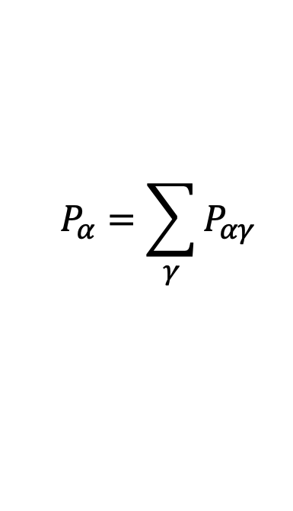
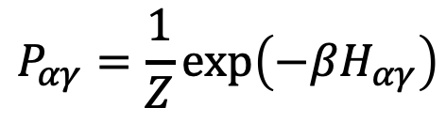
Boltzmann Machine
Still an undirected graphical model, but now only the visible states receive “inputs”
Gets its name from the Boltzmann distribution:
$$P_{αγ}=\frac{1}{Z}\exp\left(−βH_{αγ}\right)$$
$$P_{α}=\sum_{γ}{P_{αγ}}$$

Slide 14
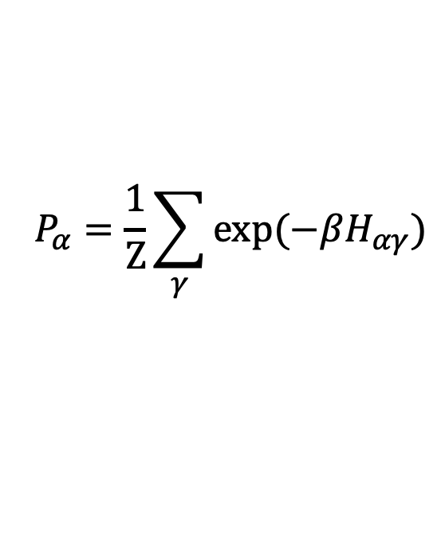
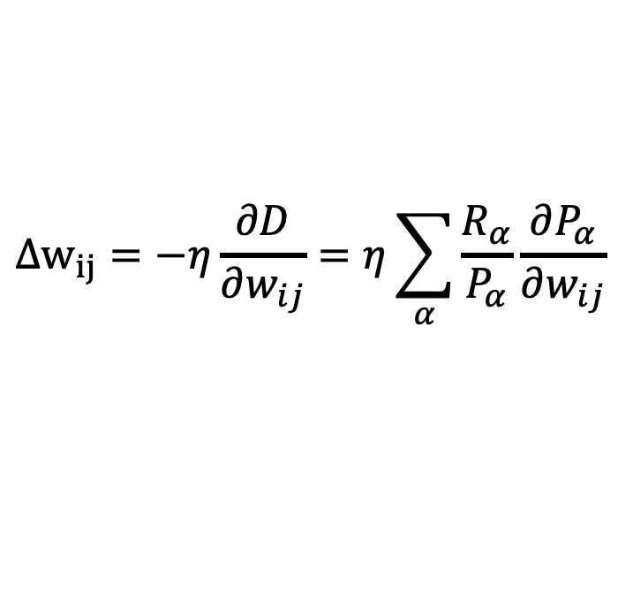
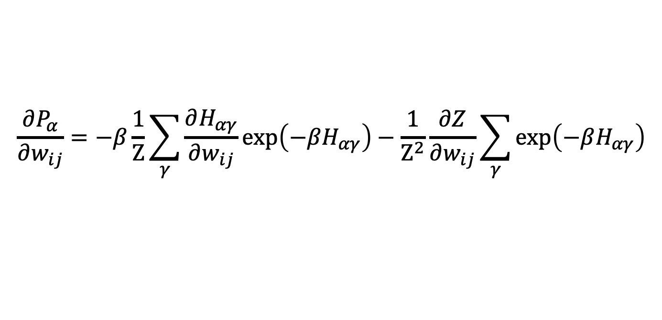
Training a Boltzmann Machine
Update rule for training the interactions:
$$Δw_{ij}=−η\frac{∂D}{∂w_{ij}}=η\sum_{α}{\frac{R_{α}}{P_{α}}\frac{∂P_{α}}{∂w_{ij}}}$$
$$P_{α}=\frac{1}{Z}\sum_{γ}{\exp{(−βH_{αγ})}}$$
$$\frac{∂P_{α}}{∂w_{ij}}=−β\frac{1}{Z}\sum_{γ}{\frac{∂H_{αγ}}{∂w_{ij}}\exp\left(−βH_{αγ}\right)}−\frac{1}{Z^{2}}\frac{∂Z}{∂w_{ij}}\sum_{γ}{\exp\left(−βH_{αγ}\right)}$$

Slide 15
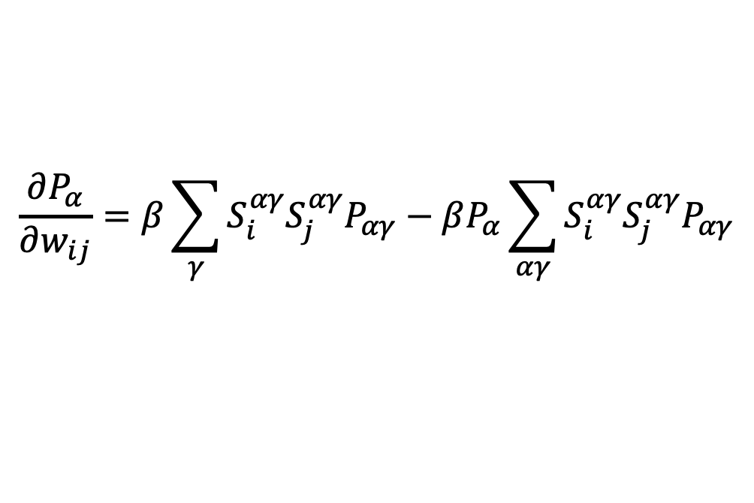
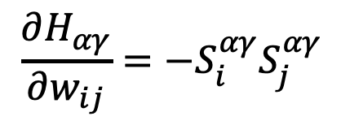

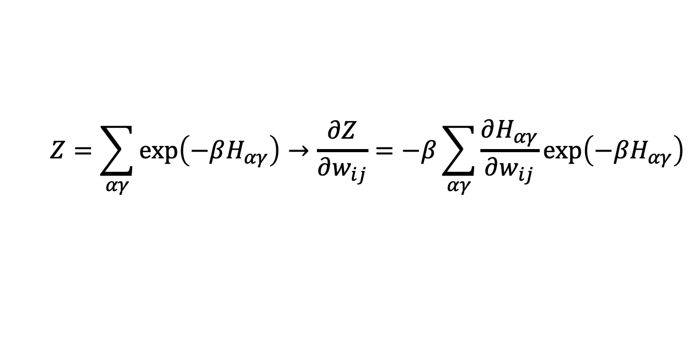



Training a Boltzmann Machine
$$Z=\sum_{αγ}{\exp\left(−βH_{αγ}\right)}→\frac{∂Z}{∂w_{ij}}=−β\sum_{αγ}{\frac{∂H_{αγ}}{∂w_{ij}}}\exp\left(−βH_{αγ}\right)$$
$$\frac{∂H_{αγ}}{∂w_{ij}}=−S_{i}^{αγ}S_{j}^{αγ}$$
$$\frac{∂P_{α}}{∂w_{ij}}=β\sum_{γ}{S_{i}^{αγ}S_{j}^{αγ}\frac{1}{Z}exp\left(−βH_{αγ}\right)}−β\sum_{γ}{\frac{1}{Z}exp\left(−βH_{αγ}\right)\sum_{αγ}{S_{i}^{αγ}S_{j}^{αγ}\frac{1}{Z}exp\left(−βH_{αγ}\right)}}$$
$$P_{αγ}$$
$$P_{α}$$
$$P_{αγ}$$
$$\frac{∂P_{α}}{∂w_{ij}}=β\sum_{γ}{S_{i}^{αγ}S_{j}^{αγ}P_{αγ}}−βP_{α}\sum_{αγ}{S_{i}^{αγ}S_{j}^{αγ}P_{αγ}}$$

Slide 16

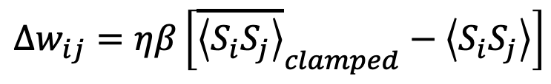

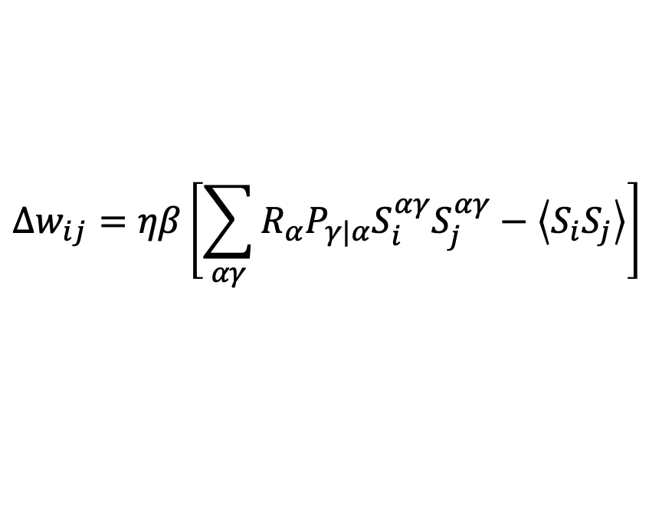

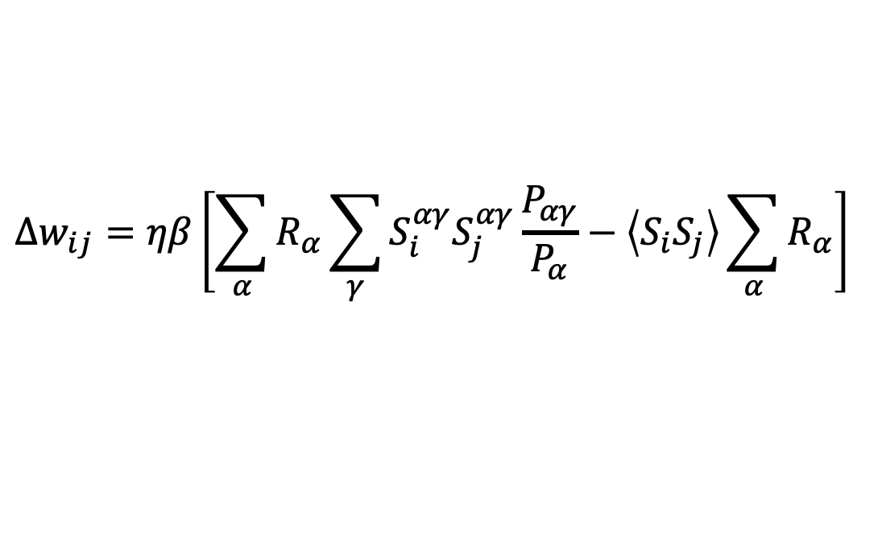
Training a Boltzmann Machine
$$\frac{∂P_{α}}{∂w_{ij}}=β\sum_{γ}{S_{i}^{αγ}S_{j}^{αγ}P_{αγ}}−βP_{α}\sum_{αγ}{S_{i}^{αγ}S_{j}^{αγ}P_{αγ}}$$
$$\left\langle S_{i}S_{j}\right\rangle$$
$$Δw_{ij}=ηβ\left[\sum_{α}{R_{α}\sum_{γ}{S_{i}^{αγ}S_{j}^{αγ}\frac{P_{αγ}}{P_{α}}}}−\left\langle S_{i}S_{j}\right\rangle \sum_{α}{R_{α}}\right]$$
$$P_{γ|α}$$
$$Δw_{ij}=ηβ\left[\sum_{αγ}{R_{α}P_{γ|α}S_{i}^{αγ}S_{j}^{αγ}}−\left\langle S_{i}S_{j}\right\rangle \right]$$
$$Δw_{ij}=ηβ\left[{\overline{\left\langle S_{i}S_{j}\right\rangle }}_{clamped}−\left\langle S_{i}S_{j}\right\rangle \right]$$

Slide 17
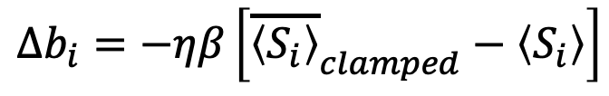
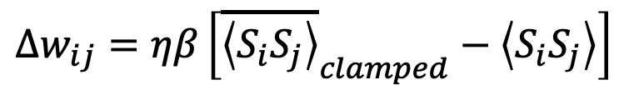

Training a Boltzmann Machine
$$Δw_{ij}=ηβ\left[{\overline{\left\langle S_{i}S_{j}\right\rangle }}_{clamped}−\left\langle S_{i}S_{j}\right\rangle \right]$$
$$Δb_{i}=−ηβ\left[{\overline{\left\langle S_{i}\right\rangle }}_{clamped}−\left\langle S_{i}\right\rangle \right]$$
Clamped
Free
$${\underline{σ}}^{(k)}=[σ_{1} σ_{2} σ_{3} σ_{4}]$$

Slide 18
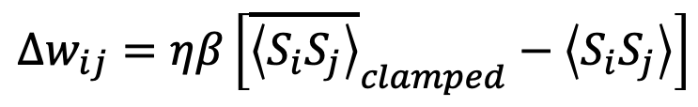
“Biological” Interpretation
Crick and Mitchison (1983) – “reverse learning” might occur in mammals during REM sleep
Training in a Boltzmann machine is said to occur in “wake-dream” cycles
$$Δw_{ij}=ηβ\left[{\overline{\left\langle S_{i}S_{j}\right\rangle }}_{clamped}−\left\langle S_{i}S_{j}\right\rangle \right]$$
Learning
Reverse Learning

Slide 19
Applying Boltzmann Machines
Restricted Boltzmann Machine
Deep Belief Network

