Slide 1
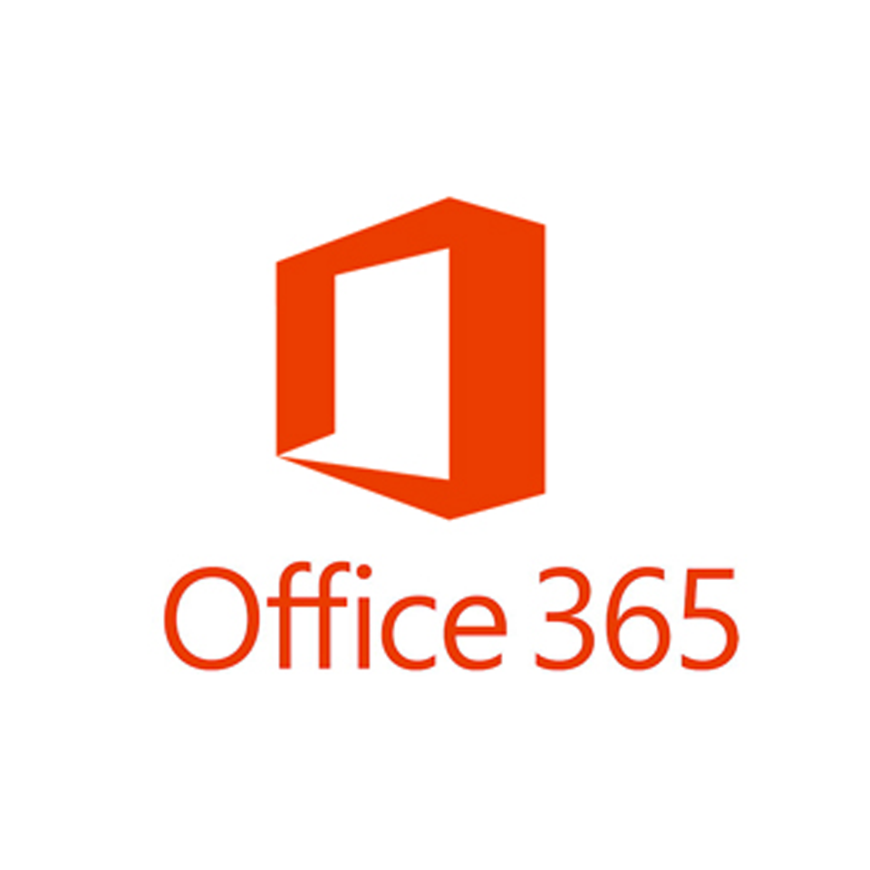


Office 365: Core Services and win.mit.edu
Microsoft Licensing Changes
What is Office 365
SharePoint Online
OneDrive
Azure Active Directory
WIN.MIT.EDU
Moira integration models
Cloud Storage
Operating system lifecycles
Richard Edelson

Slide 2
Microsoft Licensing Changes as of July 2019
Microsoft is changing how they handle volume licensing for large organizations including Hi-Ed’s. In the past, MIT licensed products such as the Windows OS and the Office Suite for on-campus use and provided the basic cloud services at no additional cost. There was also a model where certain types of staff and affiliates counted as a portion of one person when calculating the number of people MIT was licensing products for.
The new model, called the M365 Licensing model, which becomes effective July 1, 2019, does somewhat the opposite. MIT will license the number of users it wants for the basic cloud services and we will receive volume licensing for on campus use for the Windows OS and the Office Suite. Because of this, there is a one to one correspondence of people to Office 365 user accounts, no longer counting certain categories and a partial person count.
One impact of the new licensing model is additional cost due to how people are counted. This may result at some point in offering more granular tiers of services for affiliates for example, those that are sponsored and those that are not.
With the new model, Microsoft is upgrading the base bundle of Office 365 licensing each fac/staff/student receives with additional Office 365 features such as a 100GB mailbox instead of 50GB. This summer IS&T will transition users licenses to the new SKU’s. some accounts will not be transitioned such as non-sponsored affiliates.
Graduating students will no longer be able to do a permanent activation of their MIT Office installation as they do today. This is effective 07/01/2019.
Server licensing has not changed much other than the total cost is based on the people count which is calculated differently with the M365 model.

Slide 3
What is Office 365?
Office 365 is a subscription based Cloud platform that combines cloud based services with Office software as a service
  Traditionally distributed Office software can connect to the cloud services as well
  Office Mobile clients are distributed via an app store
Office 365 is available to all Faculty, Staff, Students and Affiliates.
  MIT’s integration with Office 365 automatically provisions accounts and activates supported Office 365 features
  Users logon with their MIT email address
  Authentication for mobile and web clients is Touchstone enabled.
  Office 2016 supports Touchstone authentication from within the Office App
    Except for Skype
  Install Office products on up to 5 devices PCs or Macs and on other mobile devices, including Android, iPad, iPhone, and Windows tablets.
  Product activation requires logging in to Office 365 via the app using the MIT provisioned account
  Apps check online for account validation every 30 days to maintain activation. Account validation is checking to see if the account is still active.

Slide 4
SharePoint Online as a core service
SharePoint Online is a core service of Office 365 that features web content and document repositories, the latter known as OneDrive.
SharePoint Online includes an ever growing list of applications but it’s important to focus on the platforms core functions. Office 365 was launched in June of 2011 with these core workloads in mind
Microsoft bought Yammer in 2012 and introduced Groups in 2014. since then there has been a never ending parade of applications being introduced to the platform.
Skype for Business is becoming part of Microsoft Teams. Some Office 365 applications such as Teams create directory object in Azure AD that can potentially conflict with an object synched to Active Directory via Moira.
MIT is licensed for MS Teams, but accounts do not have the feature enabled at this time.

Slide 5
OneDrive Storage
  User spaces: https://mitprod-my.sharepoint.com/personal
    OneDrive for Business – 5 TB OneDrive quota
    Team or Public Sub-Site Creation (one level down only)
  Departmental spaces: https://mitprod.sharepoint.com/sites
    http://sharepoint.mit.edu will redirect to the site
    OneDrive for Business - Storage is quota based assigned by IS&T (max 25 TB)
    Team or Public Sub-Site Creation – nested sites
  MIT Directory integration of users and groups
  Supports Touchstone and DUO integrated logon
  Documents can be opened directly from Office applications

Slide 6
Azure Active Directory
  Active Directory data from campus is synchronized with Office 365 and stored in Azure AD.
  The sync is mostly to support email and syncs user accounts, groups, lists and contacts which were synced to on campus AD from Moira.
  IS&T does not sync on campus computer objects to AAD since the data is synchronized from the Exchange environment.
  DLC’s have the potential to leverage the AAD directory for applications but they must meet some criteria to scope their use only to the directory objects the application needs to use. This means limiting the scope only to the groups and users applicable to the application
  IS&T is evaluating other products which center around computer management but is not offering such services at this time.

Slide 7
WIN.MIT.EDU: Central Active Directory Services
Domain has been running since 2001, single forest model
  With the release of Active Directory, Microsoft recommended the use of a forest root domain, MIT did not follow this model and deployed a single forest model. A number of years later Microsoft retracted the root model in favor of the single forest model
  MIT was able to address the security concerns the dedicated root model was intended to provide while avoiding security issues found in some multi-domain models
  Over 1.7 million objects
Active Directory on Server 2012 R2
LDAPS support for Active Directory
MITnet DNS
  No need to run Microsoft specific DNS services
Integration with MIT Kerberos, single sign-on
  User accounts are mapped to MIT Kerberos principals
  Requirement to have host SPN record in mit.edu namespace for Kerberos integration

Slide 8
Original domain model – full Moira integration
Integration with Moira
  Users - Centralized identity management, OU admins manage groups
  Groups – Manage access to resources via group memberships
  Computers – host record in moira is for OU mapping
    not DNS dependent
  Container Hierarchy – Computer to OU mapping
    Preserves OU assignment across OS reinstalls or hardware replacement.
    No need to pre-stage computer objects in Active Directory
Original design similar to Athena model except container’s are build your own
  The Athena model was a standard software set, the WIN domain provides a baseline framework that allows OU admins to modify policies and software distribution
  The WIN domain also provides support for hosting departmental servers
User home directories
  DFS Home Directories with Previous Versions support and geographical replication
  Users files are available via multiple computers
  Users files and some applications available via Citrix including support for mobile devices

Slide 9
Hybrid of original model and a more native Microsoft model
Hybrid Container Model 2.0
  Computers not mapped in moira or pre-staged will show up in the Computers OU when first joined to AD
  Current IS&T populator application supports a hybrid container model where Moira integrated OU’s can exist side by side with non-Moira integrated OU’s
  Container administrators can choose between traditional Moira based computer management or Microsoft tools
  IS&T will still define a departments top level OU in Moira just below /Machines. Container administrators may create non Moira integrated OU’s below it
  Non Moira OU’s can only contain non Moira defined computers. A Moira defined OU can contain both Moira defined and non Moira defined computers
  Computer objects not defined in Moira can be pre-staged in the target OU then joined to AD, this allows placement of the object in the target OU
  Moira mappings aren’t going away now, they will still work of for those using them. Populator will still move a Moira defined computer to its target OU

Slide 10
Why move to Cloud Storage?
Many cloud services are offering free storage for users at Hi-Ed institutions
  Cost savings, better scalability
Microsoft provides every user at MIT 5TB of user storage for free as part of it’s OneDrive for Business offering vs the default DFS quota of 2GB.
Connecting to OneDrive has been built into native Office applications
Users are now becoming more familiar with these services
Cloud storage services provide easier access to data for mobile devices
Better position the environment to transition to cloud based services

Slide 11
Operating Systems Lifecycles
We have a few operating system versions going out of support during January of 2020.
Windows 7 SP1 - 1/14/2020
Windows Server 2008 SP2 - 1/14/2020
Windows server 2008 R2 SP1 - 1/14/2020
Windows 10 Enterprise, version 1709 - 4/14/2020
MS SQL 2008 - 07/09/2019
These products will no longer receive security patches from Microsoft
Computers need to be upgraded or replaced
Better position the environment to transition to cloud based services
IS&T has plans to deploy Windows 10 Enterprise version 1909 via WSUS during January

Slide 12
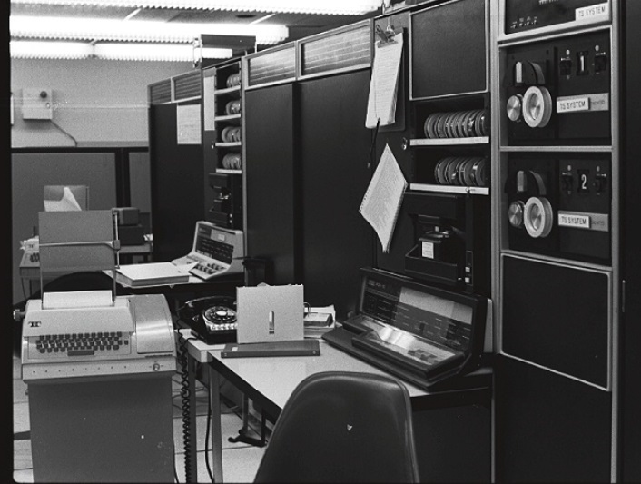
Update on email services @MIT
Brief history of email @MIT
  Brief description of older email services
  Email hygiene product history at MIT
  Spam Quarantine
  Cyrus IMAP
  MIT Alum email
  Exchange and Integrated calendaring
  IMAP / Exchange Hybrid
  Exchange / ExchangeOnline Hybrid
State of email services up to 12/03/18
DDoS attack of 12/03/18
Remediation of attack and changes
  EOP: ExchangeOnline Protection
  EOP for MIT Alum email
  Experiences with SPF, SRS, DMARC, DKIM
  New email forwarding behaviors
  Dude, where's my NDR?
  Spam quarantine vs. junk email folder
First email sent in 1971 at BBN between two systems
Richard Edelson

Slide 13
Brief description of older email services
Some forms of email services had been included in project Athena for a number of years, the latest being kpop service.
The first messaging functionality was system specific and had existed since the 60’s at MIT and in other institutions, but did not traverse multiple systems.
During the mid-90’s the Athena email services were replaced by Cyrus IMAP servers.
The Cyrus IMAP servers went through a number of iterations over the course of about fifteen years until it was retired.
IMAP and kpop were supported until the platform was retired when pop was no longer a supported method for retrieving email. Both supported MIT Kerberos for authentication.
Microsoft Exchange at MIT launched as a pilot running Exchange 2007 in late 2008.

Slide 14
  Email hygiene product history at MIT
Due to the rapidly rising frequency of malicious senders on the internet the volume of spam and virus email began to spike quickly such that in-house efforts to combat them were no longer scalable.
The first email Anti-Virus / Spam product IS&T put in front of its email services was Spam Assassin about fifteen years ago. Prior to that email hygiene was mostly an “in-house” effort.
The second product IS&T implemented were Barracuda email appliances. These were rather short lived due to the products scalability issues with the large email traffic MIT was receiving and hardware reliability issues by the vendor.
The most recent email hygiene IS&T deployed was Symantec Brightmail. This product was fairly effective and scalable, it was used as a mail front end for over ten years until just recently

Slide 15
  Spam Quarantine
Unlike todays anti-virus and anti-spam products, the earlier versions of the products did not have as efficient resources to identify spam in realtime with the same lever of confidence as we do today. There were regular data downloads but the heuristics was simply not as extensive and mature.
For this reason, and because parsing good and bad mail was something new for the MIT community, much of the mail flagged as spam was delivered to a spam folder in the users mailbox.
As the volume of spam grew tremendously, these folders began to hold the majority of the data in the users mailboxes, also because users did not do maintenance on them to delete unwanted messages.
This bloat of email data due to spam had catastrophic consequences when there was a SAN storage issue with one of the Cyrus IMAP servers which resulted in an outage that took a few days to recover due to the volume of spam on the file systems.
The result of this outage was community by-in to use the spam quarantine functionality provided in Symantec Brightmail. Something previously resisted by the community.
People discovered that spam quarantine is not perfect, but it provided stability to the email system. IS&T spent some time working with the community gathering feedback to modify the quarantine system to meet peoples expectations as much as possible, and this was an ongoing effort during the subsequent years.

Slide 16
MIT email –Cyrus IMAP architecture: Logical view
Clients
UNIX IMAP mailbox servers
UNIX Webmail servers
Load balanced
Incoming mail
Anti-Spam Appliances
DMZ inbound mailers
DMZ outbound mailers
SAN storage
Spam scoring
Anti-Virus
Load balanced
outbound mail
Outgoing mailers
Load balanced
TechTime – standalone calendaring service

Slide 17
  Alum email
MIT provides an Email for Life service (EFL) which operates outside of the general MIT Campus email services.
The MIT Alum email service is a forwarding-only service, MIT does not provide email storage services.
After Alumni have registered for an Infinite Connection account their identity resides in a dedicated LDAP directory for the Alum email service.
Infinite Connection provides a web interface were a user can enter or modify forwarding addresses they wish to use.
A spam quarantine interface was also provided as part of this service via a dedicated instance of Symantec Brightmail, similar to the campus email service.

Slide 18
MIT email – MIT Alum architecture: Logical view
Incoming mail
outbound mail
Anti-Spam Appliances
MIT Alum mailers/forwarding
DMZ outbound mailers/
Anti-spam appliances
Infinite Connection website
MIT Alum LDAP Directory
Clients

Slide 19
  Exchange and Integrated calendaring
Cyrus IMAP and TechTime were two independent systems, no integrated calendaring.
Exchange offered an integrated address book for email and calendaring.
Users who do not administer a conference room can “invite” the room as a self service feature. This is a change in behavior from TechTime where people relied on administrative staff.
IS&T did a server side migration of existing user data in TechTime to facilitate the transition.
With Exchange, users can also receive calendar invites from external systems via email.

Slide 20
MIT email: Logical view Cyrus IMAP/Exchange Hybrid
DMZ Anti-Spam/Virus Appliances
MX records mit.edu
Webmail servers
Load balanced
IMAP mailbox servers
Clients
inbound mail
Exchange Anti-Virus
Appliances/Spam-quarantine
MX records exchange.mit.edu
DMZ inbound mailers
DMZ outbound mailers
Anti-Spam/Virus appliances
SAN storage
outbound mail
Exchange outbound Edge
Transport servers
Outgoing mailers
Load balanced
Exchange outbound hubs
Exchange inbound hubs
DMZ MX records exchange.mit.edu
Outgoing mailers
outgoing-exchange.mit.edu
Load balanced
ldap.mit.edu
exchange-forwarding.mit.edu
split/forwarded for internal users
Active Directory
Moira
Exchange
Clients
SAN storage
Exchange webmail and web proxy servers
Load balanced: https and IMAP
Exchange mailbox servers

Slide 21
Exchange Email facts
MIT has been running Exchange email since 2008
55,000+ mailboxes, ~ 120 TB of storage
Data is replicated between two Datacenters
The entire infrastructure is virtualized
User default quota is currently 15 GB
Integrated calendaring services
Front end load balancing in two data centers

Slide 22
MIT campus email: Logical view Exchange
DMZ Anti-Spam/Virus Appliances
MX records mit.edu
inbound mail
Exchange Anti-Virus
Appliances/Spam-quarantine
MX records exchange.mit.edu
DMZ inbound mailers
DMZ outbound mailers
Anti-Spam/Virus appliances
outbound mail
Exchange outbound Edge
Transport servers
Outgoing mailers
Load balanced
Exchange outbound hubs
Exchange inbound hubs
DMZ MX records exchange.mit.edu
Outgoing mailers
outgoing-exchange.mit.edu
Load balanced
ldap.mit.edu
exchange-forwarding.mit.edu
split/forwarded for internal users
Active Directory
Moira
Exchange
Clients
SAN storage
Exchange webmail and web proxy servers
Load balanced: https and IMAP
Exchange mailbox servers

Slide 23




Exchange and Office 365 ExchangeOnline Hybrid
  MIT has a Hybrid model for integration with Exchange Online
    Users with an Exchange online mailbox logon via Microsoft’s web portal or use existing email clients
    Email is routed between Exchange Online and campus Exchange email routers to integrate with existing email functionality
    Quota’s of 50 GB by default, moving to 100GB this summer
    Integration with existing MIT directory services such as Moira and LDAP
    Integration allows the continued use of current redirected or split mailbox functionality
    IS&T has migrated to Exchange Online as a production pilot program
    IMAP is supported via SSL login
      GSSAPI is not supported

Slide 24
MIT campus email: Logical view Exchange and ExchangeOnline
Active Directory
Directory Sync
DMZ Anti-Spam/Virus Appliances
MX records mit.edu
Moira
MIT Touchstone Authentication
inbound mail
ExchangeOnline
Azure Active Directory
ldap.mit.edu
Exchange Hybrid front end
pool https and smtp
Exchange Anti-Virus
Appliances/Spam-quarantine
MX records exchange.mit.edu
DMZ inbound mailers
outbound mail
Outgoing mailers
Load balanced
DMZ outbound mailers
Anti-Spam/Virus appliances
Exchange inbound hubs
DMZ MX records exchange.mit.edu
Exchange outbound Edge
Transport servers
Outgoing mailers
outgoing-exchange.mit.edu
Load balanced
Exchange hubs
exchange-forwarding.mit.edu
split/forwarded for internal users
Exchange
Clients
SAN storage
Exchange webmail and web proxy servers
Load balanced: https and IMAP
Exchange mailbox servers

Slide 25
Distributed Denial-of-Service attack - 12/03/18
MIT’s on-premises email filtering infrastructure came under attack on the morning of 12/3/18.
This distributed denial-of-service (DDoS) attack disrupted delivery of email from external senders to mit.edu and alum.mit.edu addresses. Due to lack of available resources to accept incoming mail, deliveries were delayed by hours.
MIT uses Akamai Prolexic’s DDoS prevention service to protect against this class of attacks, but due to the specific nature of this attack was unable to mitigate it.
Attackers were targeting mit.edu and alum.mit.edu incoming mail via their MX records with legitimate looking traffic that Prolexic could not filter.

Slide 26
IS&T’s initial response
IS&T determined that the best path to mitigating this attack was to advance the timeline for our proposed email modernization strategy and migrate to a cloud-based email ingestion and content filtering platform: Microsoft Exchange Online Protection (EOP), part of Office 365.
This migration leveraged previous work by IS&T to support the Office 365 platform and import the MIT campus population into O365’s user directory.
The cloud-scale infrastructure provided absorbed the malicious traffic directed at MIT without affecting delivery of legitimate email.
Incoming mail to MIT.EDU addresses was completely migrated to the EOP platform the afternoon of 12/3/18.
Incoming mail for alum.mit.edu addresses was migrated to the EOP platform the evening of 12/4/18 in response to continued attacks.
Leveraged work done as part of previous day’s campus migration to keep email filtering platforms in sync between campus and EFL environments as they were previously.
Simpler migration path than alternative platforms, e.g. Google / Gmail, with fewer namespace conflicts to resolve.

Slide 27
MIT email: Logical view Exchange and ExchangeOnline + EOP
Active Directory
Directory Sync
Moira
MIT Touchstone Authentication
Forwarding only
Exchange Hybrid
front end pool
https and smtp
Inbound mail
MX record for mit.edu
ExchangeOnline
Azure Active Directory
ldap.mit.edu
DMZ inbound mailers
Outgoing mailers
Load balanced
Exchange outbound Edge
Transport servers
Outgoing mailers
outgoing-exchange.mit.edu
Load balanced
Exchange hubs
exchange-forwarding.mit.edu
split/forwarded for internal users
Exchange
Clients
SAN storage
Exchange webmail and web proxy servers
Load balanced: https and IMAP
Exchange mailbox servers

Slide 28
Email Security Technologies
SPF (Sender Permitted From) – Initial standard for improved email source authorization; allows for sites to designated IP addresses permitted to send mail from a domain.
At MIT, many decentralized systems send mail from @mit.edu addresses directly to external sites without going through central infrastructure, i.e. outgoing.mit.edu.
Use of third-party email marketing services frequently requires addition to mit.edu SPF record – concerns about scaling.
Breaks simple email forwarding without adoption of additional standards, e.g. SRS.
Resulted in intermittent issues with mit.edu email forwarding to Google / Gmail.
DKIM (Domain Keys Identified Mail) – Follow-on standard to SPF; allows for sites to cryptographically sign outgoing mail to ensure address isn’t forged and can be validated by remote recipients.
Improves upon SPF to validate more than origin IP of the email message.
Requires all mail being sent go through systems with access to private (signing) key.
Currently not in use at MIT.
Similar scaling concerns to SPF.
ARC (Authenticated Received Chain) – Successor to SPF / DKIM that resolves distribution list and forwarding issues introduced by prior technologies.
Supported by major cloud provided (Google, Microsoft)
Not currently supported by legacy MIT email handling infrastructure (Brightmail).

Slide 29
Community Impact – New Behaviors to email forwarding
Following these changes, email forwarding from @mit.edu email addresses to other email providers became less reliable due to forwarded messages failing email validation policies published and used by major email providers (Google, Yahoo, etc.).
IS&T has implemented support for Sender Rewriting Scheme (SRS) on the portion of MIT’s email infrastructure that handles email forwarding to ensure forwarded messages comply with other provider’s published policies for IP addresses allowed to originate mail from their domain.
IS&T has identified an issue with MIT’s on-premises Exchange email environment invalidating digital signatures applied to messages (DKIM) for users who forward their email.
In April, IS&T created a routing rule on Office 365 to route messages for users who forward their mail only (based on an ACL we created) to our DMZ mailers to avoid passing through the on premise Exchange environment and breaking the DKIM signed form of the email messages. This is because the Exchange mailbox server alters the message slightly and Microsoft has stated they have no plans to support a fix for this. Microsoft has implemented a solution only for Office 365.

Slide 30
Additional Community Impact
Bulk delivery via email marketing services (Mailchimp, Mailjet, etc.) affected due to more aggressive filtering performed by EOP platform:
IP address rate-limiting and blocking.
Spam and bulk email scoring.
Many email activities at MIT are not best practices on the modern internet but have worked in the past due to lax enforcement by previous email filtering technology.
On-campus community required to use new interface for spam management.
Alumni email-for-life (EFL) users currently without self-service access to spam management functionality.
IS&T has prepared both documentation for the MIT community to raise awareness of these issues and share our steps for addressing them.

Slide 31
Community Feedback & Corrective Actions
Following the migration of email filtering to EOP, IS&T has received feedback from the user community via many avenues and has worked to tune the new product to better meet the community’s needs:
Disabled Microsoft’s “bulk” email filtering – this feature is intended to quarantine messages such as newsletters and email marketing sent to many recipients. Many members of the community considered this mail solicited and wished to receive it.
Added internal infrastructure to “safe senders” list – IS&T has explicitly permitted MIT’s internal systems (Exchange, outgoing.mit.edu, Mailman, DLC infrastructure for CSAIL, Media Lab, MIT Medical) to send without being marked as spam.
Raised product issues with Microsoft – IS&T has engaged MIT’s Microsoft Premier Support team on a number of reported product issues, including anomalous spam scoring (both false positives and unexpected negatives) and performance & user experience issues in the EOP quarantine dashboard.

Slide 32
Community Impact – Alumni Email Services
IS&T implemented a quick mail routing fix on EOP for the alum.mit.edu domain to route to on campus alum mailers to mitigate the DDOS attack.
Alumni Email Forwarding for Life (EFL) users did not have accounts in MIT’s identity management systems (Active Directory, etc.) and were unable to log into Office 365 for self-service spam management after the transition to EOP.
IS&T initially planned to provision alumni users into MIT’s main Office 365 tenant but this proved unworkable due to technical limitations sharing a directory space with Moira integrated namespaces as they are propagated to Active Directory and Office 365.
Working around these limitations required obtaining new O365 tenants from Microsoft. These were obtained and alumni users provisioned at the end of January. On campus, a new Active Directory domain was provisioned just for the existing MIT Alum environment.
IS&T provisioned about 100,000 accounts for MIT Alums on ExchangeOnline in February. These accounts are integrated with Touchstone (the Alum instance) and are still a forward only email service.

Slide 33
MIT email – MIT Alum email architecture: Logical view
Active Directory
Directory Sync
Inbound mail
MX record for alum mit.edu
ExchangeOnline
Azure Active Directory
Alum LDAP
Incremental
MIT Touchstone Authentication
dedicated idp instance for alumni
Mail Forwarding only
outbound mail
Alum DMZ inbound mailers
DMZ outbound mailers/
Anti-spam appliances
Infinite Connection website
Web Clients
MIT Alum LDAP Directory

Slide 34
Dude where’s my NDR?
Another behavior change of going to EOP for users who forward all of their mail was that NDR’s (Non-Delivery Reports) were previously handled by our DMZ mailers outside of Exchange and were sent to outgoing.mit.edu to their forwarding address.
Now that we are using EOP, Microsoft routes the NDR to the Exchange mailbox of the user because in the Exchange world (on premise or on Office 365), forwarding starts with the mailbox server of the user account. This means that it’s the mailbox server of the user that has the bit set to forward the message and not store a copy in its database.
We found that NDR’s for forwarding only users were getting routed from Microsoft to the on campus Exchange hubs and after a few hops were subsequently dropped with the cause being BlockNDRToExternalUser. Years ago when the architecture was quite different we disabled NDR delivery to non defined remote domains to prevent NDR storms (yes this happened once).
We’ve now enabled remote NDR’s since we have Microsoft’s EOP to handle a lot of the potential issues associated with NDR delivery, so these messages now exit our Exchange environment back to EOP and out to the forwarded address.

Slide 35
Spam Quarantine vs. Junk Email Folder
IS&T had been offering spam quarantine for mit.edu and alum.mit.edu users for about a decade and the community had gotten very used to the service, despite some quirks here and there.
When moving to EOP, there was an expectation that the community would want the status quo of a spam quarantine service preserved, so this was enabled for users on EOP.
In a short time, it was evident that the EOP quarantine service had its own set of short comings and limitations that were burdensome even for users who were comfortable with the Brightmail spam quarantine. Examples of the issues we saw were excessive of caching in Microsoft’s quarantine web interface so it appeared that changes were not taking place, and a case where spam sent to a list could be deleted or released by anyone of the list for all members.
After looking at other institutions and email providers, IS&T concluded that spam quarantine services were mostly a thing of the past and most large email providers send spam to the users Junk Email Folder. This is possible today due to the improvements in spam detection confidence where most obvious spam is filtered by the provider and never delivered to the users junk email folder so the volume of such email actually delivered is extremely low in comparison with the technology of ten years ago.
We implemented delivery to the Junk Email Folder and disabled the EOP spam quarantine earlier this spring. In early June, a Junk Email Folder retention policy will be roller out that will delete messages after 30 days but still allow them to be recovered from deleted items for an additional 14 days. Disabling of spam quarantine and delivery to the junk email folder was also enabled for MIT Alum accounts as well.

Slide 36
Exchange on premise upgrade
Exchange users are currently having their mailboxes moved to Exchange 2013 systems.
  The migration should proceed over the summer.
Why not Exchange 2016?
  Exchange 2016 no longer allows split roles of front end and backend services. MIT’s architecture relies heavily on a front end role integrating with out load balancers and storage on the backend.

Slide 37
Questions

