Slide 1
MITvoip: Modernizing MIT’s Telephone Infrastructure
Marco Gomes, Director of Infrastructure Operations
Information Systems and Technology

Slide 2
Agenda
Overview of current systems
5ESS Retirement
Building network upgrades
Analog media gateway upgrades (Retiring CUCM)
Call center migrations from UCCX to CJP (cloud-based call centers)
Migrating on-premise VoIP and Voicemail systems to new cloud-based systems
New self-service tools
Questions

Slide 3
Overview of Current Systems
  5ESS:
  Installed in the 1980s, provides ISDN phone services (analog lines have been moved to CUCM). Currently in the process of being phased out.
  Sylantro:
  MIT Voice over IP (VoIP) system, installed in 2006 and provides the majority of telephone services for the MIT campus, approximately 16k lines.
  Cisco Call Manager
  Second generation VoIP system, installed in 2013, provides analog services for ~5k lines
  UCCX:
  Third generation call center system proving ACD services for a small number of DLCs
  Unity Voicemail:
  Third generation voicemail system installed in 2013, provides voicemail and call tree services

Slide 4
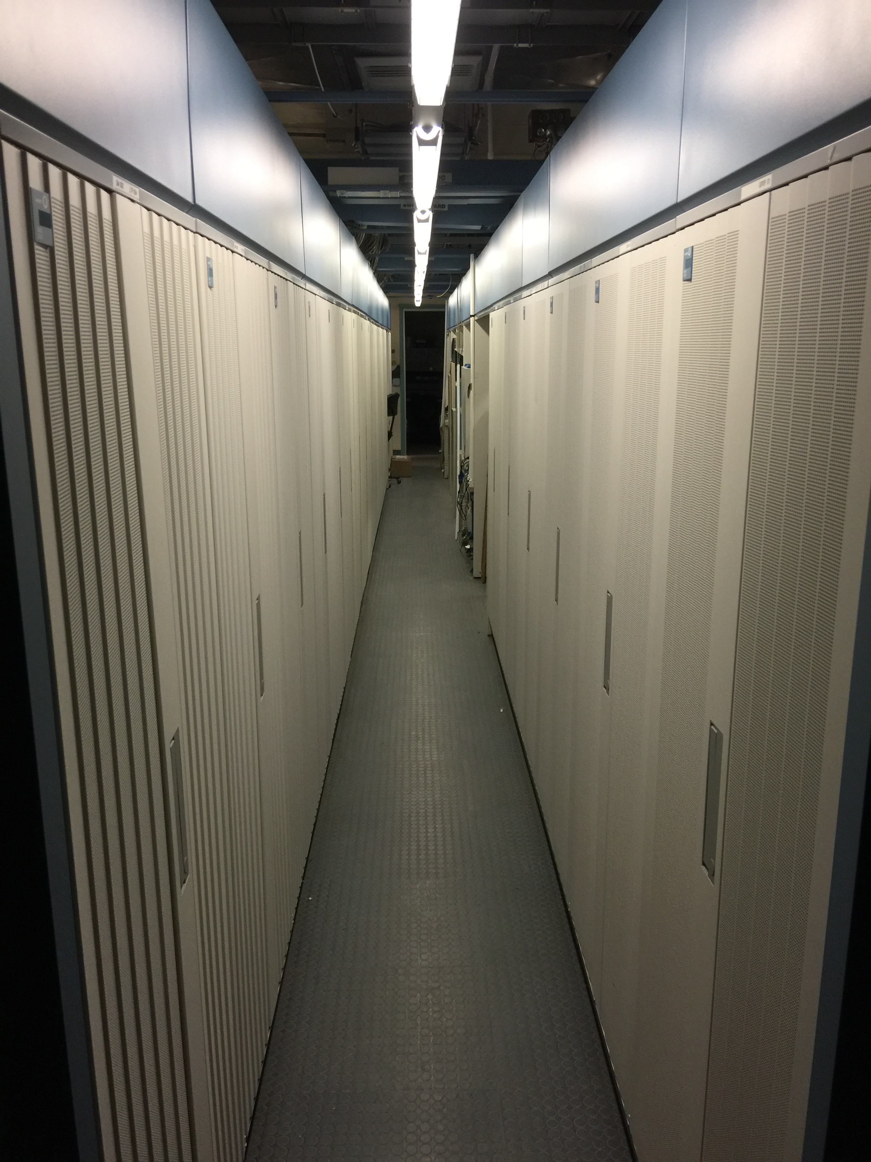
Retiring the 5ESS
The 5ESS and all of its underground copper cabling was installed in late 1980’s as part of a massive telecommunications infrastructure project to bring telephone services to the MIT campus
At the end of 2001, a new 5E55 was installed to each of the sites to ensure sustainability and compatibility to modern day standards at the time
There were over 20,000 lines served from the 5ESS before implementing MIT’s VoIP system
Support for the MIT 5ESS is no longer available after 12/31/2020
Approximately 350 lines remain on the 5ESS today

Slide 5
Network Infrastructure Upgrades to support VoIP
With support from MIT’s Capital Renewal program, IS&T launched a program in the summer of 2018 to upgrade the network in buildings with deficient infrastructure in order to support VoIP and to retire the 5ESS
These upgrades included new TRs, wiring, and electronics to support VoIP, increased throughput speeds, and better performance overall on the wired network and better Wi-Fi
Buildings identified for upgrades are NW13, NW14, NW15, NW16, NW17, NW20, NW21, NW22, 26 and building 44
Work in buildings NW16 and NW17 are complete and the phones in NW17 have been migrated to VoIP. NW16 is in the process of being transitioned
The remainder of the buildings will be upgraded by March of 2020

Slide 6
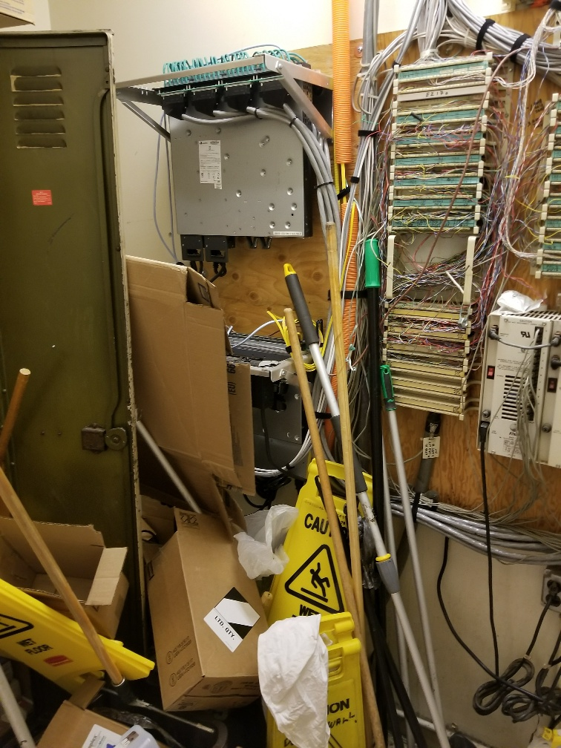
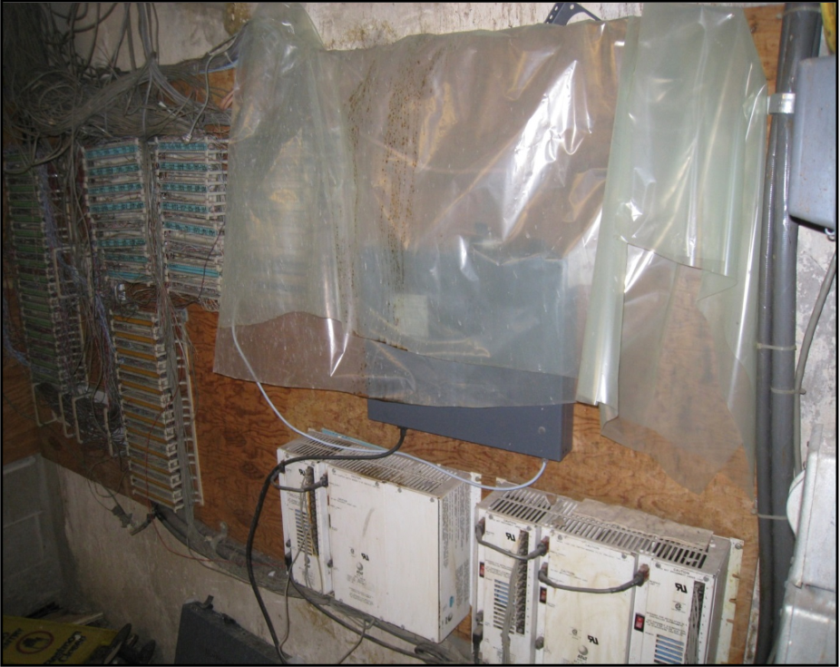
Examples of Tel/Data Rooms (TRs) in Poor Condition
Photos of existing conditions in TRs with deficient network infrastructure
NW14
NW16

Slide 7
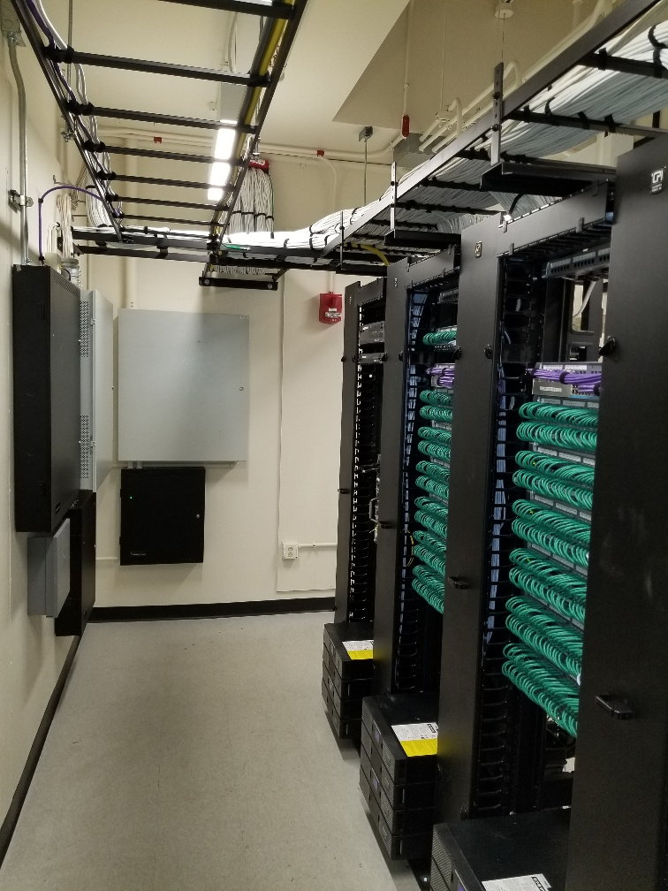
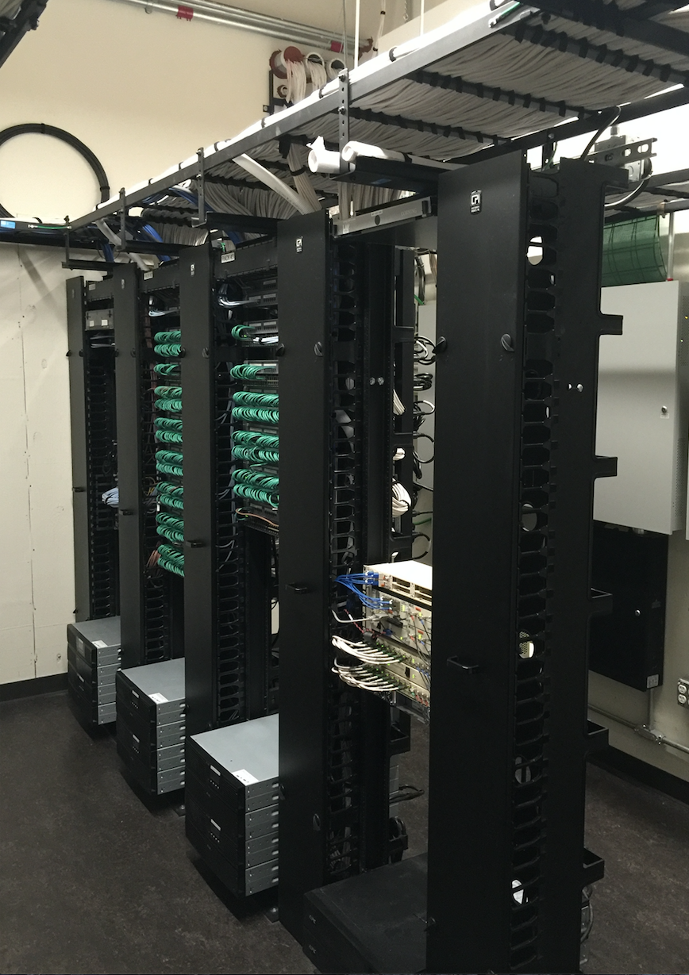
Examples of Improved Tel/Data Rooms (TRs) Supporting VoIP

Slide 8
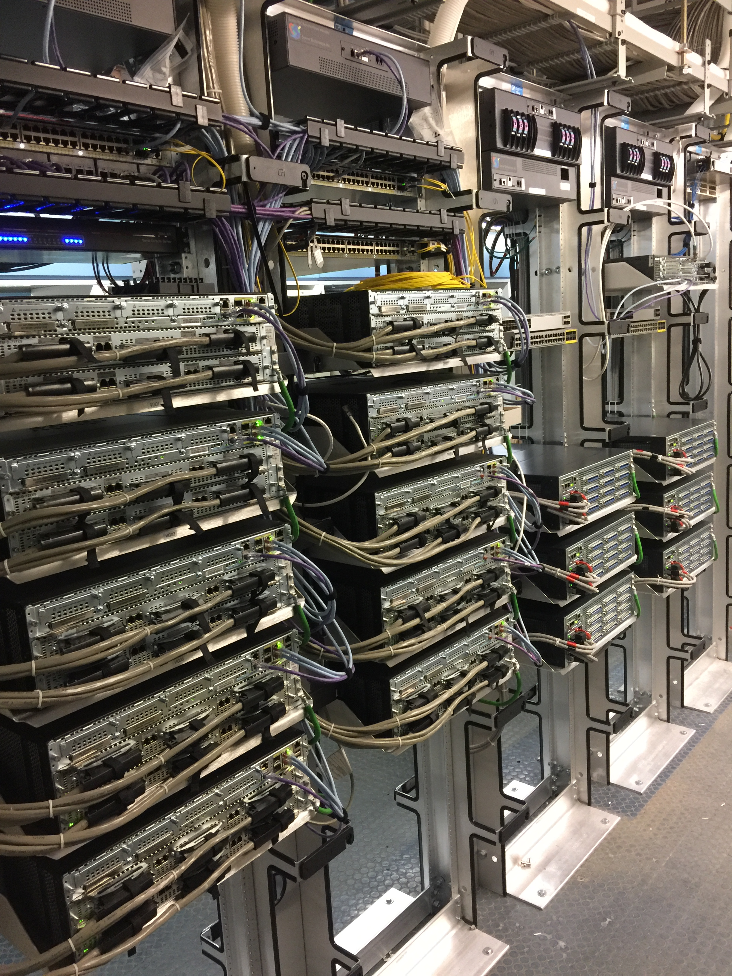
Retiring CUCM / Analog Gateway Upgrades
Approximately 5,000 lines run on CUCM (Cisco Unified Communications Manager)
Cisco VG350 Chassis’ were installed at each of the 5ESS switch sites in 2013 in an effort to migrate analog lines off of the 5ESS
These lines are used for blue light emergency phones, elevator cab phones and other services that require an analog device at a fixed location
E19

Slide 9
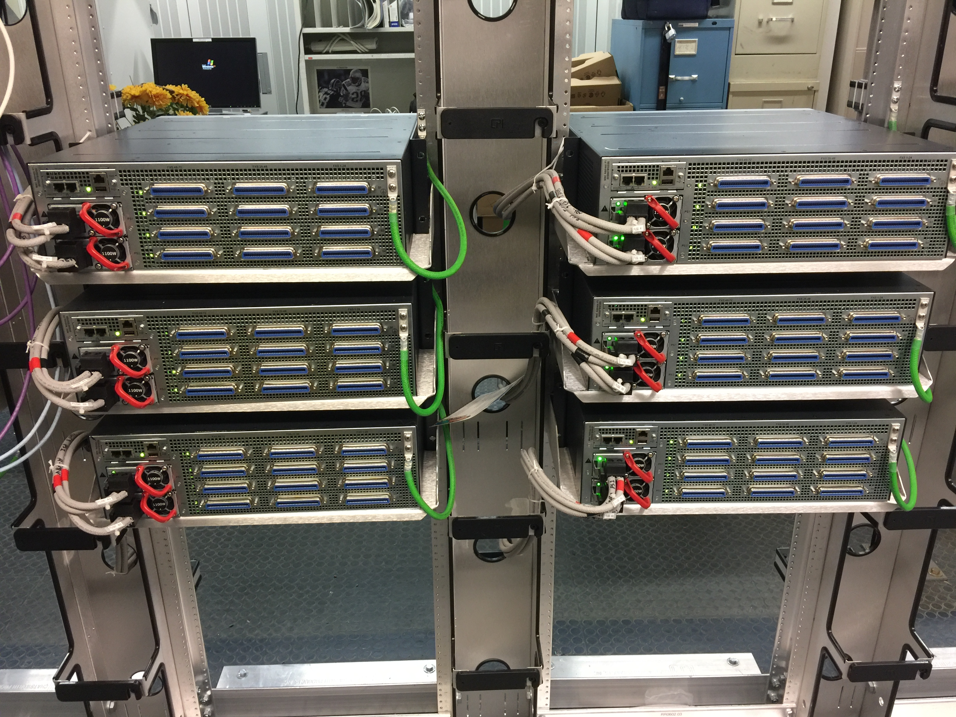
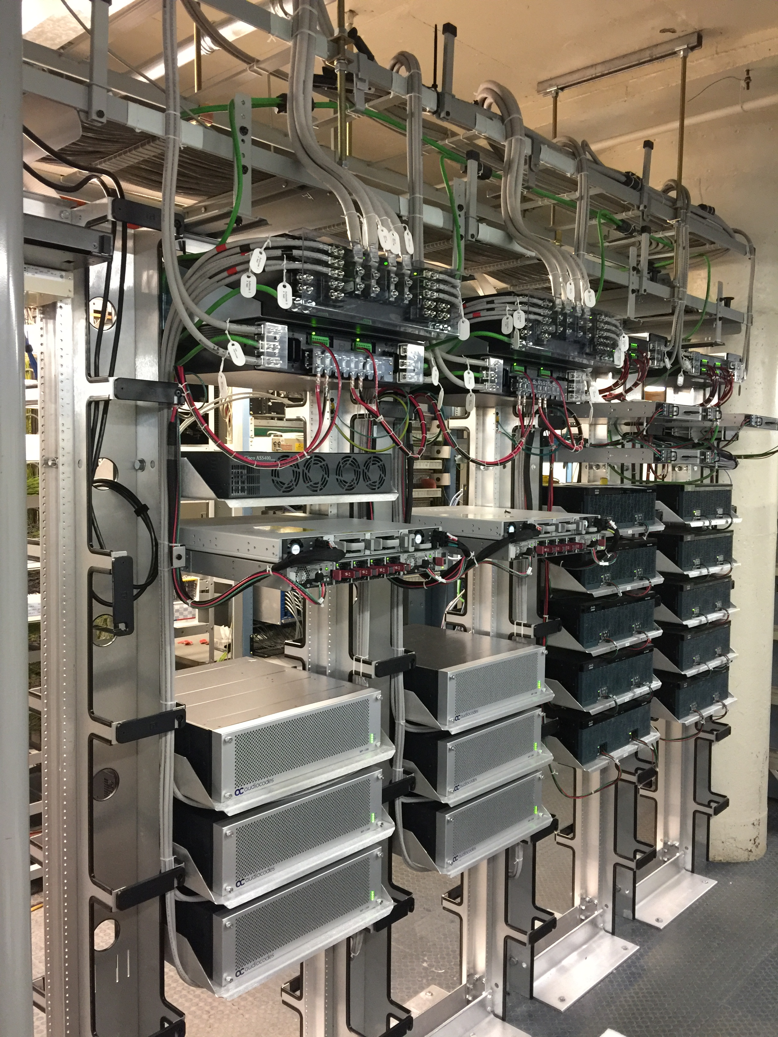
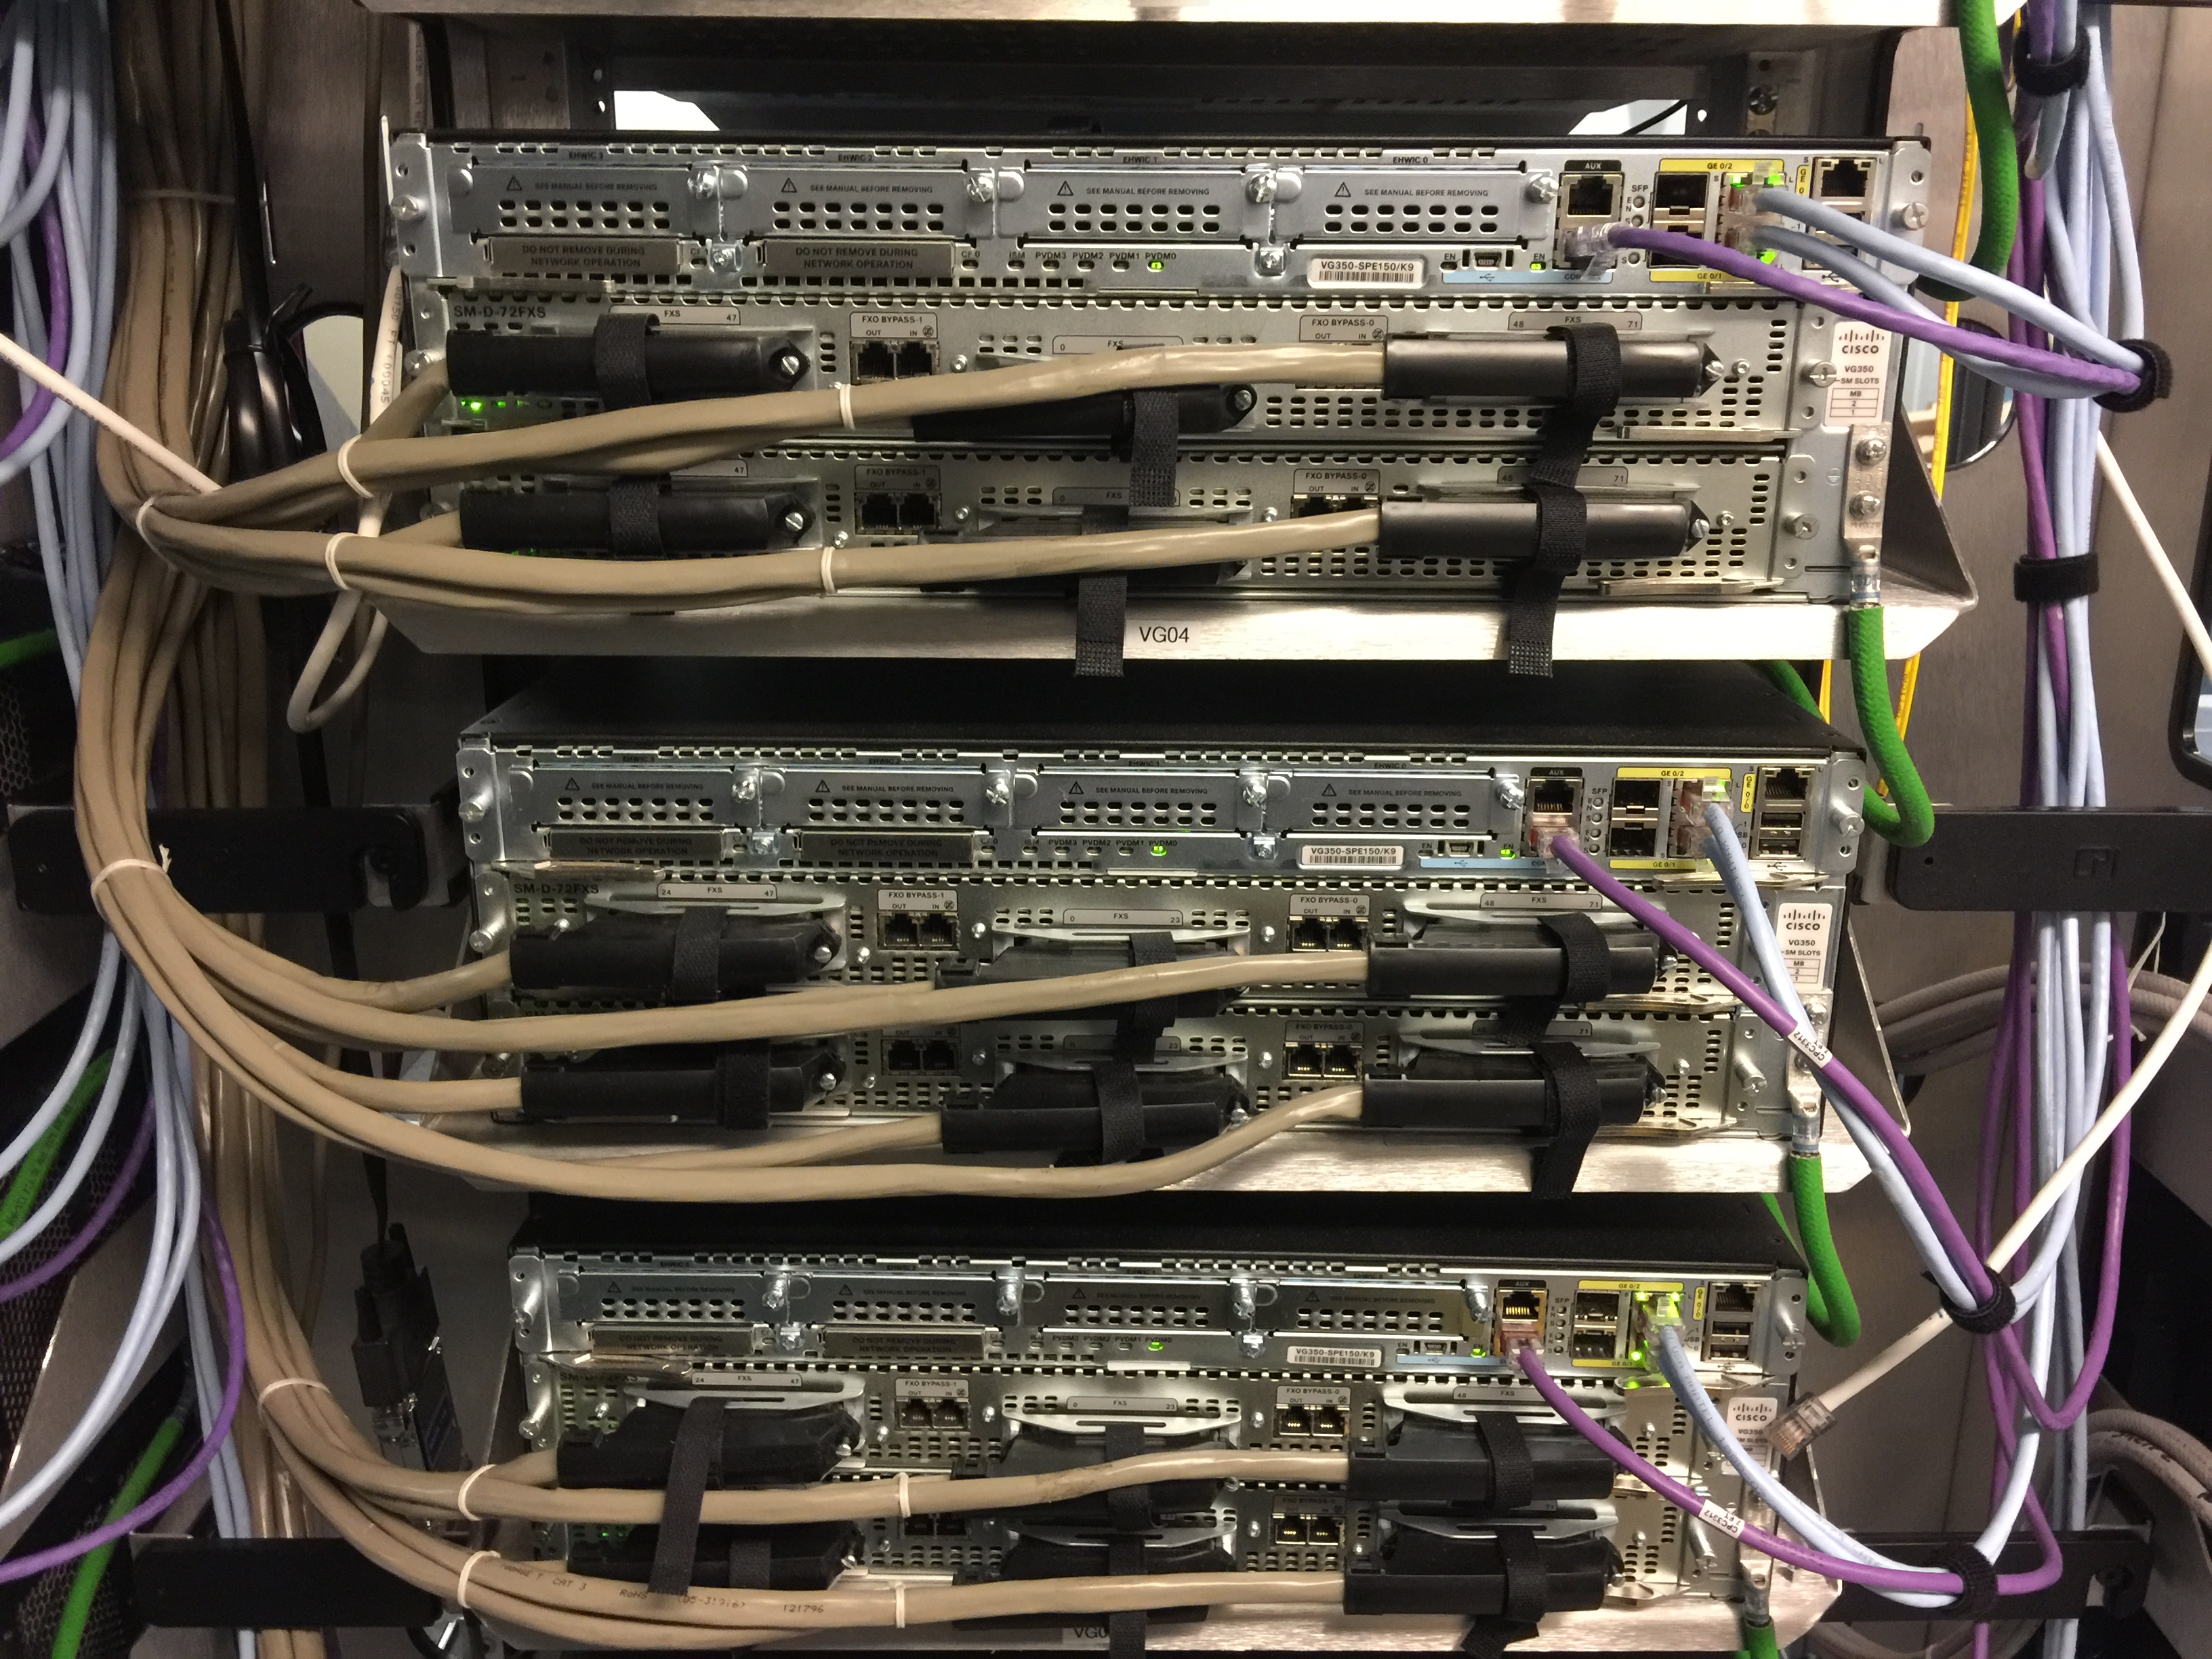
Analog Gateway Upgrades
New AudioCodes chassis will replace the Cisco VG350s
The AudioCodes chassis’ will register to BroadSoft’s cloud infrastructure
All CUCM lines will be migrated to cloud infrastructure in the coming year

Slide 10
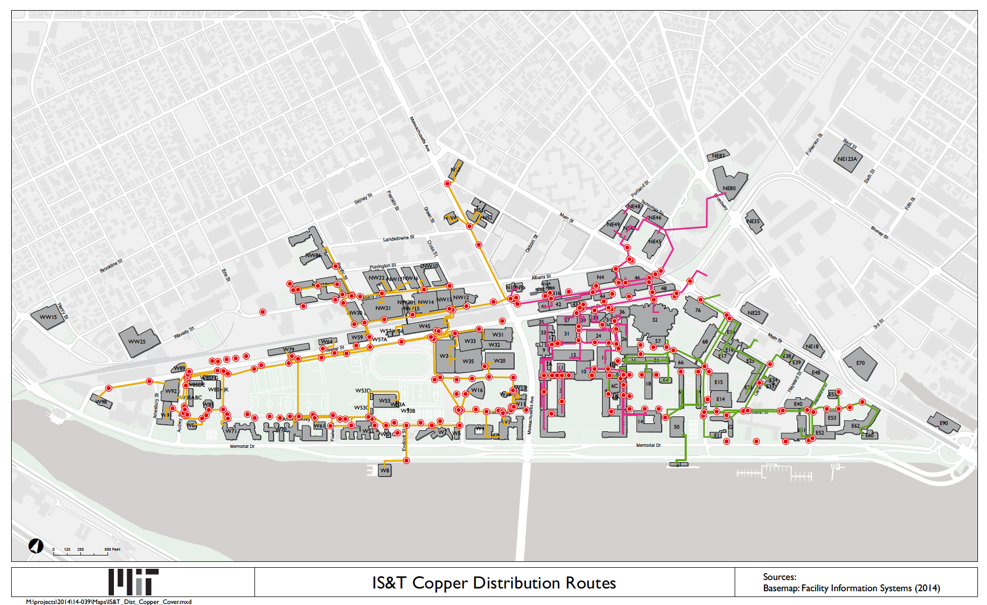
Copper Cabling Distribution for Analog Services

Slide 11
Migrating ACD Infrastructure to the Cloud
An Automatic Call Distributor (ACD) is a telephony software system that answers incoming calls and routes them to a specific agent or group of agents
Cisco UCCX is MIT’s third generation call center system proving ACD services for a small number of DLCs
All existing call centers have been moved to CJP, Cisco’s Customer Journey Platform for cloud-based call centers
CJP offers enhanced functionality and additional flexibility over UCCX (self-service model, cloud-based resiliency, remote office capabilities and better reporting features)

Slide 12
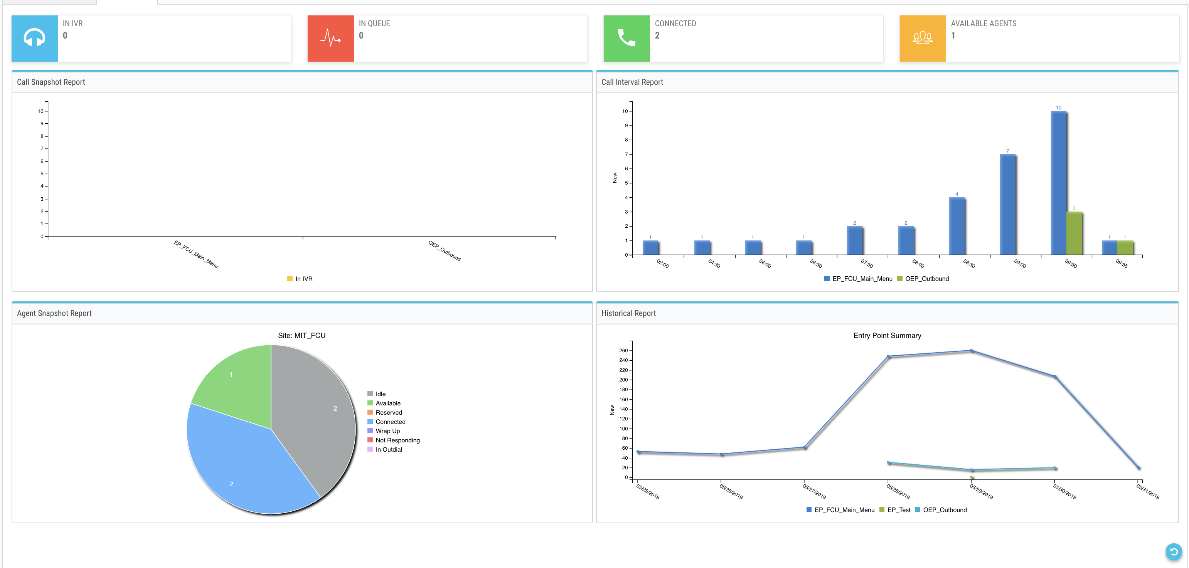
CJP Dashboard

Slide 13
Migrating on-premise VoIP and Voicemail systems to new cloud-based systems
IS&T is in the process of consolidating our various telephone & voicemail systems to a leading-edge VoIP as a Service cloud platform from Cisco (formerly BroadSoft)
The Cisco Unity voicemail system will be transitioned to BroadSoft’s cloud-based offering
The existing telephone lines from the 5ESS, Sylantro, Cisco Unified Communications Manager (CUCM) will be transitioned to BroadSoft in the coming months
We plan to accelerate the effort to transition Unity voicemail over the summer months into the Fall

Slide 14
MIT BroadSoft (Cisco) VoIP Cloud Transition
Key Milestones to Date:
IS&T Pilot – August 2018
User Portal Pilot – November 2018 (broadsoft.mit.edu)
Building NW17 5ESS phones were transitioned to VoIP (BroadSoft) – March 2019
UCCX to CJP – Complete May 2019
New provisioning / self-management system pilot – May 2019 (voip-beta.mit.edu)
Migration Schedule:
VoIP/Voicemail – begin new deployments – June 2019
  All new accounts will be BroadSoft accounts moving forward
5ESS migration – to be completed in Spring 2020
Cisco VG350 to AudioCodes MP-1288 – targeting completion for FY20
Unity Connection to BroadWorks voicemail – targeting completion for FY20
Sylantro migration – targeting completion for FY20

Slide 15
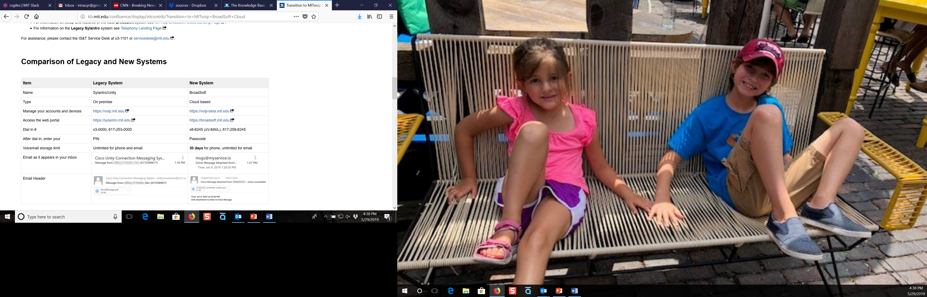
What is Changing?

Slide 16
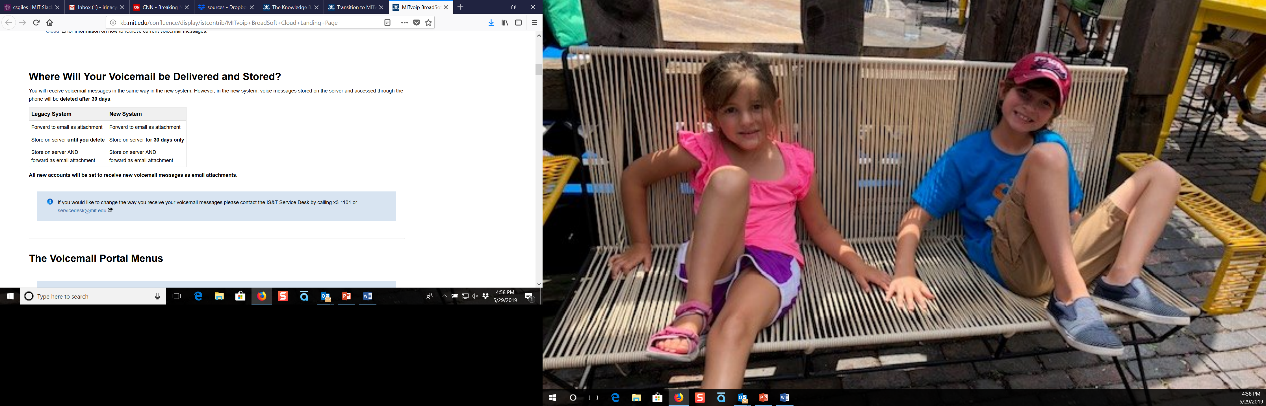
Voicemail Settings

Slide 17
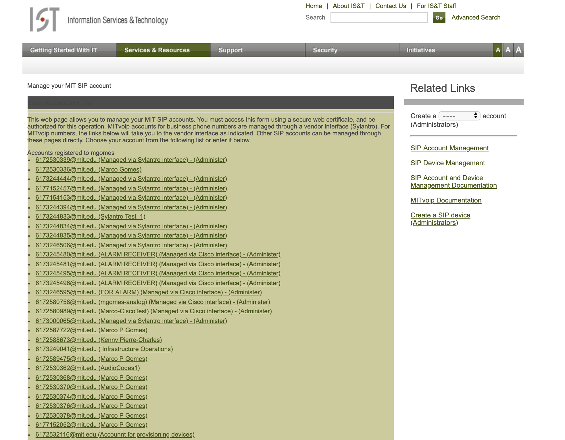
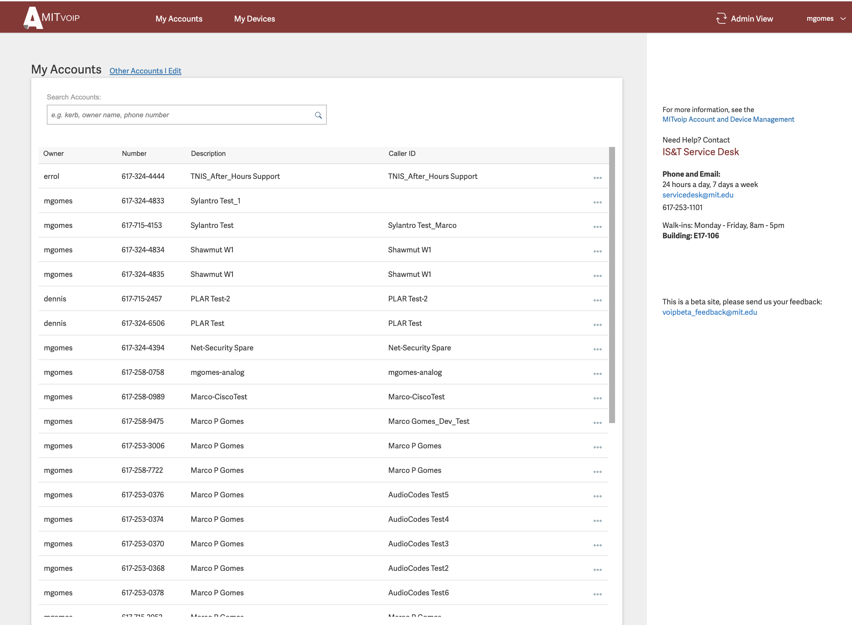
New Self-Management Portal
← Legacy voip.mit.edu site
New voip-beta.mit.edu site →
Notes:
Get better images of user screens

Slide 18
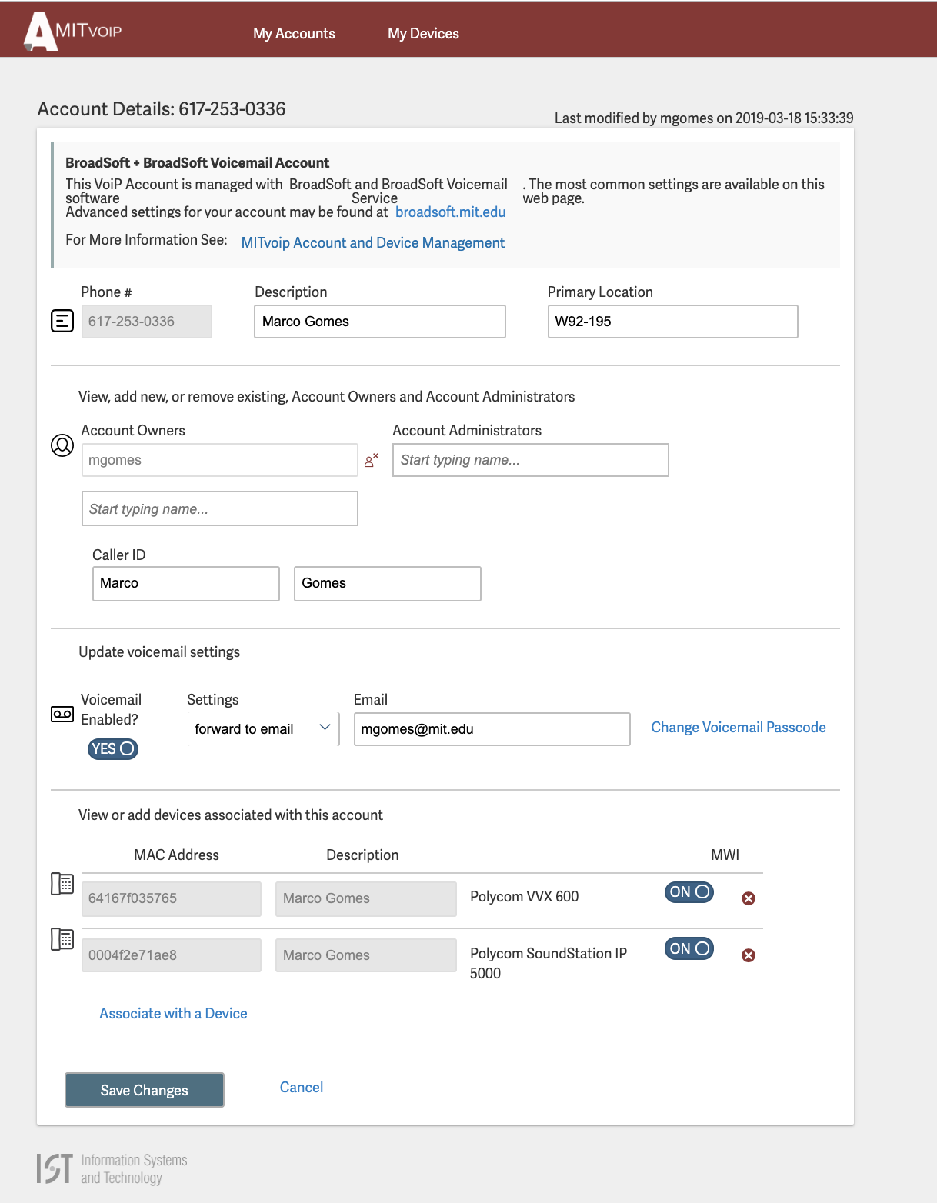
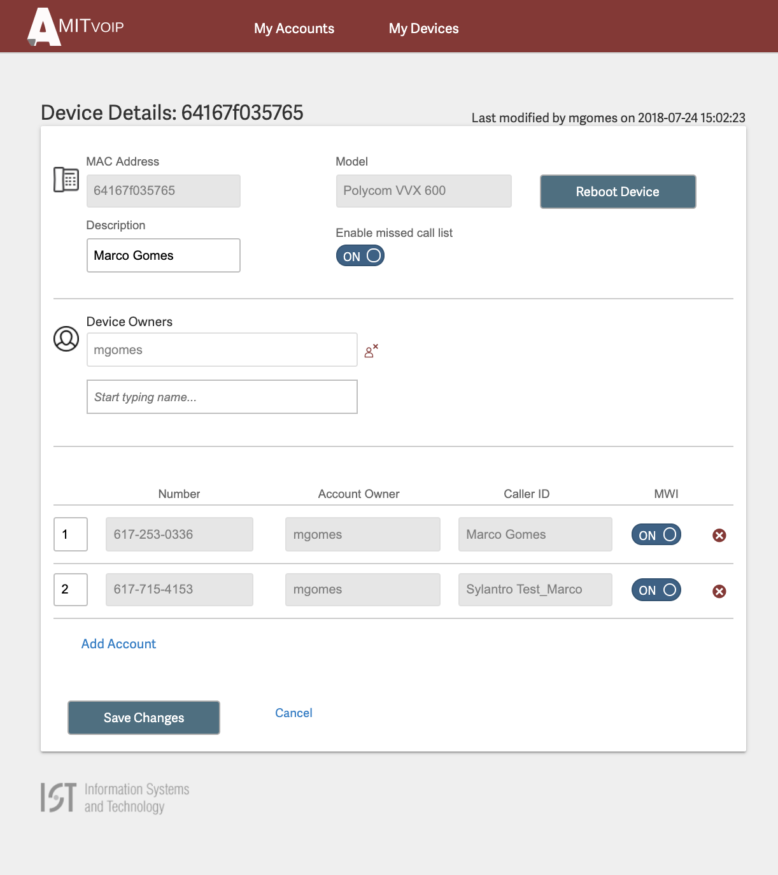
New Self-Management Portal
Account Management Details
Device Management Details

Slide 19
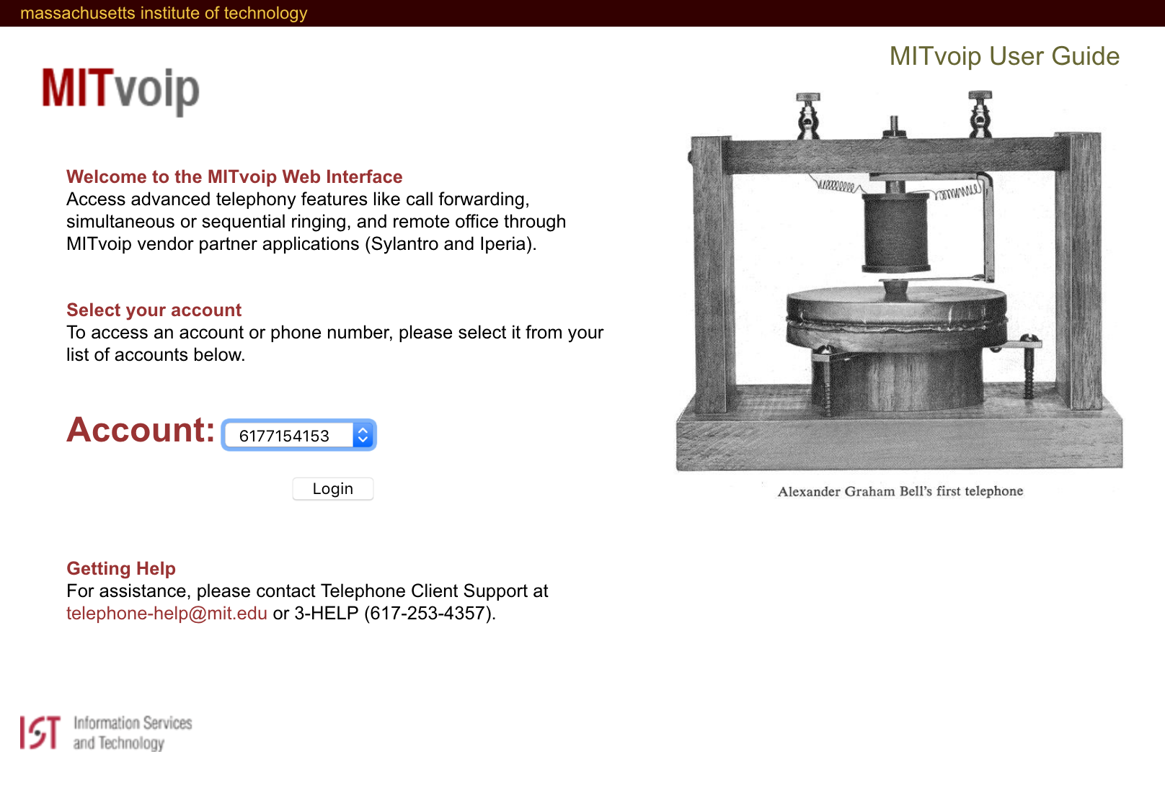
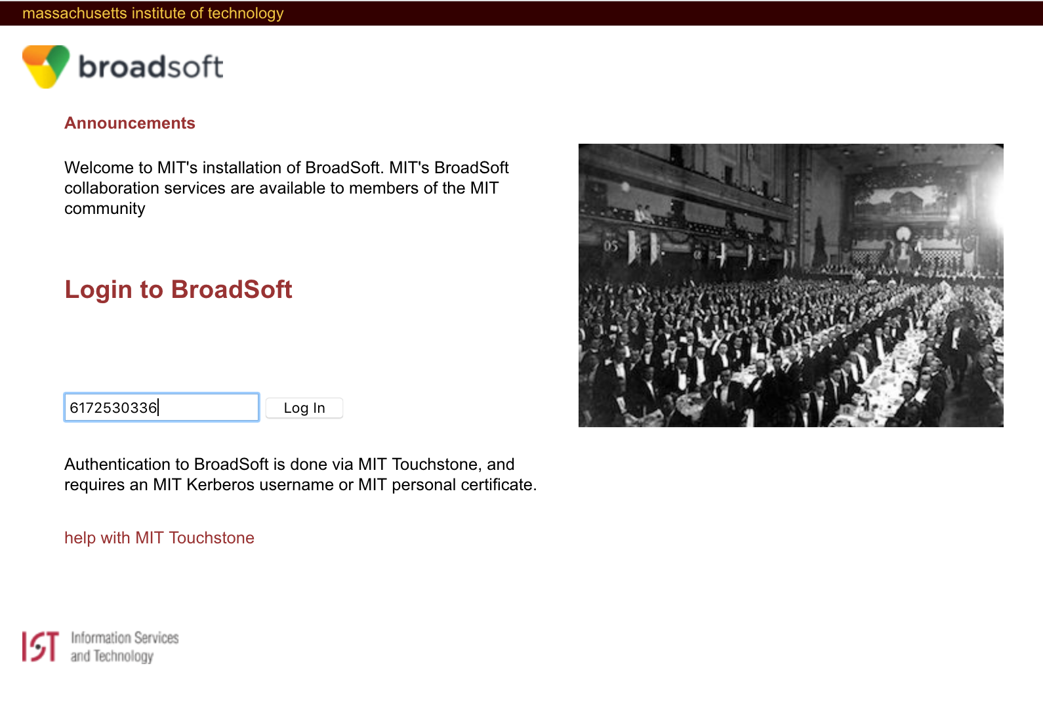
New Web Portal

Slide 20
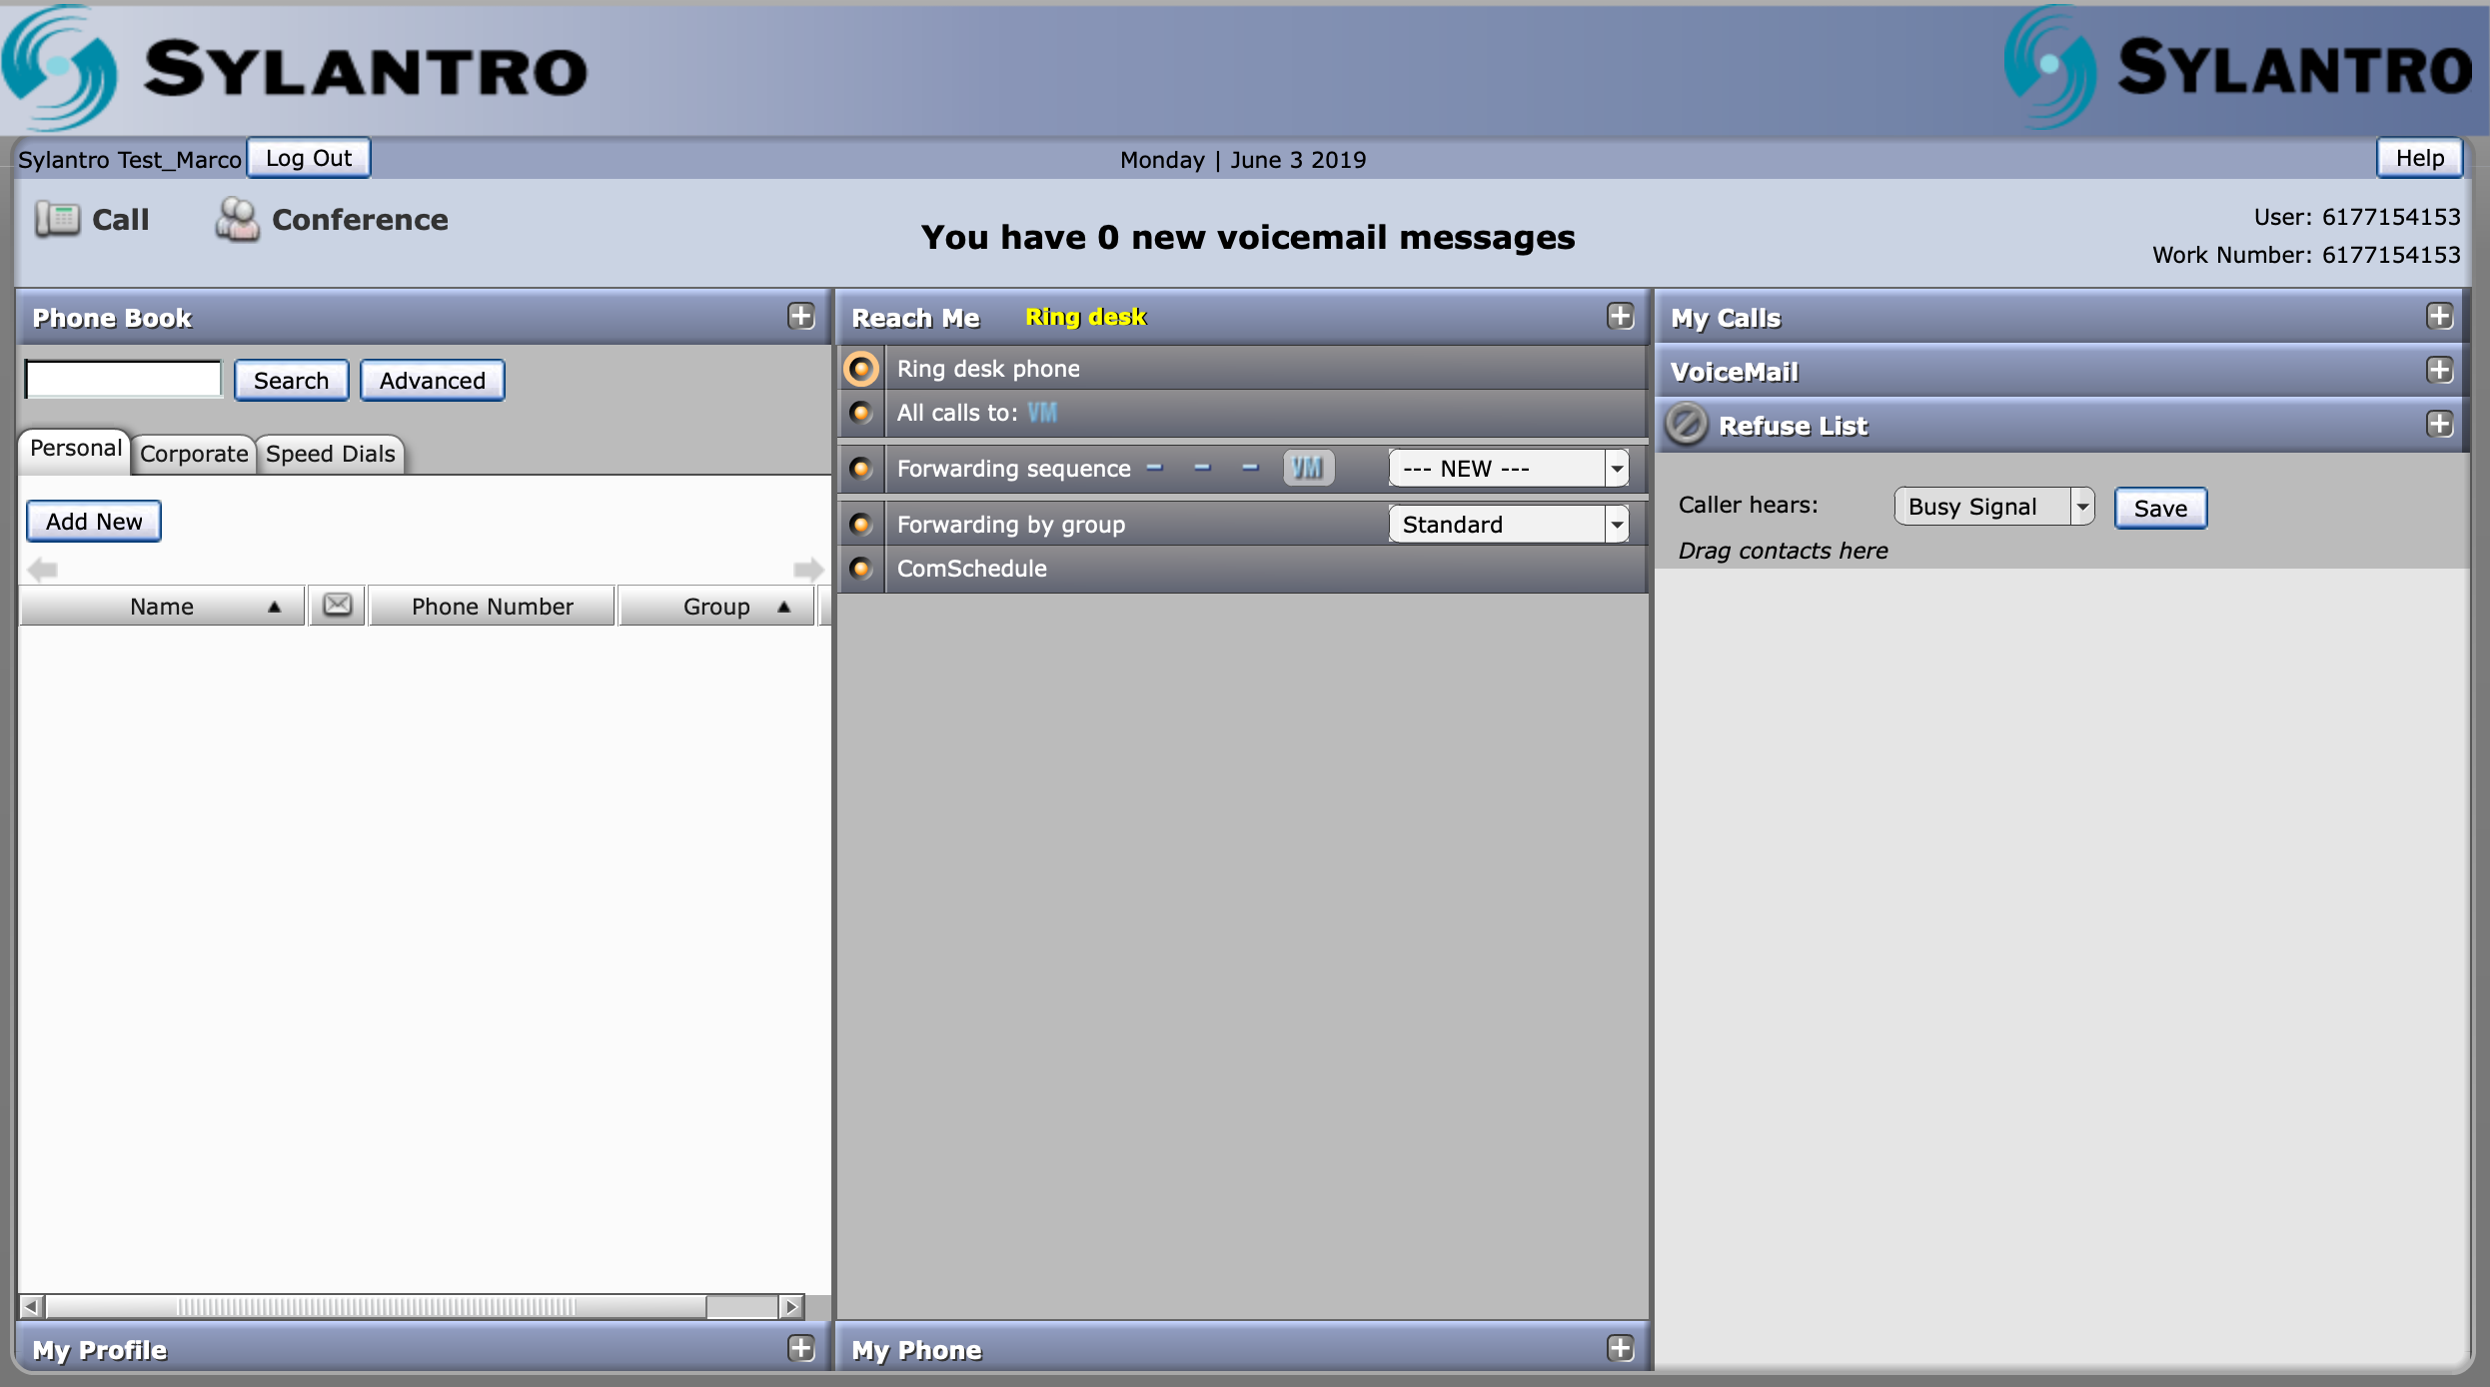
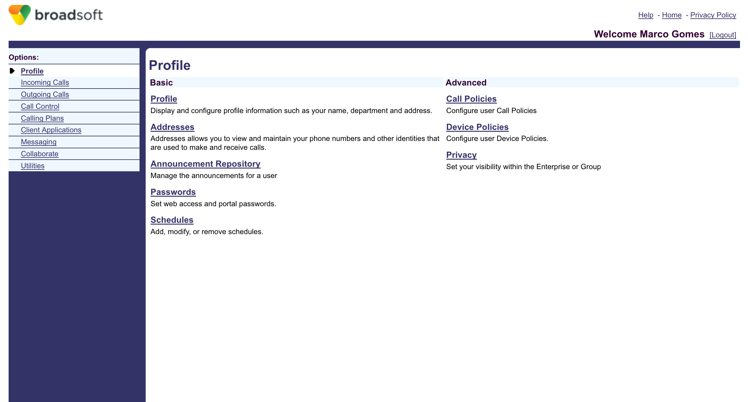
New Web Portal

Slide 21
What’s Not Changing?
No changes to desk/wall phones – keeping the existing Polycom devices
Notes:
Very small subset of Cisco phones gets changed

Slide 22
Next Steps
Complete the data analysis to match account owners to departments
Validate the data with the IT Partners and AO communities
Identify any early adopters
Finalize the transition schedules
Develop the outreach and communications plan
Continue with migrations to new systems
If you’re interested in being an early adopter please send email to:
    broadsoft-transition@mit.edu

Slide 23
Q&A
Questions?

Slide 24
Resources
Transition to MITvoip BroadSoft Cloud
http://kb.mit.edu/confluence/x/SBWACQ
MITvoip BroadSoft Cloud Landing Page
http://kb.mit.edu/confluence/x/FwaACQ
MITvoip BroadSoft Cloud Web Portal
http://kb.mit.edu/confluence/x/3xuACQ
Feature Access Codes
http://kb.mit.edu/confluence/x/5yuACQ
MITvoip Account and Device Management
http://kb.mit.edu/confluence/x/XUmACQ

