Slide 1

Avionics Bay Structure Requirements Review
Motivation:
Piston testing reveled potential failure mode where improper torqueing of bolts attaching the payload bulkhead to the piston could fail the seals
Poor piston sealing could lead to poor BP combustion near apogee, resulting in a ballistic recovery
Cause:
Piston is held together by 4 tie rods. These tie rods are tensioned, compressing the piston ends against the piston cylinder.
Avionics bay held together by 4 bolts from Payload bulkhead into piston. If these bolts are overly torqued in assembly the piston end that the firebolt is installed in sees reduced pre-load from the tie rods. With increasing preload on the avionics bay bolts, the piston tie rods no longer maintain any preload on the piston end. With no preload there is no seal compression, and no sealing

Slide 2
Avionics Bay Structure Requirements Review
Requirements:
Be confident flying the piston
  Note: we have no redundancy to mechanical defects of the piston. Loss of piston function is likely to lead to ballistic recovery.
Minimize changes to flight proven system.

Slide 3
Avionics Bay Structure Requirements Review
Options:
Operational Changes:
  Aluminum fasteners
  Torque limits
  Qualify piston with compromised seal
Piston Only Changes:
  RTV caulk sealing
  Spring Energized Seals
  Different piston design
Avionics Bay Redesign
  Radial bolted bulkheads
  New primary structure inside Avionics Bay
  Run threaded rods alongside piston

Slide 4
Backup Slides

Slide 5
Avionics Bay Challenges
Difficult to integrate
Piston Seal

Slide 6
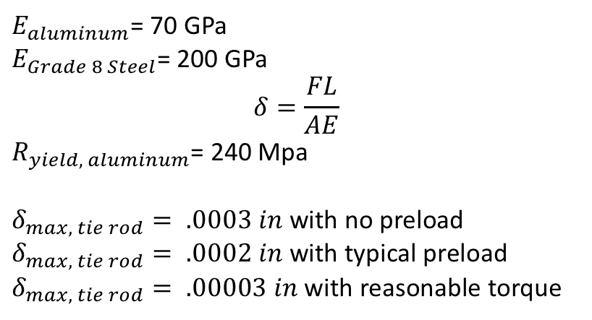
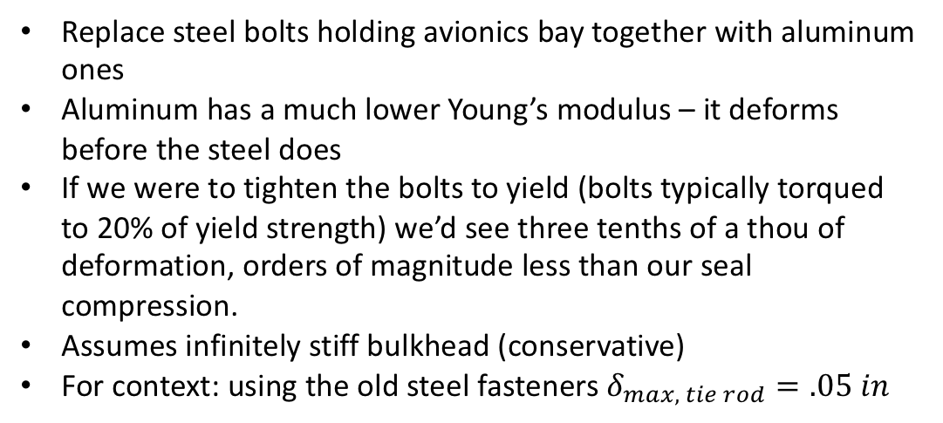
Aluminum Fasteners
Replace steel bolts holding avionics bay together with aluminum ones
Aluminum has a much lower Young’s modulus – it deforms before the steel does
If we were to tighten the bolts to yield (bolts typically torqued to 20% of yield strength) we’d see three tenths of a thou of deformation, orders of magnitude less than our seal compression.
Assumes infinitely stiff bulkhead (conservative)
For context: using the old steel fasteners $δ_{max, tie rod}=.05 in$
$E_{aluminum}$= 70 GPa
$E_{Grade 8 Steel}$= 200 GPa
$$δ=\frac{FL}{AE}$$
$R_{yield, aluminum}$= 240 Mpa
$δ_{max, tie rod}= .0003 in$ with no preload
$δ_{max, tie rod}= .0002 in$ with typical preload
$δ_{max, tie rod}= .00003 in$ with reasonable torque

Slide 7
Radially Bolted Bulkheads
Hermes 1
Avionics Tower
Av Bulkhead
Payload Bulkhead
Diaphragm
Piston
Hermes 2
Avionics Tower
Diaphragm
Payload Bulkhead
Piston

Slide 8
Radially Bolted Bulkheads
Pros
Arbitrary length avionics bay, shorter for lower mass, longer for additional volume for trackers/cameras/batteries/etc
‘Infinite Switchband’ reduced clocking requirements, more surface area for mounting switches and cameras
Reduced mass – no coupler
Eliminates awful integration catch-22 with piston bolts and payload mounting features
Eliminates any chance of compromising piston seal
Cons
Significantly different integration – need to gain experience immediately
Reduced environmental protection for avionics systems during integration
Piston and recovery loads now pass through discreet shear loaded fasteners instead of surface plane of tubes

Slide 9
SRAD Piston
Machined Flange
Unibody Piston
COTS Piston
Head
O-ring
Compression increases with piston preload
Lets not do this…

