Slide 1
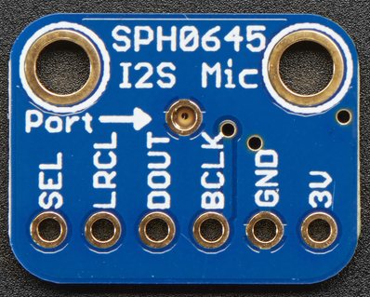
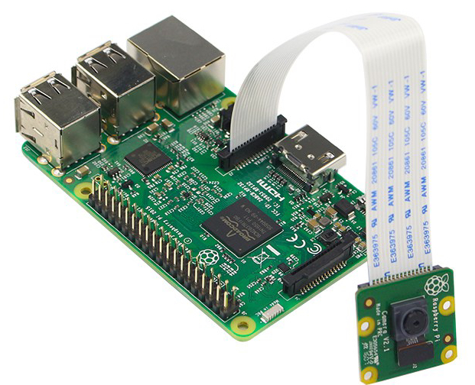
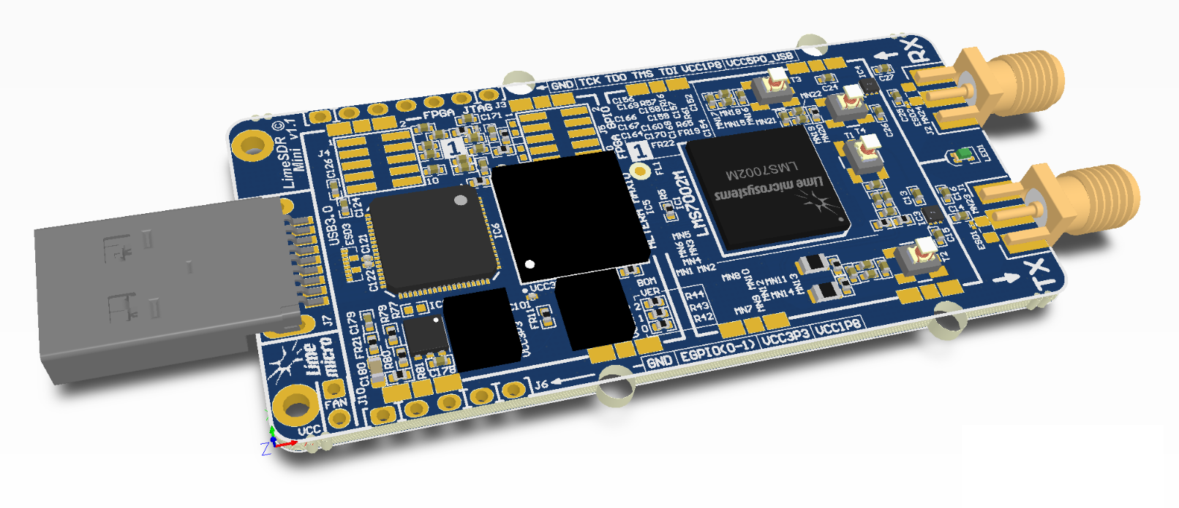
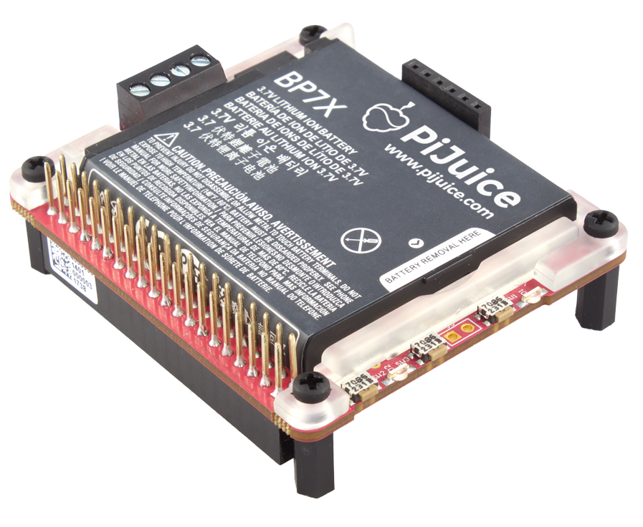
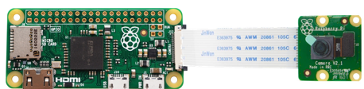
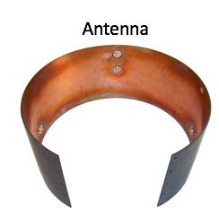
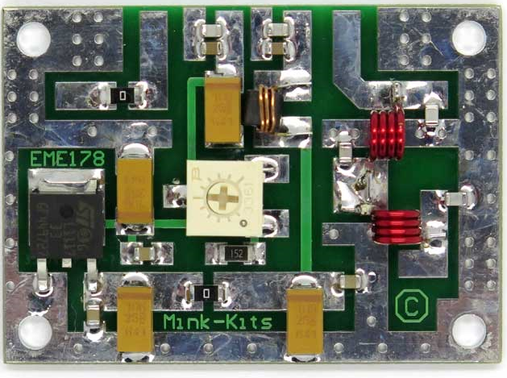
From Pyxida
Telemetry via BT-LE
I2S
Audio
Raspberry Pi 3 powered
over “PiJuice” (selfbuild)
with additional battery
Max 900mA
USB
Video Data
Sensor Data
Via BT or WiFi
LimeSDR mini
10dBm Power
PA
Record
Video to SD
Raspberry Pi Zero W

