Slide 1
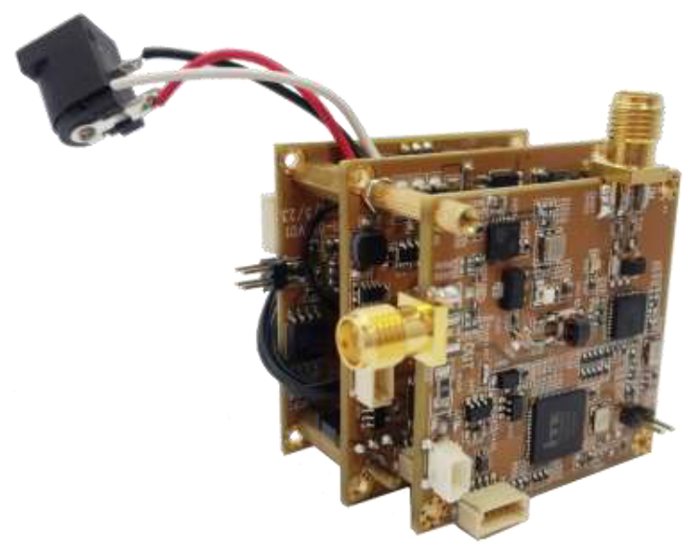
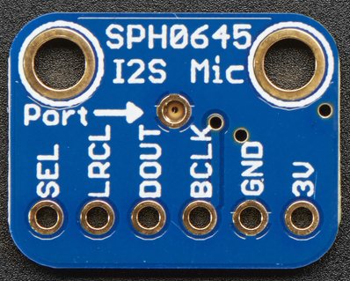

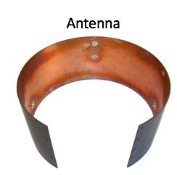
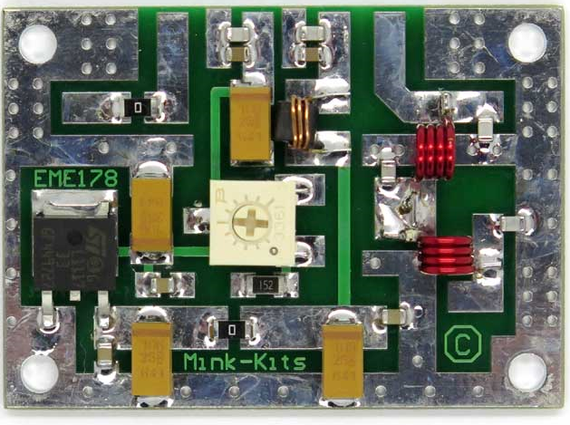
From Pyxida
Telemetry
I2S
Audio
UART
HDMI
Video Data
Sensor Data
HV-330
PA
Record
Video to SD

