Slide 1
windows 11
Tim Yager
tyager@mit.edu

Slide 2
What is windows 11
“Windows is more than just an operating system; it’s a fabric woven into our lives and in our work.”
  https://blogs.windows.com/windowsexperience/2021/06/24/introducing-windows-11/

Slide 3
overview
UI changes
New features
System requirements
Upgrade paths
Known issues
Office 2021
Questions

Slide 4
UI changes
Start menu / task bar now different!
Start menu now centered!
Live tiles are now “widgets” and separate from start menu.
New / more snaps! Snap Layouts, Snap Groups, and Desktops.
Modern icons!
New right-click context!

Slide 5
start menu / taskbar specifics
Start menu – “Utilizes the power of the cloud”
  Mostly familiar once opened.
Right-click taskbar -> Taskbar Settings (that’s all you can do)
  Can customize taskbar only
  Taskbar alignment -> Left (moves start menu back to left)
Widgets
  Require Microsoft account (you would need to separately log in)

Slide 6
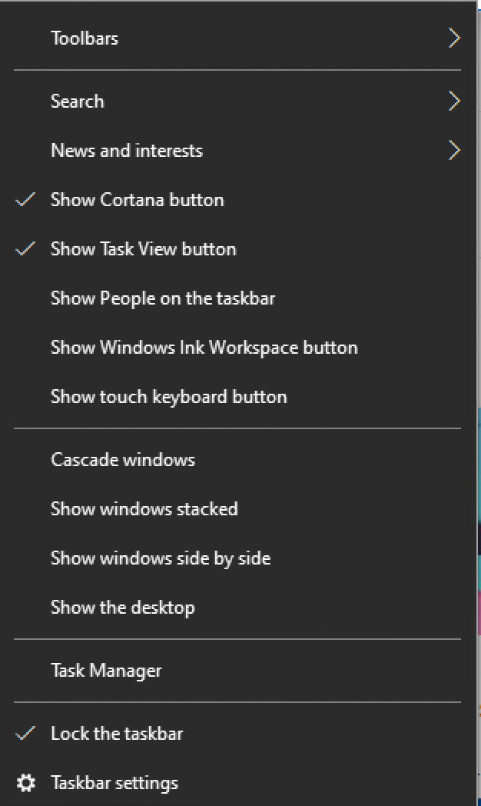
Taskbar – windows 10

Slide 7
Start menu /taskbar current issues
Multiple monitors do not show clock.
You cannot drag and drop a file to the app to open it.
Apps always combined on taskbar, no ungrouping.
No small icons.
Can’t open task manager directly from taskbar.

Slide 8
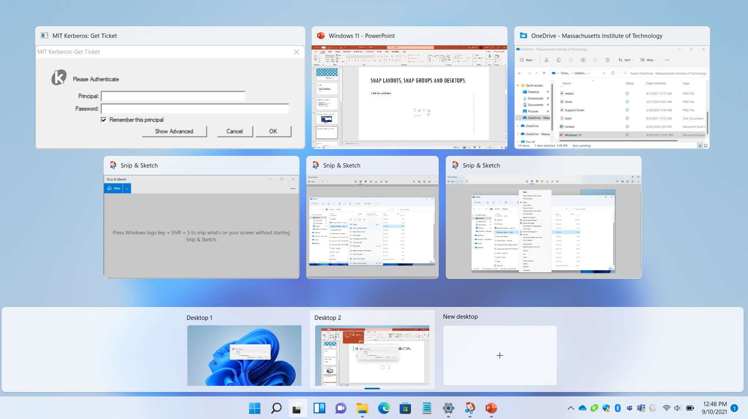
Snap Layouts, Snap Groups, and Desktops.

Slide 9
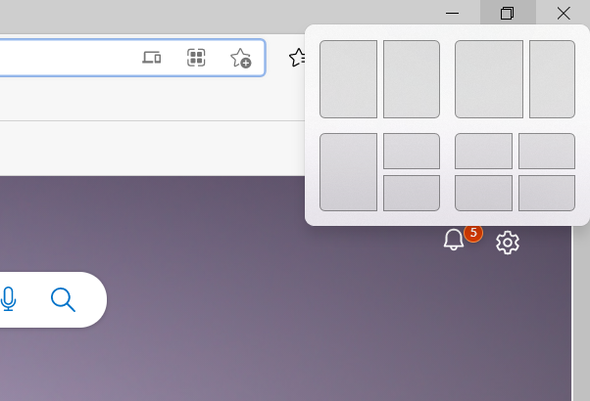
Snap Layouts, Snap Groups, and Desktops.

Slide 10
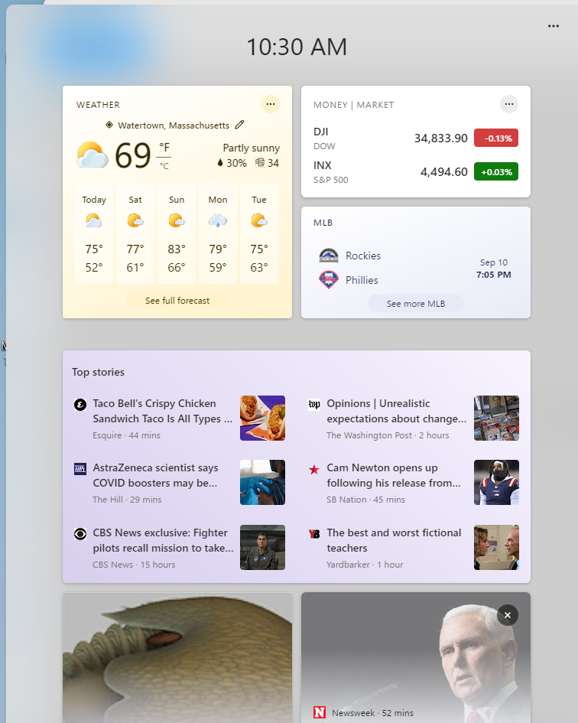
Widgets

Slide 11
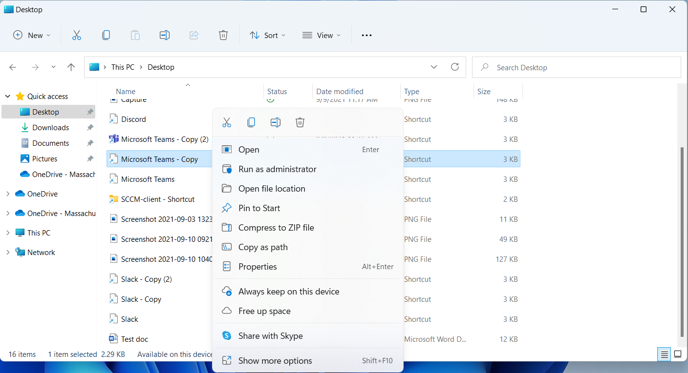
Right-click context

Slide 12
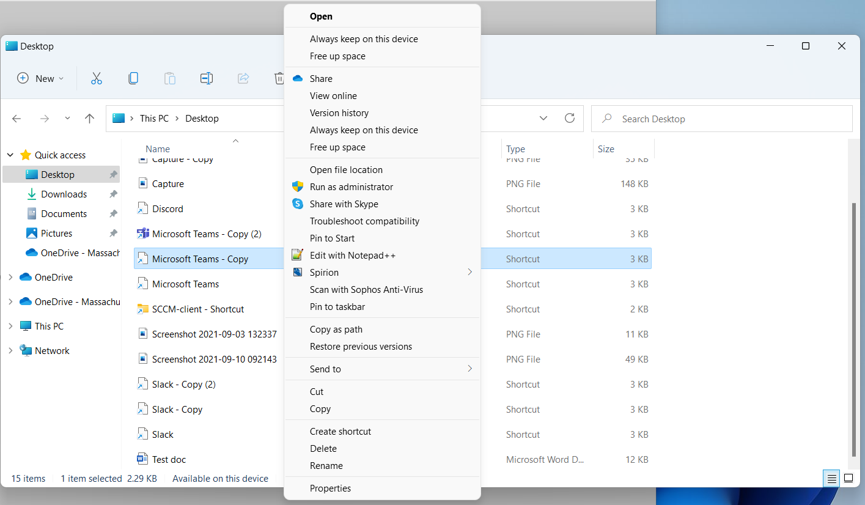
Right-click context part 2

Slide 13
App store changes
New MS app store!
  Rebuilt for speed!
  Easier to search content!
Windows Subsystem for Android (WSA)
  Amazon Appstore! – currently in preview in the beta channel.
  This is not the Google Play Store.
  ~500,000 apps compared to Google Play Store at 3.5 million.
  Think apps you get on Fire Tablets or Fire TV.
Epic Appstore!

Slide 14
Other new features
Chat from Microsoft Teams app
  Like Messages app on iOS
  Can chat or SMS with people
  This is not the enterprise Microsoft Teams!
Best PC gaming experience!
  DirectX 12 Ultimate – breathtaking, immersive graphics
  DirectStorage – faster load times
  Auto HDR – move vivid range of colors

Slide 15
hardware requirements
TPM 2.0
UEFI with Secure Boot enabled (no more legacy mode)
Can you install without these two requirements?
  Yes, but*
Why? Mitigation.
  Meltdown / Spectre
Most enterprise purchased PCs from the last five years “should” meet those requirements.

Slide 16
hardware requirements cont.
Ryzen 2nd gen or better for AMD*
Some 7th gen or better for Intel**
https://docs.microsoft.com/en-us/windows-hardware/design/minimum/supported/windows-11-supported-amd-processors
https://docs.microsoft.com/en-us/windows-hardware/design/minimum/supported/windows-11-supported-intel-processors
2/3 of MECM devices meet this criteria so this is what to look for when targeting machines to replace.

Slide 17
os Updates
Windows 11 will have an annual feature update cadence, a change from the semi-annual cadence of Windows 10
IS&T only approves one feature update a year so realistically this won’t make much difference.

Slide 18
what is removed?
No 32-bit OS offering
No Internet Explorer
  Can use “IE Mode” from Edge
  Searches for IE will point to Edge
  https://docs.microsoft.com/en-us/deployedge/edge-ie-mode
Cortana
  Still available, but not by default

Slide 19
How can I tell if my computer can upgrade?
PC Health Check app
https://aka.ms/GetPCHealthCheckApp

Slide 20
Install / Upgrade options
MECM
  OS Upgrade Task Sequence available.
Lite Touch
  Windows 11 is available for new device setup.
ISO install
  The Windows 11 ISO is available on the software grid for manual upgrade.

Slide 21
App compatibility
Known MIT app issues – None*
  *Be sure to test all apps in your environment.

Slide 22
win 7 / 10 eol
Windows 7
  Already EOL, currently on Extended Support Updates (ESU)
  ESU ends January 10, 2023
Windows 10
  EOL Oct 14, 2025
  This requires you install the latest versions
  Roughly 4 years to upgrade Win 10 machines, and some won’t support the hardware

Slide 23
when should I upgrade
Get on test machines as soon as possible and test within your environment.
Consider waiting for a few more patch cycles but most showstoppers have been resolved.
Don’t wait too long; every machine deployed with Windows 11 is a machine that doesn’t need to be upgraded later. Devices that will be fully remote are ideal candidates for Windows 11.
Most importantly, get an idea of what hardware in your environment is not compatible and target for eventual machine replacements.

Slide 24
Why upgrade?
Security (can’t stress this enough).
Keep up with EOL and extend updates for an additional 5 years.
In remote world, some devices will never come back and stay in service for years past Win 10 EOL.
Android apps.
Some productivity features.

Slide 25
Office 2021 status
Available now on software grid, MECM, and Lite Touch
Windows installer will work similarly to the past, it will nuke old version and install new one.
When to upgrade?
  Any time realistically, based on new O365 model. These features are already out there and tested.
  Always test in your environment first!
IS&T looking to change default to Office 2021 over winter break.

Slide 26
Questions
?

