Slide 1
MITvoip: Modernizing MIT’s Telephone Infrastructure
Marco Gomes, Director of Infrastructure Operations
Marla Dolan, Sr Project Manager
Tim Riley, Project Manager
Information Systems and Technology

Slide 2
Agenda
Overview of current systems
Program status update
New self-service tools & features
  Broadsoft portal
  Self-service account/device page
  Softphones
  Polycom Trio Enhancement
  Call trees
Questions

Slide 3
Overview of Current Systems
  5ESS:
  Installed in the 1980s, provides ISDN phone services (analog lines have been moved to CUCM). Currently in the process of being phased out.
  Cisco Call Manager:
  Second generation VoIP system, installed in 2013, provides analog services for ~5k lines
  Sylantro:
  MIT Voice over IP (VoIP) system, installed in 2006 and provides the majority of telephone services for the MIT campus
  Unity Voicemail:
  Third generation voicemail system installed in 2013, provides voicemail and call tree services
  WebEx Contact Center (CJP):
  Fourth generation cloud-based call center system proving ACD services for a small number of DLCs
  BroadSoft:
MIT’s newest cloud-based VoIP system introduced in 2018

Slide 4
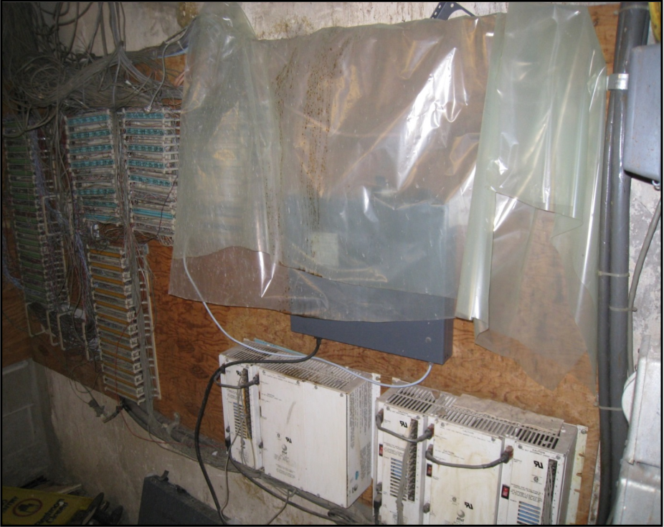
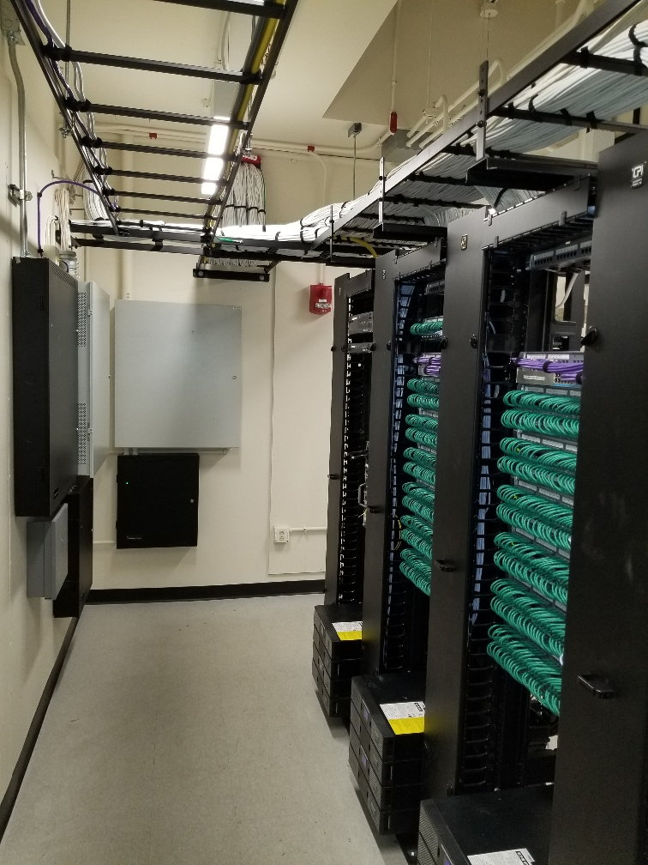
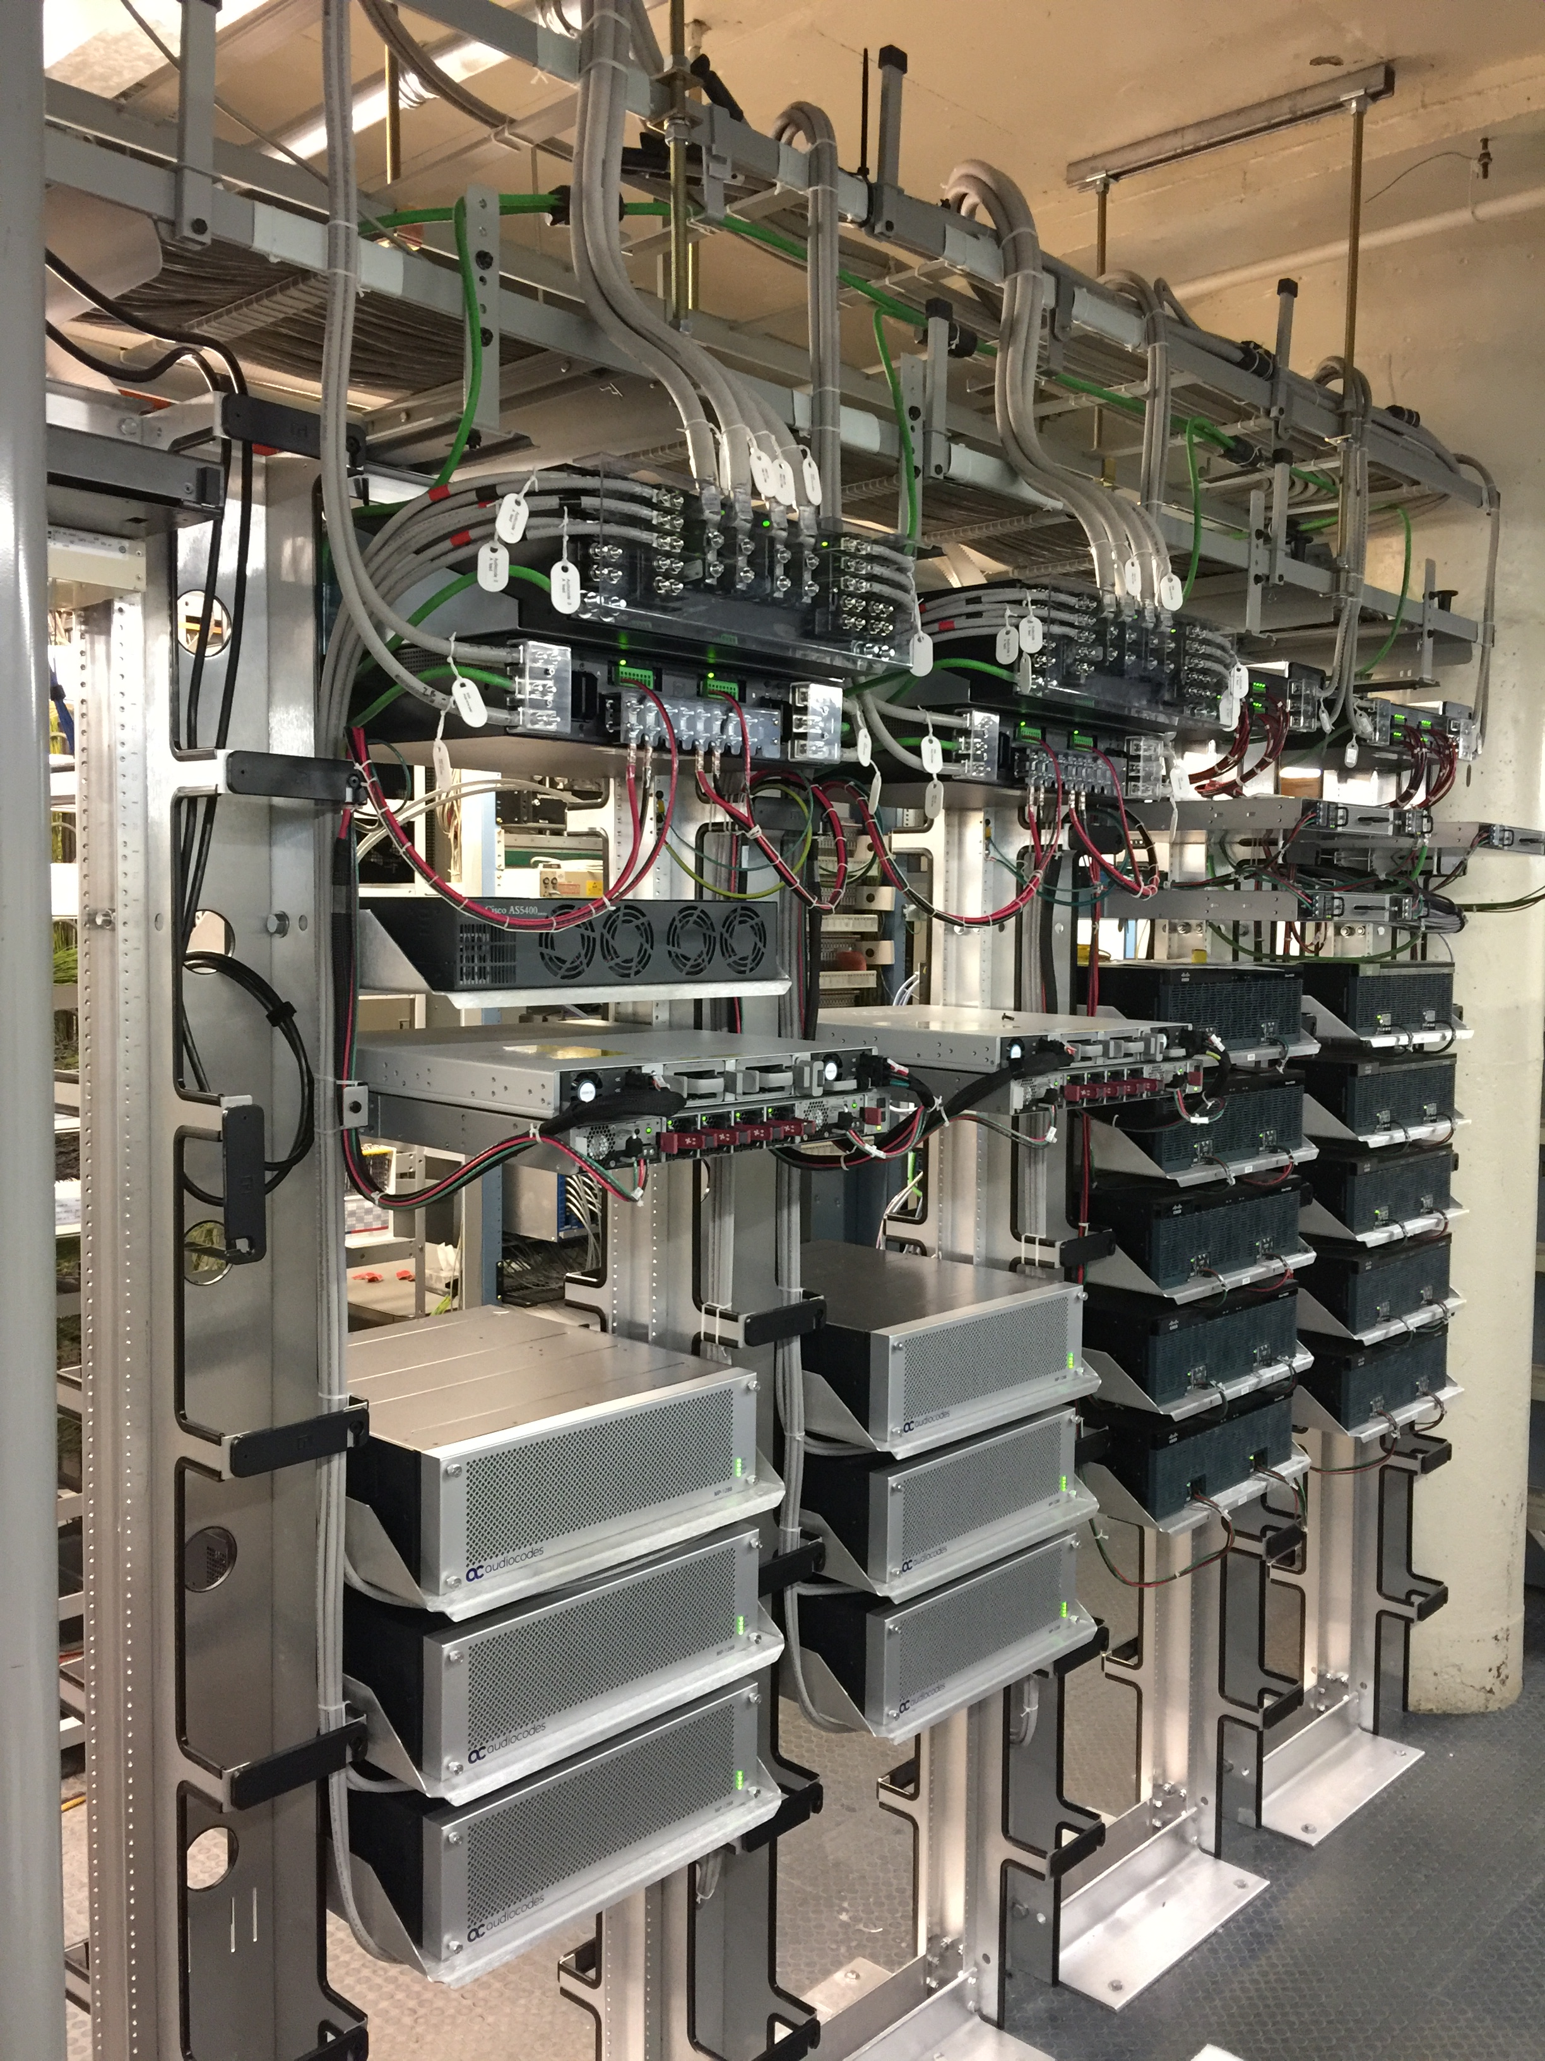
Modernization Efforts
Retiring the 5ESS
  Less than 250 lines remain; remaining lines to be transitioned in the Spring
  Network modernization work is nearly complete NW13, NW14, NW15, NW16, NW17, NW20, NW21, NW22 and 26
Analog Gateway Upgrades
  Approximately 5k lines being moved from Cisco VG350 to Audio Codes
  Retiring Cisco Call Manager Infrastructure
Migrated Cisco UCCX to cloud-based infrastructure
  Move from on-prem hardware
Migrating Sylantro VoIP and Unity Voice Mail to BroadSoft
Notes:
9 CJP call centers
13000 remaining lines
~5000 Broadsoft lines

Slide 5
BroadSoft Migration Progress
Goal is to migrate all Cisco and Sylantro accounts by the end of 2020
Approximately 25% of the campus has been migrated to BroadSoft
Migrating on a Department by Department basis
  Completed: Admissions, SFS, Libraries, Mechanical Engineering, Sloan, HR, VPF, TLO, Alumni, Haystack, portions of PSFC, Credit Union, MITIMCO
  In Process: Chemical Engineering, MIT Media Lab, Research & Development, LGO, CTL
  Next: continue with IT partners, DITR supported accounts and then remaining DLCs coordinating with AOs; Cisco Analog accounts, remaining PSFC
All new accounts are created in BroadSoft
Dependencies on Cisco migration to Broadsoft
  Building network updates for NW13, NW14, NW15, NW16, NW 17, NW20, NW21, NW26 (completed by April 2020)
  Audio Codes provisioning to support analog lines (starting in January 2020)

Slide 6
High Level BroadSoft Migration Process
Review department account details (description, ownership and administrators) with Marla Dolan, Project Manager
Use Moira list for account administration where possible
IS&T bulk updates to accounts as needed after review and confirmation
Pre-provision account in Broadsoft to allow creation of new VM PIN/Passcode
Determine cutover plan (all at once, or by building, department, etc.)
Communications plan – notify users 1 week prior to cutover
Users update PIN and record greeting
Cutover
Process takes 1- 5 weeks depending on number of accounts and accuracy of data

Slide 7
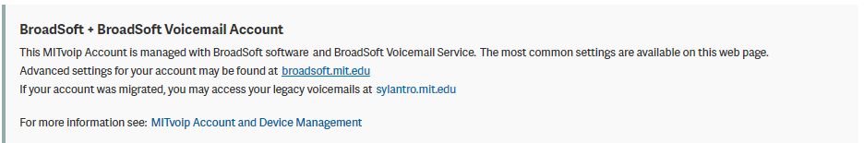
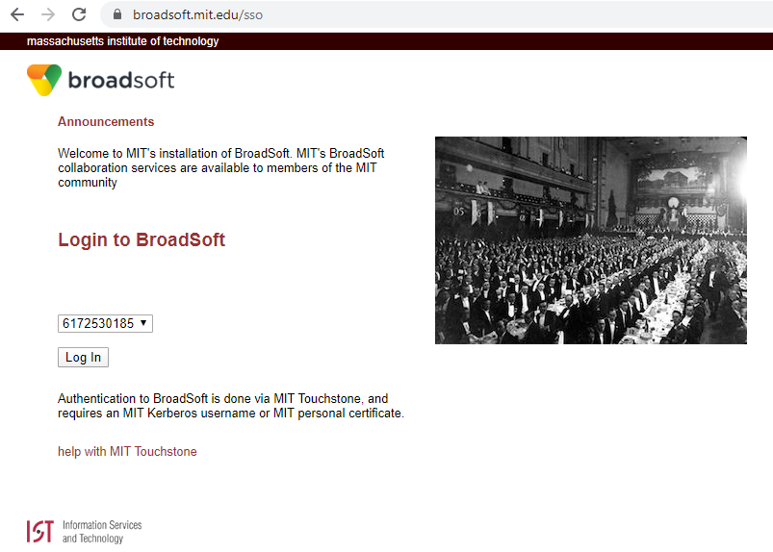
BroadSoft Portal
Access the Broadsoft Web portal from the Account Details page in the voip.mit.edu website:
Or by accessing broadsoft.mit.edu directly and selecting the number you want to review from the list of
accounts owned or administrated

Slide 8
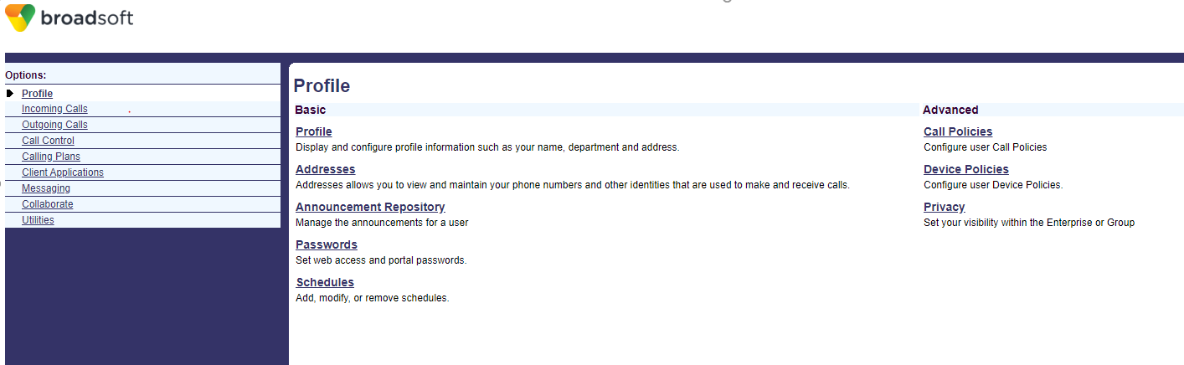
Broadsoft Portal
Broadsoft.mit.edu portal landing page:
Broadsoft.mit.edu portal landing page is the profile page
Use Schedules to set up selective call forwarding options to automatically forward your incoming calls to a different phone number when pre-defined criteria, such as the time of day or day of week, are met.
Notes:
Broadsoft cloud platform, supported by Broadsoft. Only a subset of the features apply to MIT. The most common user features can be done in the voip website ( vm preference, password reset).
Call controls can be done with star codes on the phone devices or on the soft client.

Slide 9
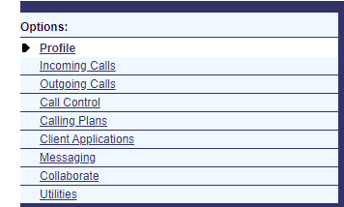
Broadsoft Portal
Incoming Calls - Call Forwarding Always, Call Forwarding Busy, Call Forwarding No Answer, or Call Forwarding Selective
Outgoing Calls - CallerID blocking, Personal Phone List
Messaging - Create distribution lists for forwarding voicemail
Utilities - Call log, list of feature access codes
Notes:
http://kb.mit.edu/confluence/display/istcontrib/Feature+Access+Codes

Slide 10
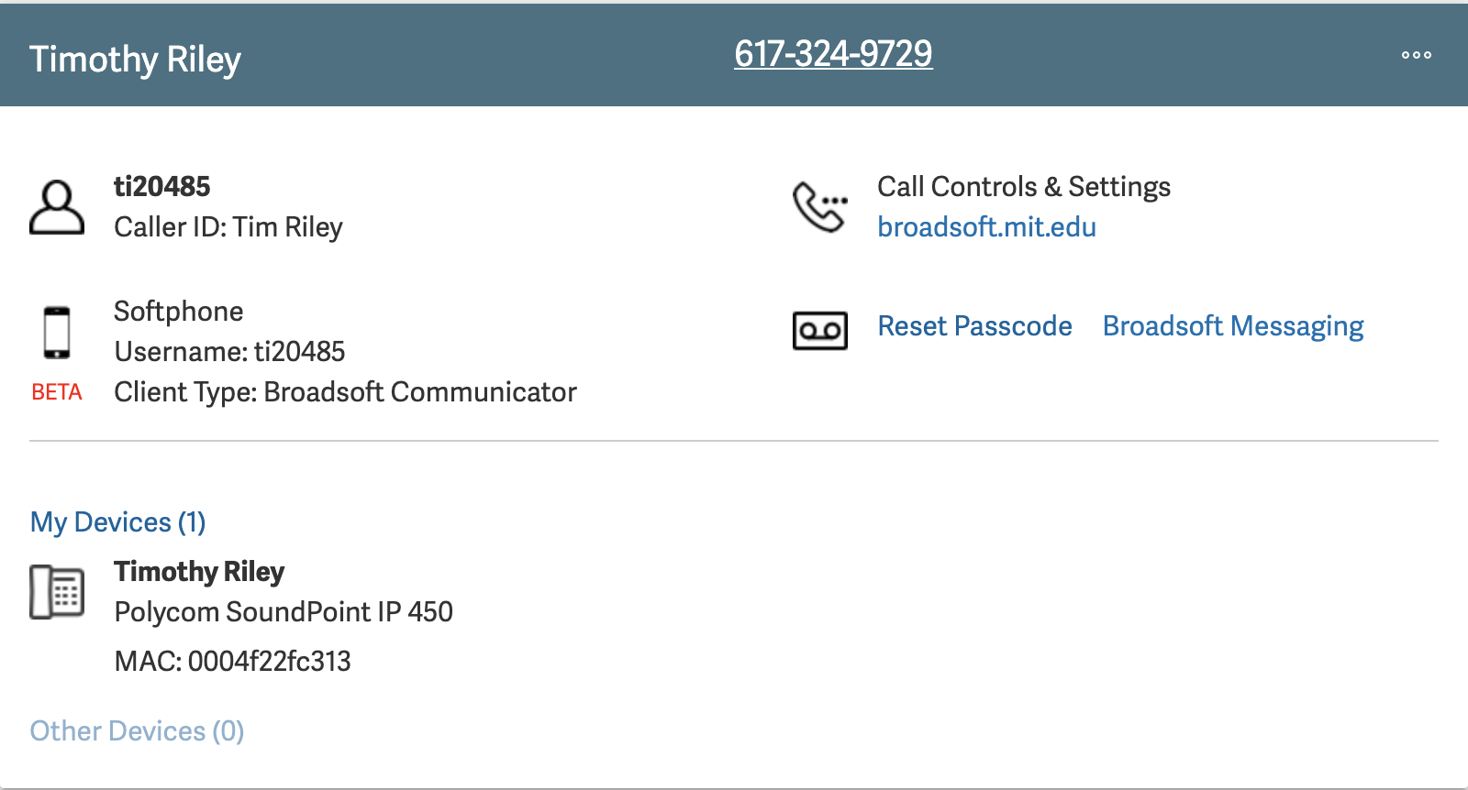
  MITvoip Provisioning Site
  Accounts (Card View)
Notes:
-For the majority of MITvoip site users, there are two main concepts to understand – (1) Accounts and (2) Devices
-Note that all of the information I’ll be covering is detailed on the wiki page located on the voip site side panel
ACCOUNTS
-For the purposes of this talk, you can think of an Account as a phone number and its associations (voicemail, softphone, etc.)
-When you log in, the site will default to showing you the Accounts that you are own – (accounts to which you are assigned as the owner)
-If you own three or fewer accounts, the site will default to what we call the Account “Card View” – seen here [display the browser with the Voip site]
-If you own more than three accounts, you will get the “list” view which is easier to navigate but does not display as much info [prepare a list view user in case someone asks]
-Review the “Card View” for a Broadsoft account [note to audience that we’ll only be reviewing BroadSoft accounts for talk]
-Account Description, phone number, ellipsis menu, Account Owner, link to broadsoft.mit.edu
-Resetting a voicemail password
-My Devices
-Open the “Account Details” page for the account
-User has ability to edit fields such as Description, etc.
-User has ability to add/remove an Account Owners, Administrators
-Account Owners – can change account settings and modify voicemail settings on MITvoip, as well as make changes in the BroadSoft web portal
-Account Administrators – can ONLY change account settings and modify voicemail settings on MITvoip, but cannot access the BroadSoft web portal for the account
-User has the ability to enable/disable voicemail, as well change how the voicemail is stored and delivered to them
-also can change the voicemail passcode from this page as well
-User can specify their softphone username – which I’ll discuss in more detail when I get to the softphone piece of this talk
-User can add/remove the account from devices they own
-Change the order in which the accounts appear on the phone
-Note that if you are assigned as an Administrator on an account, you can view those accounts by clicking the “Other Accounts | Edit” link

Slide 11
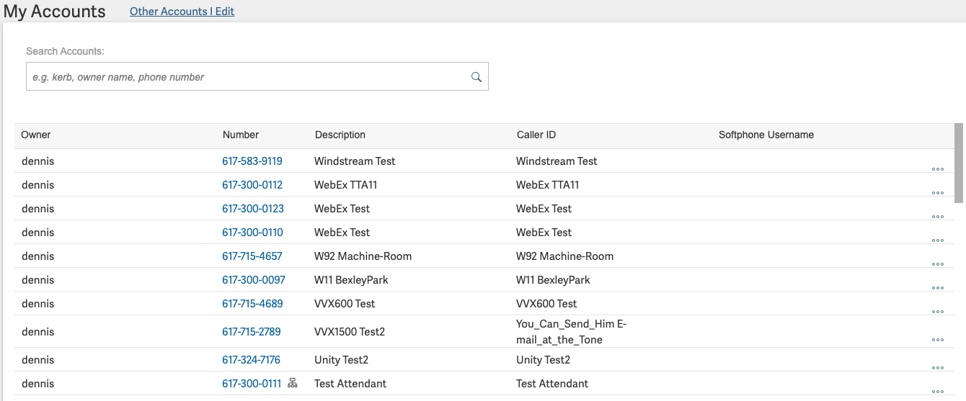
  MITvoip Provisioning Site
  Accounts (List View)
Notes:
-For the majority of MITvoip site users, there are two main concepts to understand – (1) Accounts and (2) Devices
-Note that all of the information I’ll be covering is detailed on the wiki page located on the voip site side panel
ACCOUNTS
-For the purposes of this talk, you can think of an Account as a phone number and its associations (voicemail, softphone, etc.)
-When you log in, the site will default to showing you the Accounts that you are own – (accounts to which you are assigned as the owner)
-If you own three or fewer accounts, the site will default to what we call the Account “Card View” – seen here [display the browser with the Voip site]
-If you own more than three accounts, you will get the “list” view which is easier to navigate but does not display as much info [prepare a list view user in case someone asks]
-Review the “Card View” for a Broadsoft account [note to audience that we’ll only be reviewing BroadSoft accounts for talk]
-Account Description, phone number, ellipsis menu, Account Owner, link to broadsoft.mit.edu
-Resetting a voicemail password
-My Devices
-Open the “Account Details” page for the account
-User has ability to edit fields such as Description, etc.
-User has ability to add/remove an Account Owners, Administrators
-Account Owners – can change account settings and modify voicemail settings on MITvoip, as well as make changes in the BroadSoft web portal
-Account Administrators – can ONLY change account settings and modify voicemail settings on MITvoip, but cannot access the BroadSoft web portal for the account
-User has the ability to enable/disable voicemail, as well change how the voicemail is stored and delivered to them
-also can change the voicemail passcode from this page as well
-User can specify their softphone username – which I’ll discuss in more detail when I get to the softphone piece of this talk
-User can add/remove the account from devices they own
-Change the order in which the accounts appear on the phone
-Note that if you are assigned as an Administrator on an account, you can view those accounts by clicking the “Other Accounts | Edit” link

Slide 12
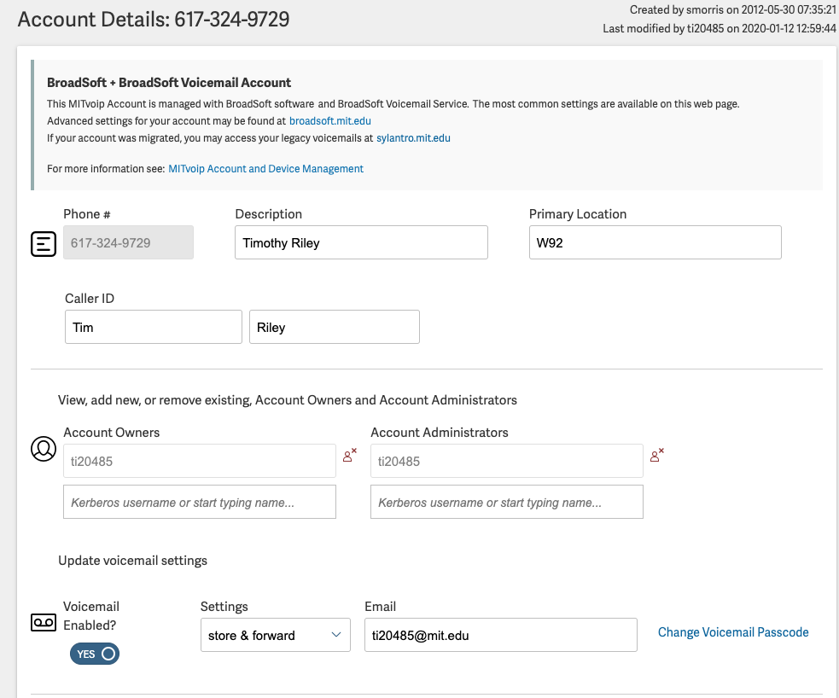
  MITvoip Provisioning Site
Notes:
-For the majority of MITvoip site users, there are two main concepts to understand – (1) Accounts and (2) Devices
-Note that all of the information I’ll be covering is detailed on the wiki page located on the voip site side panel
ACCOUNTS
-For the purposes of this talk, you can think of an Account as a phone number and its associations (voicemail, softphone, etc.)
-When you log in, the site will default to showing you the Accounts that you are own – (accounts to which you are assigned as the owner)
-If you own three or fewer accounts, the site will default to what we call the Account “Card View” – seen here [display the browser with the Voip site]
-If you own more than three accounts, you will get the “list” view which is easier to navigate but does not display as much info [prepare a list view user in case someone asks]
-Review the “Card View” for a Broadsoft account [note to audience that we’ll only be reviewing BroadSoft accounts for talk]
-Account Description, phone number, ellipsis menu, Account Owner, link to broadsoft.mit.edu
-Resetting a voicemail password
-My Devices
-Open the “Account Details” page for the account
-User has ability to edit fields such as Description, etc.
-User has ability to add/remove an Account Owners, Administrators
-Account Owners – can change account settings and modify voicemail settings on MITvoip, as well as make changes in the BroadSoft web portal
-Account Administrators – can ONLY change account settings and modify voicemail settings on MITvoip, but cannot access the BroadSoft web portal for the account
-User has the ability to enable/disable voicemail, as well change how the voicemail is stored and delivered to them
-also can change the voicemail passcode from this page as well
-User can specify their softphone username – which I’ll discuss in more detail when I get to the softphone piece of this talk
-User can add/remove the account from devices they own
-Change the order in which the accounts appear on the phone
-Note that if you are assigned as an Administrator on an account, you can view those accounts by clicking the “Other Accounts | Edit” link

Slide 13
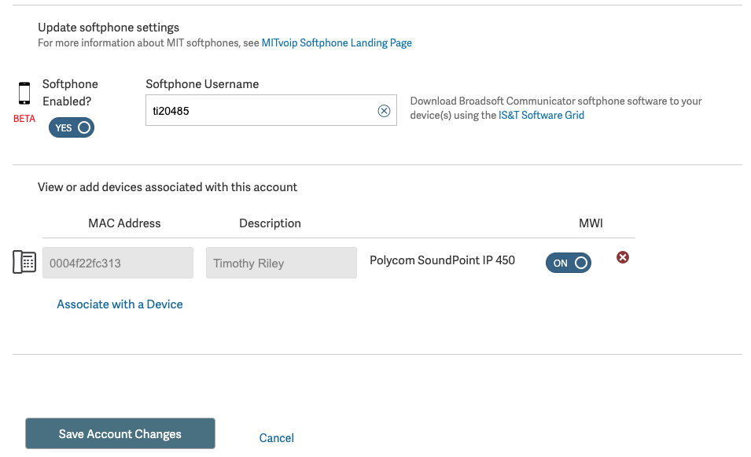
  MITvoip Provisioning Site
Notes:
-For the majority of MITvoip site users, there are two main concepts to understand – (1) Accounts and (2) Devices
-Note that all of the information I’ll be covering is detailed on the wiki page located on the voip site side panel
ACCOUNTS
-For the purposes of this talk, you can think of an Account as a phone number and its associations (voicemail, softphone, etc.)
-When you log in, the site will default to showing you the Accounts that you are own – (accounts to which you are assigned as the owner)
-If you own three or fewer accounts, the site will default to what we call the Account “Card View” – seen here [display the browser with the Voip site]
-If you own more than three accounts, you will get the “list” view which is easier to navigate but does not display as much info [prepare a list view user in case someone asks]
-Review the “Card View” for a Broadsoft account [note to audience that we’ll only be reviewing BroadSoft accounts for talk]
-Account Description, phone number, ellipsis menu, Account Owner, link to broadsoft.mit.edu
-Resetting a voicemail password
-My Devices
-Open the “Account Details” page for the account
-User has ability to edit fields such as Description, etc.
-User has ability to add/remove an Account Owners, Administrators
-Account Owners – can change account settings and modify voicemail settings on MITvoip, as well as make changes in the BroadSoft web portal
-Account Administrators – can ONLY change account settings and modify voicemail settings on MITvoip, but cannot access the BroadSoft web portal for the account
-User has the ability to enable/disable voicemail, as well change how the voicemail is stored and delivered to them
-also can change the voicemail passcode from this page as well
-User can specify their softphone username – which I’ll discuss in more detail when I get to the softphone piece of this talk
-User can add/remove the account from devices they own
-Change the order in which the accounts appear on the phone
-Note that if you are assigned as an Administrator on an account, you can view those accounts by clicking the “Other Accounts | Edit” link

Slide 14
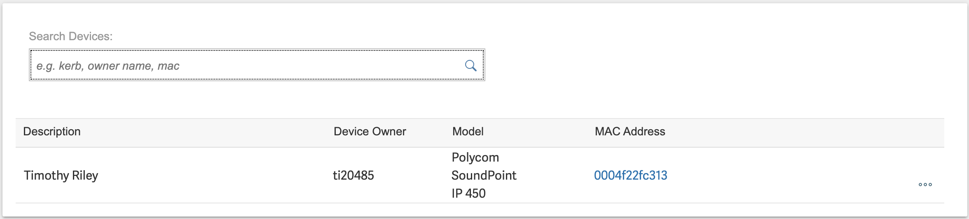
MIT Provisioning Site
  Devices
Notes:
DEVICES
-Devices are physical phones
-Devices to which you are assigned as the owner will display on My Devices list
-Note that you can search if you own a lot of devices
-Open the Device Details page for a device
-User can edit Device Description
-Add/remove owners
-Unlike accounts, the actions that can be taken on devices are limited to this page
-User can reboot the device (e.g. if the phone isn’t functioning properly)
-User can also add accounts that they own

Slide 15
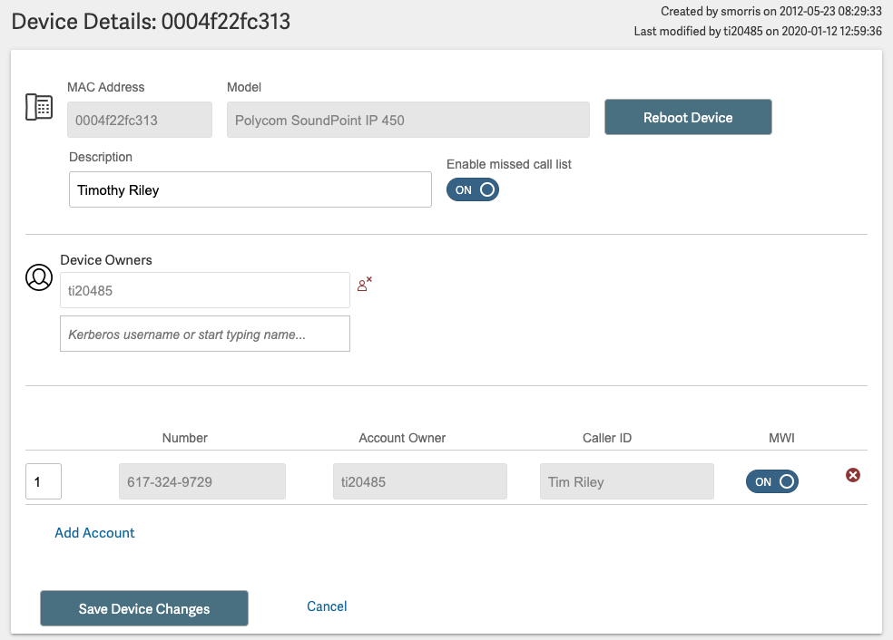
MITvoip Provisioning Site
Notes:
DEVICES
-Devices are physical phones
-Devices to which you are assigned as the owner will display on My Devices list
-Note that you can search if you own a lot of devices
-Open the Device Details page for a device
-User can edit Device Description
-Add/remove owners
-Unlike accounts, the actions that can be taken on devices are limited to this page
-User can reboot the device (e.g. if the phone isn’t functioning properly)
-User can also add accounts that they own

Slide 16
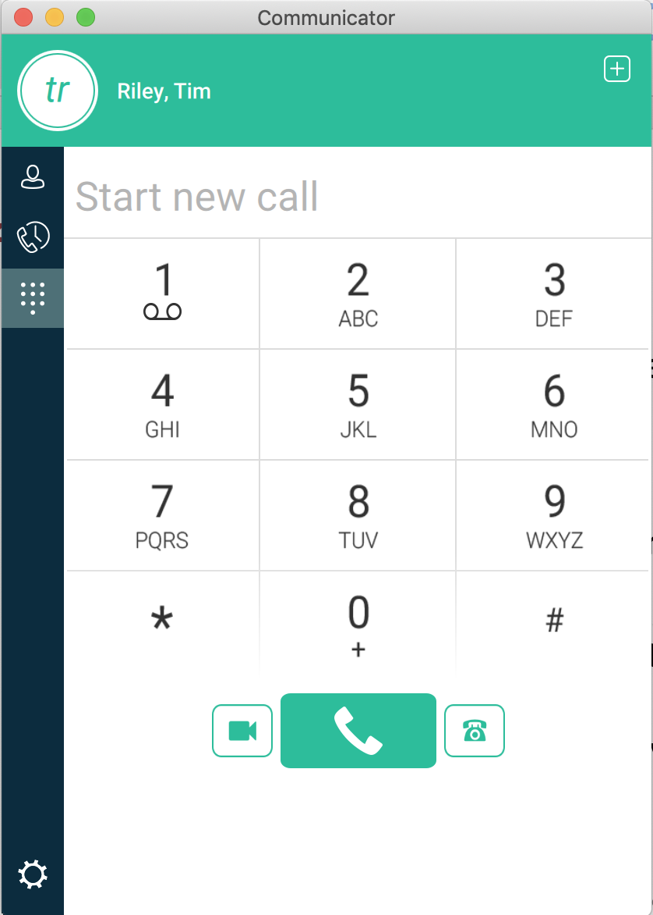
Softphones
Features
Receive calls to your MIT phone number on the supported devices of your choosing
Outgoing calls made from Communicator display your MIT phone number and contact information
Supports 5 digit extension dialing
Access to contacts saved on your device or contacts that you add in Communicator
View your call history

Slide 17
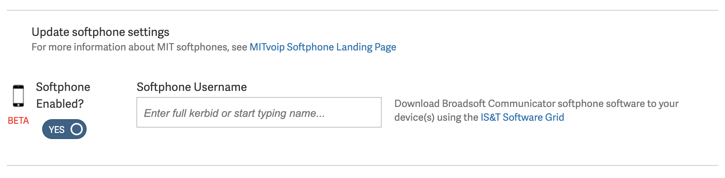
Softphone - Setup
Step 1:
Enable your softphone functionality on the MITvoip provisioning site
Step 2:
Download the BroadSoft UC Communicator client using the IS&T Software Grid or app store; configure client
Make and receive calls on your device!
Softphone KB Article

Slide 18
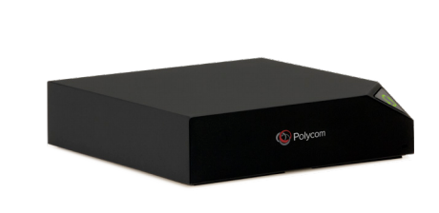
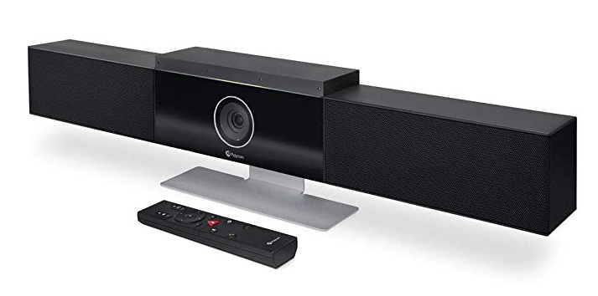
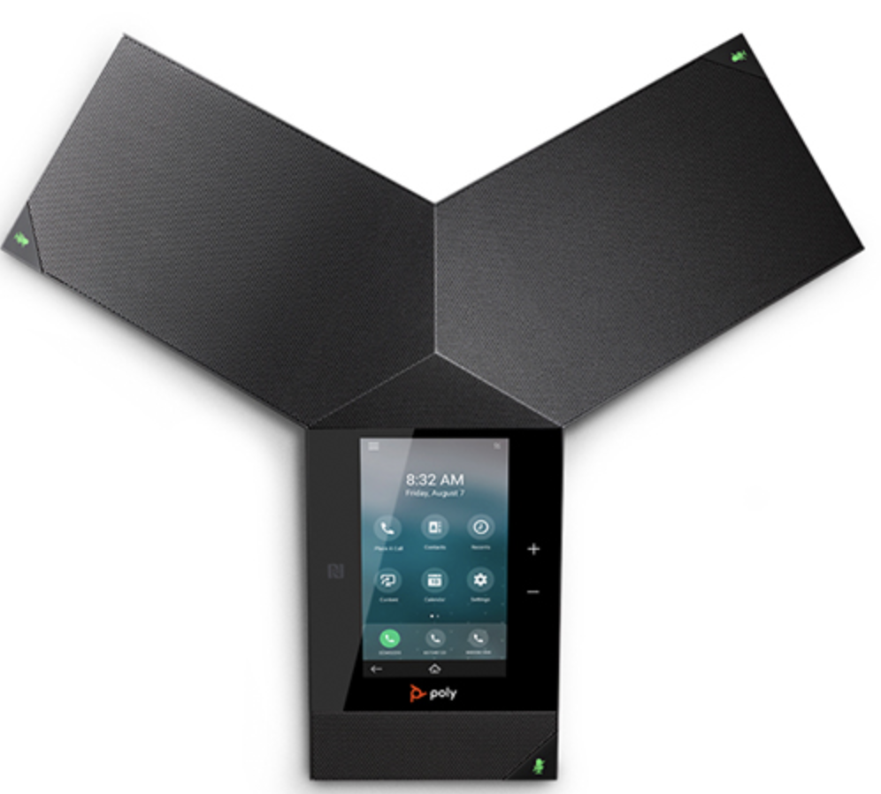
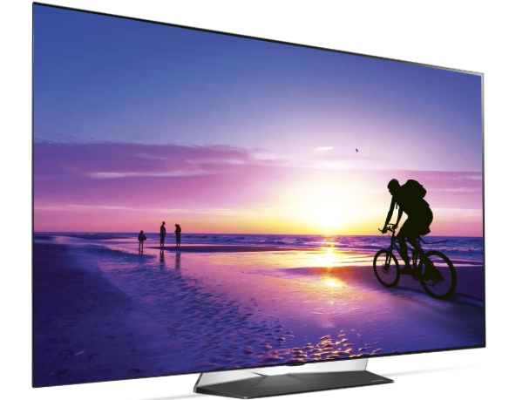
Polycom Trio Enhancement*
Benefits
Transform any small conference room into smart video conference rooms
Call directly into WebEx or Zoom rooms using this setup
Small Room Video Conferencing KB Article
*Coming soon, in beta testing

Slide 19
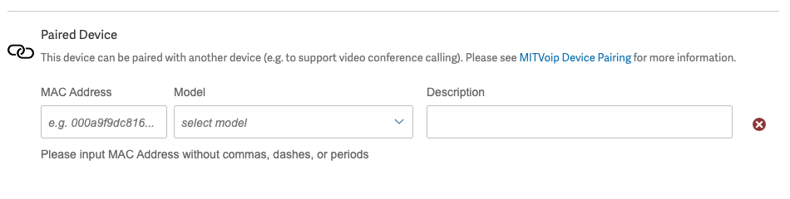
Polycom Trio Enhancement – Set Up
Step 1:
If necessary, acquire the necessary hardware via govconnection.com
Send request to IS&T to add the Polycom 8800 to MITvoip
Step 2:
Pair your PolyCom RealPresence 8800 and Visual+ via the MITvoip site
Step 3:
Physically connect your devices in a conference room with two active ethernet ports
Make video conference calls!

Slide 20
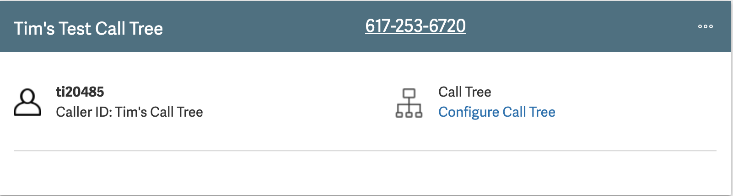
BroadSoft Call Trees
Benefits
BroadSoft call tree users can now update their announcement audio files and menu options without contacting IS&T
Call tree accounts are managed along side other MITvoip accounts

Slide 21
BroadSoft Call Tree Setup
Request new call tree
Record Announcement
Upload announcement, Set menu options
Take incoming calls!
Request and schedule call tree conversion
Call Tree KB Page

Slide 22
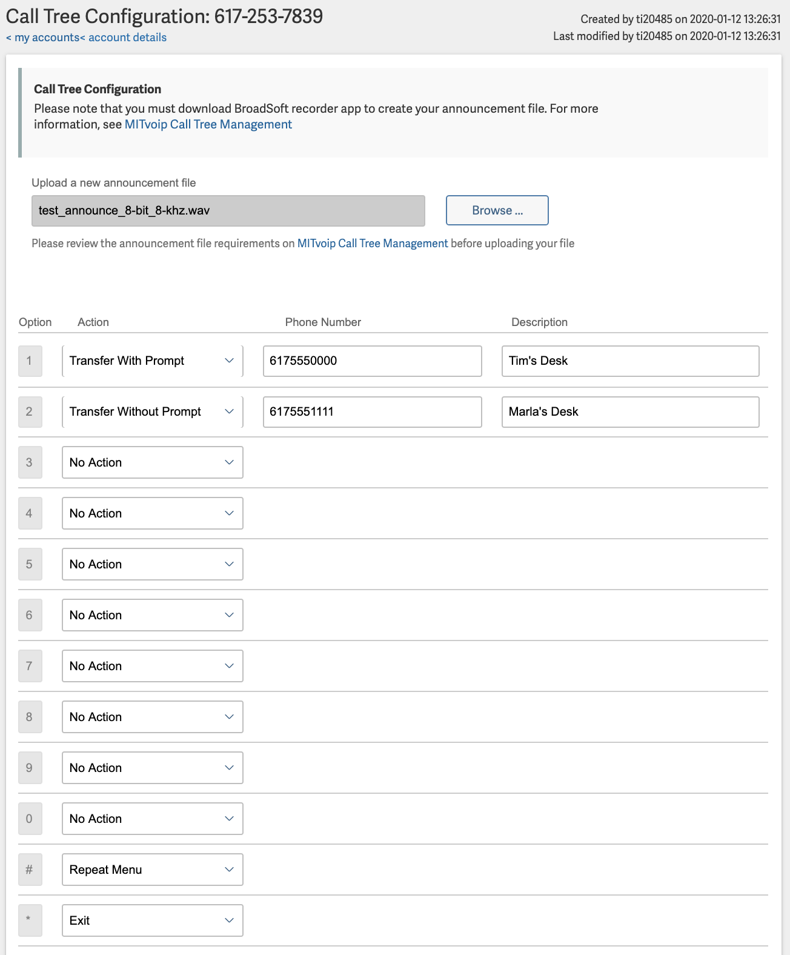
BroadSoft Call Trees

Slide 23
Q&A
Questions?

Slide 24
Resources
MITvoip BroadSoft Cloud Landing Page
http://kb.mit.edu/confluence/x/FwaACQ
MIT BroadSoft Cloud Web Portal
http://kb.mit.edu/confluence/x/3xuACQ
Feature Access Codes in Broadsoft
http://kb.mit.edu/confluence/x/5yuACQ
MITvoip Account and Device Management
http://kb.mit.edu/confluence/x/XUmACQ
Transition to BroadSoft Information
http://kb.mit.edu/confluence/display/istcontrib/Transition+to+MITvoip+BroadSoft+Cloud
Broadsoft SoftPhone
http://kb.mit.edu/confluence/display/istcontrib/MITvoip+Softphone+Landing+Page
Contact: Broadsoft-transition@mit.edu for more information about scheduling your move to Broadsoft

