Slide 1



Office 365: Core Services
SharePoint Online
Exchange Online
MIT Email Update
Discussion
Richard Edelson

Slide 2
What is Office 365?
Office 365 is a subscription based Cloud platform that combines cloud based services with Office software as a service
  Traditionally distributed Office software can connect to the cloud services as well
  Office Mobile clients are distributed via an app store
Office 365 is available to all Faculty, Staff, Students and Affiliates.
  MIT’s integration with Office 365 automatically provisions accounts and activates supported Office 365 features
  Users logon with their MIT email address
  Authentication for mobile and web clients is Touchstone enabled.
  Office 2016 supports Touchstone authentication from within the Office App
    Except for Skype

Slide 3

Office 365 Services Overview
Office 365 ProPlus for Education: Office Software
  https://portal.office.com/Home
  Office 365 ProPlus for Education is available to the MIT Community. This includes Faculty, Staff, Students and Affiliates.
  Install Office products on up to 5 devices PCs or Macs and on other mobile devices, including Android, iPad, iPhone, and Windows tablets.
  Desktop Software is downloadable via the Office 365 web portal
  Mobile apps are available via the respective app store for the device OS
  Create reports and presentations with Word, Excel, PowerPoint, OneNote, Outlook, Publisher, and Access.
  Product activation requires logging in to Office 365 via the app using the MIT provisioned account
  Apps check online for account validation every 30 days to maintain activation. Account validation is checking to see if the account is still active.
  Users can migrate to a personal Office 365 account after leaving MIT

Slide 4
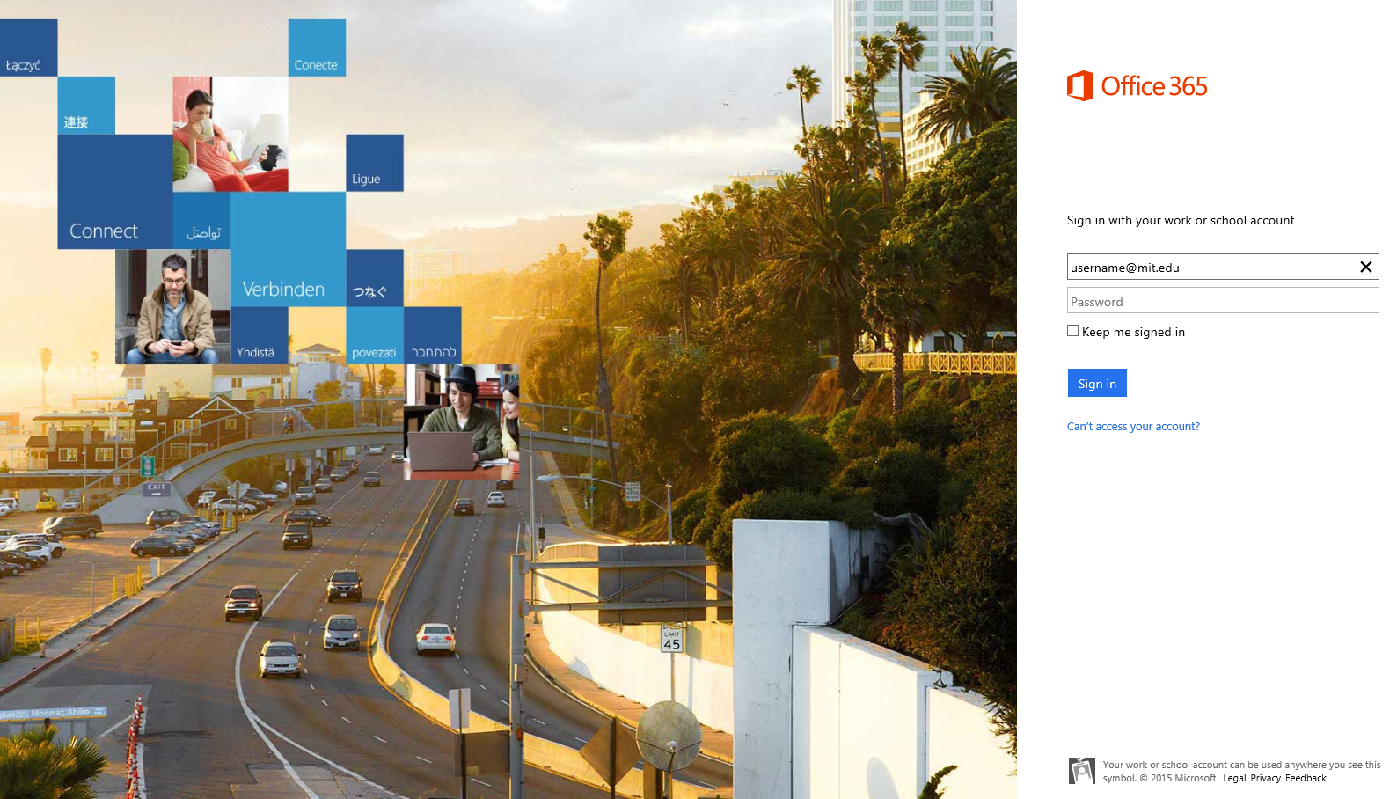
Login to the Web Portal
https://login.microsoftonline.com/ With MIT certificates you do not need to enter your password, keep it blank, just your email address. You will be asked to select “Work Account”, then you will be redirected to Touchstone for authentication

Slide 5
SharePoint Online as a core service
SharePoint Online is a core service of Office 365 that features web content and document repositories, the latter known as OneDrive.
SharePoint Online includes an ever growing list of applications but it’s important to focus on the platforms core functions. Office 365 was launched in June of 2011 with these core workloads in mind
Microsoft bought Yammer in 2012 and introduced Groups in 2014. since then there has been a never ending parade of applications being introduced to the platform.
Its important to keep focus on the core workloads the platform provides, email, web content, document storage and management.

Slide 6
Some SharePoint Online Suite Features
Microsoft Bookings: An online and mobile app for small businesses that provide services to customers on an appointment basis.
Microsoft Flow: Allows you to automate workflows across applications.
Microsoft Forms: Allows you to quickly and easily create custom quizzes, surveys, questionnaires, registrations.
Microsoft Graph API: Build apps that connect to a wealth of resources, relationships all through a single endpoint.
Microsoft MyAnalytics: Provides statistics that help you understand how you spend your time at work.
Microsoft Planner: Gives users a visual way to organize teamwork.
Microsoft PowerApps: An enterprise service that helps you quickly build, integrate, and share apps that work on any device.
Microsoft StaffHub: A cloud-based application that lets workers and their managers use their mobile devices to manage schedules.
Microsoft Stream: An enterprise video service that people in your organization can use to upload, view, and share videos securely.
Microsoft Sway: A professional digital storytelling app that helps you express ideas using an interactive, web-based canvas.
Microsoft Teams: A chat-centered workspace in Office 365 that helps team members achieve more together.
Office Delve: Enables users to search for and discover content across Office 365 based on personalized insights.
Office 365 Groups: Connects users with the colleagues, information and applications they need to get more done together.
Office 365 Video: A destination where you can upload, share and discover videos across your devices.

Slide 7
Skype for Business as a core service
In 2015 Microsoft rolled out Skype for Business as another core service of the Office 365 platform
Skype for Business is available to MIT users today but is not integrated with the MIT phone system at this time.
Skype for Business is integrated with the MIT directory which means MIT users and moira groups can be used. Directory browsing is only available to users with email already on Office 365 but without it users and groups can be entered manually.
MIT users for Skype for Business may collaborate with Skype users outside of MIT including public Skype.

Slide 8
The Bottom Line – OneDrive Storage!
  User spaces: https://mitprod-my.sharepoint.com/personal
    OneDrive for Business – 5 TB OneDrive quota
    Team or Public Sub-Site Creation (one level down only)
  Departmental spaces: https://mitprod.sharepoint.com/sites
    http://sharepoint.mit.edu will redirect to the site
    OneDrive for Business - Storage is quota based assigned by IS&T (max 25 TB)
    Team or Public Sub-Site Creation – nested sites
  MIT Directory integration of users and groups
  Supports Touchstone and DUO integrated logon
  Documents can be opened directly from Office applications

Slide 9

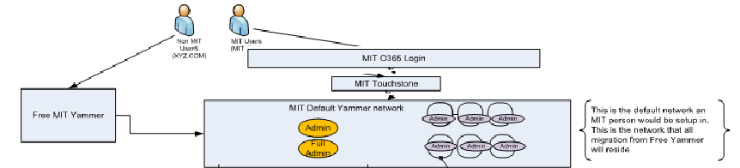
Yammer Enterprise
  Yammer is a social networking tool that helps teams collaborate and share. Using Yammer, individuals can collaborate by posting messages, sharing files, or organize around projects or groups
  Advantages to Yammer Enterprise
  Any non-MIT users must be invited to join
  Clear identification of users community
  MIT can manage content and users as necessary
  Single sign-on with Touchstone and two factor authentication support with DUO
  Managed external collaboration
  Integration with external packages

Slide 10




Exchange Online
  MIT has a Hybrid model for integration with Exchange Online
    Users with an Exchange online mailbox logon via Microsoft’s web portal or use existing email clients
    Email is routed between Exchange Online and campus Exchange email routers to integrate with existing email functionality
    Quota’s of 50 GB by default
    Integration with existing MIT directory services such as Moira and LDAP
    Integration allows the continued use of current redirected or split mailbox functionality
    IS&T has migrated to Exchange Online one year ago as a production pilot program
    IMAP is supported via SSL login
      GSSAPI is not supported

Slide 11
Exchange Email facts
MIT has been running Exchange email since 2008
50,000+ mailboxes, ~ 120 TB of storage
Data is replicated between two Datacenters
The entire infrastructure is virtualized
User default quota is currently 15 GB
Integrated calendaring services
Front end load balancing in two data centers
On premise Exchange 2013 upgrade is in progress

Slide 12


MIT email - architecture: Logical view with Exchange
Firewall
UNIX DMZ outbound mailers
mailauth separate auth/no-auth,
Internal/external delivery mailers
Symantec
Anti-Spam/Virus Appliances
MX records mit.edu
UNIX DMZ inbound mailers
Anti-Virus
Load balanced
outbound mail
UNIX Outgoing mailers
outgoing-exchange.mit.edu
Load balanced
Firewall
Firewall
Exchange
outbound hubs
exchange-forwarding.mit.edu
Split/forwarded for internal users
Exchange outbound Edge
Transport servers
Symantec
Anti-Spam Appliances
MX records exchange.mit.edu
Firewall
Exchange Clients
SAN storage
Exchange inbound hubs
DMZ MX records
Exchange webmail and web proxy servers
Load balanced: https and IMAP
Exchange mailbox servers

Slide 13
Office 365 Architecture and Integration with MIT
Exchange CAS/HUB “Hybrid Servers” for Exchange Online integration
On Premise
Exchange Mailbox
Load
Balancers
Firewall
MIT KDC’s
Microsoft Office 365
LDAP
Touchstone
Authentication
Moira
Dirsync
Active Directory
Data is fed from Active Directory via a directory sync server which sends changes to directory objects

Slide 14
Exchange Pilot and Early Adopter Program
Exchange Online (EXO) Pilot: 2016
  IS&T has been using Exchange Online mail since mid-2016
  This pilot program consisted of ~ 300 mailboxes
Early adopter program:
  IS&T is now accepting candidates who wish to migrate to EXO
  IS&T will prioritize schedules among the volunteer DLC’s
  IT Support staff are recommended to move first
Broader migration effort is anticipated for the future
  This would include students

Slide 15
What does the migration process look like?
Pre-migration checklist
  Are there users who have close to 50 GB of mail
  Delegate info inventory: Who must manage others calendars or mail
  Calendar Resource inventory: Including permissions to migrate
Client preparation
  Give out new OWA URL: http://outlook.com/owa/exchange.mit.edu
  Update to standard UPN format: user@mit.edu, this means no user@exchange.mit.edu or EXCHANGE\user
  Communicate and schedule the migration date
Mailbox and Resource Migration
  IS&T will migrate data up to 95% completion prior to the user migration date
  At the time of the scheduled migration IS&T will complete the remaining 5% and the migration will be live
  Users won’t logon for a few minutes while mailbox cleanup is in progress
  It is recommended that the go live time be when support staff are available to assist users in the transition

Slide 16
Exchange on premise upgrade
Exchange users will begin having their mailboxes moved to new Exchange 2013 systems
MessageWare: Users of the OWA add-on for extended calendaring functions will use native Exchange functionality in the new version
Why not Exchange 2016?
  Exchange 2016 no longer allows split roles of front end and backend services. MIT’s architecture relies heavily on a front end role integrating with out load balancers and storage on the backend.

Slide 17
Questions

