Slide 1
Accessibility & Usability
Accessibility & Usability
  Web Accessibility: Encouraging Digital Diversity
  Accessibility & Usability Group
  June 12, 2018
  Office of the Vice Chancellor (OVC)

Slide 2
Accessibility & Usability
Introduction
  Presenters from the Accessibility & Usability team:
  Kathy Cahill
  Katherine Wahl
Notes:
We are the Accessibility & Usability team and our goals is to work towards making products FUNCTIONALLY ACCESSIBLE!

Slide 3
Accessibility & Usability
Introduction
Accessibility
  “The ongoing process by which an organization ensures its current and future IT can be used effectively by everyone, including individuals with disabilities.” Educause
Assistive Technology
  “Assistive technology is technology used by individuals with disabilities in order to perform functions that might otherwise be difficult or impossible.” U Washington

Slide 4
Accessibility & Usability
Assistive Technology Examples
Screen Readers
    Keyboard navigation, reads all text in applications & OS
    How visually impaired users ‘see’ a Web page
    Allows users to move through a Web page to “build up a mental map in your mind one thing at a time”
    Web headings are important for screen reader users to successfully navigate
Magnification Software
    Allows users to zoom in and magnify text, graphics without breaking up the words or formatting
Notes:
Main screen readers are Jaws, NVDA, Window Eyes, Voice Over

Slide 5
Accessibility & Usability
Assistive Technology Examples
Hearing Aids
Joysticks
Wheelchairs
Eyeglasses
Grabbers

Slide 6
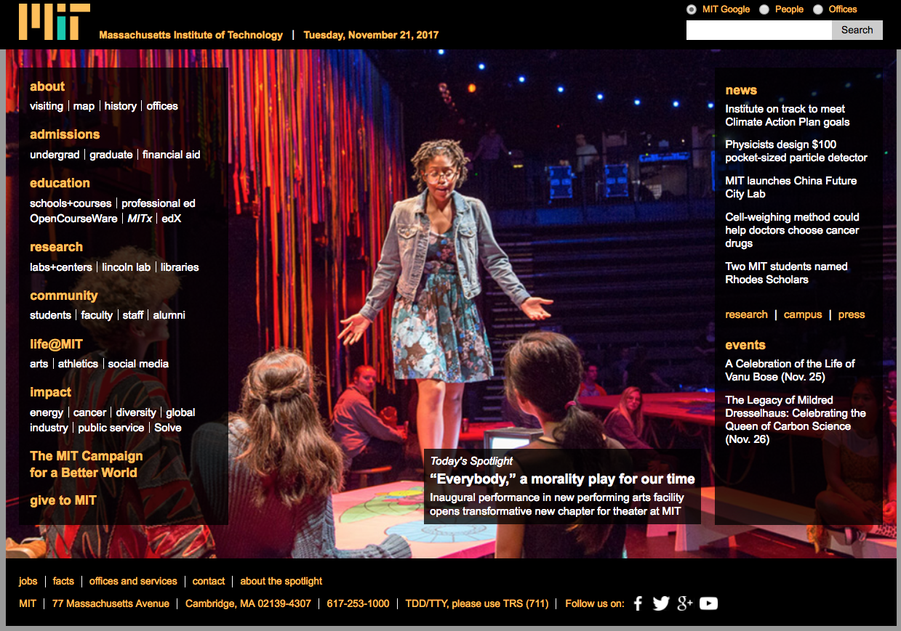
Accessibility & Usability
Different Views of the Same Web Site
  MIT Home page on November 21, 2017
Notes:
‘regular view’

Slide 7
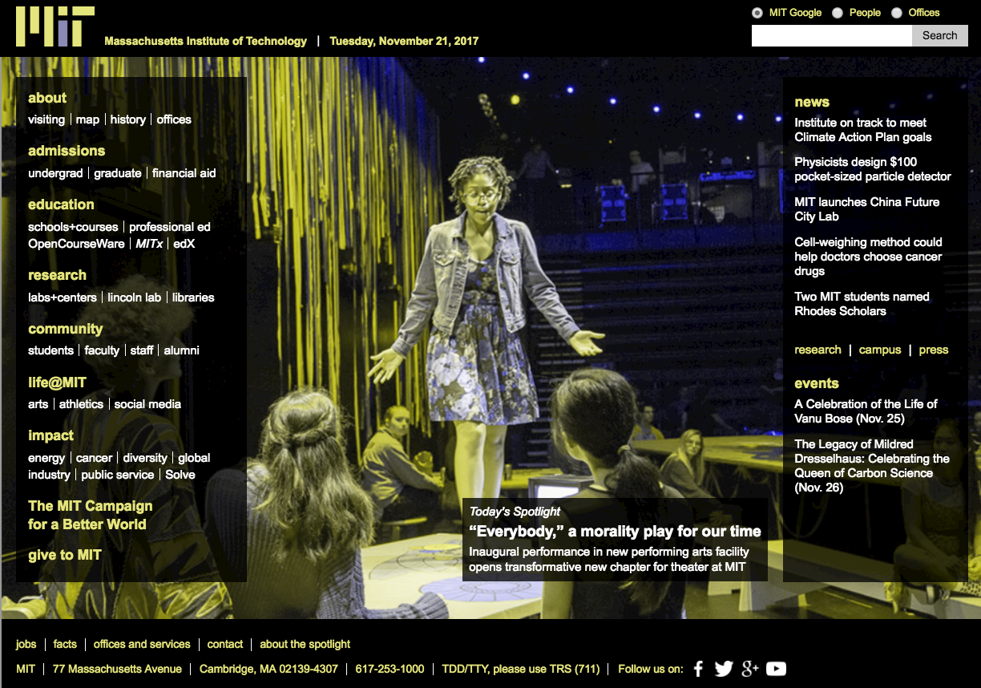
Accessibility & Usability
MIT Web Site viewed by a color blind user
  MIT Home page on November 21, 2017
Notes:
red/green color blindness

Slide 8
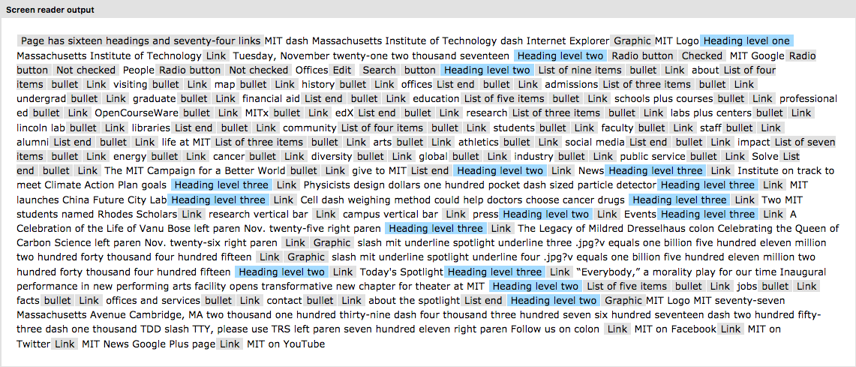
Accessibility & Usability
MIT Web Site text read by a screen reader
  MIT Home page on November 21, 2017
Notes:
for those of us who can’t see would hear it read to us

Slide 9
Accessibility & Usability
Why Accessibility @ MIT?
Why Accessibility at MIT?
  People with disabilities must receive equal access to programs, employment and information (ADA, Titles I and III, and Sec. 504 of the Rehabilitation Act of 1973)
  Diversity is part of MIT’s mission and disability is a diversity issue
  We cannot have a diverse student body or workforce if Web sites, software, and applications are not accessible
Notes:
Mention that procurement issue – once we purchase a third-party software product – we are on the hook for making sure it is ‘accessible’
Also important to remember if you are working with a vendor on a new web site
Also important if you are using a new tool (for example to create a video for your site)
First bullet point: Title I of ADA refers to equal access to employment non-discrimination on basis of disability, Title III refers to places of public accommodation and there is still a lack of clarity from Federal Govt that the web is a place of public accommodation. We need to assume this going forward.

Slide 10
Accessibility & Usability
Why Accessibility @ MIT?
Why Accessibility at MIT?
  Accessibility must be part of the the project planning and application procurement process. Once we purchase software, it is our responsibility to make sure it is accessible
  Any custom web work done by an outside vendor should meet accessibility standards
Notes:
Mention that procurement issue – once we purchase a third-party software product – we are on the hook for making sure it is ‘accessible’
Also important to remember if you are working with a vendor on a new web site
Also important if you are using a new tool (for example to create a video for your site)

Slide 11
Accessibility & Usability
Accessibility Issues Overview
Taking in information
  Color
  Font size
  Alternative text
  Audio and video
Navigation
  Keyboard access
  Structure
  Link language
Forms
Tools
Notes:
Going to go through the most common issues we see and describe how to asses for them and how to correct them

Slide 12
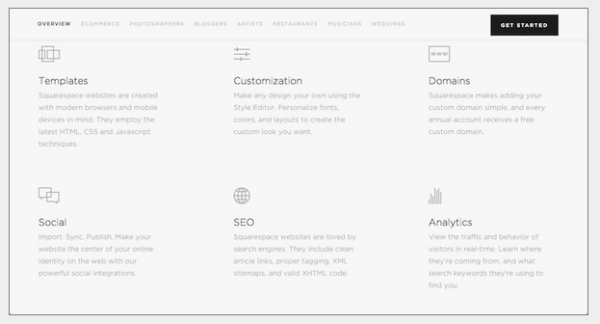
Accessibility & Usability
Color Contrast
Color Contrast – Verify strong contrast between text and background
Notes:
https://www.nngroup.com/articles/low-contrast/
There is an official standard provided by the Web Content Accessibility Guidelines. We adhere to the AA level of Compliance at MIT. A number of tools are available to measure color contrast. It’s not always easy to tell!
Complaint from an alum recently about these color schemes

Slide 13
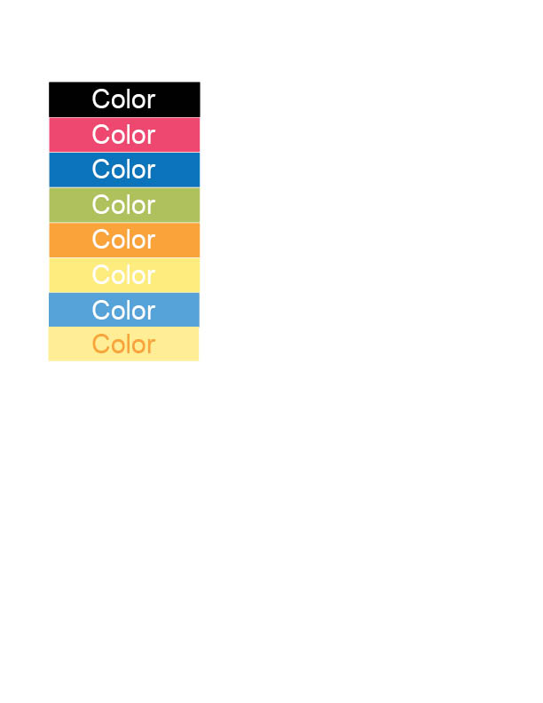
Accessibility & Usability
Color
Notes:
There is an official standard provided by the Web Content Accessibility Guidelines. We adhere to the AA level of Compliance at MIT. A number of tools are available to measure color contrast. It’s not always easy to tell!

Slide 14
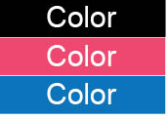
Accessibility & Usability
Color
Notes:
These are the colors that meet the standard

Slide 15
Accessibility & Usability
Color
Tools to assess color contrast
  Paciello Group Contrast Analyser
  Wave tool from Web AIM
  Various plugins that will allow you to review a whole page
Notes:
These are the colors that meet the standard

Slide 16
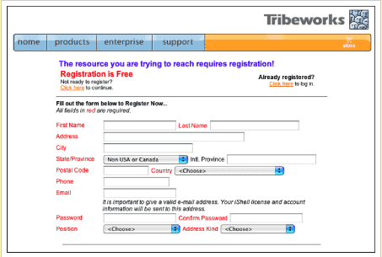
Accessibility & Usability
Color
  Do not use color as the only way to convey information
Notes:
Easy to see what the problem is here

Slide 17
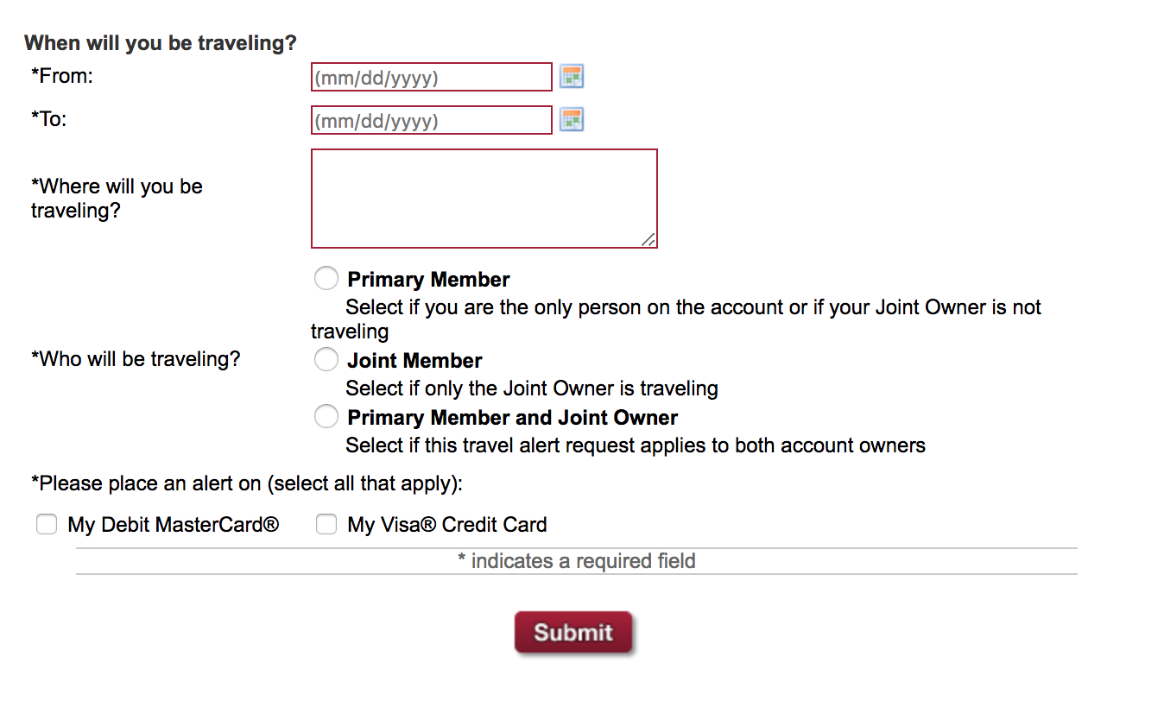
Accessibility & Usability
Color
  Using color as a secondary way to convey information
  is fine

Slide 18
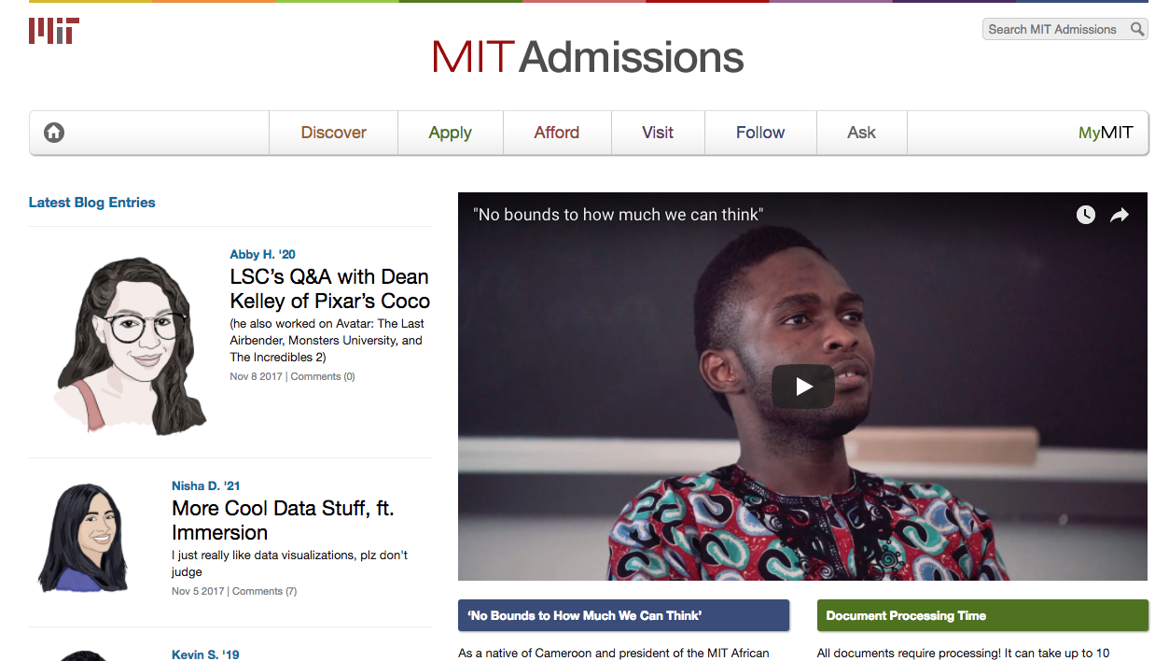
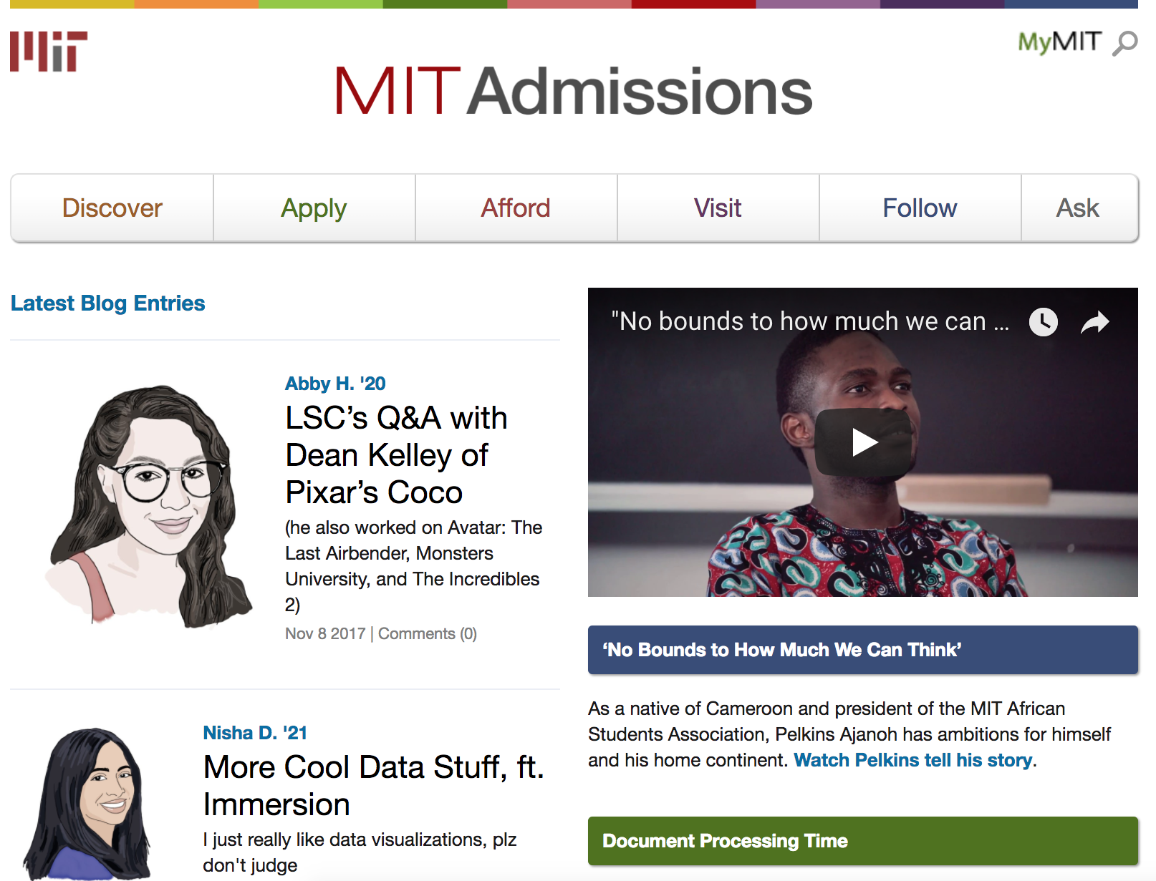
Accessibility & Usability
Font Size & Type
200 %
100 %
Notes:
Hard to give specifics because fonts are resizeable now – fixed fonts are rare – you want to make sure text is readable
Good way to test this out is to enlarge the page
MIT Admissions site at 100% and 200% - Resizes nicely

Slide 19
Accessibility & Usability
Alternative Text
Textual descriptions of images
ALT text is highly contextual
  Null text (“ ”) is used for ALT Text so the screen reader will skip an image
  Four typical categories of alt text:
    Traditional images
    Icons
    Buttons
    Complex graphics
Notes:
Note section:
We typically get questions about how to use logos and icons
These icons here are fine with null alt text because they are only decorative

Slide 20
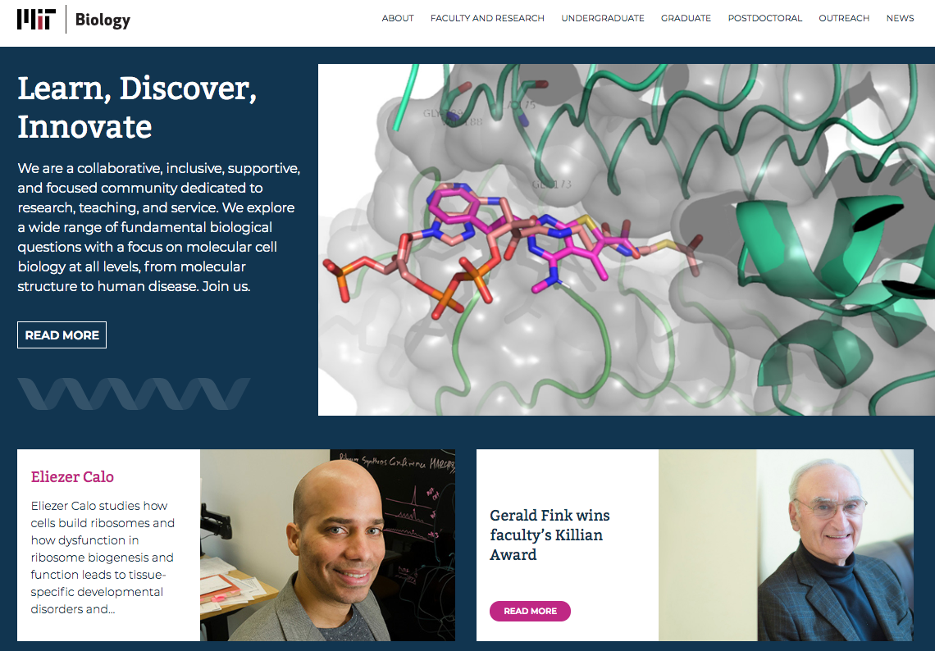
Accessibility & Usability
AlternativeText
Traditional images
Notes:
Note section:
We typically get questions about how to use logos and icons
These icons here are fine with null alt text because they are only decorative

Slide 21
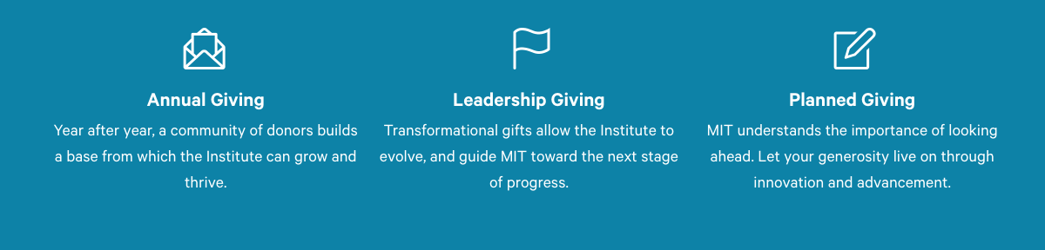
Accessibility & Usability
AlternativeText
Icons
Notes:
Note section:
We typically get questions about how to use logos and icons
These icons here are fine with null alt text because they are only decorative

Slide 22
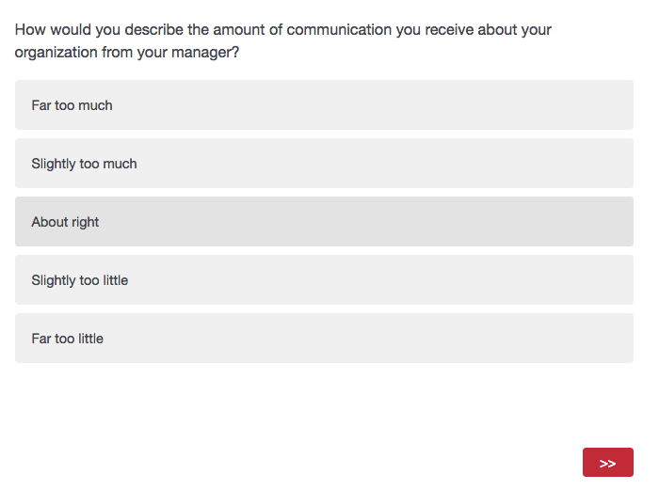
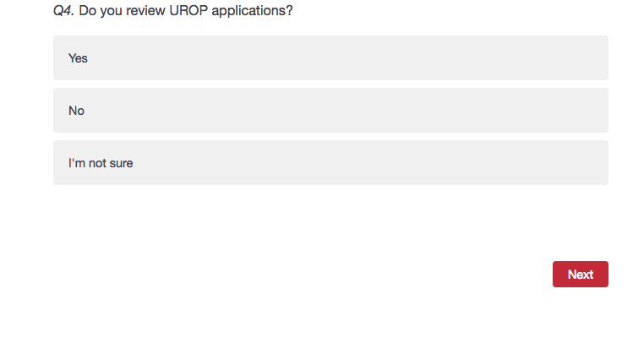
Accessibility & Usability
Alternative/ALT Text
Buttons – function, not form is important
Notes:
Example of the “next” button from a Qualtrics survey. While not technically an image, this shows the concept of just the arrows being used in the first example and the word “next” used in the second example.
In Qualtrics, under ‘tools” there is an option to check survey accessibility that will flag these issues for you and help you correct them

Slide 23
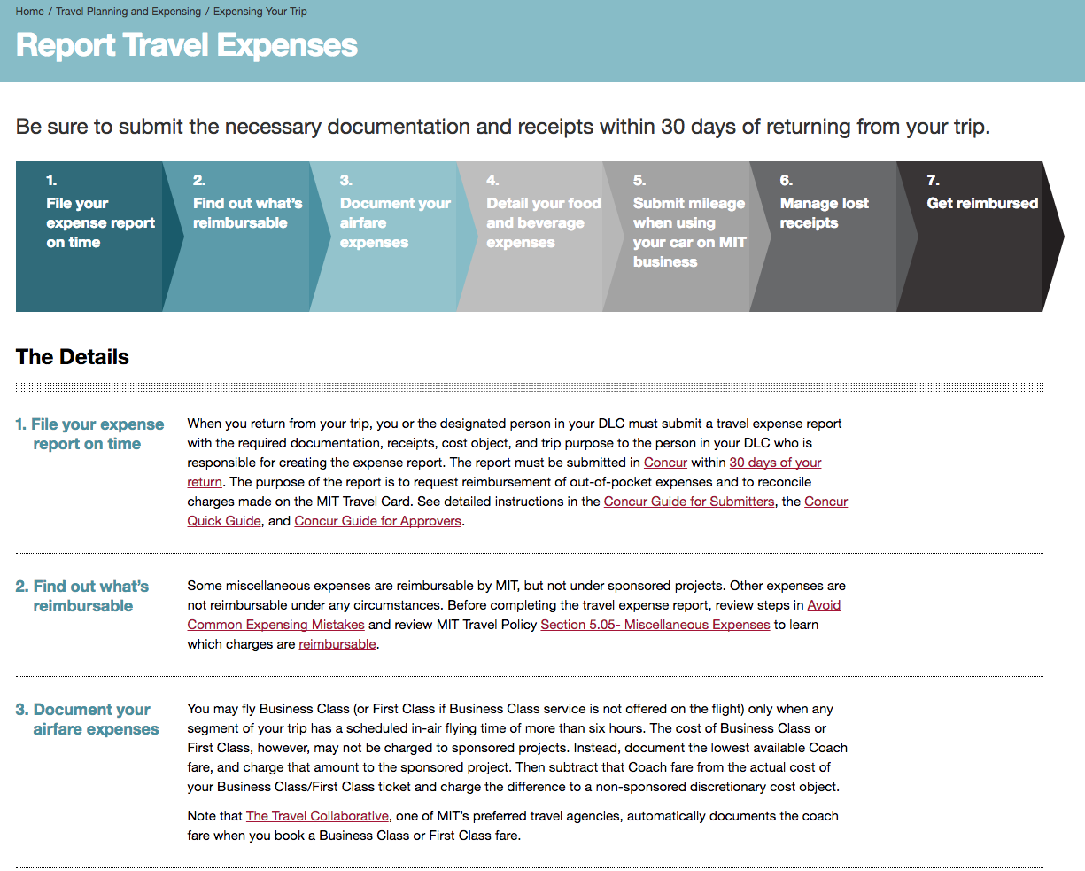
Accessibility & Usability
Complex Graphics
Complex graphics – are often used to convey information about a process or to show data trends
Notes:
Example from VPF that shows the travel expense reporting process with a graphic at the top of the page and and a description of each item below.
Two ways to present information

Slide 24
Accessibility & Usability
Audio & Video
Captions
Every video should have captions
Autocaptions are not enough
New formats create new challenges
Transcripts
Especially important for audio files like podcasts
Good to have for videos in addition to captions
  A transcript alone is not adequate for video
  If you have a transcript, it is easy to create captions
Notes:
Captions
Good to have multiple ways to get the same information
Good for speakers who are ESL
Good for speakers who might be soft speakers
Also good to be able to have captions to read at one’s own speed – not only the speaker’s speed
This can also help with SEO

Slide 25
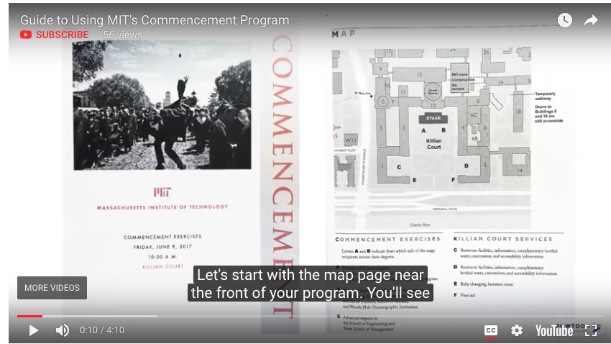
Accessibility & Usability
Captions
Notes:
Captions
Good to have multiple ways to get the same information
Good for speakers who are ESL
Good for speakers who might be soft speakers
Also good to be able to have captions to read at one’s own speed – not only the speaker’s speed
This can also help with SEO

Slide 26
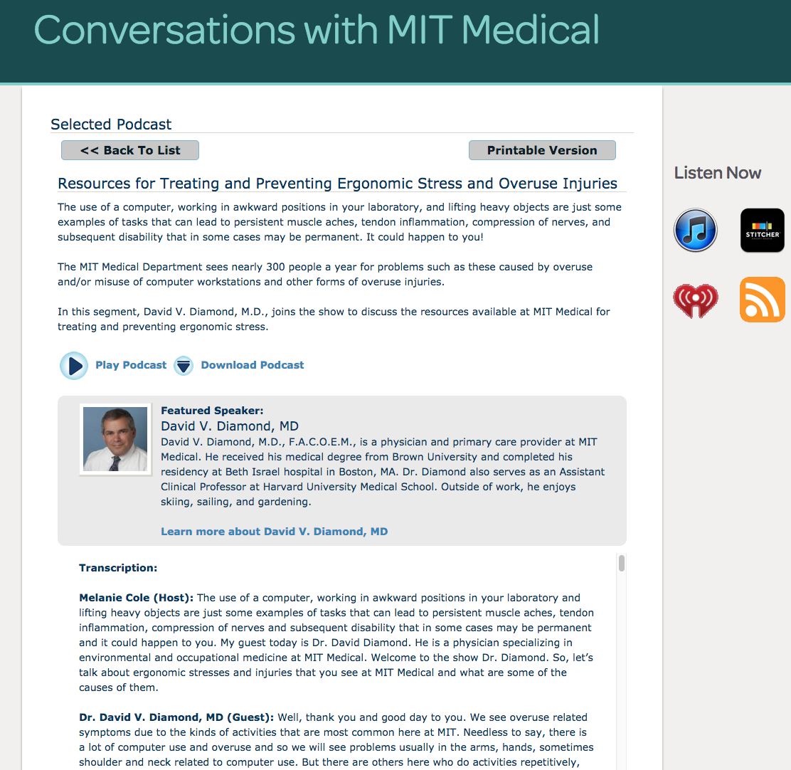
Accessibility & Usability
Podcasts
Podcasts
Always include transcripts for podcasts. They are not accessible without them
Notes:
Nice example from MIT Medical of a transcript provided with a podcast

Slide 27
Accessibility & Usability
Keyboard-Only Access
    Users should be able to navigate a site using only the keyboard
    They should also have a visual indication of where they are in the site as they navigate through it
    Keyboard-only access is EASY to test
    Simply unplug your mouse and only use the keyboard and see how things work
Notes:
Focus refers to keyboard focus – and areas of the keyboard and browser determines that
Always maintains a focusable element
Mouse has no focus
CSS Focus – always apply whatever style you want to the focusable element
Skip links – allows you to avoid information on the top of the page to go to the main content
As we state in our reviews regarding keyboard access:
“All mouse actions should also available through using the keyboard. If not properly coded for logical keyboard usage, this can confuse both power users and users relying on assistive technology.”

Slide 28
Accessibility & Usability
Audio & Video
User controls
  Include user controls that can be operated with a keyboard
    Play and pause buttons for video or audio
  Avoid automatically playing audio/video and any type
  Avoid automatically changing images
Notes:
Photo Carousels
Dropdown menus that only work with a mouse

Slide 29
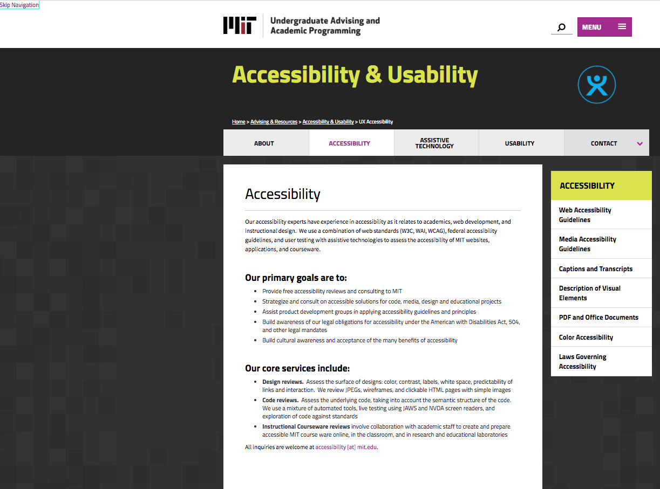
Accessibility & Usability
Keyboard-Only Access
Notes:
This tab order follows what you would expect – also note skip link in the upper left

Slide 30
Accessibility & Usability
(Semantic) Structure
Pages should have a clear structure
  Users should be able to understand the page by quickly scanning it
Headings
  Use headings, lists, and paragraphs to indicate visual structure programmatically
  Headings: H1 – H6
    We recommend each page have only one <h1> tag per page and should reflect the page title
Notes:
As we state in our reviews regarding structure and headings:
“A page with solid structure and headings is easier for all users and makes the site content easily available to search engines. Headings are also useful to screen readers because the screen reader user can move quickly among them with one keystroke. This is akin to a sighted user scanning the page for useful information.

Slide 31
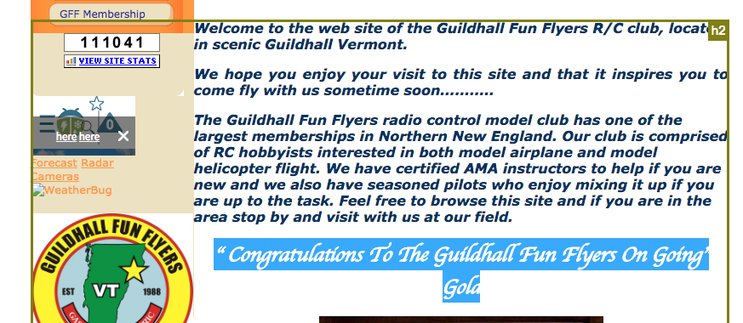
Accessibility & Usability
(Semantic) Structure
Notes:
Poor use of structure example

Slide 32
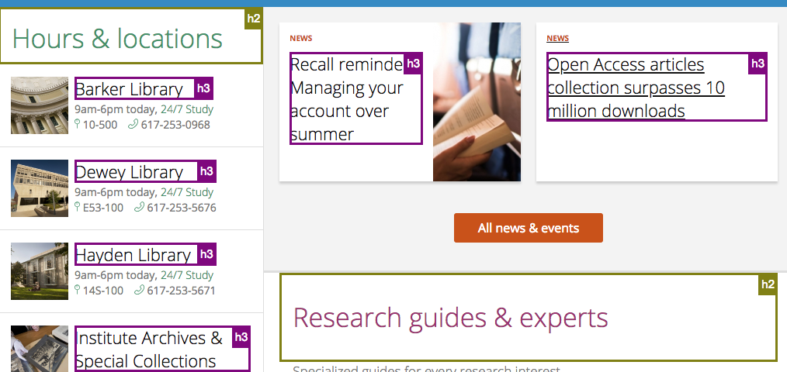
Accessibility & Usability
(Semantic) Structure
Notes:
Good structure on the MIT Libraries page

Slide 33
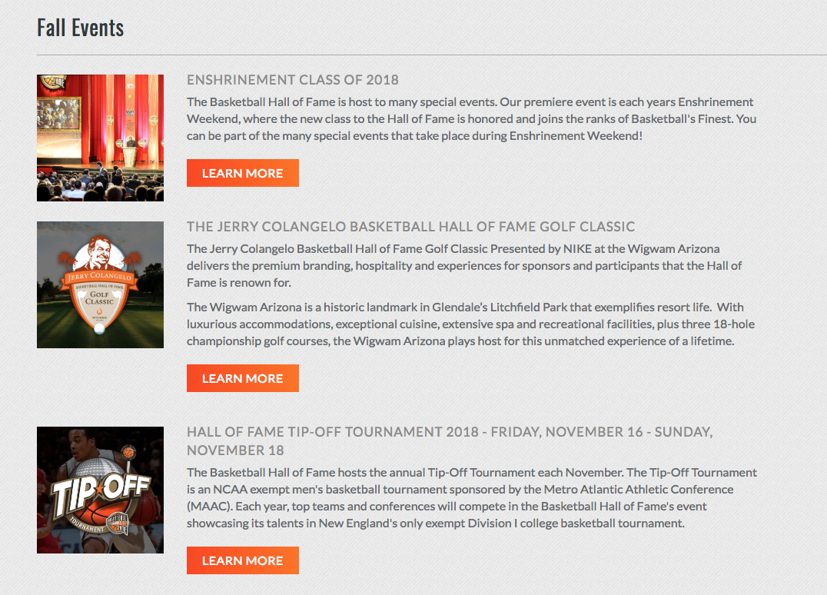
Accessibility & Usability
Link Language
Use clear link language
  Avoid using terms such as ‘click here,’ ‘more information,’ ‘learn more,’ and ‘read more’

Slide 34
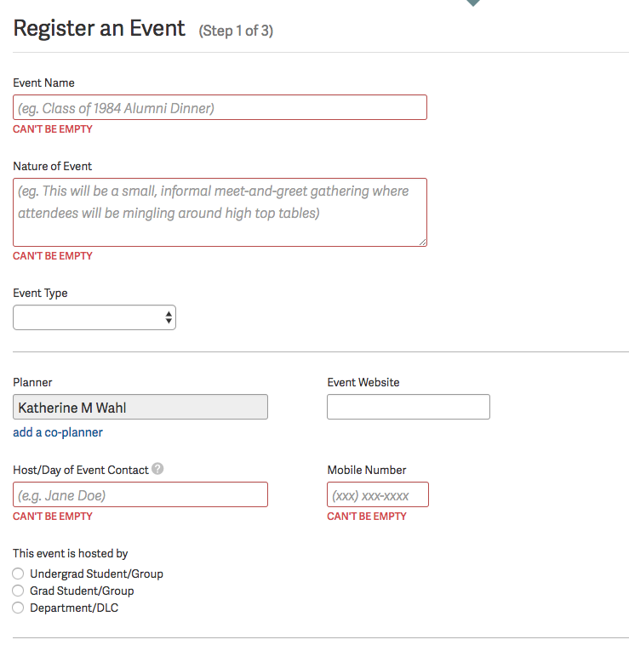
Accessibility & Usability
Forms
  Form Controls
  Associate the visual label with the form field
  This is easy to test by clicking on the field name
  Errors are clearly indicated
Notes:
Form from Atlas to register event. Nicely shows what is required
Note section:
Form with name and address and see it visually – it must be mapped so that if you cannot see it visually – form and label need to be connected.
Do this by labeling with HTML (simplest)
Search is a particularly overlooked issue here!

Slide 35
Accessibility & Usability
Accessibility Information & Tools
Built in tools on Mac | Built in tools on Windows
Zoom magnifier Voice Over screen reading Voice recognition | Change pointer size Magnifier Narrator Voice recognition

Slide 36
Accessibility & Usability
Accessibility Information & Tools
Useful Overview Information
Teach Access Tutorial: https://teachaccess.github.io/tutorial/
Udacity Web Accessibility Course: https://www.udacity.com/course/web-accessibility--ud891
WebAIM (comprehensive understandable accessibility Web site): http://webaim.org/
WCAG 2.0 Checklist: http://webaim.org/standards/wcag/WCAG2Checklist.pdf
Additional Useful Tools
WAVE Toolbar: http://wave.webaim.org/extension/
Color Contrast Analyser (CCA): https://www.paciellogroup.com/resources/contrastanalyser/
No Coffee Vision Simulator: https://chrome.google.com/webstore/
detail/nocoffee/jjeeggmbnhckmgdhmgdckeigabjfbddl?hl=en-US

Slide 37
Accessibility & Usability
Contact Us
Contact us for additional information/requests:
Accessibility — accessibility@mit.edu
Web site — ux.mit.edu

Slide 38
Accessibility & Usability
Questions
Questions?

