Slide 1
Next Generation MITnet
Presented to IT Partners Conference, 6/12/2018, by:
Marco Gomes, Director, Infrastructure Operations, IS&T
Brian Stephens, Manager, Network Engineering
John Morgante, Manager, Infrastructure Project Engineering
Matt Harrington, Senior Manager, Distributed Support

Slide 2
Next Generation MITnet Update
Hardware Upgrades
  New core routers and firewalls are in place
  Over 190 edge network switches that were no longer supported by the vendor have been upgraded to date and more edge network devices will be upgraded in the coming months
IPv4 Renumbering Efforts
Half of MIT’s IPv4 space has been consolidated and over 7,000 machines have been renumbered as a part of this effort

Slide 3
Next Generation MITnet Update
Map

Slide 4
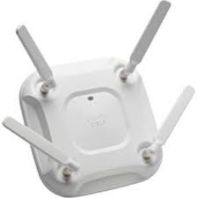

Next Generation MITnet Wireless Update
~ 12 million Useable Square Feet of campus space (~ 13 Million Gross Square Feet)
Approximately 6,200 wireless access points serving the campus
Current density is 1 wireless access point per ~ 2,000 square feet
All access points on campus have been upgraded to 802.11AC and we’re working with carriers to introduce small cell clip-ons to replace traditional DAS
New Cisco 8540 controllers coming online in the coming months will replace the current WISM2 models.
Notes:
wave 2 ( from 1.3Gbps to 2.3-3.7 Gbps)

Slide 5
Next Generation MITnet Update
Deferred Maintenance and Capital Renewal Projects:
In progress:
NW10
W7
W71
W79
UPS Program (70% completion)
TR Security Enhancements
Completed Projects:
DC power plant upgrades to critical telephony infrastructure
E17/E18/E19/E23
New TRs to support construction in E40 and 35
In planning:
NW13
NW14
NW15
NW16
NW17
NW20
NW21
NW22
26
44

Slide 6
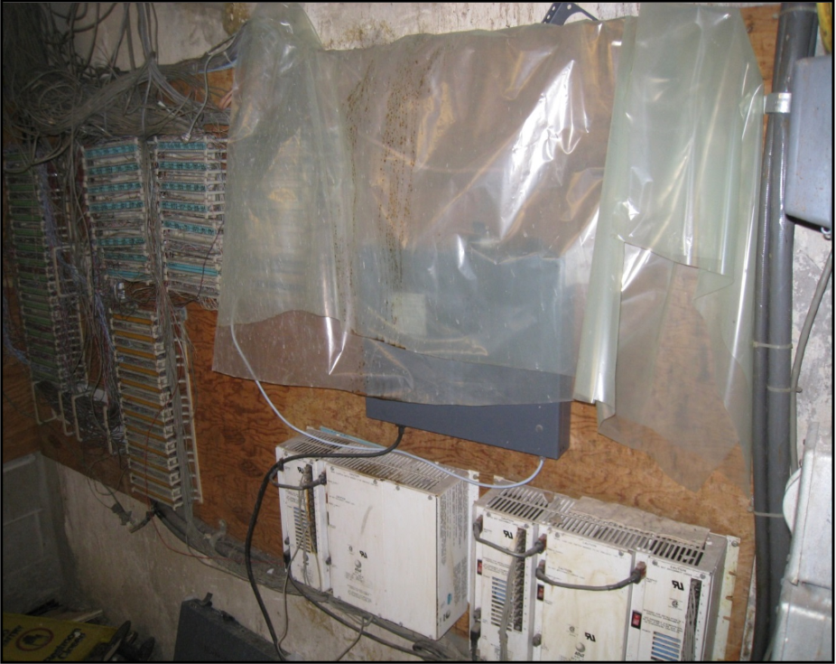
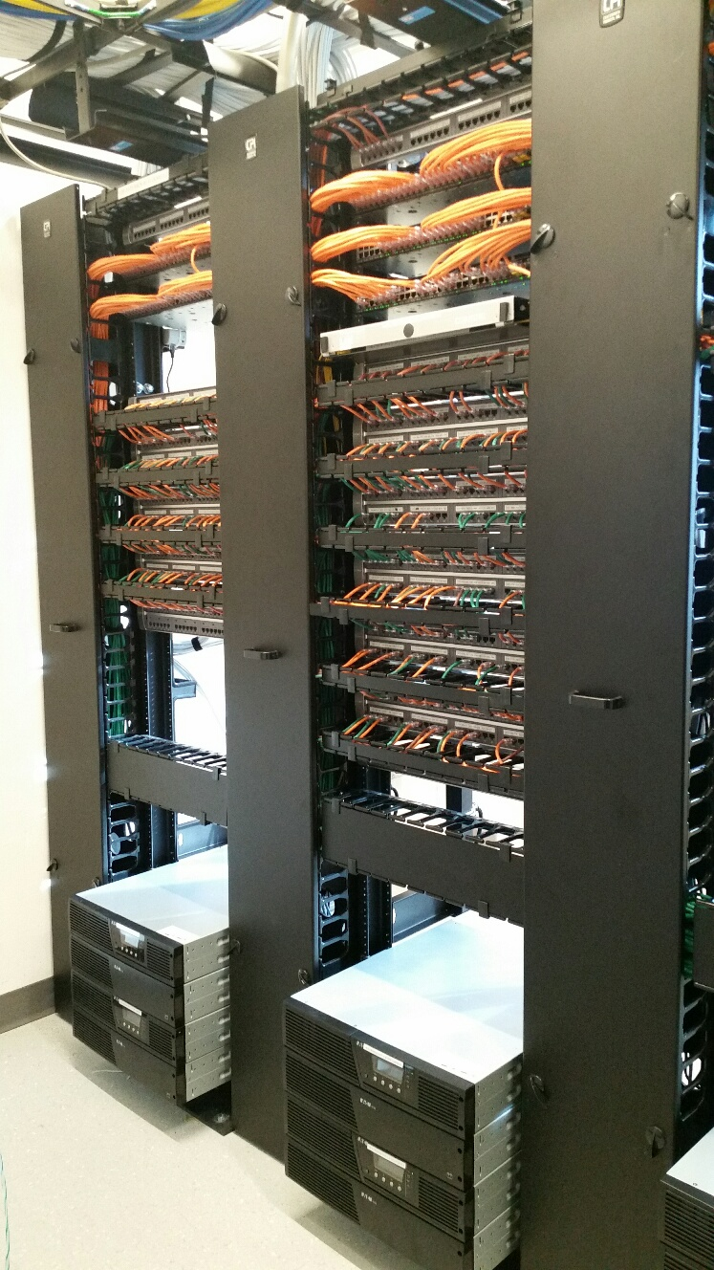
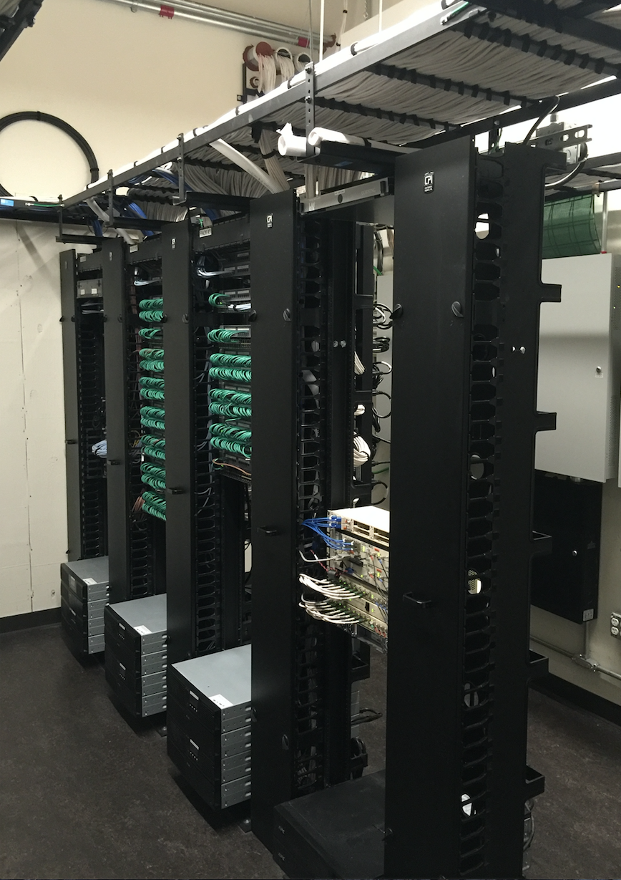
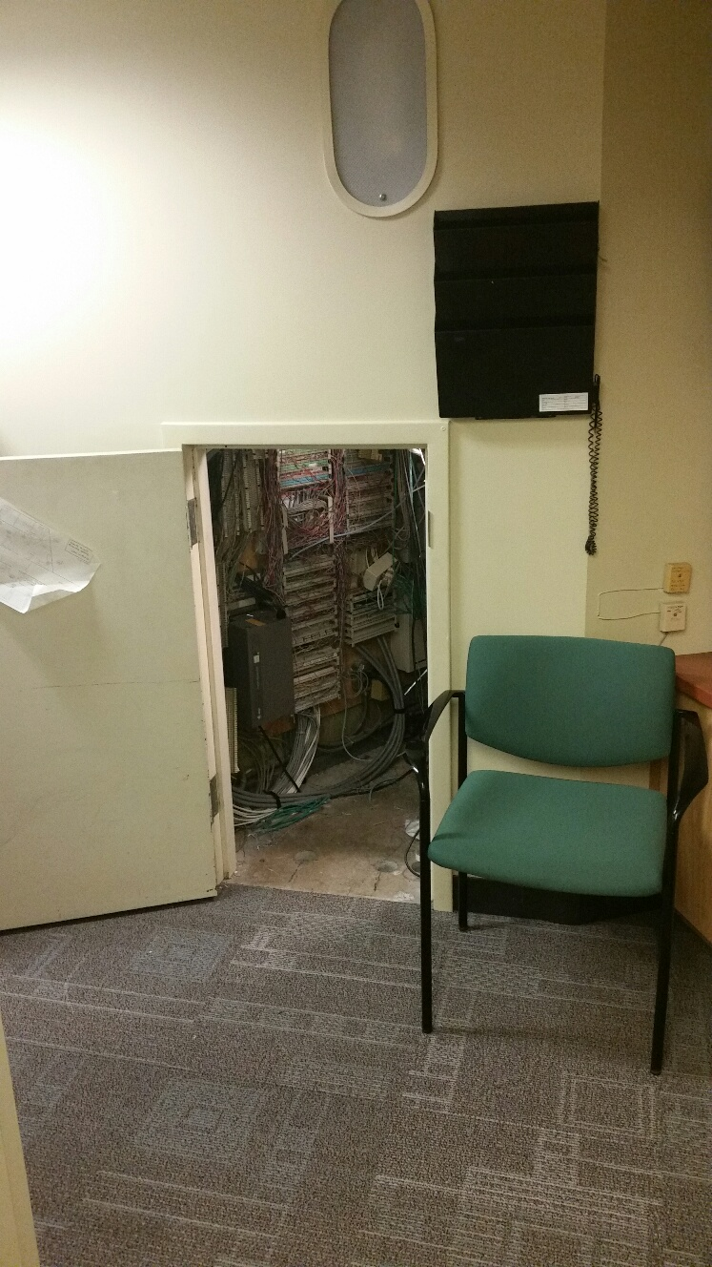
Next Generation MITnet Wireless Update
Examples of before and after infrastructure improvements

Slide 7
Next Generation Core MITnet Infrastructure

Slide 8
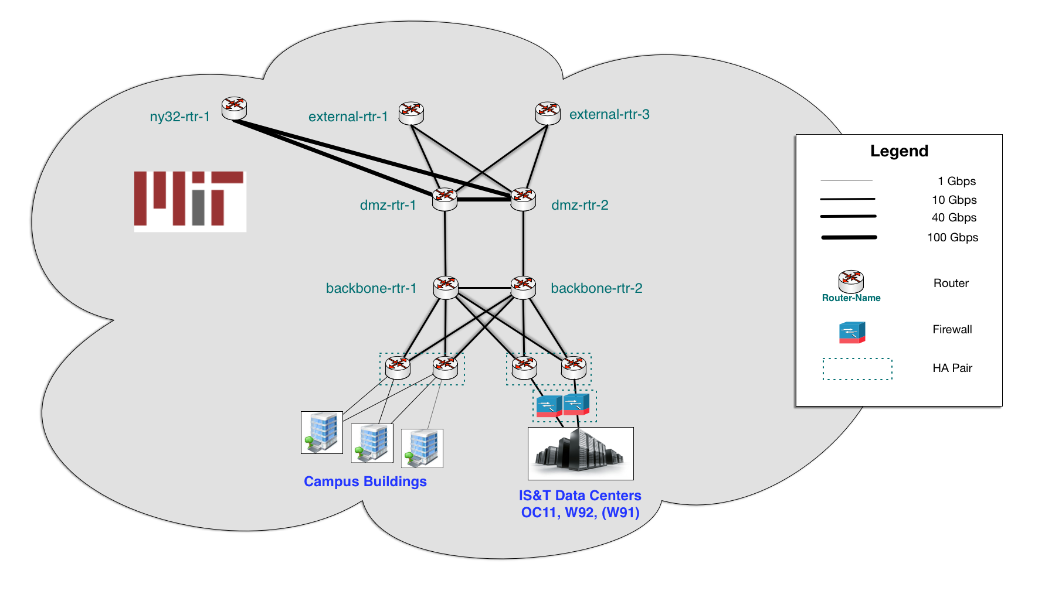
MITnet – 2016
Notes:
Point out:
border/external routers (peering)
“Entry” routers (i.e. default gateway)

Slide 9
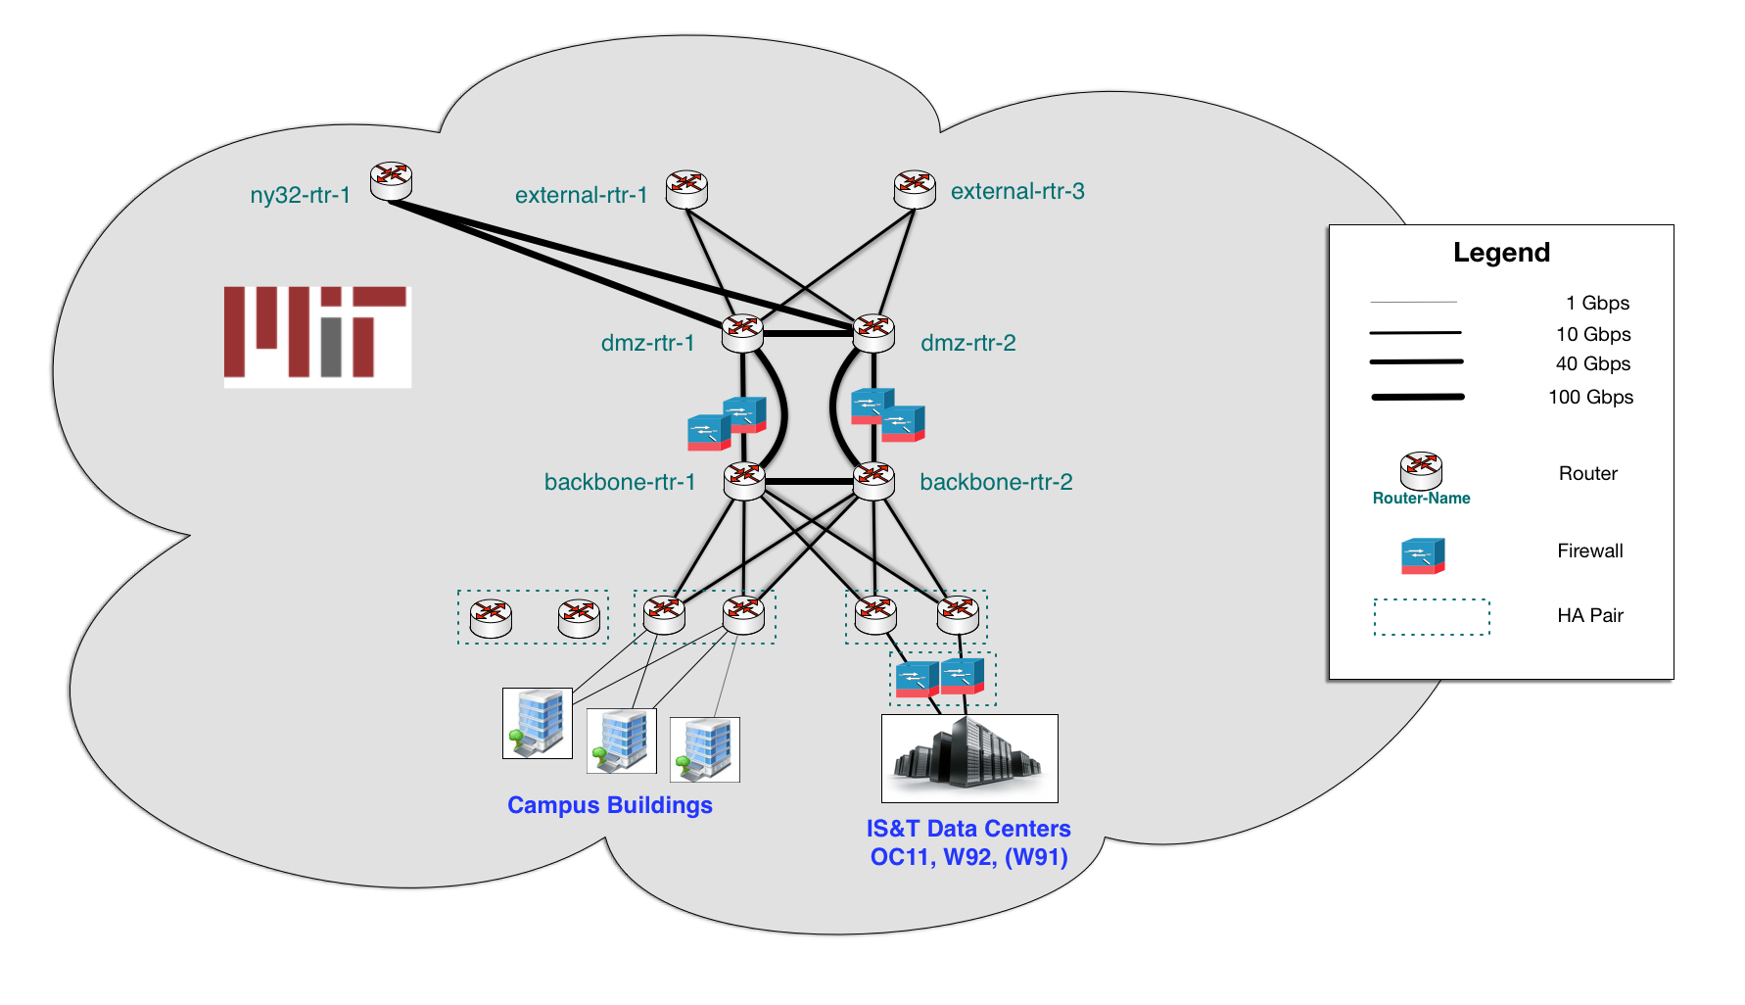
MITnet – 2017
Notes:
New firewalls in place
100Gbps links beginning
New “entry” router pair ready to go

Slide 10
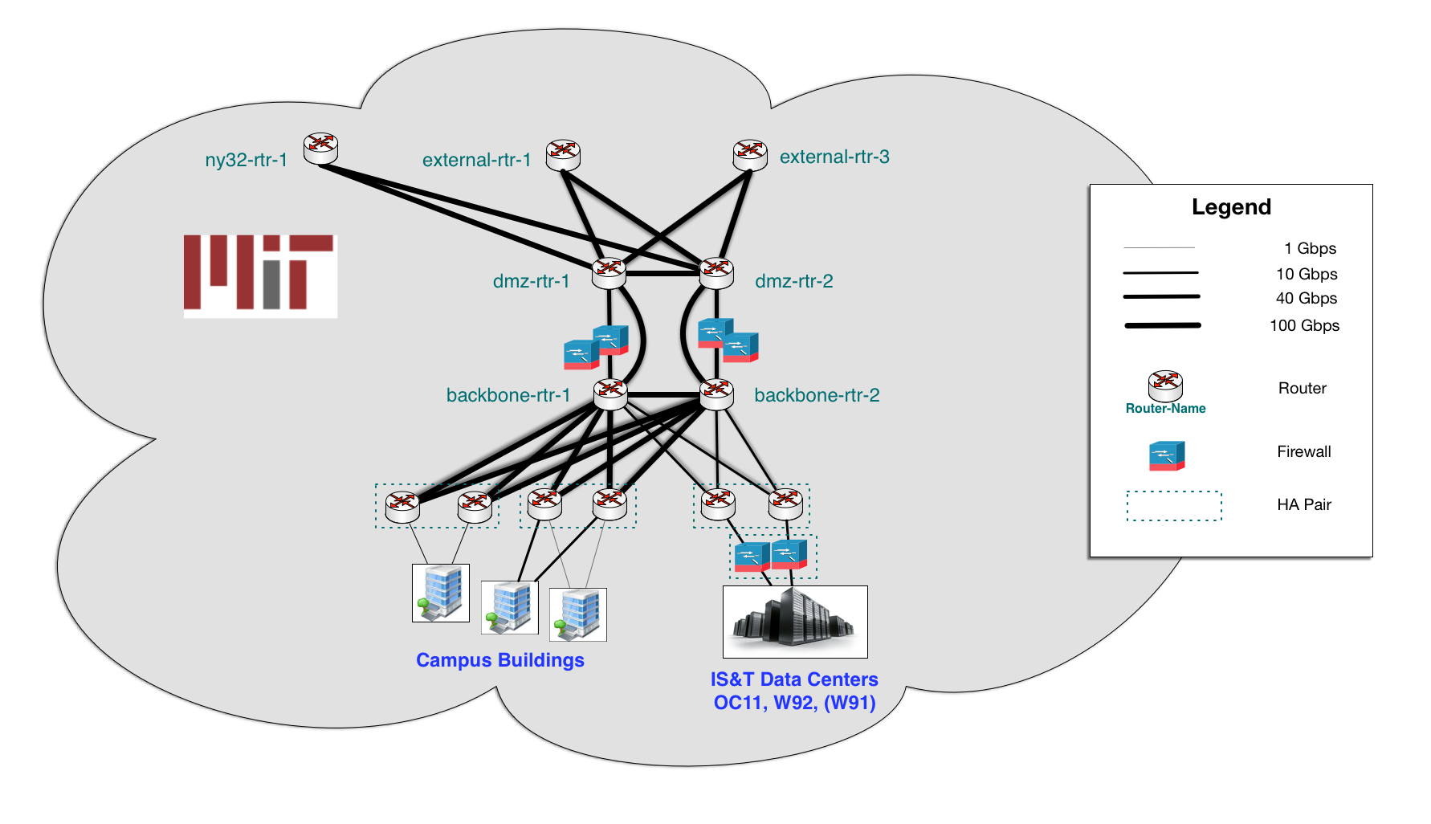
MITnet – 2018

Slide 11
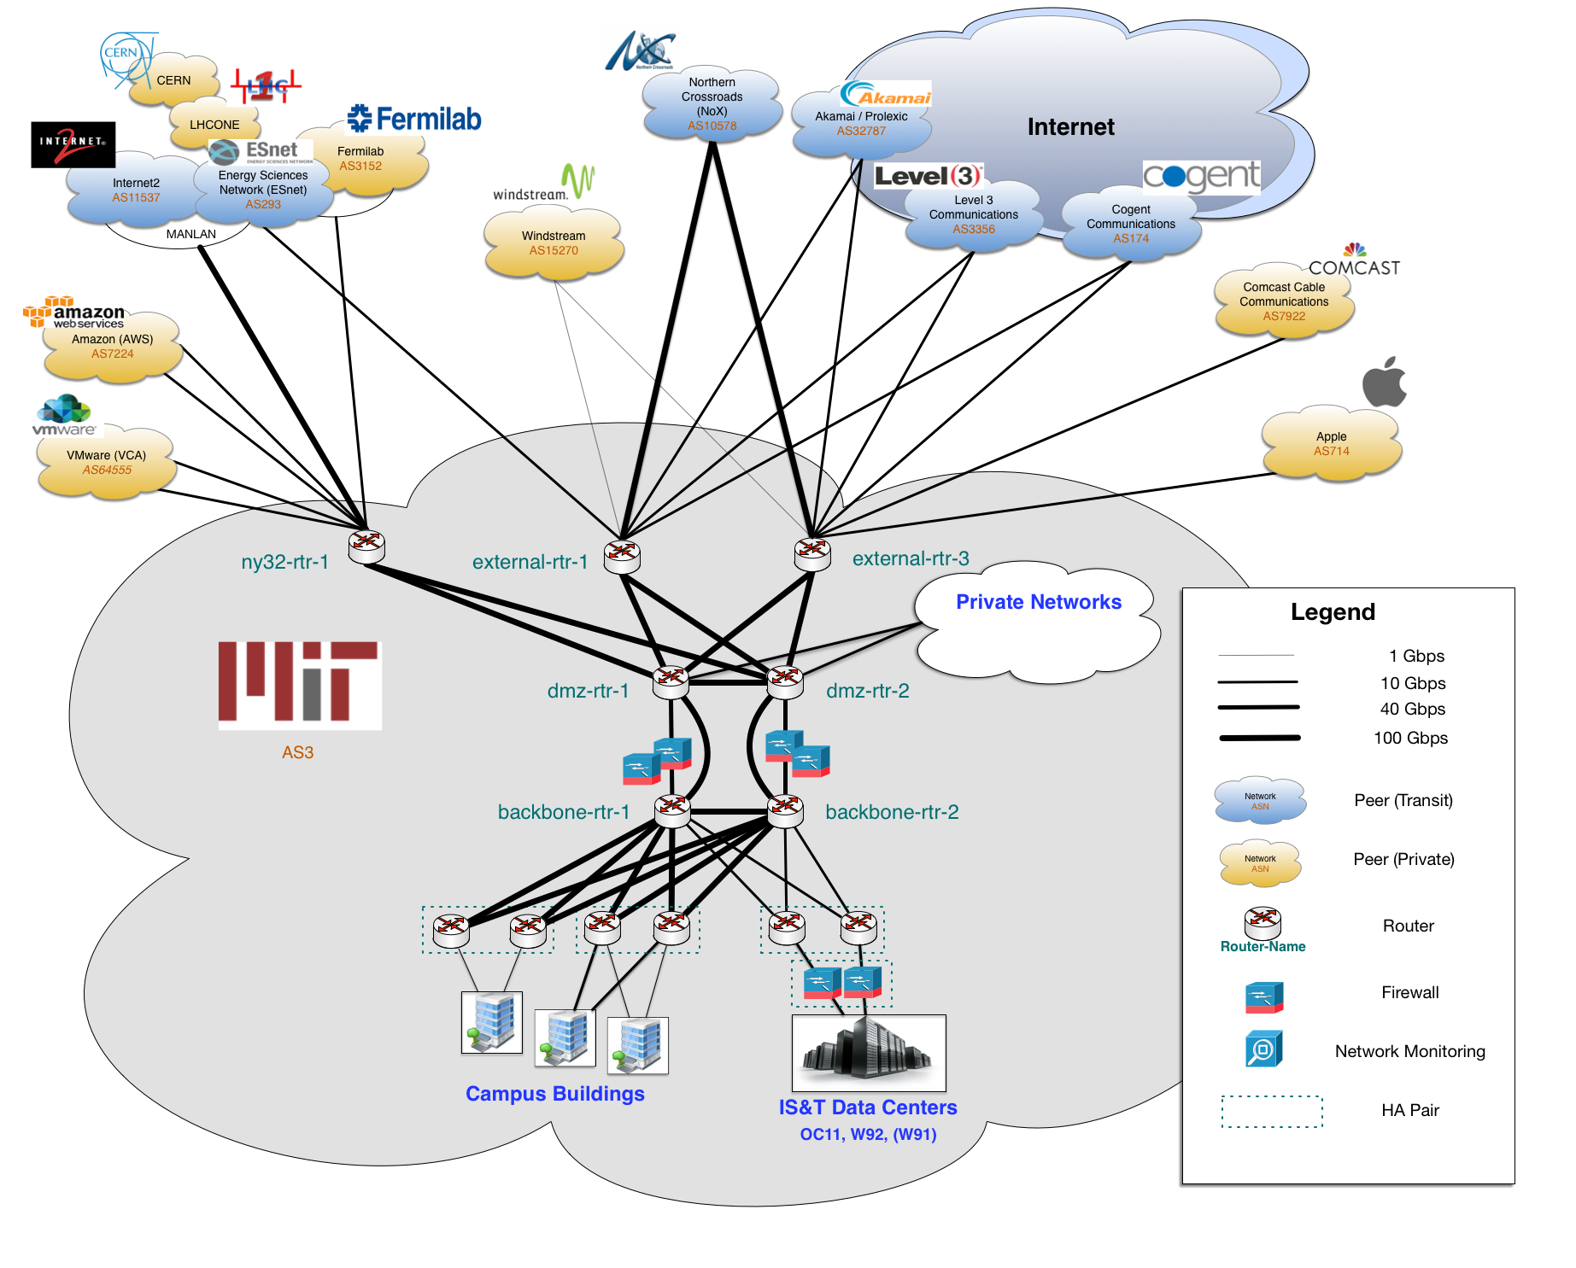
MITnet - 2018

Slide 12
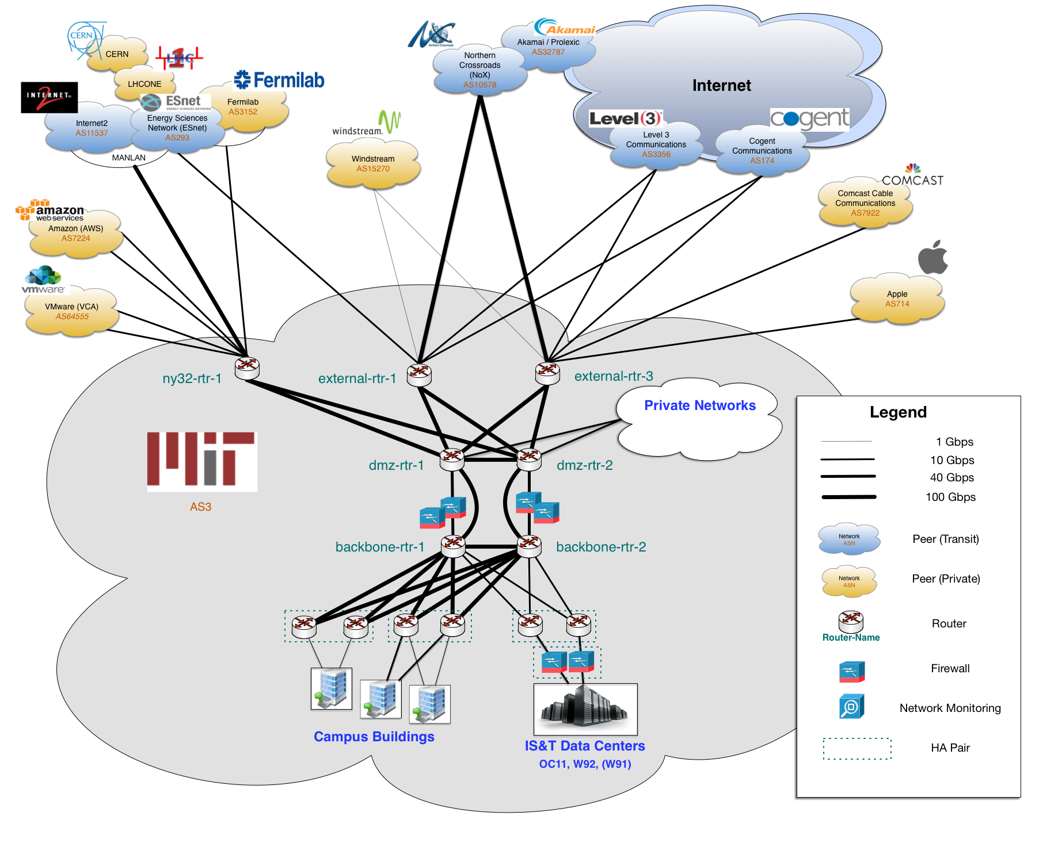
MITnet - Today
Notes:
- 80% of campus buildings are now dual-connected
- We have begun cutting over building uplinks to 10Gbps (more planned throughout FY19)

Slide 13
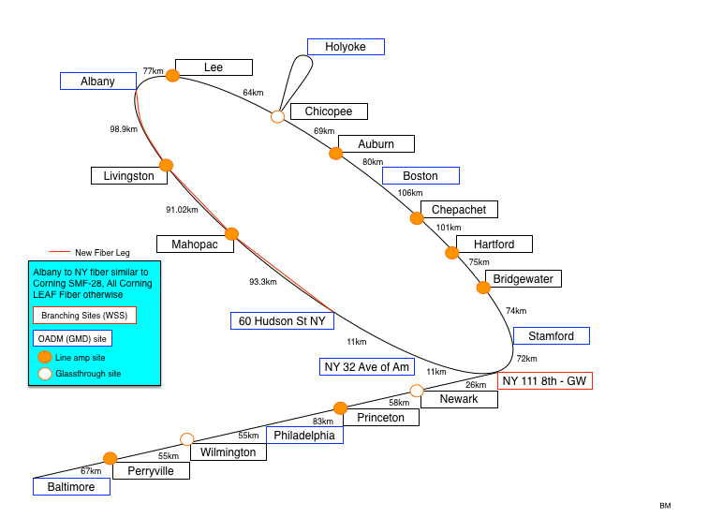
MITnet: Regional Optical Network - 2017

Slide 14
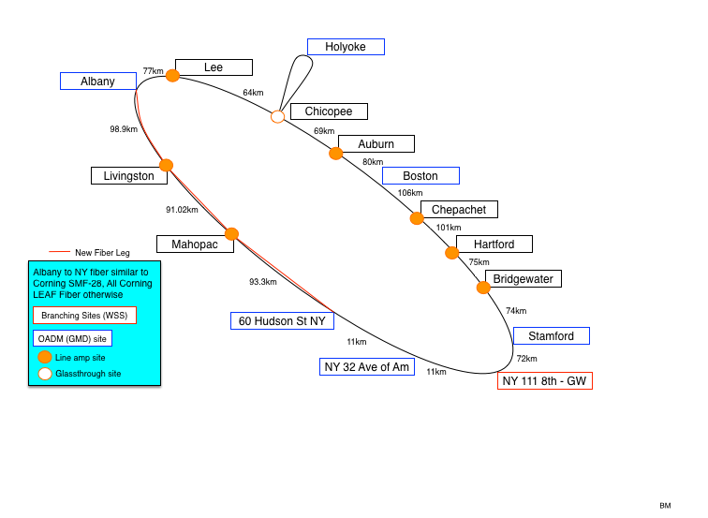
MITnet: Regional Optical Network - 2018
Notes:
3Down moved to statuspage.io

Slide 15
MITnet - Today
Notes:
- 80% of campus buildings are now dual-connected
- We have begun cutting over building uplinks to 10Gbps (more planned throughout FY19)

Slide 16

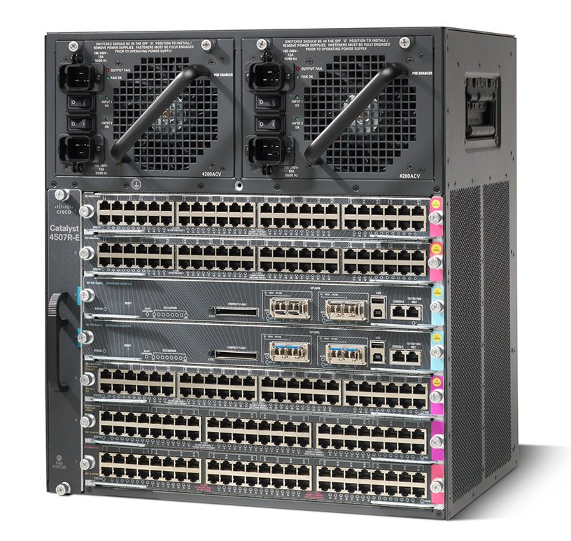
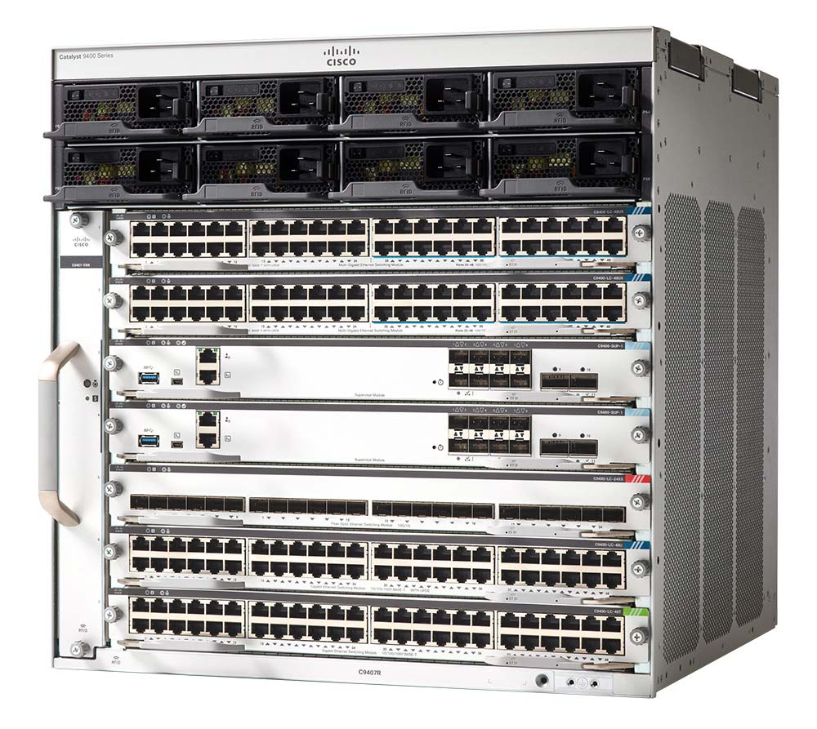
MITnet – 2019
Cisco Catalyst 4500
Cisco Catalyst 9400
Notes:
10Gbps
mGig (10Gbps uplinks from access/edge switches)

Slide 17
Next Generation Edge MITnet Infrastructure

Slide 18
Scheduled Network Switch Upgrades for FY19 and FY20
Notes:
These are the remainder of the buildings to be completed. Currently in planning for FY19 and FY20.

Slide 19
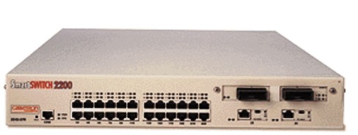
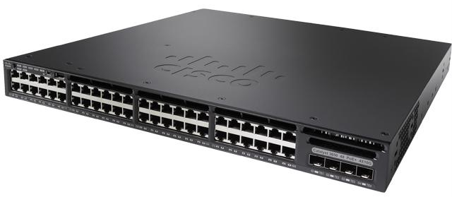
Next Generation MITnet Edge Switch Upgrades
Next Generation MITnet efforts will address years of deferred maintenance to networking infrastructure by retiring over 500 edge switches that are no longer supported by the vendor
195 edge network switches retired in FY18
Over 300 edge network switches that are no longer supported by the vendor will be retired by 2020
New modern hardware will allow for better management tools to operate the network and will also provide increased bandwidth, single equipment platform, prepare for IPv6.
Notes:
Walk through each of the bullet points. Talk about how this help with deferred maintenance of the network equipment.

Slide 20
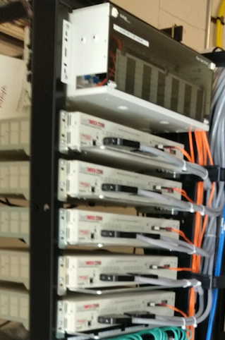
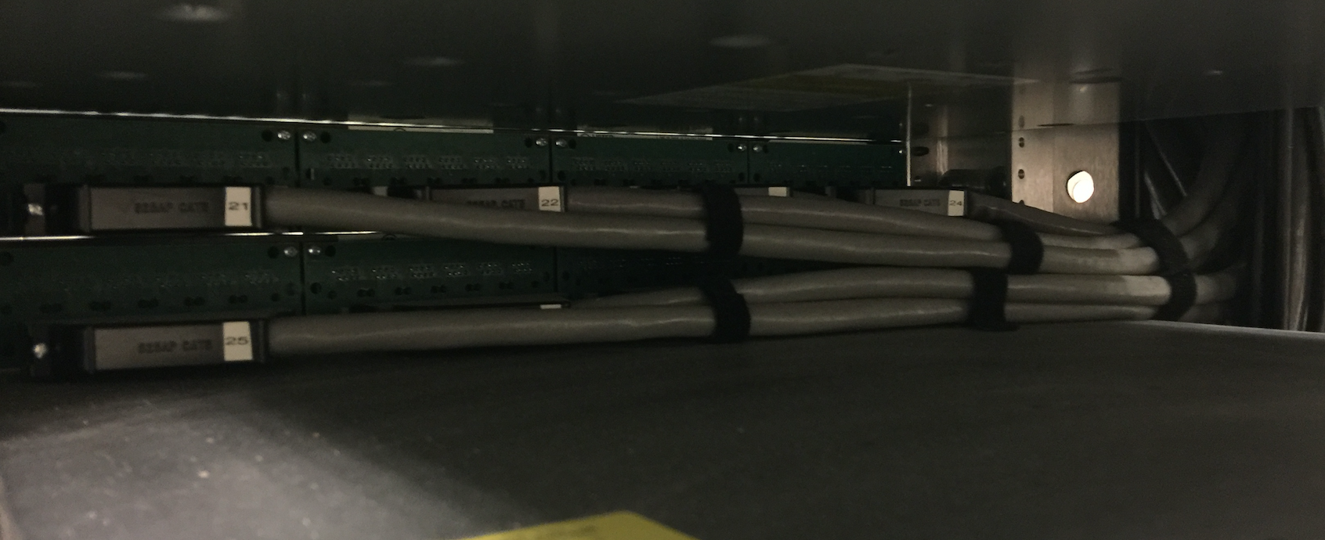
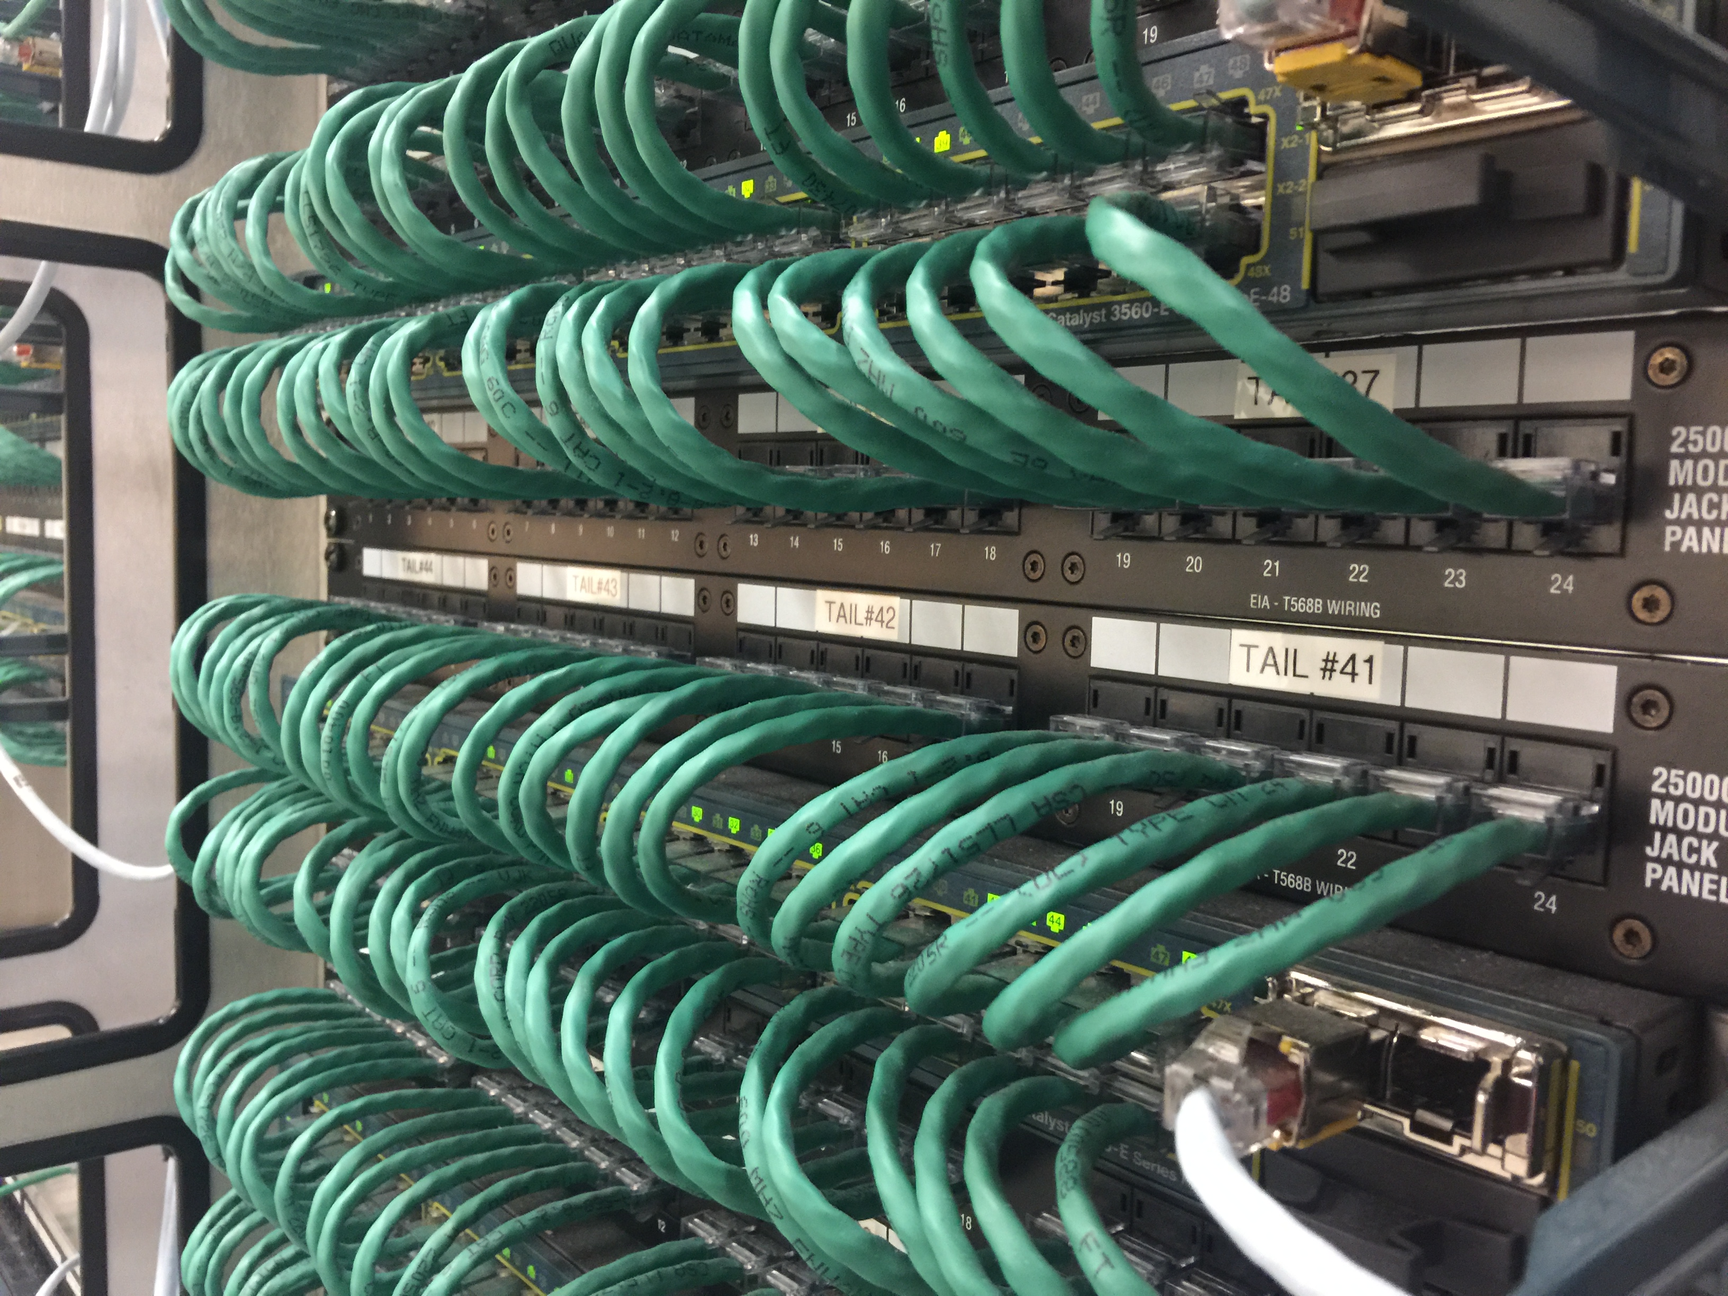
Example of Legacy Network Equipment Conversions
Notes:
Talk about the work in the TRs, the conversions from RJ21 to RJ45. Using the RJ21-RJ34 patch panels. Going from 2-pair to 4-pair x-wire for Gig connections.

Slide 21
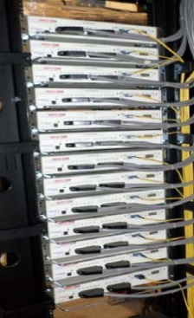
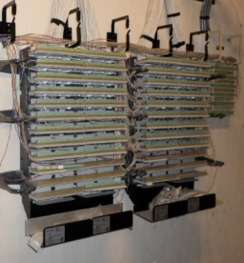
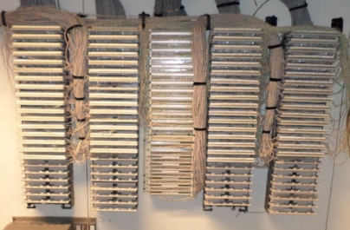
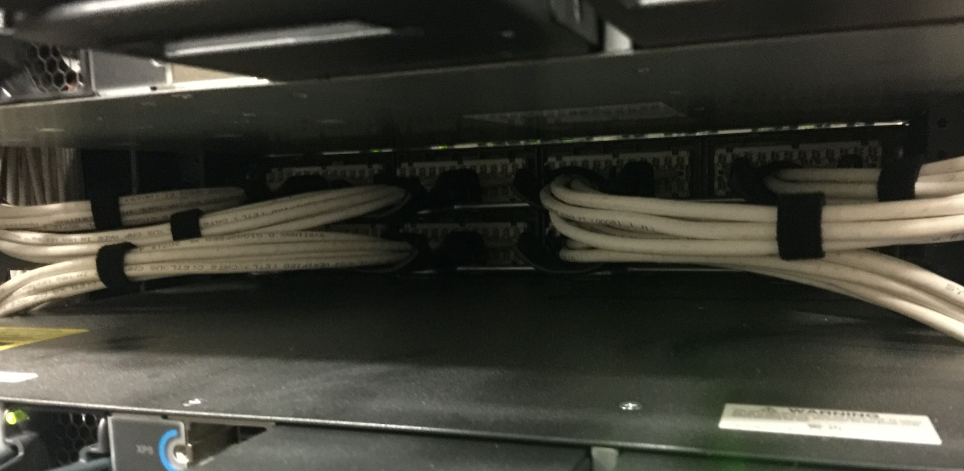
Converting Legacy Equipment to More Modern Standards
Notes:
Talk about how some conversions we’ll aim to re-terminate station cabling directly to the racks.

Slide 22
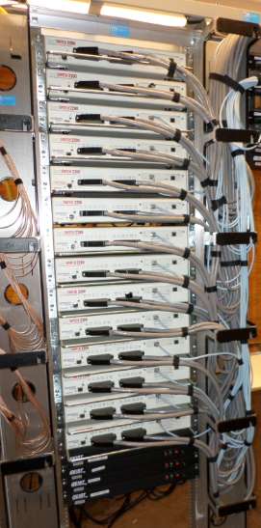
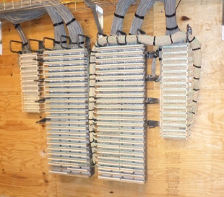
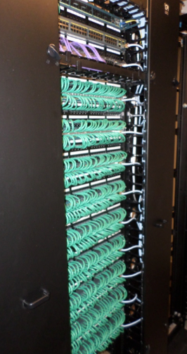
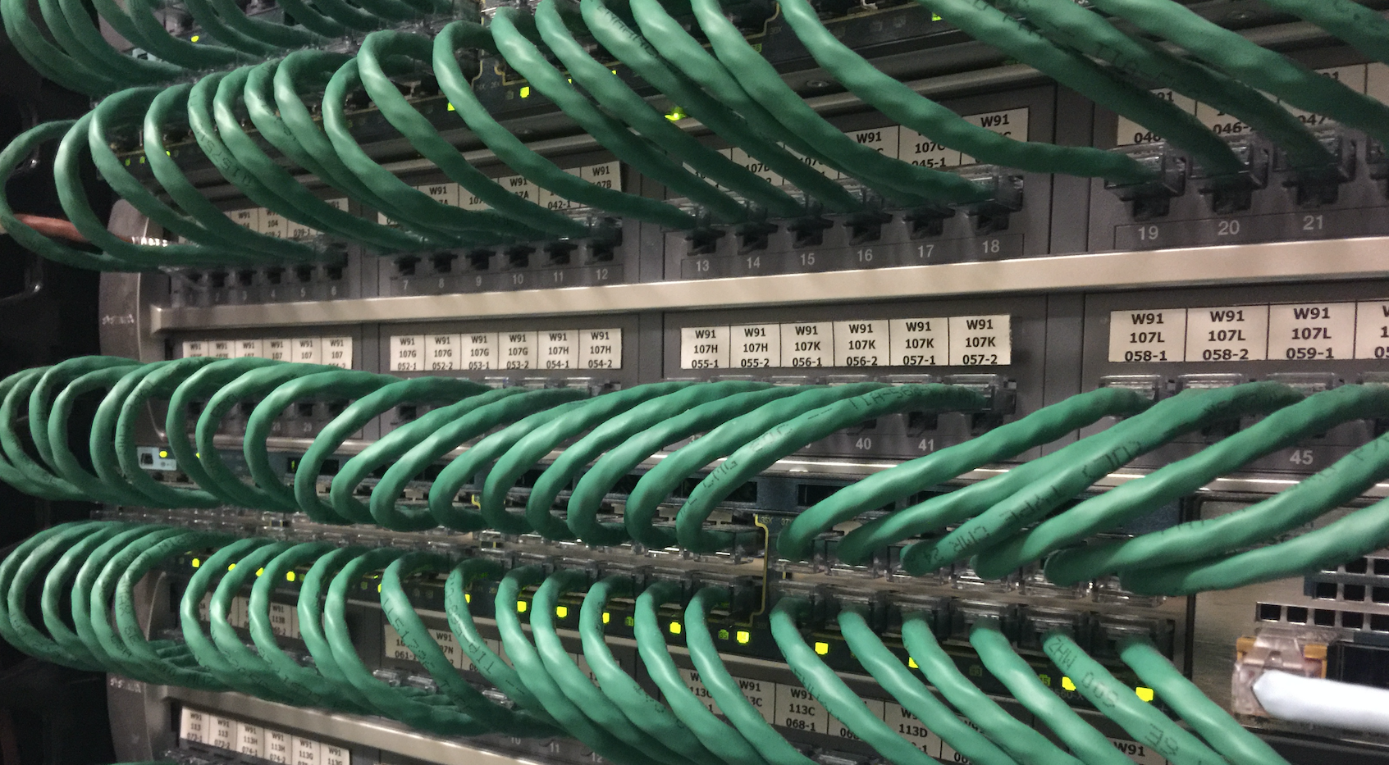
Moving to the Next Generation of Edge Network Equipment and Rack Configuration
Notes:
Talk about how we’re changing rack configurations to a more modern layout.

Slide 23
Preparing Your Endpoints and Clients

Slide 24
“The secret to getting ahead is getting started. The secret of getting started is breaking your complex, overwhelming tasks into small manageable tasks, then starting on the first one.”
-Mark Twain

Slide 25
Proactive Steps
Identify Hosts that will need public IP addresses
  Servers, Devices, or Machines that need public accessibility from outside of MITNet
  Do they need to remain onsite?
  Can these be moved to the Data Center?
Move printers and clients to host name based printing
  Reach out to 3rd party vendors for local configuration updates
  Switch Printers to DHCP
  Update print servers, if applicable
  Install printers locally via hostname instead of IP
Switch Endpoints to DHCP
  If machines need a consistent address, request a permanent DHCP reservation via the Service Desk
  Educate clients on using VPN with Duo for remote access to machines with reservations
  DHCP is the only method supported by IS&T to access MITNet

Slide 26
Endpoint Management
Take advantage of Endpoint Management offerings from IS&T
  JAMF Pro (aka Casper) for Mac OS
  SCCM or WIN Domain for Windows
  Contact epm-help@mit.edu to set up new sites and containers
  DITR is available to DLCs for a fee to consult on building sites and policies
Remove and reinstall printers that have been setup for IP printing with the new configuration
Scripts have been created for Windows and Mac to automatically flip machines to DHCP
Remove and reinstall Printers that have been setup for IP printing with the new configuration
Leverage your local Domain and/or EPM solutions

Slide 27
Resources for IT Partners
IS&T’s Next Gen FAQ - https://ist.mit.edu/network/next-gen-mitnet-faq
On-site assistance for MITNet remediation can be provided to DLCs at no cost via DITR and the Service Desk
  Contact mitnet@mit.edu to arrange for consultation
Contact the Service Desk at servicedesk@mit.edu for assistance with Host Registration, Public IP Reservation, and Private IP Reservation
Contact mitnet@mit.edu to begin engagement on how we can help prepare you and your environment
DITR is always happy to provide assistance with projects, staffing augmentation, endpoint management, and office moves. Contact Matt Harrington (mjharrin@mit.edu) to arrange consultation.

Slide 28
Conclusion and Questions?

