Slide 1
An Introduction to User Experience (UX)
Fundamentals
Accessibility & Usability
  Accessibility & Usability Group
  June 12, 2018
  Office of the Vice Chancellor (OVC)
  Undergraduate Advising & Academic Programming (UAAP)

Slide 2
Overview
I – Welcome and Introduction
II – What is User Experience (UX)?
III – Methods
IV – Context and ‘It Depends...’
V – Design – Where Does Design Fit?
VI – Future
VII – Bibliography
VIII - Contact Information

Slide 3
II. Welcome and Introduction

Slide 4
Introduction
  Presenters from the Accessibility & Usability Team:
  Chris LaRoche
  Katherine Wahl

Slide 5
II. What is User Experience (UX)?

Slide 6
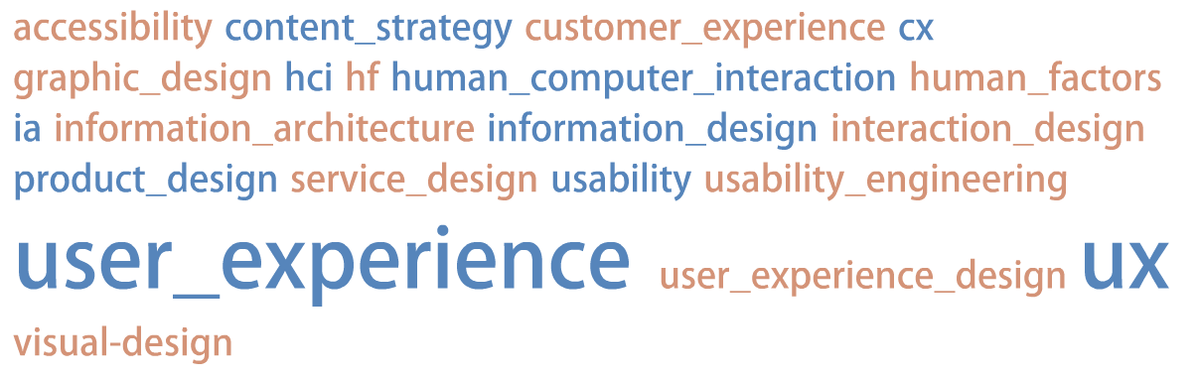
Alphabet Soup of User Experience (UX)
http://www.manyeyes.com/software/analytics/manyeyes/visualizations/new/tag-cloud/the-alphabet-soup-of-user-experien-2/1
Notes:
This is a non complete list and continues to expand
User Experience (UX) is a very fluid term – and actually does encompass all those terms
User Experience and UX is an umbrella term
Usability used to be the umbrella term – now it has become User Experience and is evolving as the most understandable and used term within the field and across many industries
Also the term user experience and UX speaks to a business/business type vocabulary (more than usability)
UPA > UXPA several years ago – more recognizable term.

Slide 7
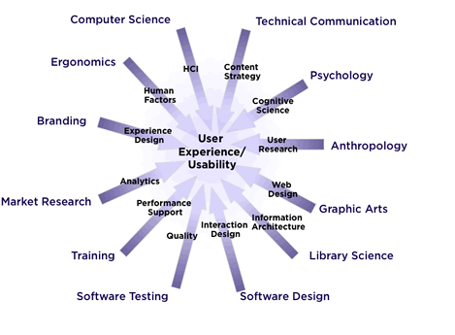
II. What is User Experience (UX)?
http://upassoc.org/usability_resources/about_usability/images/vectors.gif
Notes:
From UPA and Whitney Quesenberry – great high level over view of what encompasses UX and Usability
Further shows how and in what way the UX field is both an umbrella term and incredibly interdisciplinary
Show the expansion and overall interdisciplinary nature of the UX field

Slide 8
What is User Experience (UX)?
Usability and user experience (UX) are concepts that have been around for generations and evolved from traditional human factors. Over the last few decades, it has become standardized and greatly expanded:
  World War II – instrumentation, personnel selection, and training
  Software and computer hardware industry
  World Wide Web
  Consumer devices
  Medical devices
Notes:
Concept is as old as man – a wheel used to move something or someone more efficiently and more quickly from point A to point B
Original rotary dial phone – used in most homes post WWII
Development of the TV remote and its uses – both form and function – was an early example of a user experience in the modern era

Slide 9
What is User Experience (UX)?
Human Factors comes from the field of psychology and focuses on understanding basic biological/human traits and mapping to users’ needs
The fast growth of information technology and the internet have made UX a critical aspect of product and service design
As the field of usability matured, it evolved into the field of user experience (UX), which focuses on the full end-to-end experience for a user, not just the user’s interaction with the user interface
Notes:
***Usability is on its most basic level trying to understand how users can perform a task in the most efficient and stress-free manner possible for the user***
Brain is efficient and always tries to maximize efficiency as well as minimize use.
Humans are also pattern seekers, so the brain will often “fill in” information when it can; for example, we can often read a word or sentence with portions missing and still understand the word or sentence.
Humans are also change detectors. Humans are rarely satisfied, so we are trying to improve.

Slide 10
User-Centered Design (UCD)
An outgrowth of human factors and early usability work was User-Centered Design (UCD)
Overall, UCD is a framework & method to create products that correctly match a user’s needs and expectations
Products created using UCD principles are more likely to be be successful since user’s needs are considered and (likely) incorporated from the initial planning stages
Notes:
UCD and other frame works increase the odds – but DO NOT GUARANTEE GREAT PRODUGT

Slide 11
User-Centered Design (UCD) - Philosophy
“Know thy user, know thy user, know thy user”
“The key to making things understandable is to understand what it’s like not to understand” (Richard Saul Wurman)
Notes:
Coined the phrase Information Architecture in the 1970s & Founder of the TED talks
Empathy for users is a key component of solid UCD and UX.
EXAMPLE:
Public transportation systems and their cards to access (Boston, DC, London)
Using your TV remote

Slide 12
User-Centered Design (UCD) - Benefits
Ease of learning and relearning (learnability)
Ease of use (efficiency)
Consistency within and between products
First impressions
Error prevention and recovery
Memorability
Satisfaction or likeability
Flexibility and discoverability
Improved collaboration for groups of users

Slide 13
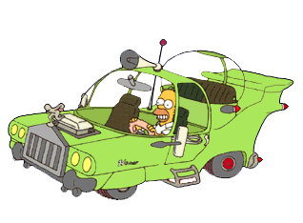
What User-Centered Design (UCD) is NOT
http://simpsons.wikia.com/index.php?title=The_Homer&image=TheHomer-png
Users are not designers and designers are not users!
It is more than common sense!
Notes:
Second season
Homer’s Long Lost Borther finds him and decides “Homer” is the ‘average guy’ so asks him to design a car since he would be represenative of a ‘average user’
Homer busted the budget and the car was super expensive, but the details included:
1 bubble domes – including one separate space for the kids to be seperated
Loud Engine
3 horns (La Cucharacha)
Huge Cupholders
Car was a huge bust and bankrupted the company.
This is a popular example of why not to exactly design what the user or one group o users dictate
When is good – good enough….

Slide 14
User Experience (UX) – Clarity?
User Experience (UX) is an open-ended term and profession that continues to grow and expand
User Experience includes three distinct groupings:
RESEARCH – DESIGN - EVALUATION

Slide 15
III. Methods

Slide 16
User Experience (UX) Methods
Within the field of User Experience (UX), there are numerous methods used to obtain information from users
When the profession was emerging in the 1970s and 1980s, the main method was usability testing. Usability testing proved quite successful as a way to understand the user’s perspective on a product – and make our profession visible
The variety of methods expanded as the field evolved from ‘just’ usability testing to looking at the full user experience.

Slide 17
UX Methods – By Grouping
Research – Understanding what the users need and their goals and behavior
Design – creating and designing the interface or experience the user expects or needs
Evaluation – once the interface or product is in a working state, users can test and evaluate if the interface or product maps to user’s mental model and needs
Notes:
Design (unlike the others) is a very iterative process and can go through many rounds of expansion/contraction before it is a solution
EXAMPLE – previous job lead a group and we were designing a first experience – and went through 17/18 solid iterations before the final.
Seemed ‘simple’ at the end – but only that could happen after going through the process a multitude of times

Slide 18
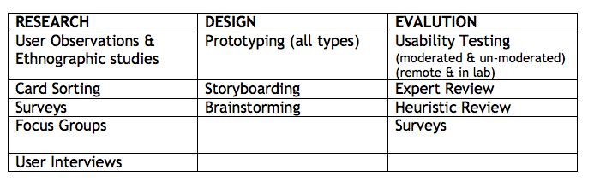
Methods – By Grouping
Here is a sampling of the most common methods used in the field today (divided into the grouping mentioned earlier)
Notes:
Usability Testing was the main one – and that is now one of many methods
Usability Testing – formative – earlier in process to understand users needs and expectations
Usability Testing - summative – later in process to understand perfomance and satisfaction
Note in Evaluation – satisfaction surveys

Slide 19
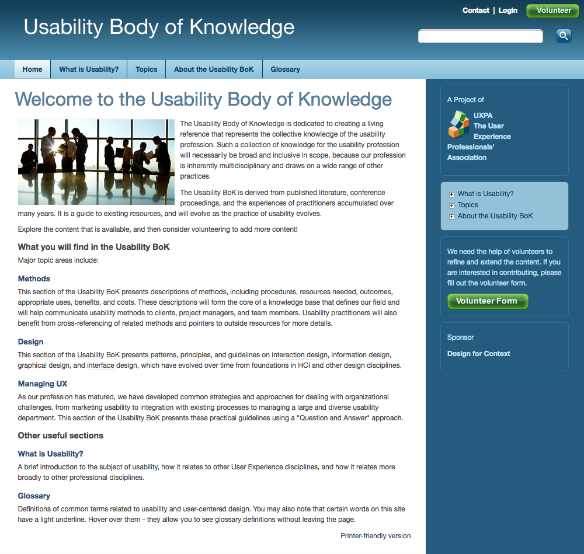
Usability Body of Knowledge (BOK)
http://www.usabilitybok.org/
The Usability Body of Knowledge (BOK) is a solid resource for all information about UX methods and design

Slide 20
IV. Context and ‘It Depends’

Slide 21
Context within User Experience (UX)
  Part of the overall issue with understanding usability and the user experience is the impact of the context of use of the product or service
  This is critical – and needs to be understood when working with a product
  This also makes ‘standardizing’ usability & user experience VERY DIFFICULT
Notes:
If a product is not usable but first to market – you put it out to gain market share and improve
If there is little differentiations in products, having a solid user experience is critical.
Do the users have extensive background and knowledge of an older system and have to learn a new system
Is there a particular amount of data they must know before using the site
Consumer products and documentation
Concept is as old as man – a wheel used to move something or someone more efficiently and more quickly from point A to point B

Slide 22
International Organization for Standardization (ISO) – Usability
  "[Usability refers to] the extent to which a product can be used by specified users to achieve specified goals with effectiveness, efficiency and satisfaction in a specified context of use." ISO 9241-11
Notes:
There are newer ISO Standards that mention usability, but this is the most usability centric one around

Slide 23
“It Depends...“
  The term ‘it depends’ is frequently used when asked if a product is ‘usable’ or a ‘good user experience’
  Again, all experiences are contextual, so often the same product can be ‘usable’ for one person and ‘not usable’ for another. This is one of the more difficult aspects of user experience is to understand how to know if a product or service is indeed usable or a positive user experience
  User research helps determine what aspects of context are most important for a good user experience
Notes:
Mention Research contradictions
Steve Jobs – user research good for something if no one knows it exists or does not envision it?
TESTING AFTER RELEASE
USER RESEARCH ANYTIME
Concept is as old as man – a wheel used to move something or someone more efficiently and more quickly from point A to point B

Slide 24
V. Design – Where does Design fit?

Slide 25
User Experience (UX) and Design
  As the field has matured and gained acceptance within organizations, the importance of design has also become crucial to the user experience profession
  As the user experience field evolved and usability testing and user research became well known, design’s influence expanded as important to the user experience
  Today, design is rightly seen as a critical component of the user experience field

Slide 26
User Experience (UX) and Design
  Using the three main groupings of research, design, and evaluation allows the user experience professional involvement with the product development through the entire product or service life cycle
  This is a recent development and a testimony to the importance & growth of the field, as only a decade or two ago, the best we could hope was a part in product evaluation (mostly usability testing)

Slide 27
VI. Future

Slide 28
So, How Bright is the Future?
            VERY BRIGHT!
            The user experience is now an important concept in many products. Products need to deliver more than just a ‘good interface’
            With the increasing visibility and importance of user experience, the idea of being strategic and the emergence of ‘UX strategy’ is continuing
            As design becomes more a part of the overall user experience, our field itself becomes bigger and more valuable
Notes:
Process/Workflow vs. user interface

Slide 29
So, How Bright is the Future?
            Recently the term of customer experience or “CX” has evolved and overtook the term and idea of User Experience in some industries. This is a natural evolution and often they can have similar meanings and goals
            Also the term experience design is now evolving as a further term to be all and much more encompassing regarding the user experience
Notes:
Cadillac ad as the ‘Customer Experience’ TV ad….
Design has helped further make UX bigger and burst much more!

Slide 30
VII. Bibliography

Slide 31
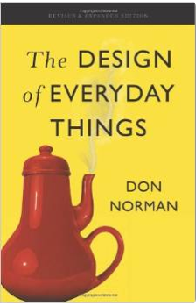
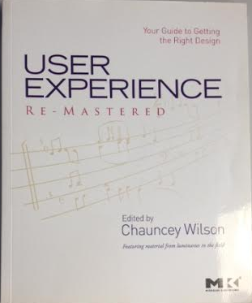
UX Books
Design of Everyday Things User Experience Remastered
Revised & Expanded Edition Chauncey Wilson
Donald Norman

Slide 32
VIII. Contact Information

Slide 33

Chris LaRoche - Bio
Chris has worked as a technical writer, information designer, user researcher, and usability consultant in the technology field for over eighteen years. He has worked most frequently as a ‘UX generalist’ with a severe interest in user research. He is also a lecturer at the College of Professional Studies (CPS) at Northeastern University, where he has taught for over a fifteen years. He teaches graduate courses in usability and user experience, user research, and sometimes courses in modern Irish history.
Email: laroche@mit.edu
Web Site: http://ux.mit.edu

Slide 34

Katherine Wahl - Bio
Katherine works as an internal accessibility/usability consultant at the Massachusetts Institute of Technology (MIT). She is also a lecturer at Northeastern University’s College of Professional Studies (CPS), where she has taught for the past six years. Katherine has more than twenty years of experience in project management, communications, and Web site development across of range of industries including health care and energy efficiency.
Email: kwahl@mit.edu
Web Site: http://ux.mit.edu

