Slide 1
Rocketry Basics
MIT Rocket Team
Jamie Abel
Original Course by Andrew Reilley

Slide 2
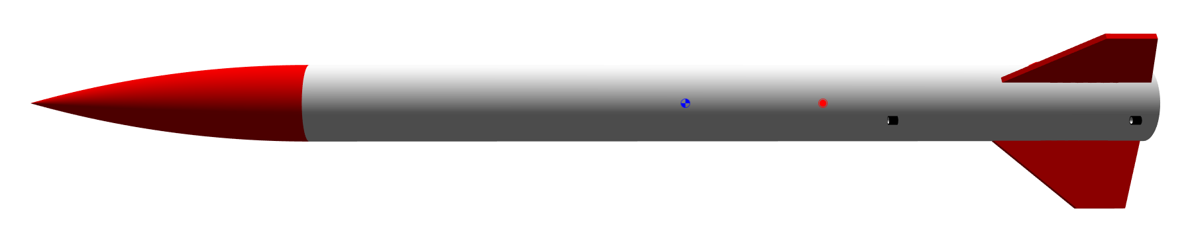
Recap
Nosecone
Body Tube
Fins

Slide 3
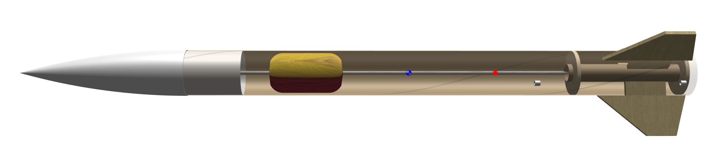
??
Motor Mount w’ H/I Motor
Recovery System
Centering Ring

Slide 4
Motor Impulse classes
Class | Impulse range | Certification required
G | 80 - 160 Ns | None!
H | 160 - 320 Ns | L1
I | 320 - 640 Ns | L1
J | 640 - 1280 Ns | L2
...
P | 40960 - 81920 Ns | L3

Slide 5
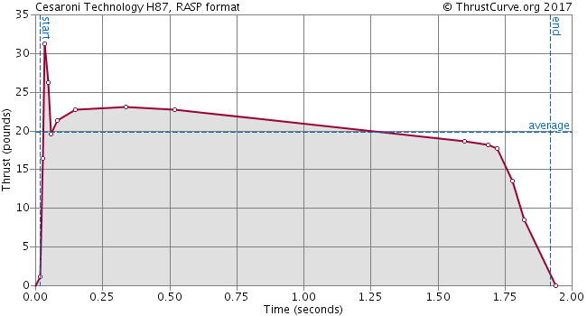
Thrust curves

Slide 6
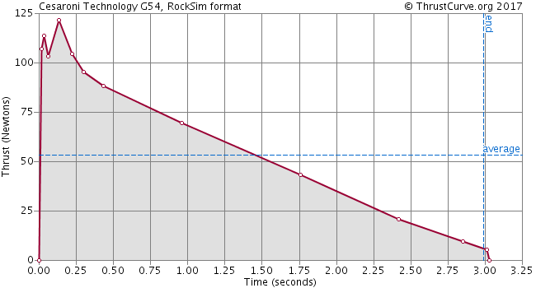
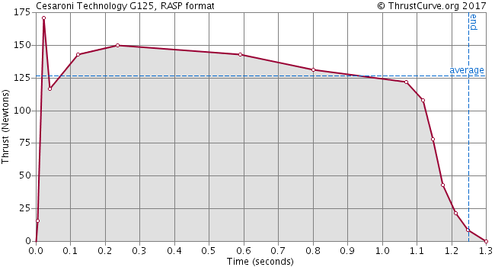
Thrust curves
G54
G125
159.1 Ns
159.6 Ns

Slide 7
Motor geometry – Bates Grain

Slide 8
Motor geometry

Slide 9
Other Motor Geometries
Moon Grain
Finocyl Grain

Slide 10
Motor hardware features
Case
Retention Ring

Slide 11
Motor hardware features
Ejection Charge
Delay Charge
Propellant Grains
Nozzle

Slide 12
Motor operation
Hole to Control Delay

Slide 13
Motor operation
Igniter

Slide 14
Motor operation

Slide 15
Motor operation

Slide 16
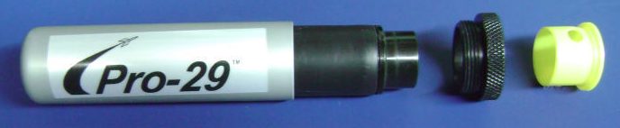
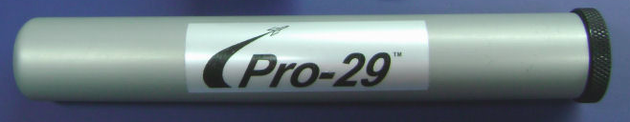
What will your motor look like?
Case
Retention Ring
Nozzle

Slide 17
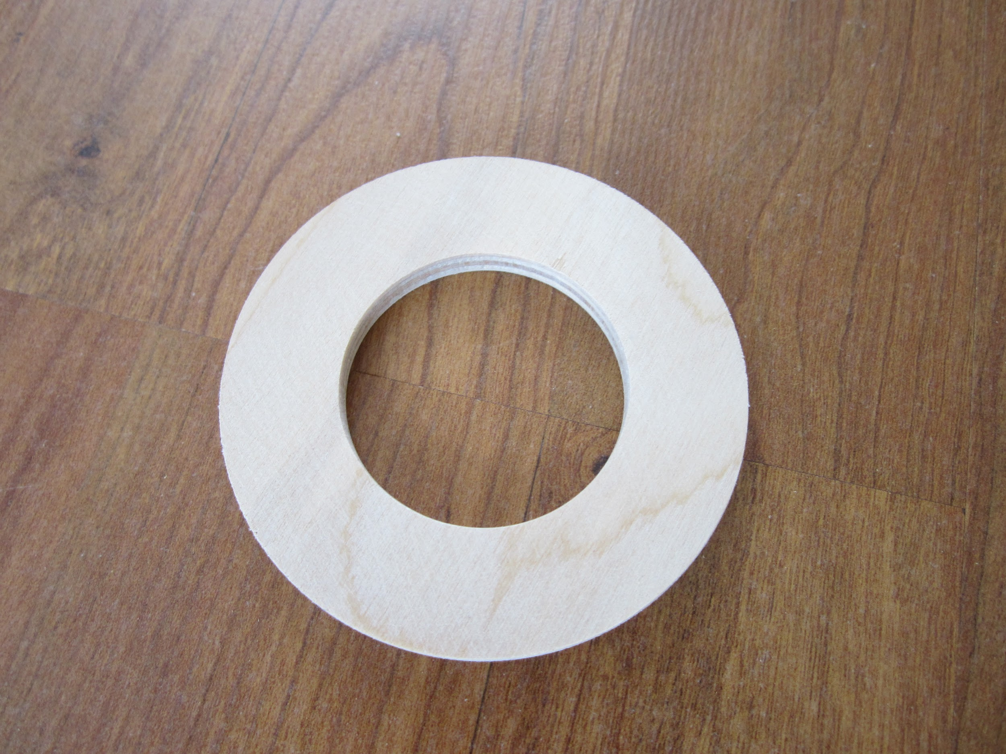
Manufacturing
Plywood Centering Ring

Slide 18
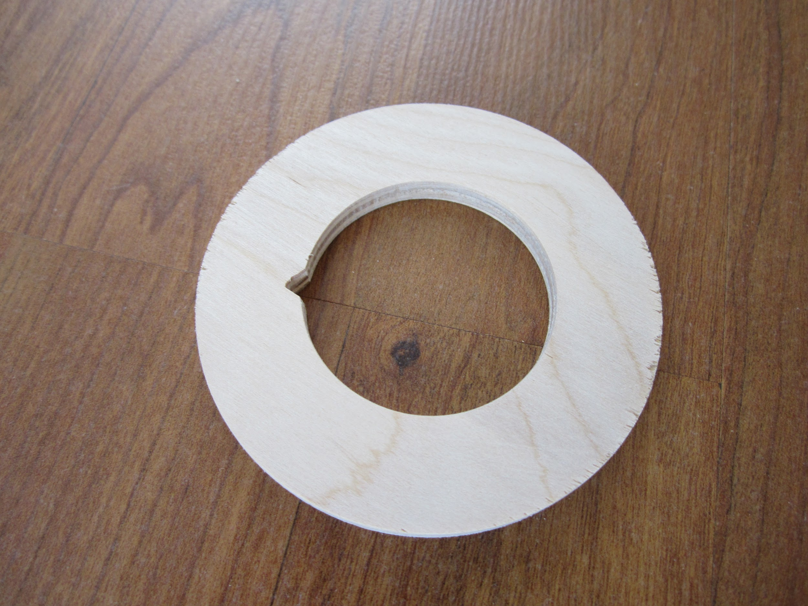
Notch for Shock Cord

Slide 19
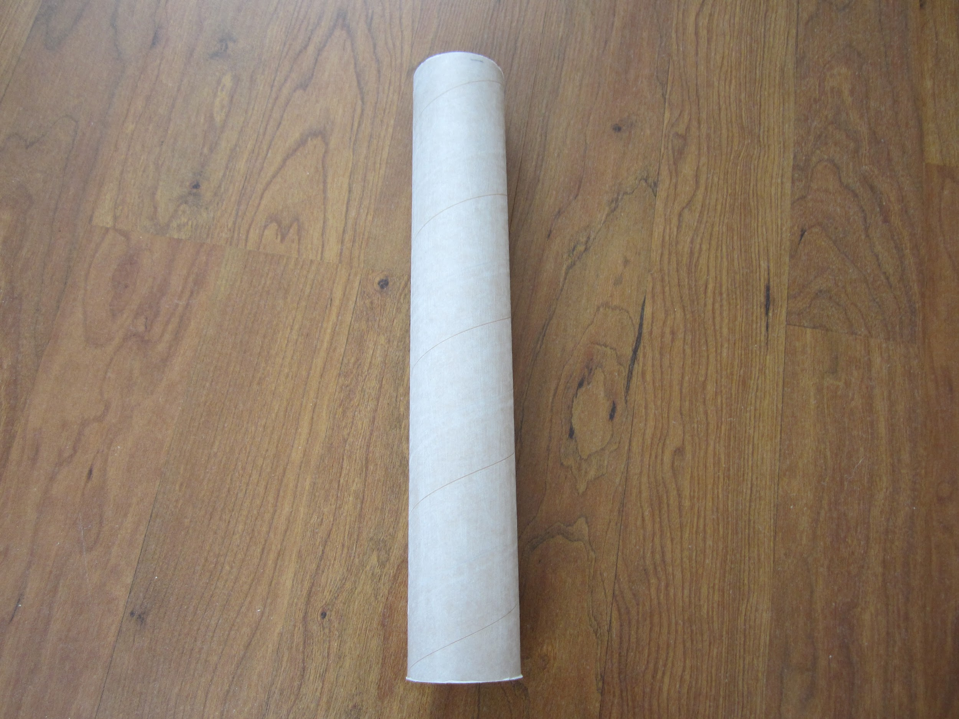
Body Tube

Slide 20
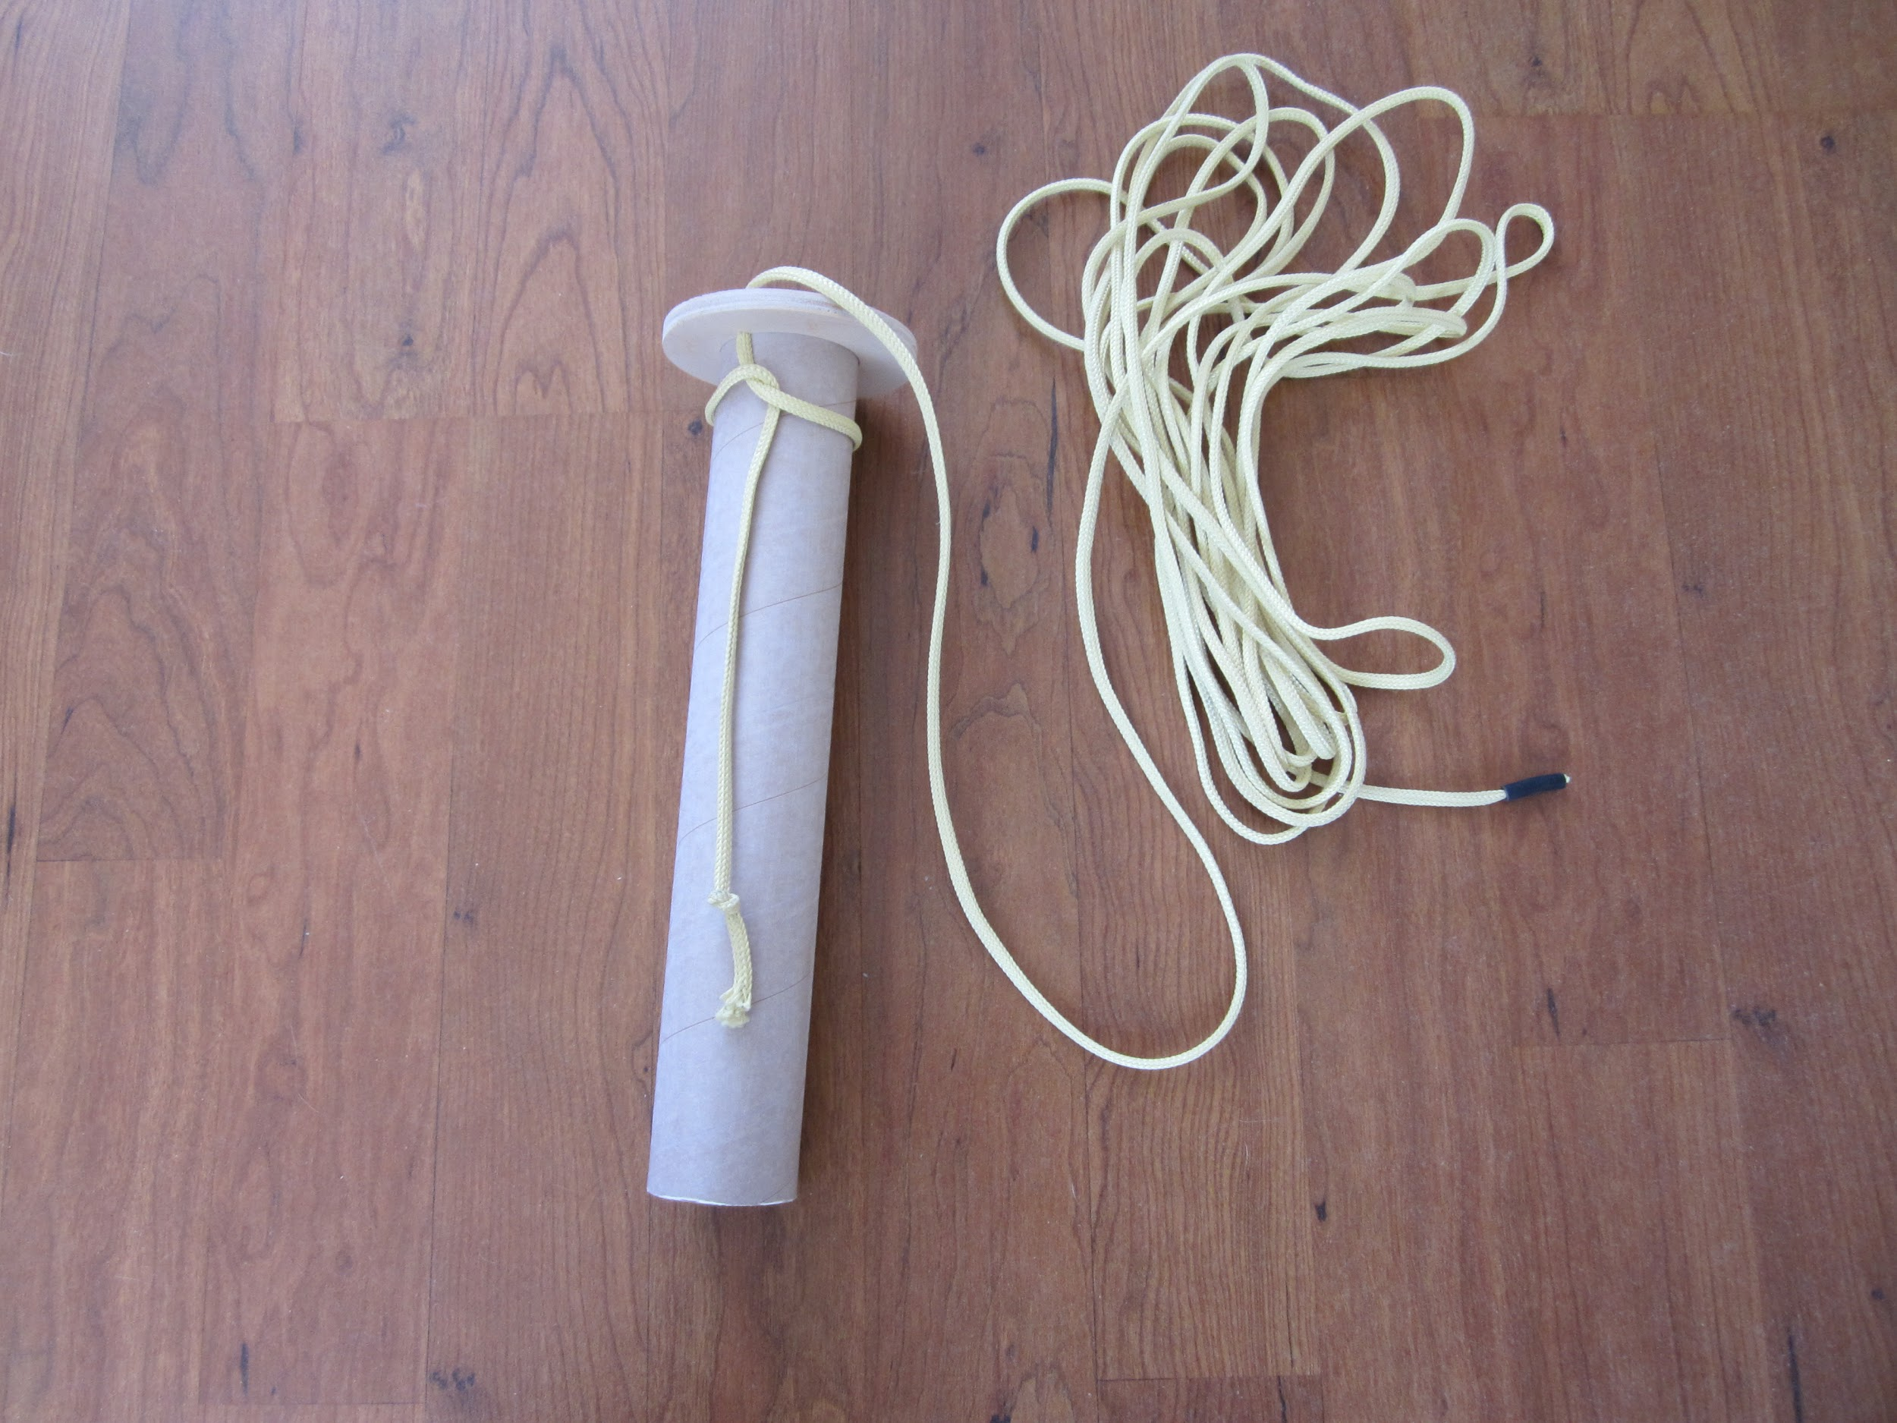
Centering Ring
Motor Mount
Shock Cord

Slide 21
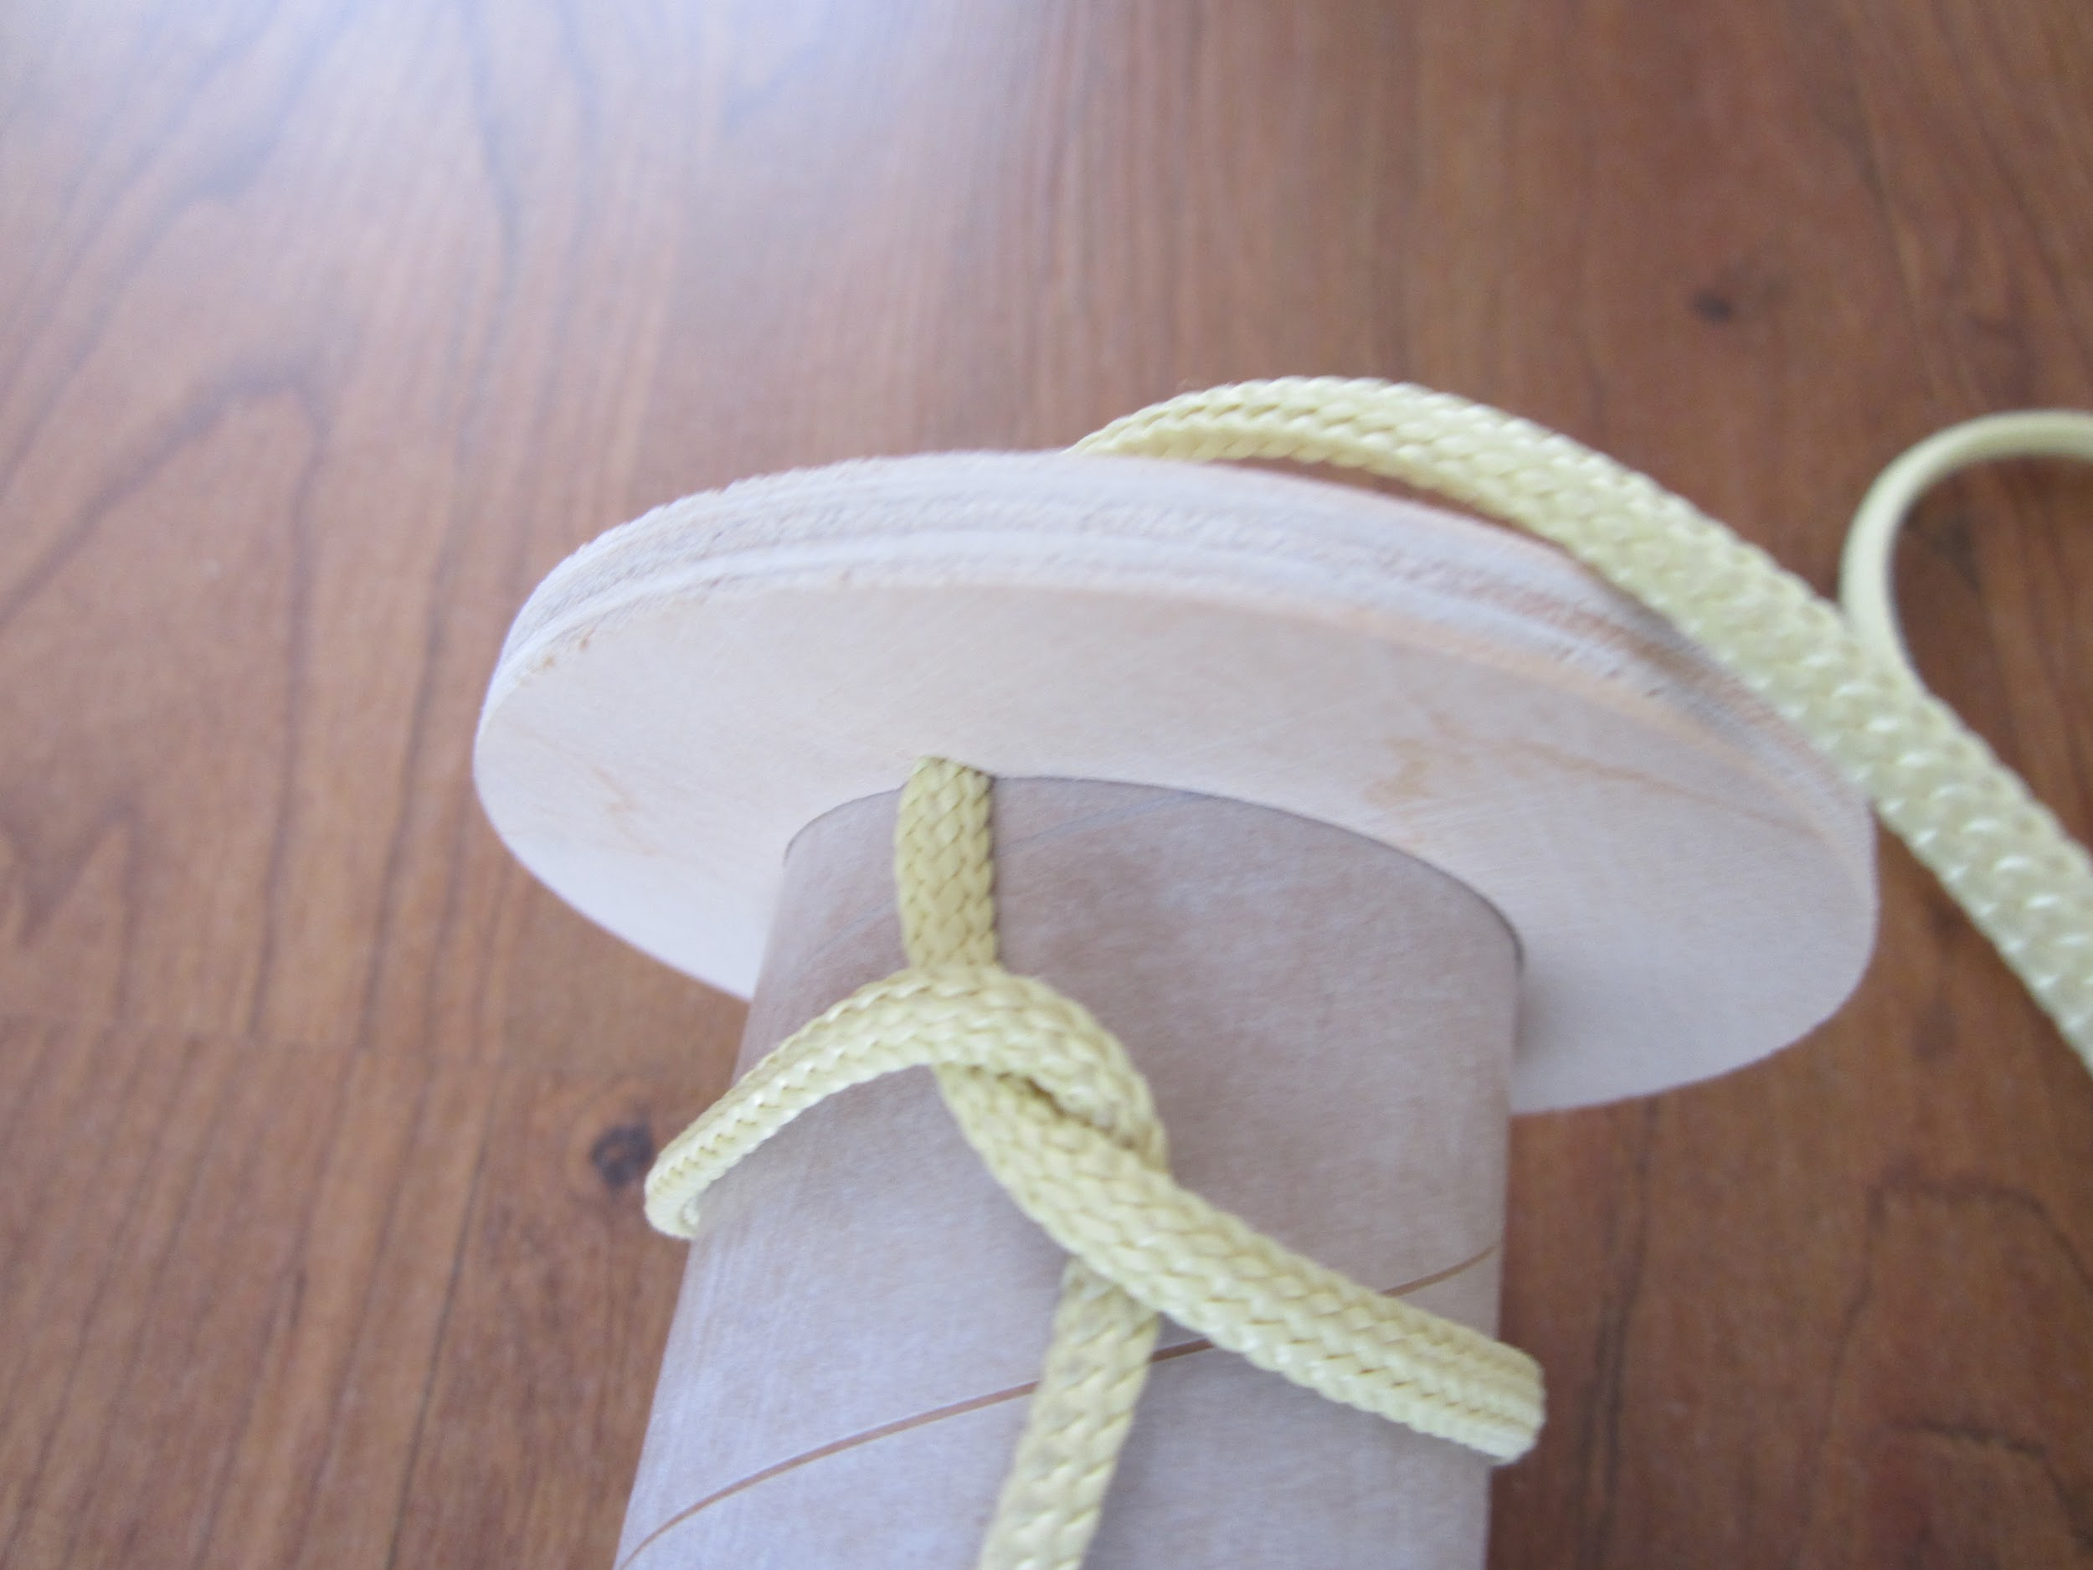
Tie & Glue

Slide 22
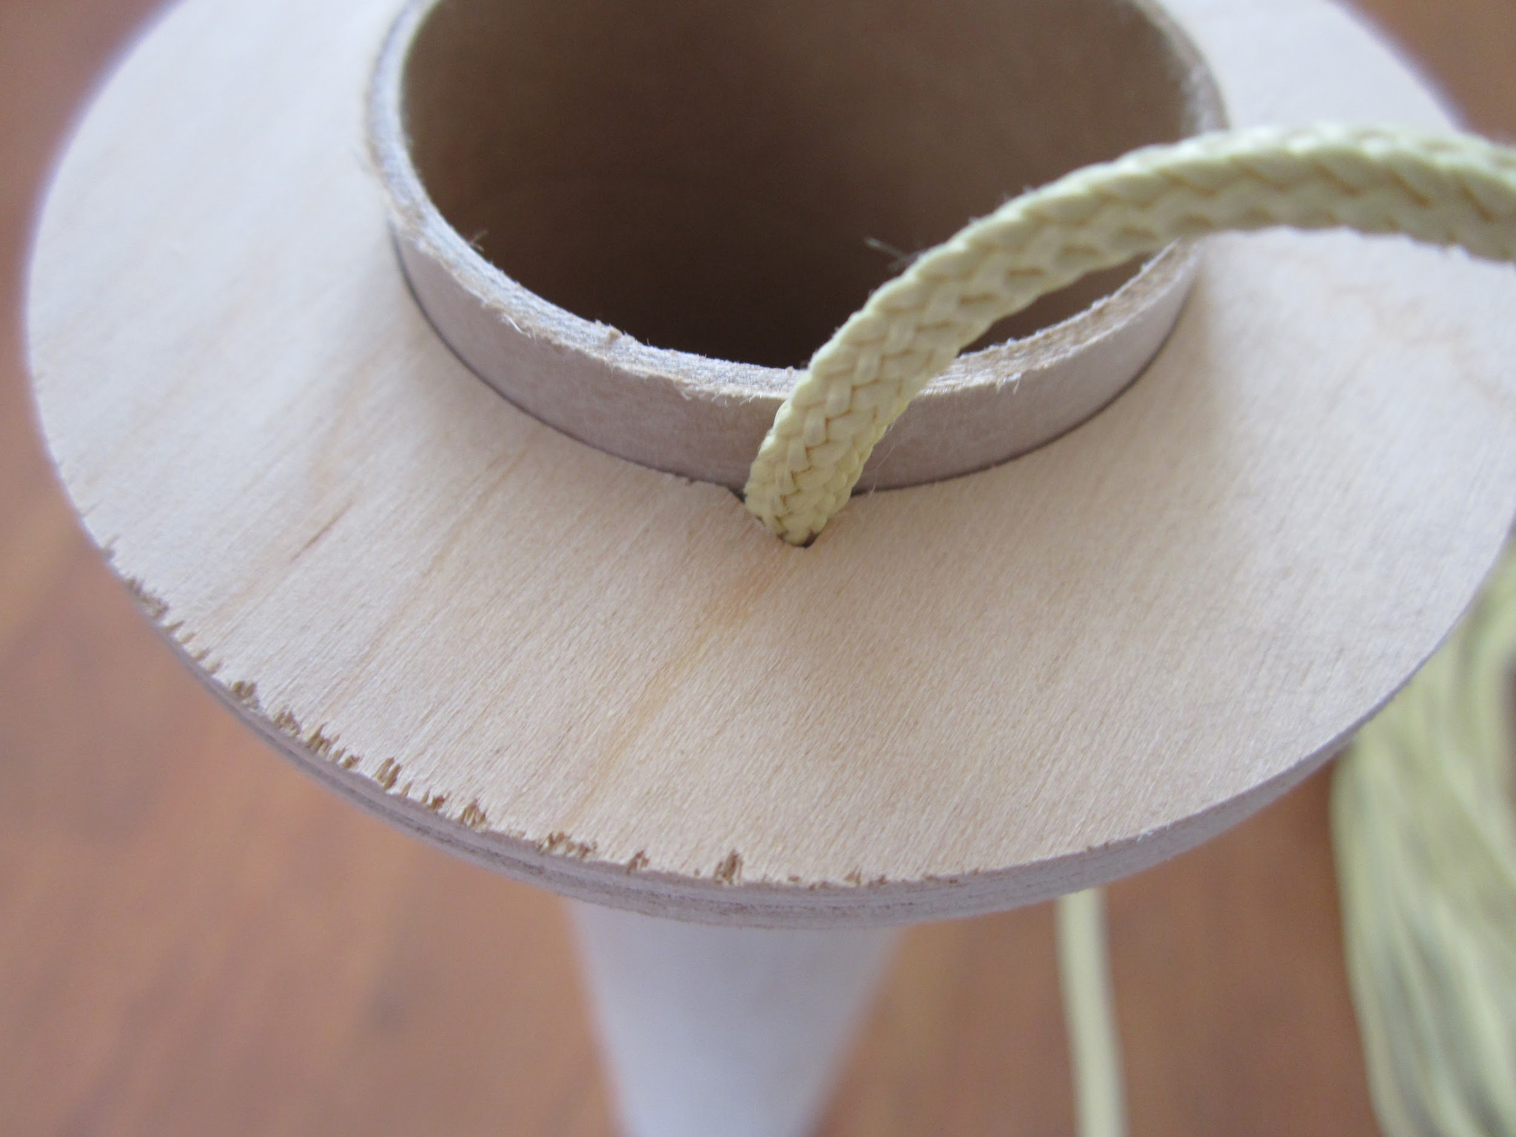

Slide 23
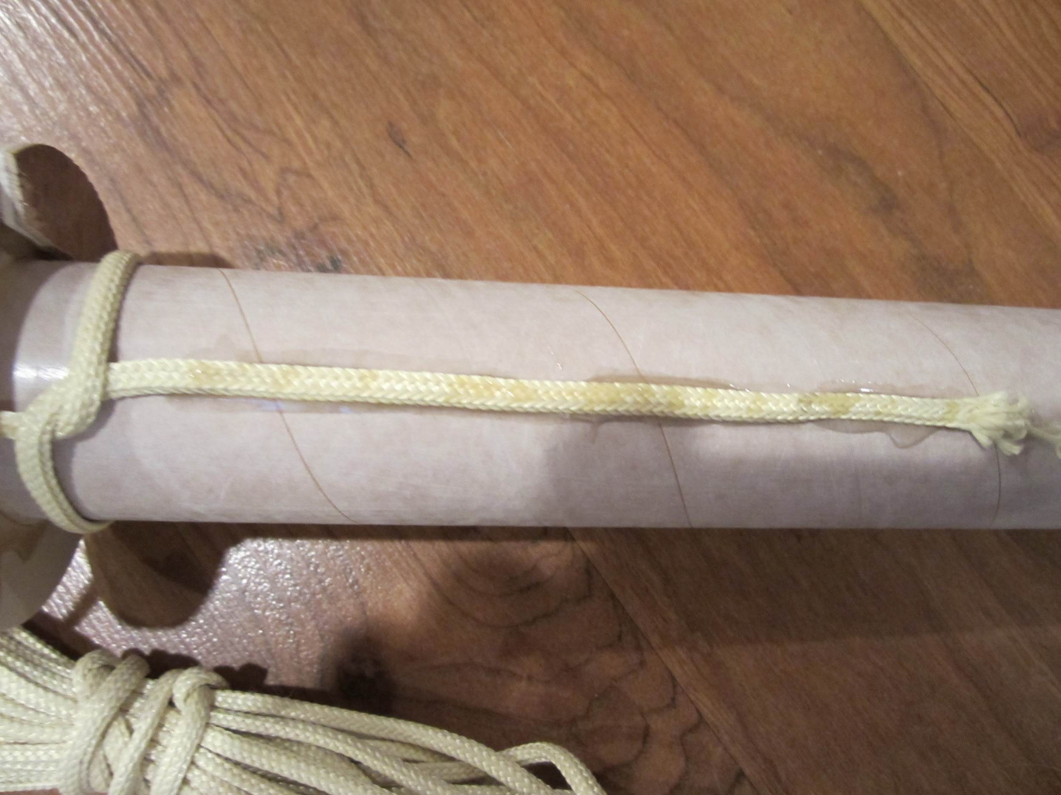
More Glue Here

Slide 24
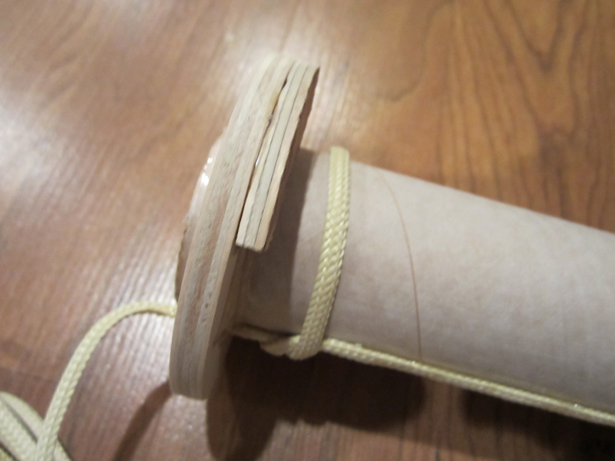
Rail Button Mount

Slide 25
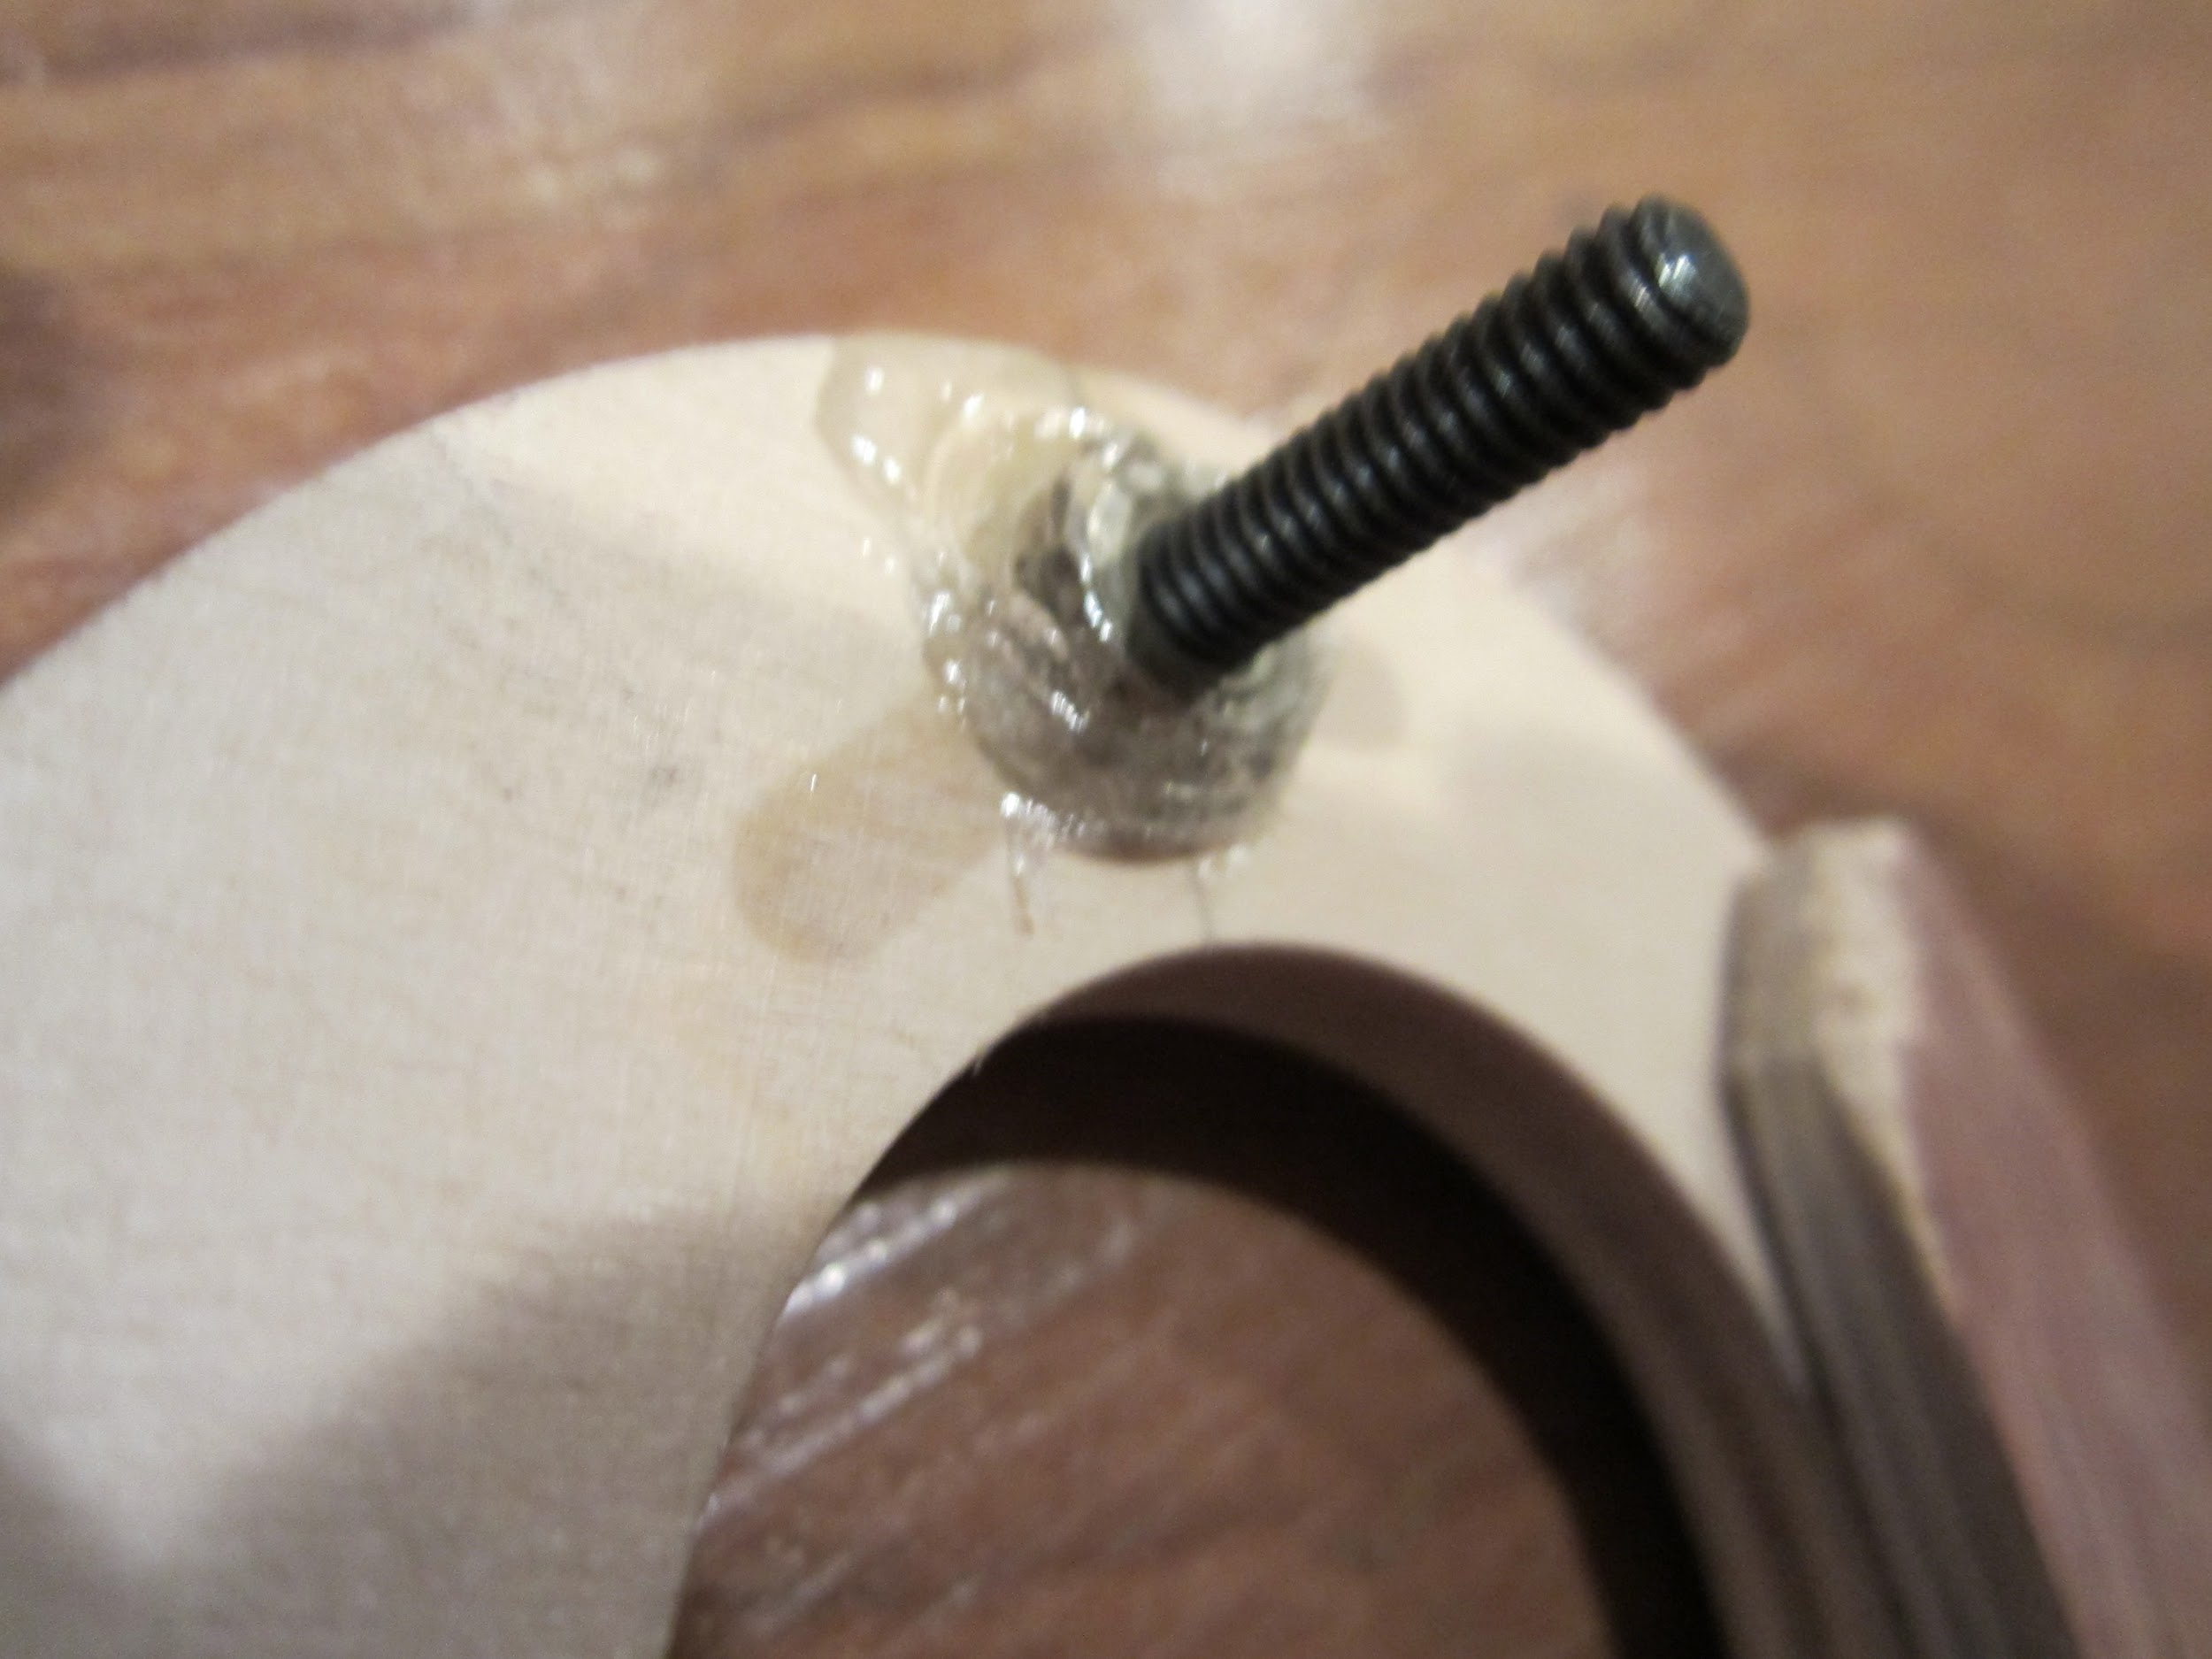
Screws for Retention Ring Clips

Slide 26
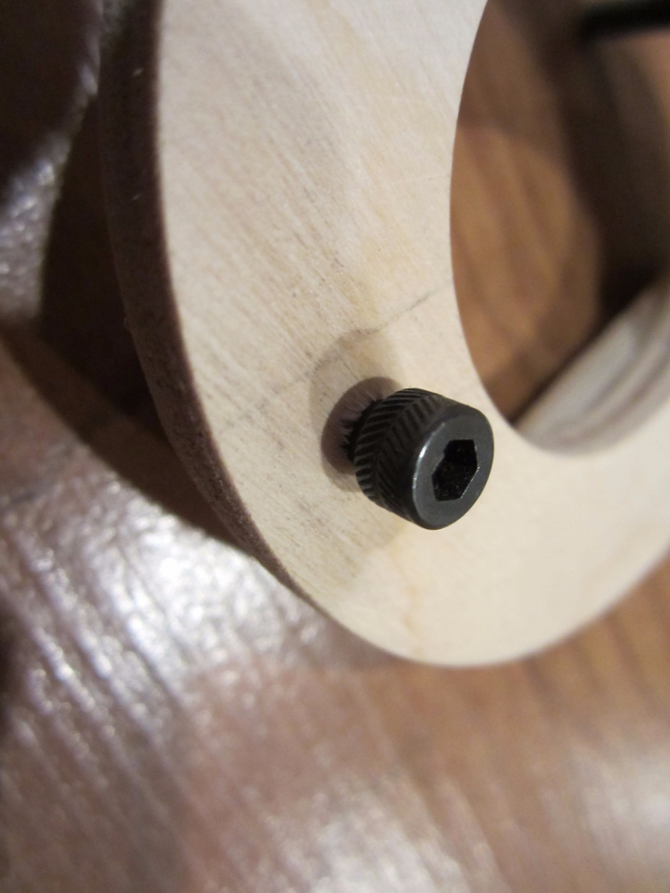
Outside

Slide 27
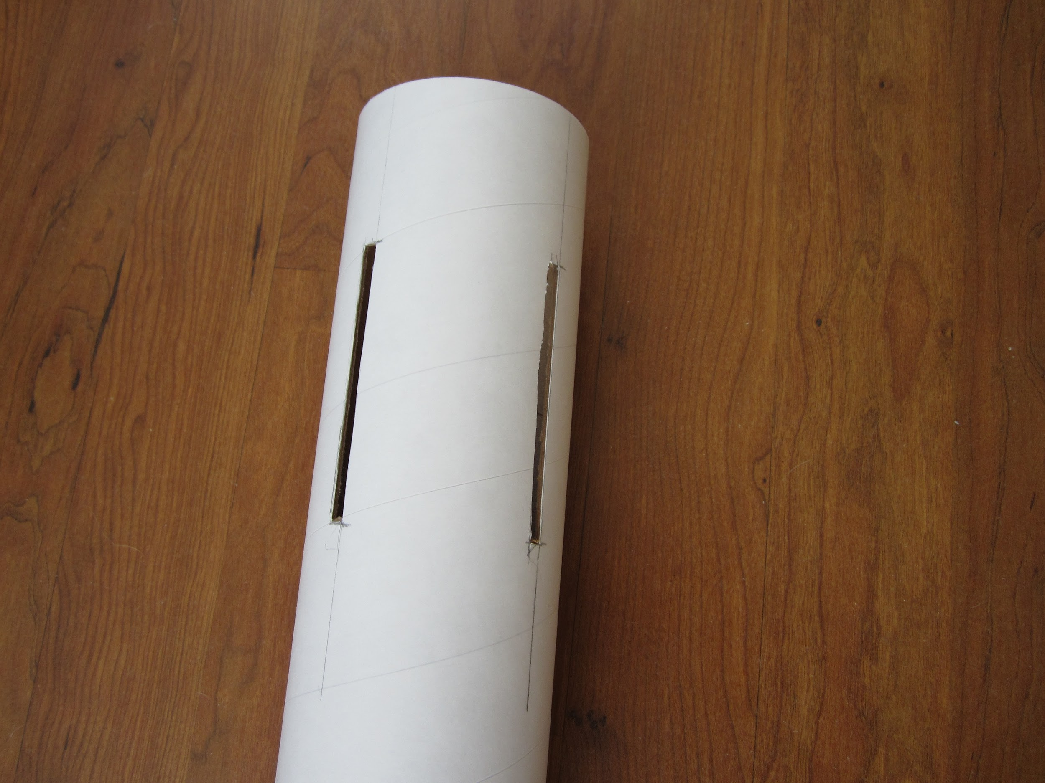
Slots for Fins

Slide 28
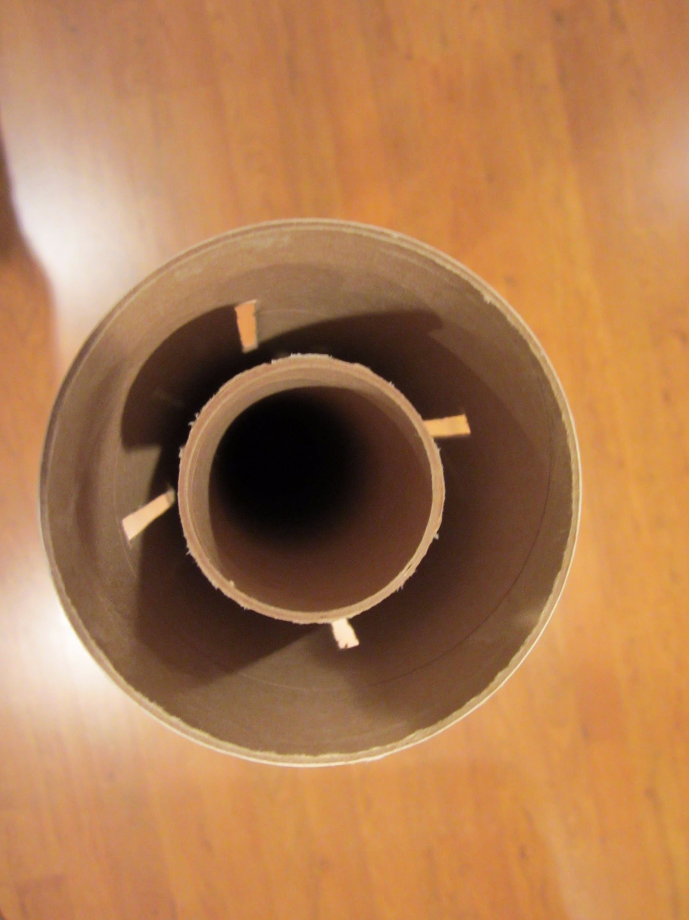
Motor Mount in Body Tube

Slide 29
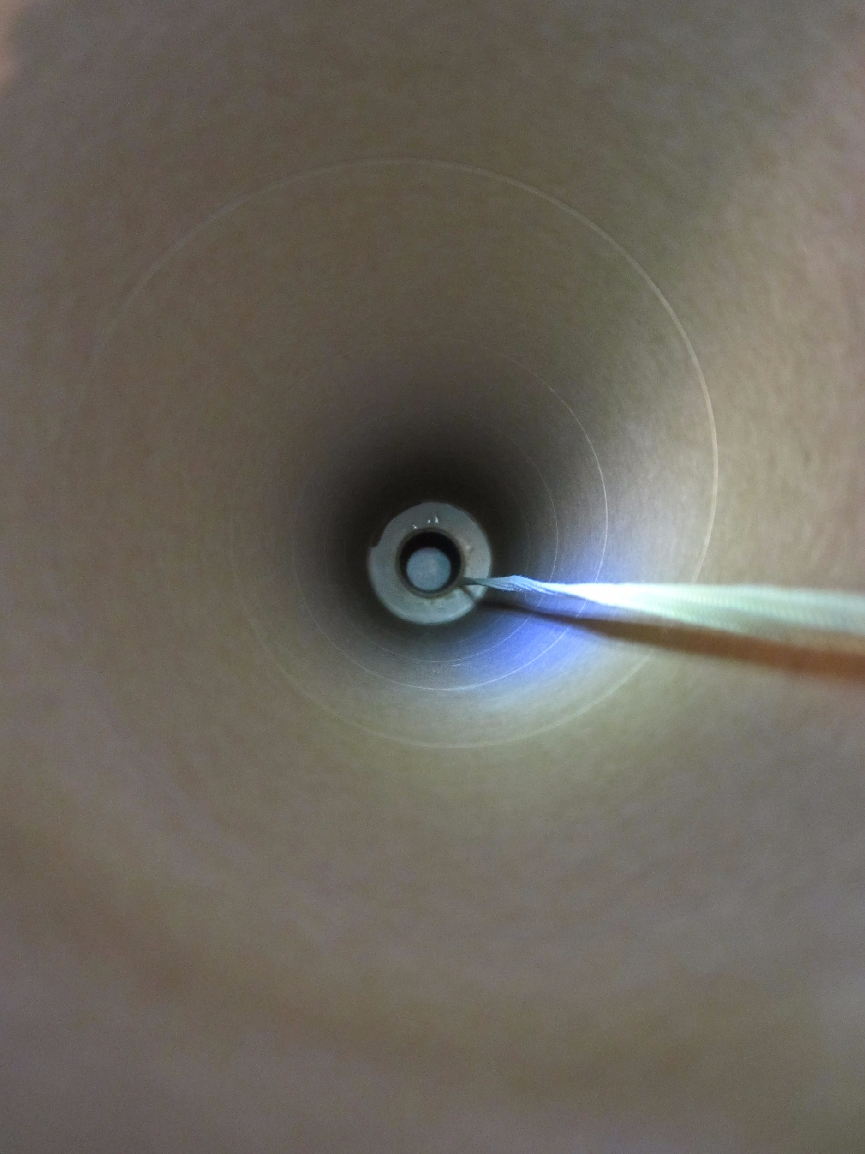
Shock Cord

Slide 30
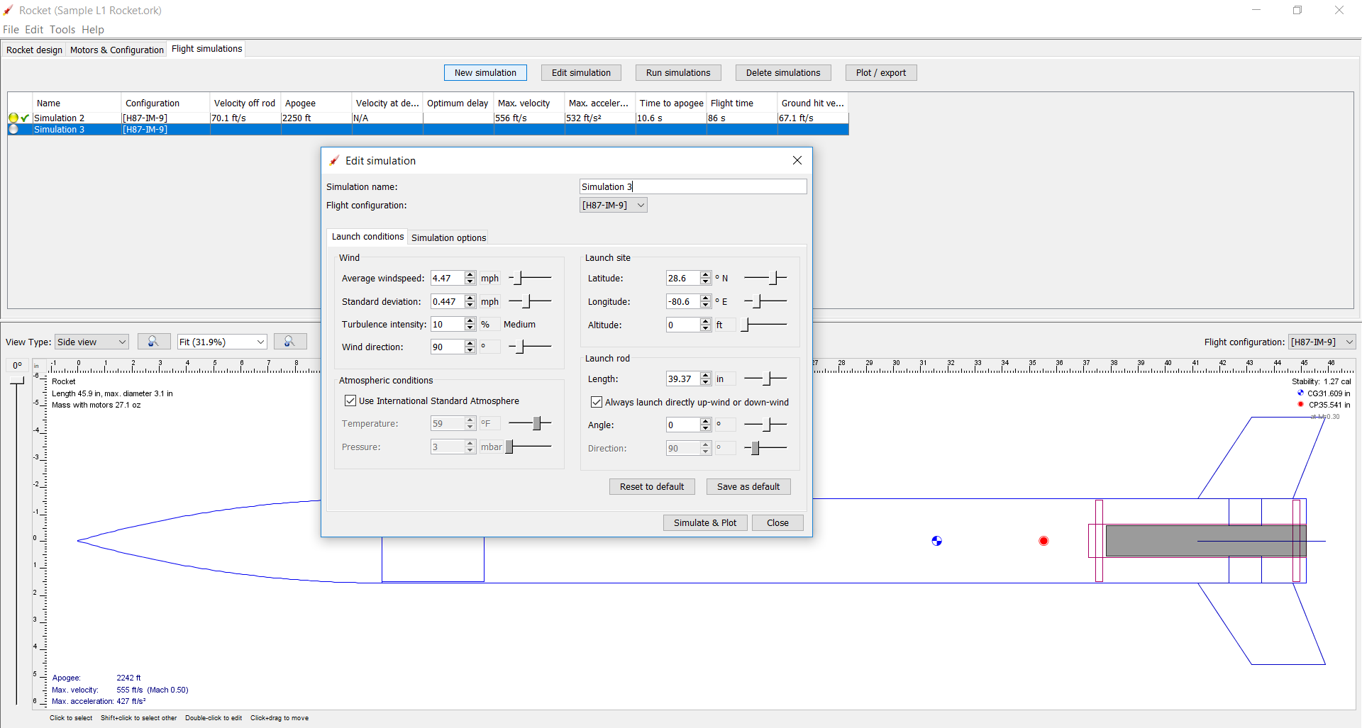
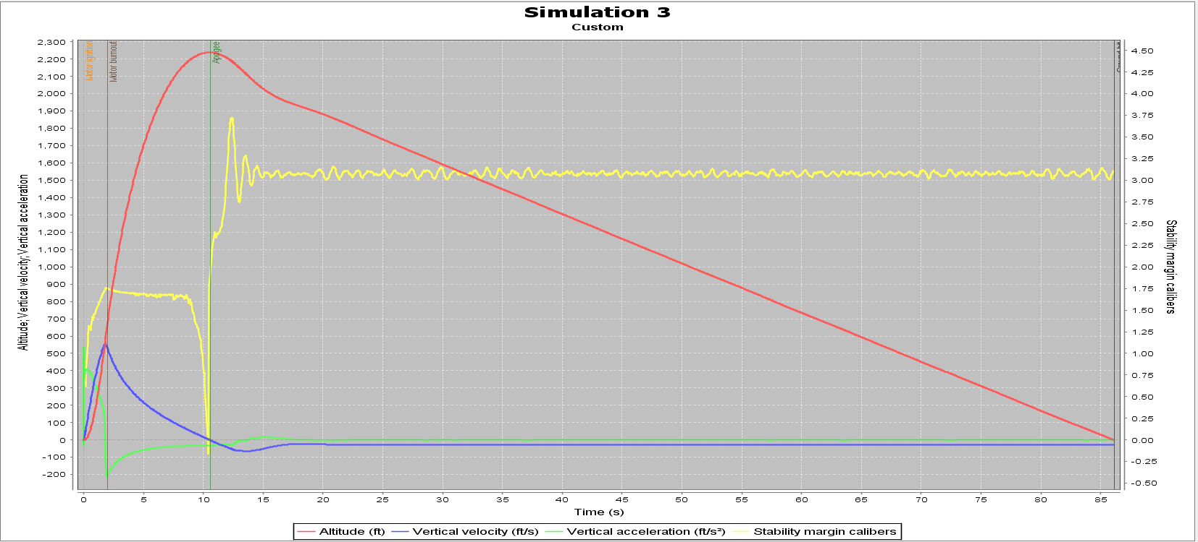
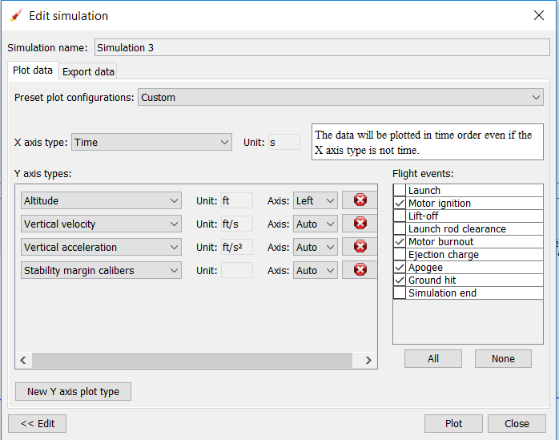
Simulations

Slide 31
Schedule
Date | Task
Sep 7 | 1st Presentation Start OpenRocket Design
Sep 14 | 2nd Presentation Finish OpenRocket Designs
Sep 17 | Submit OpenRocket + Fin Designs
Sep 21 | Safety + 1st Build Session (Gelb)
Sep 22 – Oct 2 | Further Build Sessions (exact timing TBC)
Oct 3 – Oct 4 | Pre-flight Check
Oct 5 (Backup Oct 12) | LAUNCH (details TBC)

Slide 32

Next Steps - NAR
https://www.nar.org/join-nar/

