Slide 1
Rocketry Basics
MIT Rocket Team
Jamie Abel
Original Course by Andrew Reilley

Slide 2
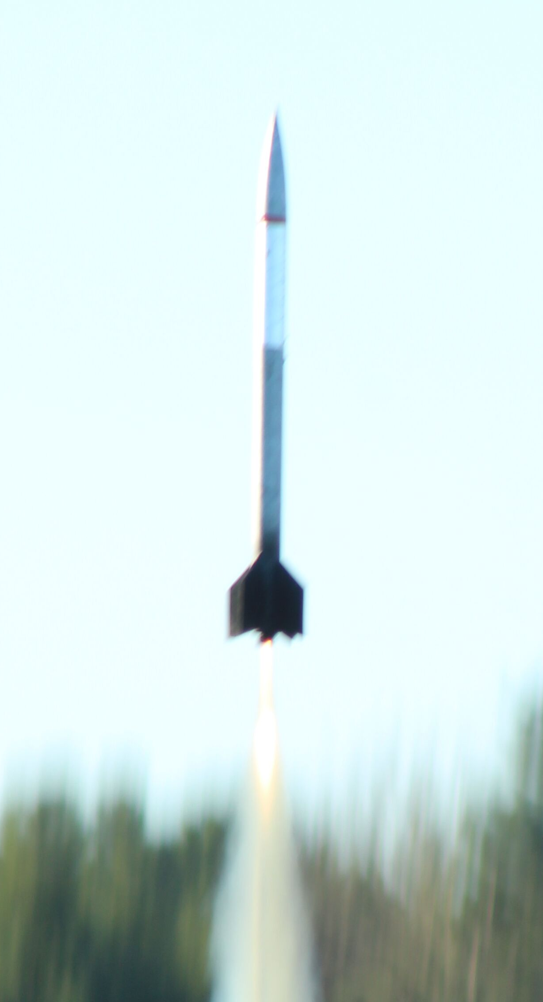
Your 1st High-Powered Rocket

Slide 3
L1 Certification
Permission from the National Association of Rocketry (or Tripoli) to use motors above a certain size at sanctioned launches.
Requirements:
Be familiar with your own rocket and how it works
Safe flight
  Doesn’t break
  Stable flight
  Recovery
Motor
  H or I impulse
  T/W > 5, ideally
Notes:
Motor, stability, recovery. How do we do all of those things? Many ways possible, here’s one that we’re going to build

Slide 4
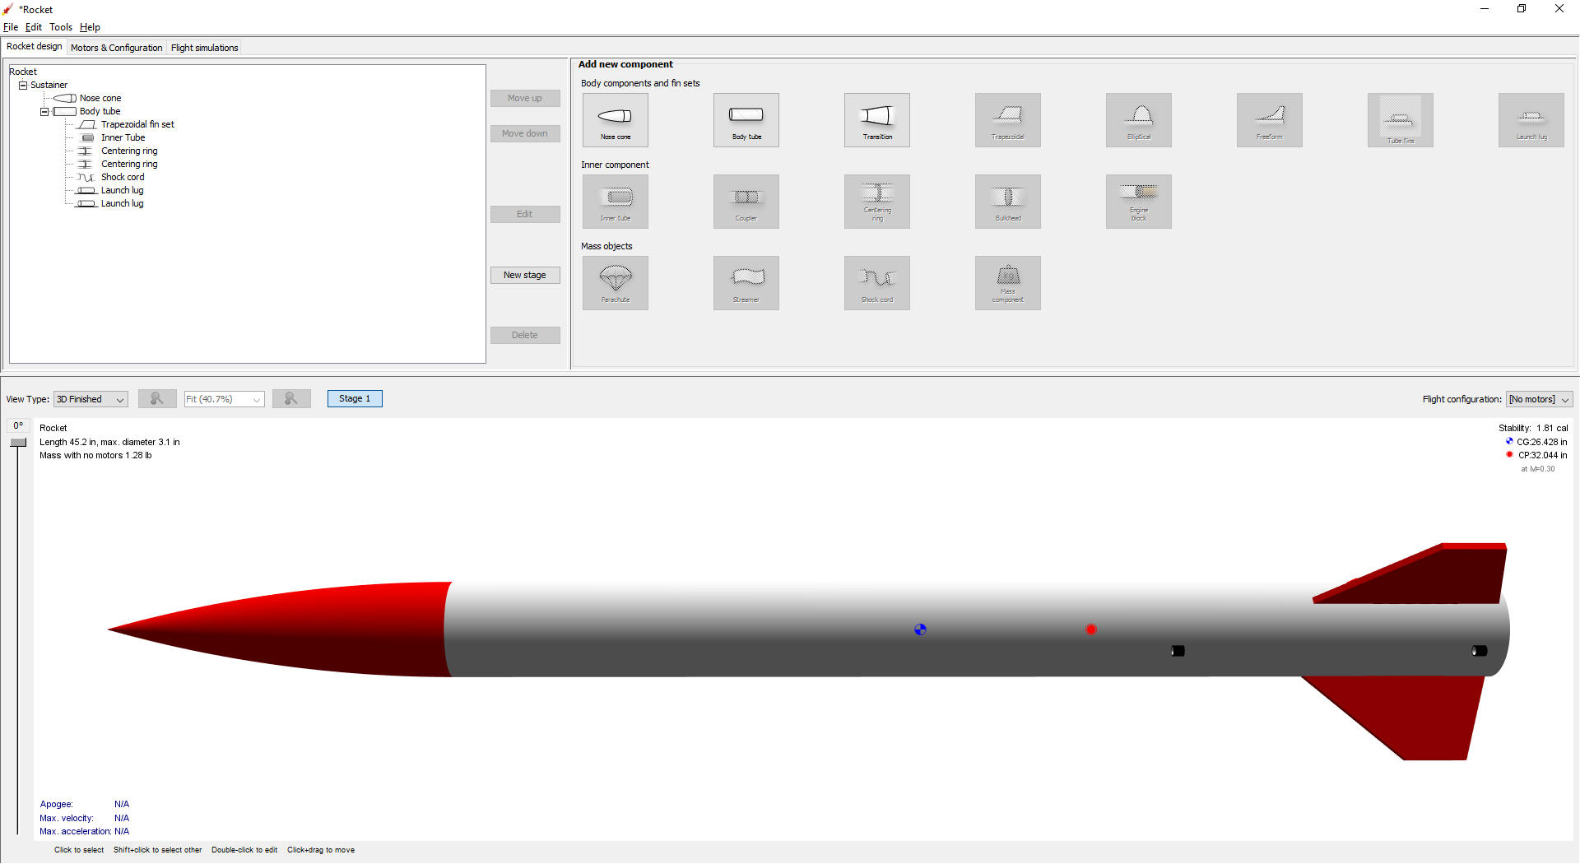
A basic rocket

Slide 5
A basic rocket
Forward
Aft
3”
~4’

Slide 6
A basic rocket
Nosecone
Body Tube
Fins

Slide 7
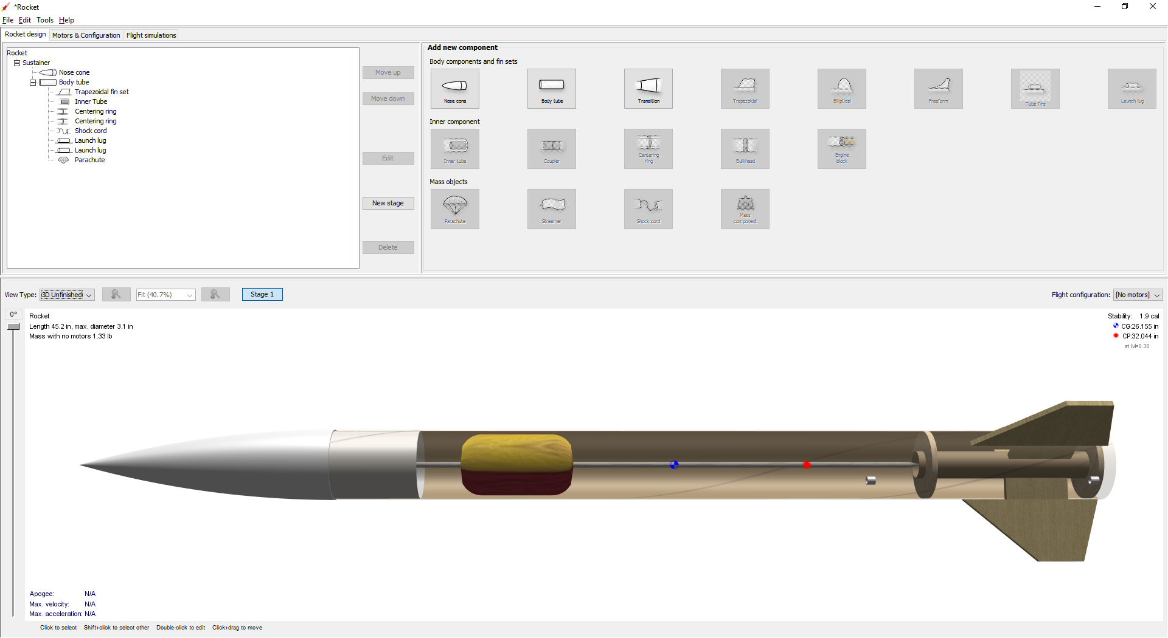
A basic rocket
Recovery System
Centering Ring
Motor Mount

Slide 8
Basic Rocket Flight
Separation
Safe recovery
Stable boost

Slide 9
Structure - Nosecone
Shoulder
Notes:
Typically plastic

Slide 10
Structure - Fins
Root
Trailing edge
Leading edge
Tip

Slide 11
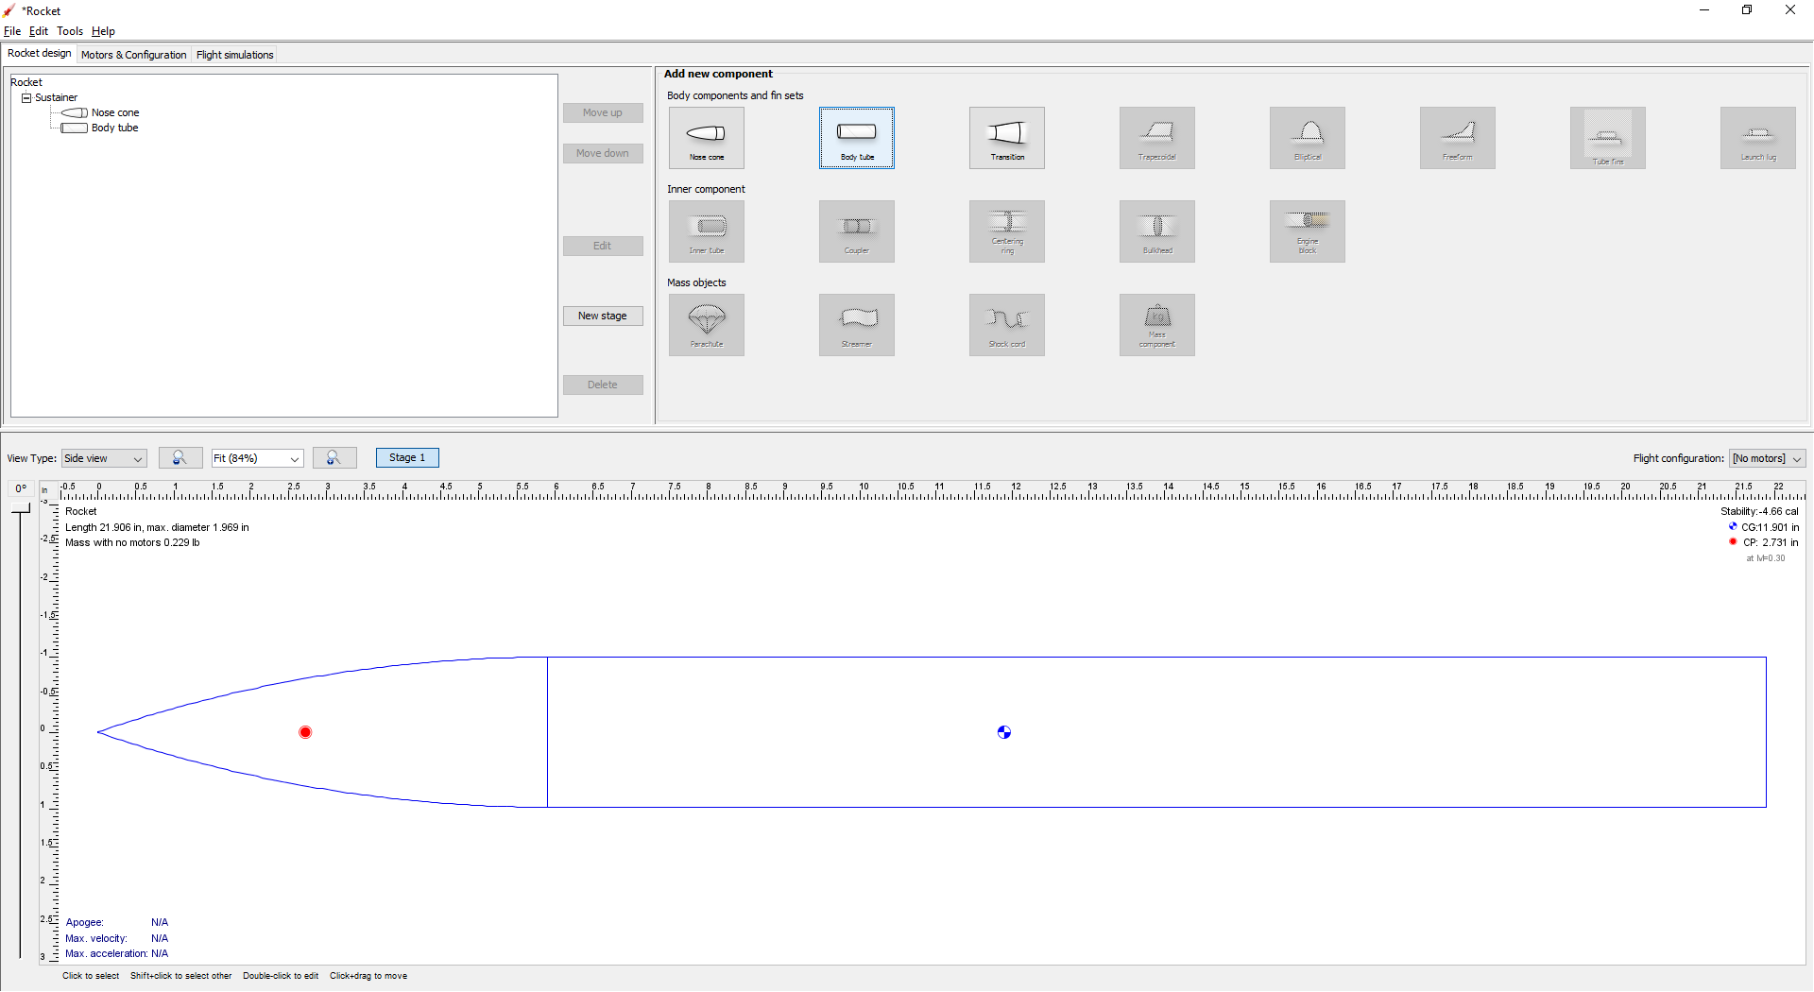
Purpose of Fins - Stability

Slide 12
Unstable

Slide 13
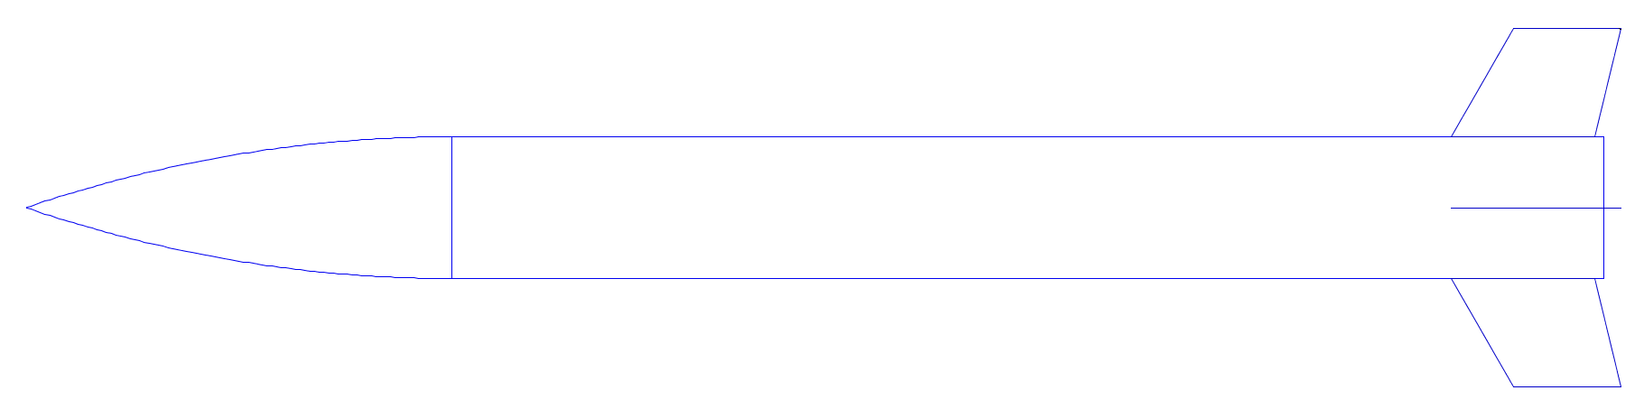
Stable

Slide 14
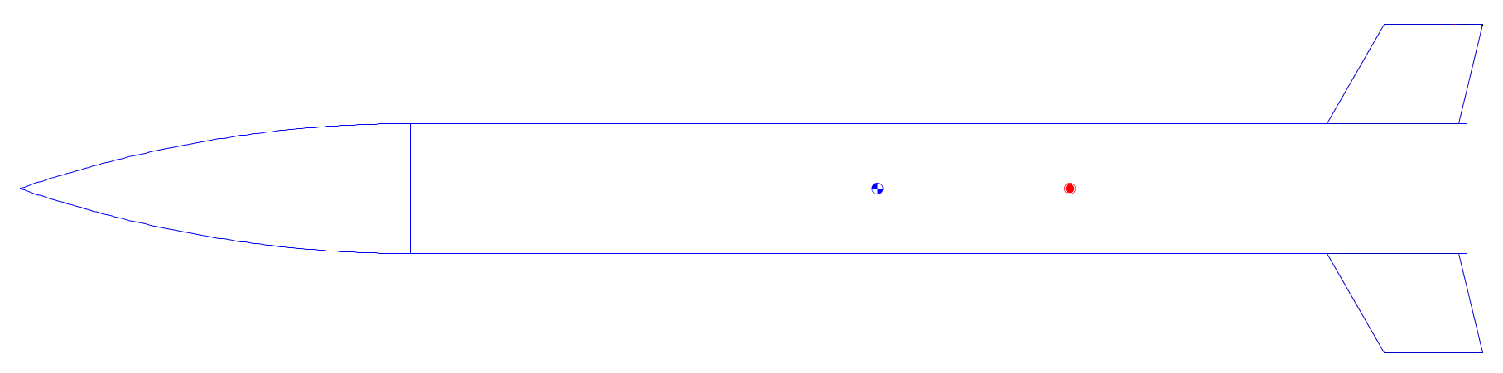
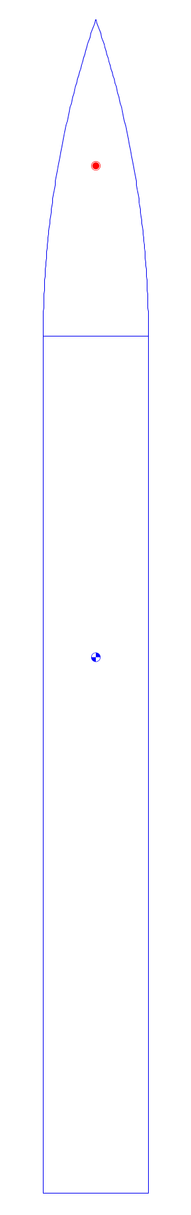
Stability Margin
Without Fins - Unstable
With Fins - Stable
Center of Mass
Static Margin
Center of Pressure
Notes:
Aim for around 1.5 cal of stability (+- 0.3)

Slide 15
Attaching Fins
Tab

Slide 16
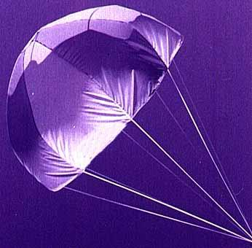
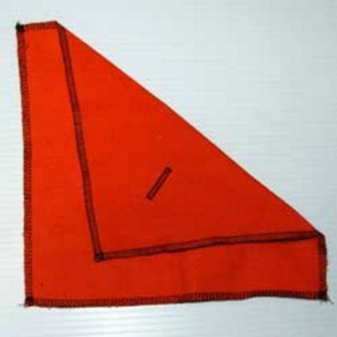
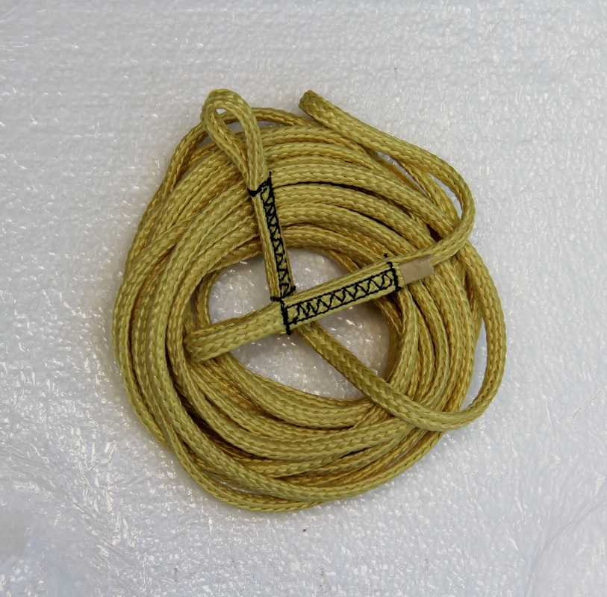
Recovery System Parts
Parachute
Parachute protector
Shock cord

Slide 17
Recovery System Deployment
Motor
Black Powder Charge
Motor
Para-chute
Protector

Slide 18
Recovery System
Parachute
Shock cord
Notes:
Typically about 12 feet of ¼” kevlar for the SC, a 24-30 inch nylon chute.

Slide 19
Recovery System Attachment
Threaded through holes in nose cone shoulder. Don’t use the built-in attachment point!
Passed through notch in centering ring glued to motor mount
Notes:
They love to ask this one during L1 checkins. Note: don’t use the built in nosecone eyelet. It is tempting, but they break really easily.

Slide 20
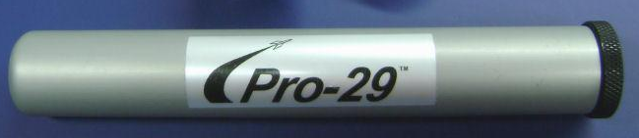
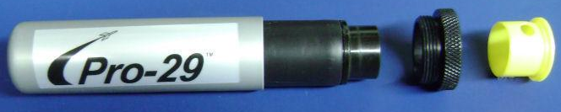
Motor
L1: Must use an H or I motor (160 - 640 NS)
Thrust ring

Slide 21
Motor Mount
Motor mount tube
Centering rings

Slide 22

Motor Retention
Motor thrust ring seats directly on MMT
Clip that prevents motor from leaving MMT
Screw threaded into nut on forward side of CR

Slide 23
Launching - Rail Buttons

Slide 24
Questions?

Slide 25
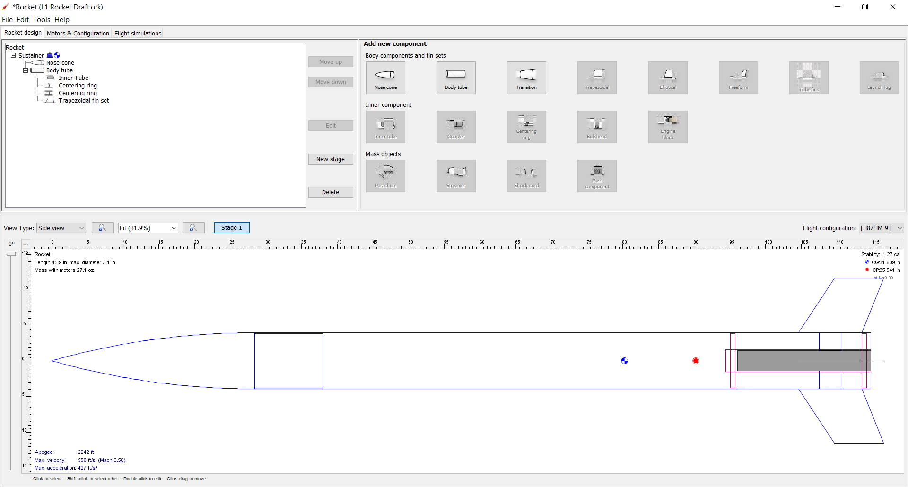
Next – OpenRocket

