Slide 1
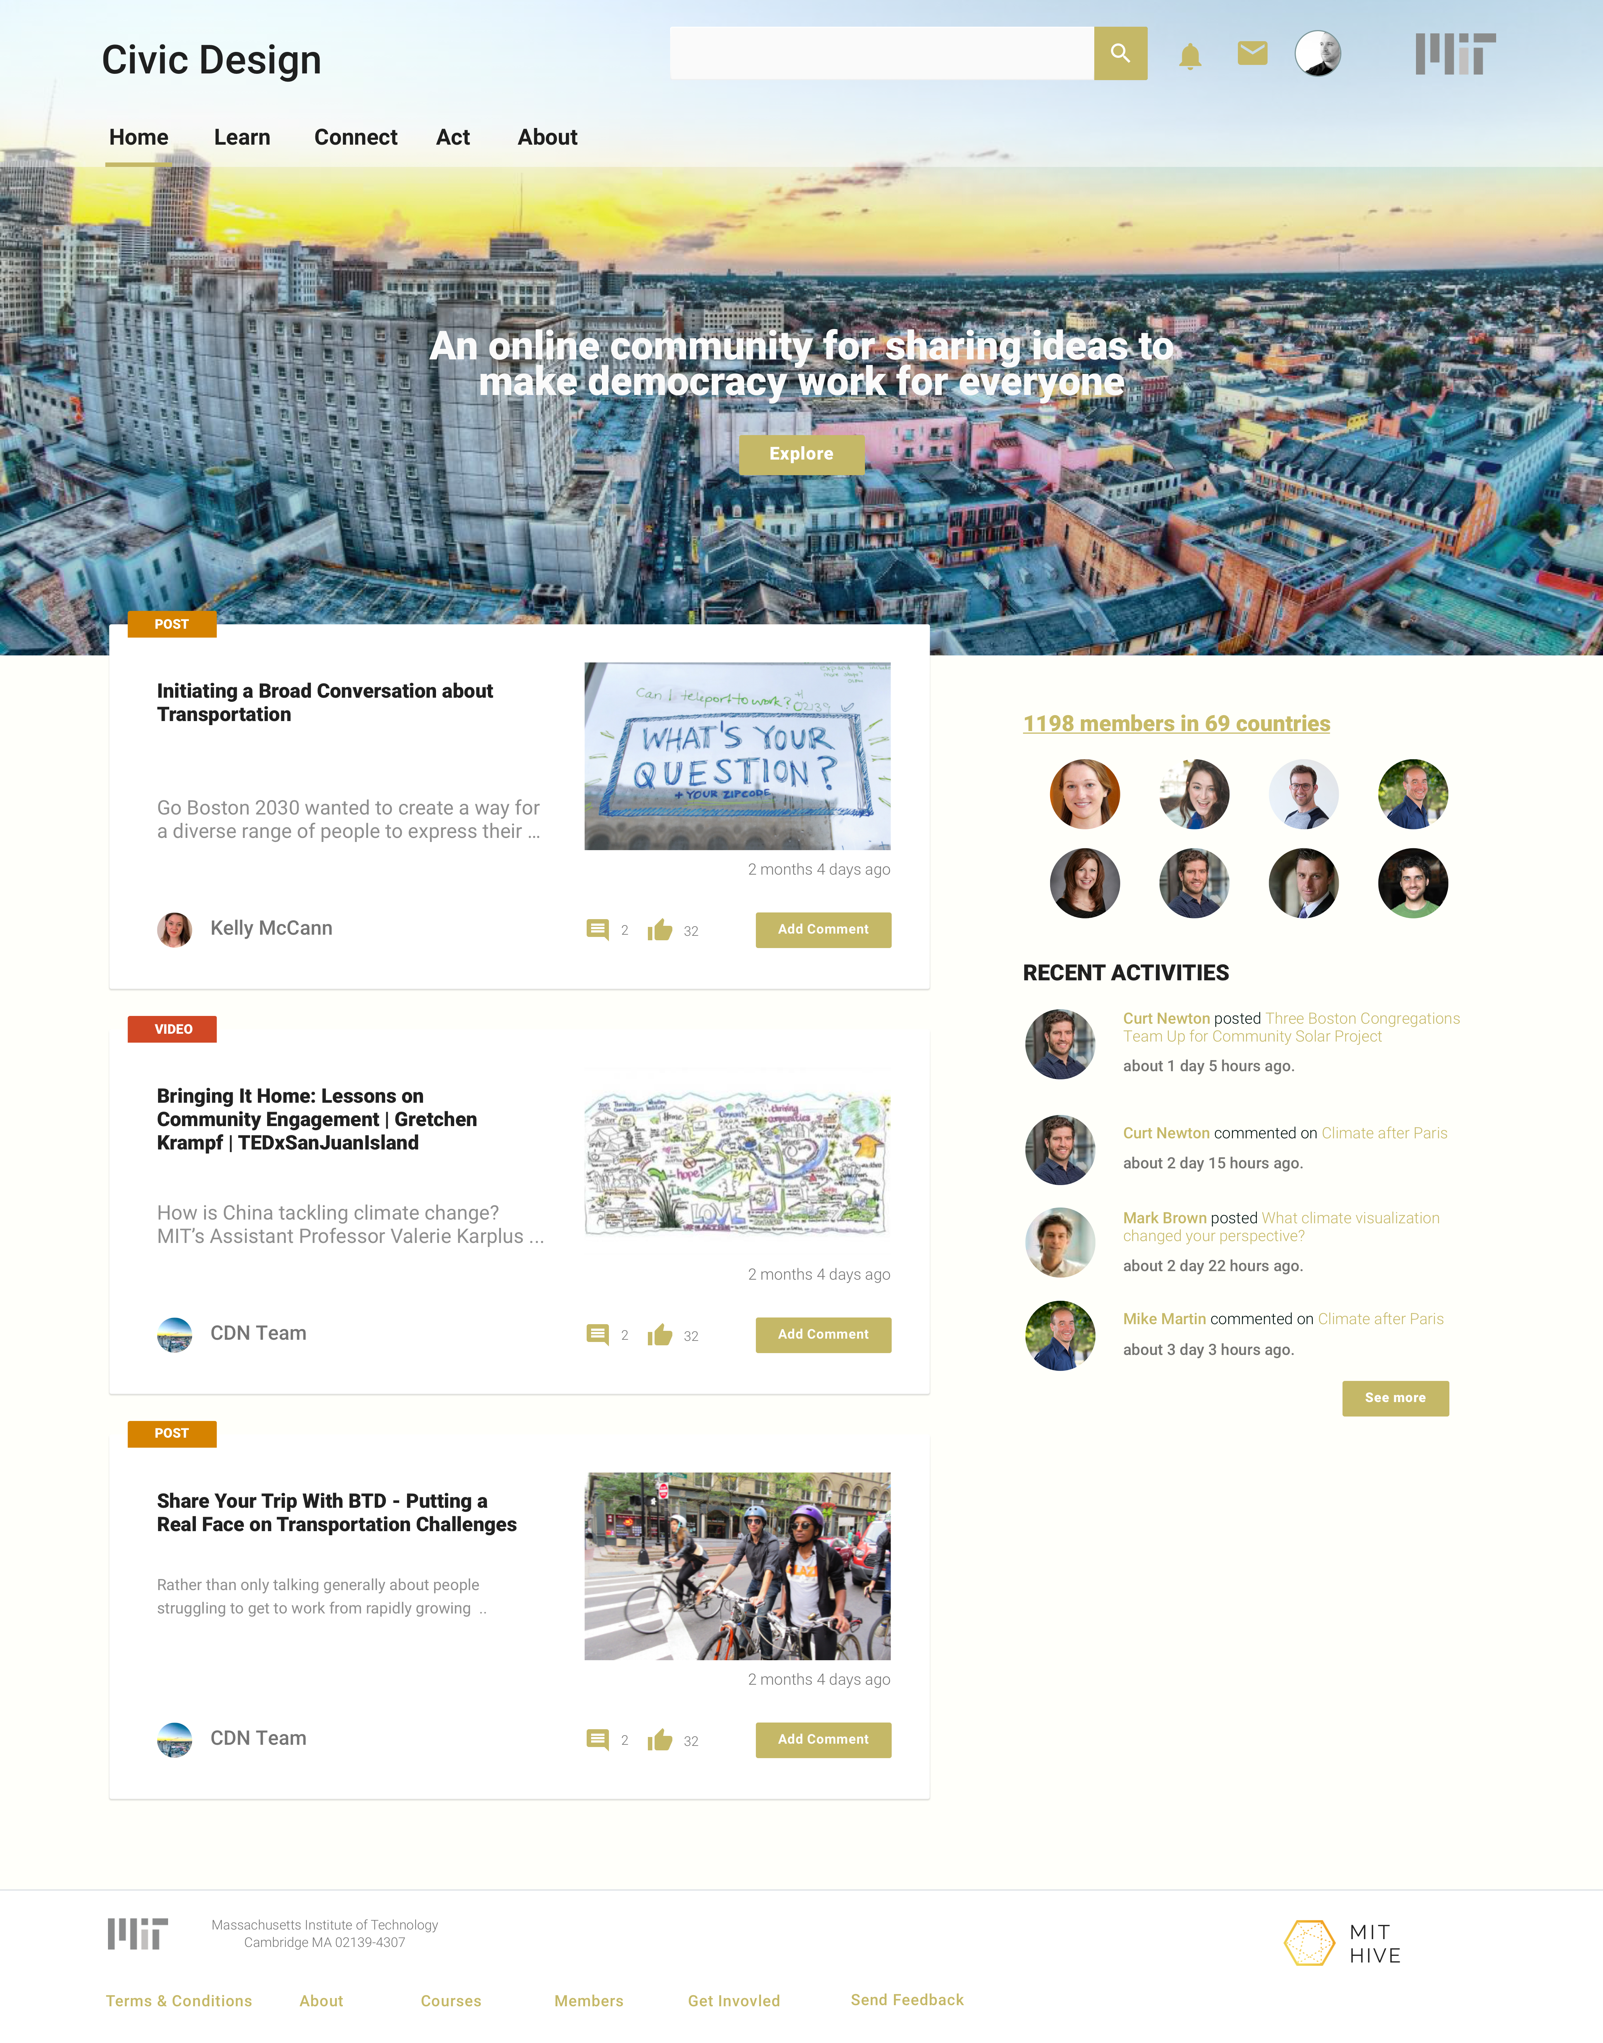
Questions:
1. Site title
2. Top nav colors
3. Button colors
4. Home Page image
5. Home Page tagline
6. Navigation labels (see next page)

Slide 2
A. Flat Navigation
Home Intro Learn Connect Act About
Goes to Intro Lander (next page)
B. “Learn” Dropdown on Hover
Home Learn Connect Case Studies About
The 8 Principles
1. Margins
2. Equity
3. In Person and Online
4. Systematic Change
5. Ways of Expression
6. Ecological / Network Solutions
7. Collaboration
8. Healing
Goes to Intro Lander (next page)
Go to pre-filtered pages
C. With “Act” variants
Home Learn Connect Case Studies About
Home Learn Connect Collaborate About

Slide 3
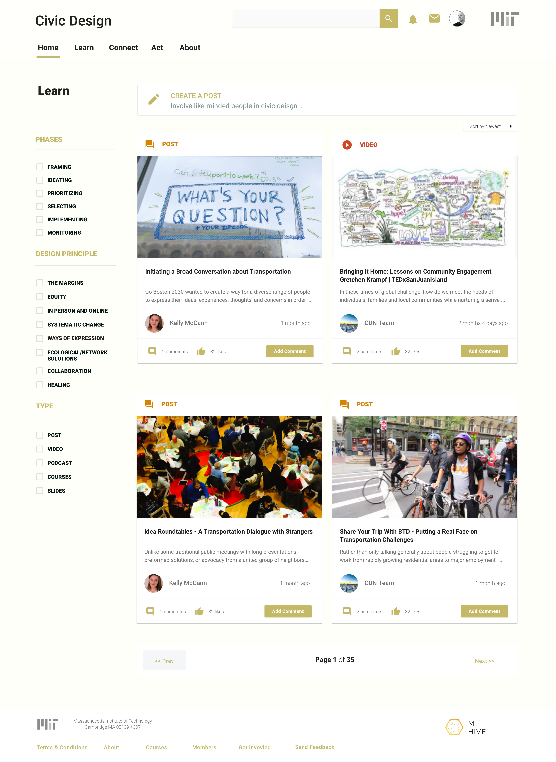
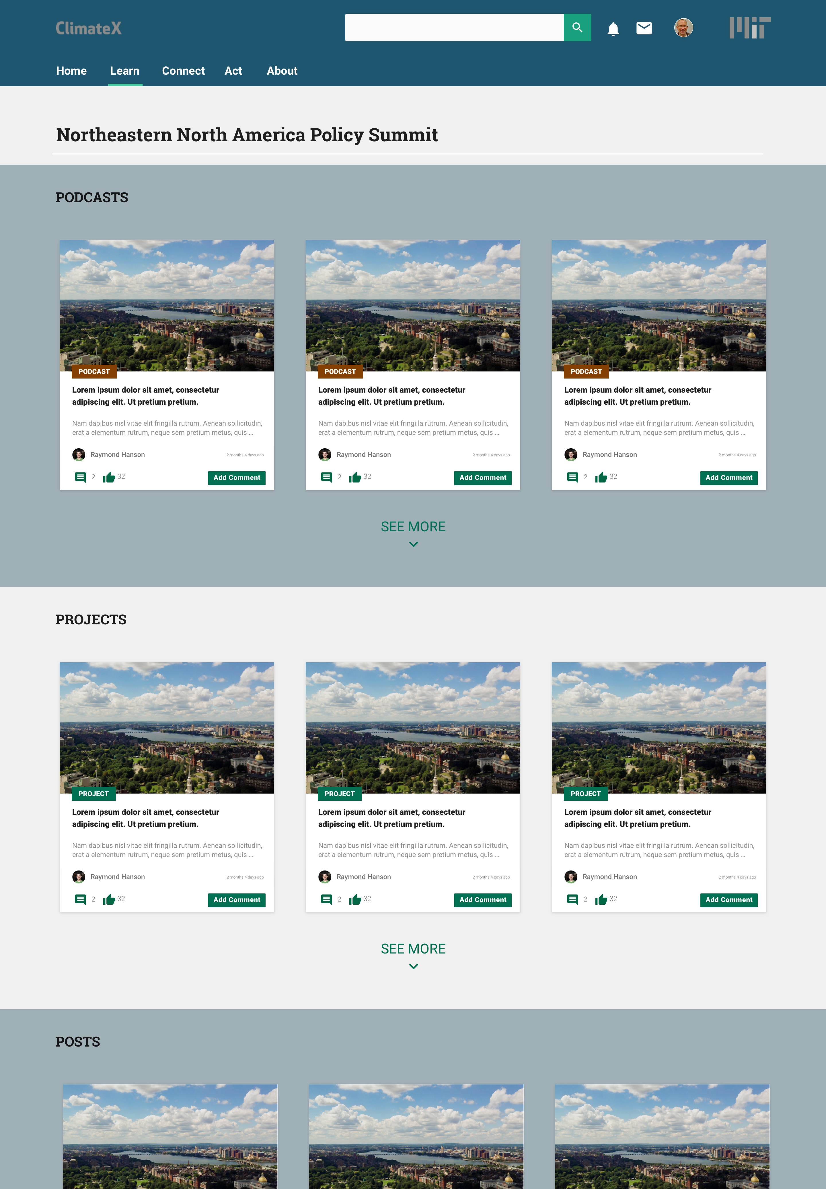
Questions:
1. Page Title
2. Additional Copy in opening section?
3. Sections will contain a mix of objects? Podcasts and posts? How many?
An Introduction to Civic Design Principles
1. The Margins
2. Equity
3. In Person and Online

Slide 4
Questions:
Phases AND Principles as filters?
How will Phases get surfaced?

Slide 5
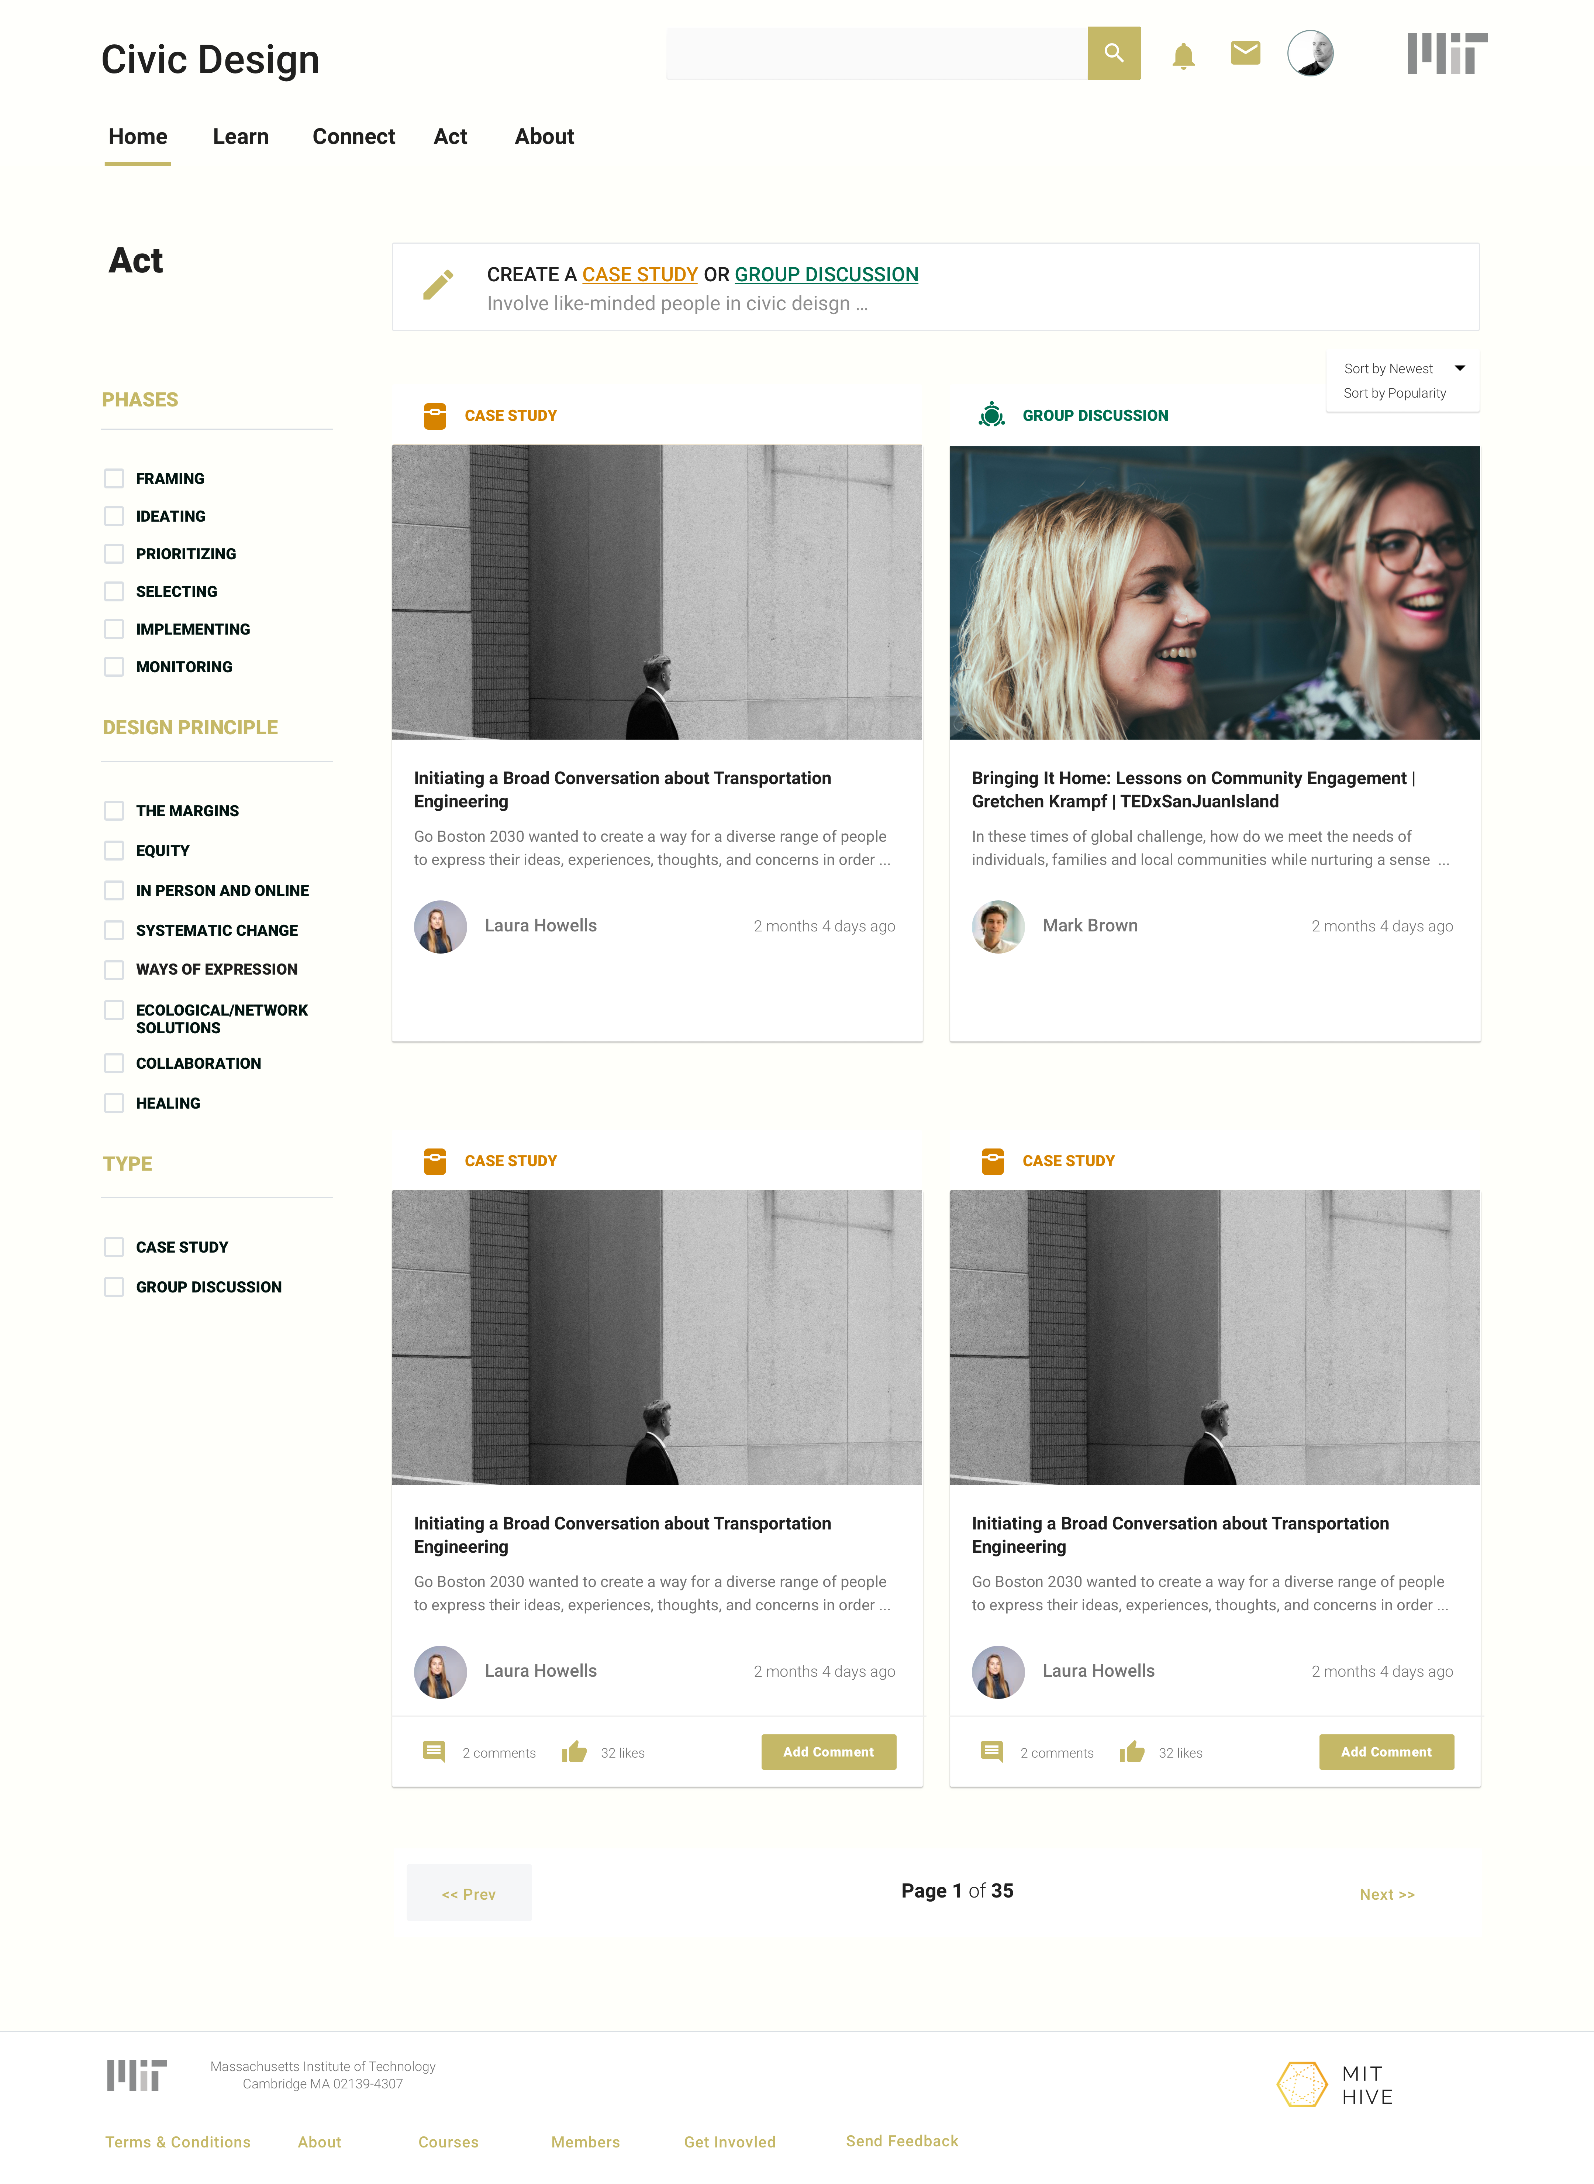

Questions:
Further discussion on how these will be used?
2. Usability conclusions coming soon.

