Slide 1
Nuclear Disarmament Verification via Resonant Phenomena
(and other adventures in nuclear security)
Areg Danagoulian

Slide 2
Outline
What’s the big problem? (Nuclear Arms Reduction Treaties)
Why template verification and how does it work?
What is Nuclear Resonance Fluorescence (NRF)?
  → NRF based verification
Epithermal neutron physics
  → epithermal neutron verification

Slide 3
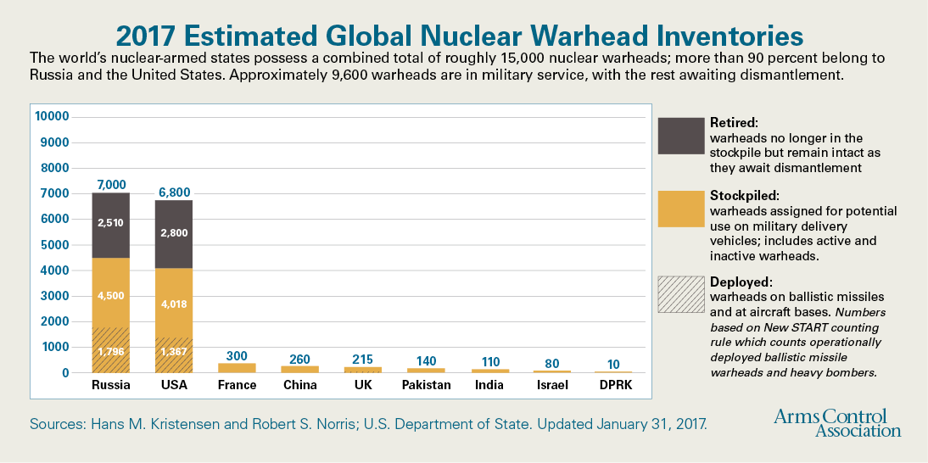
Nuclear Arsenals
Significant Reduction since the Cold War
,, Доверяй, но проверяй! ’’ Но как? How? Ինչպե՞ս:

Slide 4
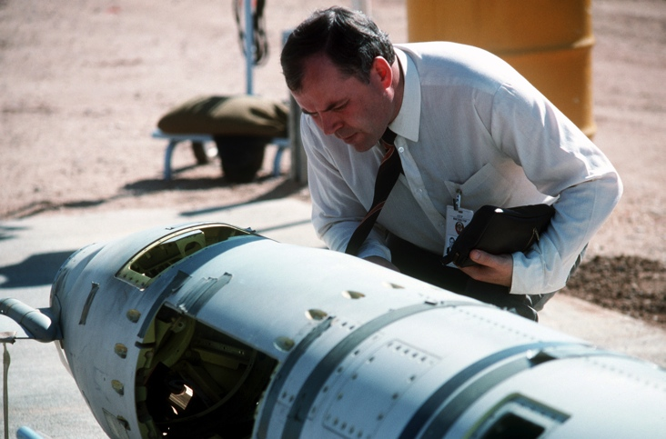
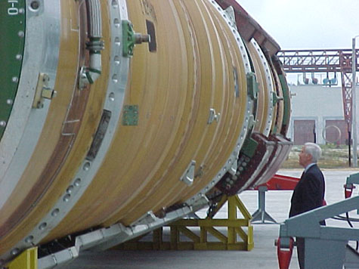
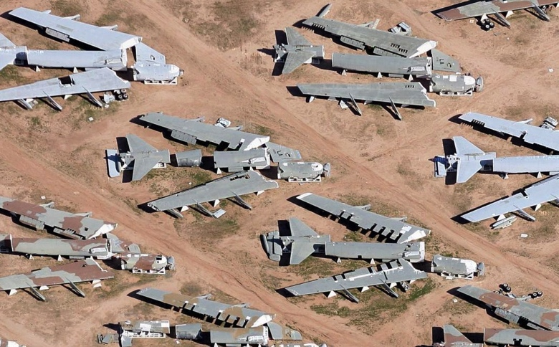
VERIFICATION
How do treaty partners verify that the other side is dismantling actual warheads and not fakes? They don’t.
Verification: delivery vehicles – easier to verify.
Problems: large leftover of non-deployed warheads
  theft → nuclear terrorism, nuclear proliferation
→ Authenticate warheads, without revealing secret information

Slide 5
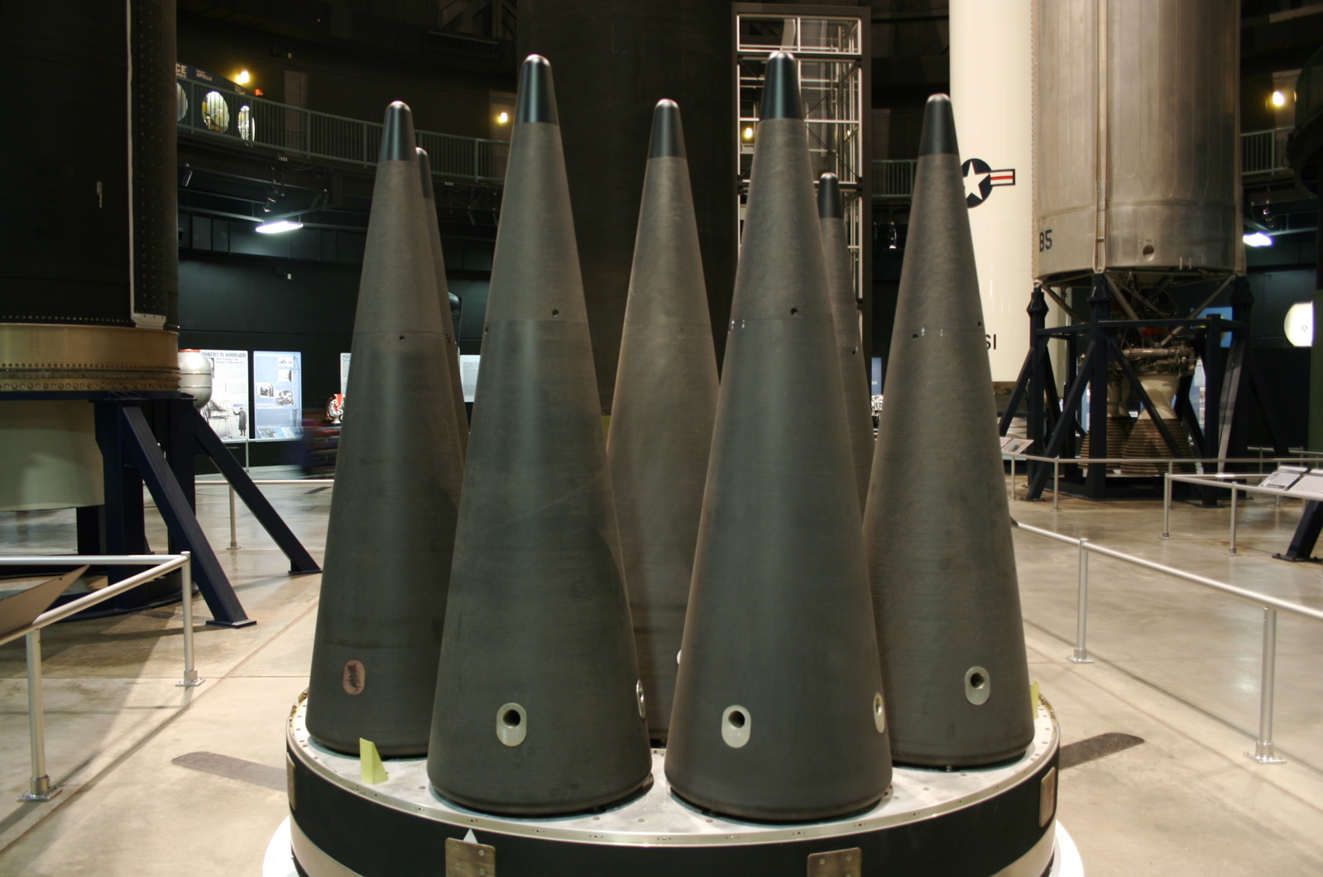

Slide 6
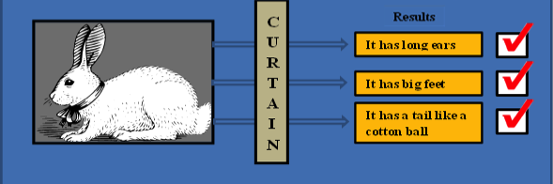
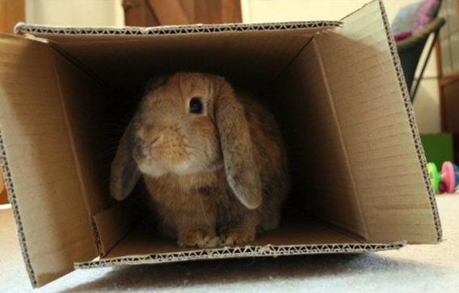
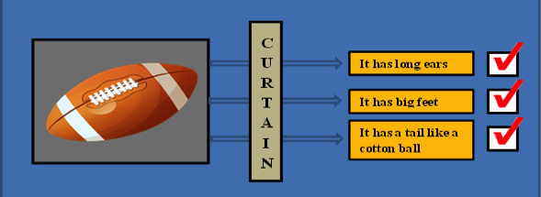
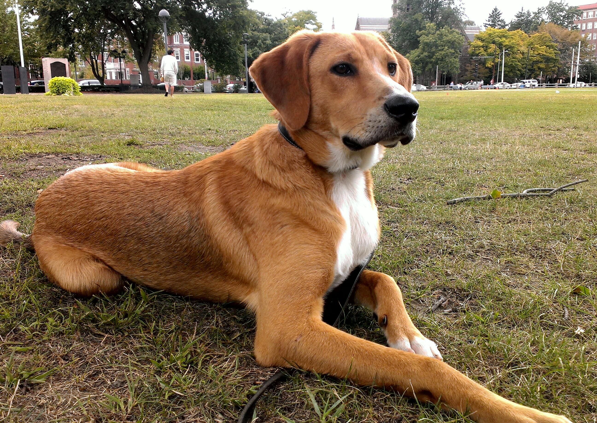
Previous Research:
information barriers, attribute verification
Developed at US national labs and AWE (UK)
Electronic Information Barrier – perform measurements, light up red/green lights. No direct access to classified data.
Verify the attributes of a weapon:
  is there plutonium inside? ✔
  High-Explosives present? ✔
  etc. ✔
→ risk of diversions/spoofing
Has long ears?
Has big feet?
Has furry tail?
Has long ears?
Has big feet?
Has furry tail?
The info. barriers are in electronics/software → backdoors, hacks, software exploits
→ risk of information leakage

Slide 7
Our Research:
physics-based cryptography, template verification
Authenticated template
“golden copy” of W88
Picked from a randomly
selected ICBM
Candidate
copies, W88
Is A₀ = A₁ ?
A₀ = A₂ ?
A₀ = A₃ ?
Challenge: perform
checks while
protecting secrets
isotopicaly sensitive
need a physical cryptography
need resonances!
A₁
. . .
A₂
A₀
A₃
. . .
To dismantlement

Slide 8
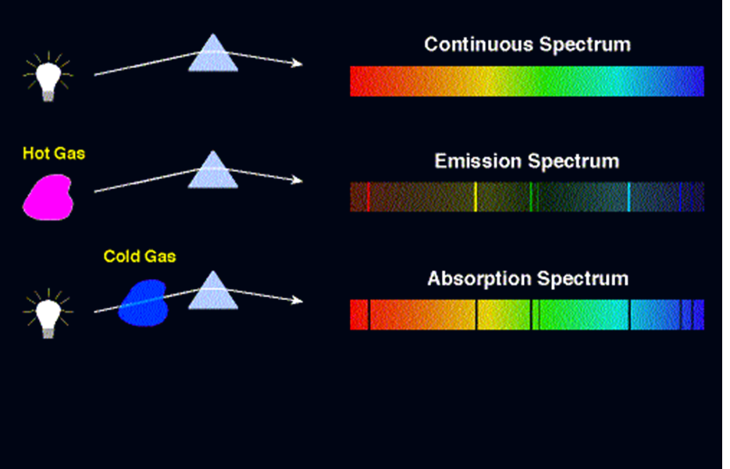
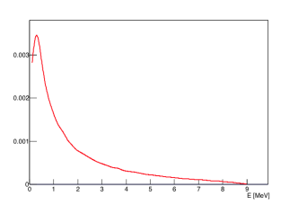
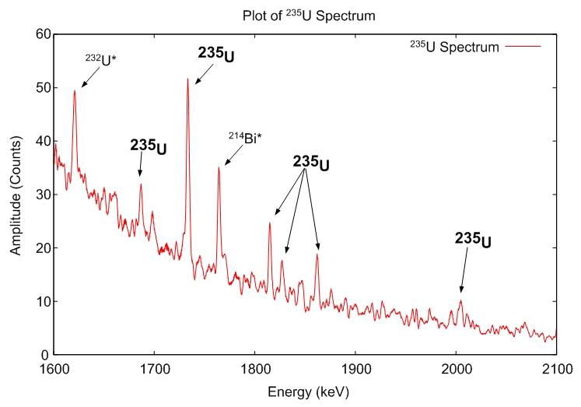
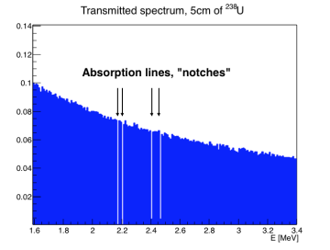
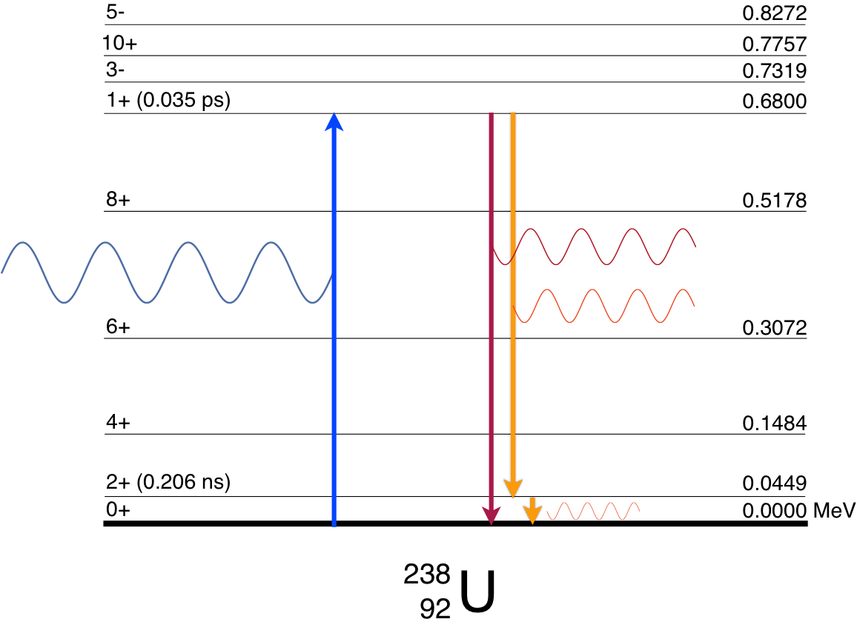
Analogy: NRF to Optical Spectroscopy
Optical Spectroscopy
Nuclear Spectroscopy
Bremsstrahlung
Back-scattered NRF
Transmitted NRF
Absorption lines, ~eV
(W. Bertozzi)
NRF: unique fingerprint of isotopics

Slide 9

Broad-spectrum source → NRF
U-235 NRF spectrum
1815 keV
1769 keV
1733 keV
detector
46 keV
0
U-235
unique line spectra for U-235, U-238, Pu-239, Pu-240…
Γ ~ meV → thermal motion → eV

Slide 10
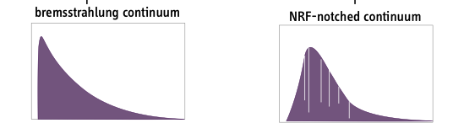
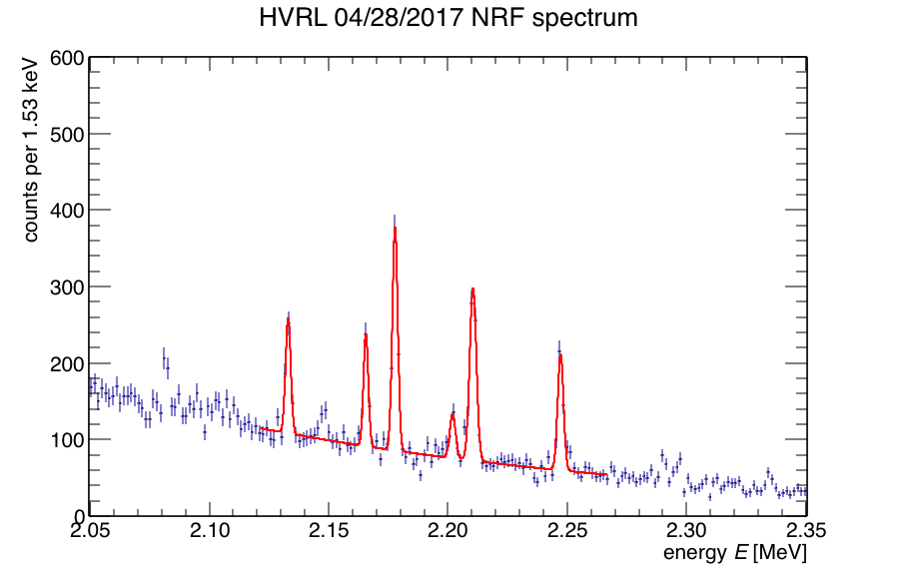
NRF Weapon authentication Concept
NRF filtered brem
Cryptographic Foil
Bremsstrahlung
(X-ray)
Everything classified by the host
Everything open
Shielding
Hosts:
provide the candidate warheads (to be authenticated)
Foil – thickness unknown to the inspectors, but of agreed upon isotopes
Inspectors:
Detector, electronics (to be verified by hosts)
Visual access to the foil
Joint:
Template (“golden copy”)
HPGe

Slide 11
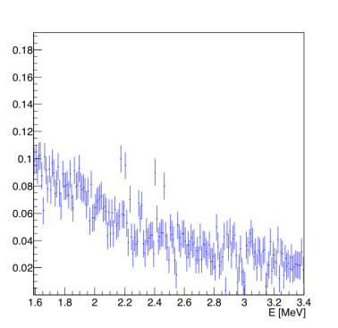
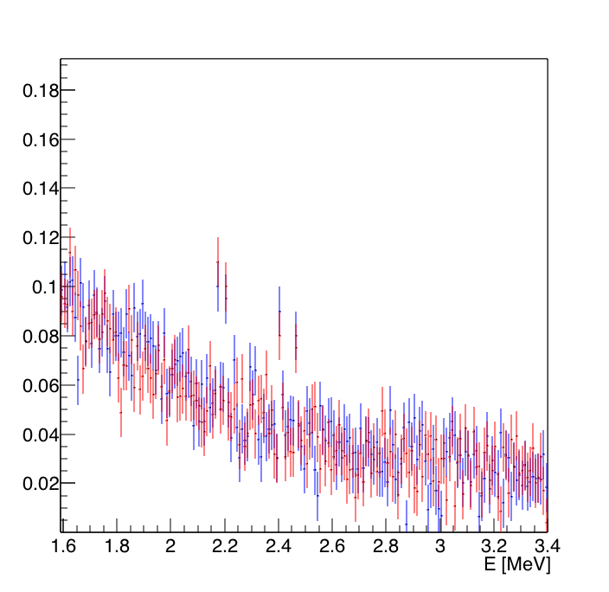

NRF Weapon authentication Concept
Weapon B: candidate
Weapon A: authenticated template
NRF filtered brem
Cryptographic Foil
Bremsstrahlung
(X-ray)
Everything classified by the host
Everything open
Shielding
A
B
Physical Cryptography:
  No direct data from the weapon itself
  SIGNAL =
  Impossible to extract (Weapon)
Soundness and completeness:
  Authenticated template A -- acquire S_{NRF}(A)
  Candidate weapon B -- acquire S_{NRF}(B) and compare
HPGe
Notes:
Mention that Brian Quitter and

Slide 12
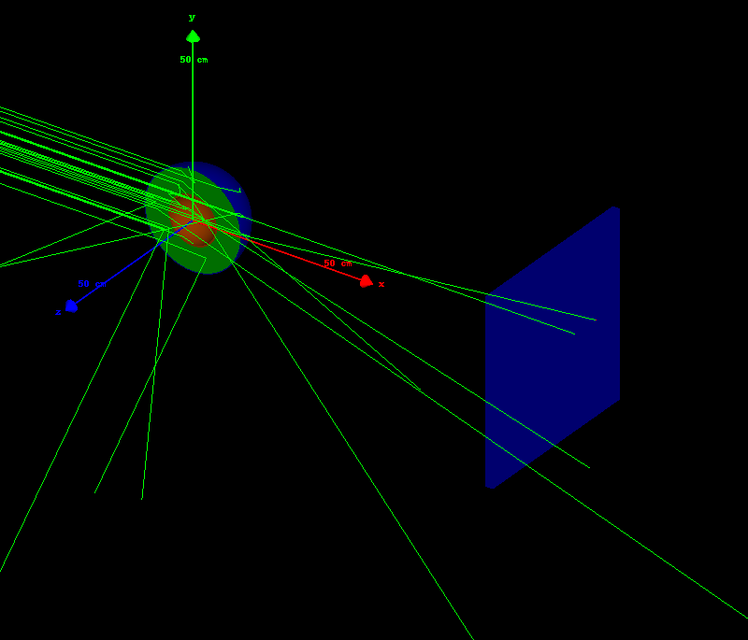
Simulated 2.1 or 2.5 MeV bremsstrahlung beam
> 1000 core hours for sufficient NRF statistics

Slide 13
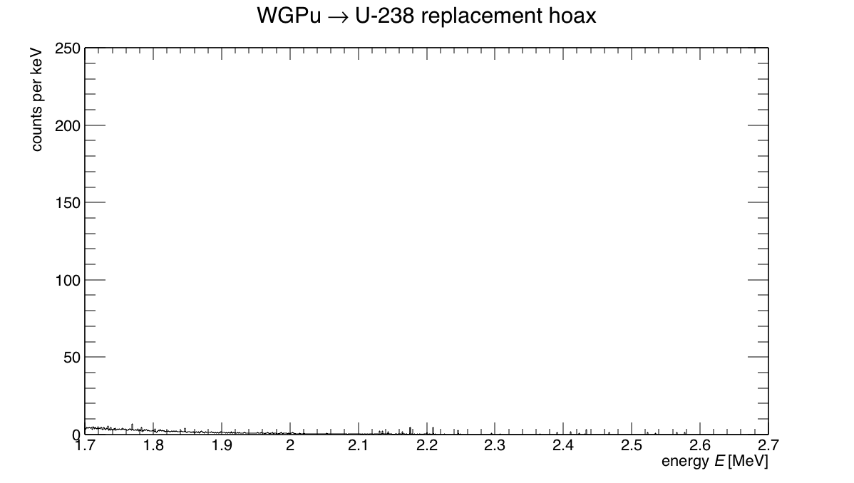
Genuine template
U-238 hoax
(J. Vavrek)

Slide 14
Canonical hoax scenarios
Hoax scenario | Strongest discrepancy (σ)
WGPu → U-238 | 107
WGPu → FGPu | 14.6
R.S. Kemp, A. Danagoulian, R. Macdonald, J.Vavrek, Physical cryptographic verification of nuclear warheads, PNAS 113 (2016) 31.
Notes:
We are sensitive to isotopics enough that we can easily detect slight changes from WGPu to RGPu. Sigma standard deviation
We pick the direction randomly

Slide 15
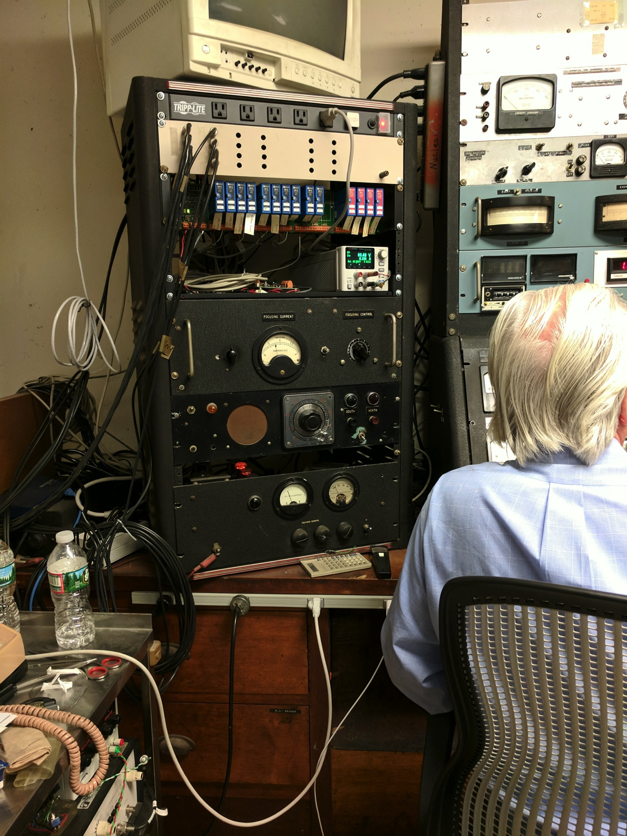
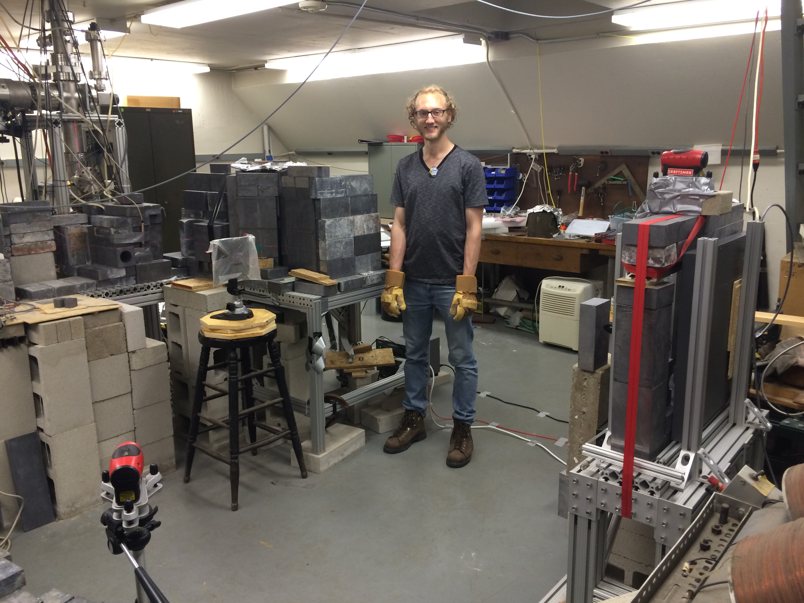
NRF experimental setup
Van de Graaff Accelerator
2.5 MeV e-, DC beam
20 μA
⁻e, 2.5MeV
Cu radiator
HPGE
γ detector
DU target
photon beam axis
x-ray
imager
Vacuum Tubes!!!

Slide 16
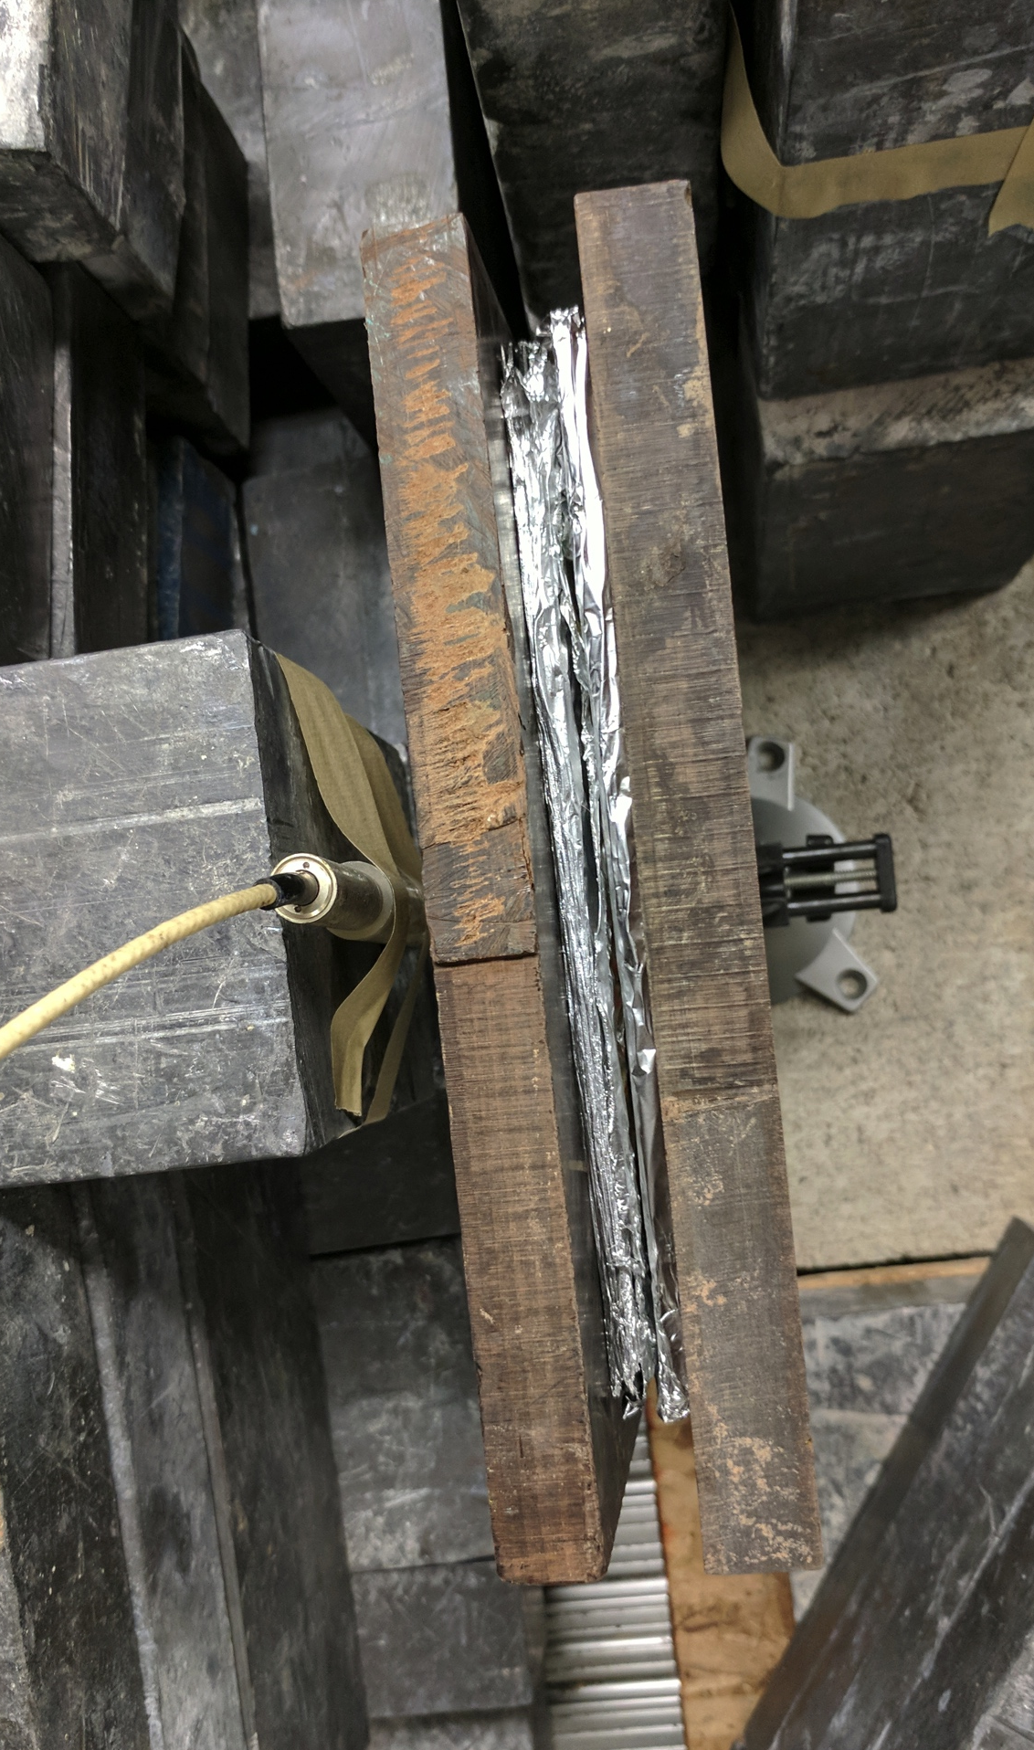
Proxy Warhead
3mm of ²³⁸U
0.5mm of ²⁷Al
1.5” of plastic
“MIT Linear Implosion Design”

Slide 17
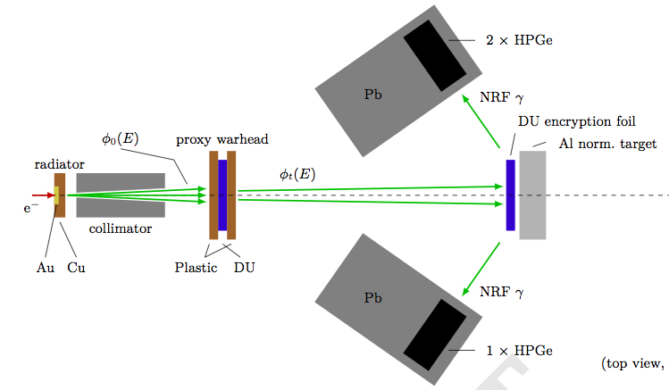
Experimental setup

Slide 18
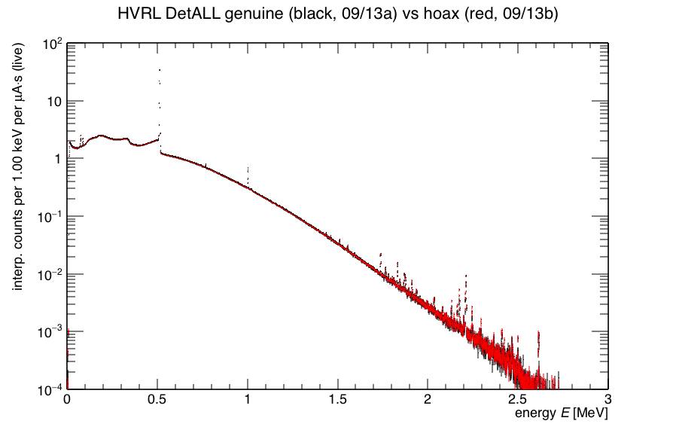
Hoax to Genuine comparisons
Uranium
Al
Target:
-- Lead Hoax
-- genuine
Plastic “explosive”
“Perfect Hoax”

Slide 19
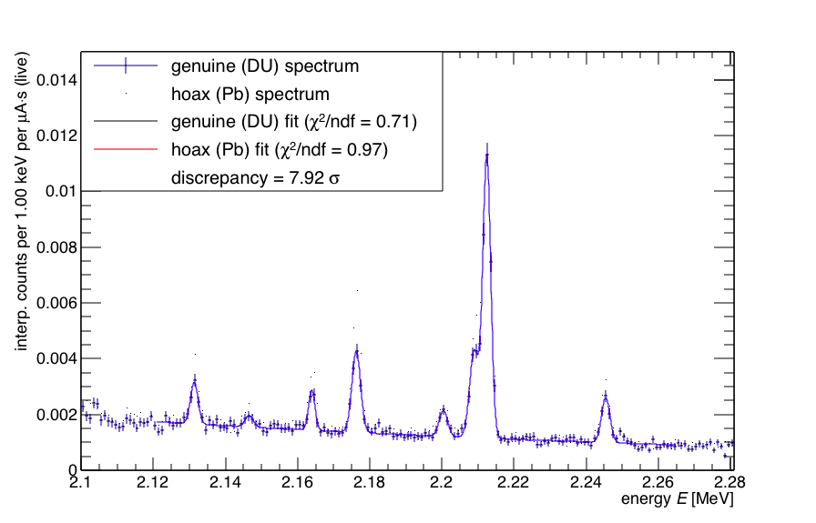
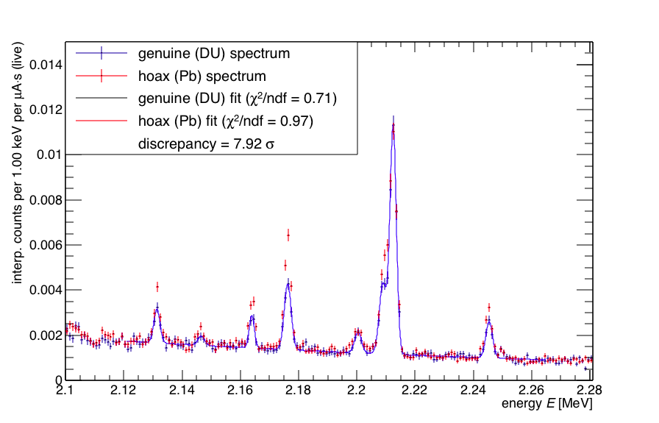
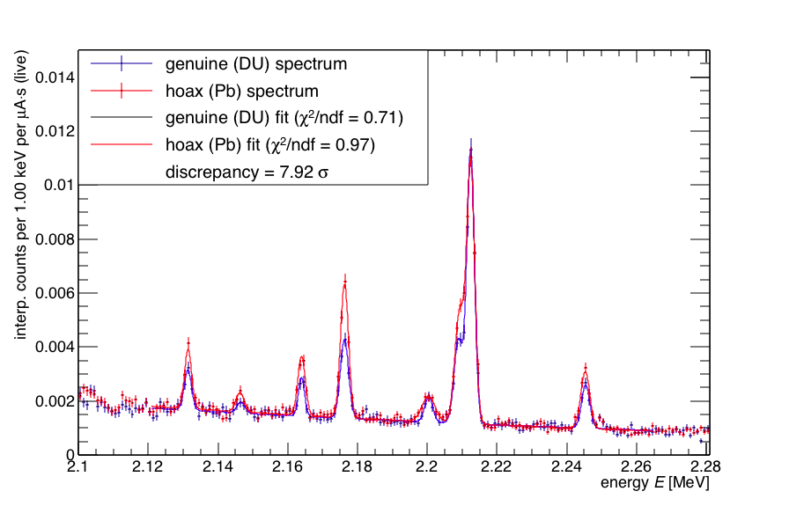
Hoax to Genuine comparisons
3mm Uranium
Pb
Al
(J. Vavrek)
Target:
²⁷Al
Plastic “explosive”
²³⁸U
8σ discrepancy in U lines
identical counts in Al

Slide 20
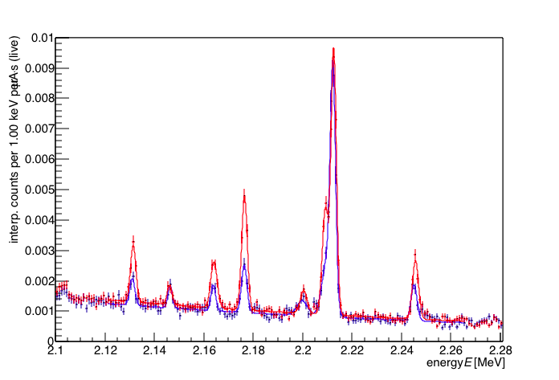
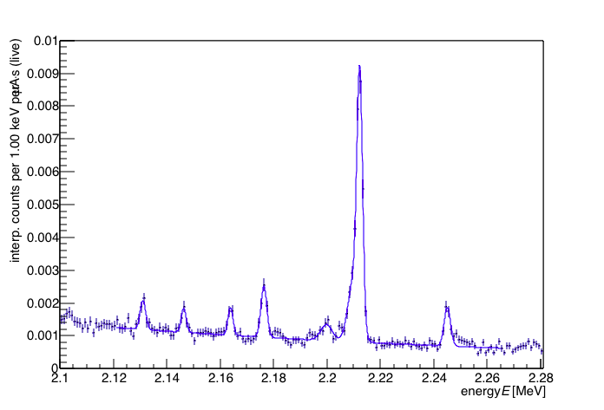
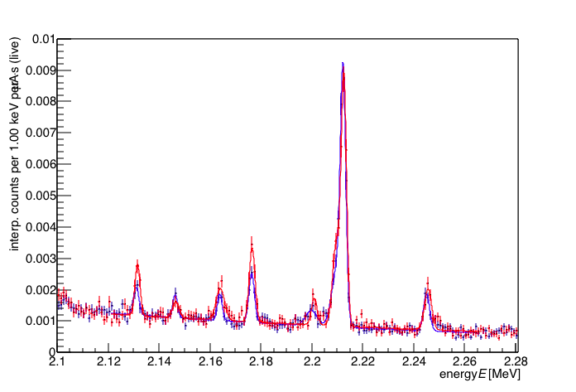
Hoax to Genuine comparisons
6mm Uranium
Pb
Al
²⁷Al
Target:
Half hoax discrepancy: 5σ
Full hoax discrepancy: 11σ
Plastic “explosive”
²³⁸U
11σ discrepancy in U lines
identical counts in Al

Slide 21
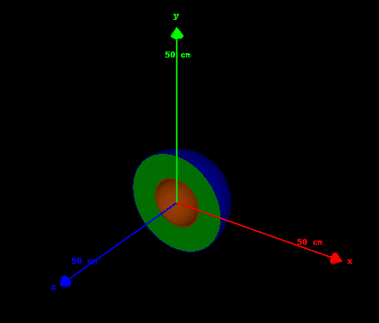
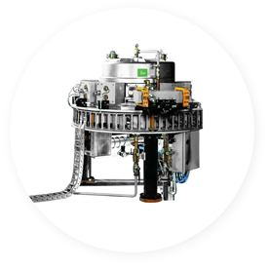
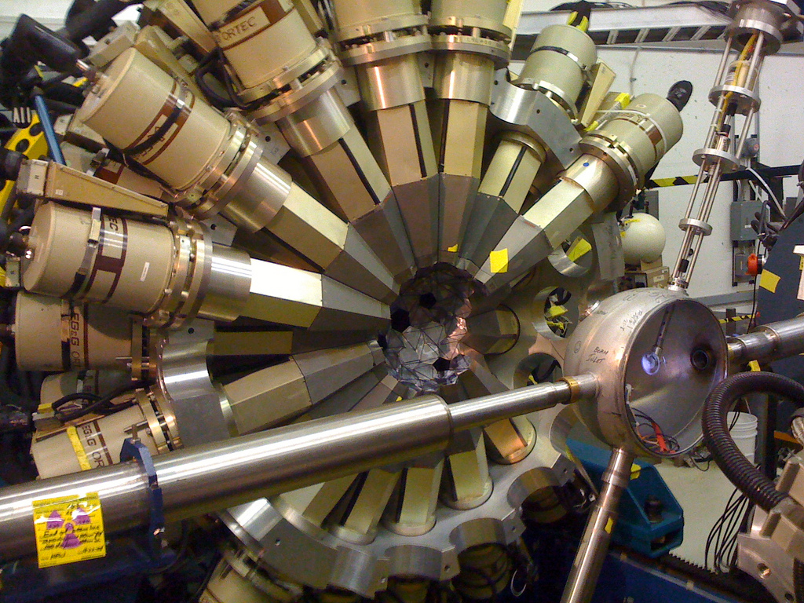
Extrapolations: the real bomb
5-10 σ in a (1+1)-hour proof-of-concept
“Black Sea” model:
6X rate decrease
25 uA → 2.5 mA beam current:
100x rate increase
3 → 30 HPGe detectors:
10x rate increase
Black Sea Model
measurement times of ~minutes
2m
IBA TT100 Rhodotron
GammaSphere
J. R. Vavrek, B. S. Henderson, A. Danagoulian, “Experimental demonstration of an isotope-sensitive warhead verification technique using nuclear resonance fluorescence,” PNAS (2018), 201721278; DOI: 10.1073/pnas.1721278115

Slide 22
Furthermore: validation of NRF models and cross sections
Multiple additional diagnostics from verification measurements:
  Accelerator current readout
  Downbeam bremsstrahlung flux monitor (LaBr₃)
  Systematics across different:
    Detectors
    Energies
    Proxy warheads
Can use verification data to make absolute NRF cross section measurements!

Slide 23
Results
Ratios of absolute NRF count rates, model over data:
NRF line | Avg model/obs ratio
U-238 2.176 MeV | 1.20 ± 0.02
U-238 2.245 MeV | 1.14 ± 0.03
Al-27 2.212 MeV | 1.06 ± 0.02
Model # | Avg model/obs ratio
Model 0 | 1.13 ± 0.01
Model 1 | 1.10 ± 0.01
Model 2 | 1.10 ± 0.01
Model 3 | 1.12 ± 0.01
More Geant4-reliant
Modest added benefit
Average: 1.11 ± 0.01 (stat)
>10% variation in literature values for NRF cross sections
Systematic uncertainty analysis ongoing
Model inversion to extract cross sections ongoing

Slide 24
Verification with Epithermal Resonant Assay
(VERA)

Slide 25
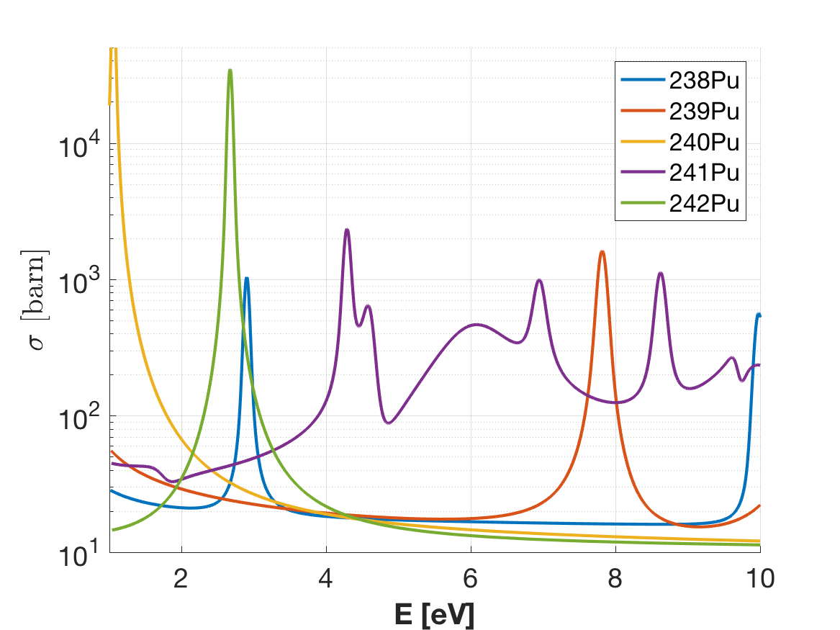

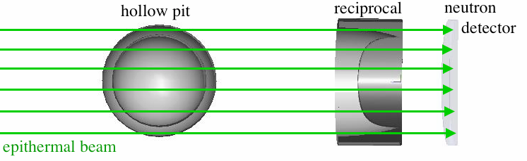
Epithermal Resonant Cryptographic Radiography
Epithermal neutron resonances in the 1-10 eV
Transmitted spectrum = isotopics geometry.
cryptographic reciprocal mask
cryptographic
(TOF)
~ flat image: no geom. information
spectrum reveals nothing about the pit

Slide 26
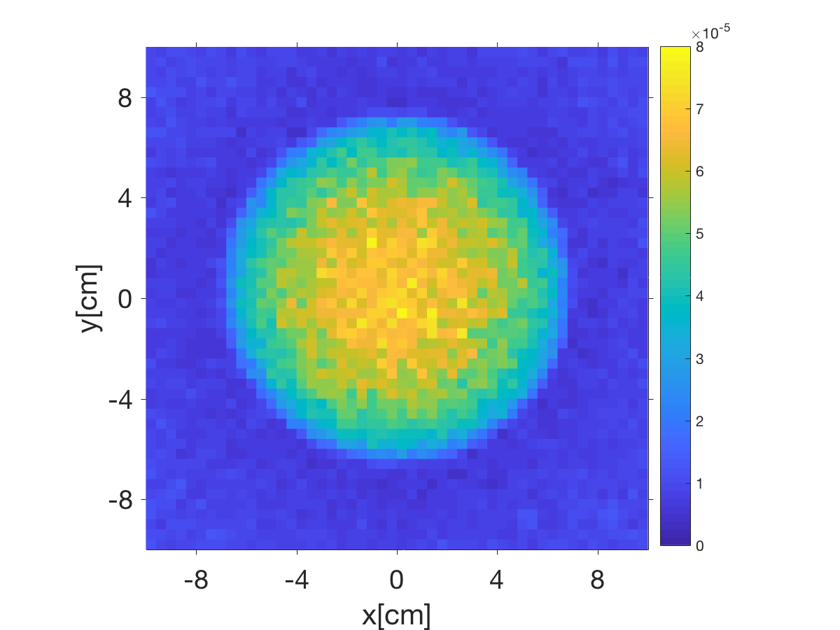
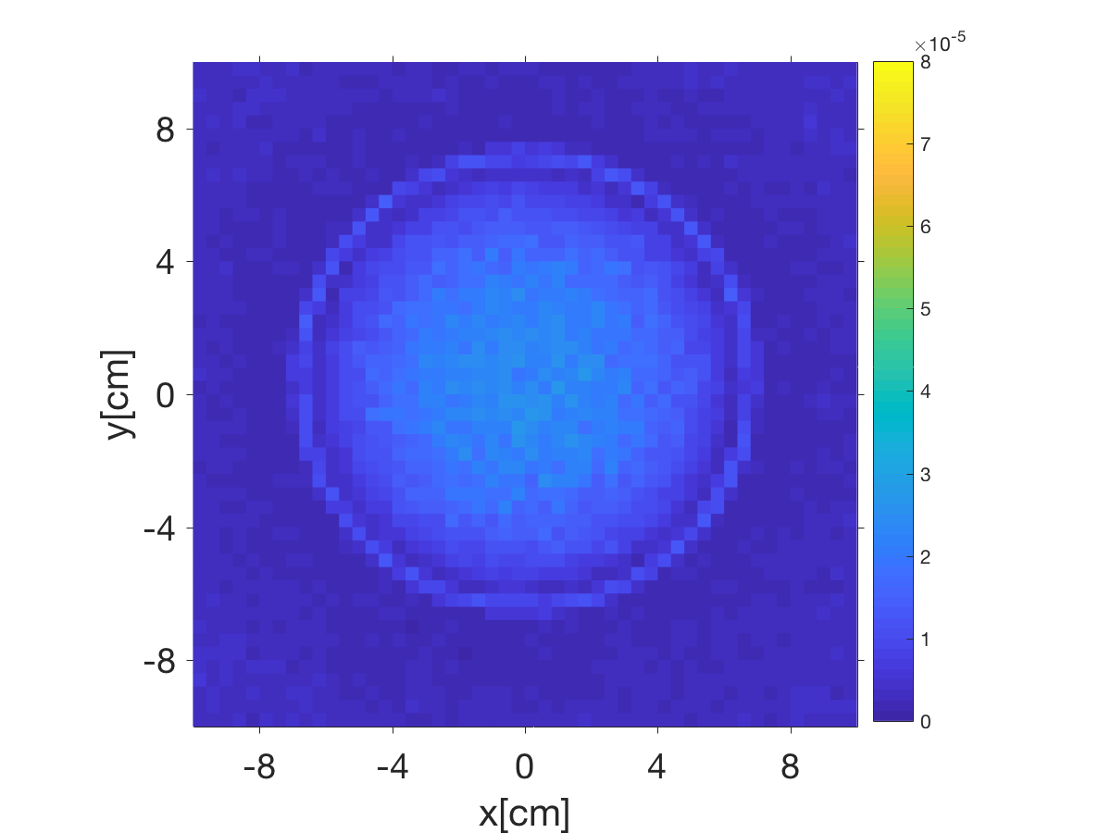
Simulations: Geometric hoax resistance
template
hoax
(J. Hecla)

Slide 27
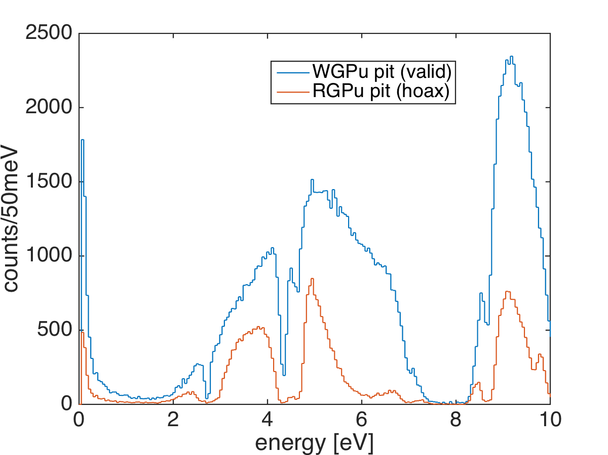
Simulations: WGPu pit vs. a RGPu hoax
+ Different isotopics result in
different transmission
spectra
+ Only ~100k incident counts necessary for a 5σ detection

Slide 28
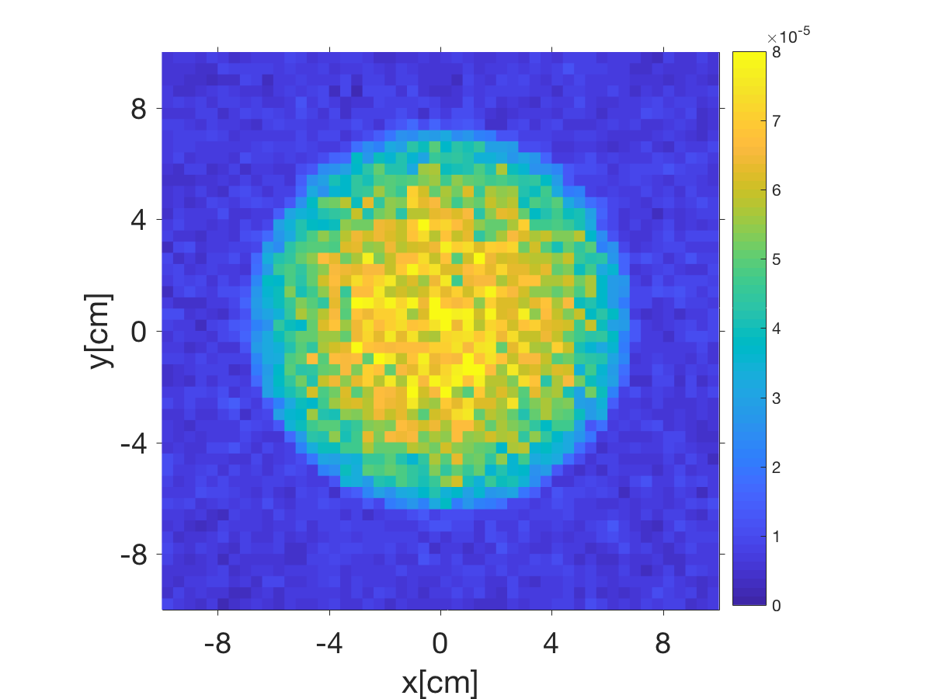
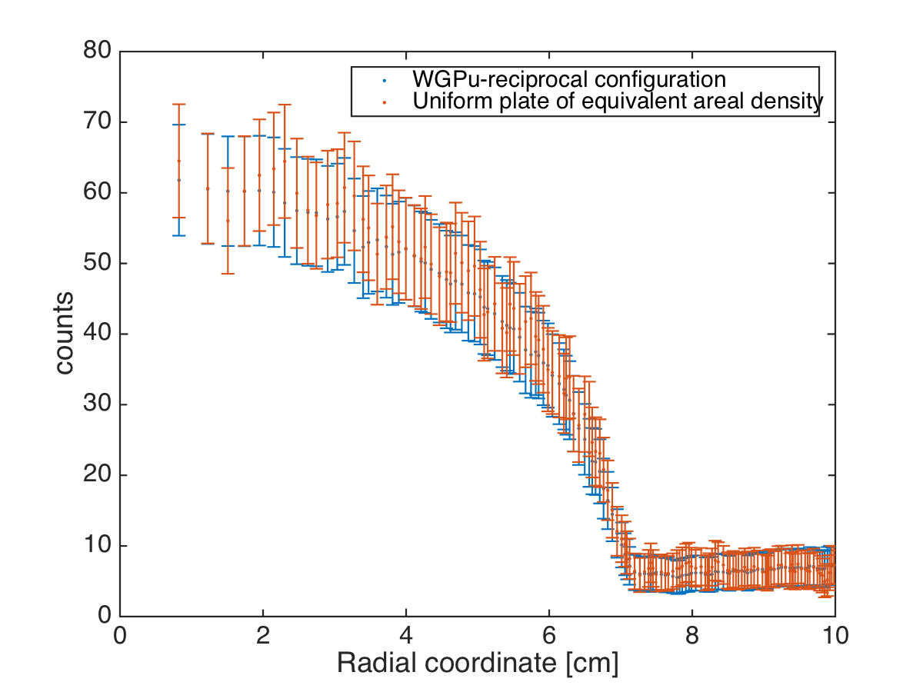
Geometric Information Security
+ Compare the transmission image of the pit+reciprocal to that of a flat plate of the
same total thickness
+ Images and spectra are identical – can’t differentiate, thus cannot infer any geometric
information → geometric Zero Knowledge!
pit+reciprocal plate radial comparison

Slide 29
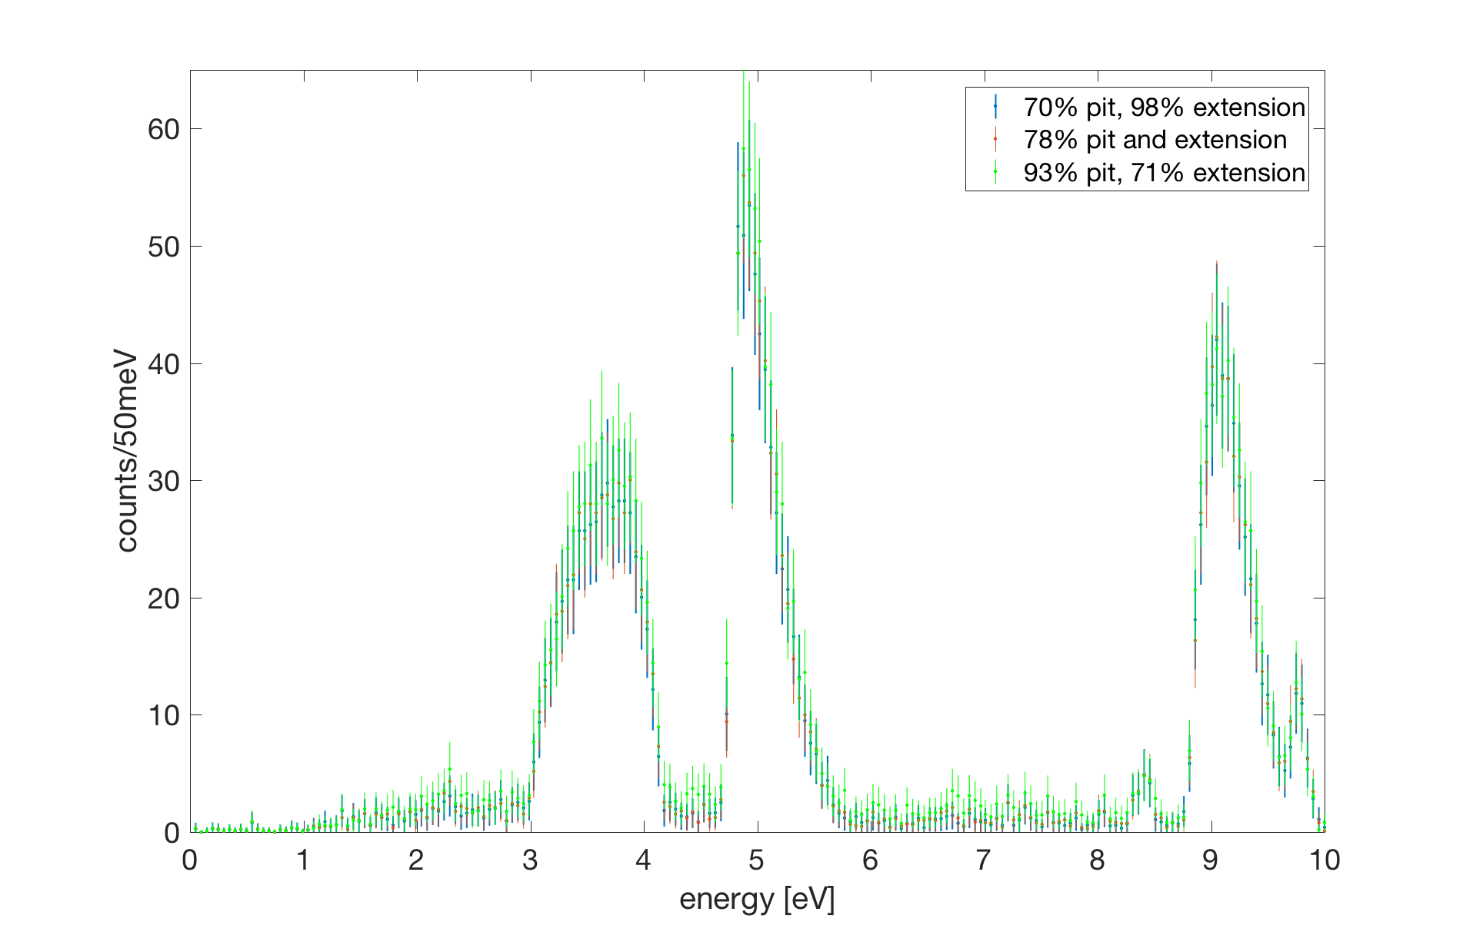
Isotopic Information Security
+ Protect the isotopics of the pit.
+ isotopics(pit+reciprocal) ≠ isotopics (pit)
+ MC simulations of three scenarios:
- 70% 239Pu enriched pit, 98% enriched extension
- 78% enriched pit and extension
- 93% pit, 71% extension
- the transmitted spectra are identical
→ isotopic Zero Knowledge
Jake’s MIT undergrad thesis
Jake J. Hecla, Areg Danagoulian, “Nuclear Disarmament Verification via Resonant
Phenomena,” Nature Communications 9, 2041-1723 (2018)

Slide 30
The Future
Perform epithermal experiments at LANL to prove the concept
Collaborate
  national labs
  other countries
  Russia
Need technological solutions for treaty verification → more ambitious, far reaching treaties

Slide 31
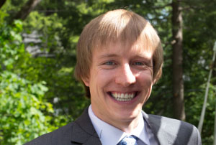
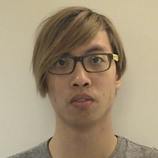


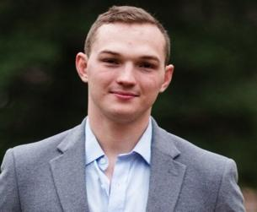

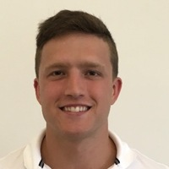

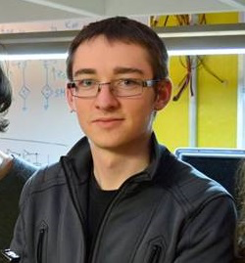
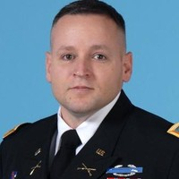
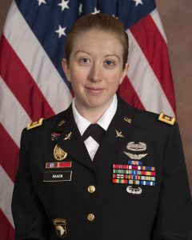
The Team
Postdoc:
Dr. Brian Henderson
Students:
PhD
S.M.
Undergraduate
Jimmy Jayson Julie Bobby Jeremiah Ezra Ben
Alumni:
Jake Hecla Dr. COL Buck O’Day Jill Rahon

Slide 32
BACKUP

Slide 33
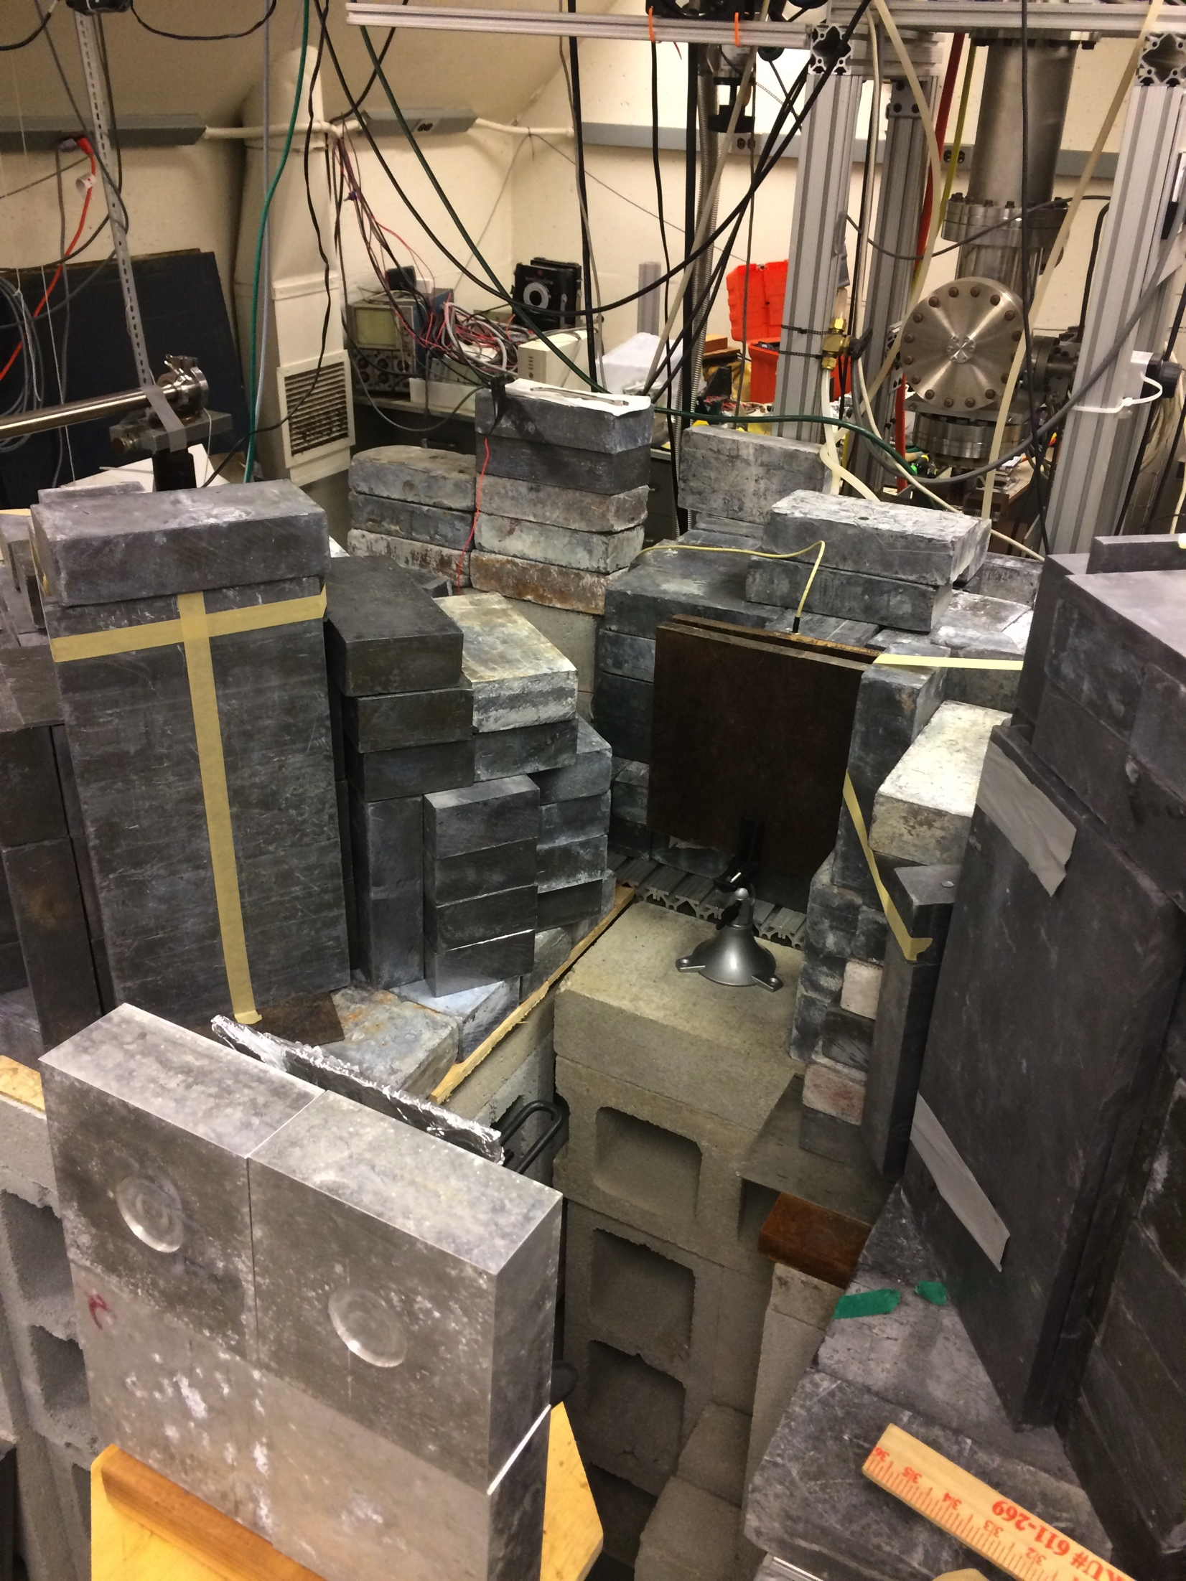
Experimental setup
~2.6 MeV e⁻
Radiator
(Cu + Au)
HPGe
Warhead proxy
Brems
Genuine: DU + plastic
Hoax: Pb + plastic
NRF
Encrypting foil
(DU + Al)
LYSO, LaBr downbeam

