Slide 1
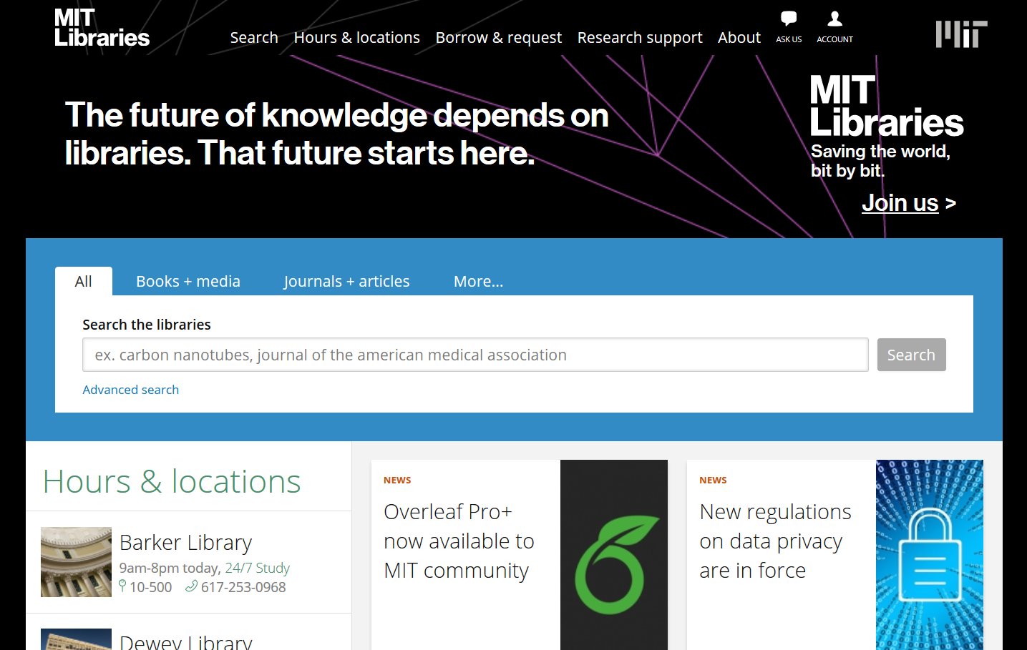
Welcome!

Slide 2
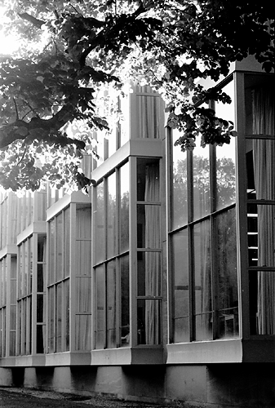
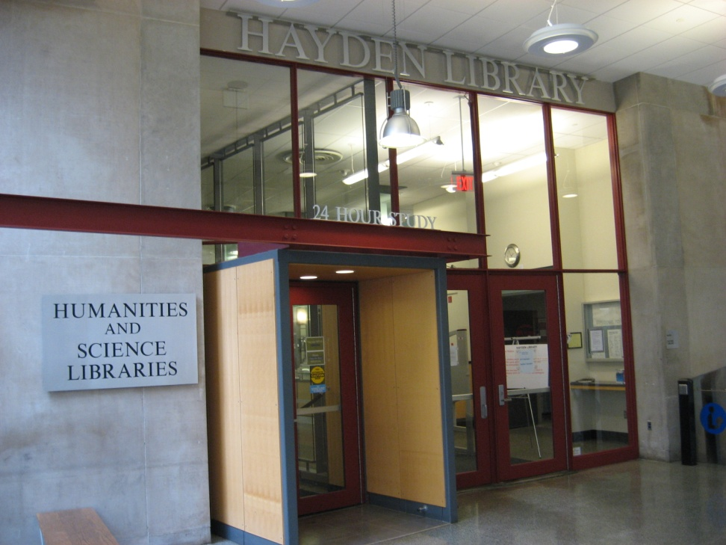
Most NSE related material is in Hayden Library (Building 14, basement) BUT…

Slide 3
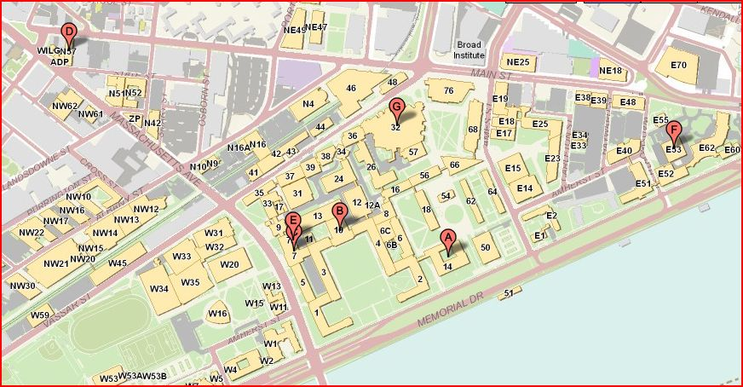
MIT has four other Libraries…
Dewey Library Social Sciences, policy, political science (E53)
Hayden Library
Humanities, Science, NSE Course Reserves (14)
Barker Engineering Library (10-500)
Rotch Library (7)
Music Library also in Building 14

Slide 4
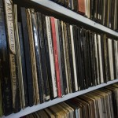
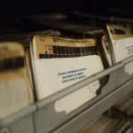
…and an Annex
The home for
MANY
historical technical reports back to the 1940s
(not listed in the Barton catalog)

Slide 5
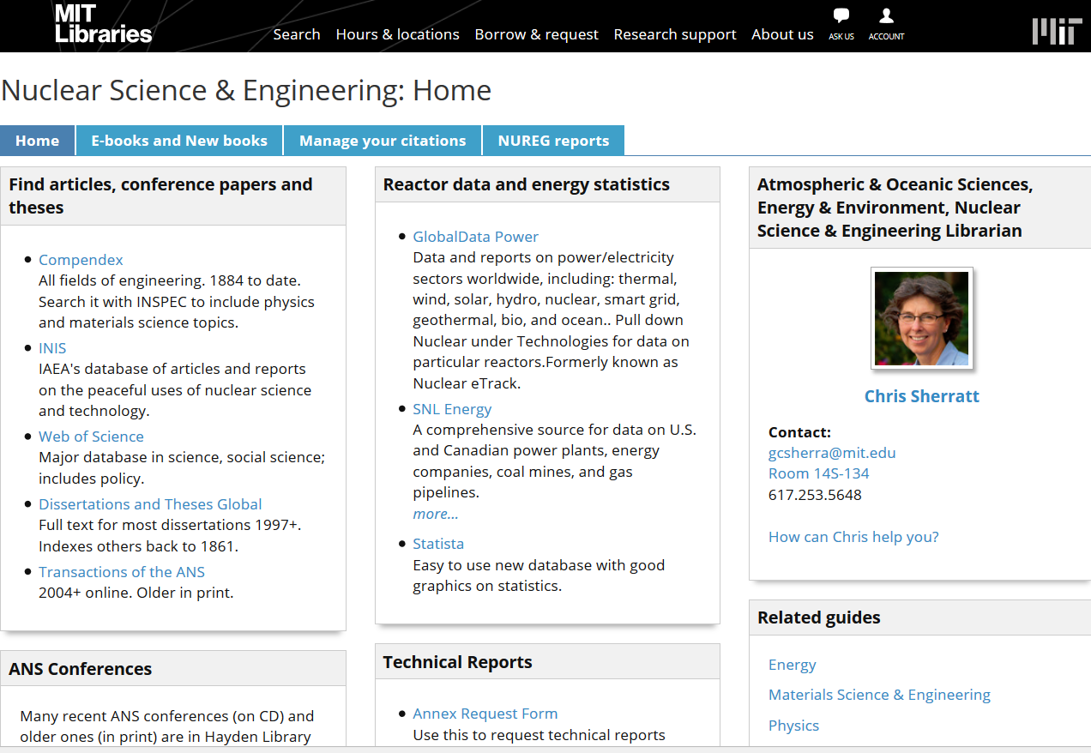
Libraries> Research Guides> Nuclear Engineering
D
A
T
A
B
A
S
E
S
TIPS

Slide 6
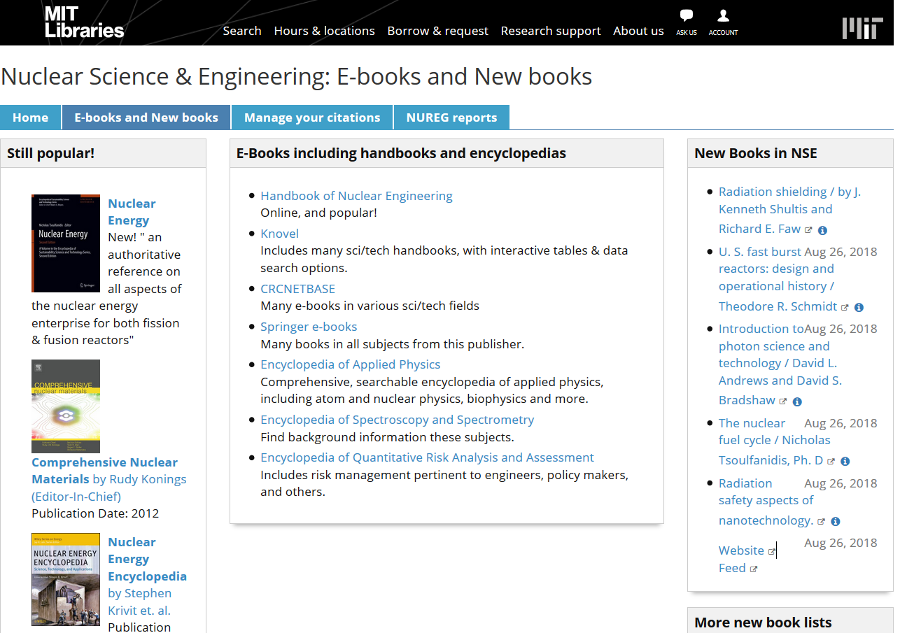
Hundreds of books are online
Keep up with what we buy

Slide 7
All ANS and other key journals are online
IEEE, ACS, APS, AIP to name a few
You should be able to connect from any location with certificates
Look for this button:
Always ask if you can’t get to full text

Slide 8

Libraries offer many services
Reference: Appointments, chat, Ask Us!
More Research Guides
Interlibrary Borrowing
Reserveable study rooms, 24/7 spaces
Classes on managing PDFs and citations
Data management, file organization tips
Publishing support and open access
Monthly canine visits

Slide 9

In short, I look forward to working with you!
Chris Sherratt
NSE Librarian
gcsherra@mit.edu
Hayden Library, Room 14S-134
617.253.5648

