Slide 1

Department Business
So, Pete, What is it you do?

Slide 2

Get Sh!t Done
My job is to administer the heck of things until they are not a problem anymore.
(your job is to bug me until its fixed)

Slide 3





Business!
Money
Travel
Buying things
Offices and other space
Fixing things
Safety
Everything else

Slide 4
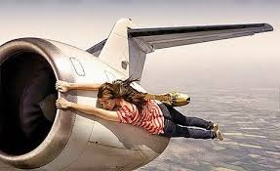
Travel
Travel card program and Concur
  Concur.mit.edu
  Full FAQ
Travel grant program
  Email nsetravelgrants@mit.edu
  Typically 50% of a domestic trip 1x/academic year.
  Presenting Results!
“Pete said we have to save money on our travel budget.”

Slide 5
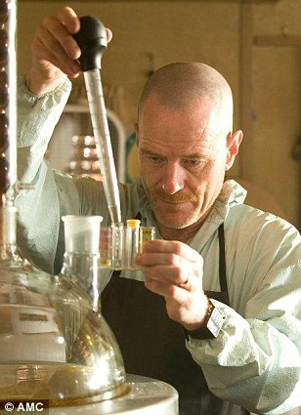
Buying Things
One offs, Office Supplies
  See your Advisor’s assistant
Printer supplies, paper, toner, computer parts
  See Rachel Morton
Lab supplies, projects
  Pcard, Authorization to spend, eCAT
TAs –Ask Pete
Invoices, Packing Slips, Documentation

Slide 6
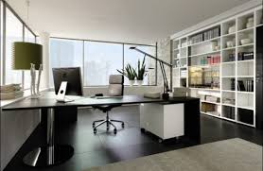
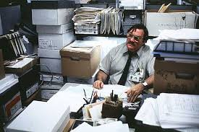
Your Office
What I think I’m giving them…
Reasonable to expect;
  Working heat/AC/wired ethernet/power/lights
  Good chair, desk, adaptive needs, door locks
  At least 60 s.f. of your own space AND/OR a fair share
  Trash removal, cleaning, security, safe working conditions
Not Reasonable to expect
  A couch
  A private office
  Lack of mice
  Pete reading your mind when something is broken
  Please try to keep your office clean
  PSFC, RLE, CMSE Spaces
What they think it looks like…

Slide 7
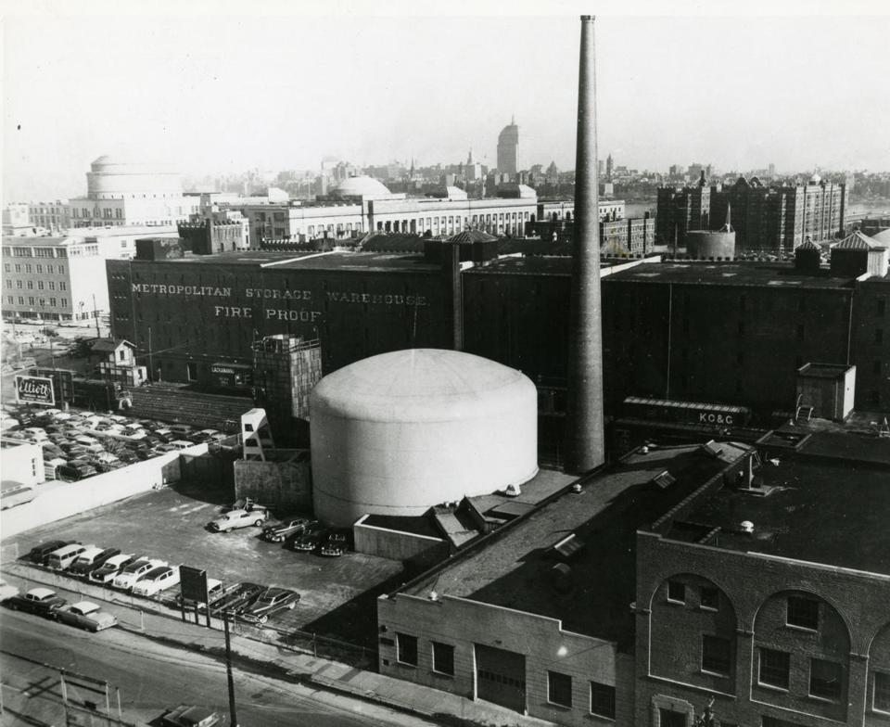
MIT Reactor Security
All buildings are connected
Don’t let people in
Be rude if you must
The NRC has NO Sense of humor!

Slide 8
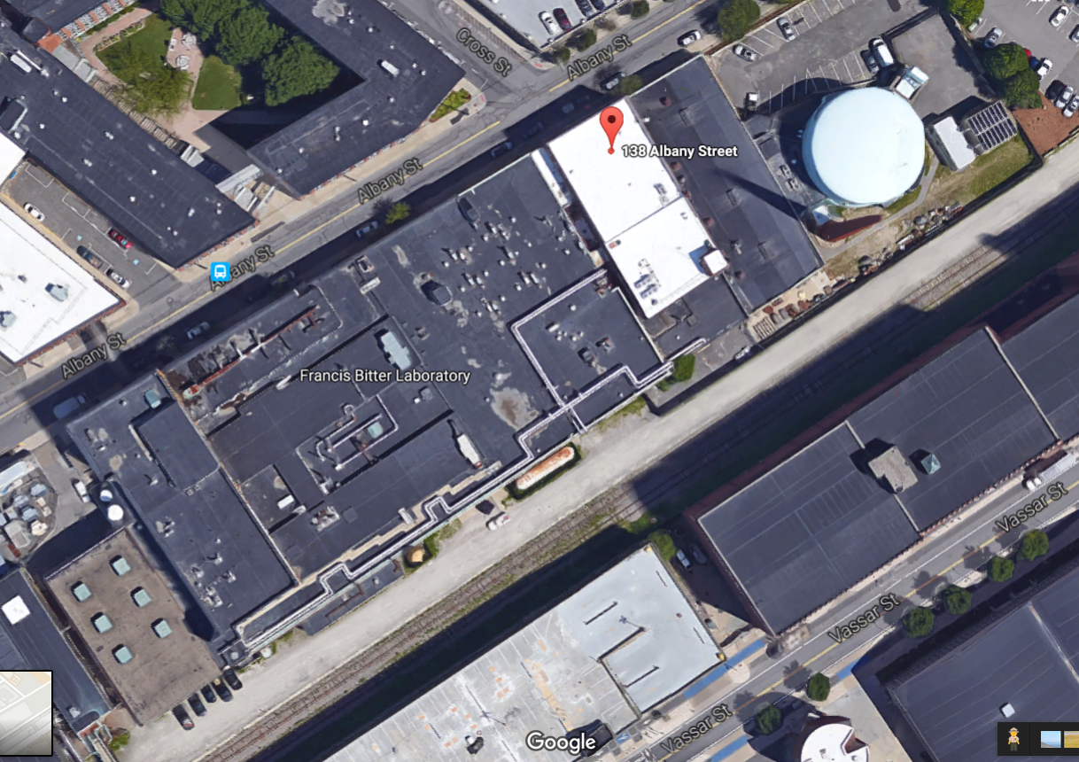

Slide 9

Safety
Every lab worker requires training before you are allowed to use the lab. Your research supervisor (or their lab representative) will initiate this.
Special topics;
NW12 radiation alarm
Fire Alarms
Hazards, issues, problems
Albany Street ‘customers’

Slide 10
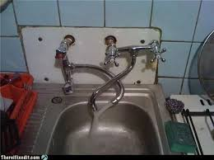
Fixing Broken things and Cleaning Messes
Report Problems!
  Email: dof-csc@mit.edu
  http://Atlas.mit.edu fill out service request
  Call FIXIT (3-4549 or 617-253-4549)
  Email me at pbrenton@mit.edu
  Especially for chronic problems or when Facilities is slow to respond.
  REPORT IMMEDIATE ISSUES TO FACILITES FIRST!
“Facilities has closed your work order.”

Slide 11
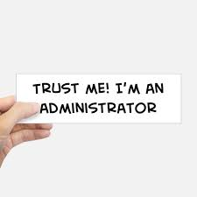
Everything Else
“Hey Pete! Who do I ask about…”
“I don’t think this is fair…”
“What’s the best way to get MIT to pay for…”
“There’s this thing about MIT that’s always bugged me…”
“This does not seem safe…”
“I don’t want to complain, but…”
Note: I am a Title IX “Required Reporter” - but an HR Professional.

Slide 12
People
Brandy Baker – Student Administration, Assisted by Heather Barry.
Valerie Censabella – HR/Payroll, Forms and issues – mostly other will talk to her.
Ellina Patton – Research Finance, Assisted by Katrina Walker.
Linda Arduino – Purchasing card paperwork, Purchase orders, invoices, payments.

Slide 13
More People
Rachel Morton – Computers, IS&T problems, Printers, Accounts, Computer codes/software
Peter Stahle – Lab Safety
Your Advisor – Academics, research direction
Your Best Friend – Sympathy, personal advice, holding your hair when you throw up
Your Mother – to clean up after you –THIS IS NOT MY JOB
Me – Everything else not covered above.

Slide 14

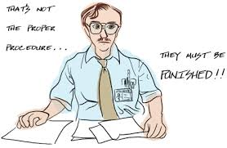
The goal of NSE’s staff is to get you out of our office…and back in your office or lab with a minimum of fuss.
Not to shame you for not knowing
https://wikis.mit.edu/confluence/display/NSE/NSE+Wiki+Home

