Slide 1

Department Business
NSE Staff; Getting Stuff done since 1958

Slide 2

NSE Staff are here to help
Our job is to administer the heck of things until they are not a problem anymore.
(your job is to bug us until its fixed)

Slide 3




Business!
Money
Travel
Buying things
Offices and other space
Fixing things
Safety
Everything else

Slide 4
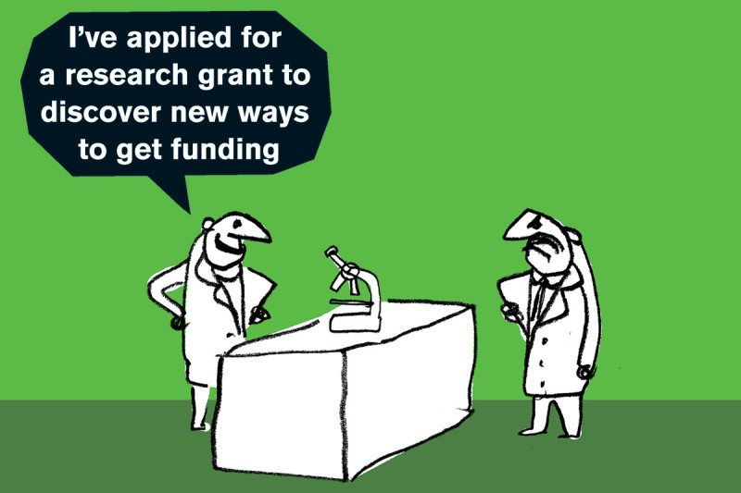
Funding Your Salary
Flavors of money – NSE/Ext Fellowship, TA, Research, Other
Implications of Sponsored Funding (Research Assistantships)
Brief Process Overview – 9-18 mo. Cycle for grants

Slide 5
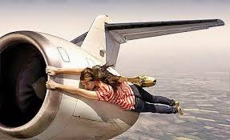
Travel
Travel card program and Concur
  Concur.mit.edu
  Full FAQ
Travel grant program
  Email nsetravelgrants@mit.edu
  Typically 50% of a domestic trip 1x/academic year.
  Present Results!
“Pete said we have to save money on our travel budget.”

Slide 6

Buying Things
One offs, Office Supplies
  See your Advisor’s assistant
Printer supplies, paper, toner, computer parts
  See Rachel Morton
Lab supplies, projects
  Pcard, Coupa b2p
TAs –Ask Pete
Invoices, Packing Slips, Documentation

Slide 7
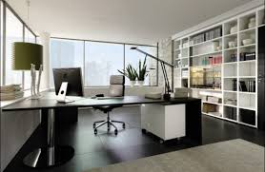
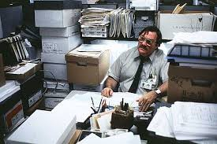
Your Office
What I think I’m giving them…
Reasonable to expect;
  Working heat/AC/wired ethernet/power/lights
  Good chair, desk, a door that locks
  About 60 s.f. of your own space
  Trash removal, cleaning, security, safe working conditions
  Accessibility accommodations
Not Reasonable to expect
  A couch
  A private office
  Lack of mice
  Pete reading your mind
  Please try to keep your office clean
  Note about PSFC, RLE, CMSE Spaces
  If you ask, we can fix it
What they think it looks like…

Slide 8
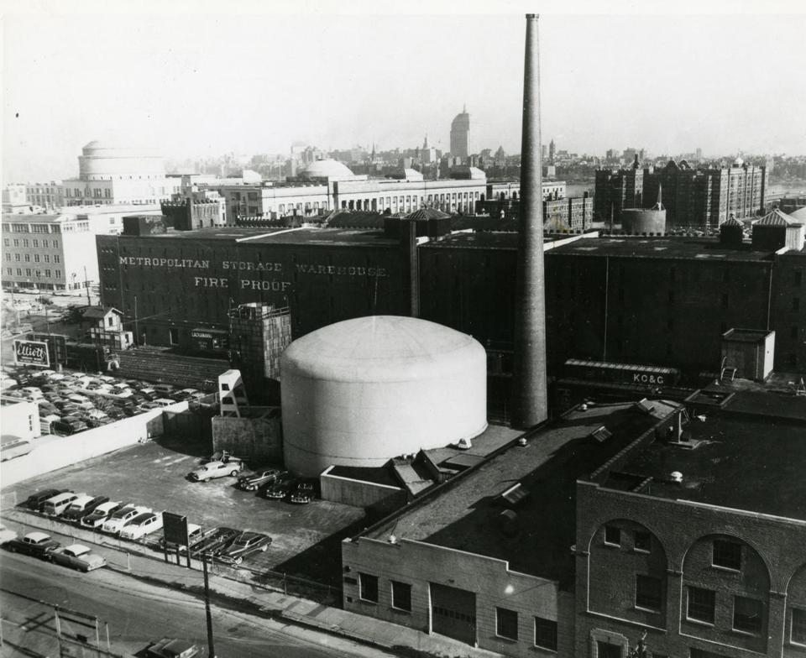
MIT Reactor Security
All NW buildings are connected, don’t let people in. Be rude if you must
The NRC has NO Sense of humor! (Trust me!)

Slide 9
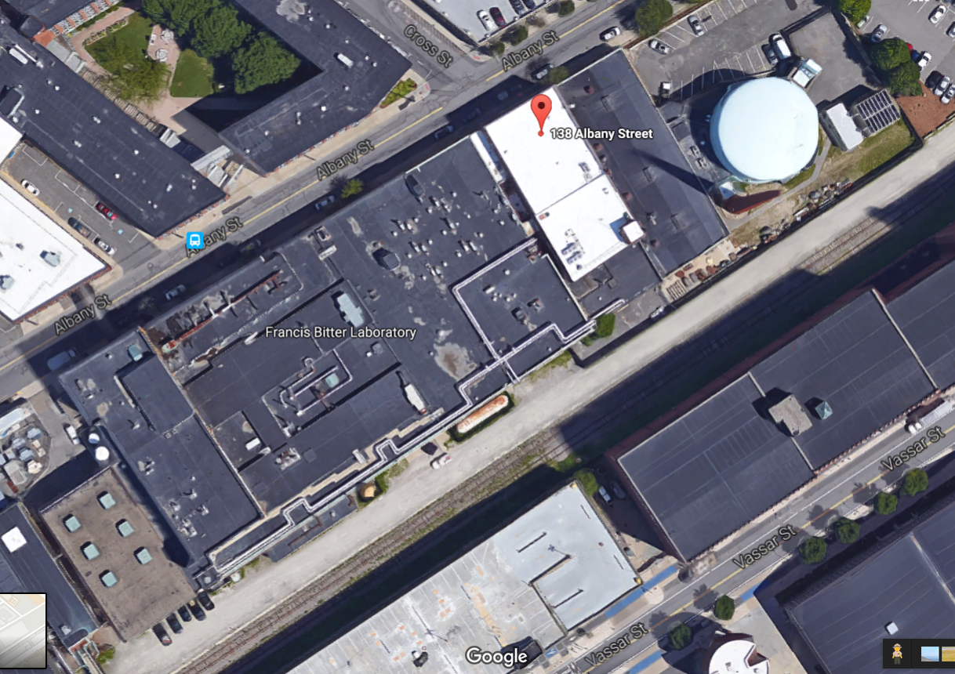
NW12
NW13
NW14
BOOM!

Slide 10

Safety
Every lab worker requires training before you are allowed to use the lab. Your research supervisor (or their lab representative) will initiate this.
Special topics;
Hazardous Chemicals
NW12 radiation alarm
Fire Alarms
Hazards, issues, problems
Albany Street ‘customers’

Slide 11
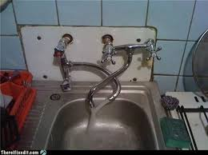
Fixing Broken things and Cleaning Messes
Report Problems!
  Email: dof-csc@mit.edu
  http://Atlas.mit.edu fill out service request
  Call FIXIT (3-4549 or 617-253-4549)
  Email me at pbrenton@mit.edu
  Especially for chronic problems or when Facilities is slow to respond.
  REPORT IMMEDIATE ISSUES TO FACILITES FIRST!
“Facilities has closed your work order.”

Slide 12
Everything Else
“Hey Pete! Who do I ask about…”
“I don’t think this is fair…”
“What’s the best way to get MIT to pay for…”
“There’s this thing about MIT that’s always bugged me…”
“This does not seem safe…”
Staff members are Title IX “Required Reporters” – what does it mean?

Slide 13

People
Valerie Censabella – HR/Payroll, Forms and issues – mostly others will talk to her.
Ellina Patton – Research Finance, Assisted by Andre Dixon.
Linda Arduino – Purchasing card paperwork, Purchase orders, invoices, payments.
Anne Dulong, Lisa Magnano-Bleheen – Admin Assistants on First Floor.

Slide 14

More People
Rachel Morton – Computers, IS&T problems, Printers, Accounts, Computer codes/software
Peter Stahle – Safety
Your Advisor – Academics, research direction
Your Advisor’s Assistant – Travel, buying, course information.
Your Best Friend – Sympathy, personal advice, holding your hair when you throw up
Your Mother – to clean up after you –THIS IS NOT OUR JOB
Me – Everything else not covered above.

Slide 15

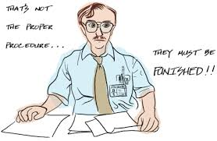
The NSE Staff wants to fix your problem.
Not to shame you for not knowing things.
https://wikis.mit.edu/confluence/display/NSE/NSE+Wiki+Home

