Slide 1



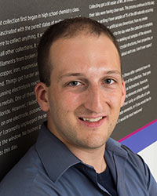

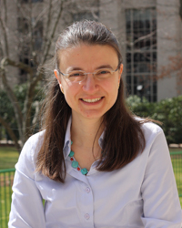

Zachary Hartwig Assistant Professor
Mingda Li
Assistant Professor
Koroush Shirvan
Assistant Professor
Michael Short
Associate Professor
Nuclear Materials @ MIT
Ju Li
Professor
Bilge Yildiz
Professor
Dennis Whyte
Professor

Slide 2
Nuclear Materials Field of Specialization
22.14 Materials in Nuclear Engineering
22.71J Physical Metallurgy
3.20 Thermodynamics
one of (22.72J Corrosion, 22.74 Radiation Damage or 3.21 Kinetics of Materials )

Slide 3
Zachary Hartwig, Assistant Professor
development and application of accelerators
radiation detectors
radiation transport simulations to magnetic fusion energy
radiation damage in nuclear materials, including high-field superconductors

Slide 4
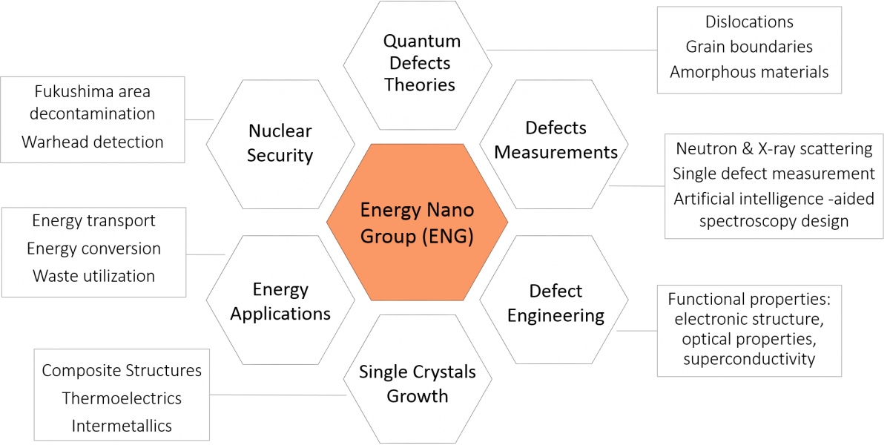
Mingda Li, Assistant Professor

Slide 5
Koroush Shirvan, Assistant Professor
nuclear fuel performance (both cladding and fuel)
accident tolerant fuels in LWR reactors with conventional and innovative fuels such as SiC/SiC, UN, FeCrAl and UO₂-BeO
design of LWR cores using coupled multi-physics analysis.

Slide 6
Michael Short, Associate Professor
Quantification of radiation damage by stored energy fingerprints (NSF CAREER award)
Non-contact, non-destructive measurement of irradiated material properties using transient grating spectroscopy (TGS)
Corrosion Deposits (CRUD) in PWRs
Composite Alloys for Increasing Fuel Performance of Next-Generation Reactors

Slide 7
Bilge Yildiz, Professor
Co-director, MIT Energy Initiative Low-Carbon Energy Center on
Materials in Energy and Extreme Environments (CME)
electrocatalytic activity on high temperature oxides for fuels and electricity production (fuel cells and electrolysis) (NSF CAREER award)
metal corrosion
transport and reactivity of charged defects on solid state ionic nanoscale thin films: probing of surface atomic and electronic structure using scanning tunneling microscopy in harsh operando conditions. On the computational front, her group is advancing multiscale methods to overcome the timescale limitation of traditional atomistic methods.

Slide 8
Dennis G. Whyte, Professor and Department Head
Plasma-Surface Interactions: basic physics of plasma-material interfaces, dynamic measurement techniques for material evolution under plasma bombardment, implications of plasma-surface interactions in magnetic fusion reactors
Accelerators and Surface Analysis: low-energy nuclear scattering techniques for material analysis and damage, development of in-situ surface diagnostic methods for magnetic fusion

Slide 9
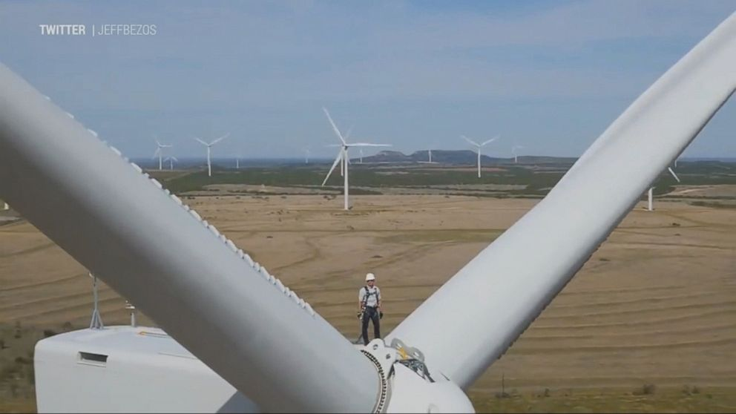
Energy is BIG

Slide 10

2014 World electricity generation : 24 Trillion kWh
energy has BIG COST Forbes.com
Energy Source Mortality Rate (deaths/trillion kWh)
Coal – global average 100,000 (41% global electricity)
Coal – China 170,000 (75% China’s electricity)
Coal – U.S. 10,000 (32% U.S. electricity)
Oil 36,000 (33% of energy, 8% of electricity)
Natural Gas 4,000 (22% global electricity)
Biofuel/Biomass 24,000 (21% global energy)
Solar (rooftop) 440 (< 1% global electricity)
Wind 150 (2% global electricity)
Hydro – global average 1,400 (16% global electricity)
Hydro – U.S. 5 (6% U.S. electricity)
Nuclear – global average 90 (11% global electricity w/Chernobyl&Fukushima)
Nuclear – U.S. 0.1 (19% U.S. electricity)

Slide 11
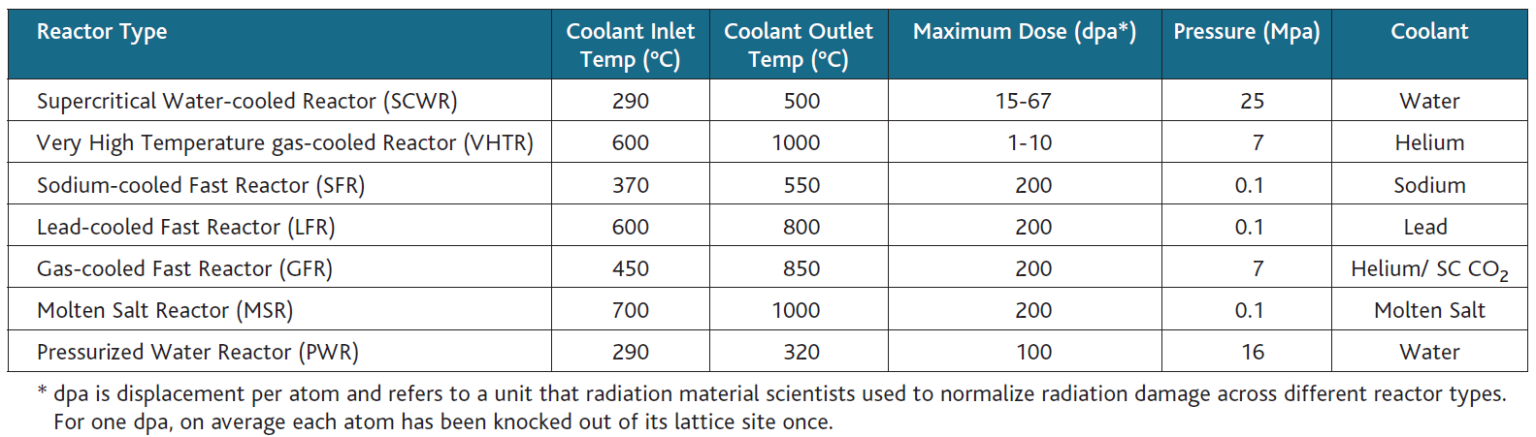
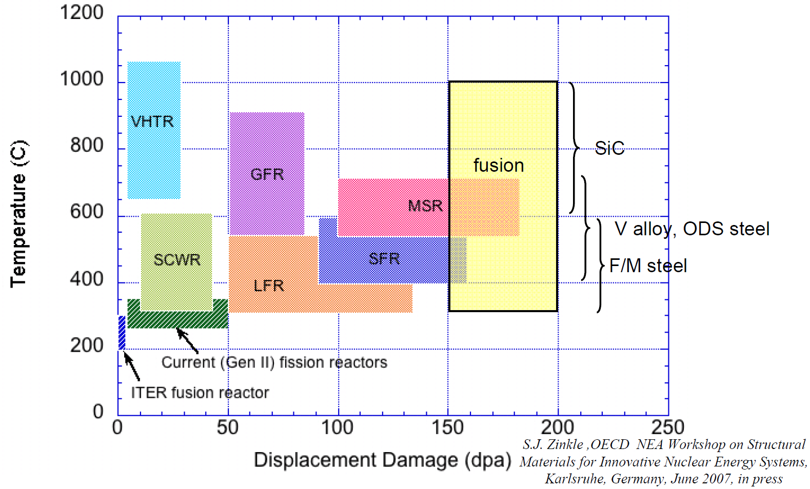
Both fission and fusion reactors seek radiation-resistant
and
high-temperature load-bearing materials
Zinkle, Busby, Materials Today 12 (Nov 2009) 12

Slide 12
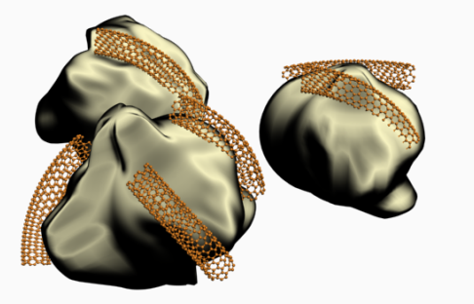
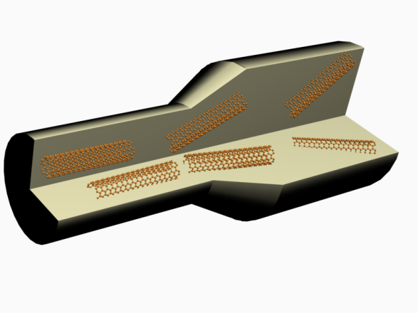
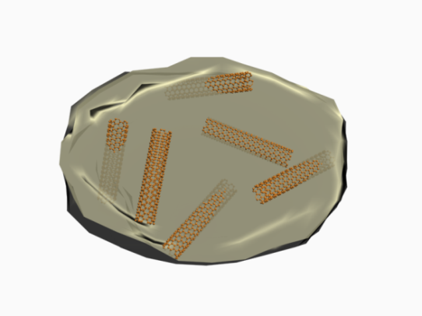
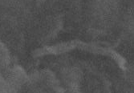
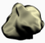
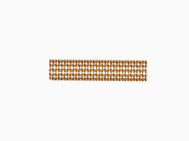
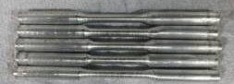
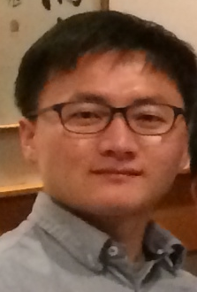
Aluminum/Carbon Nanotube composite
CNT align
CNT
Al particle
100㎚
CNT
Encapsulation
& consolidation
Declustered CNTs on Al
Extrusion
3cm
Dr. KangPyo So
Li & Short groups
ASTM E8 tensile specimen

Slide 13
Superior Mechanical Performance

Slide 14
With Prof. Young Hee Lee at Sungkyunkwan University:
“Ton-scale metal-carbon nanotube composite: The mechanism of strengthening while retaining tensile ductility,”
Kang Pyo So et al, Extreme Mechanics Letters 8 (2016) 245

Slide 15
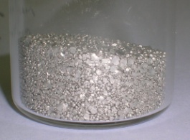
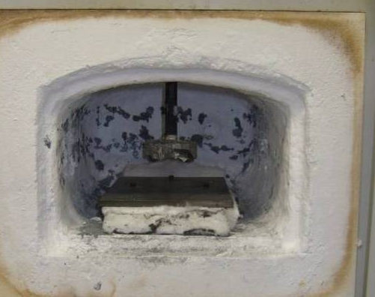
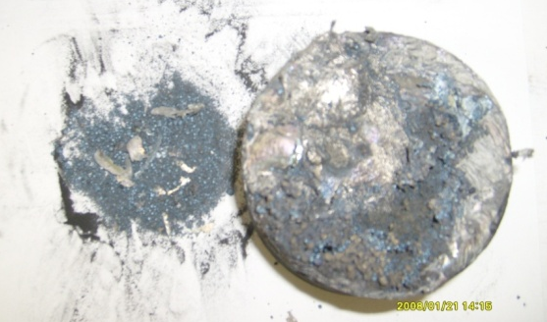
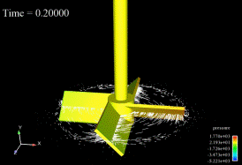

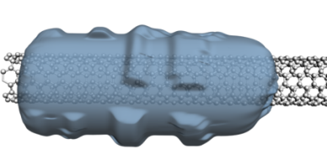

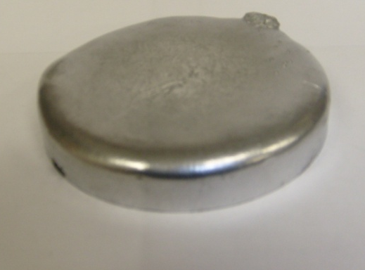
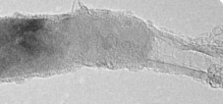
Wettability is Critical for Dispersion of CNT into Al
Melt blending
Failed !!
+
http://www.acusim.com/
images/gallery/startup.gif
CNT dispersed!!
Introduce
SiC coating !!
SiC layer
CNT
10 nm
CNT was successfully dispersed in Al melt

Slide 16
control Al
CNT 0.5wt%
1 ㎛
1 ㎛
Nano Energy 22 (2016) 319

Slide 17
Al self-ion radiation
Carbon nanotube
↓
Tubular carbide
Al₄C₃ nanorod
Nano Energy 22 (2016) 319

Slide 18
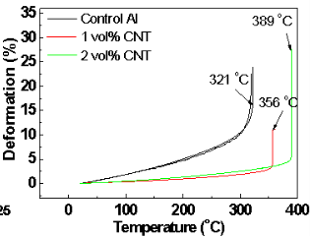
Enhanced Creep Resistance
Advanced Science (2018) 1800115

Slide 19
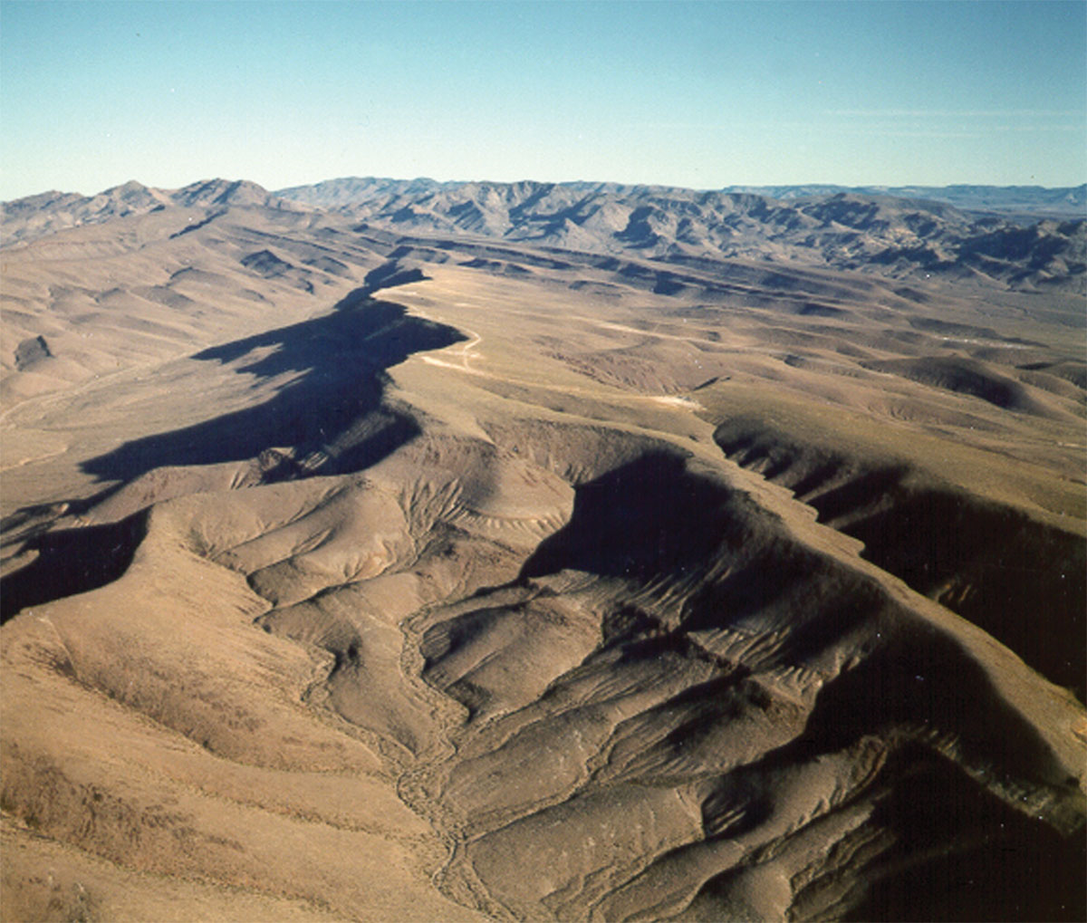
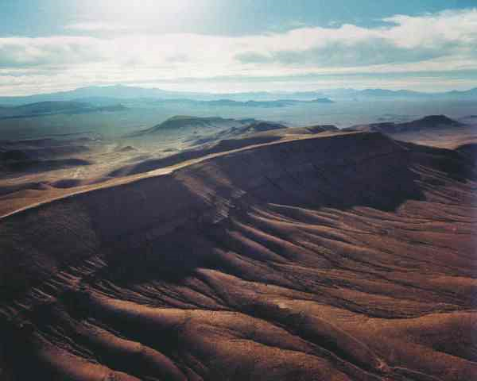
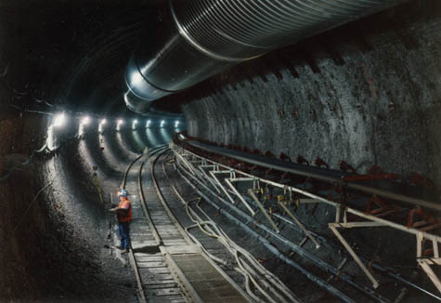
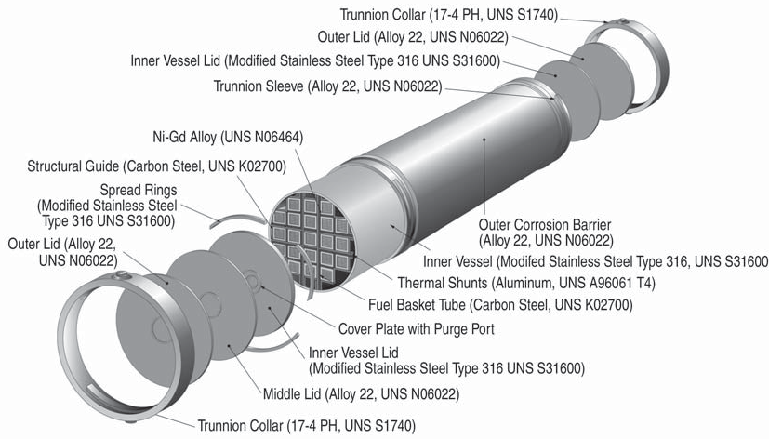
Can one trust man-made materials for 10⁴ years?
T > 100°C for several hundred years
Brine film
Radiation
welded container with
316 stainless steel
(low C-high N-Fe-18Cr-12Ni-2.5Mo) inside and
alloy 22 (Ni-22Cr-13Mo-4Fe-3W) outside
& drip shield of a Ti-0.15Pd alloy
Andresen, Gordon, Lu, JOM (2005) 27

Slide 20
Extending the Timescales
Lengthscale
Extended timescale atomistic simulation
In situ
TEM
Molecular
Dynamics
10²
nm
to years,
millennia
ns
s
Timescale

Slide 21
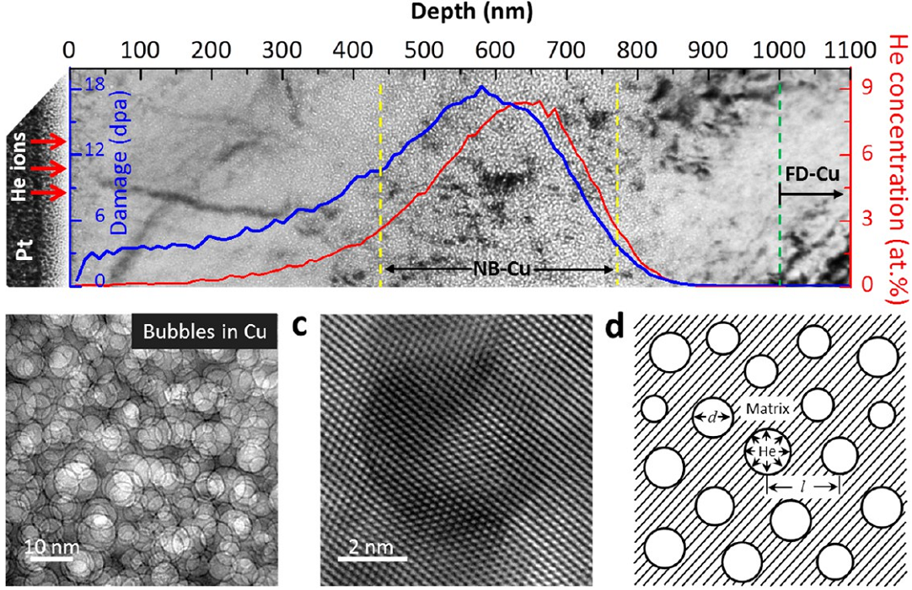
Helium Nanobubbles Enhance Ductility in Submicron-Sized Single-Crystalline Copper
Prof. Weizhong Han
Xian Jiaotong Univ.

Slide 22
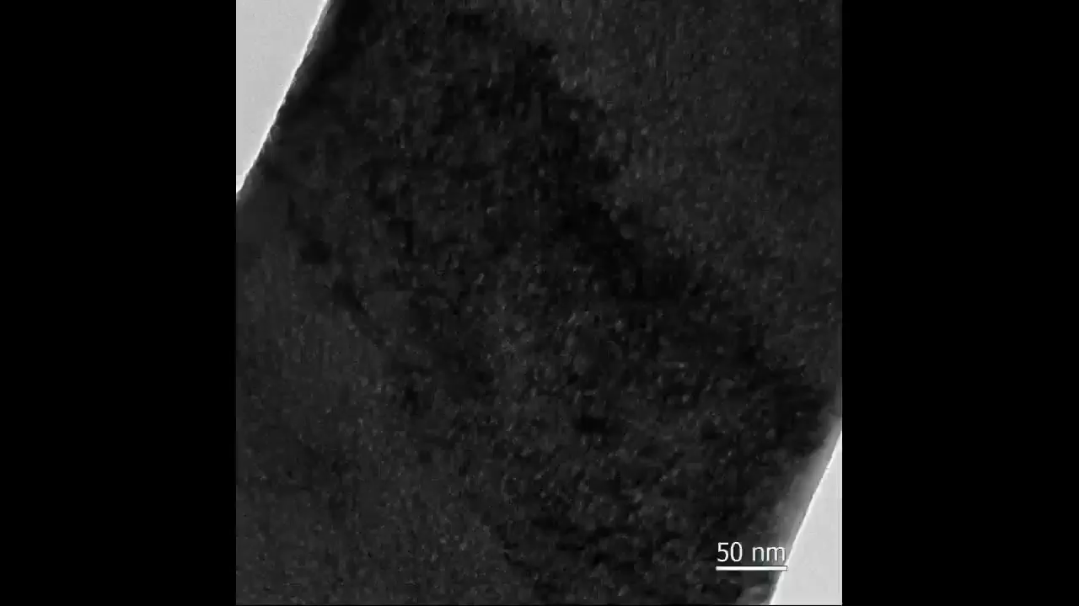

Slide 23
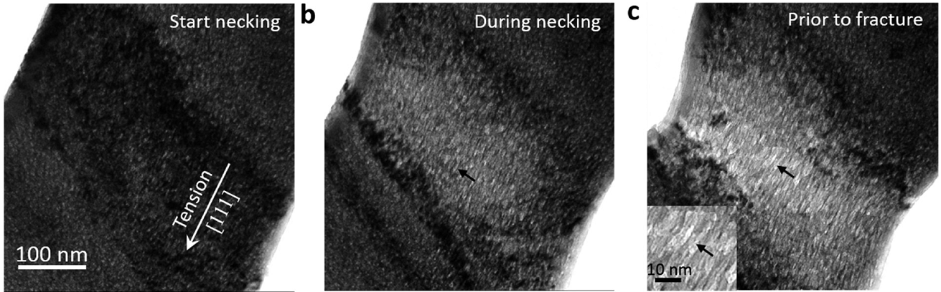
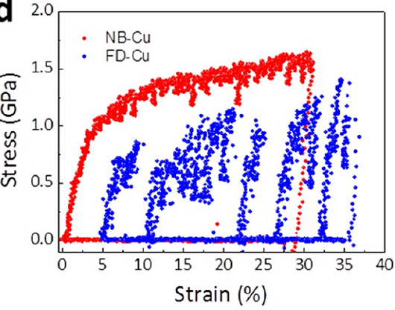
A marshmallow like deformation: Radiation enhanced ductility in small structures
Nano Letters 16 (2016) 4118

Slide 24
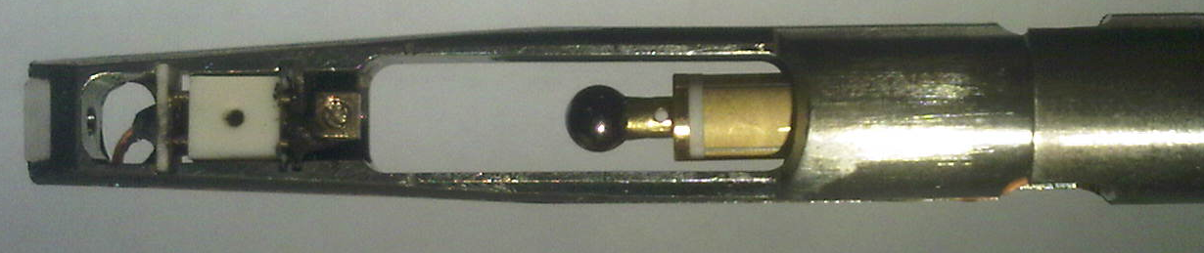
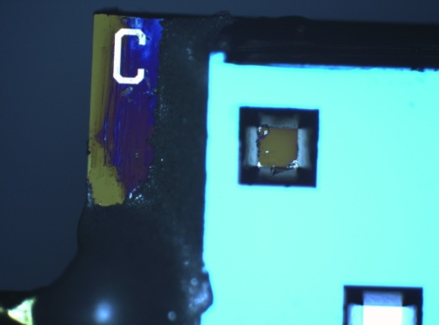
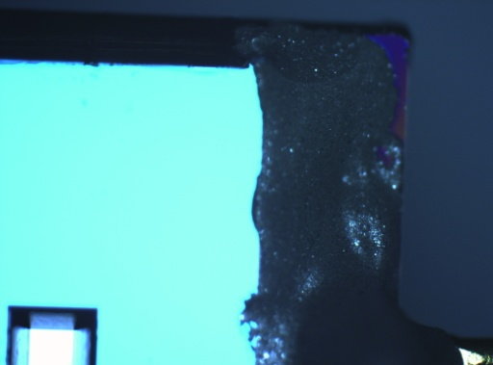
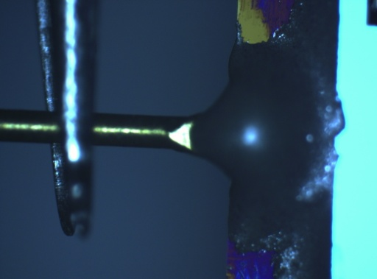
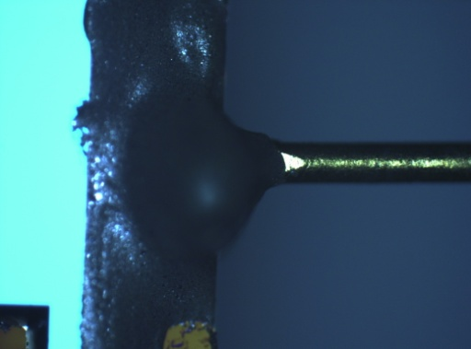
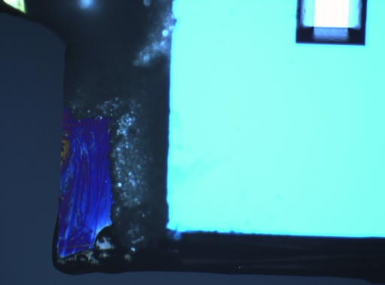
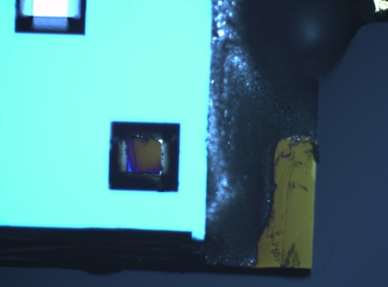
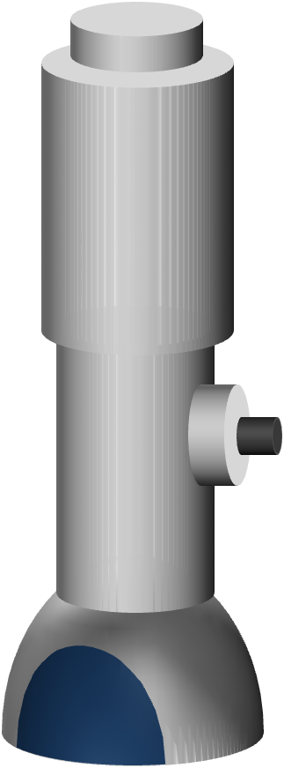
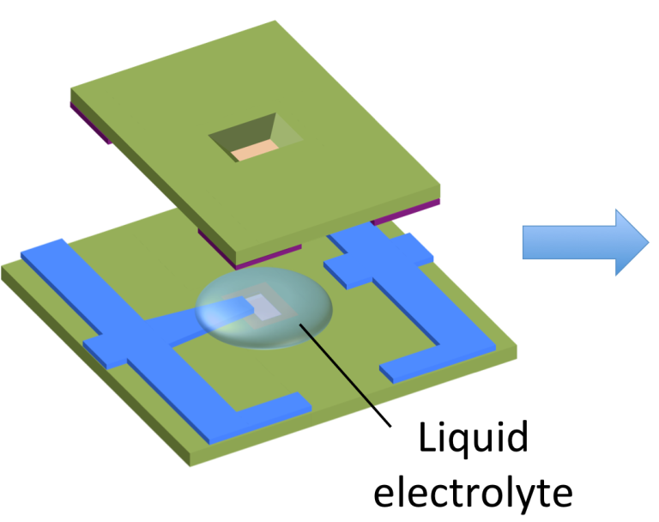
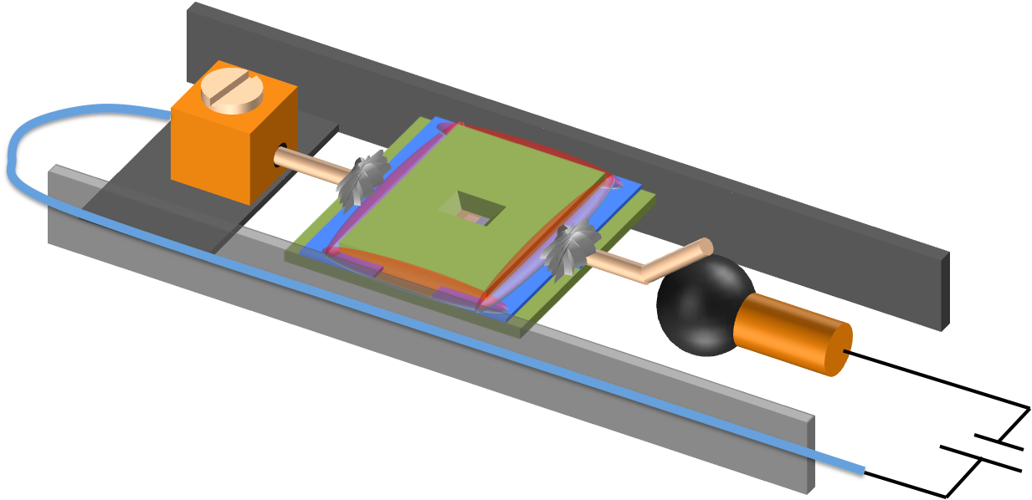
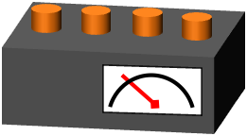
Conducting epoxy
Nanofactory STM-TEM holder
Au wire
Lab-on-a-chip
Liquid Cell Electrochemical
in situ TEM
Transmission Electron
Microscope
STM-TEM holder
Potentiostat

Slide 25
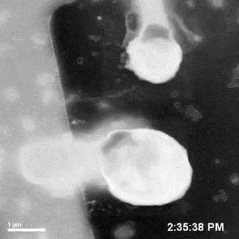
Solid-Liquid-Gas
triple-phase boundary
Boiling
Surface Fouling
Erosion
Catalysis
…
at nanoscale
Adv Mater 29 (2017)
1605902

Slide 26
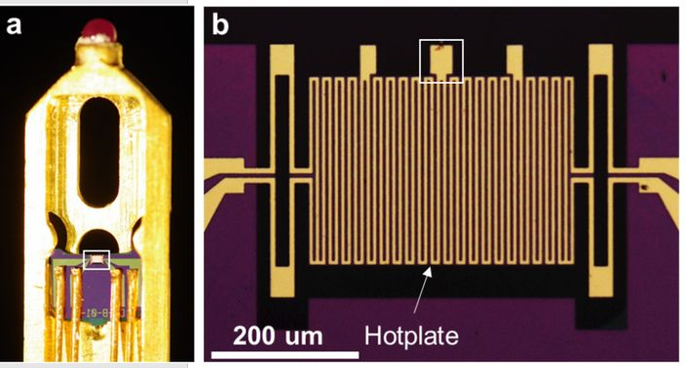
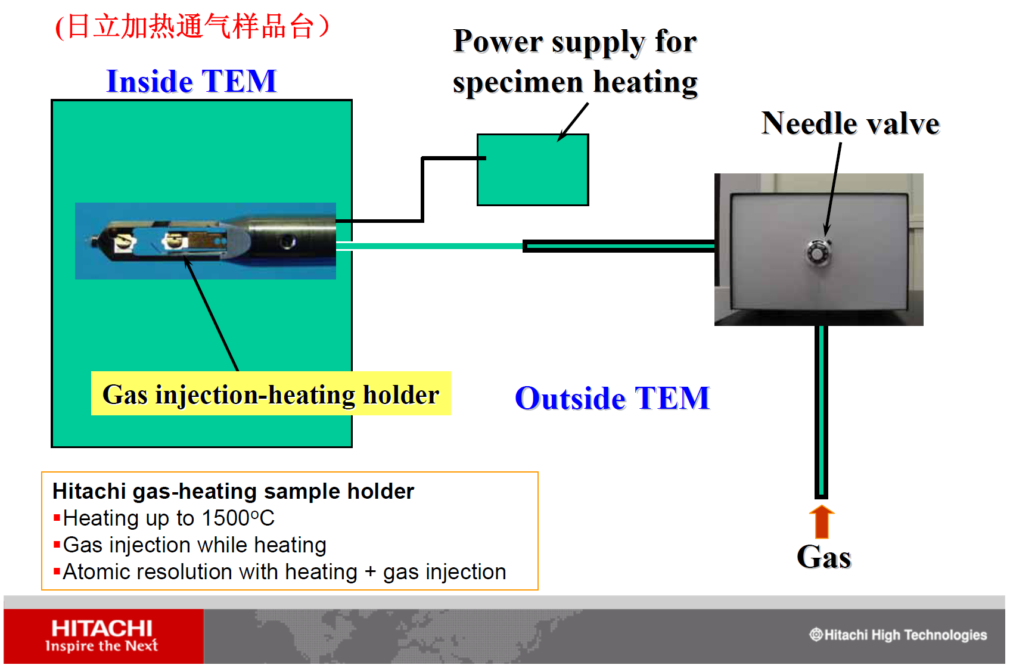

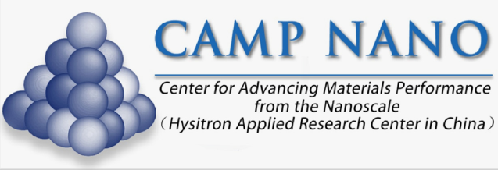
Hitachi H-9500 high resolution TEM
Yang Yang

Slide 27
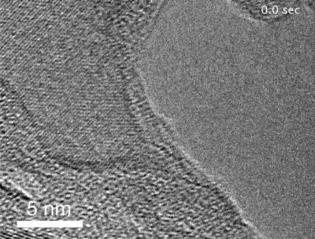
Aluminum
Oxygen
Reactive Chemomechanics
“Liquid-Like, Self-Healing Aluminum Oxide during Deformation at Room Temperature,” Yang Yang, Akihiro Kushima, Weizhong Han, Huolin Xin and Ju Li, Nano Letters 18 (2018) 2492

Slide 28
Questions?
Zachary Hartwig Assistant Professor
Mingda Li
Assistant Professor
Koroush Shirvan
Assistant Professor
Michael Short
Associate Professor
Nuclear Materials @ MIT
Ju Li
Professor
Bilge Yildiz
Professor
Dennis Whyte
Professor

