Slide 1


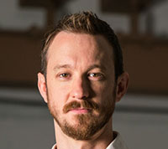
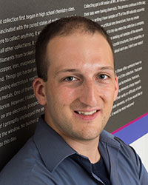
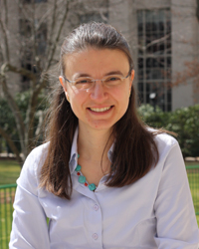

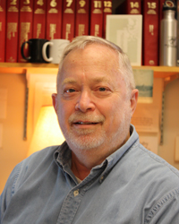

Zachary Hartwig Assistant Professor
Mingda Li
Assistant Professor
Koroush
Shirvan
Assistant
Professor
Bilge Yildiz
Associate Professor
with tenure
Michael Short
Assistant Professor
Nuclear Materials @ MIT
Ju Li
Professor
Ron Ballinger
Professor
Dennis Whyte
Professor

Slide 2
Nuclear Materials Field of Specialization
22.14 Materials in Nuclear Engineering
22.71J Physical Metallurgy
3.20 Thermodynamics
one of (22.72J Corrosion, 22.74 Radiation Damage or 3.21 Kinetics of Materials )

Slide 3
Zachary Hartwig, Assistant Professor
development and application of accelerators
radiation detectors
radiation transport simulations to magnetic fusion energy
radiation damage in nuclear materials, including high-field superconductors

Slide 4
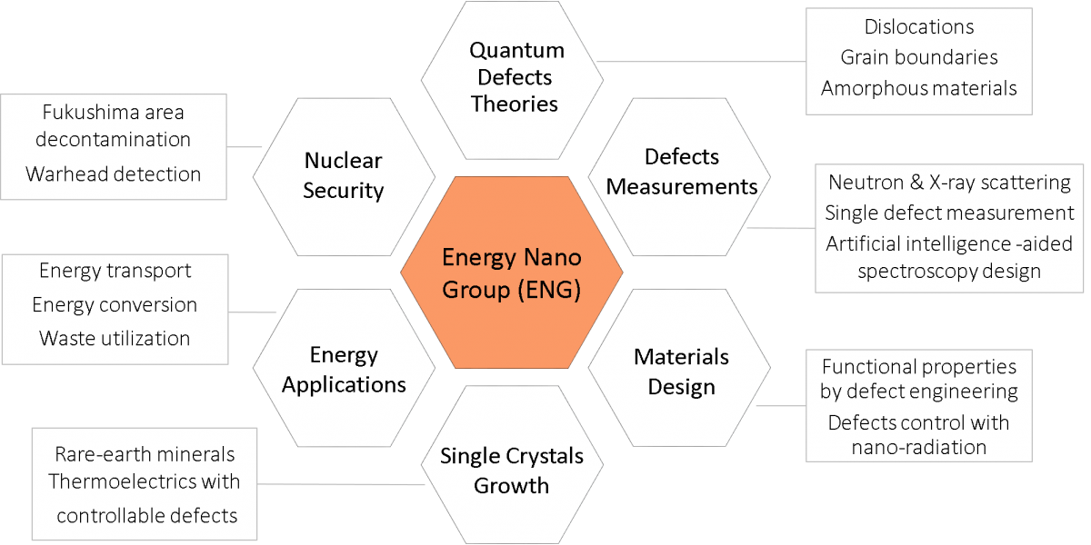
Mingda Li, Assistant Professor

Slide 5
Koroush Shirvan, Assistant Professor
nuclear fuel performance (both cladding and fuel)
accident tolerant fuels in LWR reactors with conventional and innovative fuels such as SiC/SiC, UN, FeCrAl and UO₂-BeO
design of LWR cores using coupled multi-physics analysis.

Slide 6
Michael Short, Assistant Professor
Quantification of radiation damage by stored energy fingerprints (NSF CAREER award)
Non-contact, non-destructive measurement of irradiated material properties using transient grating spectroscopy (TGS)
Corrosion Deposits (CRUD) in PWRs
Composite Alloys for Increasing Fuel Performance of Next-Generation Reactors

Slide 7
Bilge Yildiz, Associate Professor
Co-director, MIT Energy Initiative Low-Carbon Energy Center on
Materials in Energy and Extreme Environments (CME)
electrocatalytic activity on high temperature oxides for fuels and electricity production (fuel cells and electrolysis) (NSF CAREER award)
metal corrosion
transport and reactivity of charged defects on solid state ionic nanoscale thin films: probing of surface atomic and electronic structure using scanning tunneling microscopy in harsh operando conditions. On the computational front, her group is advancing multiscale methods to overcome the timescale limitation of traditional atomistic methods.

Slide 8
Ronald G. Ballinger, Professor
Environmental effects on materials behavior
Electrochemistry
Corrosion
Advanced materials for fusion systems advanced statistical and experimental techniques for experimental analysis
Nuclear fuel performance analysis

Slide 9
Dennis G. Whyte, Professor and Department Head
Plasma-Surface Interactions: basic physics of plasma-material interfaces, dynamic measurement techniques for material evolution under plasma bombardment, implications of plasma-surface interactions in magnetic fusion reactors
Accelerators and Surface Analysis: low-energy nuclear scattering techniques for material analysis and damage, development of in-situ surface diagnostic methods for magnetic fusion

Slide 10
Modeling Radiation Damage
Nanoscale Characterization of Radiation and Environment Effects
Making Radiation-resistant Materials at Bulk scale

Slide 11
IM3D: parallel Monte Carlo code for efficient simulations of primary radiation displacements and damage in 3D
SRIM replacement: open-source,
runs ~10⁴ times faster, 3D
Yong Gang Li, Yang Yang, Michael P. Short, Ze Jun Ding, Zhi Zeng, Ju Li
Scientific Reports 5 (2015) 18130
http://Li.mit.edu/im3d

Slide 12
He

Slide 13
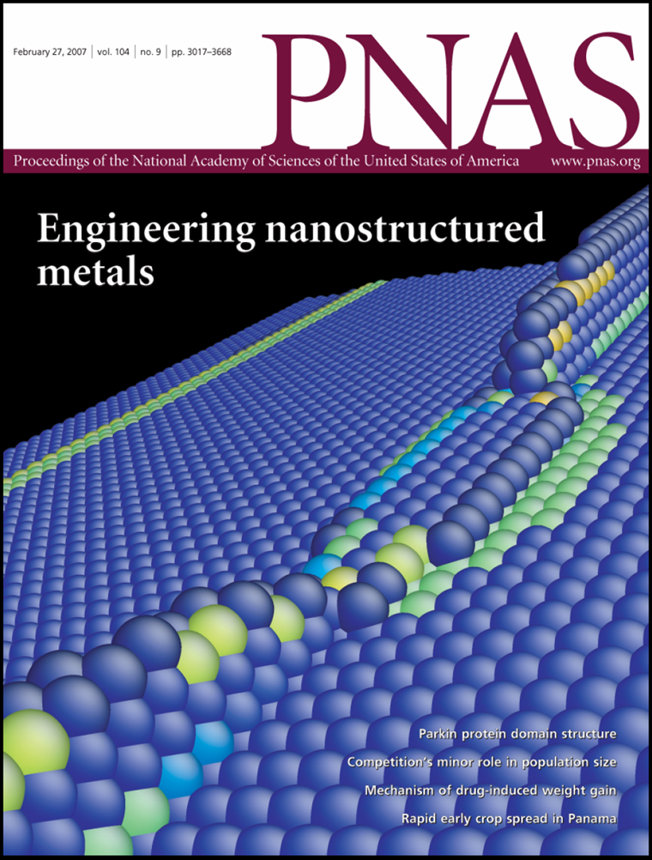
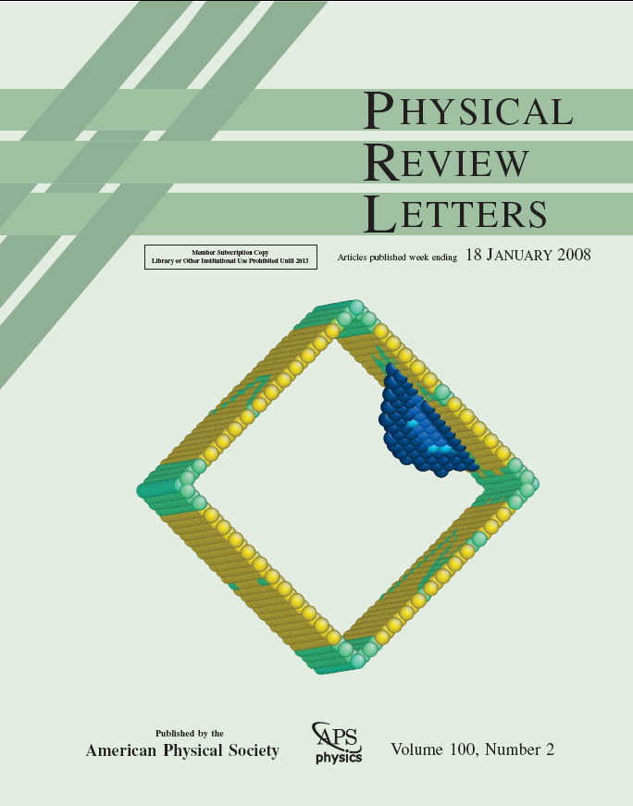
Timescale Challenge: Atomistic simulations are not just molecular dynamics → track long-timescale structural/damage evolution
6nm Cu nanowire
PNAS 104
(2007) 3031
Phys. Rev. Lett. 100 (2008) 025502

Slide 14
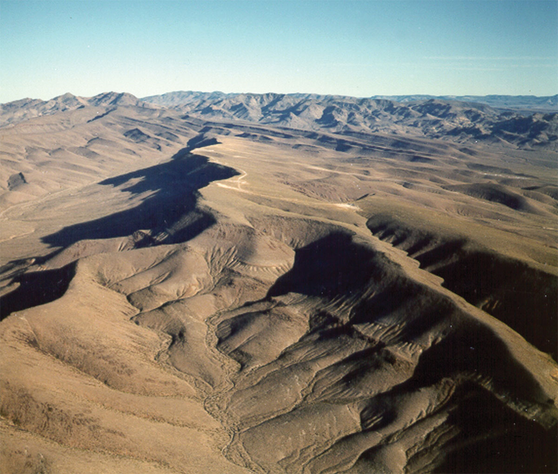
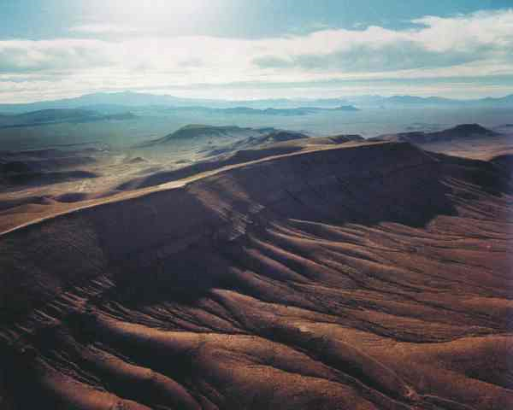
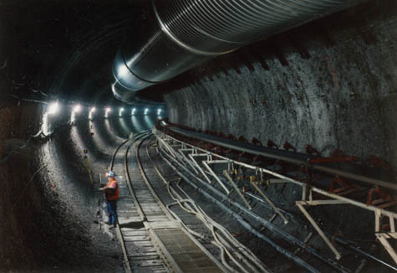
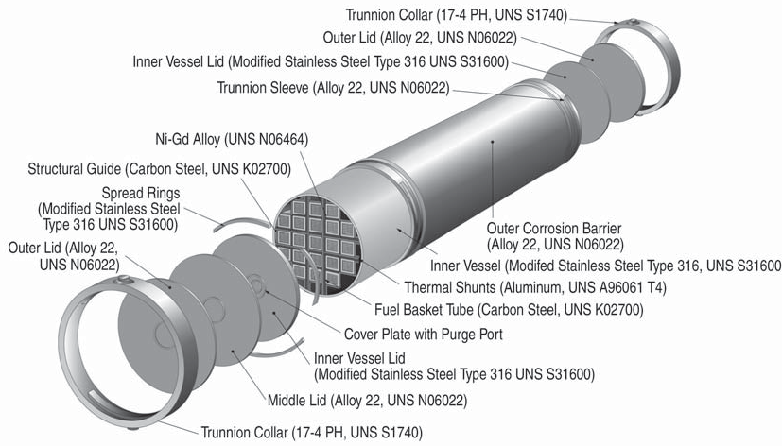
Can one trust man-made materials for 10⁴ years?
T > 100°C for several hundred years
Brine film
Radiation
welded container with
316 stainless steel
(low C-high N-Fe-18Cr-12Ni-2.5Mo) inside and
alloy 22 (Ni-22Cr-13Mo-4Fe-3W) outside
& drip shield of a Ti-0.15Pd alloy
Andresen, Gordon, Lu, JOM (2005) 27

Slide 15
Extending the Timescales
Lengthscale
Extended timescale atomistic simulation
In situ
TEM
Molecular
Dynamics
10²
nm
to years,
millennia
ns
s
Timescale

Slide 16
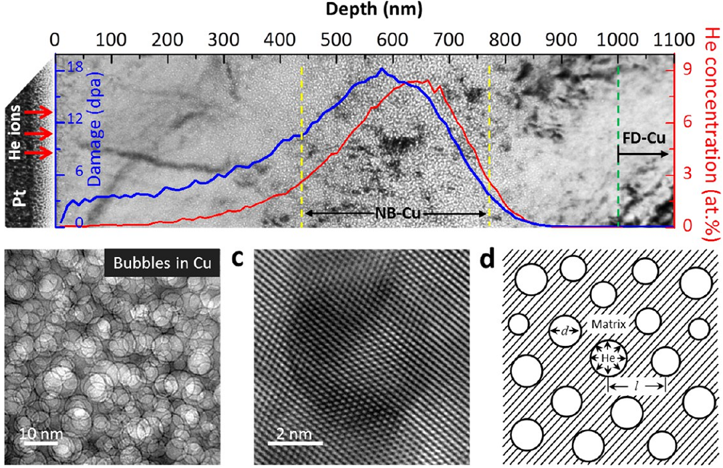
Helium Nanobubbles Enhance Ductility in Submicron-Sized Single-Crystalline Copper
Prof. Weizhong Han
Xian Jiaotong Univ.

Slide 17
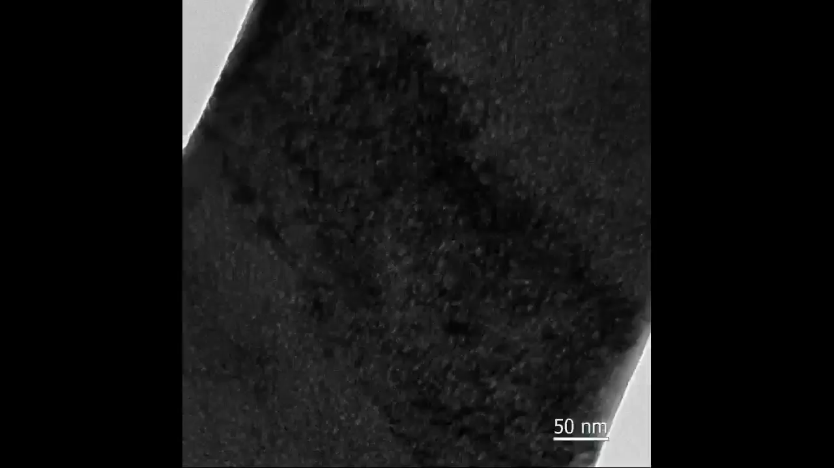

Slide 18
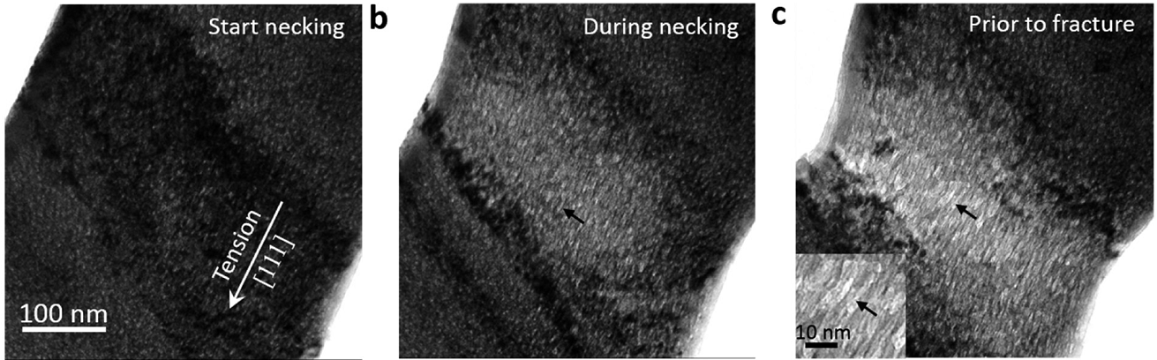
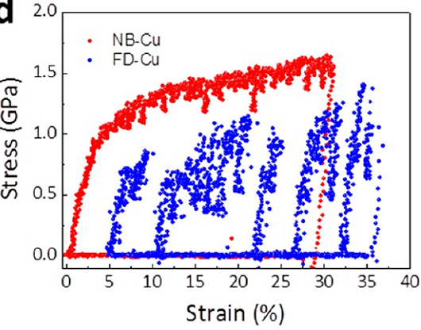
A marshmallow like deformation: Radiation enhanced ductility in small structures
Nano Letters 16 (2016) 4118

Slide 19
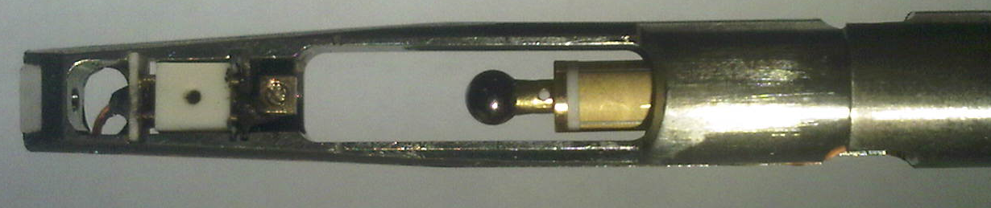
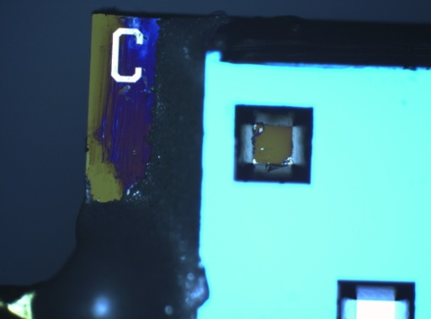
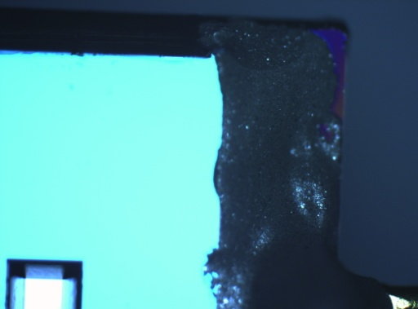
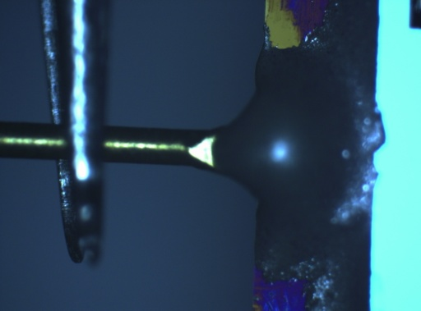
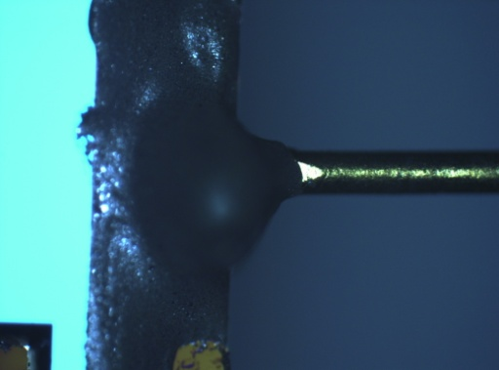
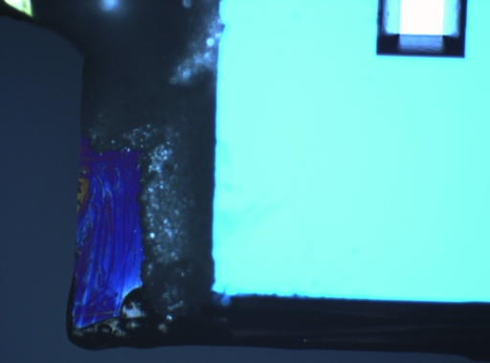
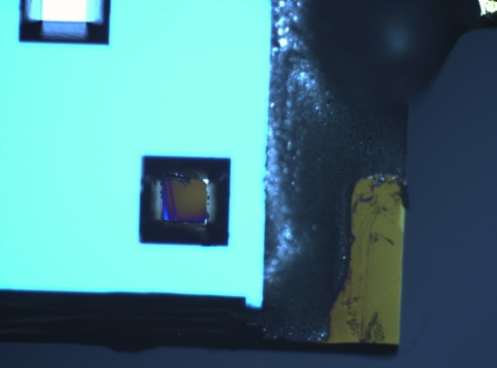
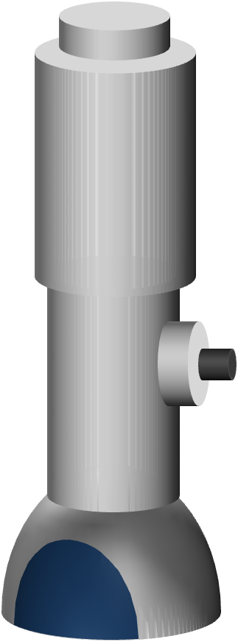
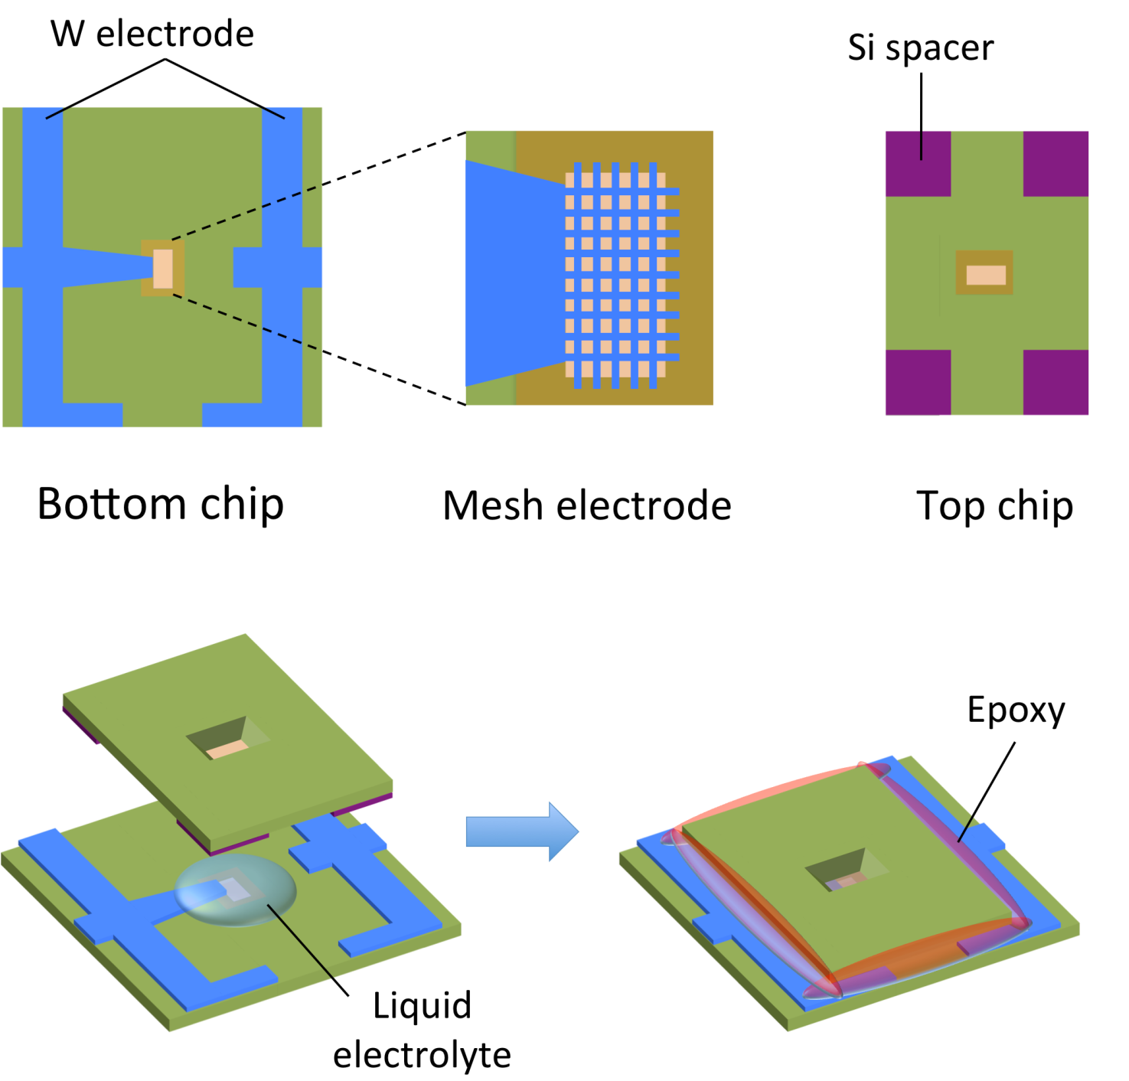
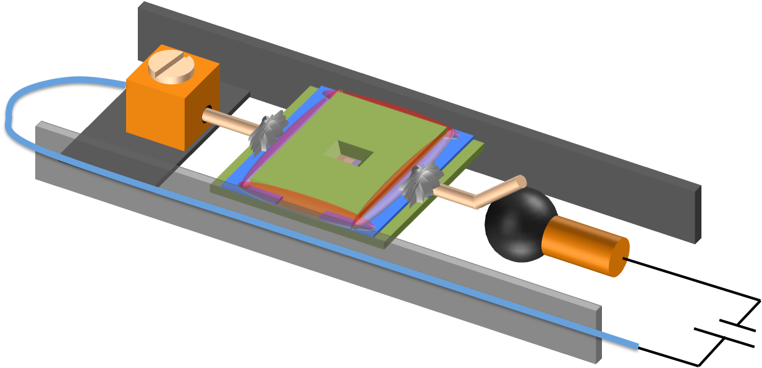
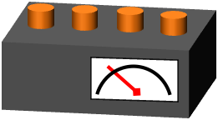
Conducting epoxy
Nanofactory STM-TEM holder
Au wire
Lab-on-a-chip
Liquid Cell Electrochemical
in situ TEM
Transmission Electron
Microscope
STM-TEM holder
Potentiostat

Slide 20
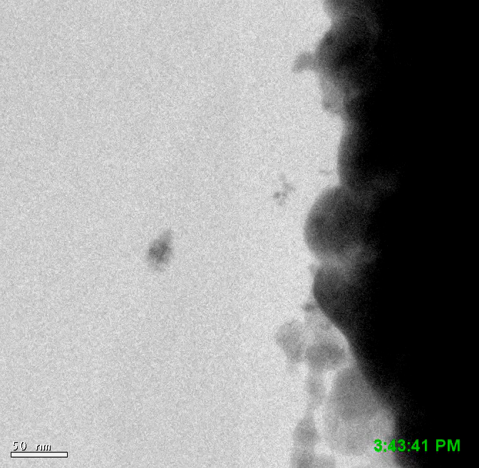
Lithium peroxide
(Li₂O₂) dendrite
for Li-Air
battery
@ MIT
Nano Letters 15 (2015) 8260
Volatile
Liquid cell
DMSO +
1M LiTFSI
bubbled with O₂

Slide 21
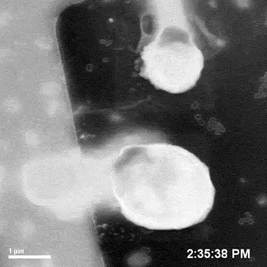

Slide 22
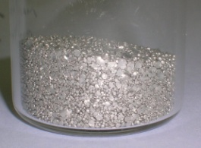
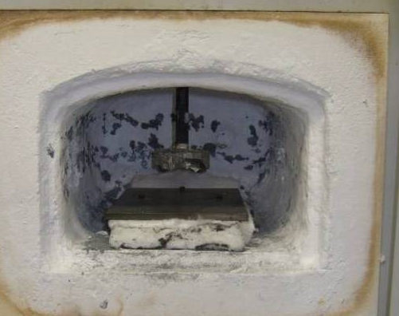
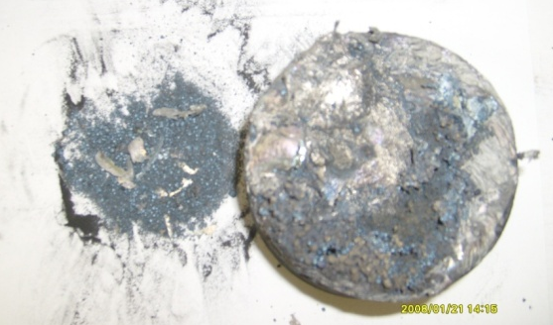
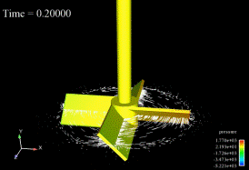

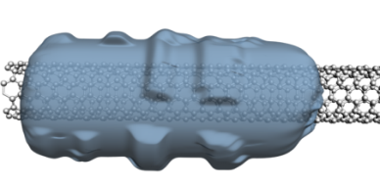

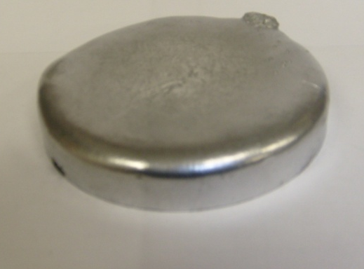
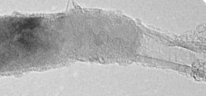
Wettability is Critical for Dispersion of CNT into Al
Melt blending
Failed !!
+
http://www.acusim.com/
images/gallery/startup.gif
CNT dispersed!!
Introduce
SiC coating !!
SiC layer
CNT
10 nm
CNT was successfully dispersed in Al melt

Slide 23
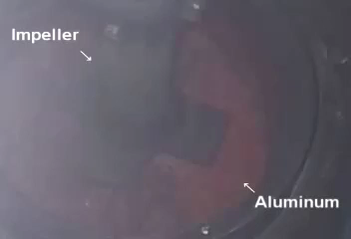

Slide 24
control Al
CNT 0.5wt%
1 ㎛
1 ㎛
Nano Energy 22 (2016) 319

Slide 25
Al self-ion radiation
Carbon nanotube
↓
Tubular carbide
Al₄C₃ nanorod
Nano Energy 22 (2016) 319

Slide 26


Thank you!
http://Li.mit.edu
http://Li.mit.edu/nm

