Slide 1
Fission Research Overview
Benoit Forget
Associate Professor

Slide 2
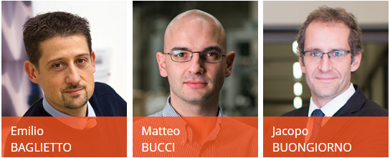

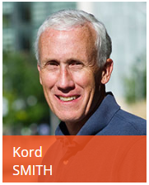

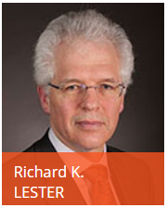
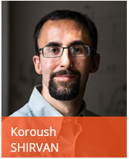

Fission Faculty
Thermohydraulic
Reactor Physics
Energy Policy
Reactor Design

Slide 3
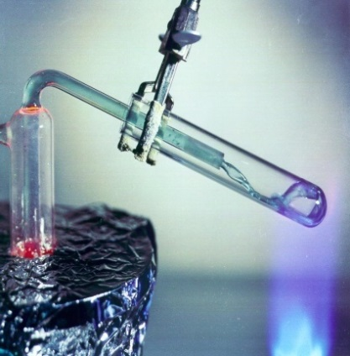
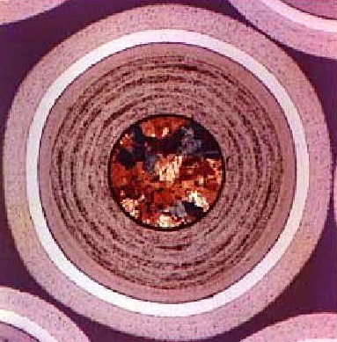
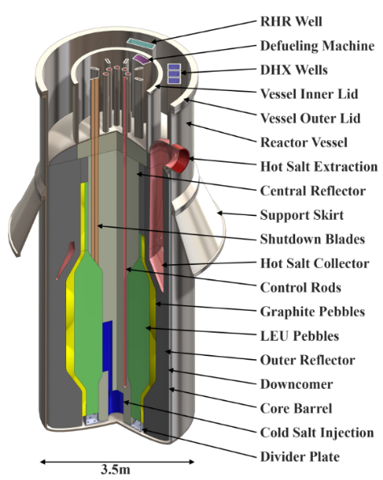
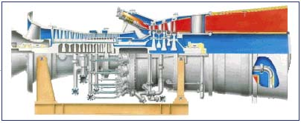
Fluoride-Salt-Cooled High-Temperature Reactor
  Fuel: TRISO particle fuel, no failure up to ~1650°C, strongly negative Doppler feedback
Coolant: FLiBe liquid salt, low-pressure, chemically inert, large margin to boiling (1430°C), high heat capacity, enables power density up to 10x gas-cooled reactors
Power Cycle: Modified natural-gas air Brayton power cycle with General Electric 7FB turbo-compressor
  GE Power Systems MS7001FB
Drs. C. Forsberg, L. Hu

Slide 4
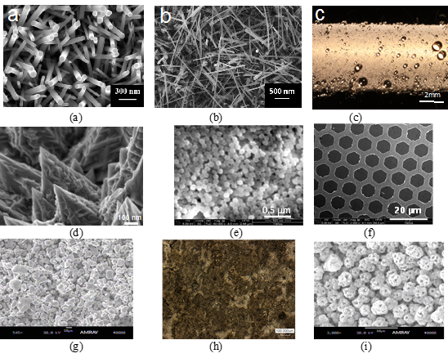
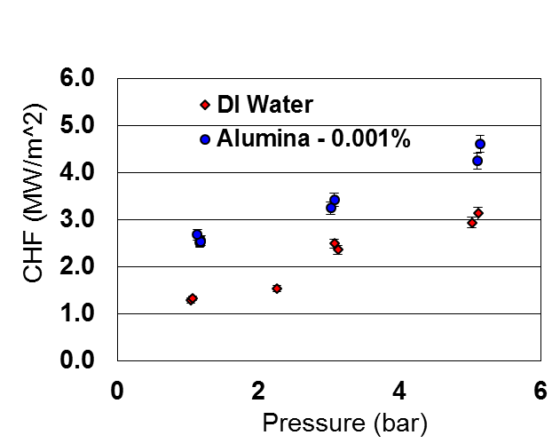
Engineered surface nano- and micro-scale features (coatings, pores, posts, patterns, …) enhance CHF
G=1000 kg/m²s, x_{e}~0, SS316 surface
Increases design-basis and beyond-design-basis safety margins and/or enables power uprates in LWRs
Profs. J. Buongiorno, M. Bucci

Slide 5
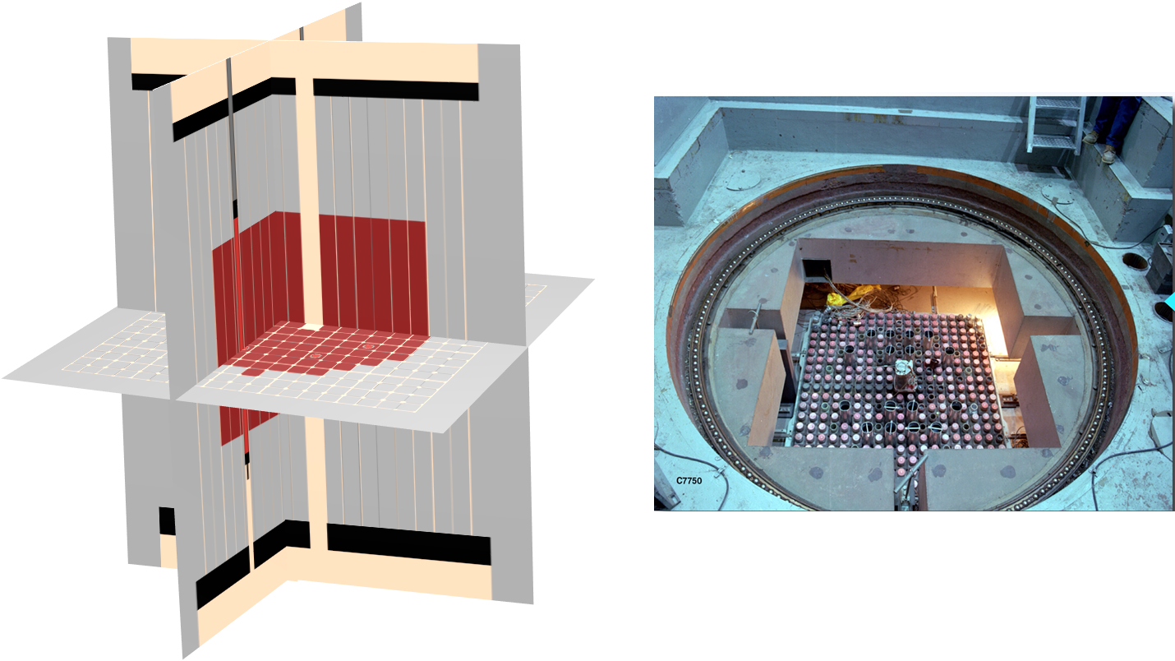
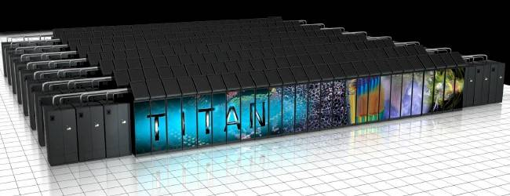
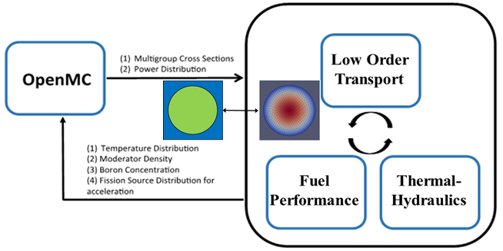
High-fidelity Monte Carlo simulations
Focus on high performance computing in particle transport, improved physical models, and open source software for research and education
  On-the-fly Doppler Broadening
  Time-dependent Monte Carlo
  Multi-physics coupling
  Acceleration and convergence analysis
  Efficient parallelization algorithms
TREAT Reactor
Integration in multi-physics environment
Profs. B. Forget and K. Smith

Slide 6
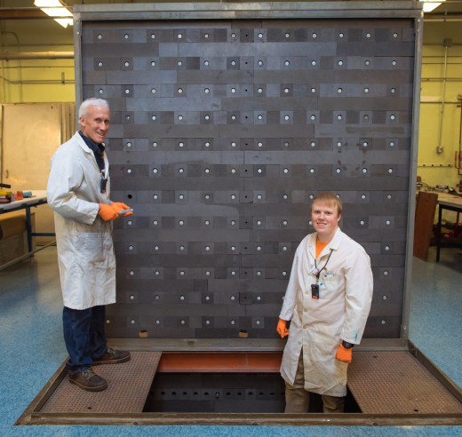
MIT Graphite Pile
25 MT of graphite
2.5 MT of natural uranium
Education
  Approach to critical
  Spatial flux distribution
  Rod worth
Research
  Validation of graphite S(a,b)
  Validation of high-fidelity simulation tools
Profs. K.Smith and B.Forget

Slide 7
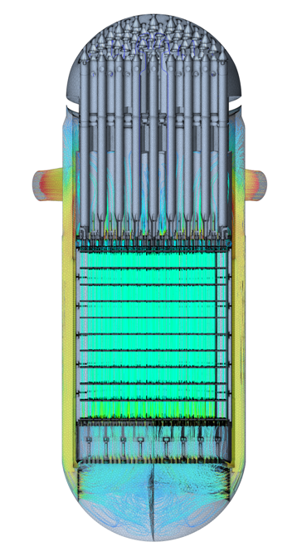
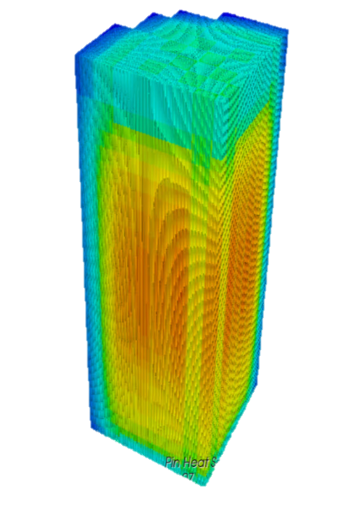
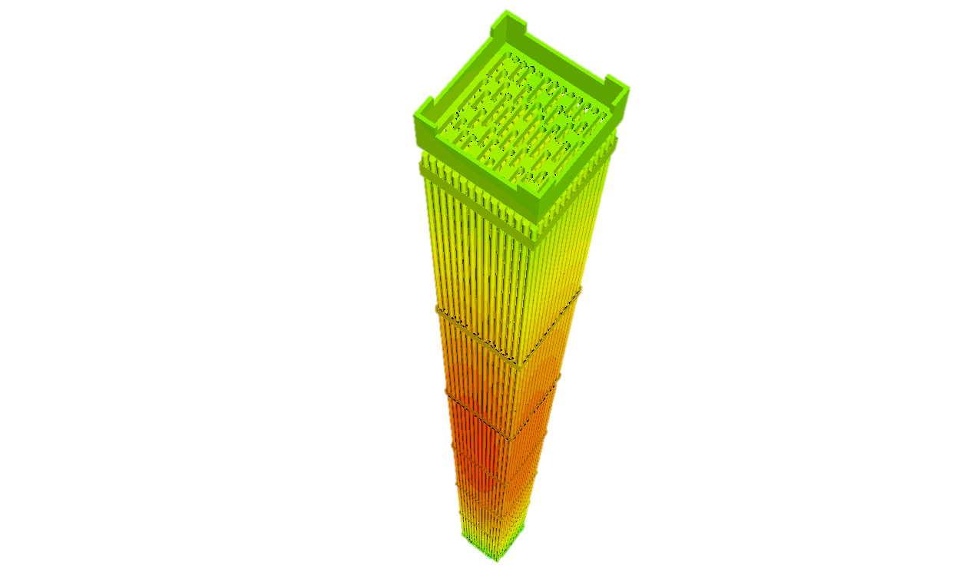
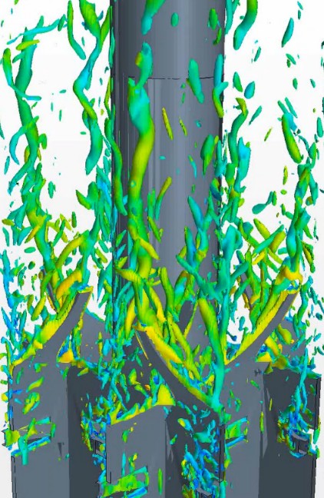

High-fidelity simulations of coolant flow in reactor core
Objective: High fidelity flow-thermal simulations of reactor cores
Challenge: Complex turbulence / computational requirements
Approach: STRUCTure-based hybrid turbulence modeling
Prof. E. Baglietto

Slide 8
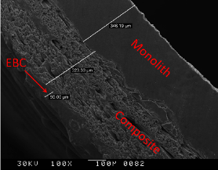
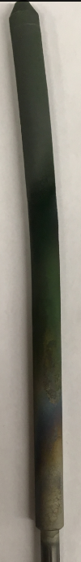
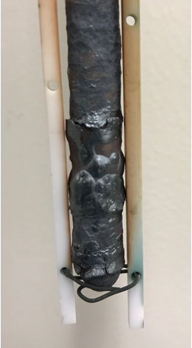
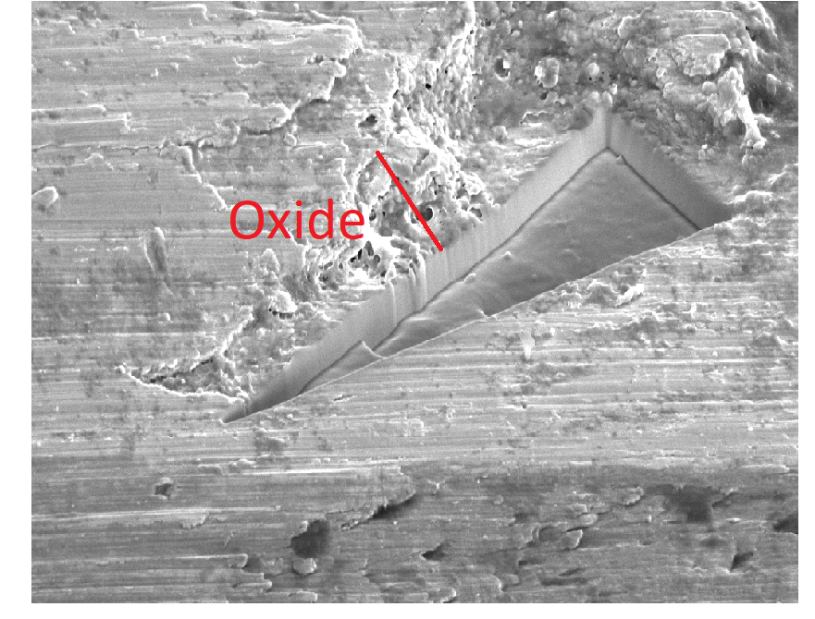
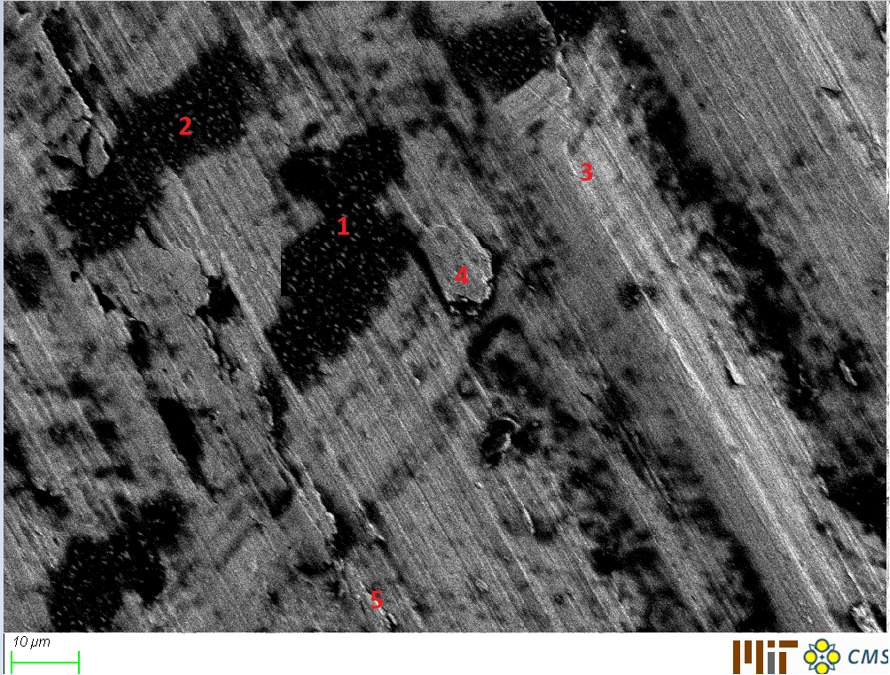
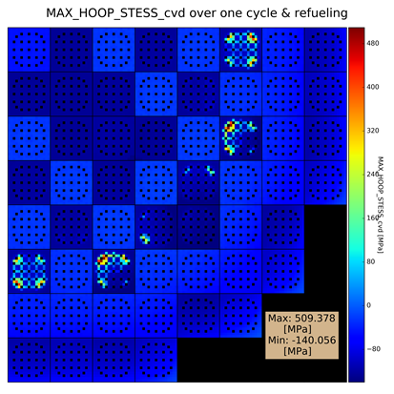
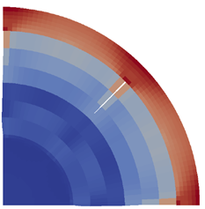
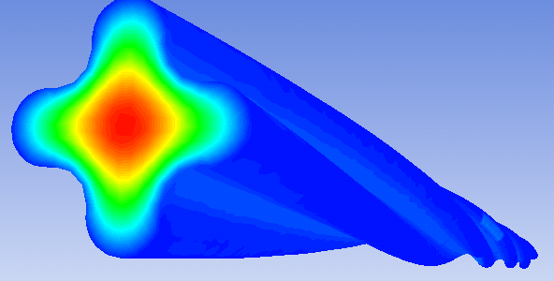
Testing and Modeling of Nuclear Fuels
  Objective: Improve Economics and Safety
    Impact of Fuels on System Level
  Experimental Effort (Steady & Accidents):
    Fuel Cladding: Zirc-4, Coatings, SiC Composites
    Fuel Pellet: UO₂, UN
    Unique High Temperature (up to 2000 ºC) & High Pressure Testing Capability
  Simulation Effort (Steady & Accidents):
    Reactor Physics Analysis (Application)
      Proven/Commercial Tools - STUDSVIK
    Thermal Hydraulics Development and Analysis
      Advanced Simulation Tools - TRACE
    Structural Mechanics Development and Analysis
      High Fidelity Tools – MOOSE/BISON
Prof. Shirvan

Slide 9
Improving Economics of Reactors
  Objective: Acceleration of Innovative Technology R&D to Reduce Nuclear Cost
  Projects Focus on Design and Economics Modeling with Uncertainty for Advanced Reactors (including light water SMRs and power cycles)
    Sponsored by ARPA-E, DOE, EDF, TEPCO
Prof. Shirvan

Slide 10
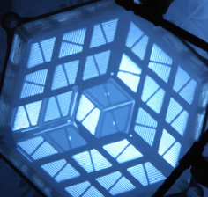
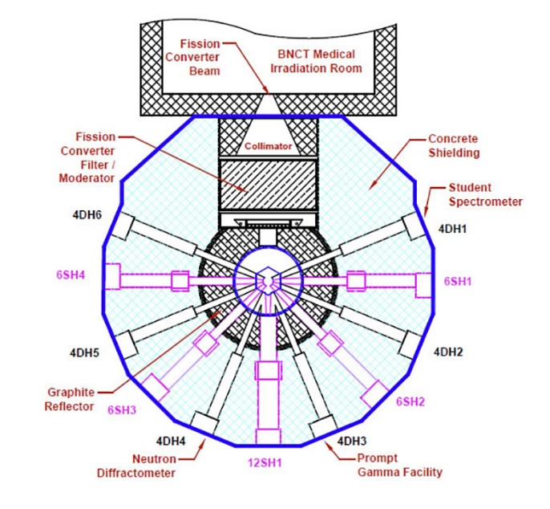
MIT Nuclear Reactor Laboratory
6 MW light water reactor
  HEU fuel
Education
  Student operators
  Lab experiments using beam ports
Research
  LEU conversion
  FHR salt-irradiation
  Accident tolerant fuels and cladding
  Beam optics
Drs. Hu, Kohse, Sun, Carpenter, Moncton, Khaykovich…

