Slide 1
Department Overview
Prof. Dennis Whyte
Grad Orientation Aug 2017

Slide 2
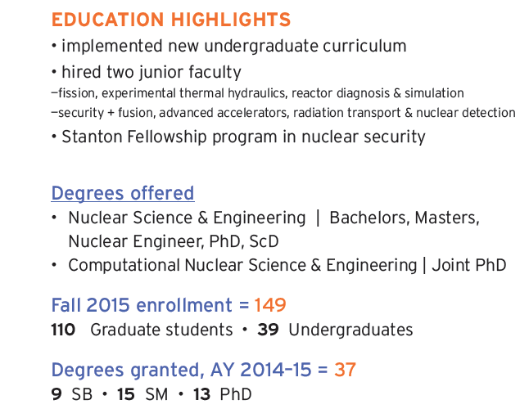
MIT NSE: At a glance

Slide 3
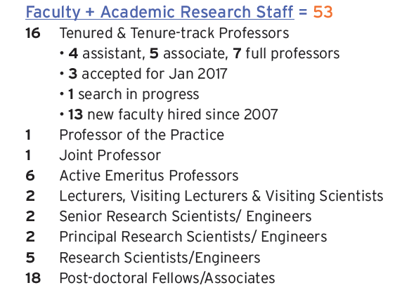
MIT NSE: At a glance

Slide 4
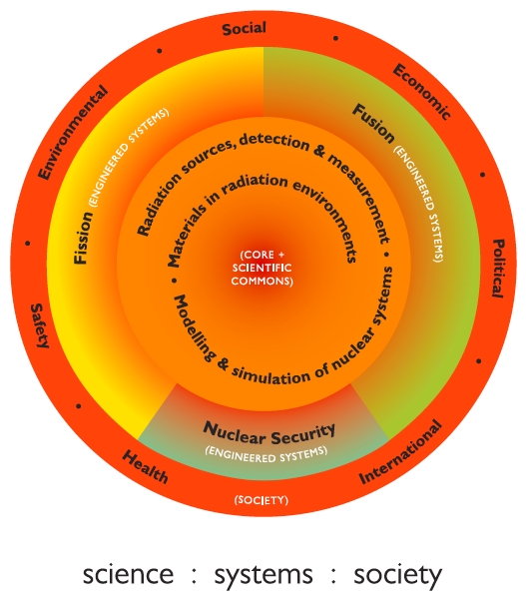
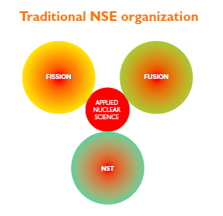
Intellectual structure for NSE
Notes:
Much of this is captured in this diagram, which I showed last time, which describes the shift from three relatively disconnected areas to a more unitary whole, with a strong scientific core supporting research and education in three kinds of engineered systems, and with the societal interface identified more explicitly.
Science. Systems. Society.

Slide 5
Fission energy
Fusion & plasmas
Nuclear Security
Baglietto
Ballinger
Buongiorno
Forget
Golay
Lester
Li
Short
Smith
Yildiz
Hutchinson
White
Whyte
Loureiro
Danagoulian
Kemp
Lanza
Computation & Simulation
Extreme Materials
Sources, detection & control
Notes:
We have lost headcount in some of the traditional application areas, but over the same period, we’ve been building new cross-department networks in the core areas of computation, materials, and radiation sources.

Slide 6
Fission energy
Fusion & plasmas
Nuclear Security
Baglietto
Ballinger
Buongiorno
Forget
Golay
Kazimi
Lester
Smith
Yildiz
Hutchinson
Parra Diaz
White
Whyte
Kemp
AA
EECS
ME
CCE
Computation & Simulation
Baglietto, Forget, Hutchinson, Li, Smith, Yildiz, Yip
Extreme Materials
DMSE
ME
Ballinger, Li, Short, Whyte, Yildiz, Yip
Sources, detection & control
Physics/LNS
RLE
CUA
Cappellaro, Danagoulian, Hartwig, Li, Lanza, Whyte
Integration: systems engineering, design, management & policy
Buongiorno, Forsberg, Golay, Kazimi, Kemp, Lester
Sloan
Poli Sci
MITEI
IPC
CIS
CANES
PSFC
Security Studies
STS, CSAIL
Notes:
NOTE THAT WE’VE MADE MORE PROGRESS IN THE FIRST TWO THAN THE THIRD
In this figure I’ve added in the faculty in the integration areas: systems engineering, design, management, and policy.
These cross-departmental groupings, in addition to building cohesion within the department, are also strengthening our connections with other parts of the Institute.
SO, for example, there is a natural bridge developing between our computation and simulation faculty and the School-wide center for computational engineering, which we believe will create new opportunities for us to attract outstanding graduate students in the computational area.

Slide 7
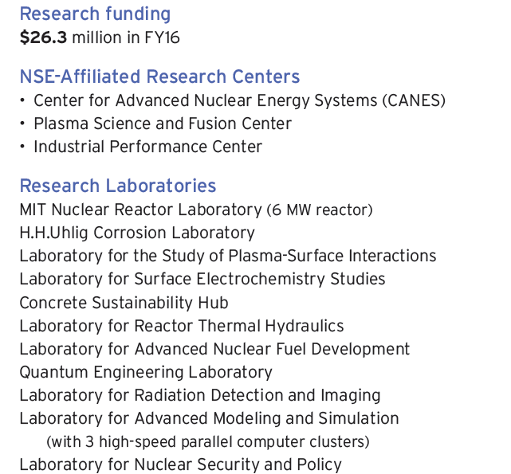
MIT NSE: At a glance

Slide 8
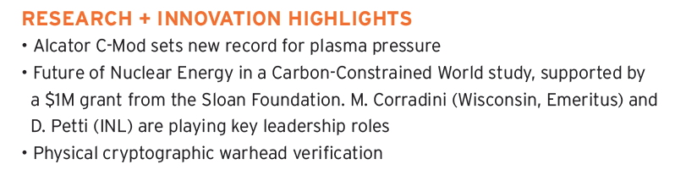
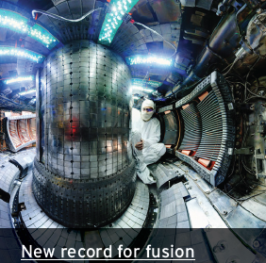
MIT NSE: At a glance

Slide 9
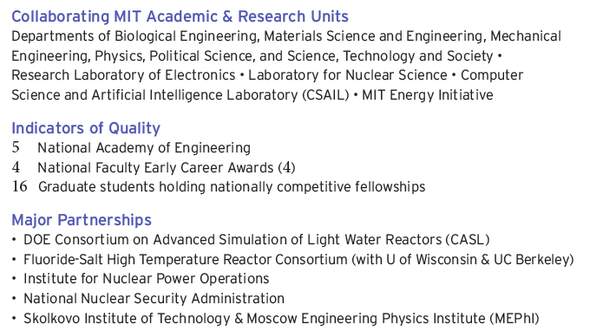
MIT Nuclear Science & Engineering
At a glance

Slide 10
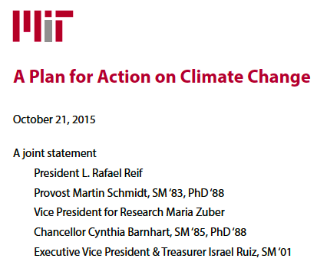
Nuclear is a major part of MIT’s research commitment to tackle climate change
Accelerate progress towards low- and zero-carbon energy technologies
MIT will collaborate with a diverse group of companies to launch
eight Low-Carbon Energy Centers
  Solar, Energy storage, Materials, Carbon Capture, Nuclear Energy
  2017: Fusion, energy bioscience, grid
8 M$ / year for each center over 5 years in funded in industrial / private consortium model
Source: climateaction.mit.edu

Slide 11
Substantial nuclear research infrastructure on the MIT campus

Slide 12
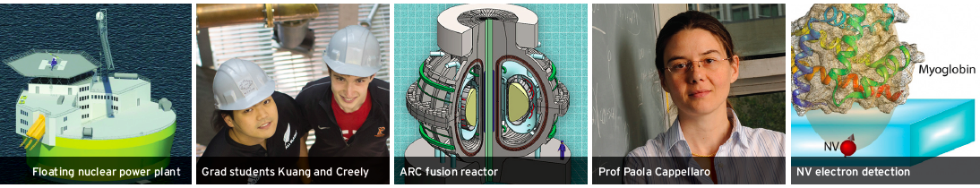
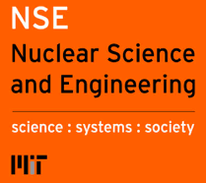
Excellence in NSE research & education, communicated to a broad audience
→ Small but impactful department
Diverse topics: fission, fusion, quantum information, nuclear security
Ten NSE front-page MIT web articles
(Jan.-Sept. 2016)
Critical role in Climate Action Plan of MIT & Low-Carbon Energy Centers

Slide 13
Top Five Misconceptions for Starting Graduate Students
I have to find a research advisor and project on Day 1 or I’ll miss out
This will be like undergraduate, except classes are harder
Qualifying oral exams are an institutionallly approved method of torturing graduate students
I don’t need to pay attention to topic XXX in class YYY because it is not related to my research
If I’m struggling, it will be counted against me if go get help from (pick one: advisor, student officers, MIT Medical)

Slide 14
My advice
Own your education
Work hard
Do something else that isn’t work
Be passionate about our collective mission
“Never doubt that a small group of thoughtful, committed people can change the world; indeed, it's the only thing that ever has”
Margaret Mead

Slide 15
End of Overview

Slide 16
CANES MISSION
We develop transformative methods, materials and technologies to make fission energy systems more:
  Affordable
  Easy to deploy
  Safe
  Sustainable

Slide 17
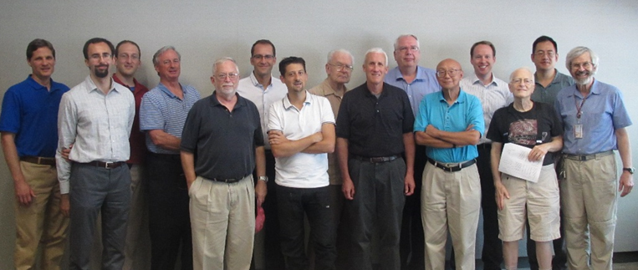
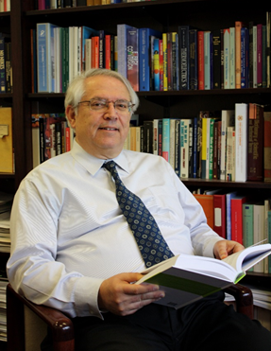
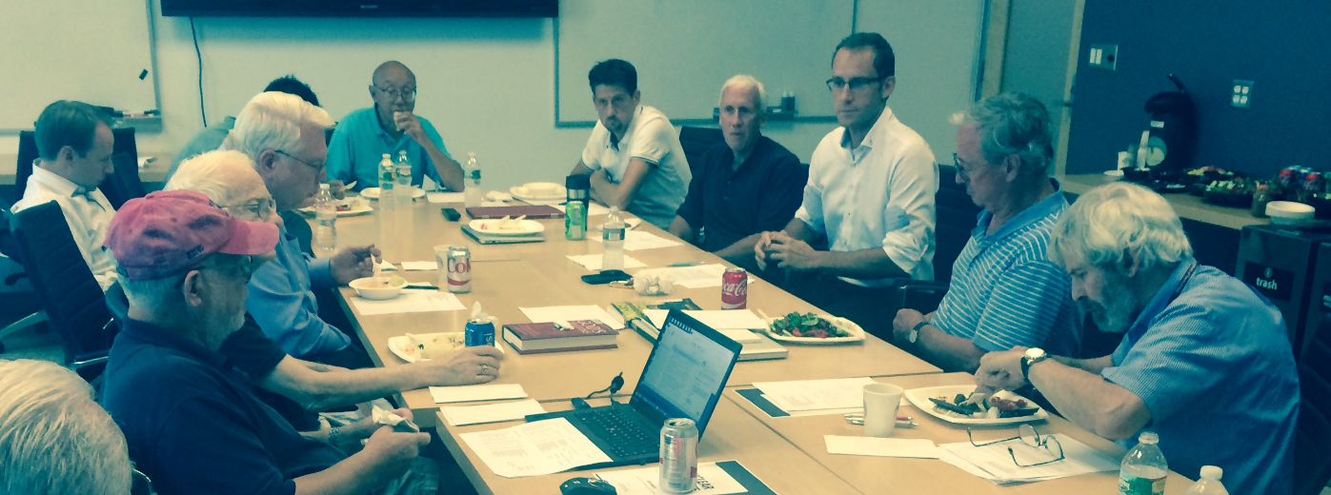
WHO
Founder: Mujid Kazimi
12 full time faculty, 4 research staff, and has continuous collaborations with 20 other faculty and staff who belong administratively to other units of MIT (e.g. MIT Reactor)

Slide 18
RESEARCH VOLUME
$10M/year from external sources. Includes 3 large contracts:
  CASL (~$1.4M/yr)
  DOE-IRP on Salt Cooled Reactors (~$1.25M/yr)
  DOE-IRP on Accident Tolerant Fuels (~$1.6M)~
~75% from DOE and its laboratories and NSF
~25% from industry (EPRI, AREVA, Westinghouse, EdF, Terrapower, Lockheed Martin, Hitachi, DCNS, Exxon-Mobil), foreign labs (CEA) and private foundations and donors
~$700K/yr (additional) is from professional education

Slide 19
CANES activities can be grouped by
APPLICATIONS
  LWRs
  Advanced Reactors
  Nuclear Fuel Cycle
  Nuclear Energy Sustainability and Policy

Slide 20
DISCIPLINES
  Reactor Physics
  Thermal Hydraulics
  Nuclear Materials
  Risk Analysis

Slide 21
THEMES
  Innovations that Matter Now
  Inventing the Future of Fission
  Working at the Foundations of Nuclear Energy Technology
  Educating the Community, Informing the Policy

Slide 22
  Innovations that Matter Now
High-fidelity, high-efficiency methods for reactor physics analysis
CFD methods/models for core performance and boiling heat transfer
New models and codes for LWR fuels
Risk informed regulations and design
Advanced methods for uncertainty quantification and reduction in system and CFD codes
Near-term Accident Tolerant Fuels (ATF)
Deep borehole disposal of spent nuclear fuel

Slide 23
  Inventing the Future of Fission
New nuclear power plant concepts:
Fluoride-Salt-Cooled High-Temperature Reactor (FHR)
Offshore Floating Nuclear Plant (OFNP)
Renewable Boiling Water Reactor (RBWR)
Superheat Boiling Water Reactor
New fuels, cladding and structural materials:
Annular fuel and cruciform rod fuel for LWRs and SFRs
SiC cladding for ATF
Multimetallic layered composite (MMLC) cladding for ATF
Lead-Bismuth Eutectic (LBE) corrosion resistant cladding
Materials for molten salt reactors
Micro-/nano-engineered surface coatings for enhanced heat transfer in LWRs
Engineered coolants (nanofluids) for enhanced heat transfer in LWRs

Slide 24
  Inventing the Future of Fission (2)
New balance-of-plant ideas:
Compact heat exchangers
Supercritical CO₂ cycle (SC-CO₂)
New resources for and products from nuclear plants:
Integrating nuclear with renewables + nuclear beyond the grid
High-temperature electrolyzer cells for H₂ generation
Uranium from seawater

Slide 25
  Working at the Foundations of Nuclear Energy Technology
Advanced diagnostics for boiling and condensation
Study of effects of surface features on boiling heat transfer
Zr alloys corrosion and hydrogen-pickup
CRUD mitigation
Creep nano-, micro- and meso-scale studies
Clad fretting and wear
Corrosion mechanisms and resistance in liquid sodium (TiN films) and molten salt fuel (many alloys)
Advanced environmental TEM to study chemical reactions at nanoscale in situ
Effects of radiation on materials
Non-contact laser ultrasonic quantification of radiation damage in-situ

Slide 26
  Educating the Community, Informing the Policy
Professional Courses:
Nuclear Plant Safety (MIT’s oldest summer course)
Reactor Technology for Nuclear Utilities Executives (23 years, joint with INPO)
Risk-Informed Operational Decision Making (joint with INPO)
International Nuclear Leadership Education Program (joint with IAEA and INPO)
Ad-hoc Courses for Industry (AREVA and ENEC)

Slide 27
  Educating the Community, Informing the Policy (2)
Symposium Series:
Future of Fissile Fuels
Advanced LWR Fuel
Nuclear Energy and the Hydrogen Economy
Simulation of Fuel Cycle
Next Generation Reactor
Innovative Systems
Rethinking the Fuel Cycle
Supercritical CO₂ Power Cycle
Directions for Breakthrough Research

Slide 28


  Educating the Community, Informing the Policy (3)

Slide 29
NUCLEAR AND CLIMATE CHANGE MITIGATION
Strategic goal: replace …% of world’s fossil energy feed with nuclear by 2050
Objective | Near term (<10 years) | Mid-term (10-20 years) | Who will care
Massive electrification of transportation sector | LWRs* | FHRs*, OFNPs* | Automotive industry, electric utilities
Integration of large renewable capacity without electricity price collapse: Ultra-cheap energy storage Production of syn fuels | FIRES* Jet/diesel fuel from seawater (NRL) | H₂ from high-T electrolysis* | Electric utilities, energy/oil/gas companies, energy-intensive industries (e.g. manufacturing, smelters)
Sustainable nuclear fuel cycle: Uranium resources Spent fuel | Mined U Deep boreholes* | U from seawater* Fast reactors* | Mining industry, drilling companies, chemical industry
* Ongoing projects at MIT

Slide 30
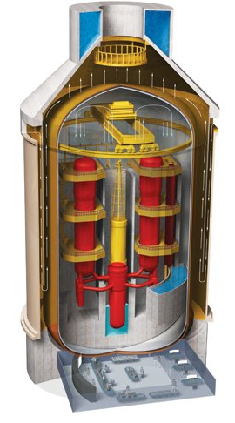
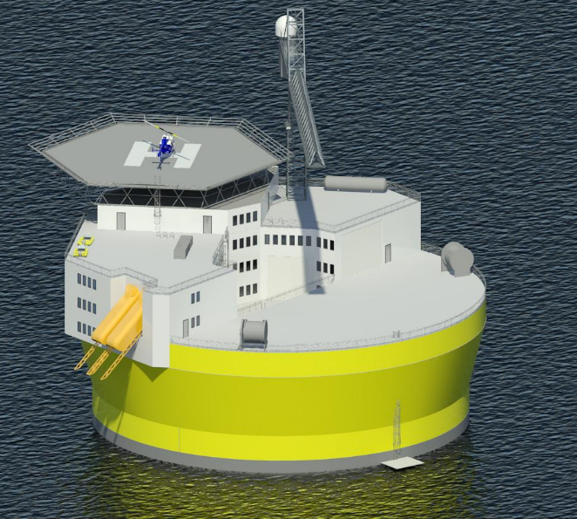
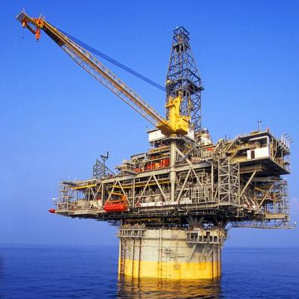
Offshore floating nuclear power plant
+
=
Floating rig
Nuclear reactor
OFNP
Reduced capital cost (>90% cut in reinforced concrete)
Reduced construction/decommissioning schedule
Flexible siting + minimal local infrastructure (‘plug and play’)
Reliable passive cooling; no land/ocean contamination
Profs. J. Buongiorno, M. Golay, N. Todreas

Slide 31
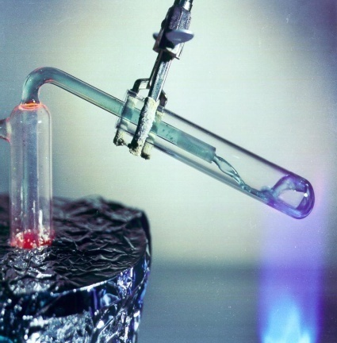
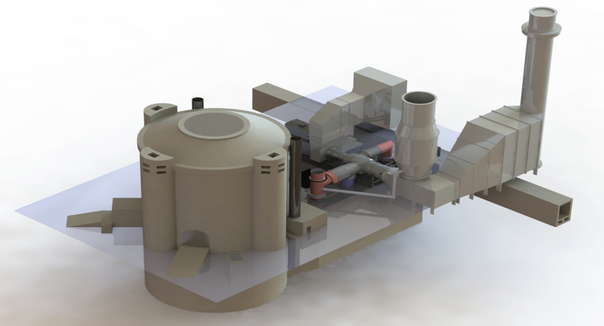
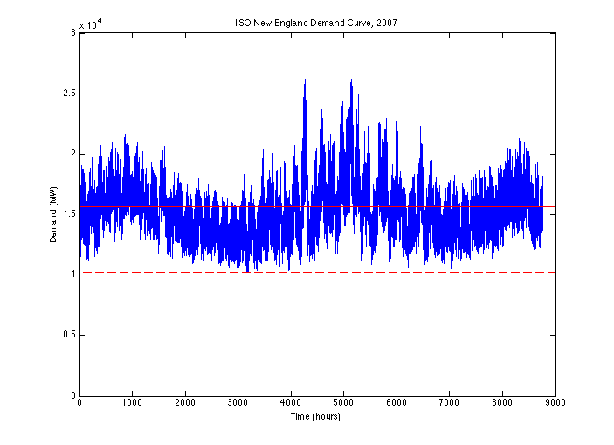
Fluoride-Salt-Cooled High-Temperature Reactor (FHR) with Nuclear Air-Brayton Combined Cycle (NACC)
Stored Heat and/or Natural Gas
Base-Load
Reactor
Gas
Turbine
Variable
Electricity
Low-pressure, inert coolant; accident-tolerant TRISO fuel
50 to 100% greater revenues than base-load plant
Enables zero-carbon electricity grid when coupled to heat storage
Drs. C. Forsberg, L. Hu

Slide 32
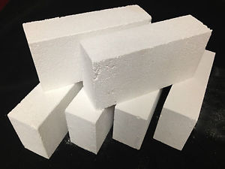
Firebrick Resistance-Heated Energy Storage (FIRES) Stops Renewable Revenue Collapse
Firebrick electrically heated when low electricity prices; less than price of natural gas
Hot firebrick provides hot air to partly substitute for natural gas in industrial furnaces
Expect capital cost less than $5/kWh based on history with home-heating firebrick systems
Changes electricity price curves
Aids nuclear and renewables
Tokyo Electric example
Dr. C. Forsberg

Slide 33

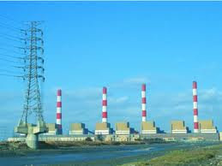
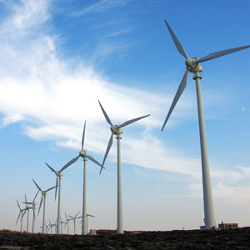
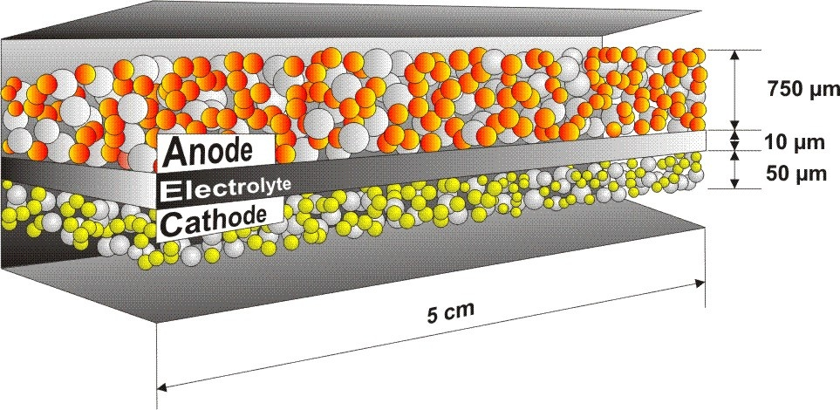
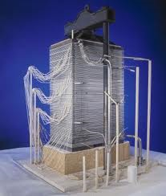
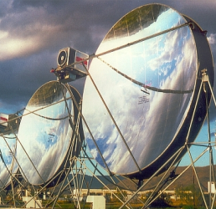
Coupling of nuclear energy- and CO₂-sources through high-temperature fuel cells and electrolyzers
Coal Power Plant
Synthetic fuel, gasoline
CO₂
Nuclear, Solar, Wind
CO₂ + H₂O
H₂ + CO
Solid Oxide Fuel / Electrolysis Cell
Heat, Electricity
V
O⁼
ANODE
e⁻
ELECTROLYTE
CATHODE
O₂
Electricity to grid
Stored energy
(Electricity)
Syn-gas for liquid fuels synthesis
SOEC technology is at developmental stage (support by DOE and NASA)
Profs. B. Yildiz, A. Ghoniem
Notes:
Technology is not widely commercial yet. SOFC has been commercialized, at scale of home-use, for example in Japan and in some European countries. SOEC for electrolysis of H2O and CO2 is rather developmental stage now, in the US supported by DOE and NASA.
Also, the same picture could be drawn by replacing the SOEC with a thermochemical splitting of H2O and CO2, only by taking the high temperature heat from the nuclear, concentrated solar etc. While I was skeptical to it earlier, there has been recent developments using almost exactly the same materials as in SOECs. I am working on a related activity with Ahmed Ghoniem, for example.

Slide 34
Uranium from Seawater
Virtually unlimited supply: could support ~10,000 GWe of current LWRs for ~2000 years; more FBRs and longer by factor of >10
Mined uranium is plentiful: Seawater U represents a backstop for U price
MIT hosted an International Meeting on Uranium from Sea in 1980
NSE project 1976-1987, including sea trials at Woods Hole, established Acrylic Amidoxime as the best absorber – still the case today, with new refinements underway by ORNL
Currently evaluating advanced contactor and recovery systems
Profs. M. Driscoll, A. Slocum

Slide 35
Deep Borehole Disposal of Spent Nuclear Fuel
Drill and pay as you go
Vast oil, gas and geothermal drilling contractor experience
Not heat limited
Situated in chemically reducing environment, below water zone
Confinement assurance improves with depth
Can be hosted by a variety of ubiquitous rock strata: granite, basalt, salt (dome or bedded), shale
Profs. M. Driscoll, E. Baglietto, J. Buongiorno

Slide 36
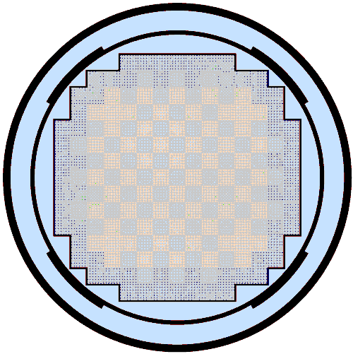
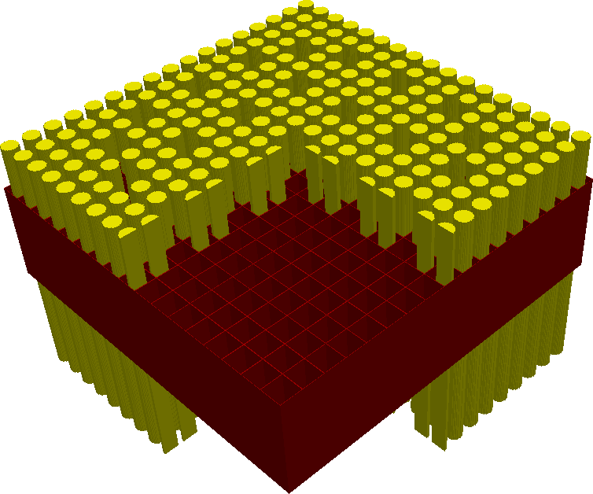
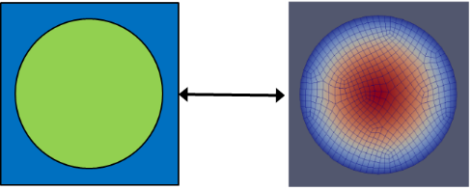
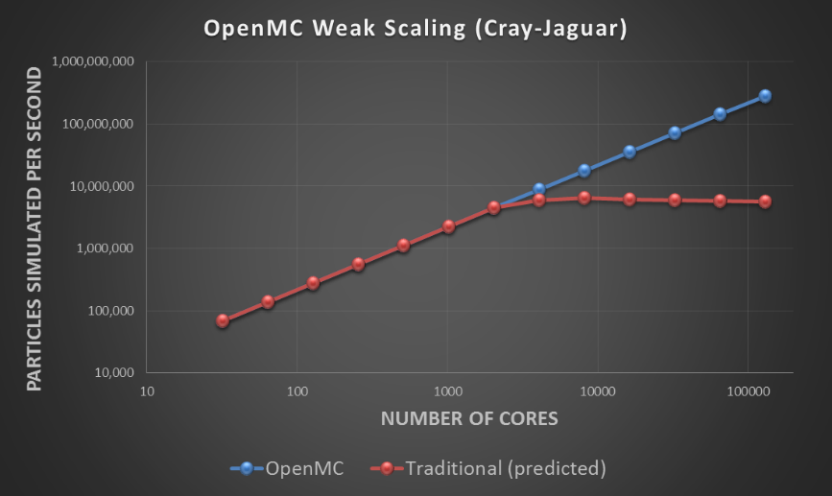
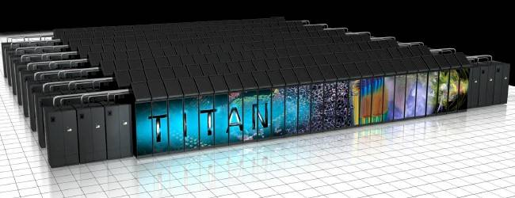
High-fidelity simulations of full reactor cores
Coupling from MC mesh to FEM mesh using orthogonal basis
Full core PWR model
MIT Computational Reactor Physics Group
  Profs. Benoit Forget and Kord Smith
  17 graduates students
Focus on high performance computing in particle transport, improved physical models, and open source software for research and education
DOE Funding sources: CASL, CESAR, INL, NEUP

Slide 37
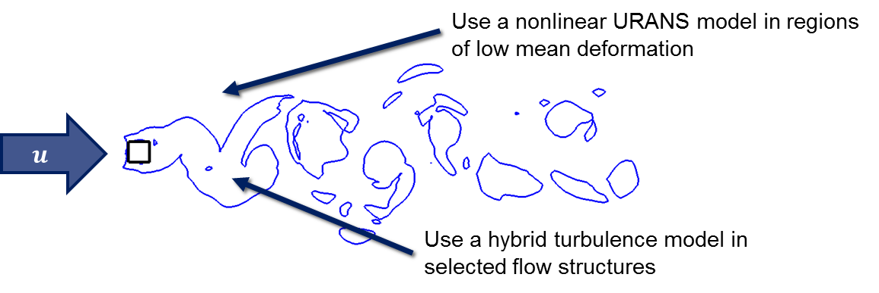
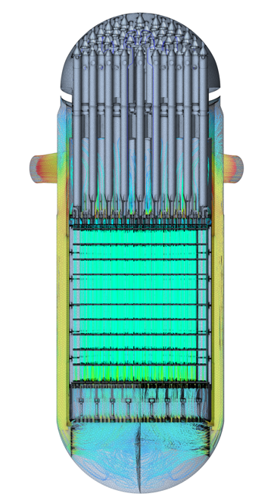
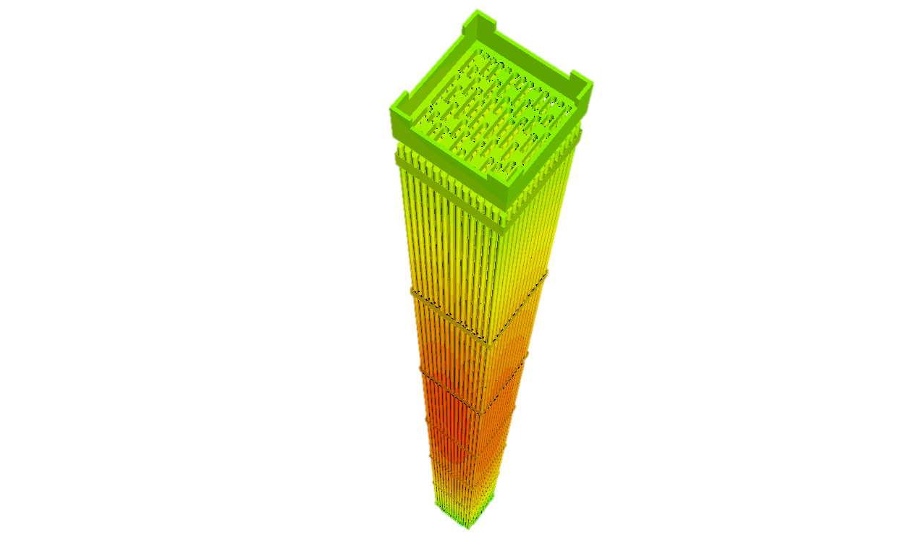
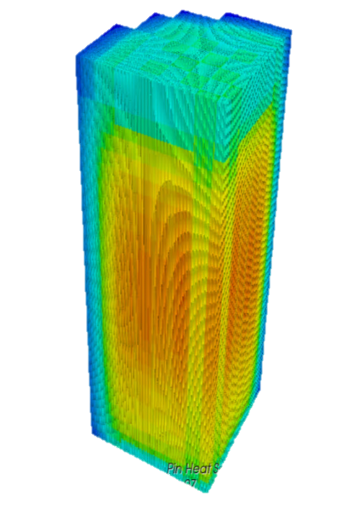
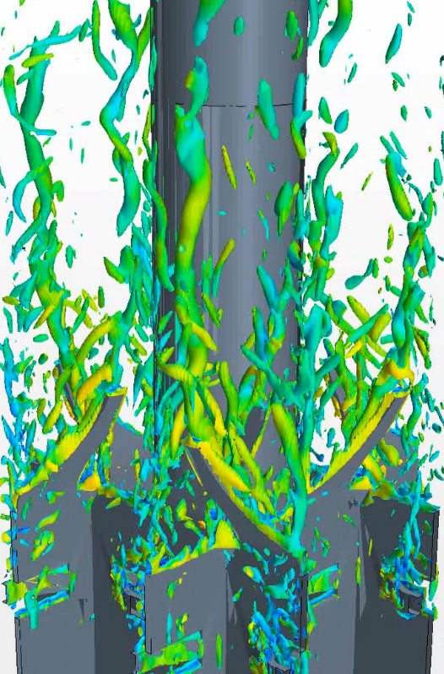

High-fidelity simulations of turbulent flow in reactor core
Objective: High fidelity flow-thermal simulations of reactor cores
Challenge: Complex turbulence / computational requirements
Approach: STRUCTure-based hybrid turbulence modeling
Prof. E. Baglietto

Slide 38
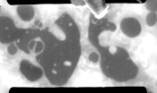
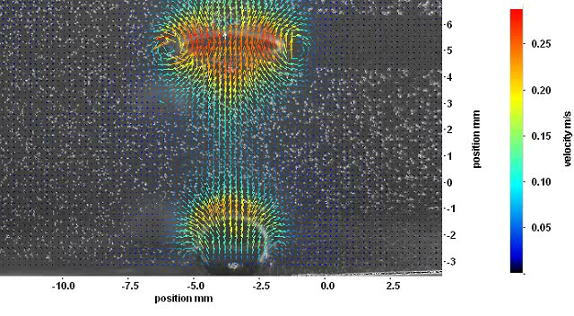

Painting the complete physical picture of boiling heat transfer
Phase distribution on the boiling surface
Velocity distribution near the boiling surface
Temperature distribution on the boiling surface
Prof. J. Buongiorno, Dr. T. McKrell

Slide 39
Supercritical CO₂ Power Cycle
Better than Rankine and Brayton above 550ºC: Higher Efficiency, More Compact, Cheaper
Improvements in gas turbines and compressors continue to elevate prospects
Prof. M. Driscoll

Slide 40
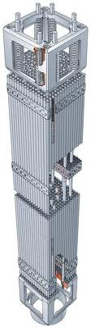
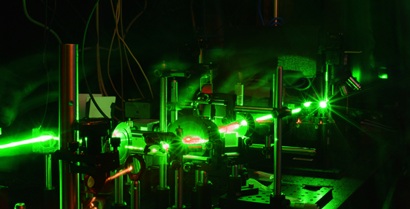
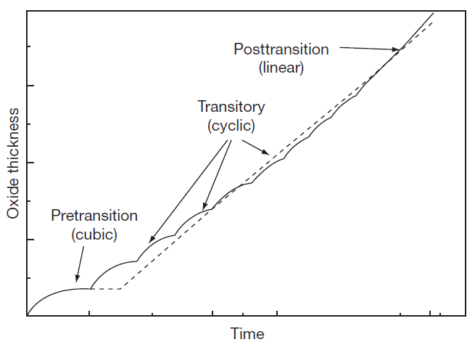
Corrosion, radiation and embrittlement resistant alloys for LWRs
Planar Compression
Profs. B. Yildiz, R. Ballinger, M. Short
Notes:
First example is on zirconium alloys. Zr alloys are used for making a very critical component in nuclear reactors, that is the cladding of nuclear fuel (so, the first barrier to enclose the radioactivity). Corrosion and the amount of hydrogen that gets into them are a safety criterion. An oxide layer forms on the metal in high temperature water, called ZrO2. And the ZrO2 serves then as the barrier both to corrosion and to hydrogen penetration. The microstructure is complex, polycrystalline, under stress, defected and even cracked.
Because of low solubility of many metals in hcp Zr, the alloy typically has very small precipitates. In the oxide, these precipitates dissolve and dope the Zr-oxide barrier layer. What happens at this outer interface is the following: water splits, releases its oxygen, oxygen diffuses and oxidizes the metal. A byproduct of this reaction is hydrogen. Ideally we want hydrogen simply be disposed as H2 gas into the liquid. But it doesn’t always only do that. Some of the hydrogen actually gets into the metal. This is a detrimental outcome! Because…. It makes the metal more susceptible to fracture. The crack initiation stresses decrease, and the crack growth rates increase. In the metals, this problem has been really widely studied. BUT, hydrogen goes into the metal THROUGH THE OXIDE. So just like the oxide serves as a barrier to corrosion, we believe it serves also as a barrier to hydrogen.

Slide 41
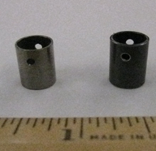
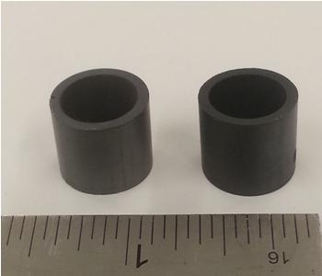
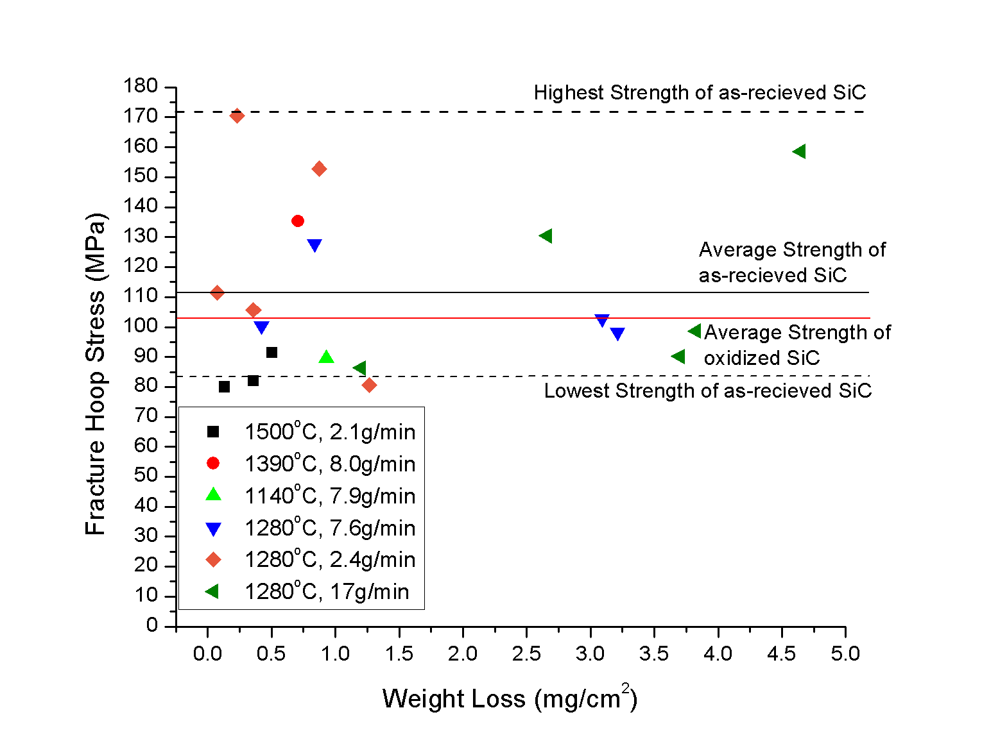
Accident Tolerant Fuel for LWRs
Objectives:
Reduce or eliminate cladding-coolant interaction and hydrogen production in accidents
Lengthen time-to-melt for the fuel
Solutions:
Metallic (FeCrAl) or ceramic (MAX phase) coated Zry cladding (near-term)
SiC cladding (long-term)
Zry-4: before and after oxidation
SiC : before and after oxidation
Dr. K. Shirvan, Profs. M. Short, R. Ballinger

Slide 42
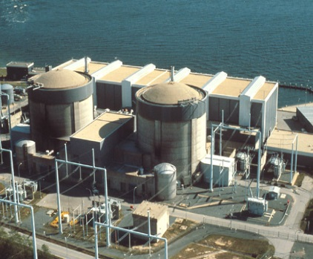
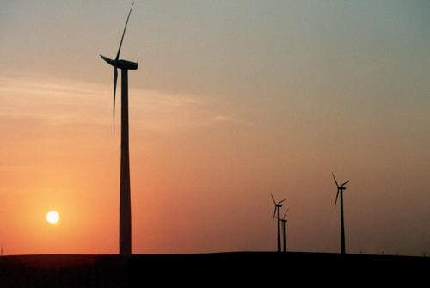
Options to Integrate Nuclear & Renewables
Electricity
Variable
Electricity Storage
Variable
Variable Heat
Store Heat to Produce Variable Electricity
Variable
Full Capacity for High-Capital-Cost,
Low-Operating-Cost Electricity Generation
Electricity to Stored Heat: Sets Minimum Electricity Price
Heat to
Industry
Heat
Variable
Heat
Electricity Grid with Variable Electricity
Demand
Steady-State Heat
Nuclear Topping Cycle
Peak
Base
H₂
Second Product
Variable Heat
Hybrid
Variable
Electricity
Dr. C. Forsberg (Strategies for a Low-Carbon Electricity Grid With Full Use of Nuclear, Wind and Solar Capacity to Minimize Total Costs, MIT-ANP-TR-162, August 2015; http://mitei.mit.edu/publications/reports-studies/strategies-low-carbon-electricity-grid-full-use-nuclear-wind-and-solar-)

