Slide 1

Department Business
NSE Staff; Getting Stuff done since 1958
Peter Brenton, NSE Grad Orientation August 2020

Slide 2
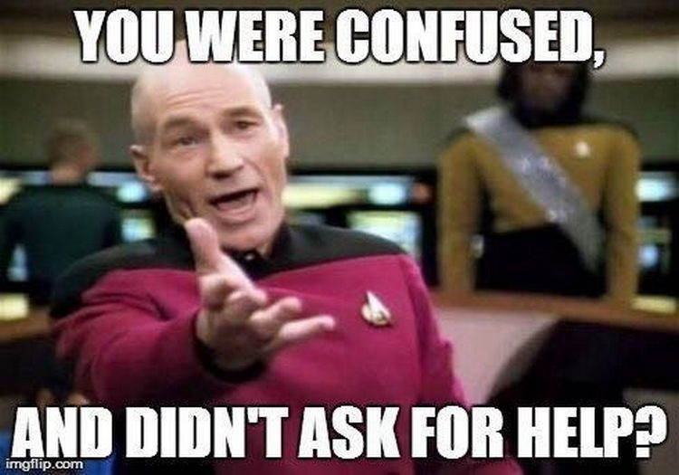
NSE Staff are here to help
But we need you to ask.

Slide 3


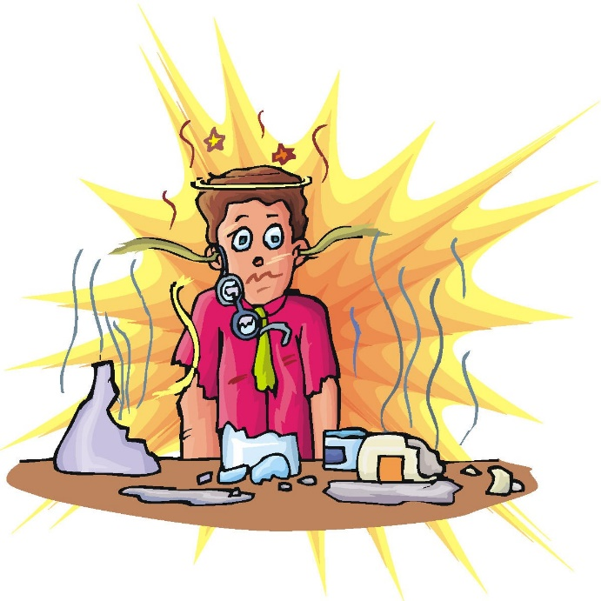
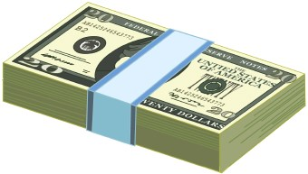
Business!
Money
Travel
Buying things
Offices and other space
Fixing things
Safety
Department Staff

Slide 4
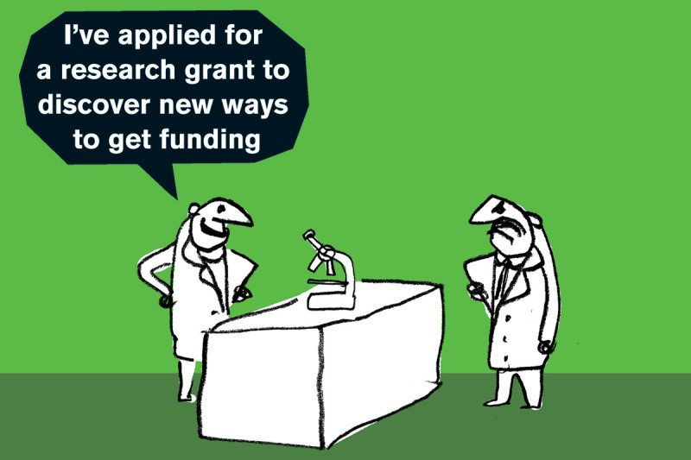
Funding Your Salary
Flavors of money – NSE/Ext Fellowship, TA, Research, Other
Implications of Sponsored Funding (Research Assistantships)
Brief Process Overview – 9-18 mo. Cycle for grants

Slide 5
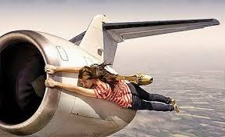
Travel
Travel card program and Concur
  Concur.mit.edu
  Full FAQ
Travel grant program
  Email nsetravelgrants@mit.edu
  Typically 50% of a domestic trip 1x/academic year.
  Present Results!
“Pete said we have to save money on our travel budget.”

Slide 6

Buying Things
One offs, Office Supplies
  See your Advisor’s assistant
Printer supplies, paper, toner, computer parts
  See Teva Regule
Lab supplies, projects
  Pcard, Coupa b2p
TAs –Ask Pete
Invoices, Packing Slips, Documentation

Slide 7
Covid-19 Access
Campus access via covidpass for research – see your research supervisor.
Limited doors, testing, daily attestation.
Course access handled by the Registrar.
Whereis.mit.edu door overlay.

Slide 8
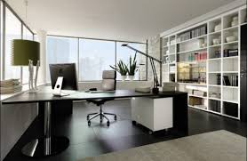
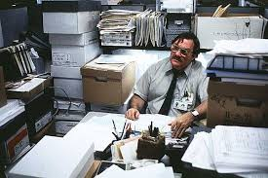
Your Office
What I think I’m giving them…
Reasonable to expect;
  Working heat/AC/wired ethernet/power/lights
  Good chair, desk, a door that locks
  About 60 s.f. of your own space
  Trash removal, cleaning, security, safe working conditions
  Accessibility accommodations
Not Reasonable to expect
  A couch
  A private office
  Lack of mice
  Pete reading your mind
  Please try to keep your office clean
  Note about PSFC, RLE, CMSE Spaces
  If you ask, we can fix it
What they think it looks like…

Slide 9
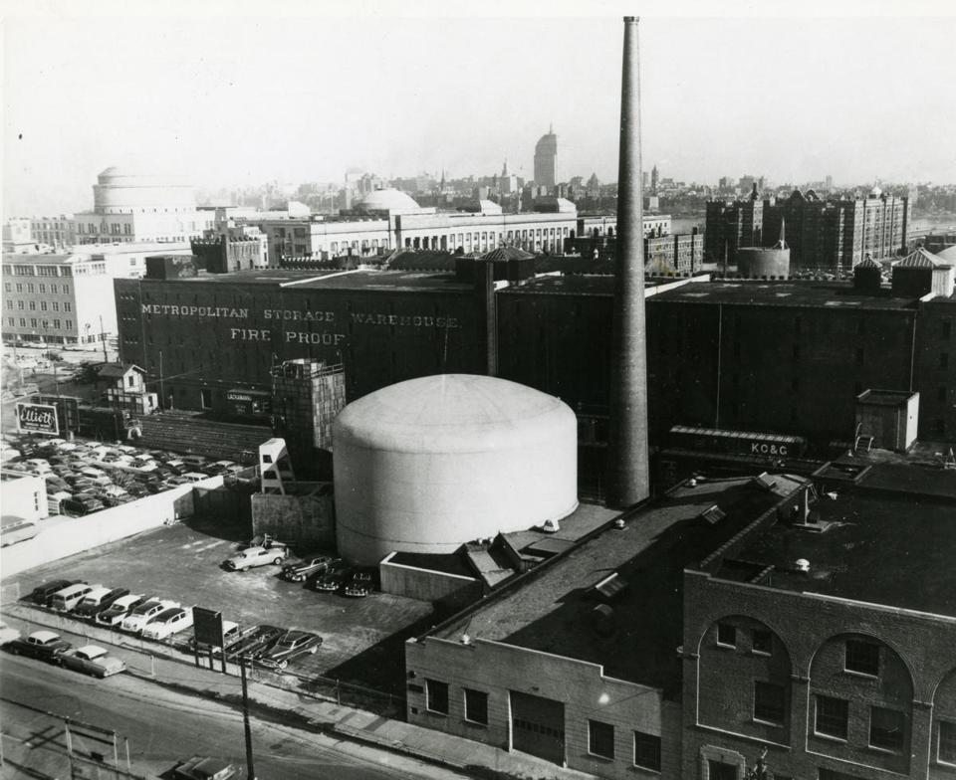
MIT Reactor Security
All NW buildings are connected, don’t let people in. Be rude if you must
The NRC has NO Sense of humor! (Trust me!)

Slide 10
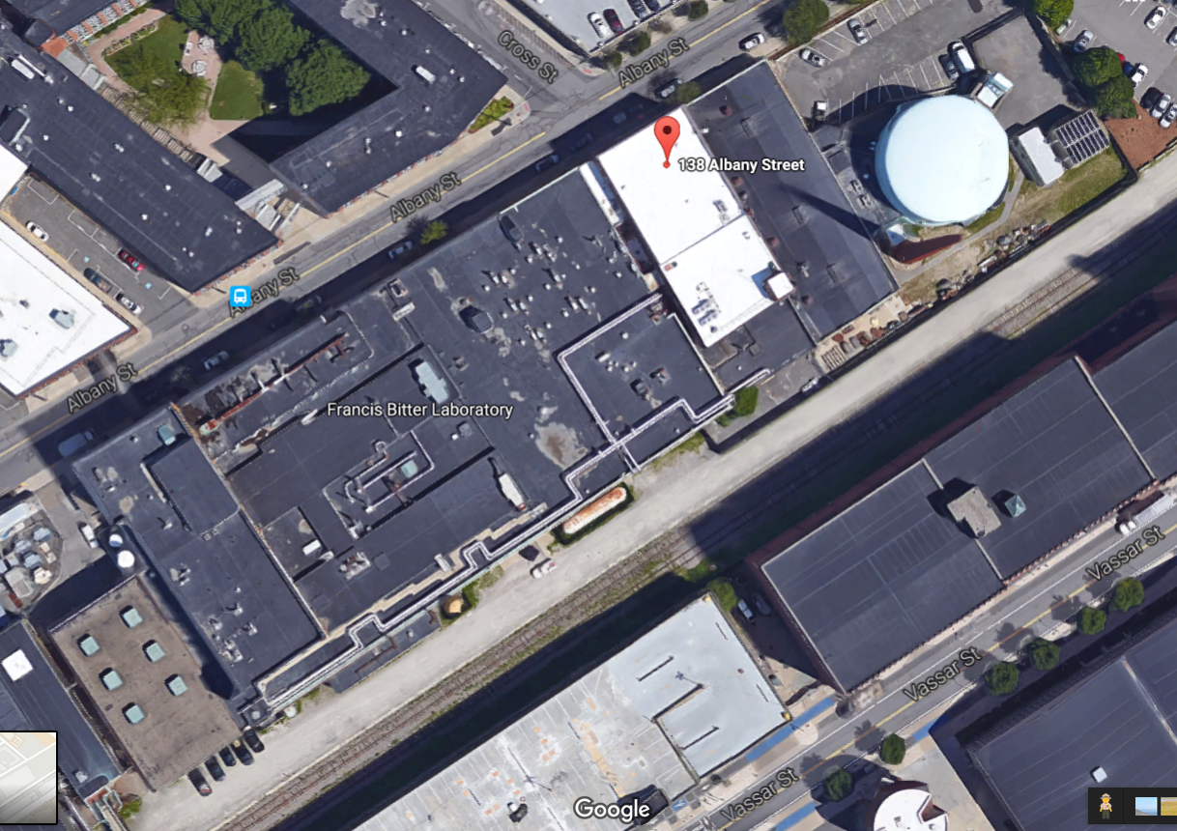
NW12
NW13
NW14
BOOM!

Slide 11

Safety
Every lab worker requires training before you are allowed to use the lab. Your research supervisor (or their lab representative) will initiate this.
Special topics;
Hazardous Chemicals
NW12 radiation alarm
Fire Alarms
Hazards, issues, problems
Albany Street ‘customers’

Slide 12
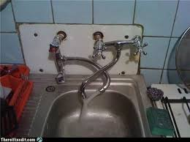
Fixing Broken things and Cleaning Messes
Report Problems!
  Email: dof-csc@mit.edu
  http://Atlas.mit.edu fill out service request
  Call FIXIT (3-4549 or 617-253-4549)
  Email me at pbrenton@mit.edu
  Especially for chronic problems or when Facilities is slow to respond.
  REPORT IMMEDIATE ISSUES TO FACILITES FIRST!
“Facilities has closed your work order.”

Slide 13
Everything Else – Brandy and Pete
“Who do I ask about…”
“I don’t think this is fair…”
“What’s the best way to get MIT to pay for…”
“There’s this thing about MIT that’s always bugged me…”
“This does not seem safe…”
Other serious issues – Title IX, office behavior, accessibility.

Slide 14

People
Valerie Censabella – HR/Payroll, Forms and issues (for hourly jobs like graders)
Ellina Patton, Katrina Ricotta – Research Finance, travel and purchase approval.
Rob Allison– Purchasing card paperwork, Purchase orders, invoices, payments.
Anne Dulong, Lisa Magnano-Bleheen – Admin Assistants on First Floor.

Slide 15
More People
Teva Regule– Computers, IS&T problems, Printers, Accounts, Computer codes/software
Peter Stahle – Our EHS Officer - Lab Safety
Your Advisor – Academics, research direction
Your Advisor’s Assistant – Travel, buying, course information.
Pete B./Brandy – Everything else not covered above.

Slide 16
Professor’s Assistants
Rachel Batista – Short, Danagoulian, Ju Li
Nancy Iappini – Golay, Yildiz, Kemp, Mingda Li
Carolyn Carrington – Buongiorno, Baglietto, Bucci
Kristi Stone – Shirvan, Forsberg
Valerie Censabella –Loureiro, Hutchinson
Lisa Magnano-Bleheen – White, Forget
Jennifer James (PSFC) Hartwig, Whyte
Dianne Lior (RLE) Cappellaro

Slide 17

We want to fix your problem.
https://wikis.mit.edu/confluence/display/NSE/NSE+Wiki+Home

