Slide 1


NSE Communication Lab
Communication support for scientists, by scientists
Marina Dang
Manager

Slide 2
Grad student milestones
are often coupled with communication tasks.
Relative stress
Committee meeting presentations
Quals paper
+ presentation
Thesis
+ defense
Paper submission
Fellowship app. deadline
CV
+ cover letter
Expo poster
You Are Here
Conference talk
22.16 paper
Time in NSE’s PhD program
Individual experiences vary

Slide 3
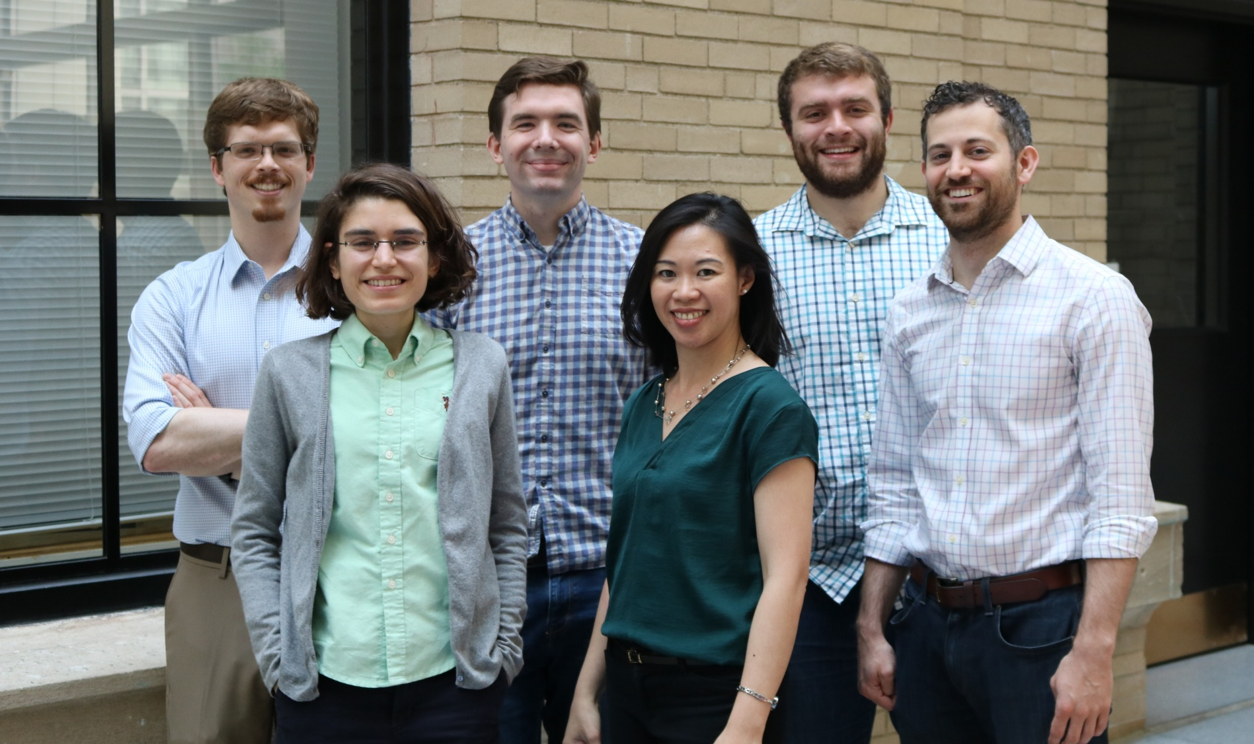
The NSE Communication Lab
is here to support you.

Slide 4
We help with a spectrum
of communication tasks.
160
111
104
68
49
47
43
36
29
22
19
18
14
10
Total appointments: 730
NSE Communication Lab | Data period 9/15/14 – 8/15/18

Slide 5
We help with a spectrum
of communication tasks.
28
43
Quals papers and presentations
NSE Communication Lab | Data period 9/15/14 – 8/15/18

Slide 6
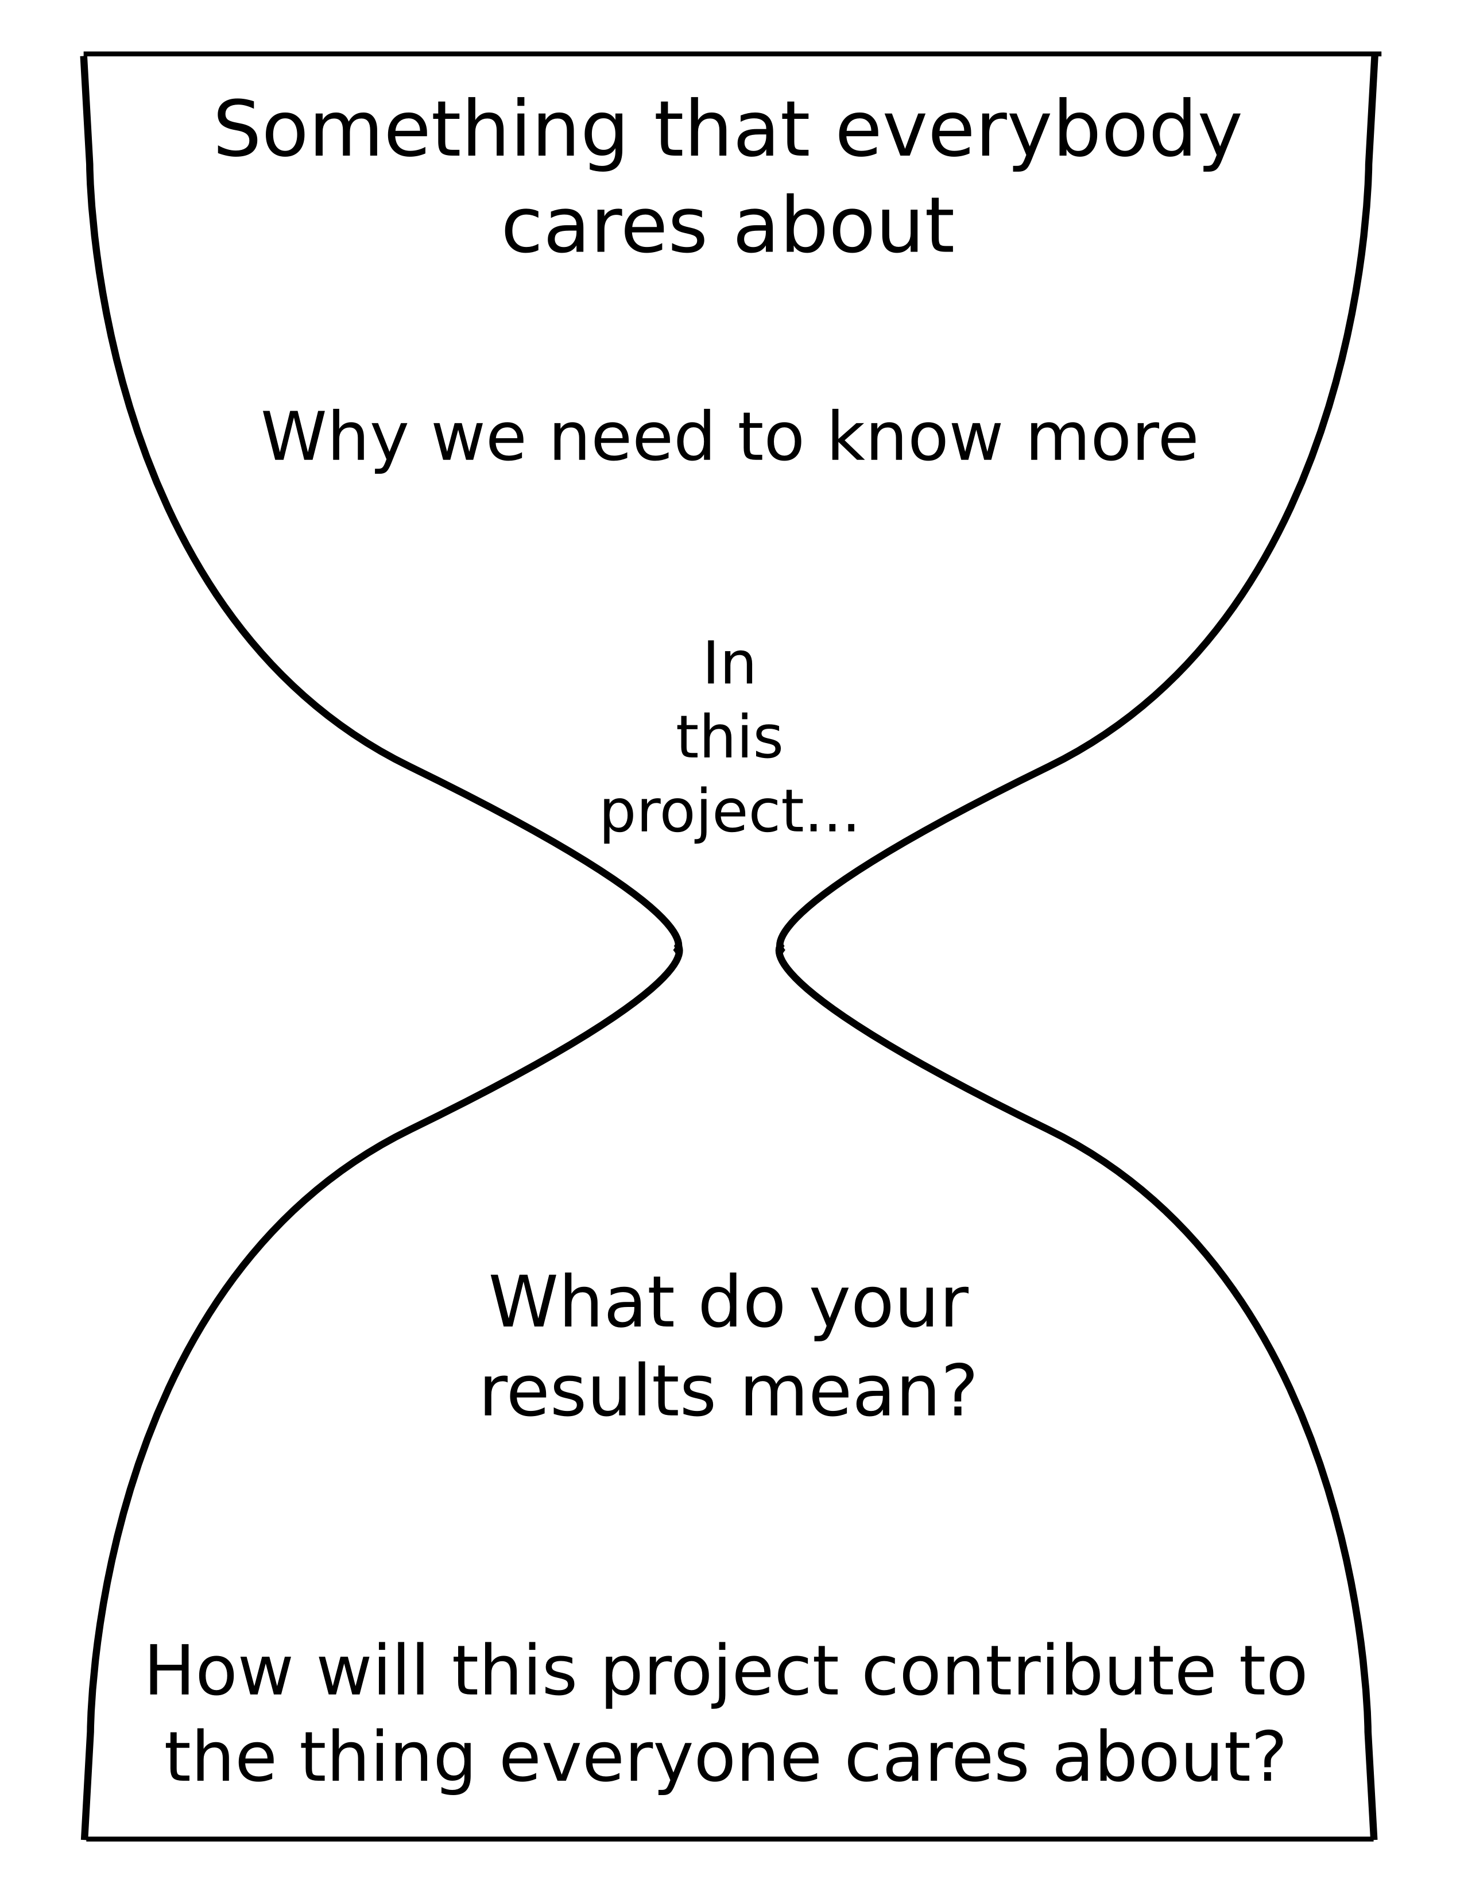
An effective abstract
is an hour-glass shaped message.

Slide 7
An effective abstract
Effective communication in engineering fields has been recognized as a crucial tool for success. In fact, NSE alumni who responded to an MIT survey reported that communication skills were more important in their careers than technical and analytical skills. However, the survey also revealed that while MIT had prepared its students well to solve complex problems, their training in communication had been insufficient. Here we describe the impact of a communication resource “for scientists by scientists” launched by NSE to fill this educational gap. As a peer coaching program, the Communication Lab is designed to help students and post-docs with their writing, speaking, and visual design needs, including oral presentations, coursework, and theses. Over the last four years, NSE graduate students trained as Communication Fellows hosted over 730 coaching appointments to 209 individual students and postdocs. In 2017-2018, 63% of users were return clients. Lab users reported higher levels of confidence, while faculty noticed stronger communication skills among their students. The Communication Lab model highlights the importance of a coach’s familiarity with the technical content, and offers a new alternative to traditional communication resources where the coach is primarily a trained writing professional.
General background

Slide 8
An effective abstract
Effective communication in engineering fields has been recognized as a crucial tool for success. In fact, NSE alumni who responded to an MIT survey reported that communication skills were more important in their careers than technical and analytical skills. However, the survey also revealed that while MIT had prepared its students well to solve complex problems, their training in communication had been insufficient. Here we describe the impact of a communication resource “for scientists by scientists” launched by NSE to fill this educational gap. As a peer coaching program, the Communication Lab is designed to help students and post-docs with their writing, speaking, and visual design needs, including oral presentations, coursework, and theses. Over the last four years, NSE graduate students trained as Communication Fellows hosted over 730 coaching appointments to 209 individual students and postdocs. In 2017-2018, 63% of users were return clients. Lab users reported higher levels of confidence, while faculty noticed stronger communication skills among their students. The Communication Lab model highlights the importance of a coach’s familiarity with the technical content, and offers a new alternative to traditional communication resources where the coach is primarily a trained writing professional.
General background
Specific background

Slide 9
An effective abstract
Effective communication in engineering fields has been recognized as a crucial tool for success. In fact, NSE alumni who responded to an MIT survey reported that communication skills were more important in their careers than technical and analytical skills. However, the survey also revealed that while MIT had prepared its students well to solve complex problems, their training in communication had been insufficient. Here we describe the impact of a communication resource “for scientists by scientists” launched by NSE to fill this educational gap. As a peer coaching program, the Communication Lab is designed to help students and post-docs with their writing, speaking, and visual design needs, including oral presentations, coursework, and theses. Over the last four years, NSE graduate students trained as Communication Fellows hosted over 730 coaching appointments to 209 individual students and postdocs. In 2017-2018, 63% of users were return clients. Lab users reported higher levels of confidence, while faculty noticed stronger communication skills among their students. The Communication Lab model highlights the importance of a coach’s familiarity with the technical content, and offers a new alternative to traditional communication resources where the coach is primarily a trained writing professional.
General background
Specific background
Statement of problem or knowledge gap

Slide 10
An effective abstract
Effective communication in engineering fields has been recognized as a crucial tool for success. In fact, NSE alumni who responded to an MIT survey reported that communication skills were more important in their careers than technical and analytical skills. However, the survey also revealed that while MIT had prepared its students well to solve complex problems, their training in communication had been insufficient. Here we describe the impact of a communication resource “for scientists by scientists” launched by NSE to fill this educational gap. As a peer coaching program, the Communication Lab is designed to help students and post-docs with their writing, speaking, and visual design needs, including oral presentations, coursework, and theses. Over the last four years, NSE graduate students trained as Communication Fellows hosted over 730 coaching appointments to 209 individual students and postdocs. In 2017-2018, 63% of users were return clients. Lab users reported higher levels of confidence, while faculty noticed stronger communication skills among their students. The Communication Lab model highlights the importance of a coach’s familiarity with the technical content, and offers a new alternative to traditional communication resources where the coach is primarily a trained writing professional.
General background
Specific background
Statement of problem or knowledge gap
“Here we show / report …”
(a 1-sentence summary)

Slide 11
An effective abstract
Effective communication in engineering fields has been recognized as a crucial tool for success. In fact, NSE alumni who responded to an MIT survey reported that communication skills were more important in their careers than technical and analytical skills. However, the survey also revealed that while MIT had prepared its students well to solve complex problems, their training in communication had been insufficient. Here we describe the impact of a communication resource “for scientists by scientists” launched by NSE to fill this educational gap. As a peer coaching program, the Communication Lab is designed to help students and post-docs with their writing, speaking, and visual design needs, including oral presentations, coursework, and theses. Over the last four years, NSE graduate students trained as Communication Fellows hosted over 730 coaching appointments to 209 individual students and postdocs. In 2017-2018, 63% of users were return clients. Lab users reported higher levels of confidence, while faculty noticed stronger communication skills among their students. The Communication Lab model highlights the importance of a coach’s familiarity with the technical content, and offers a new alternative to traditional communication resources where the coach is primarily a trained writing professional.
General background
Specific background
Statement of problem or knowledge gap
“Here we show / report …”
(a 1-sentence summary)
Detailed summary
of high-level results

Slide 12
An effective abstract
Effective communication in engineering fields has been recognized as a crucial tool for success. In fact, NSE alumni who responded to an MIT survey reported that communication skills were more important in their careers than technical and analytical skills. However, the survey also revealed that while MIT had prepared its students well to solve complex problems, their training in communication had been insufficient. Here we describe the impact of a communication resource “for scientists by scientists” launched by NSE to fill this educational gap. As a peer coaching program, the Communication Lab is designed to help students and post-docs with their writing, speaking, and visual design needs, including oral presentations, coursework, and theses. Over the last four years, NSE graduate students trained as Communication Fellows hosted over 730 coaching appointments to 209 individual students and postdocs. In 2017-2018, 63% of users were return clients. Lab users reported higher levels of confidence, while faculty noticed stronger communication skills among their students. The Communication Lab model highlights the importance of a coach’s familiarity with the technical content, and offers a new alternative to traditional communication resources where the coach is primarily a trained writing professional.
General background
Specific background
Statement of problem or knowledge gap
“Here we show / report …”
(a 1-sentence summary)
Detailed summary
of high-level results
Implications

Slide 13
An effective abstract
Effective communication in engineering fields has been recognized as a crucial tool for success. In fact, NSE alumni who responded to an MIT survey reported that communication skills were more important in their careers than technical and analytical skills. However, the survey also revealed that while MIT had prepared its students well to solve complex problems, their training in communication had been insufficient. Here we describe the impact of a communication resource “for scientists by scientists” launched by NSE to fill this educational gap. As a peer coaching program, the Communication Lab is designed to help students and post-docs with their writing, speaking, and visual design needs, including oral presentations, coursework, and theses. Over the last four years, NSE graduate students trained as Communication Fellows hosted over 730 coaching appointments to 209 individual students and postdocs. In 2017-2018, 63% of users were return clients. Lab users reported higher levels of confidence, while faculty noticed stronger communication skills among their students. The Communication Lab model highlights the importance of a coach’s familiarity with the technical content, and offers a new alternative to traditional communication resources where the coach is primarily a trained writing professional.

Slide 14
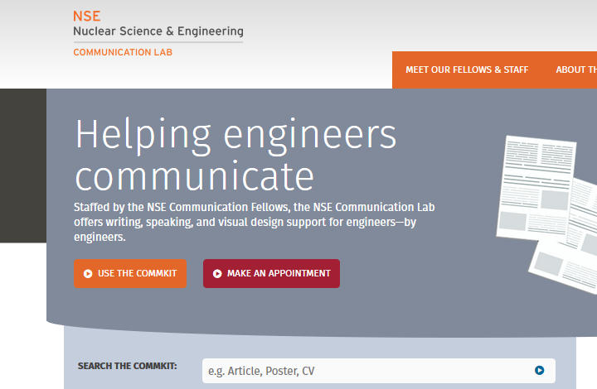
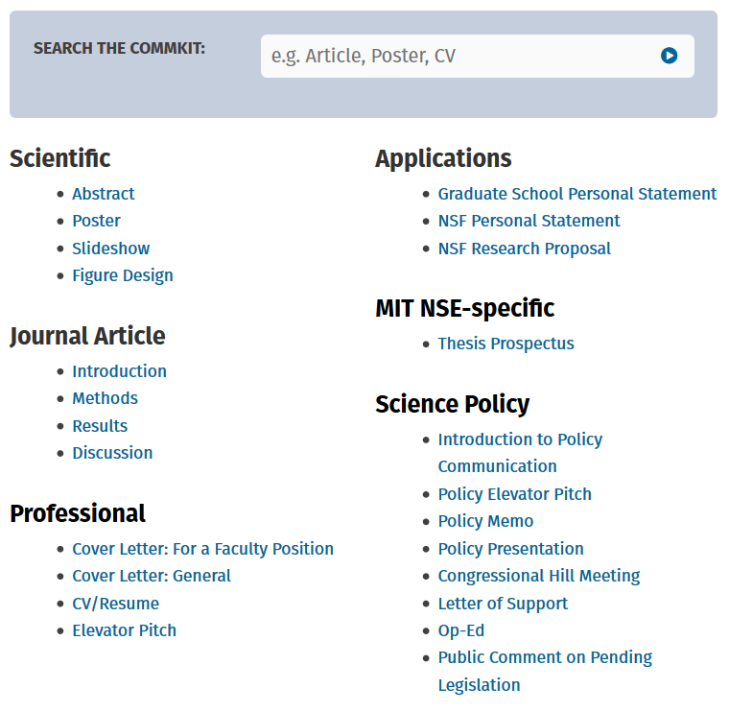
Access our resources online
http://mitcommlab.mit.edu/nse
CommKit online
Was developed by
Communication Fellows
Contains NSE examples
Offers anytime access

Slide 15
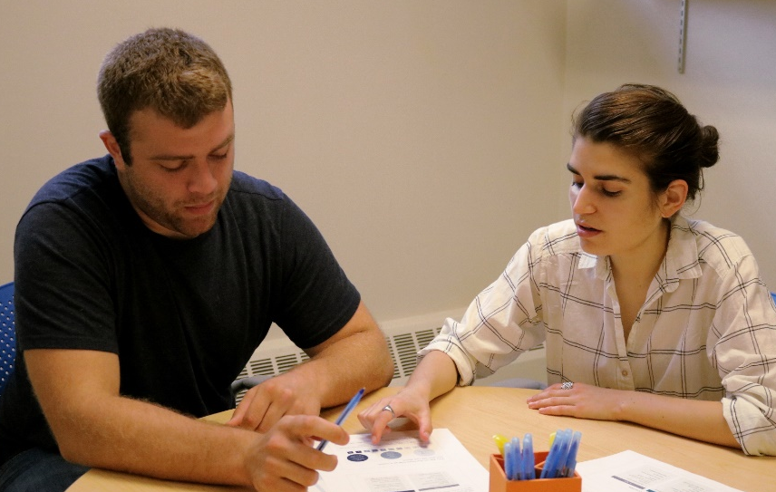
Access our resources online and in person.
CommKit online
Coaching session
Was developed by
Communication Fellows
Contains NSE examples
Offers anytime access
Provides one-on-one
communication support
Offers peer feedback
Provides emotional support and access to additional resources

Slide 16
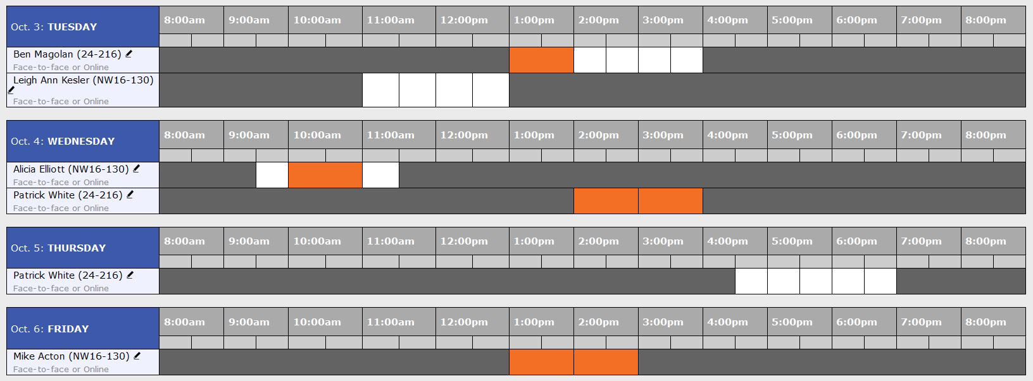
Make an appointment online
or just email us.
Screenshot of the NSE Comm Lab Fall 2017 coaching schedule

Slide 17


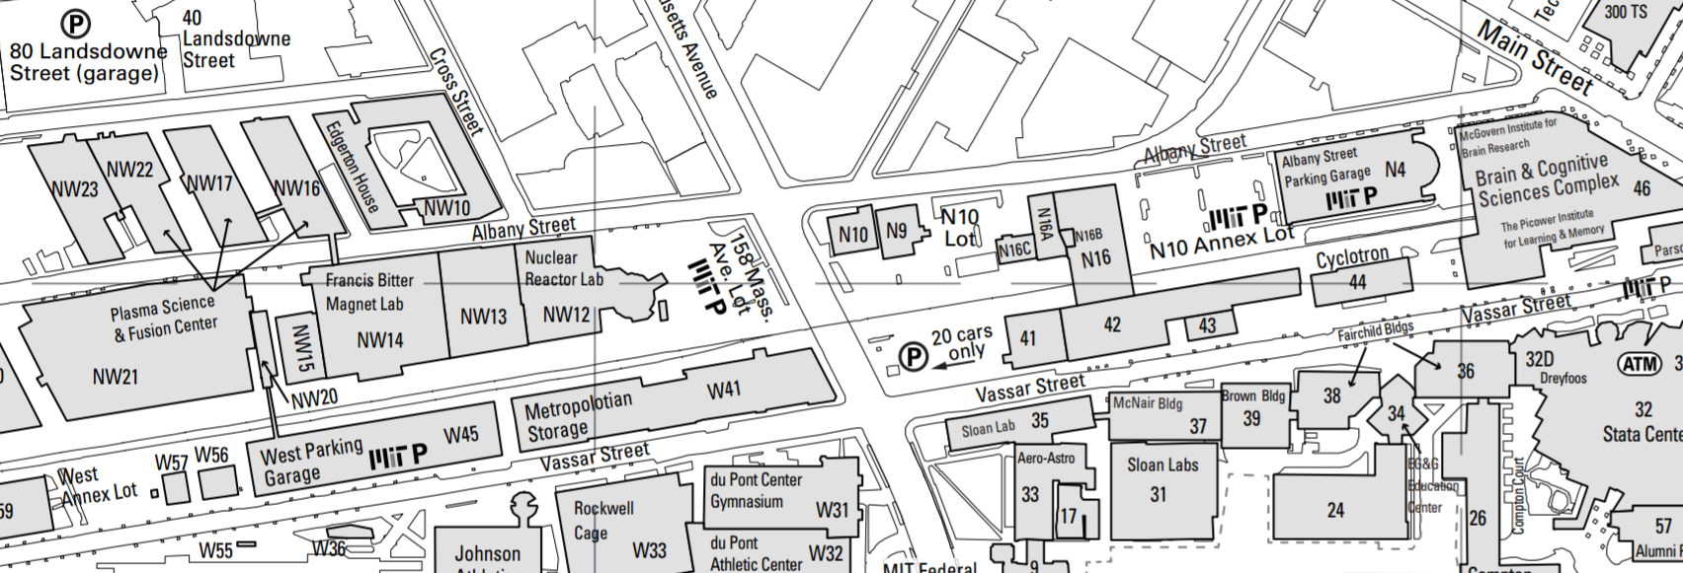
We have two meeting locations.
NW16
-130
24-216

Slide 18


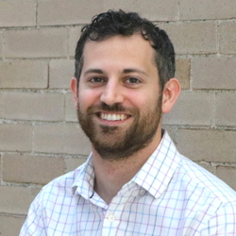


Meet the NSE Communication Fellows.
Steve Jepeal
Fusion Materials
Julie Logan
Materials / Technology
Mike Acton
Fission
Cody Dennett
Materials
Patrick White
Policy

Slide 19
You too can be trained to become a Fellow.
Steve Jepeal
Fusion Materials
Julie Logan
Materials / Technology
Mike Acton
Fission
YOU
Cody Dennett
Materials
Patrick White
Policy

Slide 20
NSE Communication Lab
http://mitcommlab.mit.edu/nse
Marina Dang
dangm@mit.edu

