Slide 1



Preliminary Design Review
Project Hermes
Overview | Propulsion | Recovery | Avionics | Structures | Payload
Notes:
Is ”exhibition” a category?

Slide 2
Schedule
Overview - Charlie Garcia 2:00
Propulsion - Sam Austin 2:10
Avionics - Josef Bieberstein 2:45
Structures - Matthew Campbell 3:10
Recovery - Madeleine Jansson 3:45
Payload - Maddie Garcia 3:25
Conclusion - Charlie Garcia 3:50
Questions will be taken for a period of time after each subteam’s presentation
Overview | Propulsion | Recovery | Avionics | Structures | Payload

Slide 3

Organizational Structure
President
Charlie G
Vice President
Andrew R
Executive Council
Maddie J; Joanna Z; Isaac P; Joey M; Juan S;
High Altitude Flight
Viper Program
Recovery
Maddie J
Avionics
Josef B
Payload
Maddie G
Solid Propulsion
Sam A
Structures
Matthew C
Liquid Propulsion
Nick B
Overview | Propulsion | Recovery | Avionics | Structures | Payload

Slide 4
2017|2018 Budget
Expenses
Income
Team | Allotment
Solid Propulsion | $6,250
Liquid Propulsion | $6,000
Structures | $7,000
Avionics | $2,000
Recovery | $1,200
Payload | $2,000
Social | $1,000
Team Expenses | $18,000
Total | $43,450
Source | Contribution (projected)
Finboard | $4,200 ($5,000)
Blue Origin | $2,000
AeroAstro | ($8,000)
Edgerton | ($10,000)
Northrop Grumman | ($1,000)
Shapiro Grant | ($6,000)
Course 2 | $1,250
Carry Over | $2,000
Total | $9,450 ($36,350)
Overview | Propulsion | Recovery | Avionics | Structures | Payload

Slide 5
2017|2018 Schedule
September
27 | 28 | 29 | 30 | 31 | 1 | 2
3 | 4 | 5 | 6 | 7 | 8 | 9
10 | 11 | 12 | 13 | 14 | 15 | 16
17 | 18 | 19 | 20 | 21 | 22 | 23
24 | 25 | 26 | 27 | 28 | 29 | 30
February
28 | 29 | 30 | 31 | 1 | 2 | 3
4 | 5 | 6 | 7 | 8 | 9 | 10
11 | 12 | 13 | 14 | 15 | 16 | 17
18 | 19 | 20 | 21 | 22 | 23 | 24
25 | 26 | 27 | 28 | 1 | 2 | 3
1st Semester
Preliminary Design Review: November 3
First Recovery Flight Test: November 11
Propulsion Subscale Test: November 11
Avionics Hardware Freeze: December 9
2nd Semester
Propulsion Subscale Test: February 10
Mission Package Complete: February 24
Propulsion Full Scale: March 10
Payload Flight Qualification: March 31
Camera Flight Qualification: March 31
Avionics Flight Qualification: March 31
Flight Readiness Review: April 7
Technical Report Due: April 28
October
1 | 2 | 3 | 4 | 5 | 6 | 7
8 | 9 | 10 | 11 | 12 | 13 | 14
15 | 16 | 17 | 18 | 19 | 20 | 21
22 | 23 | 24 | 25 | 26 | 27 | 28
29 | 30 | 31 | 1 | 2 | 3 | 4
March
4 | 5 | 6 | 7 | 8 | 9 | 10
11 | 12 | 13 | 14 | 15 | 16 | 17
18 | 19 | 20 | 21 | 22 | 23 | 24
25 | 26 | 27 | 28 | 29 | 30 | 31
April
1 | 2 | 3 | 4 | 5 | 6 | 7
8 | 9 | 10 | 11 | 12 | 13 | 14
15 | 16 | 17 | 18 | 19 | 20 | 21
22 | 23 | 24 | 25 | 26 | 27 | 28
29 | 30 | 1 | 2 | 3 | 4 | 5
November
5 | 6 | 7 | 8 | 9 | 10 | 11
12 | 13 | 14 | 15 | 16 | 17 | 18
19 | 20 | 21 | 22 | 23 | 24 | 25
26 | 27 | 28 | 29 | 30 | 1 | 2
3 | 4 | 5 | 6 | 7 | 8 | 9
Overview | Propulsion | Recovery | Avionics | Structures | Payload

Slide 6
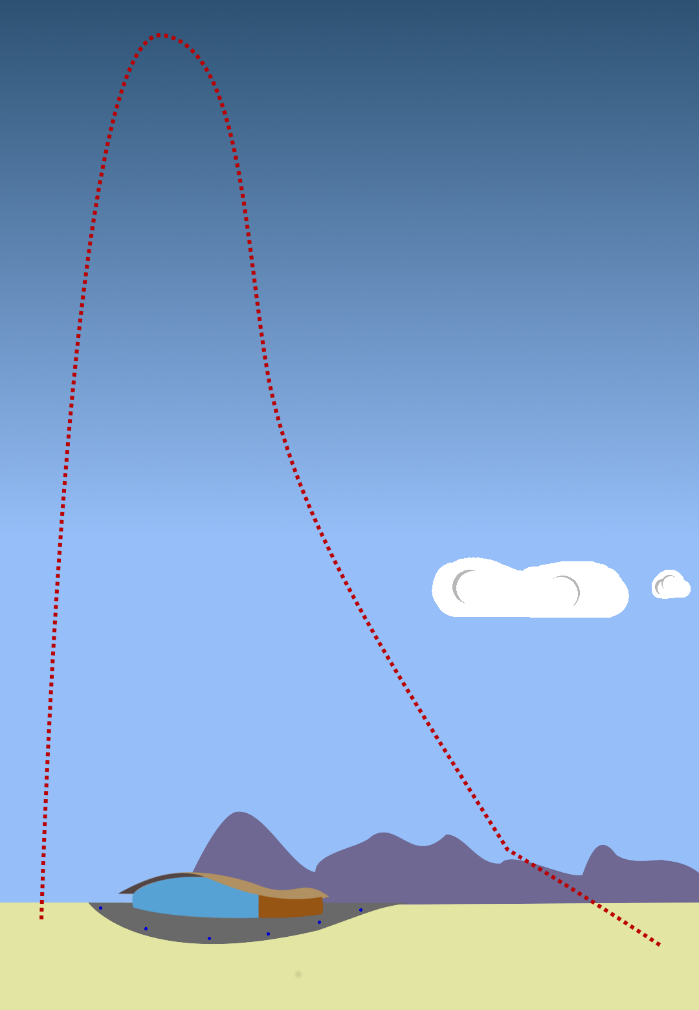
Concept of Operations
Pre-launch: New systems enable infinite pad sit time
Boost: A 70% P motor burns for 7 seconds at approximately 10kN of thrust
Coast: Travelling at Mach 2.9 the vehicle coasts to its 80,000 foot apogee
Apogee: Grab pictures, video, barometric readings, and a few GPS packets!
Ballistic Descent: Drogue parachute deployed but ineffective due to low atmospheric pressure
Drogue Descent: At around 68,000 ft the drogue begins to slow the vehicle
Main Descent: At 2,000 ft the main parachutes are deployed
Landed: After touchdown cameras are stopped and power is conserved until recovery forces arrive
Overview | Propulsion | Recovery | Avionics | Structures | Payload

Slide 7
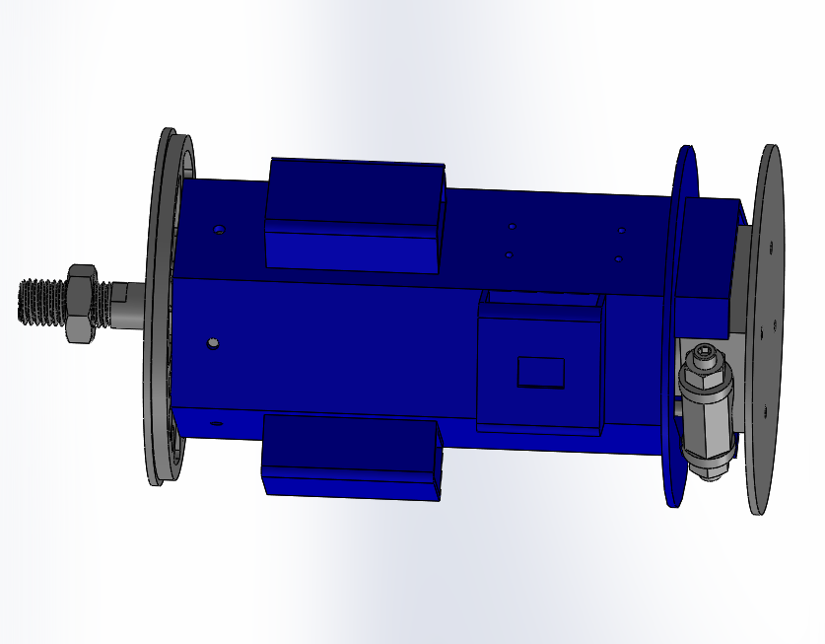
Vehicle Overview
Payload
Booster
Mission Package
Avionics Tower
Common, well defined booster interface makes mission package robust to propulsion development issues.
Payload uses well defined Cubesat standard, making vehicle robust to payload changes during all phases
Overview | Propulsion | Recovery | Avionics | Structures | Payload

Slide 8
Vehicle Overview
Payload
Booster
Mission Package
Component | Mass | Length
Booster | 66 lbs | 114 in
Mission Package | 28.3 | 44 in
Subteam | Mass
Structures | 16.65
Propulsion | 55.93
Recovery | 9.79
Avionics | 2.13
Payload | 5.0
Overview | Propulsion | Recovery | Avionics | Structures | Payload

Slide 9
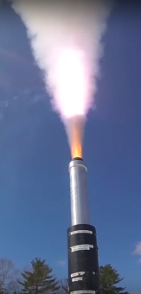
Propulsion Overview
Design, build, and test a 70,000 N-s solid rocket motor for flight to 80,000 feet
Revise and characterize a custom APCP propellant formula
Modify and implement mixing and casting techniques suitable for large batch sizes
Overview | Propulsion | Recovery | Avionics | Structures | Payload

Slide 10
70 kNs Solid Rocket Motor Overview
Motor Case
Radial Bolted Closure Retention
Nozzle Carrier/Tailone
Grain-Spacer O-rings
Propellant Grain (x10)
Forward Retention and Coupler
Nozzle
Insulation Disc
Casting Tube
Forward Closure
Liner
Overview | Propulsion | Recovery | Avionics | Structures | Payload

Slide 11
Propellant Formula
Iteration on last year’s formula (Xaphan Blue)
Theoretical Specific Impulse: 242.6s
Solids Loading: 81.7%
Realized Density: 0.05943 lb/in³, 1,1645.0 kg/m³
Targeting 1,750.0 kg/m³ with new processes
Component | Composition (%)
200 micron Ammonium Perchlorate (AP) | 58.2
400 micron AP | 11.6
90 micron AP | 2.9
Aluminum, Atomized | 7.5
HTPB + HX-752 | 11.6
MDI Isocyanate Curative | 1.9
Isodecyl Pelargonate Plasticizer | 4.72
Copper Chromite | 1.5
Castor Oil | 0.2
Triton X-100 processing agent | 1 drop/600g propellant
Polydimethylsiloxane processing agent | 1 drop/600g propellant
Overview | Propulsion | Recovery | Avionics | Structures | Payload

Slide 12
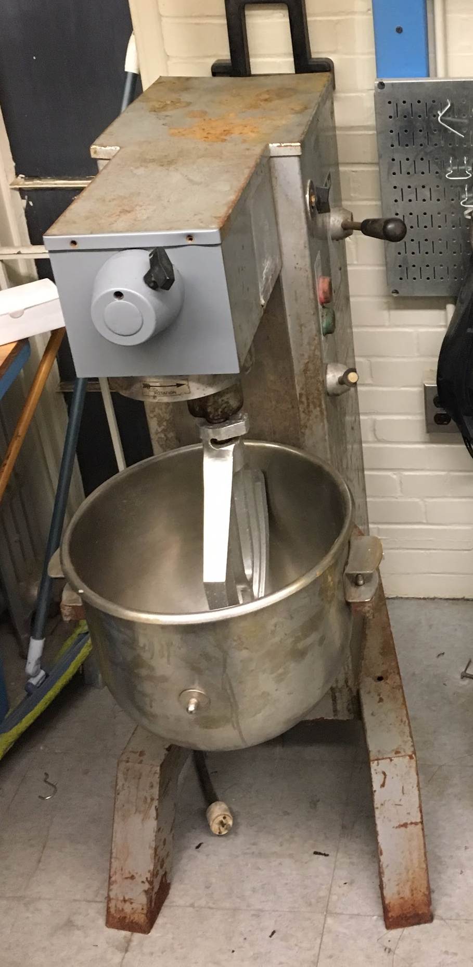
Propellant Mixing
Mixing will occur in a 30 qt. industrial mixer
Total mixing time: 70 minutes
2 hour vacuum time before adding curative
Overview | Propulsion | Recovery | Avionics | Structures | Payload

Slide 13
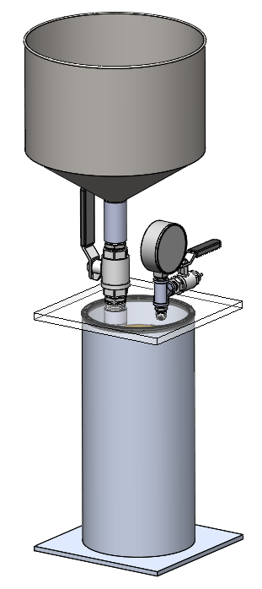
Propellant Casting and Vacuum Processing
Mixed propellant loaded into hopper with valve closed
Vacuum drawn in chamber containing casting tube
Propellant valve opened
Propellant sucked into casting tube, de-gassing as it falls
Uniform de-gassing of propellant
Overview | Propulsion | Recovery | Avionics | Structures | Payload

Slide 14
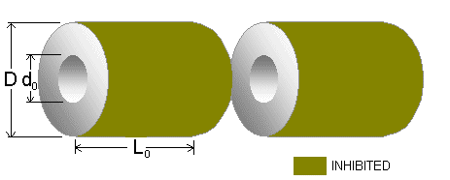
Grain Geometry and Ballistic Analysis
BATES geometry, 10 grains
Bottom two grains have larger cores to mitigate erosive burning
Burn time: 7.20 seconds
Peak pressure: 869 psi
Propellant Mass: 85 lbs
Total Impulse: 70,800 N-s
Overview | Propulsion | Recovery | Avionics | Structures | Payload

Slide 15
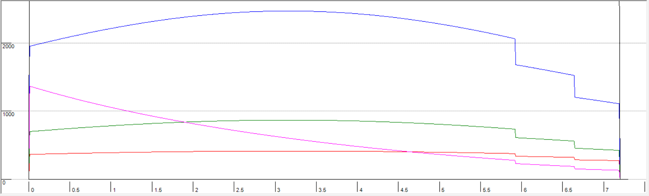
Thrust Curve
Blue curve
Thrust in pounds, time in seconds
Overview | Propulsion | Recovery | Avionics | Structures | Payload

Slide 16
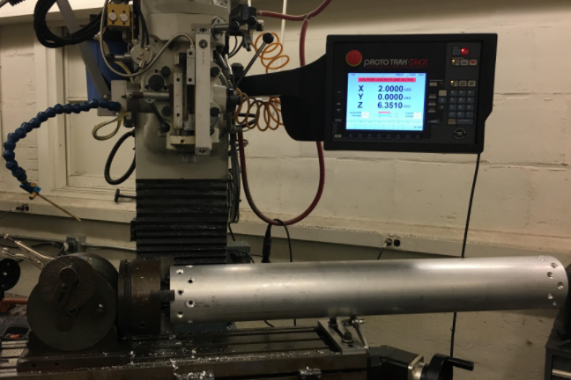
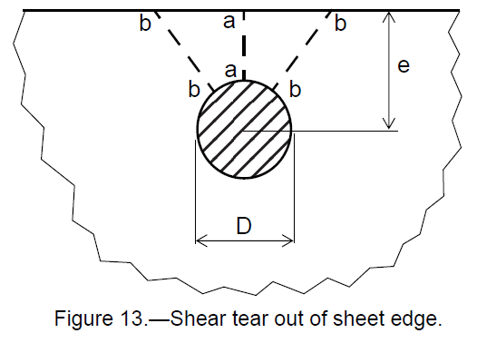
Motor Case Design
6” OD, ¼” thick wall 6061-T6 Aluminum tube, 94.2” long
Designed to hold the maximum operating pressure with a FoS of 1.5x: 1,305 psi
Aluminum is a ductile material that is commonly used in rocket motor casings.
Radial bolt pattern drilled to retain closures
Overview | Propulsion | Recovery | Avionics | Structures | Payload

Slide 17
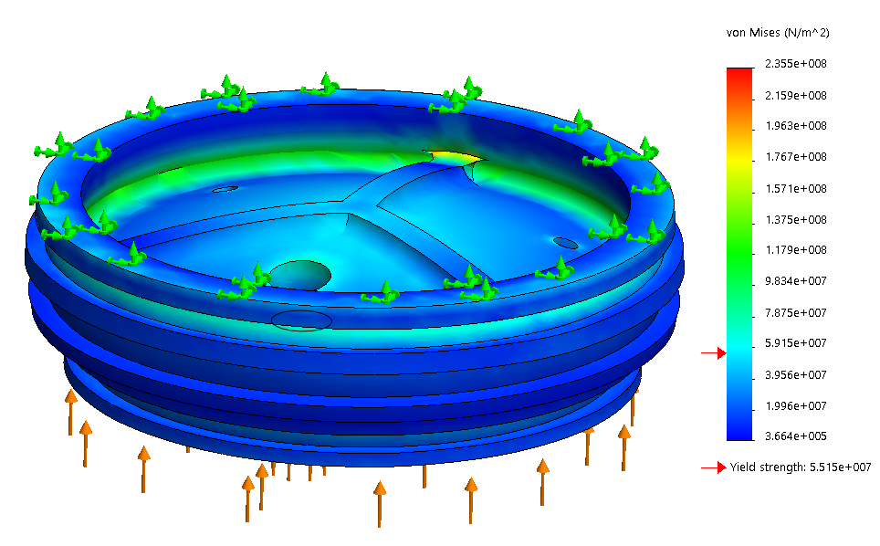
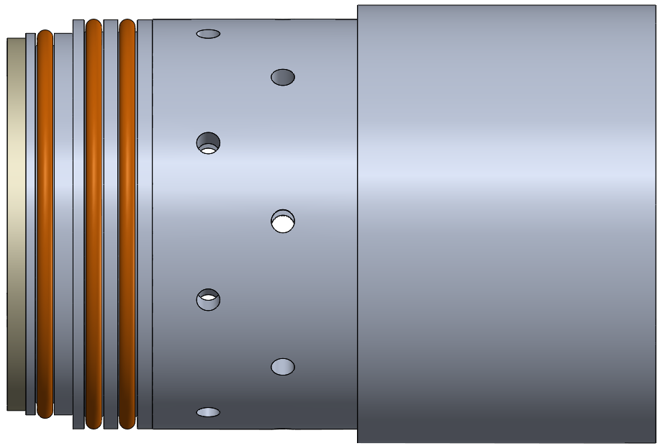
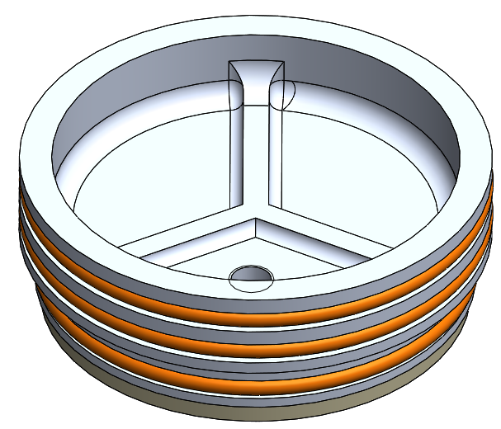
Closure/Closure Retention Design
Forward closure seals motor at forward end
O-ring in liner and redundant O-rings contacting the case
Fiberboard insulation disc attached to bottom
Forward retention ring doubles as upper airframe interface
Stress analysis on closure
Overview | Propulsion | Recovery | Avionics | Structures | Payload

Slide 18
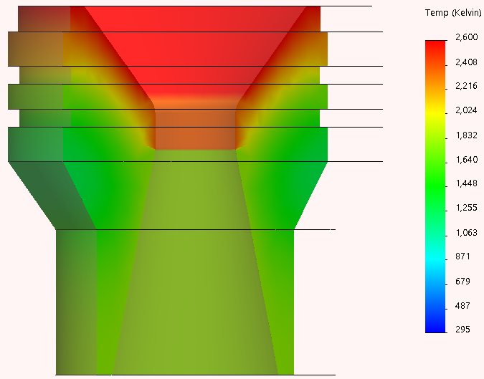
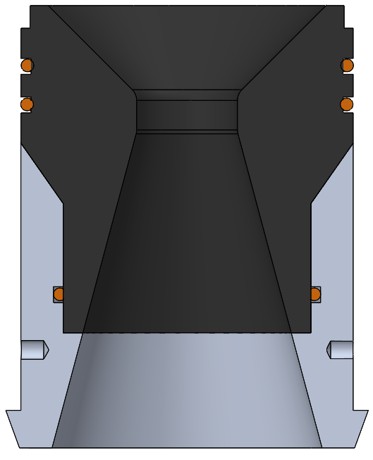
Nozzle/Nozzle Carrier Design
Graphite nozzle with aluminum nozzle carrier/retention ring
Nozzle carrier acts as vehicle tailcone and nozzle extension
Thermal expansion analysis on graphite nozzle
Inlet Angle | 45 degrees
Throat diameter | 1.655”
Exit diameter | 5.13”
Expansion ratio | 9.61
Divergent half angle | 15 degrees
Optimum Expansion | 10.1 psi, ~10,000 ft
Overview | Propulsion | Recovery | Avionics | Structures | Payload

Slide 19
Ignition System
29mm Blue ThunderTM propellant grain fixed to forward closure
Initiated by redundant e-matches
Goal: achieve full pressurization within 100ms of e-match burning
Overview | Propulsion | Recovery | Avionics | Structures | Payload

Slide 20
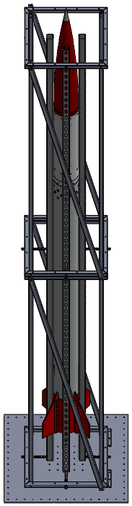
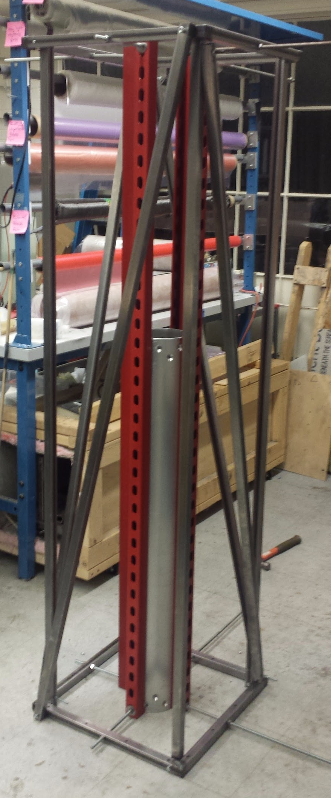
Test Stand/Launch Pad
Supports rocket during first 12 feet of flight
Doubles as a test stand for both subscale and full scale 6” motors
1”x1” steel tubing construction
Overview | Propulsion | Recovery | Avionics | Structures | Payload

Slide 21
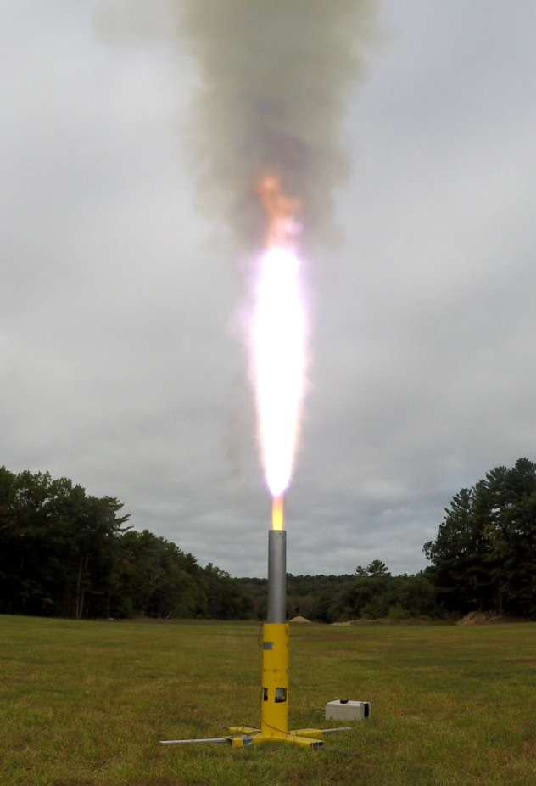
Test Plan
Propellant characterization static fires: Nov. 18-25
Hydrostatic Case Testing: Dec. 2
6” four grain (subscale) static fire 1: Dec. 9/Jan. 20
6” subscale static fire 2: February 3-10
6” 10 grain (full scale) static fire 1: March 3-10
Overview | Propulsion | Recovery | Avionics | Structures | Payload

Slide 22
Risks
Technical Risks
Erosive burning
Grain collapse under high acceleration
Closure retention failure
Graphite nozzle failure
Health/Safety Risks
Flammability of propellant product
Schedule Risks
Propellant characterization takes longer than expected
6” subscale motor suffers a CATO
6” full scale motor suffers a CATO
Overview | Propulsion | Recovery | Avionics | Structures | Payload

Slide 23
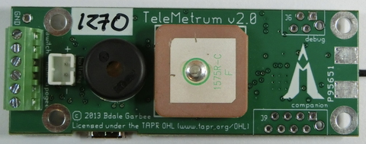
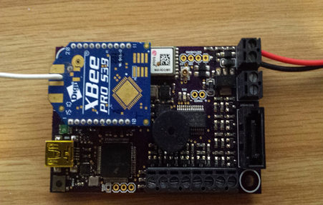
Avionics Overview
Hermes Avionics Systems
Telemetrum
COTS
Telemetry downlink
Comparable sensor package
Well tested
Pyxida
SRAD by MIT Rocket Team
4 onboard sensors
Telemetry downlink
4th hardware revision
Overview | Propulsion | Recovery | Avionics | Structures | Payload

Slide 24
Pyxida Hardware Overview
Pyxida SRAD Flight Computer
  Based on Teensy 3.5 (120 MHz Single-thread ARM processor)
  Interfaces: 9DOF IMU, high-g accelerometer, barometer, GPS
  Onboard flash memory
  TI CC1120 SOC Radio boosted by CC1190
  Eight pyro channels
  2-4 LIPO batteries or through USB
Avionics Bay
  Vertical mounting near nose cone surrounding separation piston
  Mounts Pyxida, commercial altimeters, and batteries
  Battery power routed through switch band accessible on rocket exterior
Overview | Propulsion | Recovery | Avionics | Structures | Payload

Slide 25
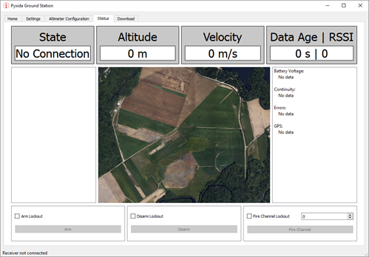
Pyxida Software Overview
Firmware (C++)
State Machine Architecture
Serial and I2C Sensor Interfaces
Logging to Flash
  Sensor Values/Location
  Events
Radio Communication Interface
  Live Telemetry
  Sensor Values
Pyro Channel Interface
State Transition Logic/Filtering
Ground Station (python)
Radio Communication Interface
GUI
  Live Telemetry
  Sensor Values
  3D Orientation Rendering
  Connection Status
Manual Flight Event Triggers
Overview | Propulsion | Recovery | Avionics | Structures | Payload

Slide 26
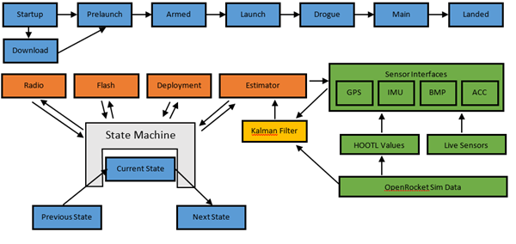
Pyxida State Flow
Overview | Propulsion | Recovery | Avionics | Structures | Payload

Slide 27
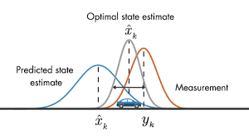
Kalman Filter
State estimation algorithm for high uncertainty data
  Aerospace grade filter used commonly in industry
Memoryless
Efficient
Linear or Nonlinear models
Theory of operation:
  Filter compares noisy sensor data and physical model
  Reconciled estimation more accurate than either separate information
  Optimal filter assuming Gaussian error
Overview | Propulsion | Recovery | Avionics | Structures | Payload
Notes:
Memoryless - Recursive, we only need to consider the last time step -- Markov process → It doesn’t depend on the history, we care only about the previous step
Linear
9 Degrees of Freedom
Operates well within noisy environments -- errors is Gaussian -- gathered from the data sheet
Relevant kinematic eqautions that yield estimations for the orientation and position of the rocket

Slide 28

Hardware Out of the Loop Testing
Test Avionics software without Pyxida hardware
  Compiles on regular computer
Flight simulated with pre-generated data
  E.g., OpenRocket simulation
Sensor interfaces rewritten for HOOTL
Arduino hardware interface rewritten for HOOTL
Allows for frequent high-level code tests
  Not bottlenecked by hardware
  Tests can be run more frequently
Overview | Propulsion | Recovery | Avionics | Structures | Payload

Slide 29
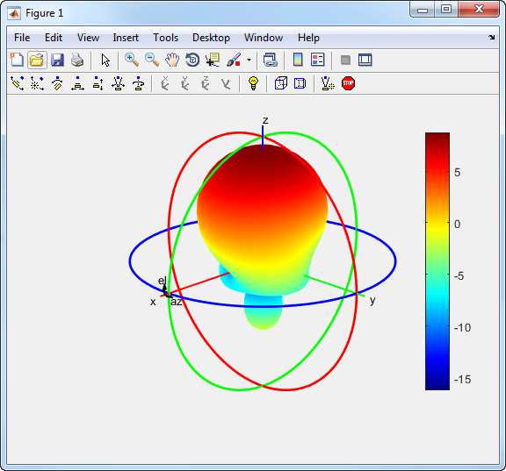
Future Tasks
Avionics Bay Design
Antenna/RF Design
Overview | Propulsion | Recovery | Avionics | Structures | Payload

Slide 30
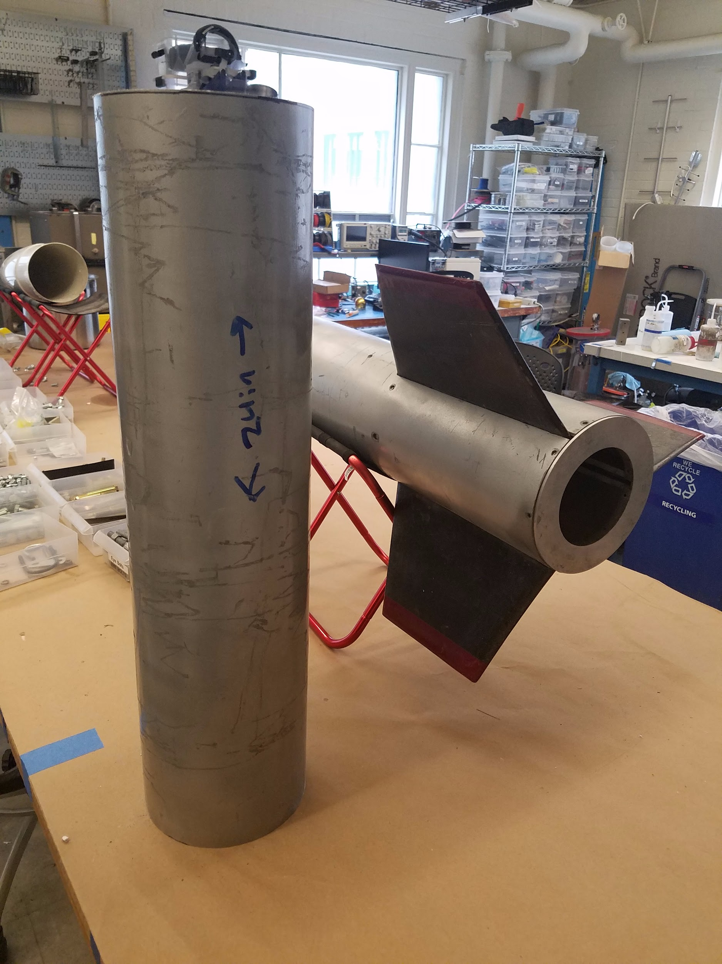
Structures Overview
Design, construct and test structural components of the mission package and fins
Protect all exterior components from flight heating
Overview | Propulsion | Recovery | Avionics | Structures | Payload

Slide 31
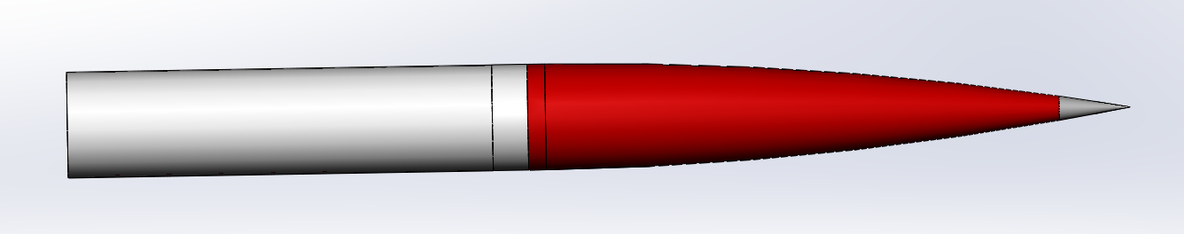
Airframe Tube
The airframe tube will be a composite tube housing the recovery and avionics systems
Airframe Tube
Coupler
Nose Cone
Overview | Propulsion | Recovery | Avionics | Structures | Payload

Slide 32
Fabric Type
Airframe/Coupler
5.7 oz. 3K tow, 2x2 twill weave carbon fiber
Carbon fiber has greatest strength to weight ratio
Nose Cone
9 oz. satin weave S-glass fiberglass
Nose cone must be RF transparent
S-glass is the strongest type of fiberglass
Material | Ultimate Tensile Strength at ~22C [MPa]^{[1]} | Density [g/cc] | Ratio
Carbon Fiber, 5.7 oz | 4205 | 0.63 | 6674
S-Glass Fiber, 9 oz | 4585 | 1.23 | 3727
E-Glass Fiber, Generic | 3790 | 2.54 | 1492
Overview | Propulsion | Recovery | Avionics | Structures | Payload

Slide 33
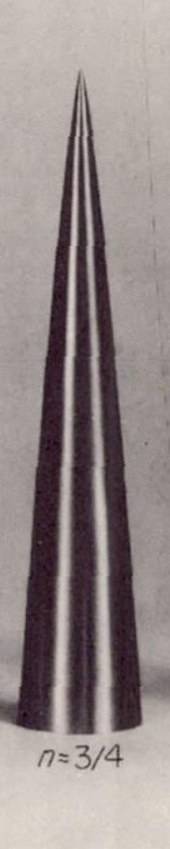
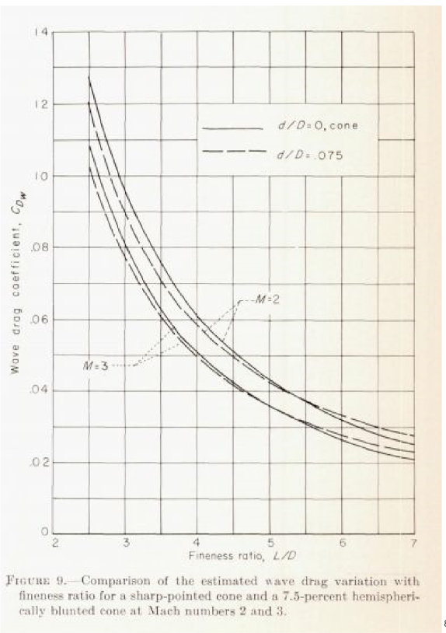
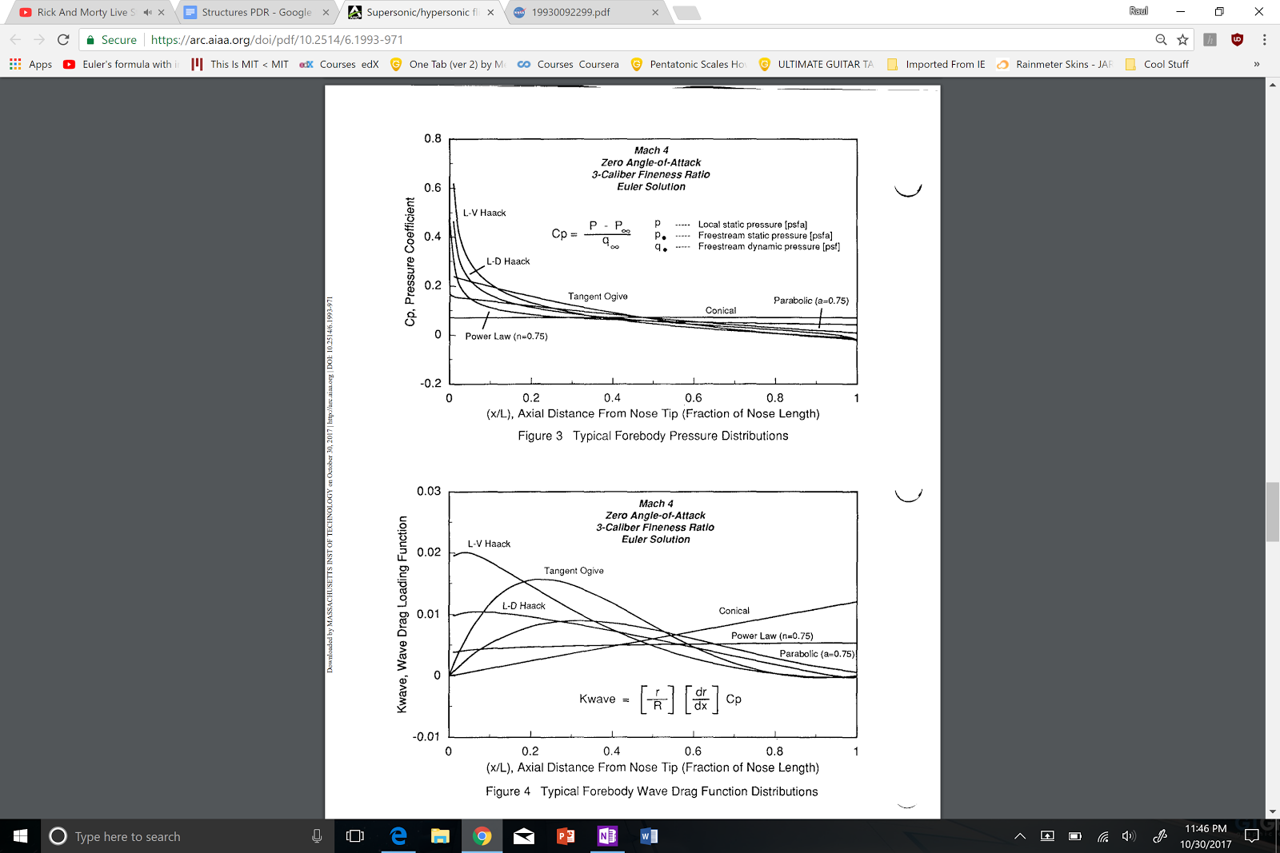
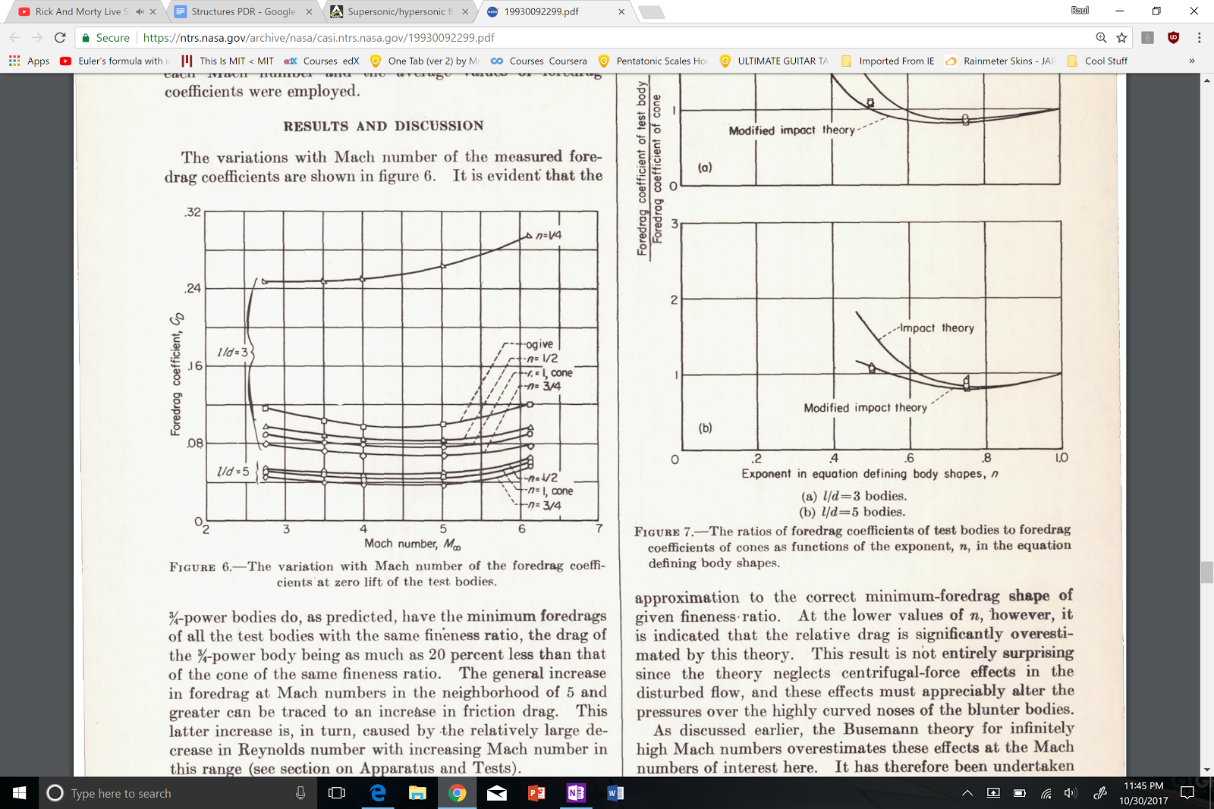
Nose Cone Geometry
Top speed: Mach 2.9
Time supersonic: 50 seconds
Optimal nose cone: ¾ power series, 5.5 fineness ratio
Overview | Propulsion | Recovery | Avionics | Structures | Payload

Slide 34
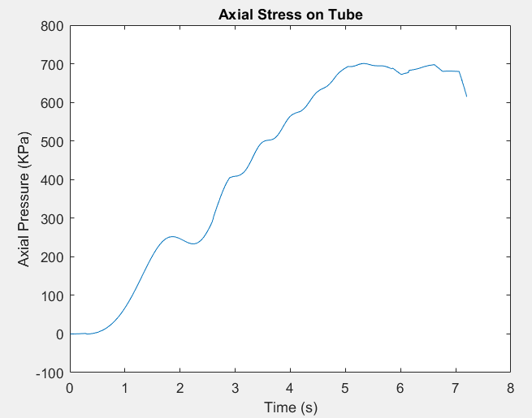
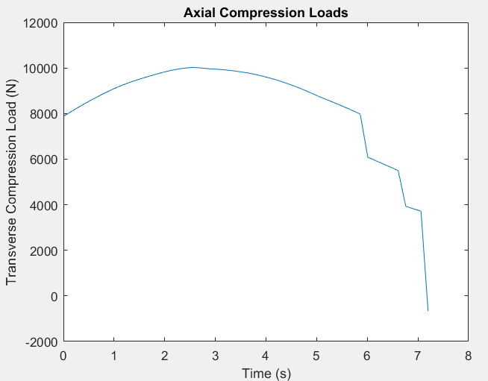
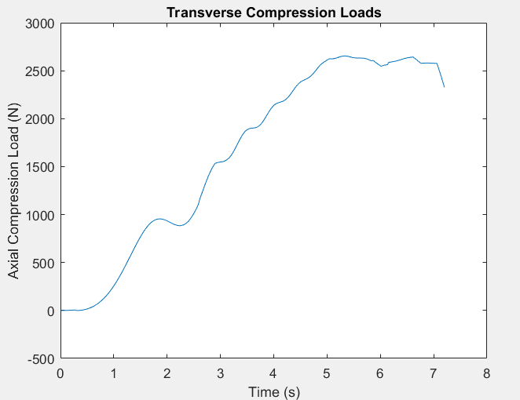
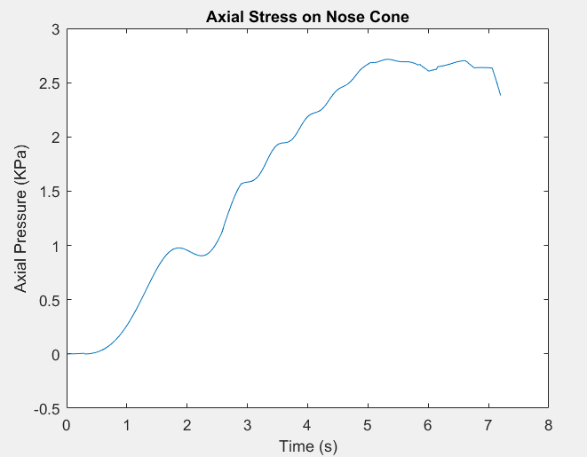
Flight Loads
Axial load: 3155 lbs (14034 N) Transverse Load: 835 lbs (3715 N)
  Safety factor of 1.4
Airframe buckling:
  NASA-SP8007
  .06” thick carbon fiber tube
  Can support: 270500 lbs axial, 50700 lbs transverse
Overview | Propulsion | Recovery | Avionics | Structures | Payload

Slide 35

Flight Heating
Reach max velocity, Mach 2.9 around 11,500 ft
Adiabatic Wall Heating:
T_{AW} = 740 F (666 K)
T_{AW} = stagnation temperature
y = specific heat ratio
r = recovery factor
M = Mach
T = Ambient temperature
This method does not account for shocks experienced at the nose cone tip or fin leading edges
Overview | Propulsion | Recovery | Avionics | Structures | Payload

Slide 36
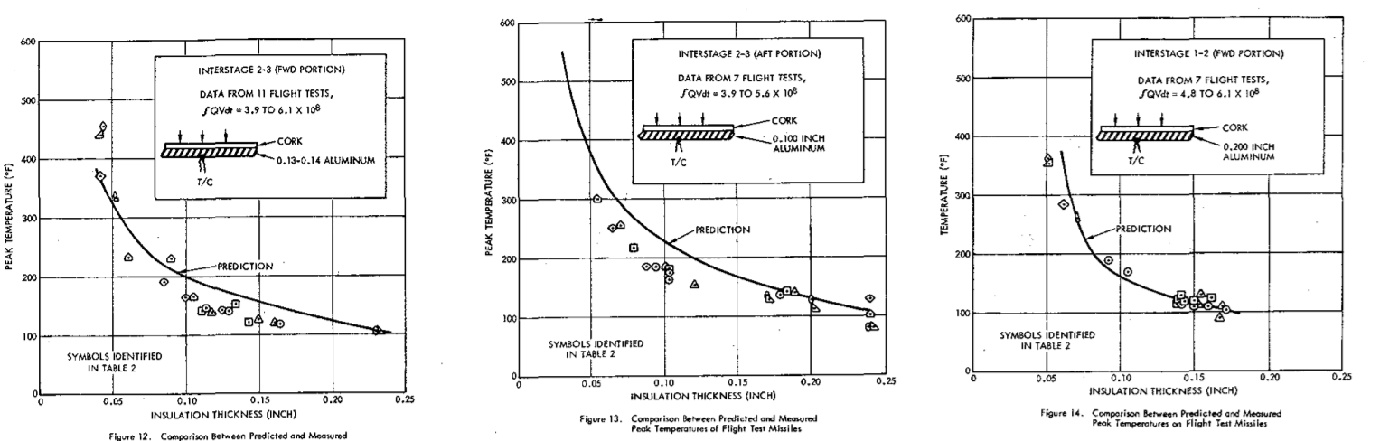
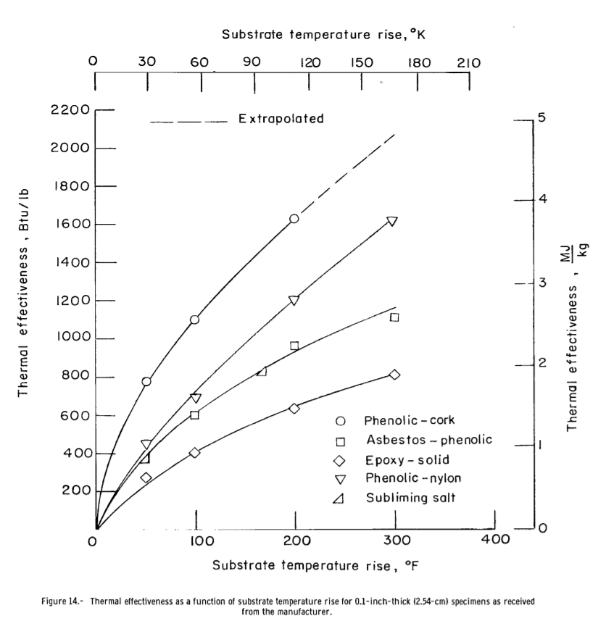
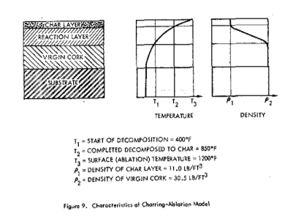
Ablative Coating
80% granulated cork, 20% phenolic resin
.15” thick exterior layer
adds about 2.5 lbs
Overview | Propulsion | Recovery | Avionics | Structures | Payload

Slide 37
Nose Cone Tip
Nose Cone tip will be Ti-6 titanium
Linear cone
 | Working Temperature | Density
301 Stainless Steel | 1700 F | .3 lbs/in^3 (8.03 g/cc)
Grade 2 Titanium | 800 F | .16 lbs/in^3 (4.5 g/cc)
Tungsten | 3600 F | .69 lbs/in^3 (19.25 g/cc)
Ti-SF61 (Titanium) | 1150 F | .16 lbs/in^3 (4.5 g/cc)
Overview | Propulsion | Recovery | Avionics | Structures | Payload

Slide 38
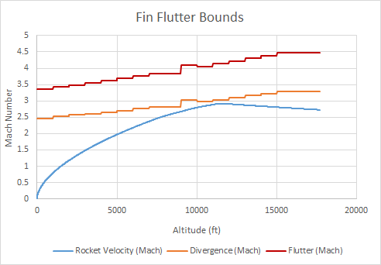
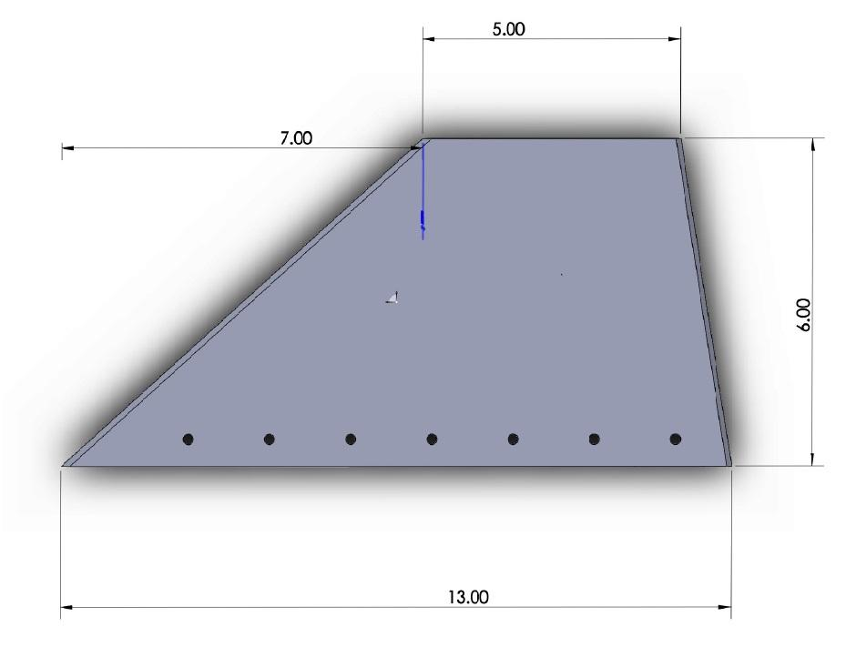
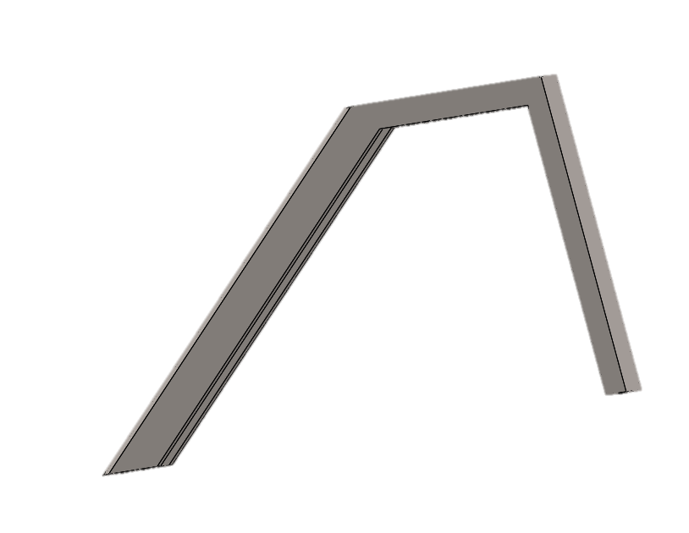
Fin Design
4 1/4in 6061 Aluminum, about 5.3 lbs
  Mach 0.3: 3.5 calibers stability
  Mach 1: 4 calibers
  Mach 2: 4.3 calibers
  Mach 2.9: 4 calibers
Titanium leading edges
Fins sized to reduce coning and flutter
Overview | Propulsion | Recovery | Avionics | Structures | Payload

Slide 39
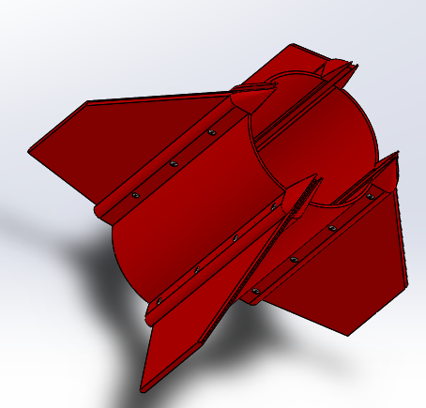
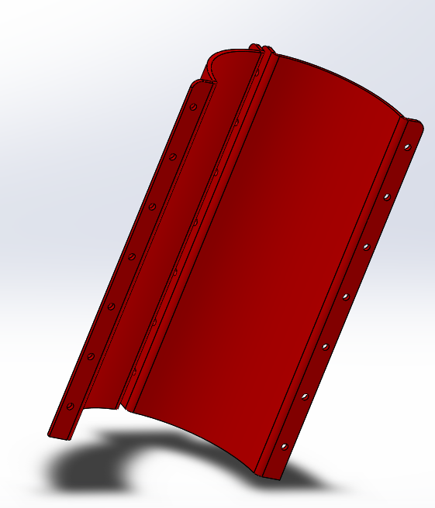
Fin Collar
Order aluminum collar from manufacturer
Make one in-house with carbon fiber
retains fins with 7 8-32 bolts
Overview | Propulsion | Recovery | Avionics | Structures | Payload

Slide 40
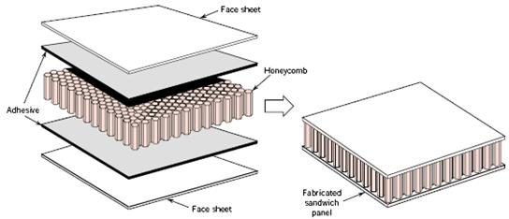
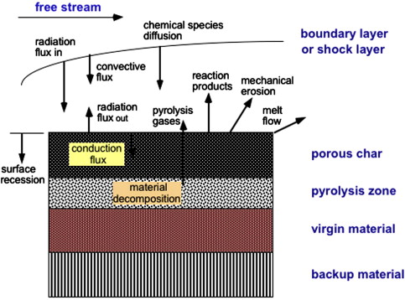
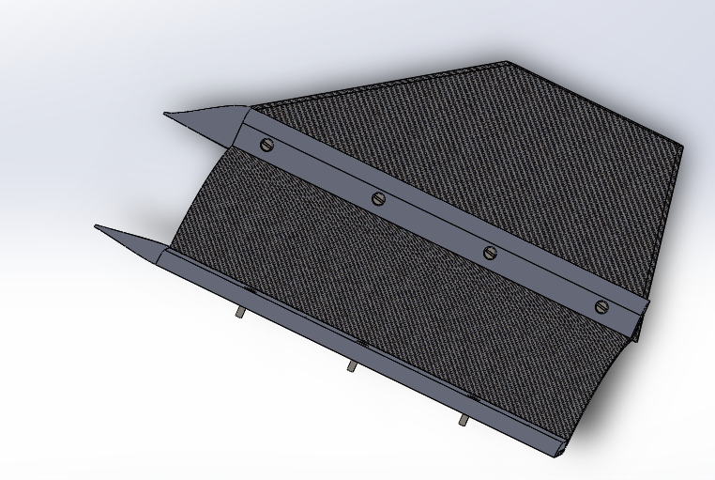
Future Goals
Phenolic impregnated felt ablative Carbon fiber/honeycomb fins
Overview | Propulsion | Recovery | Avionics | Structures | Payload

Slide 41
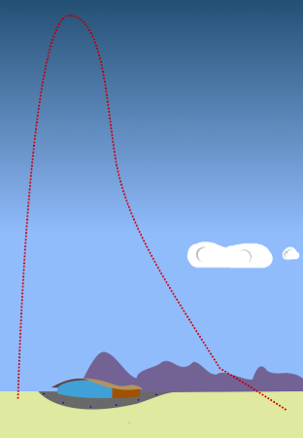
Recovery – CONOPS
Prelaunch
Boost
Coast
Apogee: drogue deployment
2,000 ft: main parachute deployment
Landing
Apogee: drogue deploys
2,000 ft: main chute deploys
Overview | Propulsion | Recovery | Avionics | Structures | Payload

Slide 42
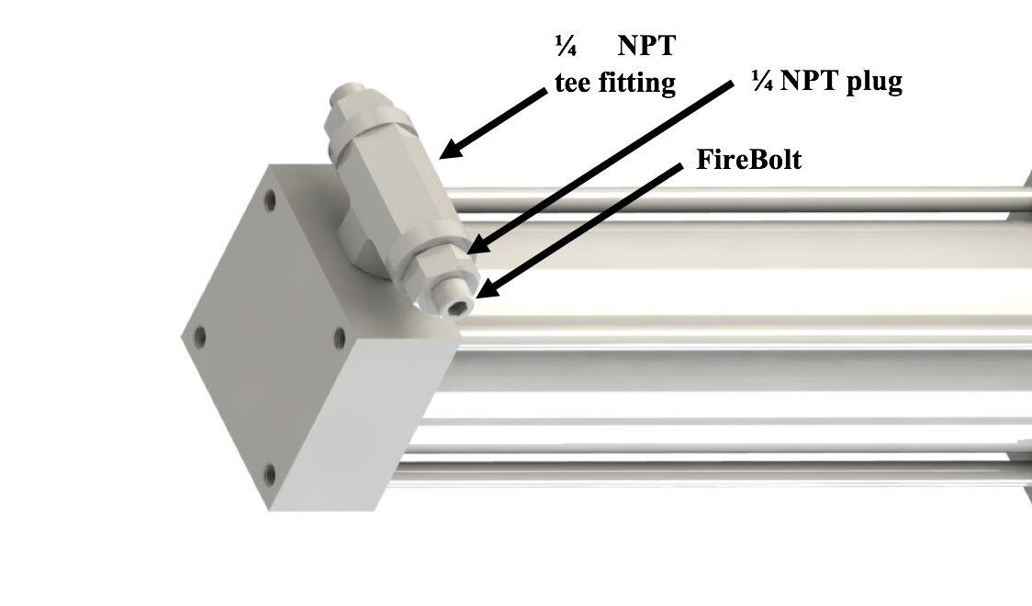
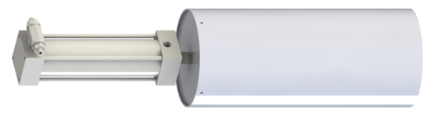
Recovery – Piston Cup Assembly
T-Fitting
NPT Plug
Piston-Cup Assembly held in Mission Package
Redundant electric matches
Firebolt
Piston
Cup Assembly (Cylinder + Diaphragm)
Overview | Propulsion | Recovery | Avionics | Structures | Payload

Slide 43
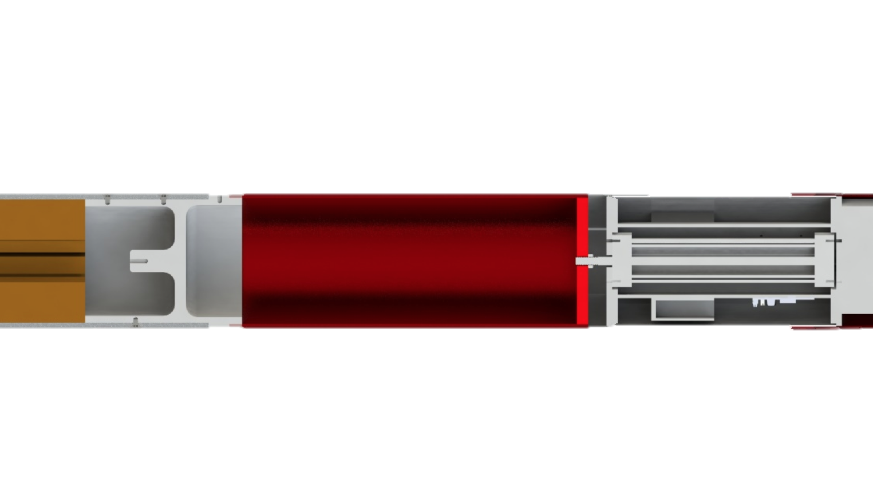
Recovery – Piston Cup Assembly
Booster coupler
Cylinder
Diaphragm
Piston
Shear pins
T-fitting with electric matches
Overview | Propulsion | Recovery | Avionics | Structures | Payload

Slide 44
Recovery – Piston Cup Assembly
Pyrotechnic reaction initiated by electric match
Electric matches triggered
Combustion occurs in T-fitting
Overview | Propulsion | Recovery | Avionics | Structures | Payload

Slide 45
Recovery – Piston Cup Assembly
Pyrotechnic reaction initiated by electric match
Piston actuates
Piston actuates
Overview | Propulsion | Recovery | Avionics | Structures | Payload

Slide 46
Recovery – Piston Cup Assembly
Pyrotechnic reaction initiated by electric match
Piston actuates
Cup assembly (Diaphragm + Cylinder) provides force on Booster coupler
Force transferred to Booster coupler
Piston actuates
Overview | Propulsion | Recovery | Avionics | Structures | Payload

Slide 47
Recovery – Piston Cup Assembly
Pyrotechnic reaction initiated by electric match
Piston actuates
Cup assembly (Diaphragm + Cylinder) provides force on Booster coupler
Nylon pins holding Booster coupler shear
Force transferred to Booster coupler
Piston actuates
Nylon pins shear
Overview | Propulsion | Recovery | Avionics | Structures | Payload

Slide 48
Recovery – Piston Cup Assembly
Pyrotechnic reaction initiated by electric match
Piston actuates
Cup assembly (Diaphragm + Cylinder) provides force on Booster coupler
Nylon pins holding Booster coupler shear
Mission Package separates from rocket
Mission Package detaches
Overview | Propulsion | Recovery | Avionics | Structures | Payload

Slide 49
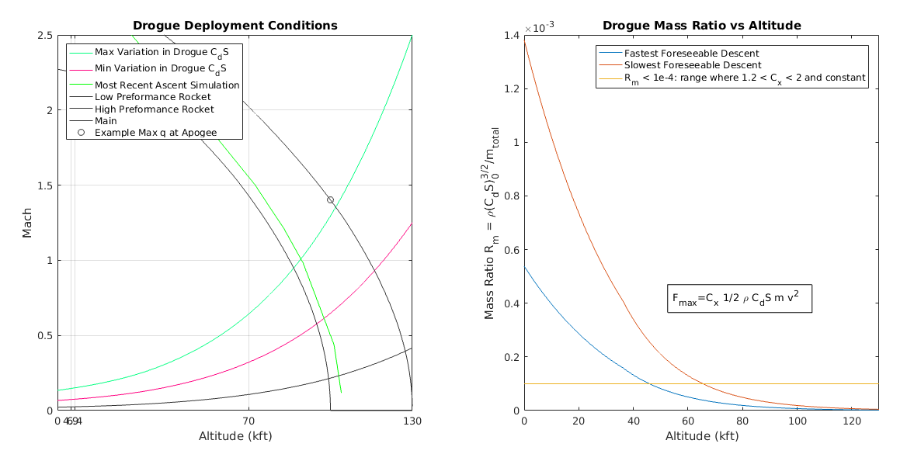
Recovery – Drogue Deployment
Overview | Propulsion | Recovery | Avionics | Structures | Payload

Slide 50
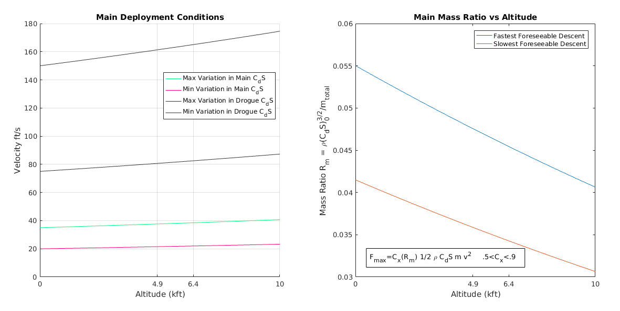
Recovery – Main Deployment
Overview | Propulsion | Recovery | Avionics | Structures | Payload

Slide 51

Recovery – Force and Stress Analysis
Forces: Preliminary Design Method
Good enough for most design work
Plan on using Sandia (c. 1975) and Potvin (2015) methods for drogue
  Better model high angle of attack, low density, supersonic deployment
Canopy Stress: Analytical Membrane Analysis
Significant error in calculations
Significant uncertainty in deployment conditions
  Inflation time, geometry, speed
Significant uncertainty in manufacturing
  Not master seamstresses
Large safety factors, base on working designs
Overview | Propulsion | Recovery | Avionics | Structures | Payload

Slide 52


Recovery – Drogue Parachutes
Disk-Gap-Band (DGB)
Designed for rockets about our size going to about our attitudes in 60’s
Common on interplanetary probes
Well tested at low dynamic pressures
Conical Ribbon
Better linage
Very stable
Much harder to manufacture
Only if later analysis shows DGB is not sufficient
Overview | Propulsion | Recovery | Avionics | Structures | Payload

Slide 53
Recovery – Drogue Supersonic Considerations
Stability
Current CONOPS is long double pendulum
Keep the parachute far away
Cd of DGB changes at sound barrier
Dynamics analysis planned
Heating
It will get warm both during ascent and descent
  High temperature materials (Kevlar)
  Thermal safety factors
Deployment
Airflow may be still, turbulent, or on shock boundaries
Simulations will tell us what to prepare for
Cannot simulate conditions in test
Overview | Propulsion | Recovery | Avionics | Structures | Payload

Slide 54

Recovery – Main Parachute Selection and Sizing
Semi-ellipsoidal - high packing density
Aspect ratio of 0.707
Gores
-Ripstop nylon fabric
-Vent hole
Overview | Propulsion | Recovery | Avionics | Structures | Payload

Slide 55
Recovery – Main Parachute Selection and Sizing
Section 3.1 of Design, Test, & Eval Guide (DTEG):
150 ft/s under drogue parachute
30 ft/s under main parachute
½ρV²AC_{D,eff,main}=mg
C_{D,eff,main}=1.44
v = 8.3 m/s ≈ 27 ft/s
Overview | Propulsion | Recovery | Avionics | Structures | Payload

Slide 56

Recovery – Load Path & Webbing Lengths
Knacke
“Lines First Deployment” sequence:
Orderly deployment
Reduced inflation time
Mitigates snatch force
Overview | Propulsion | Recovery | Avionics | Structures | Payload

Slide 57


Recovery – Load Path & Webbing Lengths
PISTON
Parachutes must exit vehicle
Reduced impact of forebody wake
Auxiliary constraints
Collision avoidance
W_{A,H} > W_{A,E,F,G} + R_{D} + S_{D} + Ꙇ_{fc}
W_{A,E,F} > Ꙇ_{mp}
W_{C,D} > R_{B}
W_{A,B} > Ꙇ_{mp} + ~5D_{M}
W_{A,E,F,G} - Ꙇ_{mp} > 5D_{D}
W_{A,H} > Ꙇ_{mp} + h_{mp} + Ꙇ_{fc}
Tender Descender loading
W_{A,E,F} < W_{A,B} + S_{M} + W_{C,D,F} + R_{M}
Overview | Propulsion | Recovery | Avionics | Structures | Payload

Slide 58


Payload-Spinal Load Experiment Overview
Primary goal is to look at the mechanical forces on the spine and to analyze the stress and strain on the spine to different stages of flight. I
Experimental design
  Bovine lumbar spine (L1-L5) force analysis
  Pressure sensing fabric inlays between the ballistic intervertebral discs (IVDs)
  Teensy 3.6 Data Logger
Outcome:
  Optimal angle for launch
  Empirical axial force load data
Overview | Propulsion | Recovery | Avionics | Structures | Payload

Slide 59




Payload-Anatomical Background
Background
Traditional Force Analysis
Spinal geometry
  Disc shape
  Curvature
Movement
Spine types
  Resin vs. Bovine vs. Human Spine
    Material properties
    Structure
  IVD Materials
    Inner nucleus
    Outer annulus
Loads
  Expected Loads
Overview | Propulsion | Recovery | Avionics | Structures | Payload

Slide 60

Payload-Force Sensing
Requirements
  Read voltages
  Translate voltages to forces
  Log readings
Deformation sensing circuit
  Voltage divider that uses 80 kΩ resistor and variable resistor
  Variable resistor is pressure sensing fabric
Thermal changes cause resistance
Overview | Propulsion | Recovery | Avionics | Structures | Payload

Slide 61
Program Level Risk
One-off nature of components prevents good understanding of risk
Mitigate risk through simple solutions
Accept flight risk to reduce personal risk
Design Test and Evaluation Guide, FAA Waiver Requirements, NFPA Guidelines, and practices from the hobby will inform risk assessment
Overview | Propulsion | Recovery | Avionics | Structures | Payload

Slide 62

Closing Remarks
Questions?
Overview | Propulsion | Recovery | Avionics | Structures | Payload

