Slide 1

Hermes III 101
9/14/2019

Slide 2
Agenda
A Brief History of MIT RT
Project Hermes Requirements
Systems
  Structures - Nose Cone
  Payload
  Avionics
  Recovery
  Motor
  Structures - Fin can
Launch Operations
Outstanding Risks
Closing Statements

Slide 3
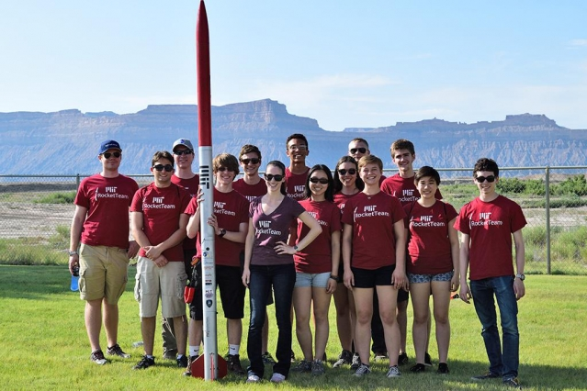
2014-2015
Notes:
We built this

Slide 4
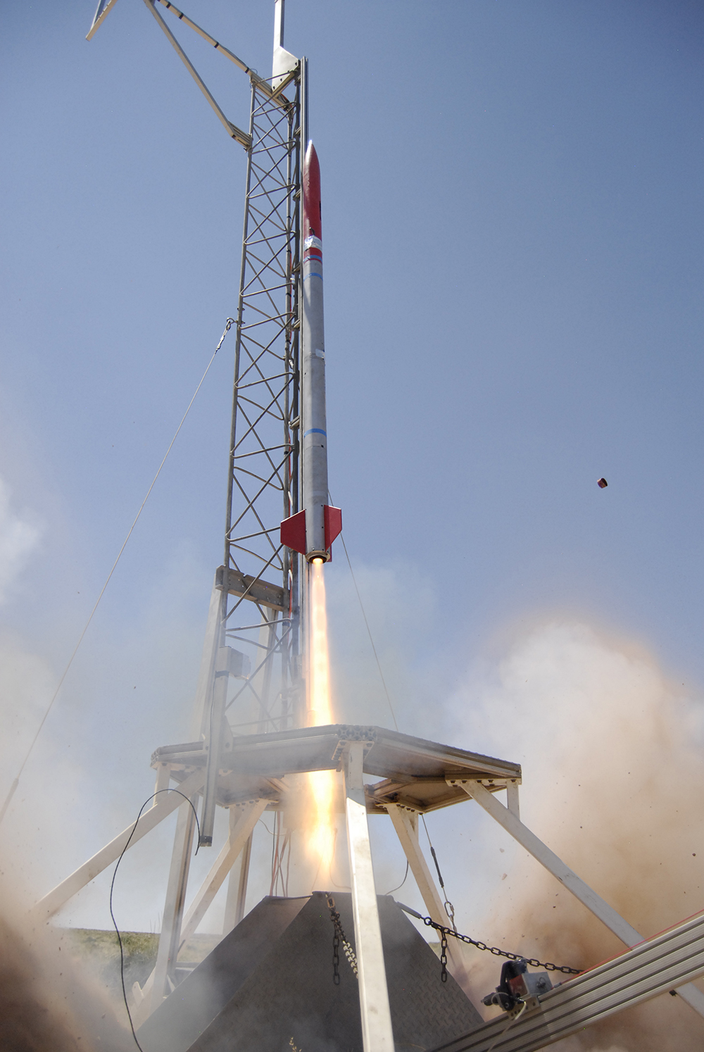
2014-2015
Stats:
4” diameter, mixture of CF and FG
10,000’ target altitude
1st place in competition (IREC)
Mostly off-the-shelf parts
Lessons learned:
Basic rocket construction
Fin can construction techniques
Low altitude recovery strategies
Notes:
We built this

Slide 5
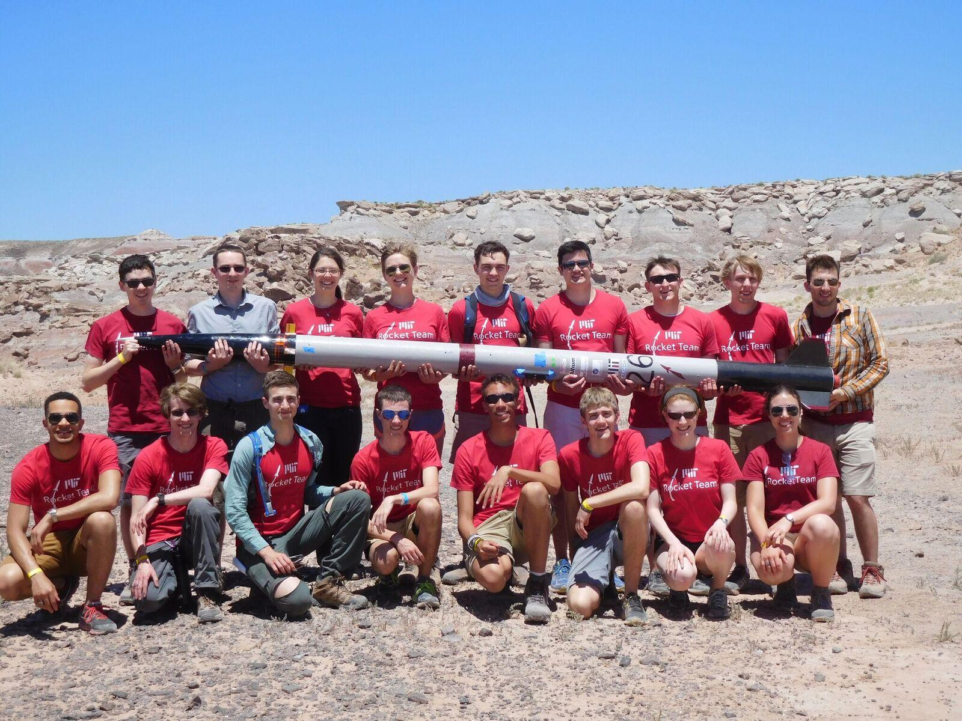
2015-2016
Notes:
We built this

Slide 6
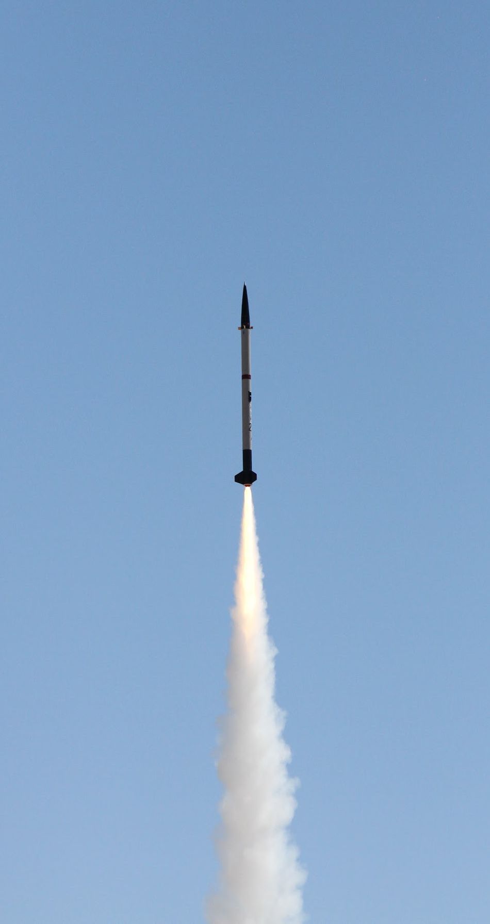
2015-2016
Stats:
6” diameter, FG/AL/CF
10,000’ target altitude
Custom airframe tubes, off-the-shelf motor and nosecone
Lessons learned:
Recovery difficulties - We over-complicated things
How to work with composites
Project scope
Notes:
We built this

Slide 7
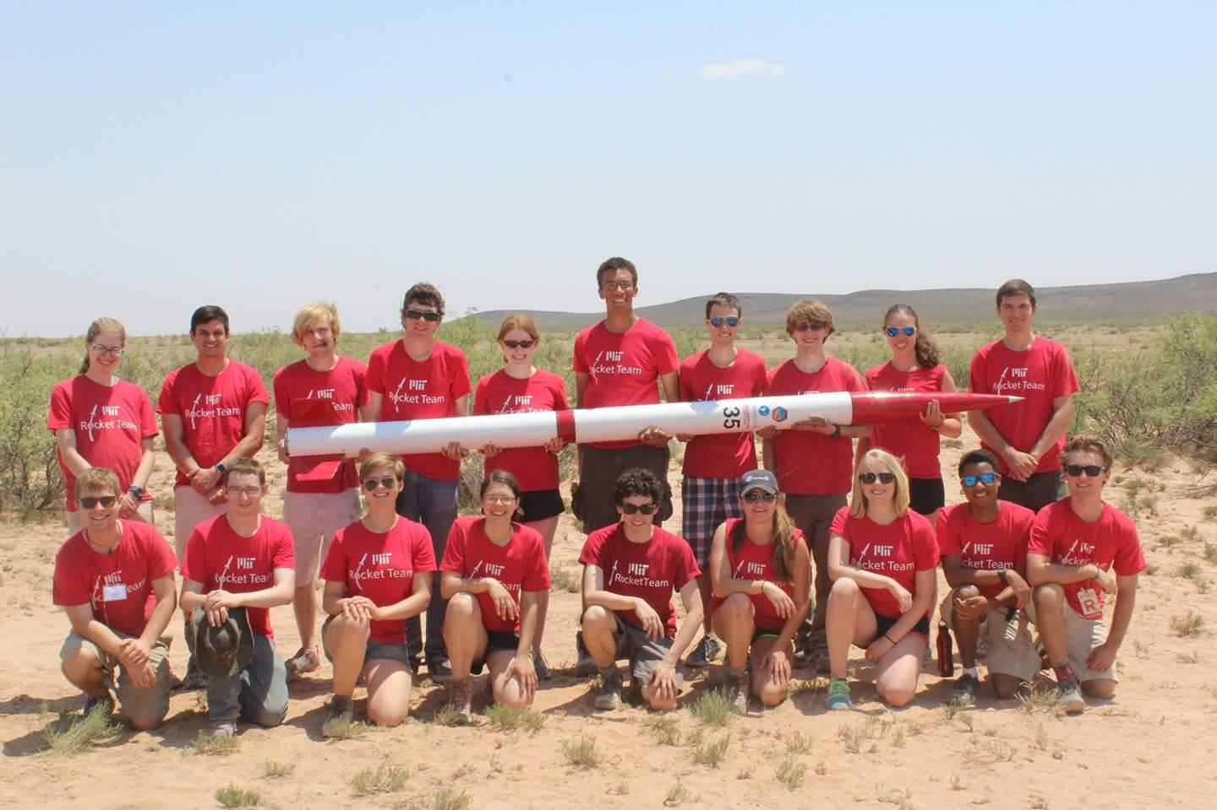
2016-2017
Notes:
We built this

Slide 8
2016-2017
Stats:
6” diameter, FG/AL/CF
10,000’ target altitude
Fully custom airframe, off-the-shelf motor
2nd place
Lessons learned:
Simple is better (recovery, avionics)
More composites techniques
Custom propulsion groundwork
Project scope (!!!)
Notes:
We built this

Slide 9
People started to get excited about space → how do we get there?
Notes:
Mission statement

Slide 10
What do we need to do to go to space?
Learn how to make high-altitude sounding rockets which:
  Survive large accelerations (~Mach 3) and aerothermal heating
  Consistently collect accurate telemetry
  Recover reliably
Learn how to stage rockets
  Stage separation
  Reliable second stage motor ignition
Use incremental flights to inform final design of Spaceshot
Build a sustainable team, follow safety and legal policies

Slide 11
The Age Of Project Hermes
Notes:
Mission statement

Slide 12
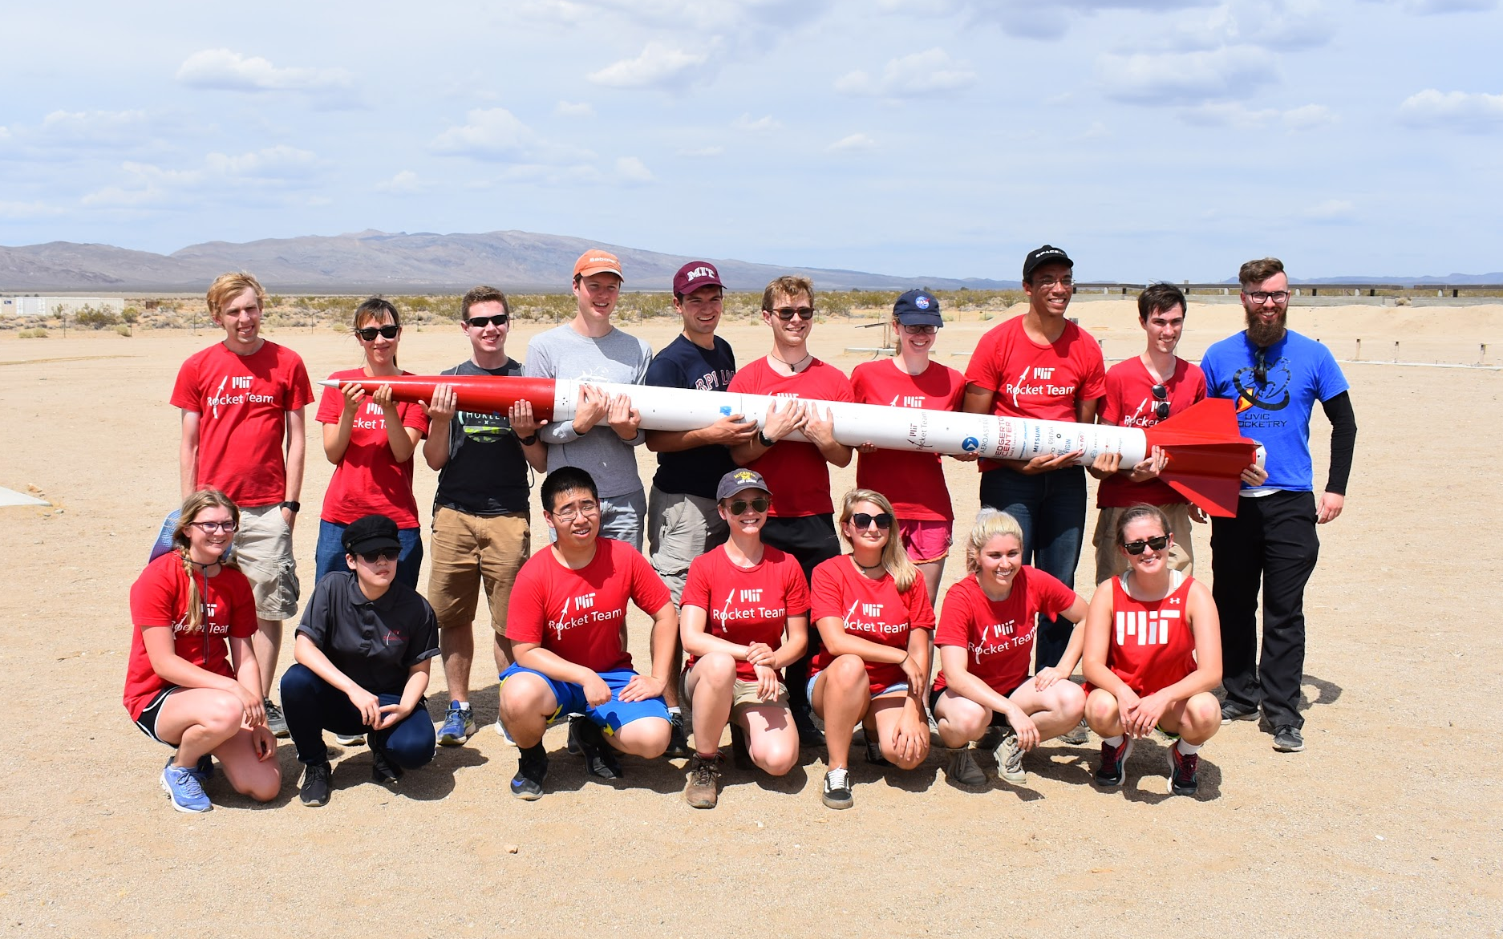
2017-2018
Notes:
We built this

Slide 13
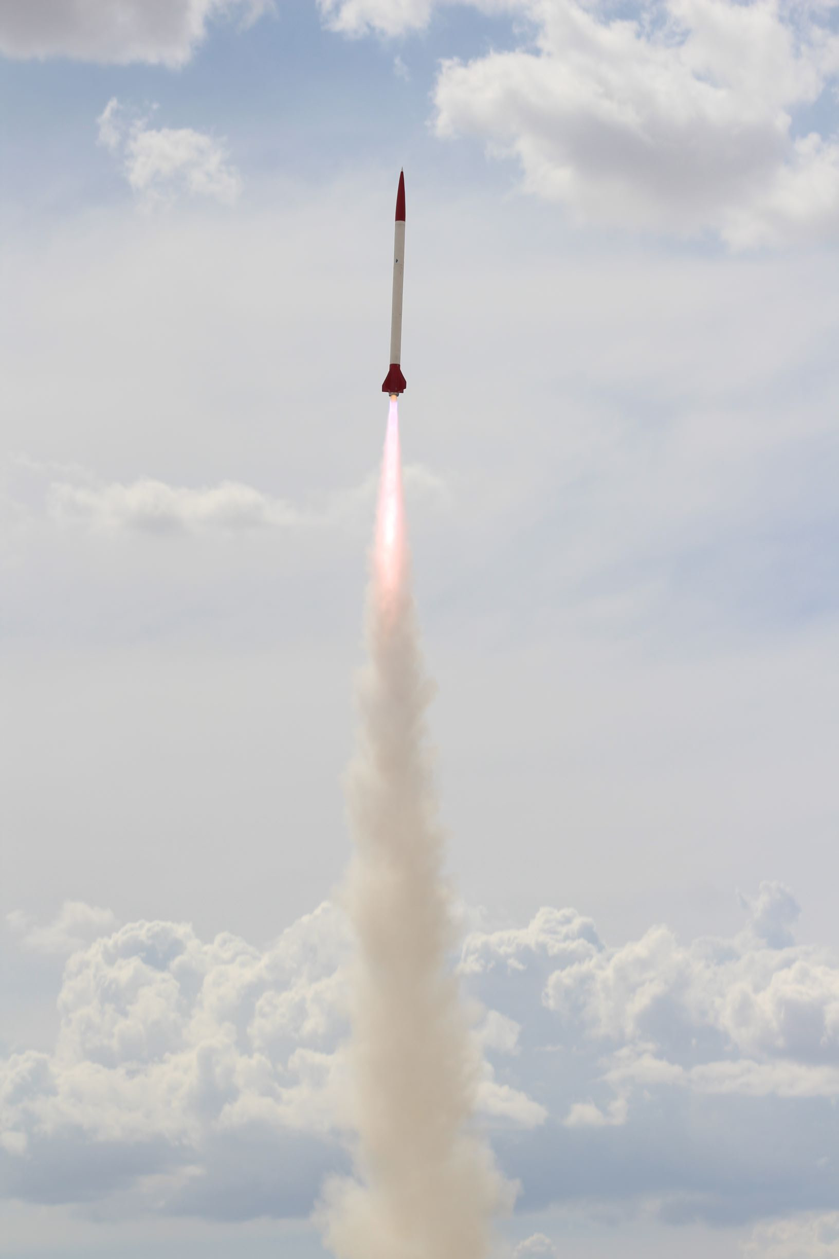
2017-2018
Stats:
6” diameter, FG/AL/CF
30,000’ target altitude
Custom motor and fincan, off-the-shelf nosecone and airframe tubes
Custom high-altitude-ready recovery system
Lessons learned:
How to build a rocket motor
How to withstand supersonic flight
How to deploy parachutes at high altitude
Notes:
We built this

Slide 14
What do we need to do to go to space?
Learn how to make high-altitude sounding rockets which:
  Survive large accelerations (~Mach 3) and aerothermal heating
  Consistently collect accurate telemetry
  Recover reliably
Learn how to stage rockets
  Stage separation
  Reliable second stage motor ignition
Use incremental flights to inform final design of Spaceshot
Build a sustainable team, follow safety and legal policies

Slide 15
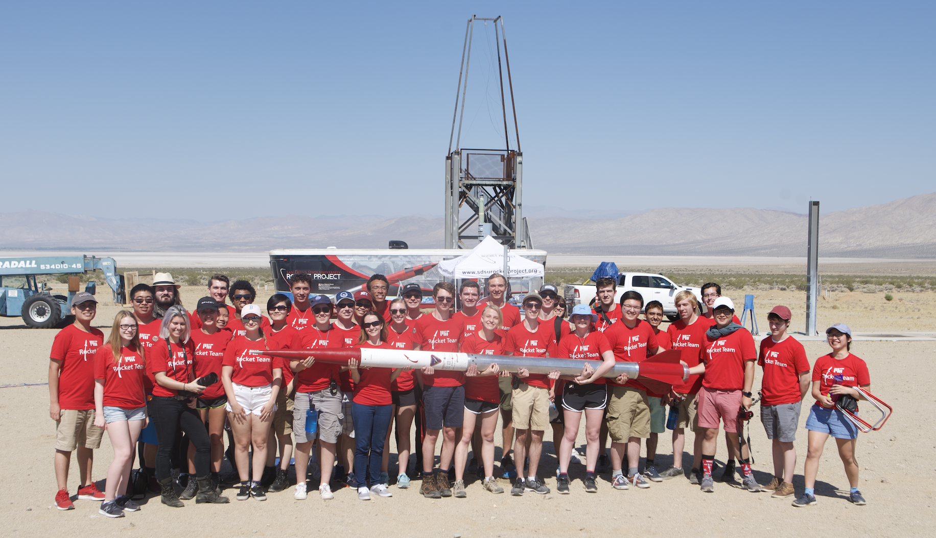
2018-2019
Notes:
We built this

Slide 16
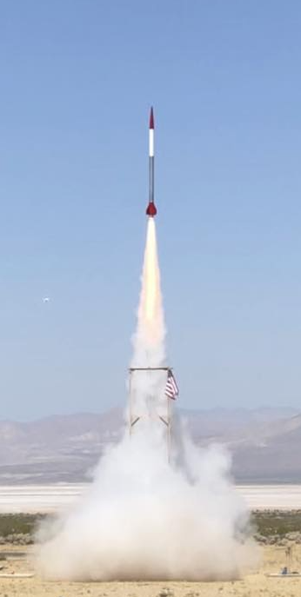
2018-2019
Stats:
6” diameter, FG/AL/CF
90,000’ target altitude
Lower and Upper Electronics packages to collect data on flight
Custom flight computer Pyxida collecting Telemetry, not in command
Custom motor, nose cone, and fincan, off-the-shelf airframe tubes
Custom high-altitude-ready recovery system
Notes:
We built this

Slide 17
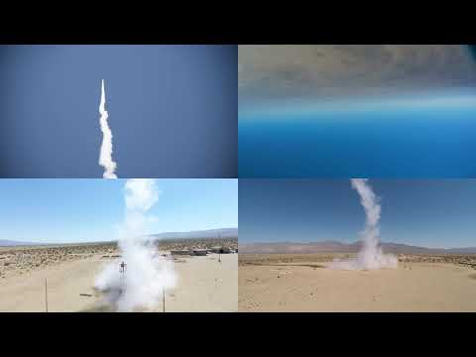

Slide 18
Lessons Learned
The team has grown
  Bigger in size and in scope of projects
Need culture of the team to grow too in order to be successful at projects of this scale
  Increased accountability
  Better processes and checks
  INITIATIVE
Notes:
We built this

Slide 19
What Next?
Notes:
We built this

Slide 20
Project Hermes Mission Objectives:
To bridge the gap between the intercollegiate competitions to spaceshot
To validate our current manufacturing and design methods
To reduce the risks of the spaceshot
Notes:
To bridge the gap between the intercollegiate competitions and spaceshot
Validating our current ways of doing things and flight profile
Get info about challenges
Gateway to space
Bridge the gap from the old way to do things (hobby competition based, to go to a targetted low atltide)
To a top down bottoms up systems model
Multi year project
Team is triple, budget is triple
Start with rocket team mission
Graph of altitudes
Mission for hermes
Conops for hermes
Tech demonstrator and sounding rocket
Payload is to reduce risk in modelling and manufacturing for the space shot

Slide 21
Hermes III
Here we go again
Notes:
We built this

Slide 22
Spaceshot Risk Categories
Mitigated by Project Hermes
Mathematical and Numerical Models | Component Selection | Manufacturing Methods | Operation Logistics
Nose cone tip thermal model Parachute deployment loads Drag model Motor thrust curve | Avionics Ground communications Parachute Materials Recovery deployment mechanism | Nose cone and fincan layup Motor case manufacturing and tolerancing Rocket integration | FAA Waivers Transportation Budgets Team structure
Notes:
The four risk categories

Slide 23
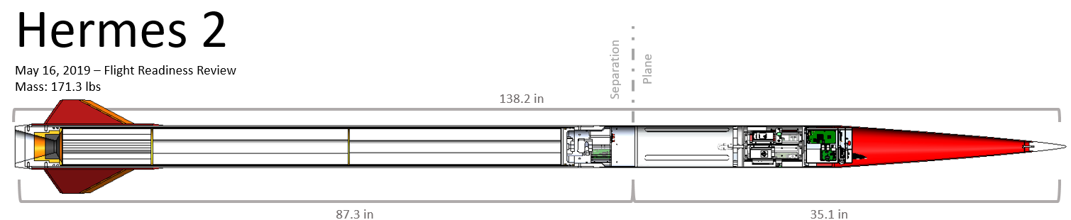
The Rocket
12’ 10”
7’ 3"
5’ 7”
P Class Motor
Total Impulse: 74 kNs
Isp: 227 s
Total mass: 167 lbs (measured)
Propellant mass: 73.3 lbs (measured)
4 Composite Fins
Passively stabilized
Payload
Custom Flight Computer
5 IMUs
10 Thermocouples
5 Cameras
3 Barometric Altimeters
2 GPS
Notes:
We built this

Slide 24
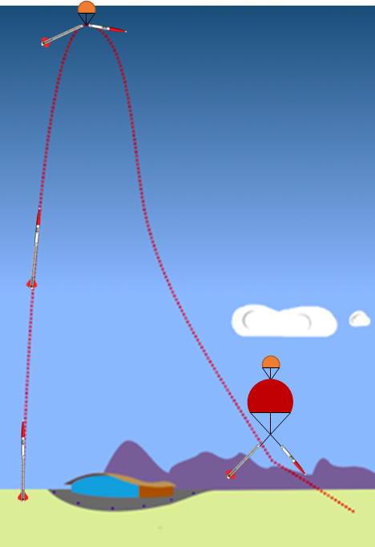
Expected Flight Profile
ID | Time | Event | Altitude (ft)
1 | -5:00 | Arm Avionics | 0
2 | 0:00 | Go/No Go, Ignition | 0
3 | 0:08 | Burnout | 15,000
4 | 1:15 | Apogee | 93,000
5 | 1:15 | Recovery Separation | 93,000
6 | 1:25 | Drogue Inflation | 90,000
7 | 6:00 | Main Parachute Release | 2,000
8 | 6:10 | Main Parachute Inflation | 1,800
9 | 7:00 | Impact | 0
4, 5, 6
3
1, 2
7, 8
9
Notes:
Switch time and event cols
Check altitudes
Include schedule
Include driving dates on conops
And integration

Slide 25
Systems

Slide 26
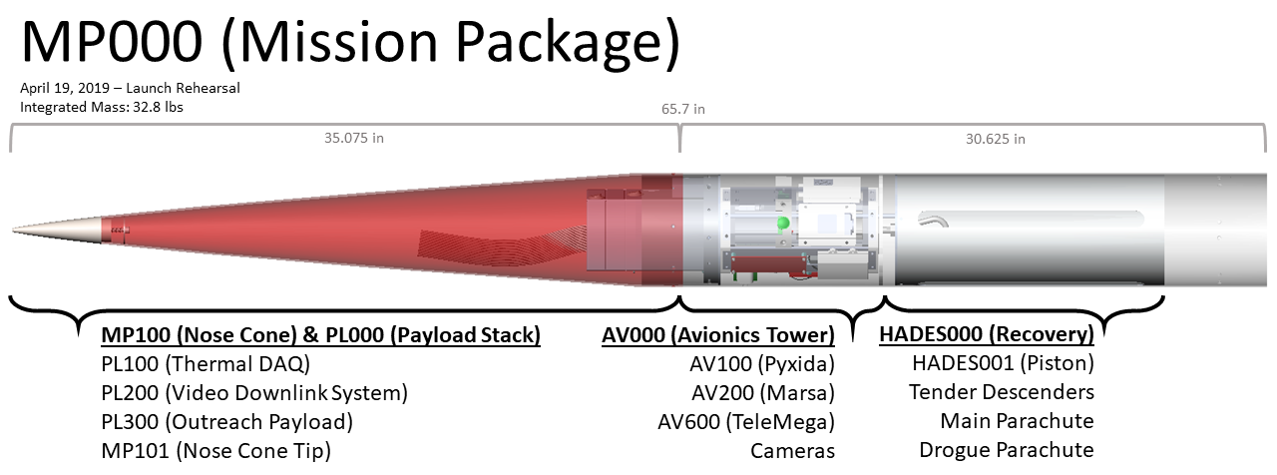
Mission Package (MP) - Overview

Slide 27
Payload Overview
Primary Objective: Acquire thermal data to inform design of spaceshot nose cone, particularly how ablative performs
Secondary Objectives:
  Characterize vibration environment of Hermes III
  Characterize parachute deployment
Custom data acquisition system that reads and logs data from:
  Thermocouples
  Resistance Temperature Detectors
  3-axis accelerometer

Slide 28
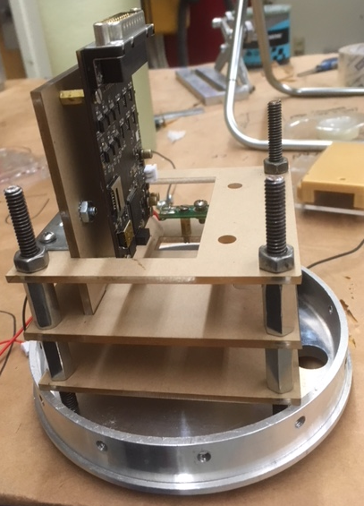
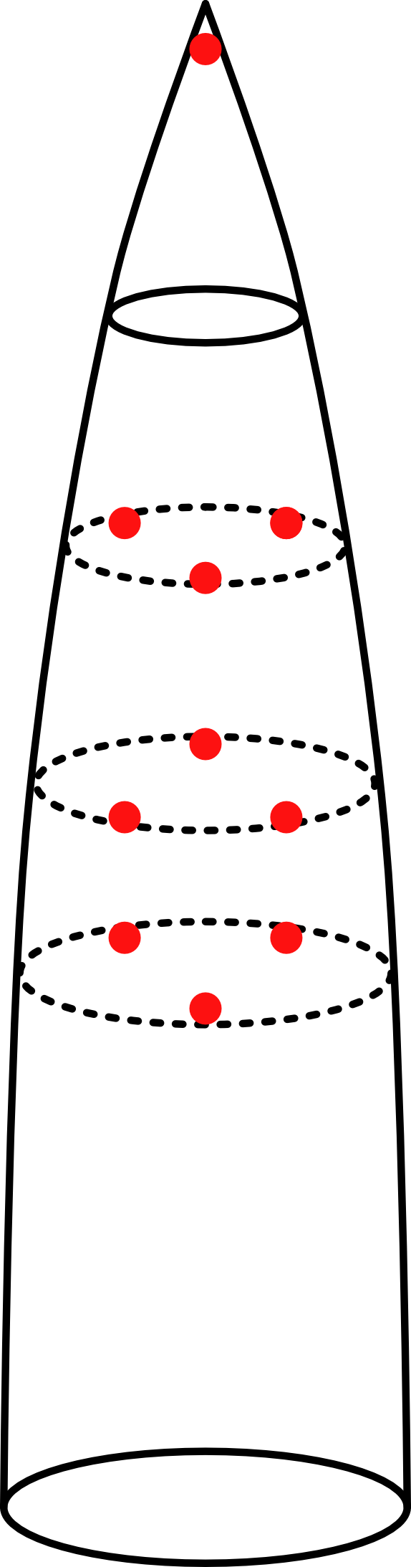
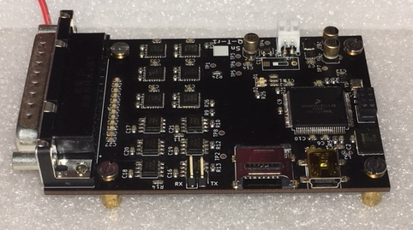
Configuration

Slide 29
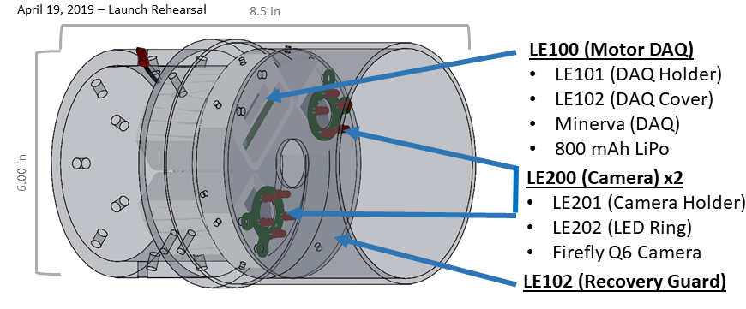
Lower Electronics - Overview

Slide 30
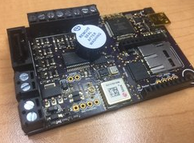
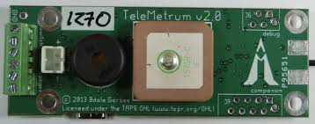
Hermes: Avionics Systems
Telemetrum: collects and transmits data, deploys parachutes
BBC: British Broadcasting Circuit
Pyxida: collects and transmits data
Transmitted and stored data includes GPS position, altitude, velocity, and acceleration.

Slide 31
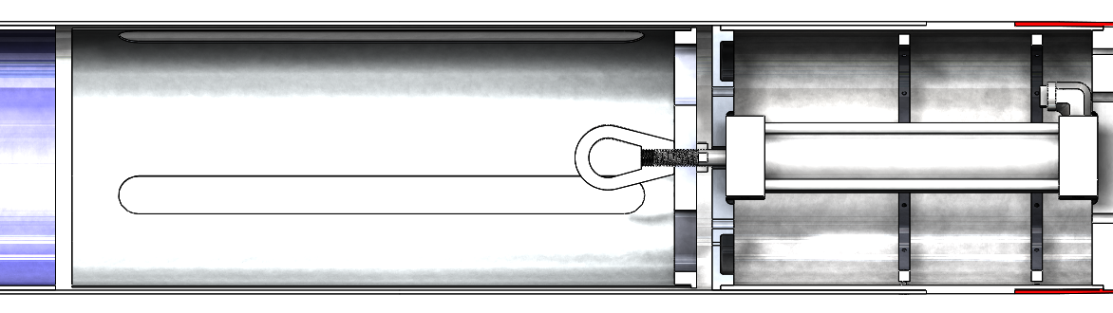
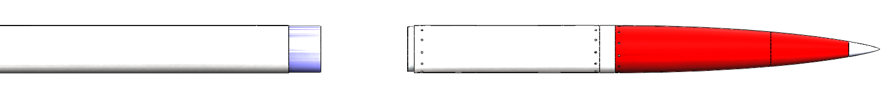
Project Hermes: Recovery System
Dual deploy - Doesn’t land behind the mountains
Piston deployment - Will work at any altitude
Disk-Gap-Band parachute - Ready for supersonic descent

Slide 32
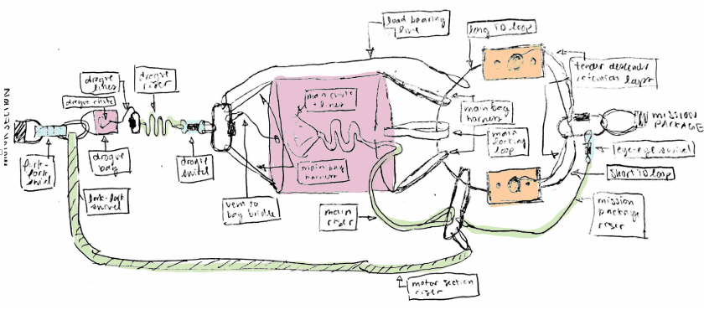
Recovery - Soft goods
Reqs. | Parachutes must deploy and inflate properly, and lines cannot break
Design
Load-Bearing Line
Long TD Loop
Drogue Lines
Drogue Riser
Tender Descender Retention Loops
Drogue
Main Chute and Lines
Main Bag Harness
Mission Package
Motor Section
Locking Loop
Drogue Bag
Drogue Swivel
Eye-to-Eye Swivel
Fork-to-fork swivel
Main Bag Handles
Short TD Loop
Vent-to-Bag Bridle
Main Riser
Mission Package Riser
Motor Section Riser

Slide 33
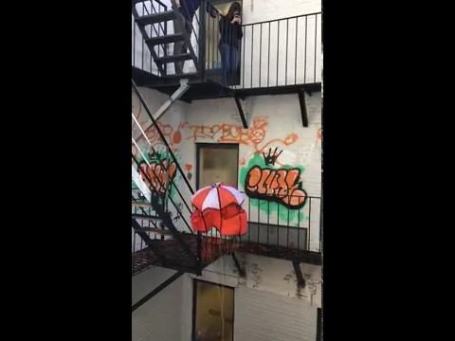
Recovery- Soft goods
Verify | Parachutes: Tow test behind a car Drop test at minimum load to check inflation Lines: Safety factors and load path analysis Drop test with load cell
Open Risks | Line tangling

Slide 34
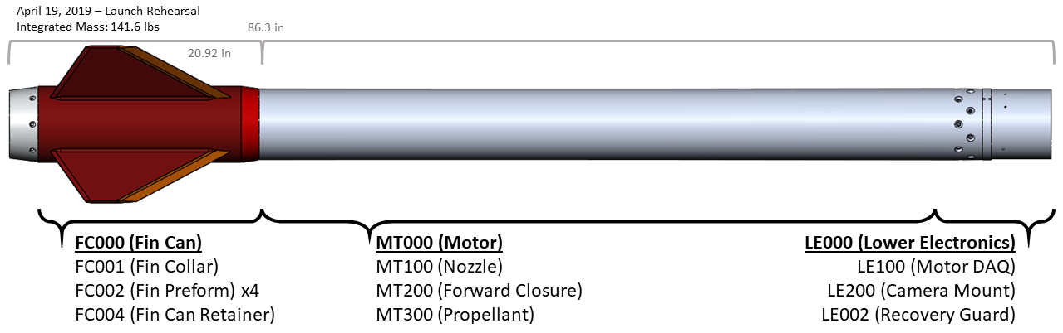
Booster - Overview

Slide 35
Motor - Key Features
73.3 lbs of ammonium perchlorate composite propellant
  82.5% solids, 7.5% aluminum
  Three grains: one finocyl at the aft end and two BATES at the forward end
Convolute wound canvas phenolic liner for thermal insulation
6061-T6 aluminum case and closures retained by 16 alloy steel bolts
  3.4x calculated safety factor
  Hydrostatic tested to 1600 psi (2x operating pressure)
Nozzle assembly contains a significant amount of linen phenolic
  Sacrificial layer that prevents erosion of aluminum components
  Lighter than a fully aluminum nozzle
  Graphite throat has low coefficient of thermal expansion and does not erode

Slide 36
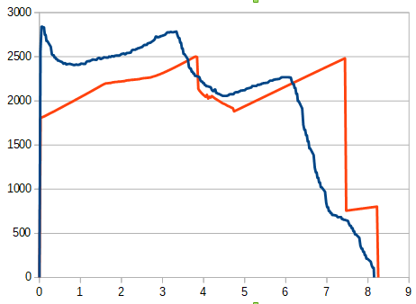
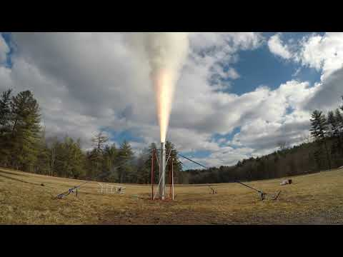
Static Fire
 | Simulated | Actual
Impulse | 74014 Ns | 74042 Ns
Average thrust | 8950 N | 9095 N
Peak thrust | 11120 N | 12500 N
Peak pressure | 5.17 MPa | 6.3 MPa
Specific Impulse | 226s | 227s

Slide 37
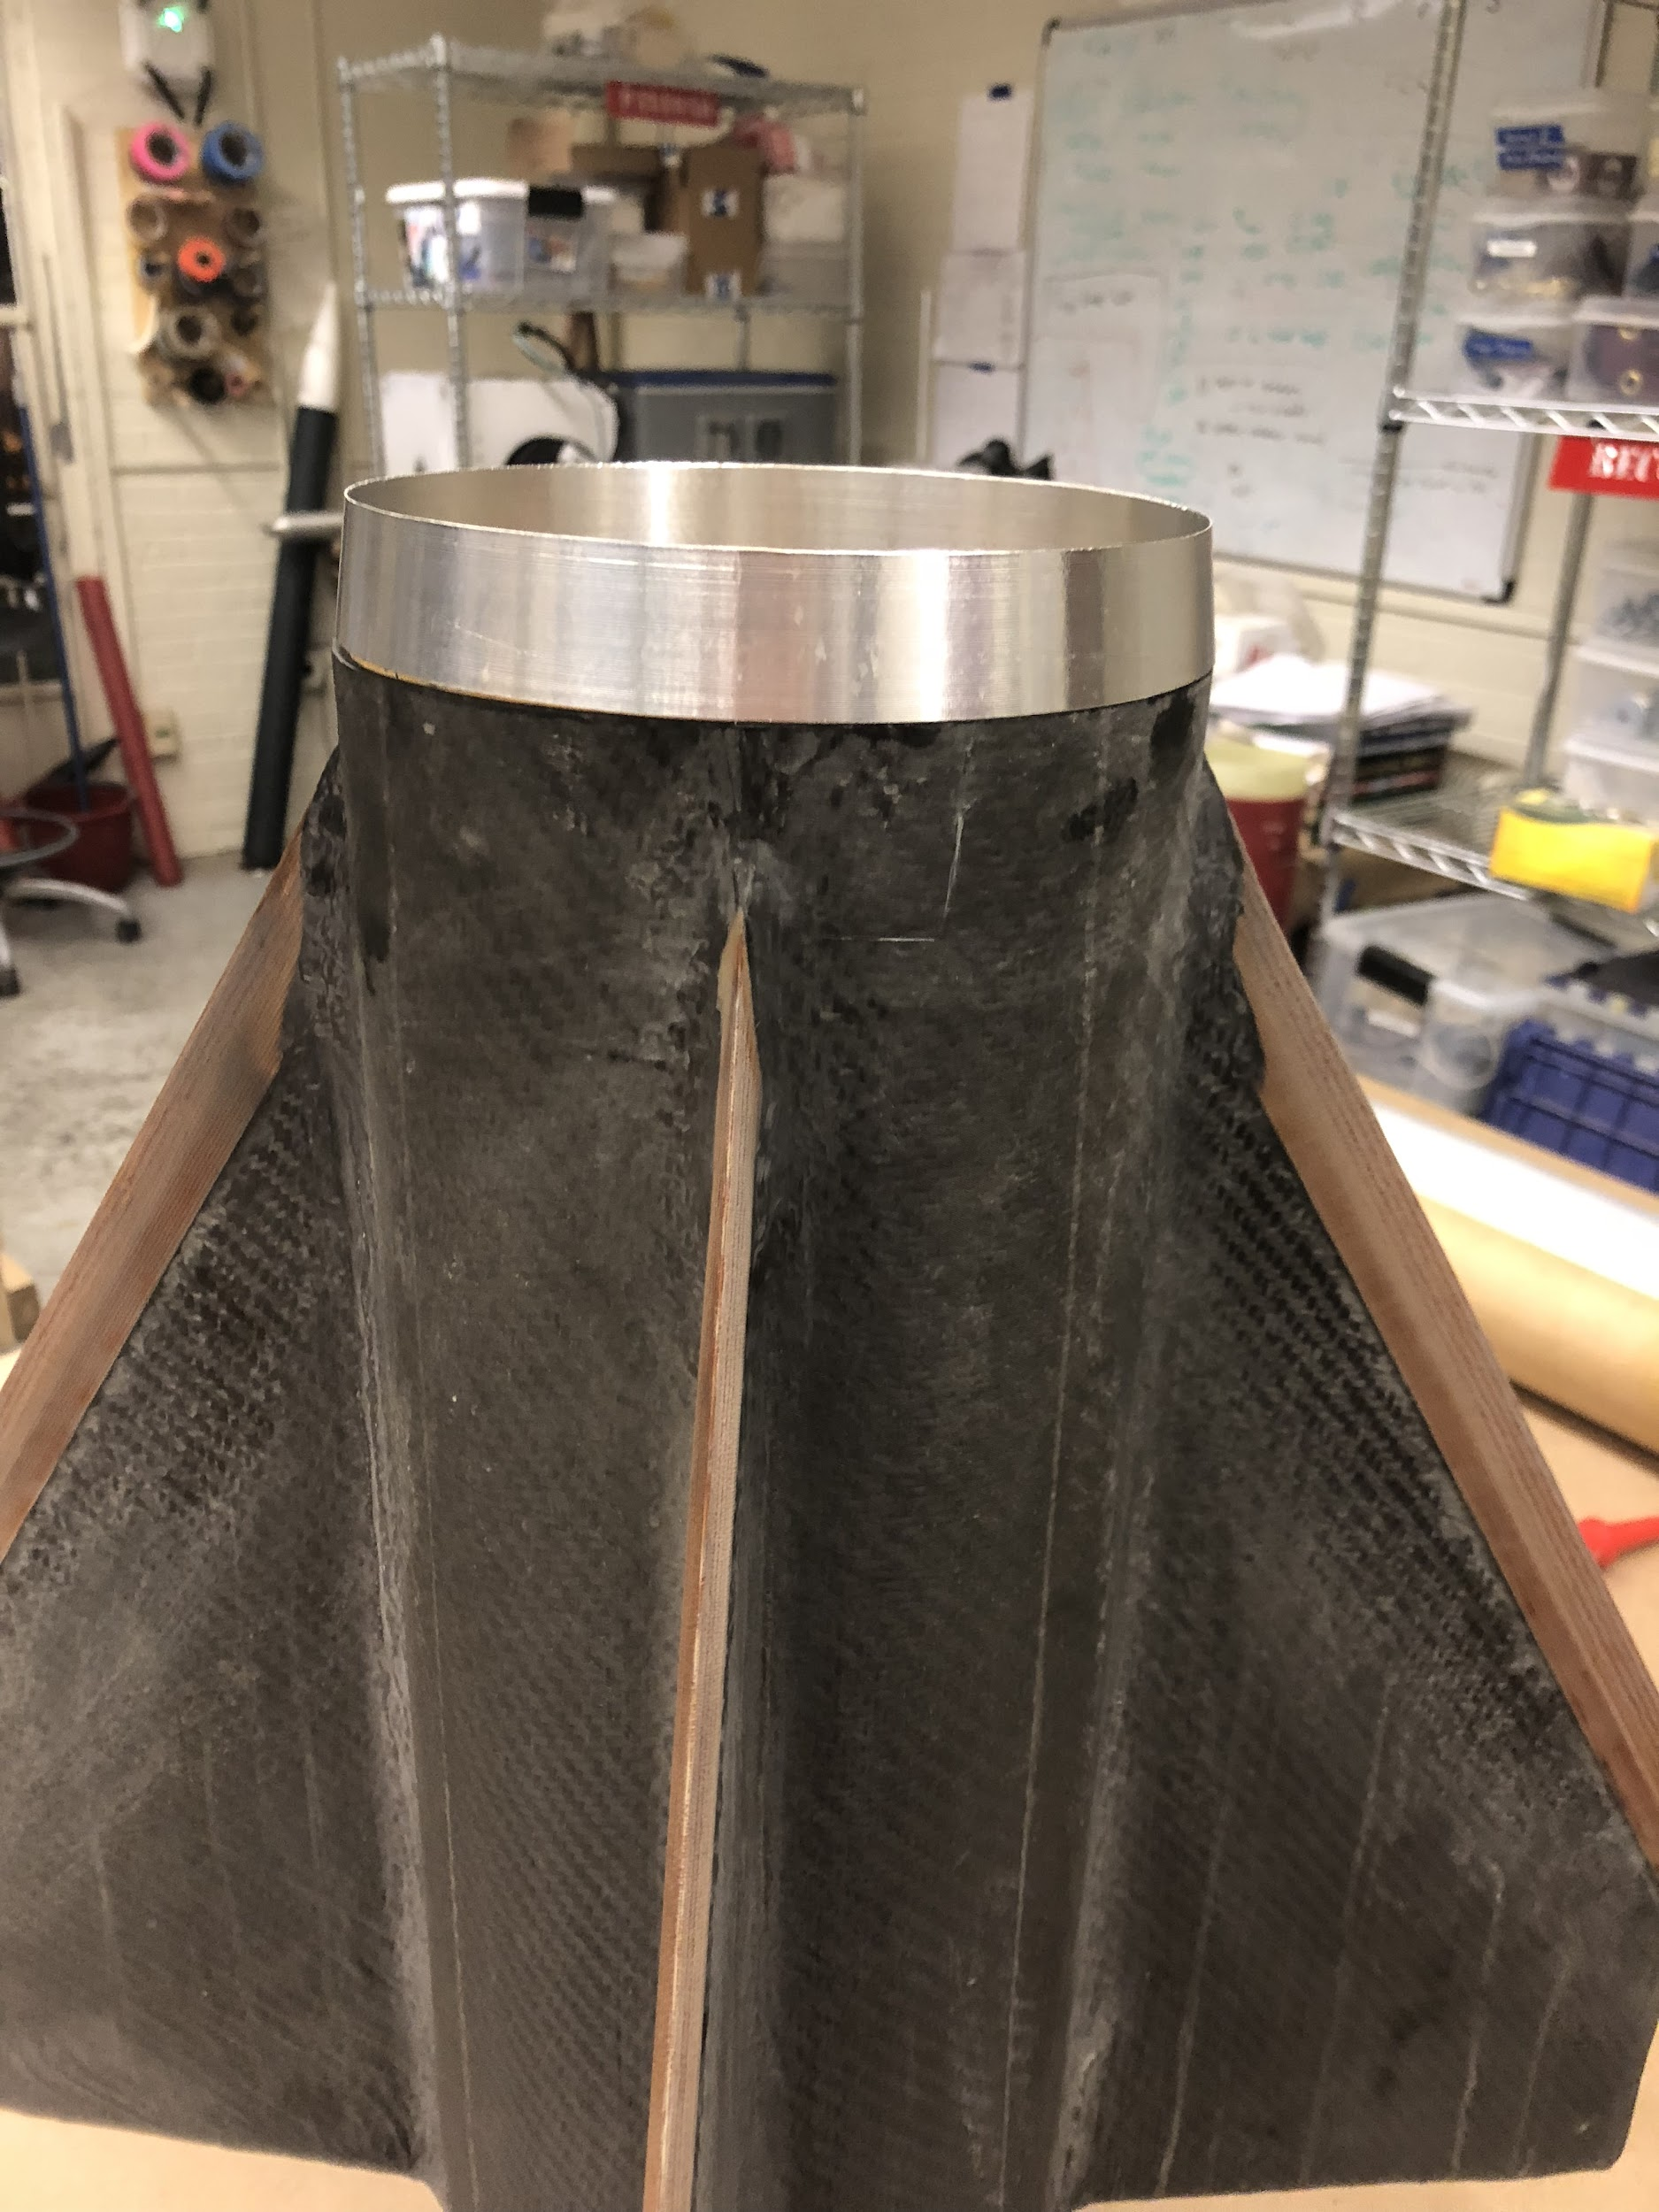
Fin Can - Overview
Four fins (planform shown)
4.5 calibers minimum stability from 18’ rail (Requirement: 2.0 calibers)
12 ply CF sandwich panel with G10 core
Phenolic leading edges with 15 degree taper
Design supported by heritage from:
  Hermes I
  USC

Slide 38
Project Hermes: Fin Can

Slide 39
Project Hermes: Fin Can

Slide 40
Project Hermes: Fin Can

Slide 41
Project Hermes: Fin Can

Slide 42
Project Hermes: Fin Can

Slide 43
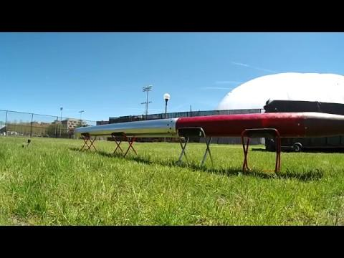
Launch Operations
Flight Assembly
Highly detailed procedures for reference
Integration checklists highlight single-point failures
  Require signatures from two members
Completed rehearsals of assembly and launch operations
Simulated adverse scenario of changing a battery on-site (95 minutes)
Completed two full-up ground tests after flight assembly completed
Successful piston and TD actuation during ground test
Outstanding risks:
Assembly procedures and integration checklists not yet combined
Clearly integrate roles & responsibilities of non-flight assembly

Slide 44
Today’s Schedule
12:00 - All Hands
12:30 - Subteam Work Sessions
2:00 - L1 Sessions

Slide 45
Conclusion
ID | Time | Event | Altitude (ft)
1 | -5:00 | Arm Avionics | 0
2 | 0:00 | Go/No Go, Ignition | 0
3 | 0:08 | Burnout | 15,000
4 | 1:15 | Apogee | 93,000
5 | 1:15 | Recovery Separation | 93,000
6 | 1:25 | Drogue Inflation | 90,000
7 | 6:00 | Main Parachute Release | 2,000
8 | 6:10 | Main Parachute Inflation | 1,800
9 | 7:00 | Impact | 0
4, 5, 6
3
1, 2
7, 8
9
Notes:
Switch time and event cols
Check altitudes
Include schedule
Include driving dates on conops
And integration

