Slide 1
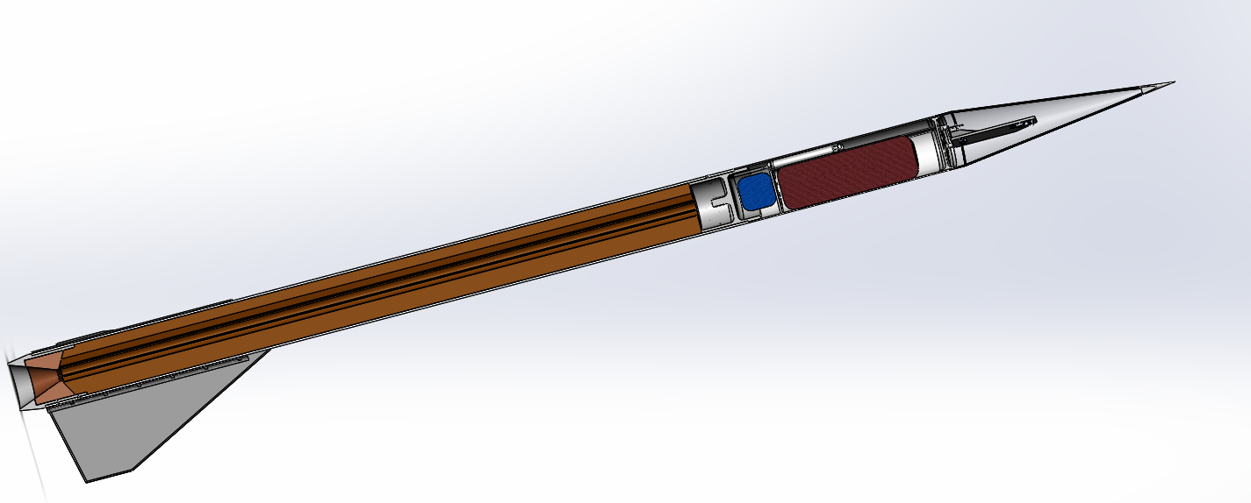

Concept Design Review
High Altitude Flight
Overview | Propulsion | Recovery | Avionics | Structures | Payload

Slide 2
Organizational Structure
President
Charlie G
Vice President
Andrew R
Executive Council
Maddie J; Joanna Z; Isaac P; Joey M; Juan S;
High Altitude Flight
Viper Program
Recovery
Maddie J
Avionics
Josef B
Payload
Maddie G
Solid Propulsion
Sam A
Structures
Matthew C
Liquid Propulsion
Nick B
Overview | Propulsion | Recovery | Avionics | Structures | Payload

Slide 3
2017|2018 Budget
Expenses
Income
Team | Allotment
Solid Propulsion | $6,250
Liquid Propulsion | $6,000
Structures | $7,000
Avionics | $2,000
Recovery | $1,200
Payload | $2,000
Social | $1,000
Team Expenses | $18,000
Total | $43,450
Source | Contribution (projected)
Finboard | $2,100 ($4,000)
Blue Origin | $2,000
AeroAstro | ($8,000)
Edgerton | ($10,000)
Northrop Grumman | ($1,000)
Shapiro Grant | ($6,000)
Course 2 | $1,250
Carry Over | $2,000
Total | $7,350 ($34,250)
Overview | Propulsion | Recovery | Avionics | Structures | Payload

Slide 4
2017|2018 Schedule
September
27 | 28 | 29 | 30 | 31 | 1 | 2
3 | 4 | 5 | 6 | 7 | 8 | 9
10 | 11 | 12 | 13 | 14 | 15 | 16
17 | 18 | 19 | 20 | 21 | 22 | 23
24 | 25 | 26 | 27 | 28 | 29 | 30
February
28 | 29 | 30 | 31 | 1 | 2 | 3
4 | 5 | 6 | 7 | 8 | 9 | 10
11 | 12 | 13 | 14 | 15 | 16 | 17
18 | 19 | 20 | 21 | 22 | 23 | 24
25 | 26 | 27 | 28 | 1 | 2 | 3
1st Semester
Preliminary Design Review: September 29
First Recovery Flight Test: October 28
Propulsion ¼ Scale Test: November 11
Avionics Hardware Freeze: December 9
2nd Semester
Propulsion ½ Scale Test: Feburary 10
Mission Package Complete: February 24
Propulsion Full Scale: March 10
Payload Flight Qualification: March 31
Camera Flight Qualification: March 31
Avionics Flight Qualification: March 31
Flight Readiness Review: April 7
Technical Report Due: April 28
October
1 | 2 | 3 | 4 | 5 | 6 | 7
8 | 9 | 10 | 11 | 12 | 13 | 14
15 | 16 | 17 | 18 | 19 | 20 | 21
22 | 23 | 24 | 25 | 26 | 27 | 28
29 | 30 | 31 | 1 | 2 | 3 | 4
March
4 | 5 | 6 | 7 | 8 | 9 | 10
11 | 12 | 13 | 14 | 15 | 16 | 17
18 | 19 | 20 | 21 | 22 | 23 | 24
25 | 26 | 27 | 28 | 29 | 30 | 31
April
1 | 2 | 3 | 4 | 5 | 6 | 7
8 | 9 | 10 | 11 | 12 | 13 | 14
15 | 16 | 17 | 18 | 19 | 20 | 21
22 | 23 | 24 | 25 | 26 | 27 | 28
29 | 30 | 1 | 2 | 3 | 4 | 5
November
5 | 6 | 7 | 8 | 9 | 10 | 11
12 | 13 | 14 | 15 | 16 | 17 | 18
19 | 20 | 21 | 22 | 23 | 24 | 25
26 | 27 | 28 | 29 | 30 | 1 | 2
3 | 4 | 5 | 6 | 7 | 8 | 9
Overview | Propulsion | Recovery | Avionics | Structures | Payload

Slide 5
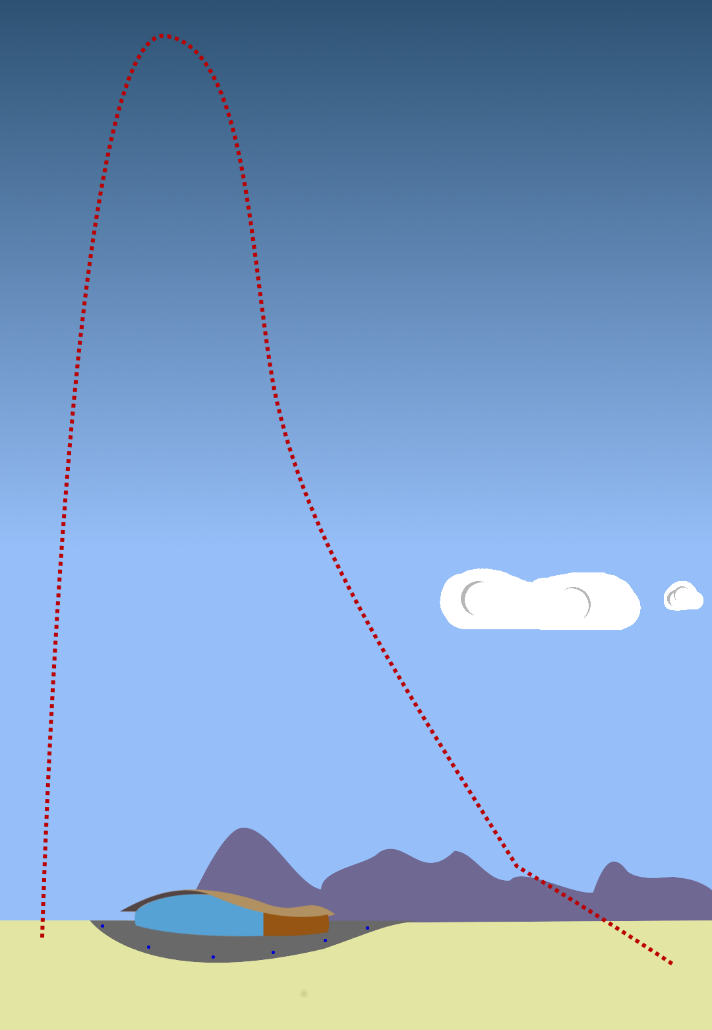
Concept of Operations
Pre-launch: New systems enable infinite pad sit time
Boost: A 70% P motor burns for 7 seconds at approximately 10kN of thrust
Coast: Travelling at Mach 3.1 the vehicle coasts to it’s 80,000 foot apogee
Apogee: Grab pictures, video, barometric readings, and a few GPS packets!
Ballistic Descent: At .01 PSIA the drogue parachute isn’t particularly useful
Drogue Descent: At around 60,000 ft the drogue begins to slow the vehicle
Main Descent: At 2,000 ft the main parachutes are deployed
Landed: After touchdown cameras are stopped and power is conserved until recovery forces arrive
Overview | Propulsion | Recovery | Avionics | Structures | Payload

Slide 6
Design Space Exploration
Diameter | Aerodynamics | Flight Heritage | Scalability
4” | Good | Okay | Bad
6” | Good | Good | Okay
8” | Horrible | Horrible | Amazing
4” vehicle has acceptable aspect ratios, decent stability, and low drag for an 80,000 ft altitude vehicle.
6” vehicle has acceptable aspect ratios, decent stability, and low drag for an 80,000 ft altitude vehicle.
8” is a detrimentally short vehicle that exhibits a rapid increase in base drag and decrease in stability due to an aft C.G.
4” Vehicles were flown by the team in 2015 and 2017. The team has extensive experience with 4” motors.
6” Vehicles are common. A 6” motor is a significant, but feasible undertaking.
8” Airframe and Motor are undeveloped and a significant schedule and technical risk.
4” airframe to the Karman line requires staging to avoid infeasible motor aspect ratios. May still require larger diameter booster.
6” airframe could feasibly be used in a spaceshot. There are serious technical concerns to be addressed however
8” vehicle could reach the Karman line with no novel technical barrier to overcome.
Overview | Propulsion | Recovery | Avionics | Structures | Payload

Slide 7
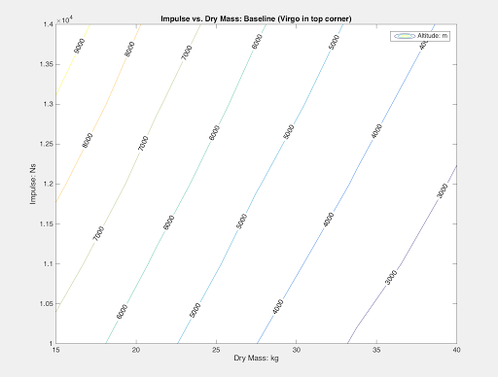
Design Space Exploration
Considered 4 in, 6 in, and 8 in diameter vehicle.
Sought good trade between achievement this year and supporting future goals.
Evaluated Technical and Schedule Risk, hardware maturity, scalability, financial cost, manpower cost, logistics, and awe factor.
6 in vehicle with 6in motor yields acceptable performance and minimizes risk to most subteams.
Does have a large ask from propulsion.
Overview | Propulsion | Recovery | Avionics | Structures | Payload

Slide 8
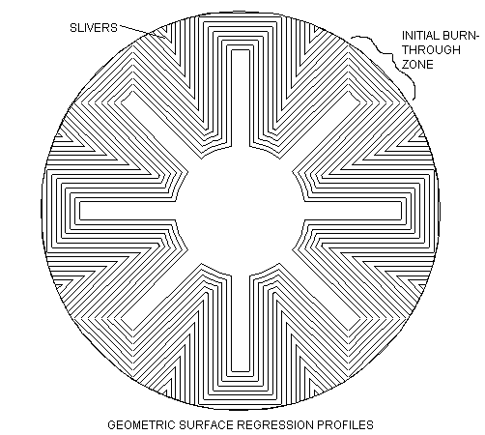
Solid Propulsion – Motor Architecture
Monolithic Geometry
Can be manufactured in either a monolithic or multigrain configuration
Grain geometry can be optimized to produce a flat Kn curve with a neutral burn profile
Thermal stresses on case minimized due to case insulation by propellant (monolithic)
Web support along entire length of motor (monolithic)
Manufacturing considerations with casting large amounts of propellant
Storage/logistics issues arise with the motor fully casted (monolithic)
Overview | Propulsion | Recovery | Avionics | Structures | Payload

Slide 9
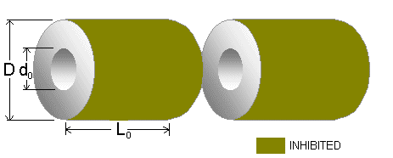
Solid Propulsion – Motor Architecture
Grain Geometry
Can be manufactured with existing equipment
Core mandrel is relatively simple
Grains are modular; easier to transport and assemble motor
Institutional knowledge
Thermal considerations - hot spots on case at grain boundaries
Acceleration loading problem on bottom grain
Liner procurement difficulties
Overview | Propulsion | Recovery | Avionics | Structures | Payload

Slide 10
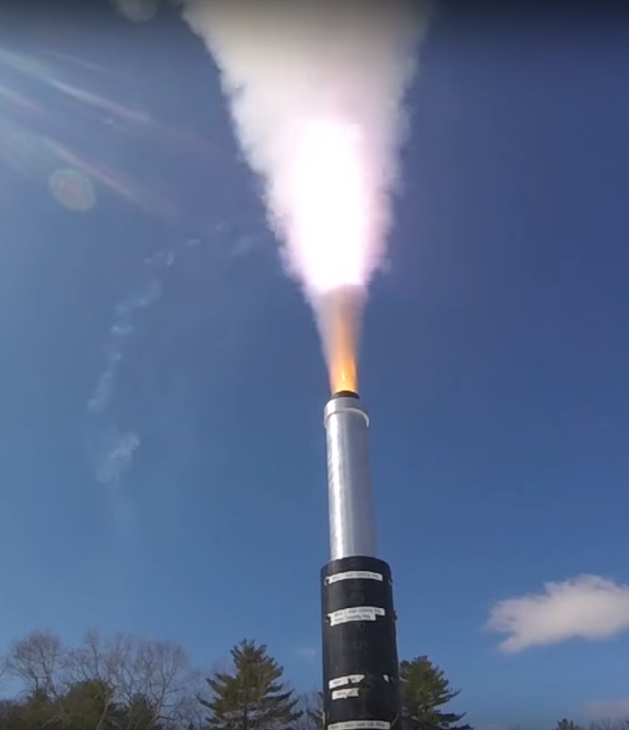
Solid Propulsion – Chemistry
To Avoid Schedule and Technical Risk, use qualified propellant:
Xaphan Blue:
17 Hot-fires to date
No Evidence of propellant instability
Good mixing and casting properties
Acceptable Performance
HTPB + HX 752 + CAO5 | 13.8%
Isodecyl Pelargonate | 4.5%
Multi-modal AP, 125 to 500 um blend | 67.4%
Castor Oil | 0.3%
Copper Chromite | 1.5%
Copper Oxychloride | 3%
Powdered Aluminum | 7.1%
MDI Isocyanate | 2.4%
This slide should not be distributed beyond team members! This is NOT ITAR controlled, but is considered sensitive.
Overview | Propulsion | Recovery | Avionics | Structures | Payload

Slide 11
Recovery – Parachutes
Current packing strategy: Fold ‘N Wrap + Deployment Bag
  Packing density of 265.7 kg/m³
Given 324.63 in³ available space
  Max vehicle weight of 126lb for 30 ft/s landing rate (SAC requirement 3.1.1.2)
  See Appendix for calculations and graph
Drogue
  Steady-state descent rate at Mach 0.13-0.14, with higher deployment velocities
  Prospective Geometries: Supersonic-X, Cross
  Decision due 9/15/17—can reevaluate worst-case opening speeds with OpenRocket simulation
Main
  Heritage technology: semi-ellipsoidal (re-use if possible)
Overview | Propulsion | Recovery | Avionics | Structures | Payload

Slide 12
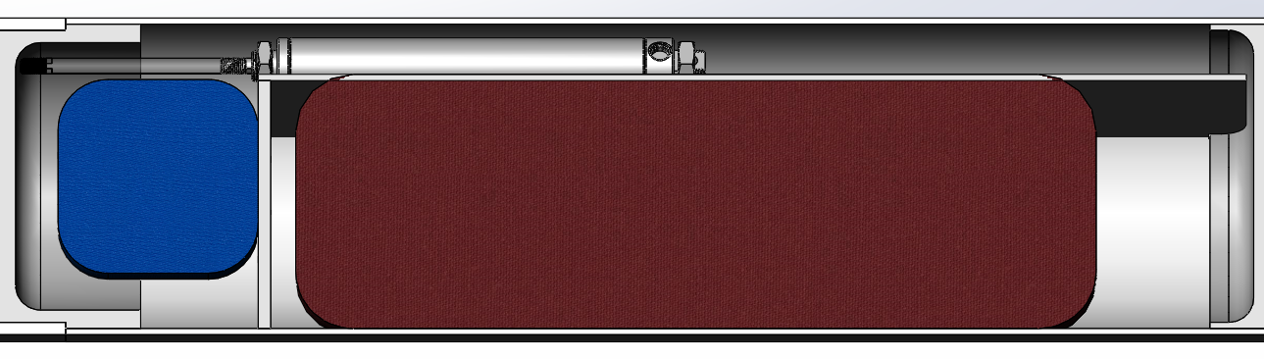
Recovery – Landing
SSDD Architecture
  COTS Pneumatic Actuator for Drogue
  Main retention and deployment via TD
    Planned up-scope to SRAD nichrome pin retention following FT1 (10/28)
Pneumatic Actuator
DRG
MAIN
Overview | Propulsion | Recovery | Avionics | Structures | Payload

Slide 13
Recovery – Mass Breakdown
Component Name | Mass (lb)
Main chute | 3.116
Deployment bag | 0.278
Drogue chute | 0.397
Tender descender + 2 quicklinks | 0.109
Webbing (50 ft total) | 0.706
7x 1000lb quicklinks | 0.529
2x 1500lb swivels | 0.053
Parachute Board + Main Chute Bulkhead (G10) | 1.115
Total | 6.303 lb
2016-2017 deployment bag—lighter alternative without webbing straps possible for future flights
Assumes identical drogue to 2016-2017… can be updated upon chute geometry decision
Level 2 TD—Level 3 discontinued by manufacturer, can likely still purchase within immediate future
Overview | Propulsion | Recovery | Avionics | Structures | Payload

Slide 14
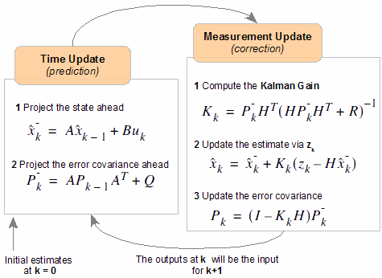
Avionics – Controls
Flight events
  Drogue event at 80,000 ft
  Main event at at 2,000 ft
  Triggered by Pyxida pyro channels
Sensor filtering
  Will implement Kalman Filter
    Best estimate of state assuming Gaussian error
    State = rocket rectangular coordinates
  Will fuse data from accelerometer, barometer, and GPS
  Will hopefully allow mach immunity
  Implement in C++ for Pyxida
  Eventually will give full six degree state of rocket (coordinates + orientation)
Overview | Propulsion | Recovery | Avionics | Structures | Payload
Notes:
Drogue event occurs when apogee is detected, or after __ seconds.
Main parachute is deployed at ___ feet.
You guys know more about this then me at this point - Josef

Slide 15
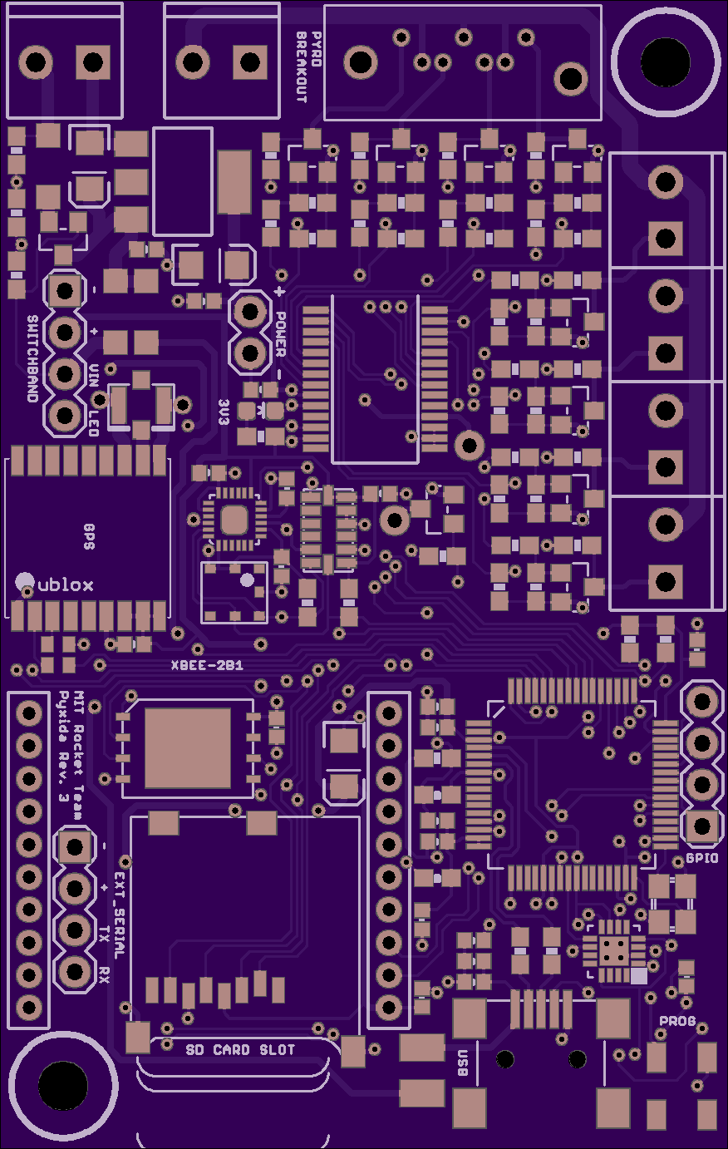
Avionics – Hardware Upgrades & Telemetry
Add capacitors in Pyxida power rail
  Prevents brownouts from flight turbulence
  Allows graceful shutdown
  Brings Pyxida to rev 4.1
Upgrad Pyxida telemetry chip
  Xbee -> CC1120 (from TI)
  CC1120 operates at sub 1GHz
    Supports high altitude flights
    Lower data rate but higher range
  Supports similar packet protocol to current firmware
  Brings Pyxida to rev 5.0
Ground station computer
  Avionics will explore options for a dedicated ground station computer
  This will save personal laptops in the desert
Overview | Propulsion | Recovery | Avionics | Structures | Payload

Slide 16
Avionics – Mass Budget
Component Name | Mass (lb)
Avionics bay (sled) | ~3
Batteries | ~1.5
Pyxida and wiring | ~0.5
Total | ~5.0 lb
Avionics bay must be redesigned since it has been moved to the nose cone this year
  Will integrate charging pad power to prevent components from dying while on the pad
Overview | Propulsion | Recovery | Avionics | Structures | Payload

Slide 17
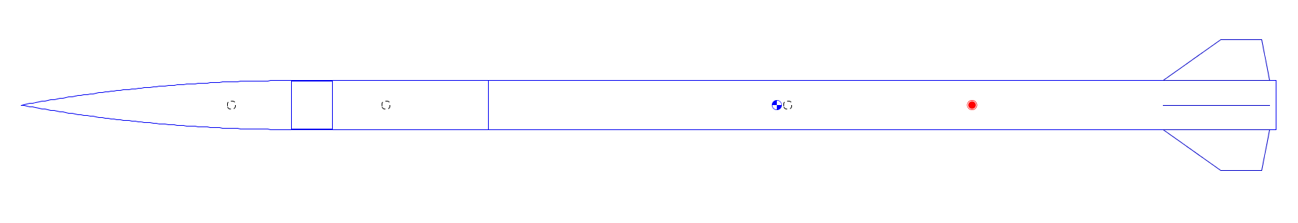
Structures – Vehicle Integrity
Structural analysis has determined that the loads on the composite tube comprising the forward airframe will be 439 lbs (1955 N) in the axial direction and 222 lbs (986 N) in the normal direction.
These will be satisfied by a 9 ply carbon fiber tube. This load expects a motor thrust of 12000N.
The nose cone will be constructed from S-Glass for radio frequency transparency. 9 layers of S-glass will be used.
4 ¼ in 6061 aluminum fins will be assembled around the aft of the motor case. These fins will be 13in long at the root chord and 5 in tall. They will be assembled with a collar around the motor case.
Aluminum Fins
Fiberglass Nose Cone
Carbon Fiber Tube
Overview | Propulsion | Recovery | Avionics | Structures | Payload

Slide 18
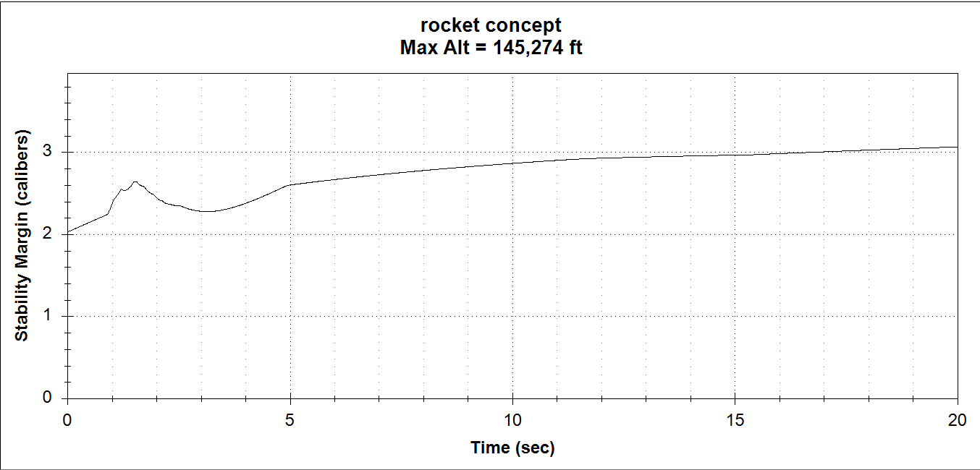
Structures – Stability
Minimum Stability:
2 Cal; Tower clear
CG moves aft by 6 in during burn.
Slightly Worrisome Oscillations off rail at 9+ MPH windspeed
Overview | Propulsion | Recovery | Avionics | Structures | Payload

Slide 19
Structures – Mass Budget
Component Name | Mass (lb)
Motor Case | 42.3
Forward Airframe | 0.938
Nosecone | 2
Fins | 4.4
Primary Bulkhead | 4.5
Fasteners | 2
Total | 56.224 lb
Overview | Propulsion | Recovery | Avionics | Structures | Payload

Slide 20
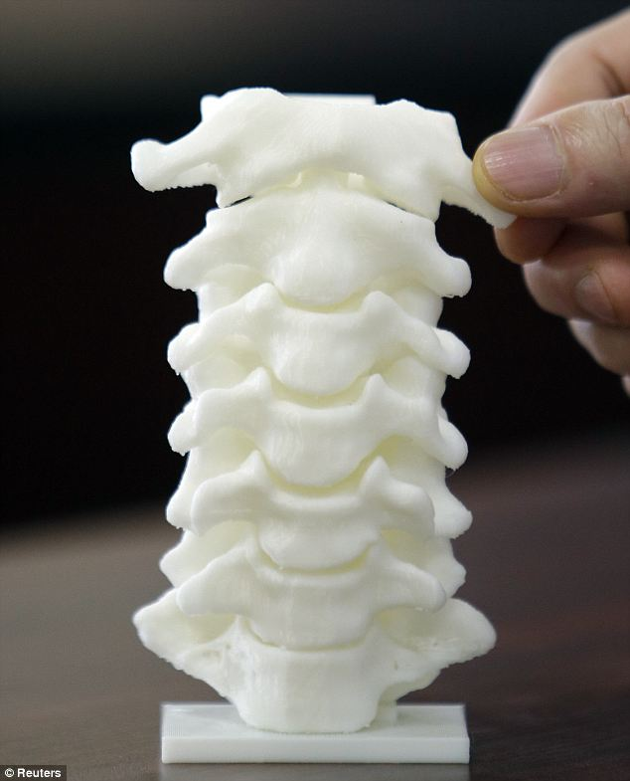
Payload – Research Mission
Cervical Spine Mechanical Force + Cerebrospinal Fluid Analysis
Primary goal is to look at the mechanical forces on the spine, investigating the spinal cord fluid movement and pressure over time would be an awesome way to integrate fluid flow in the payload but not necessary. Goal is to see the mechanical reactions of the spine to different stages of flight.
Mechanical Force Measurement (Primary)
  Observing axial forces throughout stages of flight between vertebrae on spinal column
  Vertebral column will most likely be 3D printed or a pig/cow spine depending on accuracy and feasibility
  Space constraints allow us only enough room for sections of the spine, so we will preferably work with the cervical spine, but can use the lumbar spine section
  Use strain gauge load sensors to measure the force readings over time between vertebral discs
Cord Pressure Measurement (Secondary)
  Classic spinal tap puncture method to measure pressure over time
  Cord acquisition/modeling to be determined
Overview | Propulsion | Recovery | Avionics | Structures | Payload

Slide 21
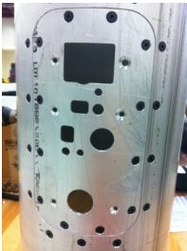
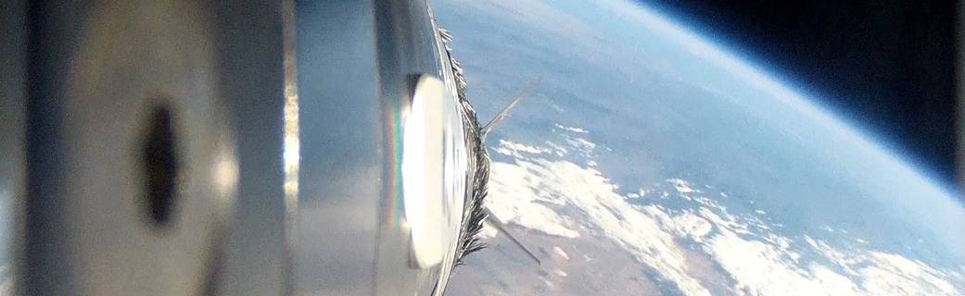
Payload – Video
This year onboard video is a primary mission objective, assigned to the payload team.
Key Challenges:
Thermal Management
Pad duration
Remote Start
Awesome Views
Overview | Propulsion | Recovery | Avionics | Structures | Payload

Slide 22
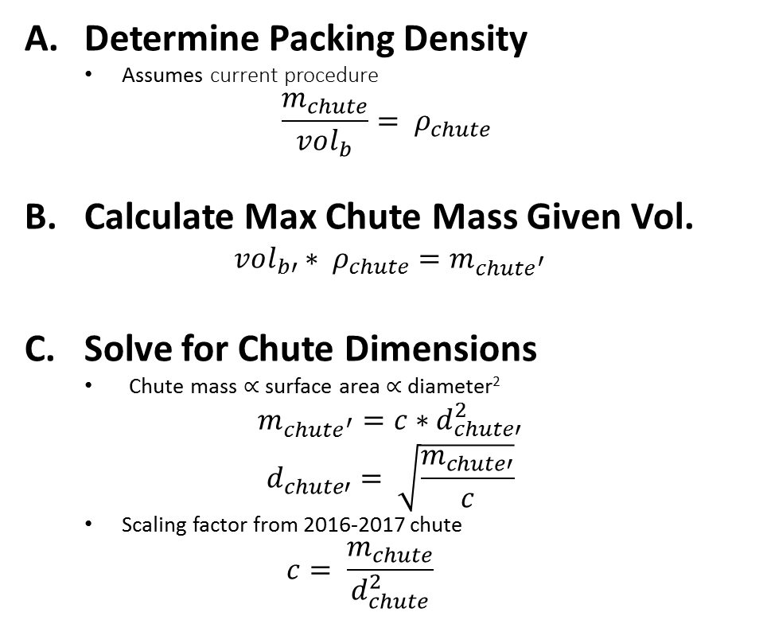
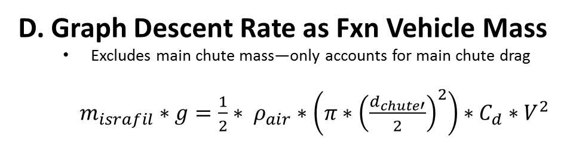
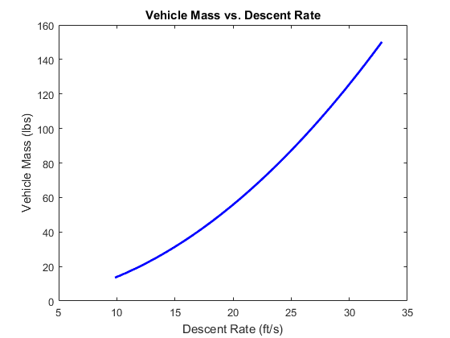
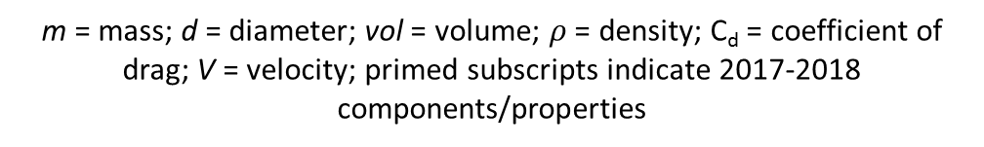
Appendix – Determining Maximum Vehicle Weight
Overview | Propulsion | Recovery | Avionics | Structures | Payload

Slide 23
Appendix – Mass Budget
Vehicle Mass Budget (wet)
Propulsion | 55 pounds (130 pounds)
Structures | 18 pounds
Recovery | 12 pounds
Payload | 9 pounds
Avionics | 6 pounds
Total | 95 pounds (175 pounds)
Overview | Propulsion | Recovery | Avionics | Structures | Payload

Slide 24
Appendix – Qualification Testing
The desert sucks. For humans, AND hardware. This year before we take anything to Las Cruces we’ll run the following tests:
Oven test: demonstrate functionality after sitting in maximum expected heat for 3 hours
Battery duration test: Characterize maximum pad stay time
Remote activation: The system can be started within the flow of a normal (read: long) ESRA salvo and function nominally.
Transportation test: The system still works after we drive over rough terrain with it for 2 hours.
Overview | Propulsion | Recovery | Avionics | Structures | Payload

