Slide 1
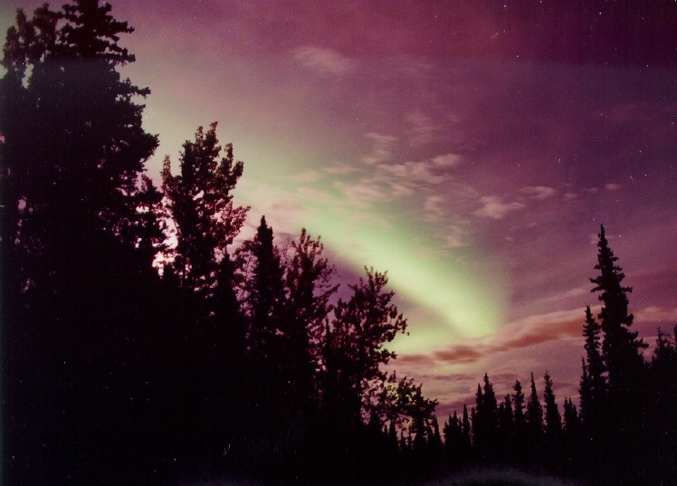
The Auroral-Ionosphere Response to Interplanetary Shocks
The Auroral-Ionosphere Response to Interplanetary Shocks
Xiaoyan Zhou
Earth, Planetary, and Space Sciences, UCLA
Xiaoyan Zhou
Earth, Planetary, and Space Sciences, UCLA
Acknowledgments
B. T. Tsurutani, G. Haerendal, Y.-Q. Jin, J. Moen, R.J. Strangeway
Seminar Presentation, MIT Haystack Observatory, Oct 26, 2016
Notes:
The auroral ionospheric response to interplanetary shocks
Abstract
Collisionless shocks are one of the most fundamental nonlinear phenomena in lab and space plasma. Among shock parameters and features (such as the upstream plasma beta, ThetaBn, the shock Mach number, the shock normal, and the shock criticality, etc.), the most important ones are the shock Mach number, the shock normal and the upstream IMF in terms of the geo-effect. As a visible effect, shock aurora has transient, global, and dynamic significances and provides a direct manifestation of the solar wind – magnetosphere – ionosphere coupling. The aurora first appears around the shock touchdown, then propagates antisunward along the oval at a very high speed in 6-25 km/s in the ionosphere. By nature, one of their collateral processes in the ionosphere is the abrupt enhancement in TEC. Our recent study revealed, for the first time, the prompt, intense, and global ionospheric TEC response to interplanetary fast-forward shocks. The findings include that the TEC increased by 10-20% and that shock-generated TEC variations are a “duplication” of the shock aurora from the global picture to the auroral forms and their dynamics. These results open a door for the TEC to be an important tool to understand the solar wind and geospace coupling.

Slide 2
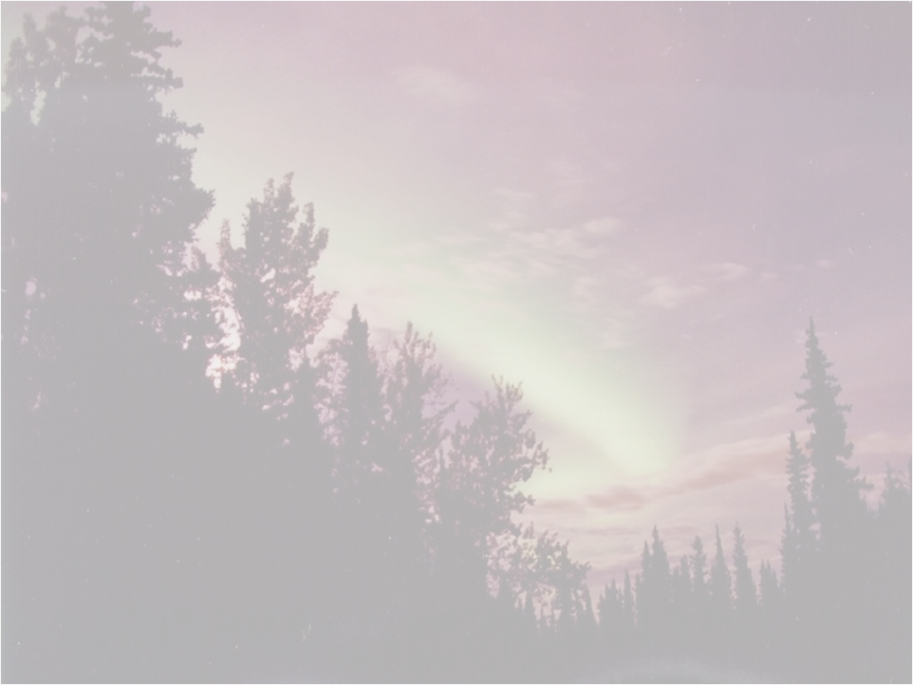
Outline
Shock-aurora dynamics
- From space, ground and in situ
- Near local noon and at dawnside
Ionospheric TEC response to interplanetary shocks
- High and low latitudes
- Global dynamics
Conclusions
Notes:
What is aurora? Aurora is an ionospheric photochemistry effect caused by precipitated particles (electrons and protons). But drivers of the precipitation, which decides where, when, how (means for the auroral variation) and what auroral forms to occur in the ionosphere, are somewhere thousands of kilometers, or even more then 10 Re away. That is to say, aurora is not only the most visible space physics phenomenon, but also a manifestation of the SW-magnetosphere-ionosphere coupling. That is why aurora is important and interesting, and why it still keeps us a job and “tortures” us, if you will, day and night.
Why do we need to image sunlit aurora?
- The idea was inspired by a significant dayside auroral phenomenon – shock aurora

Slide 3
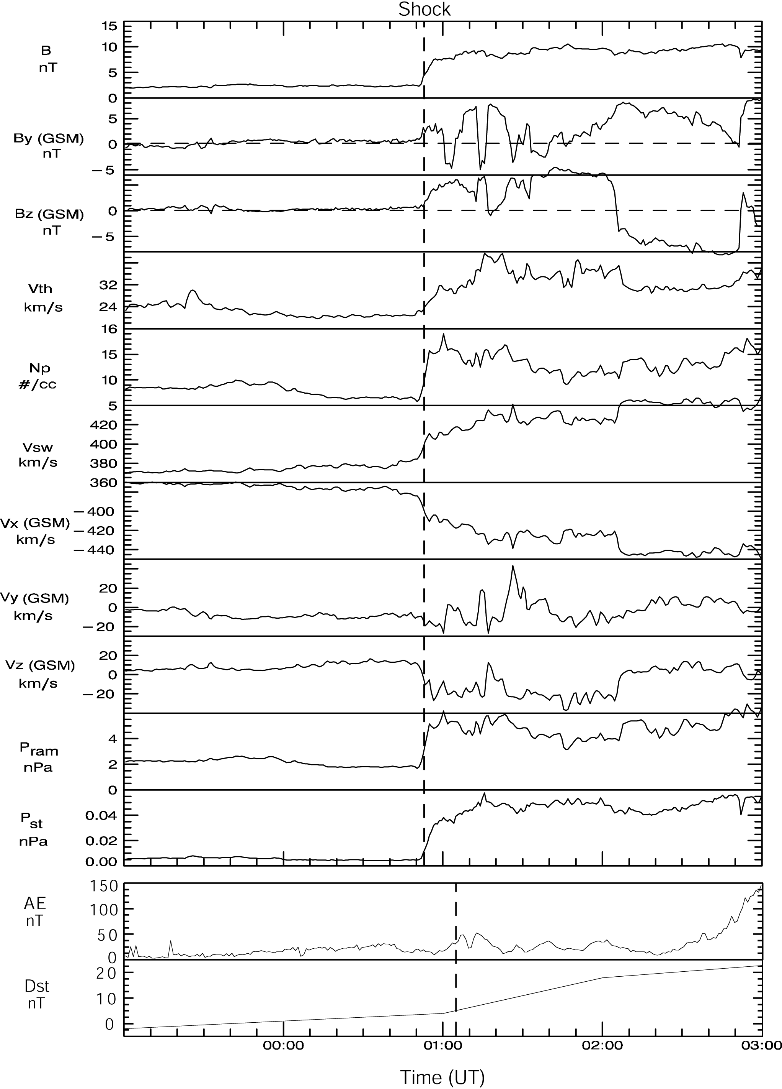
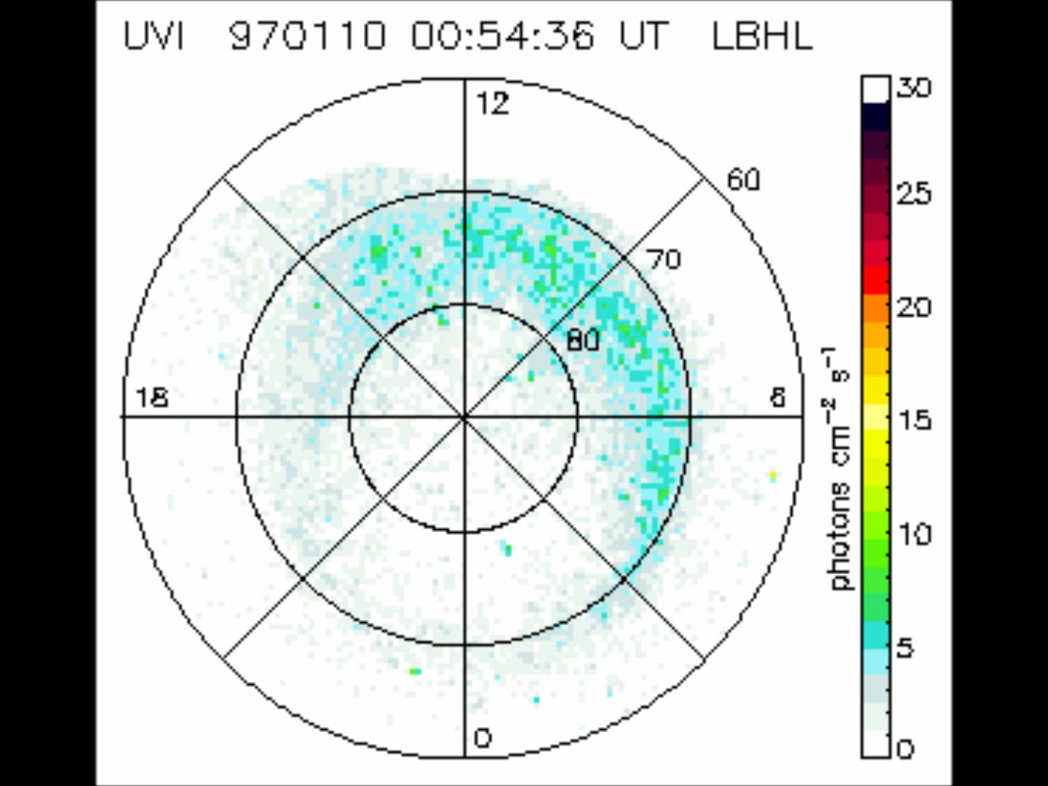
Shock Aurora
Generated by interplanetary shocks or solar wind pressure pulses, shock-aurora first appears around local noon, then propagates antisunward along the oval at a very high speed of 6-11 km/s in the ionosphere. The aurora was first captured by the space-based UV imagers.
Zhou and Tsurutani, GRL, 1999
SI at 0103 UT, Jan 10, 1997
Shock-aurora event on 10 Jan 1997
Notes:
Shock-aurora: Sudden auroral brightenings occur in local-noon sector followed by a fast auroral propagation towards midnight
along the oval. The aurora occurs in the ionosphere within seconds after the shock impinges on the nose of the magnetopause.
For the January 10, 1997 event, the dayside aurora take ~10 min to reach the nightside sector. So the aurora propagates at ~6 km/s in the duskside, and at ~11 km/s in the dawnside.

Slide 4
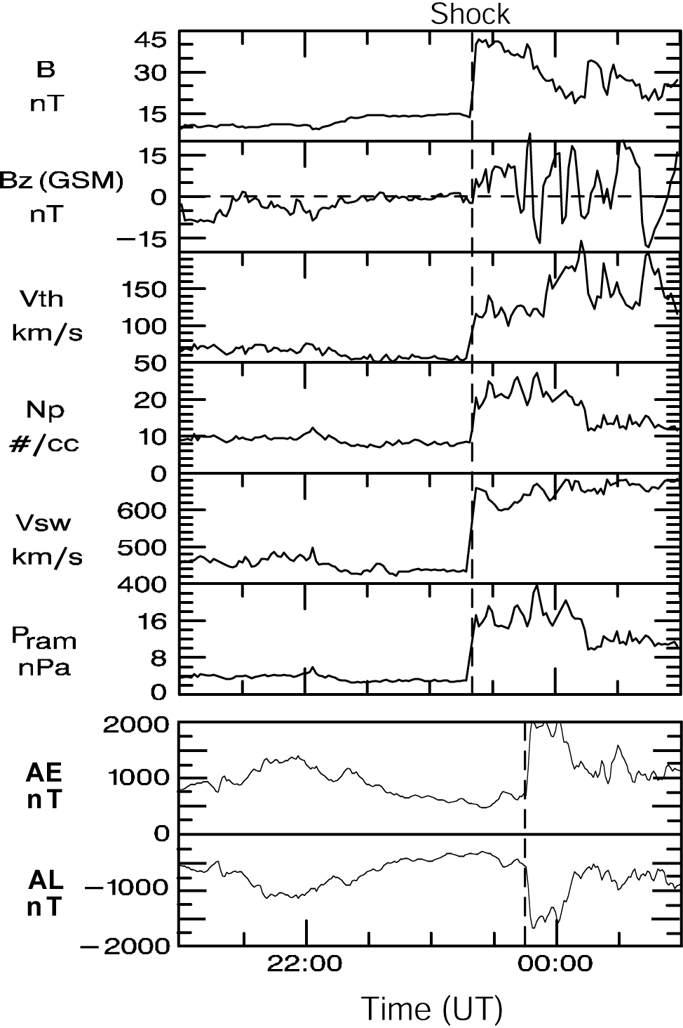
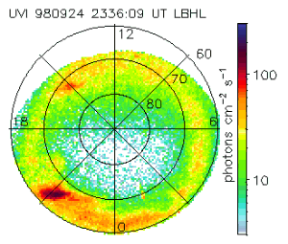
Shock Aurora
Shock aurora can lead to substorm further expansion and intense global auroral activity when the shock is intense with a southward IMF precondition.
Russell et al., 2000; Tsurutani and Zhou et al., 2001;
Zhou et al., 2001, 2002
SI at 2344 UT, Sep 24, 1998
Shock-aurora event on 24 Sep 1998
Notes:
Shock-aurora: Sudden auroral brightenings occur in local-noon sector followed by a fast auroral propagation towards midnight
along the oval. The aurora occurs in the ionosphere within seconds after the shock impinges on the nose of the magnetopause.
UVI images for making this movie are at C:\Users\xyzhou\Zhou_jpl\Presentations\AGU Meetings\SprAGU_02\FAST - JGR\UV auroral movies\Sep24-98 movie\

Slide 5
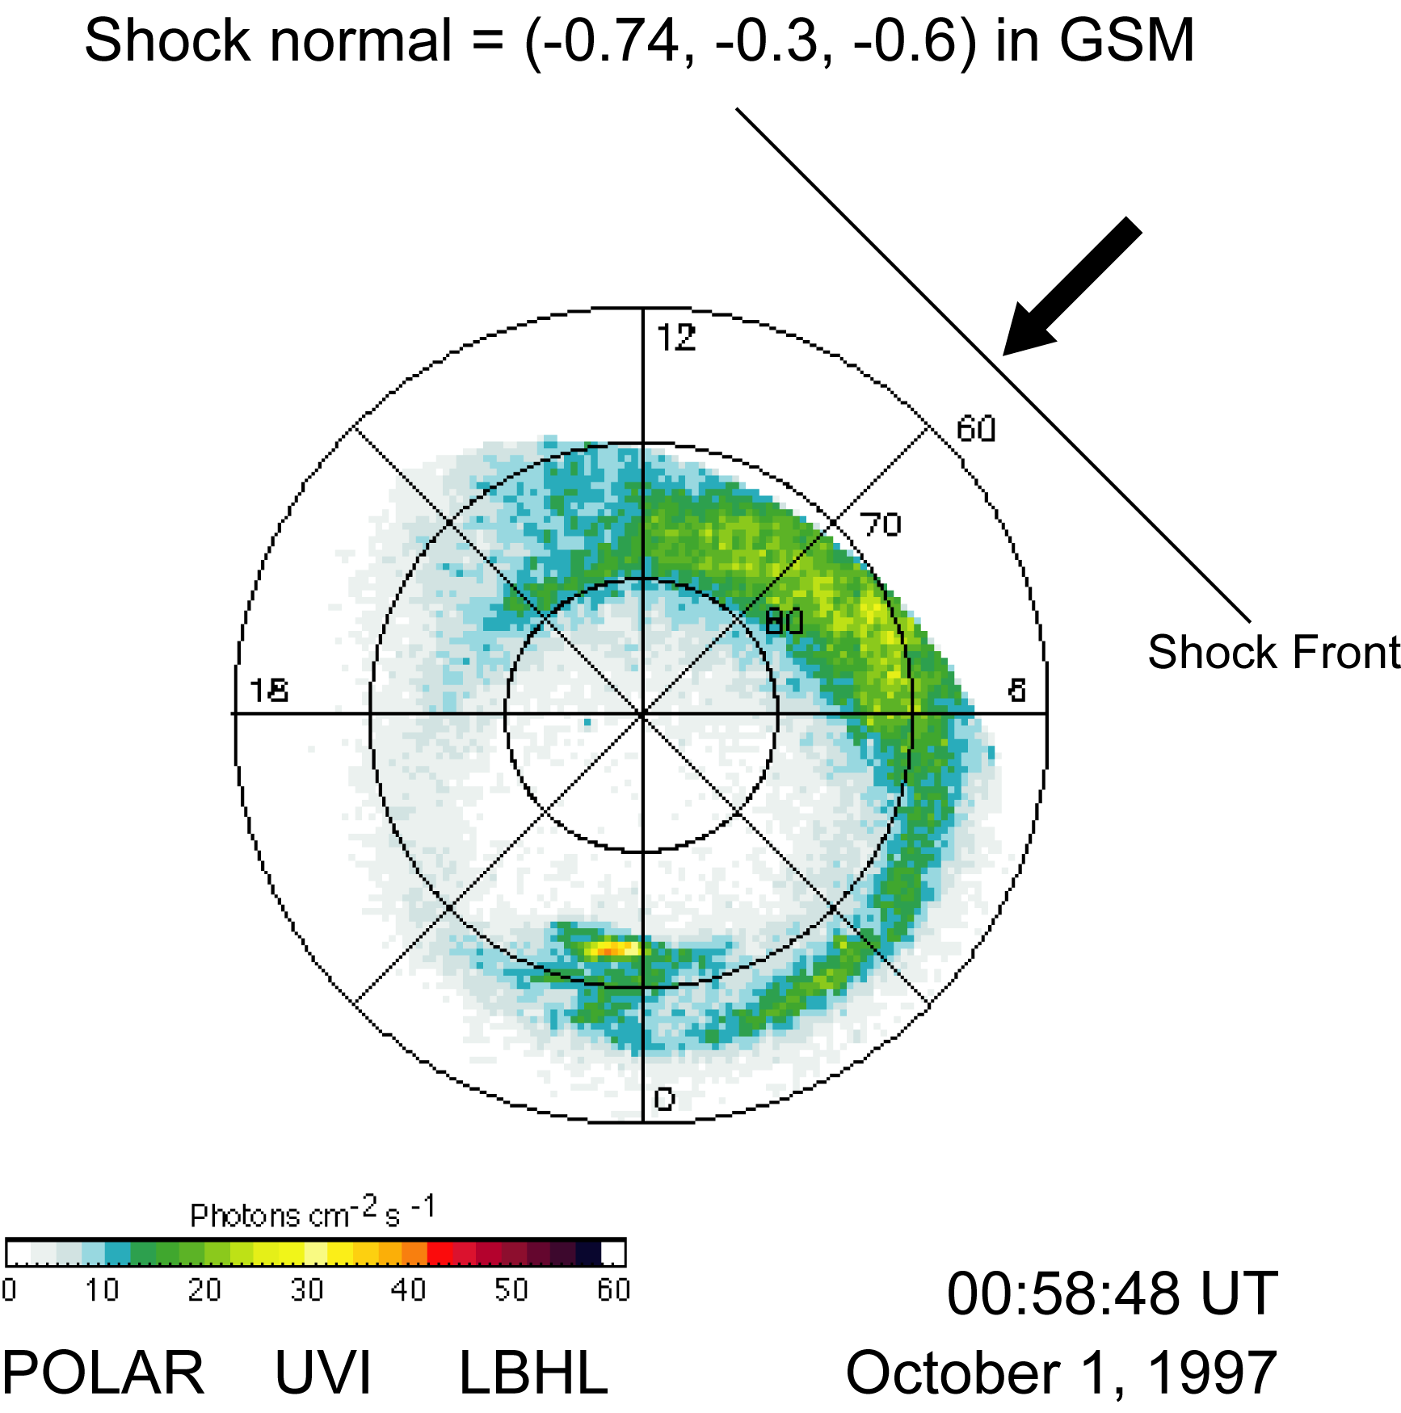
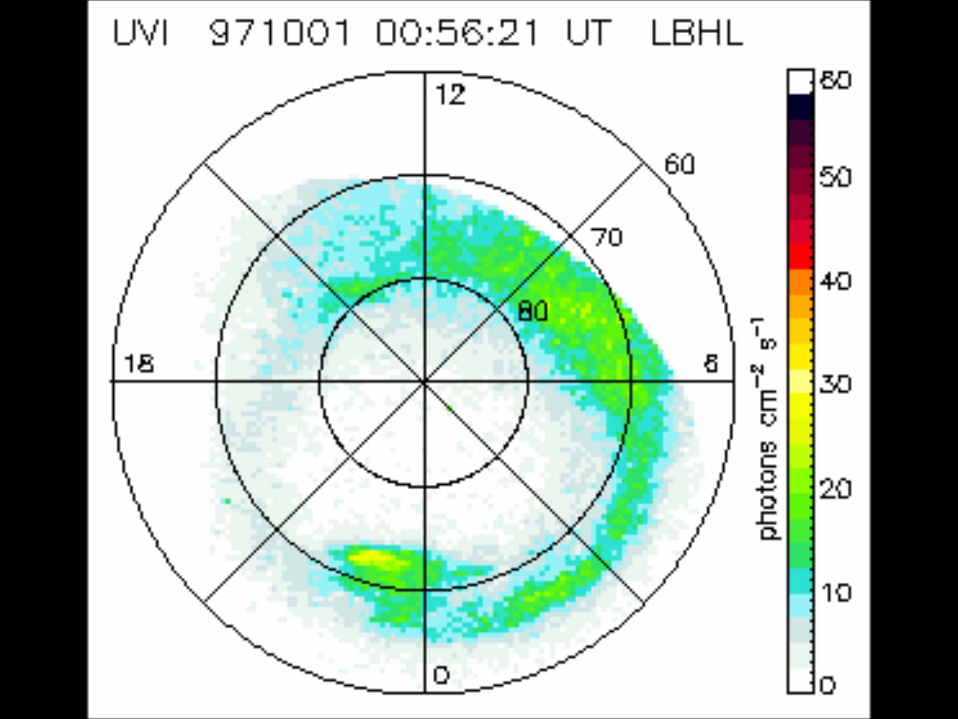
Shock Aurora
The onset of the shock aurora is the diagnosis of the shock impact location that is determined by the shock normal.
SI at 0059 UT, Oct 1, 1997

Slide 6
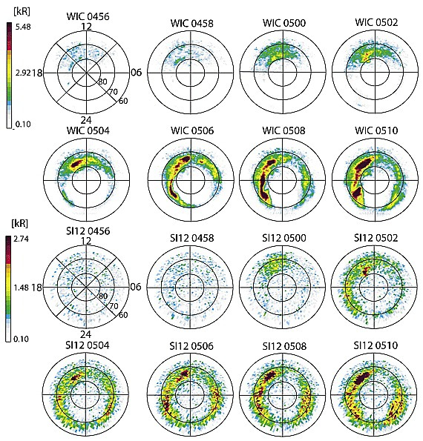
Shock arrival at 0500 UT
Shock aurora on April 28, 2001, shows a clear shock impact at post noon ~14 LT.
Sequence of WIC (top two rows for electron aurora) and SI12 (bottom two rows for proton aurora) images from the northern hemisphere displayed on a geomagnetic grid with local noon at the top of each image.
The weak WIC signal on the dayside is a residual dayglow contribution not completely removed by the dayglow
subtraction scheme.
(Meurant et al., GRL2003; JGR2005).

Slide 7
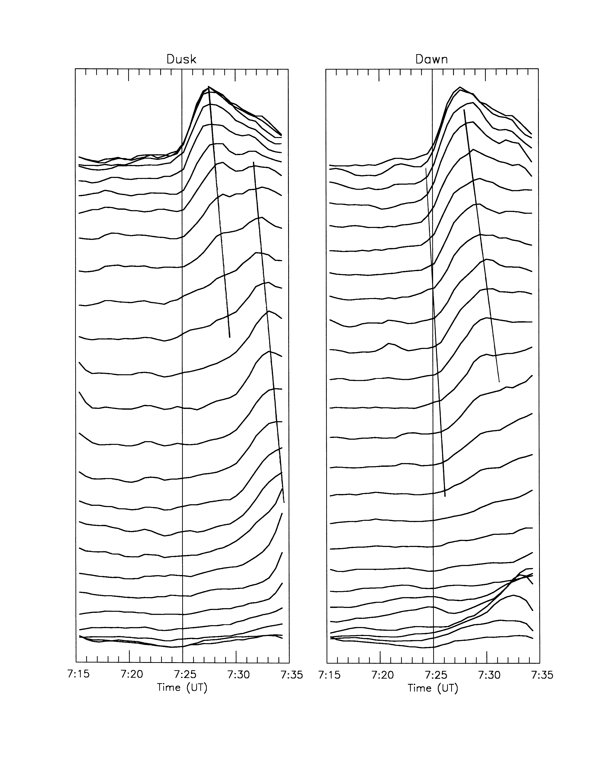
The curves are averaged auroral intensity from 67° to 78°magnetic latitude in each 0.5 hour MLT segment.
From the slope of the lines, the estimated propagation speed of the auroral brightening front is ~20 km/s. With this speed, the aurora can reach the midnight sector (21 or 03 LT) within 4 min.
October 2, 1998 event
SI at 0725 UT
(By courtesy of Dirk Lummerzheim)
Notes:
Files at C:\Users\xyzhou\Zhou_jpl\Presentations\Seminars\UCLA-04\Dirk L
The calculation of 4 min is based on a assumption that the oval is a 75 deg circle. The calculated traveling time is 3.25 min. The speed of 20 km/s matches to 773 km/s based on Vmp=(Rmp/Ri)Vi. The Vsw is ~750 km/s. So there is a good match between Vi and Vmp.
Q: why shock-aurora can propagate in different speeds? What decides the speed? If there are different auroral forms in the shock-aurora, are they all propagate in the same speed? If not, what will decide discrete arc speed and diffuse aurora speed?

Slide 8
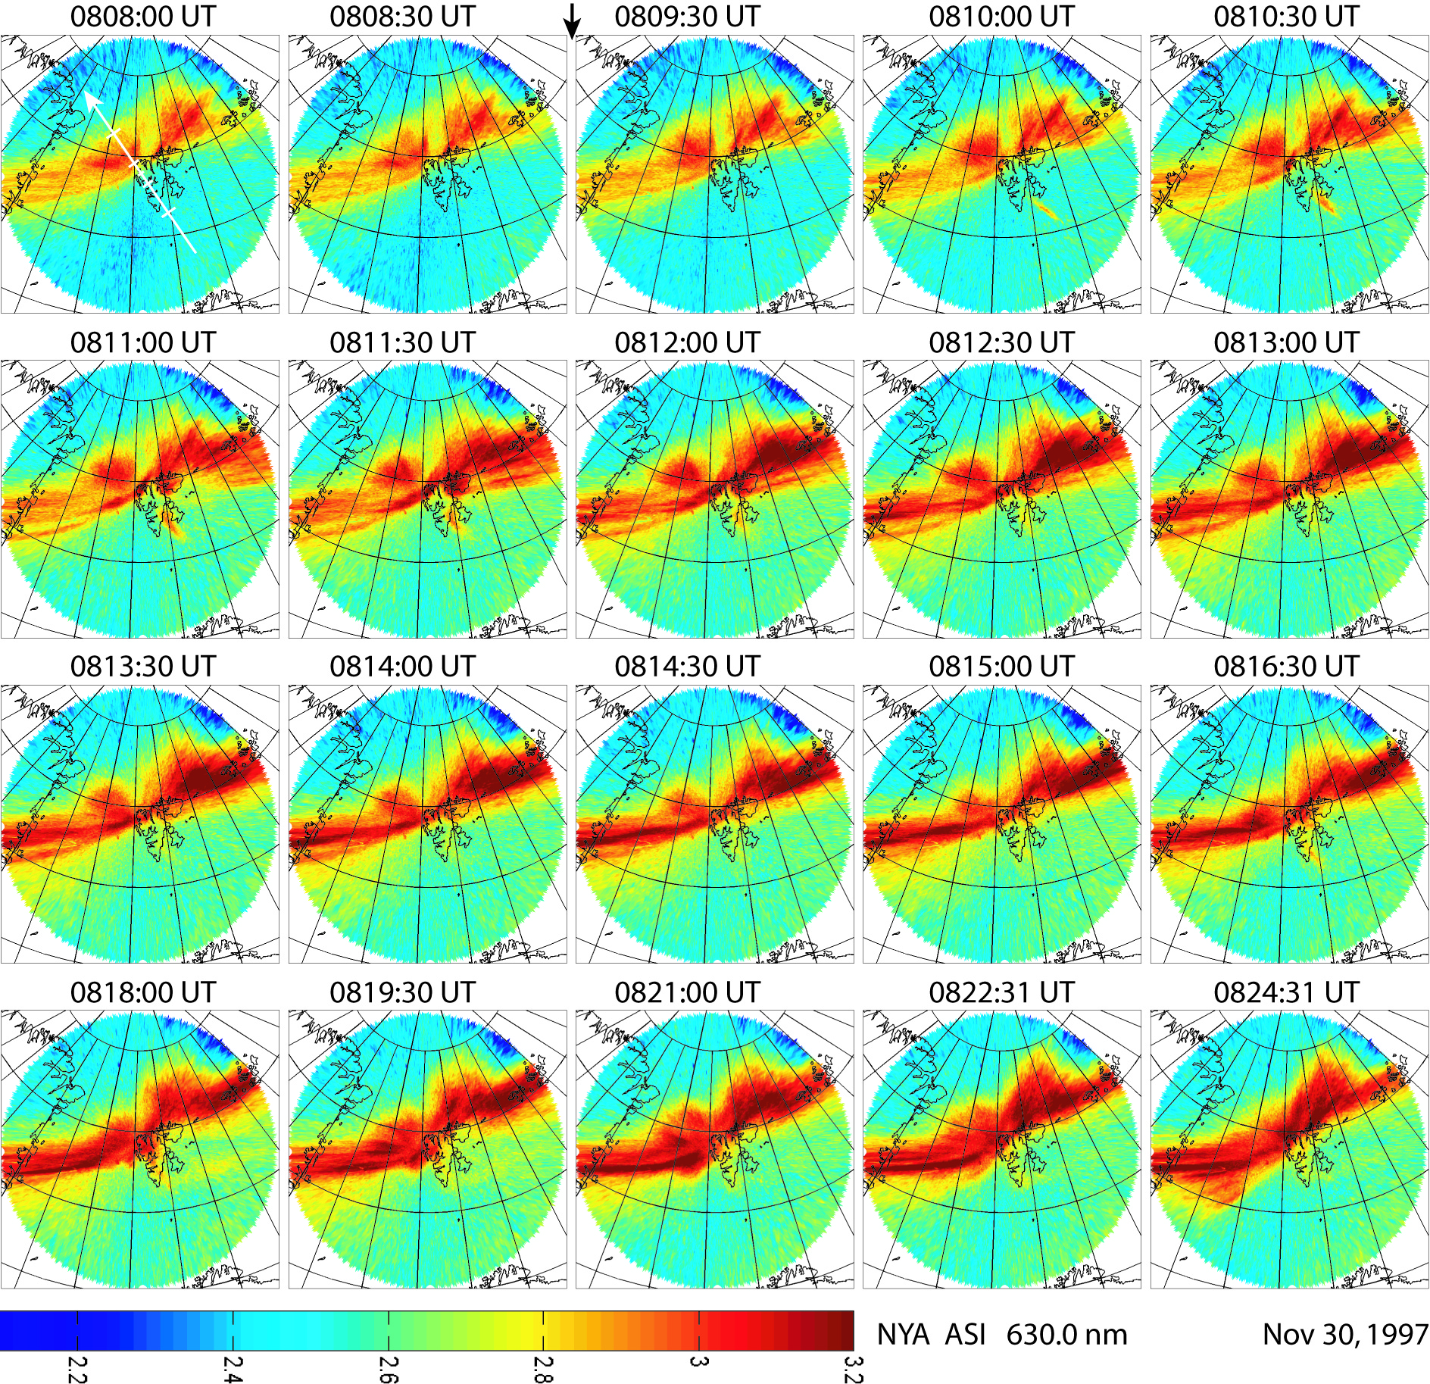
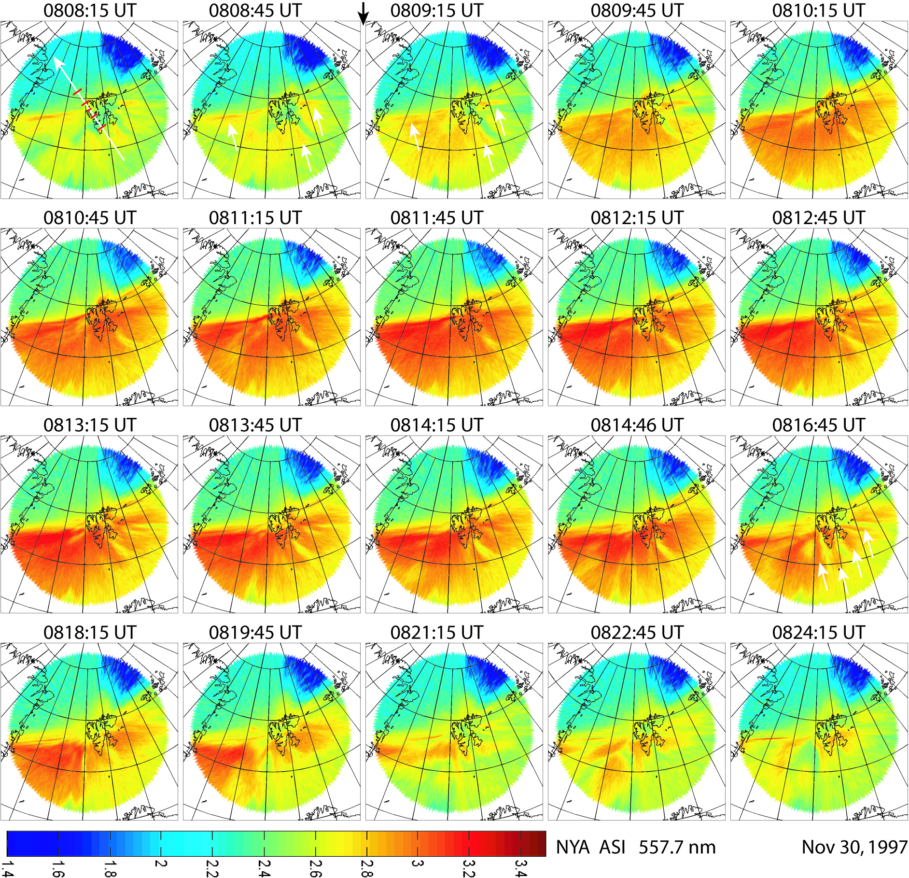
Grids in images are in geographic coordinates. In the first image, the white arrow points to the magnetic north and indicates the MSP scanning direction. The black arrow on top shows that the shock arrival time at the Earth was between 0808:45 and 0809:15 UT (SC at ~0809 UT) when Svalbard was at ~1120 MLT.
Ny Ålesund (76.24° MLat) 630.0 nm red line emissions of the shock-aurora on November 30, 1997.
Ny Ålesund 557.7 nm green line emissions of the shock aurora on November 30, 1997. (Zhou et al., JGR, 2009)
Notes:
The green emissions are at ~150 km, and red at ~250 km altitudes. The ASI images are provided by Joran Moen
After studies of FAST and DMSP, we got better ideas what to expect to see in the ground ASI images i.e., diffuse green auroras at lower latitudes of poleward boundary and red discrete aurora on the boundary and what aurora is in the UV images.

Slide 9
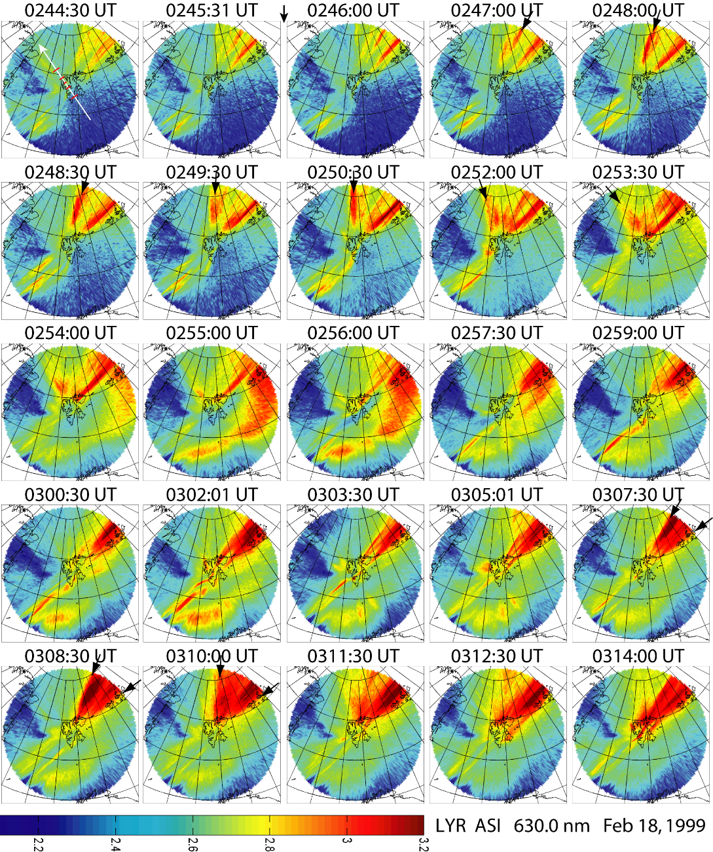
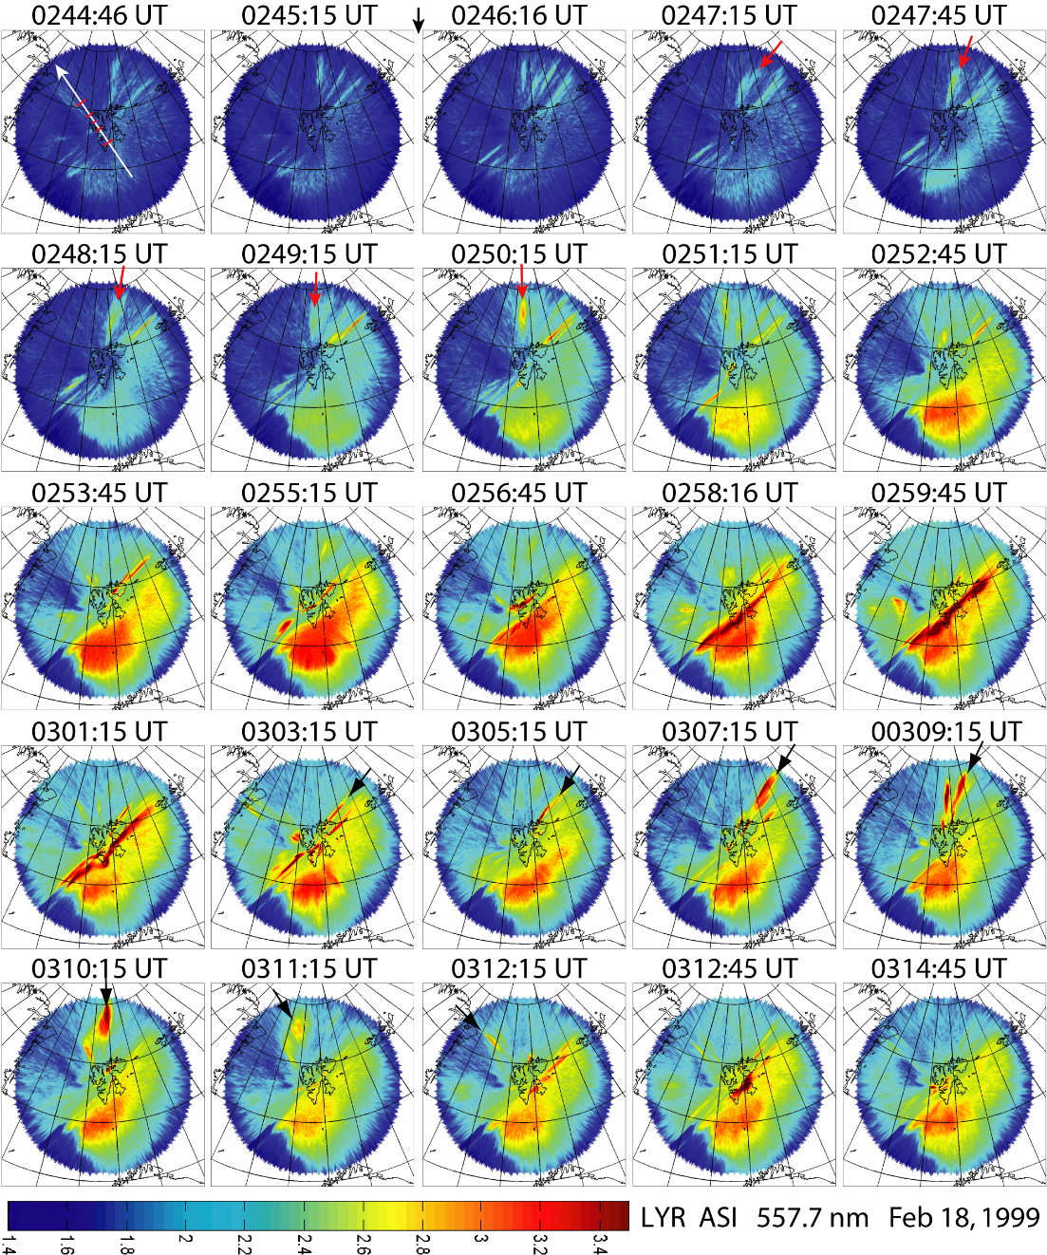
Longyearbyen 557.7 nm green line emissions of the shock aurora on February 18, 1999. SI at 0246 UT.
Zhou et al., JGR, 2009
Longyearbyen (75.24° MLat) 630.0 nm green line emissions of the shock aurora on February 18, 1999.
(Zhou et al., JGR, 2016)

Slide 10
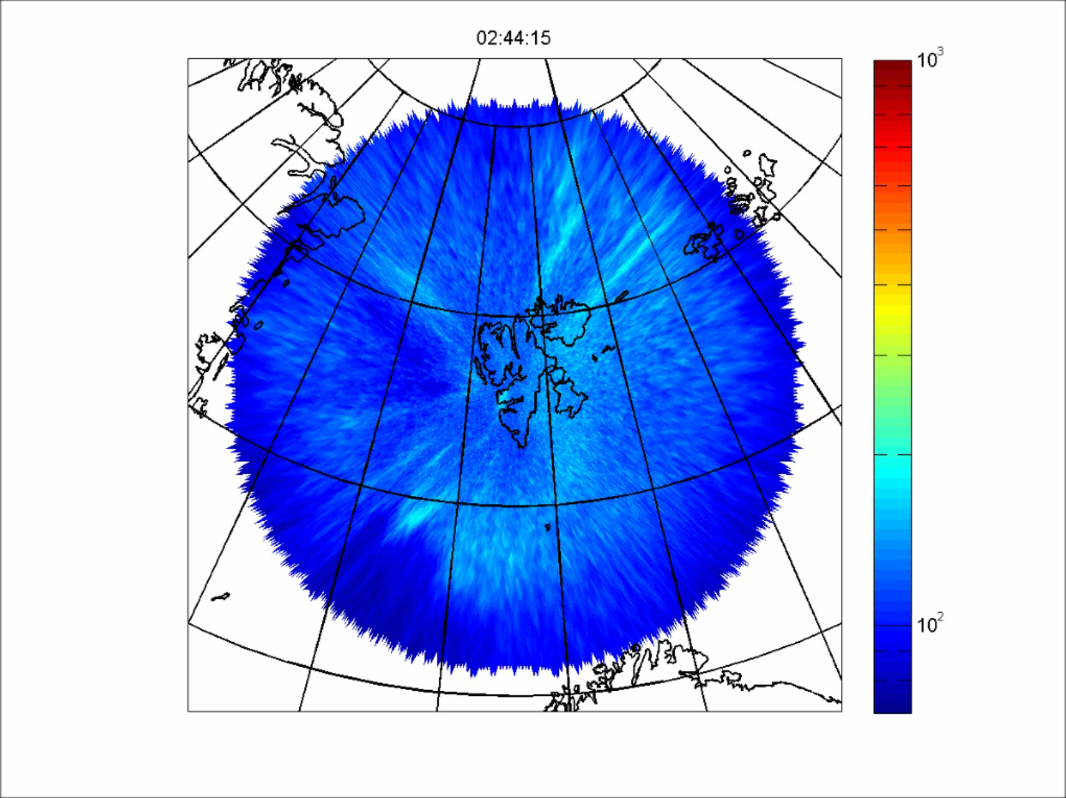
12 MLT

Slide 11
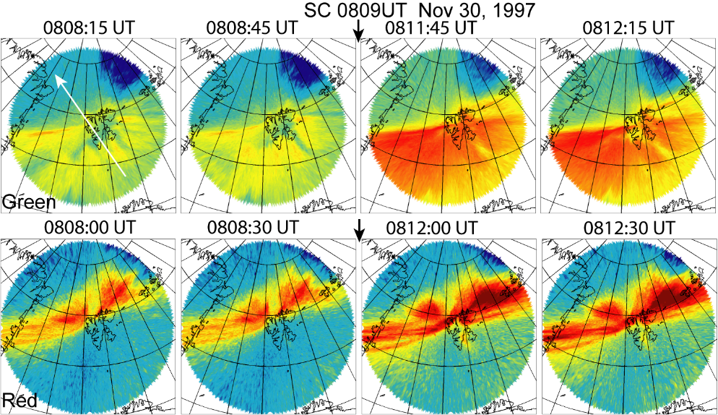
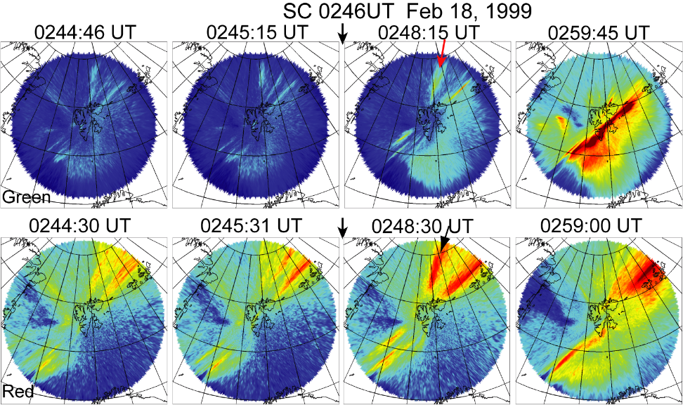
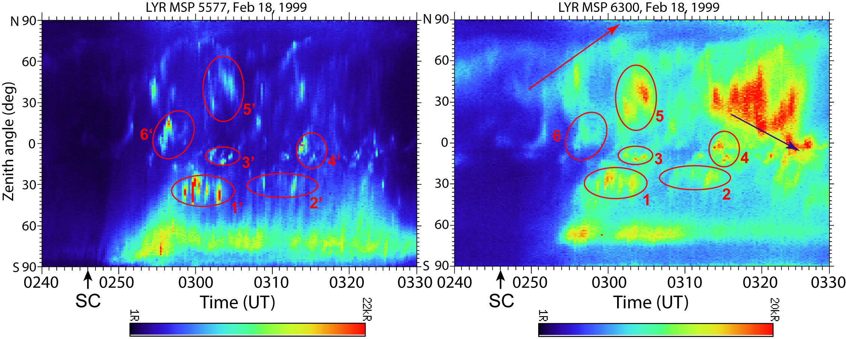
Shock aurora at local noon
Adiabatic compression plus
magnetic reconnection near local noon
Shock aurora at 0630 MLT
Adiabatic compression plus
K-H instability & Magnetic shearing at the flanks
Notes:
The striking difference is that near local noon the green and red auroras are mainly separated in location and basically different in forms, which implies that there are two major populations of the precipitating electrons. One is the isotropic hard electrons with energy above 1 keV. They are mainly on closed field lines. The other one is FA soft electrons (Alfvenic electronic electrons) along the open-close field line boundary. But at dawnside/duskside, it looks like the two populations are hard electrons in both isotropic and FA, and the soft electrons in both isotropic and FA as well. But confirmations are needed from in situ observations that can provide the energy spectrum and phase space distribution.

Slide 12
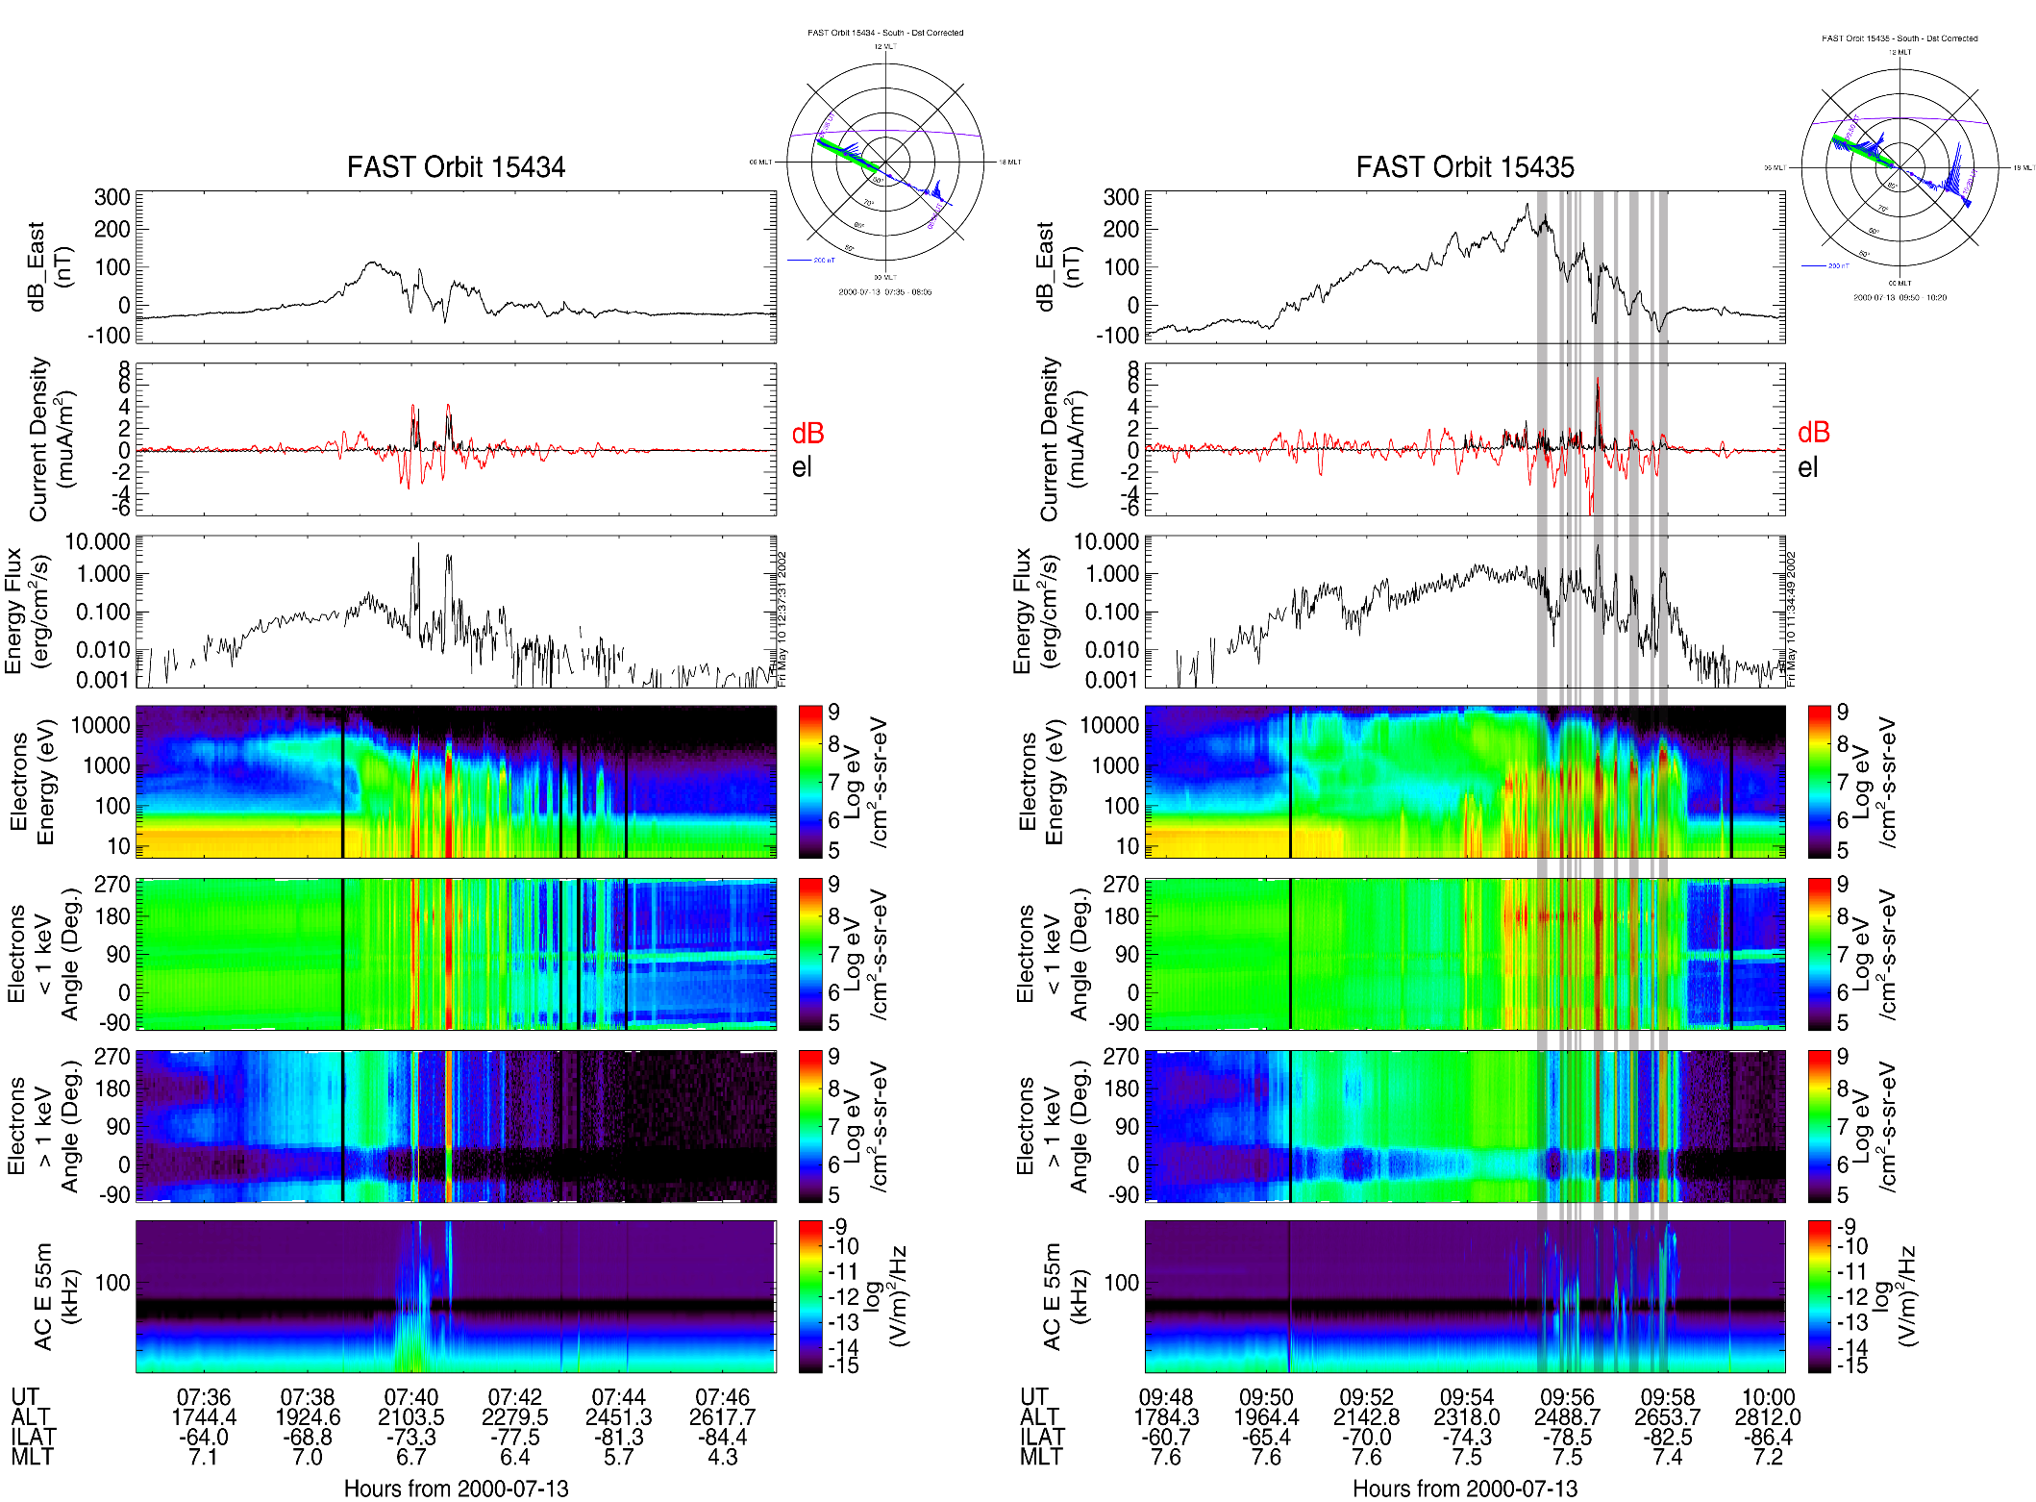
SI at 0942 UT
Zhou et al., JGR, 2003
Notes:
Zhou et al. Figure 2. FAST observations for the July 13, 2000 event during a dawnside auroral zone pass in the southern hemisphere. FAST was at 2000-2500 km altitude. FAST orbit plots in invariant latitudes are at the top of the figures. The red segments along the orbits are the intervals during which the FAST observations are shown in the panels below the orbit plots. The blue lines projecting from the orbit plots are magnetic field changes. The purple lines show the sunlight termination. Figure 2a shows the observations of orbit 15434 above the auroral oval prior to the shock arrival. Figure 2b shows the observations of orbit 15435 above the auroral oval after the arrival.
Figure 2a (2b) shows the observations prior to and after the shock arrival at ~0942 UT. The top two panels of Figure 2 are FAST orbit plots. FAST crossed the magnetic pole region in the southern hemisphere from dawn (on the left) to dusk (on the right). After the shock arrival, the plasma convection increased significantly, as indicated by the increased magnetic field change (blue lines). The red segments along the passes are the intervals of auroral oval crossings during which the FAST observations are shown in the panels below the orbit plots.
In Figure 2a, ΔBE is the magnetic field perturbation, positive eastwards. For a southward spacecraft trajectory (i.e., towards the south pole in the southern hemisphere, away from the north pole in the north), as is the case for Figure 2, a positive gradient indicates a field-aligned current away from the ionosphere. Weak upward region 2 and downward region 1 field-aligned currents were detected from ~0738 to 0742 UT. Two upward field-aligned currents, at 0740:05 and 0740:45 UT, were detected in the downward region 1 current as shown by the two peaks in the calculated current densities. We calculated the current densities using two methods as indicated by the red and black traces. The red trace is for the current density obtained from ΔBE, assuming a sheet-like and stationary field-aligned current, and the black trace is from the number flux of precipitated electrons. By convention, positive current density is along the magnetic field direction, i.e., away from the ionosphere for the southern hemisphere, into the ionosphere for the northern hemisphere. The two calculations are consistent where there are down going electrons (up going currents).
As shown in the first panel of the FAST observation in Figure 2b, the intensity of the region 1 and 2 field-aligned currents increased significantly after the shock arrival as the change in ΔBE by ~300 nT. There were highly structured upward field-aligned currents (the vertical shadings where ΔBE increased abruptly) embedded in the high latitude downward region 1 currents. Within these upward currents, the current density and the downward electron energy flux abruptly increased (the shadings in the second to the fifth panels). In panel 3, the downward electron energy flux increased about an order of magnitude on average over that shown in Figure 2a. In the fourth panel, the energy spectrum shows that the electron precipitation with electron energy in the region of ~1 - 10 keV was mainly at the lower latitudes from ~65° - 79° ILAT (invariant latitude), which is shown by the fairly constant green background from ~0950 to 0956 UT. These high energy electrons were highly isotropic and filled the loss cone as shown by the pitch angle distribution in the second panel from the bottom. On the other hand, the electron precipitation with electron energy lower than ~1 - 2 keV was mainly at the higher latitude region of ~76° - 83° ILAT (see the fourth, fifth and sixth panels). These electrons precipitated along field-aligned currents as shown by those intense electron energy beams in the fourth panel. In a region of ~76° - 79° ILAT, there is an overlap of high and low energy electron precipitation. This is also the boundary between upward region 2 and downward region 1 field-aligned currents as shown by the ΔBE component.
The right bottom panel of Figure 2 shows that electromagnetic broadband waves were observed with intensity at ~10-12 - 10-11 V2 m‑2 Hz-1. It should be noted that these waves were detected at higher latitudes where the field-aligned currents were (aligned by the vertical shadings). The plasma waves were 4 - 40 kHz magnetic waves and 2 - 500 kHz electric emissions, which are polar cap boundary layer waves. It has been reported that the broadband waves in the magnetopause boundary layers are associated with the auroral brightening because the waves are on the magnetic fields mapping into the auroral oval (Gurnett and Frank, 1977; Gurnett et al., 1979; Tsurutani et al., 1981; Lakhina et al., 2000; Tsurutani et al., 2001c). The characteristics of wave modes will be studied in future.

Slide 13
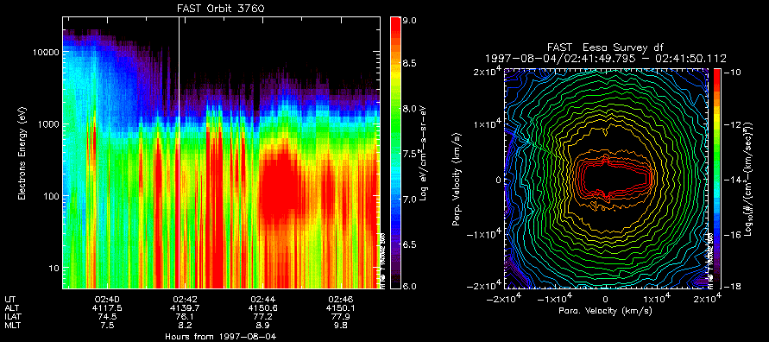
FAST electron observations on 4 August 1997. Left is the electron energy spectrum, which Zhou et al. [2003] described. Right is electrons in phase space at the time shown by the vertical line in the spectrum. The phase space density contours have been restricted to values less than 10¹⁰ s³ cm³ km³ so that the pitch angle structure can be seen more clearly. This approach also has the effect of excluding phase space density contours for lower-energy electrons (visible as a hole at the center). The loss cone is clearly visible on left, and the distribution near the center shows that the low-energy electrons move along
the field line in both directions. This signature is considered an effect of kinetic Alfven waves.
Zhou et al., JGR, 2009

Slide 14
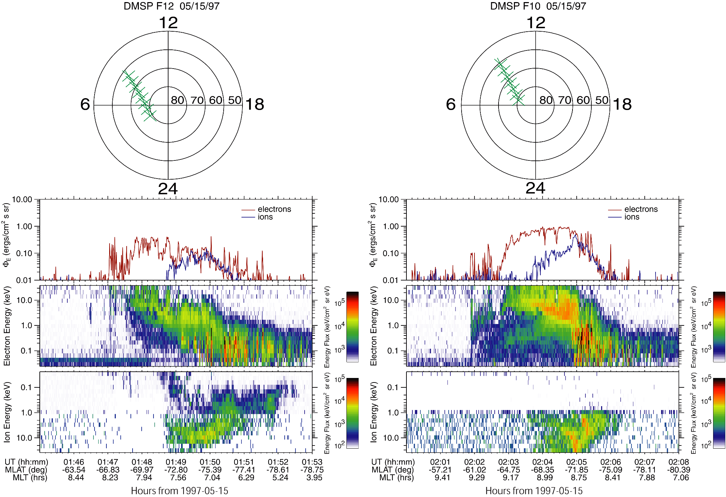
SI at 0159 UT
Zhou et al., JGR, 2003
Notes:
Figure 7. DMSP observations for the May 15, 1997 event during a dawnside auroral zone pass in the southern hemisphere. The figure format is the same as Figure 3. Figure 7a shows the F12 observations ~7 - 12 min prior to the shock arrival. Figure 7b shows the F10 observations ~3 - 7 min after the shock arrival. SSC at 0159 UT.
Figure 7a shows that the DMSP satellite F12 crossed the dawnside auroral oval in the southern hemisphere from ~0147 to 0152 UT, ~7 - 12 min prior to the shock arrival at the Earth. Within 5 min after the shock arrival F10 crossed almost the same location as the F12 pass (see the orbit plots at the top). Figure 7b shows that downward electron energy flux increased about a fact of 2 with a maximum of ~1 erg cm‑2 s‑1 sr‑1. The electron energy spectrum shows that at lower latitudes from ~65° to 72° MLAT, the increased energy flux was mainly caused by the high energy electron (2 - 8 keV) precipitation; at higher latitudes from ~72° to 75° MLAT, the increased energy flux was mainly caused by low energy electrons (<~1 keV). The energy flux of the high energy electron precipitation was fairly constant along the satellite path. While the energy flux of the low energy electron precipitation was highly structured as shown by the vertical shadings where there are spikes of electron energy fluxes. There were no SSM data from F10 for this event, so we can't show whether there were upward currents at the spikes. However, the FAST observations and the DMSP data in Figure 3 have shown that spikes of the energy flux for low energy electrons are highly correlated to the upward field-aligned currents. The overlap region of the high and low energy electron precipitation was less than 1° MLAT at ~71° MLAT. This is the same structure as shown in the FAST observations in Figures 2 and 5. This structure has been seen in all events of the dawnside sector crossings in Table 2.

Slide 15
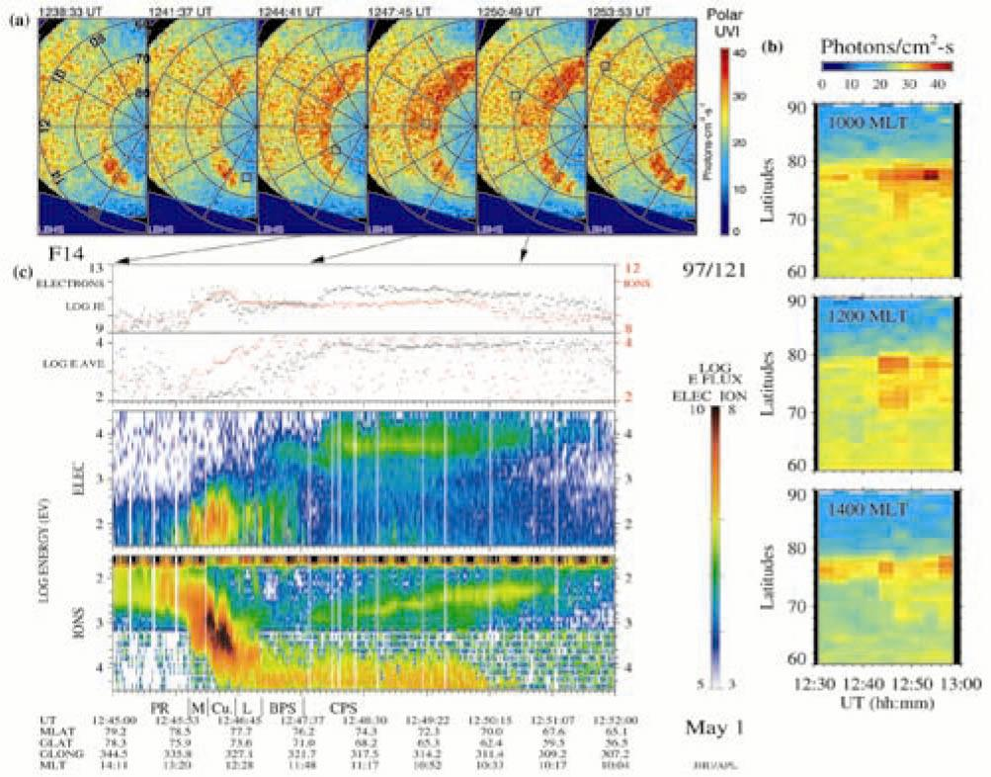
Liou et al. (2002 GRL). Interplanetary shock-created midday sub-auroral
patches (MSPs). MSPs are mainly in the noon sector (9-15 LT) can be as
low as ~55 deg MLat. Later, more UV imaging data showed that MSP can
be detached from the oval.
Notes:
DMSP data show the electrons at energies of 5-10 keV.

Slide 16
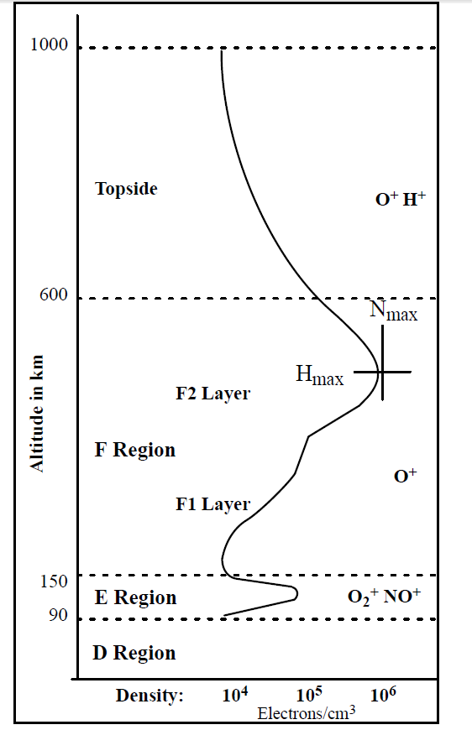
~1000-2000 km, SMEI aurora in visible band
emission from N2+ (Mizuno et al.,
JGR2005).
The correlation between TEC enhancement and auroral activity has been well established (e.g.,Pi et al., 1997; Aarons et al., 2000; Watson et al., 2011]).
A weak discrete arc of 1.5 kR corresponds to an increase in plasma density of 5 x10⁵ e/cm³ (Basu et al., 1993)
E Region diffuse aurora corresponds an increase of 5 x10⁵ e/cm³ (Anderson et al., 1997)
10 TECU corresponds an increase of 10¹³ e/cm², i.e., an increase in plasma density of 1.25 x10⁶ e/cm³. (Kintner et al., 2002).
250 km, Peak of the red emissions at 630.0 nm
mainly caused by soft electrons with
energies < 1 keV, corresponding to
transitions from O(¹D).
120 km, Peak of the green emissions at 557.7 nm
mainly caused by hard electrons with
energies > 1 keV, corresponding to
transitions from O(¹S).
Notes:
Fig. Various layers of the ionosphere and their predominant ion populations. The density varies considerably, as shown.
The Solar Mass Ejection Imager (SMEI) experiment [Eyles et al., 2003; Jackson et al., 2004] was designed to observe and obtain time sequences of heliospheric phenomena propagating from the Sun and in interplanetary space, such as coronal mass ejections (CMEs) and corotating structures using CCD cameras.
The auroral green (557.7 nm) and red (630.0 nm) line emissions correspond to transitions from O(¹S) and O(¹D) metastable states of oxygen, which have a radiative lifetime of ~1 sec and ~100 sec, respectively.
On the other hand, Pi et al. [JGR1997] present an example of high-latitude GPS phase fluctuations during a geomagnetic storm with maximum values of ROT of 10.

Slide 17

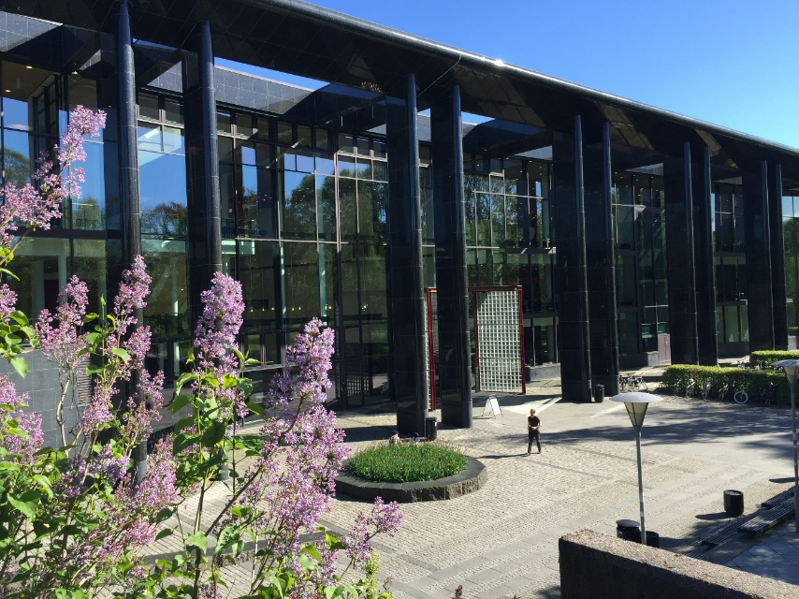
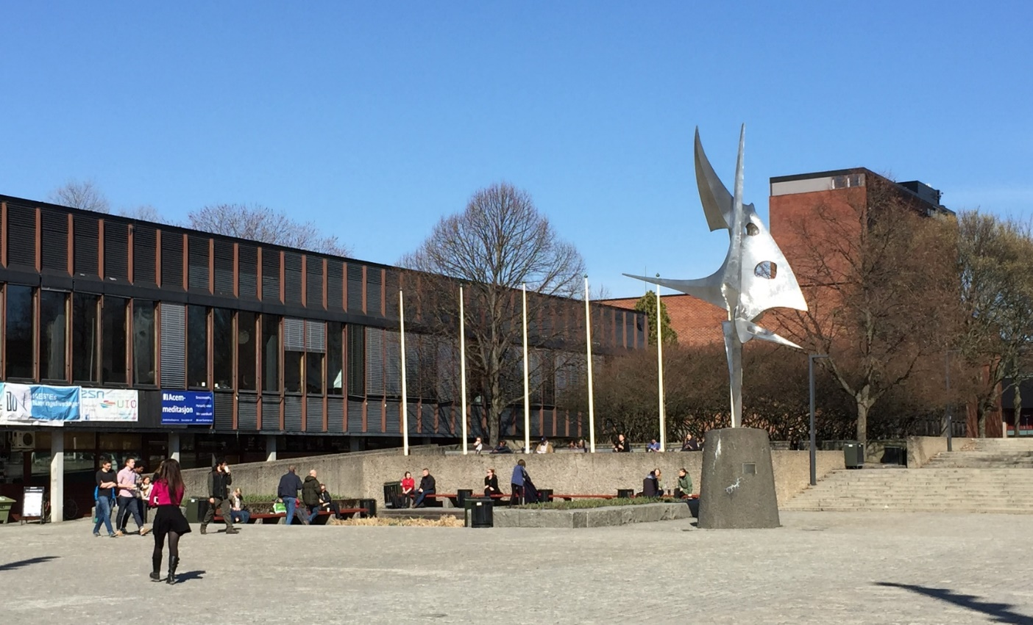
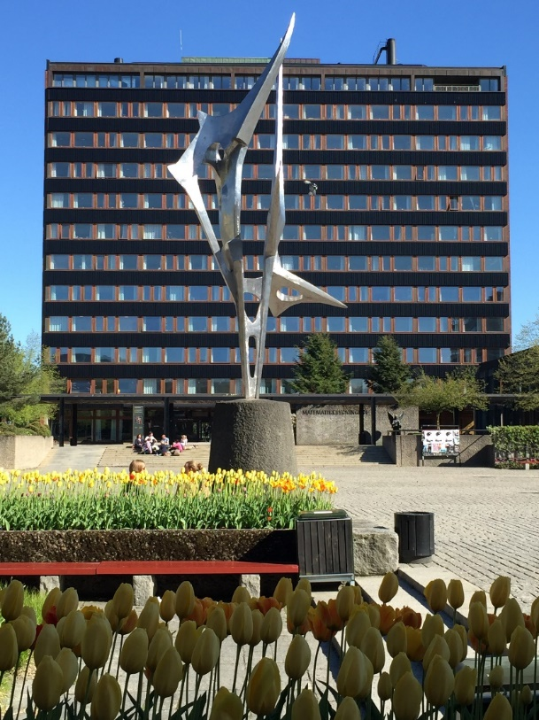
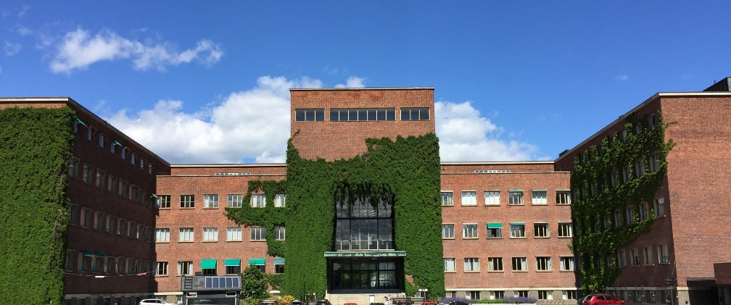
University of Oslo
April-June, 2015

Slide 18
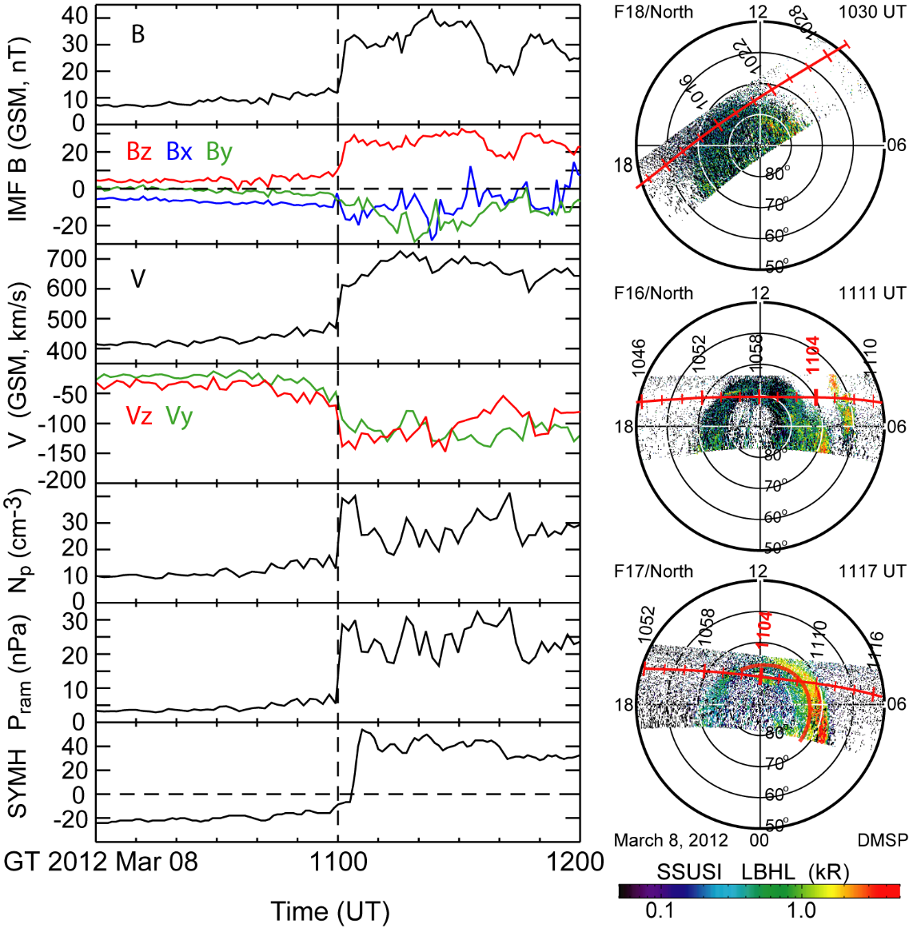
By the giving fact that aurorae are caused by particle precipitations that deposit energy into the ionosphere while enhances it ionization, one should have some idea what to look for in the TEC variation.
Solar wind observations (left column) from Geotail, SYM-H index in Figure 1 (left column, seventh row), and the
UV auroral data (right column) from DMSP/SSUSI when the shock arrived on 8 March 2012. Geotail was at (13.0, 7.4, 7.9) R_{E} in GSM at ~1100 UT. M = 2.7
March 3, 2012 event, M = 2.7
Acknowledge to Dr. Yaqi Jin at UiO for his study of the shock-aurora related TEC variations.

Slide 19
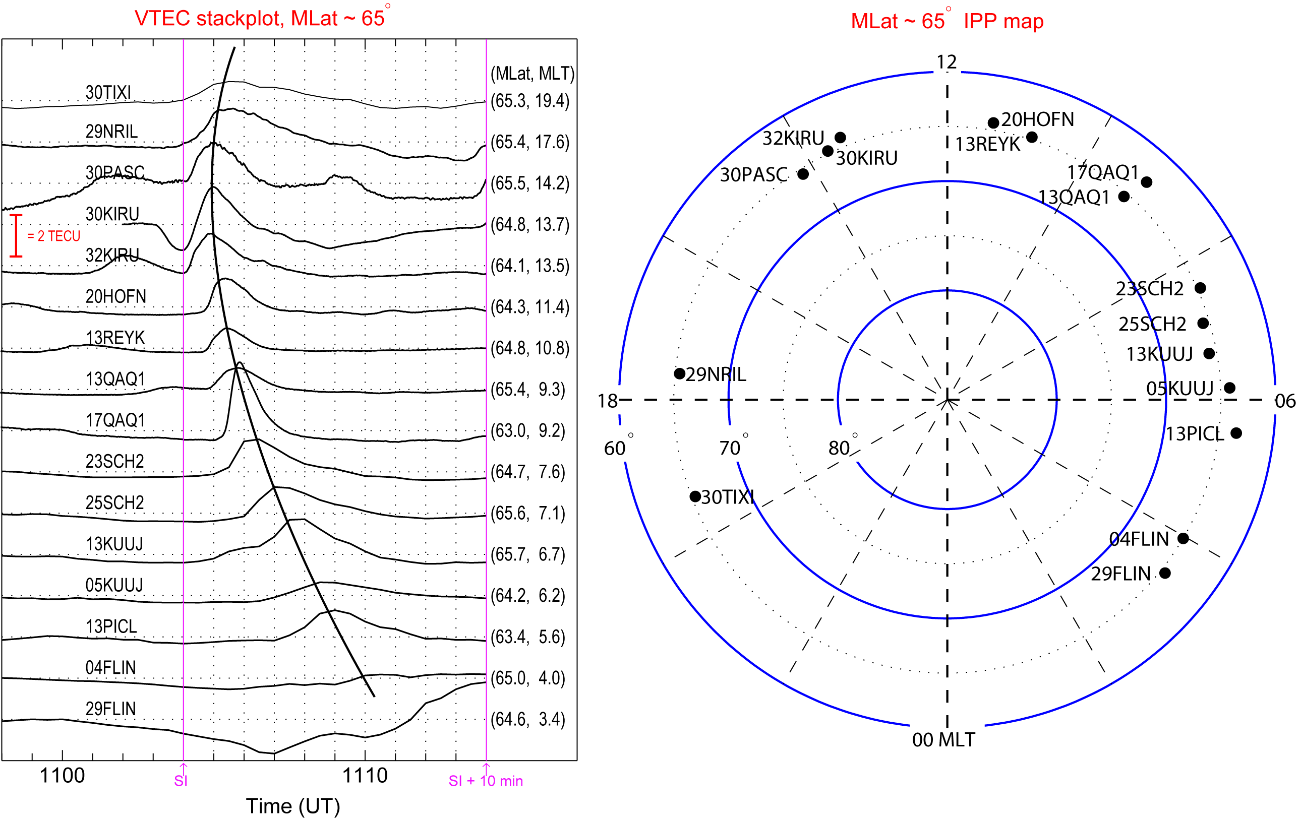
The GPS TEC is calculated by combining the dual-frequency carrier phase and pseudorange measurements that are obtained from the RINEX (receiver-independent exchange) data [e.g., Horvath and Crozier, 2007].
Low-latitude chain along close field lines foot prints
Data point selection: 1) the most clear variation; 2) higher elevation angle; 3) better coverage (i.e., farther away from previous data points when all variations are similar.)
(Shock aurora related TEC on March 8, 2012, Jin et al., GRL 2016.)
Notes:
Proton aurora does not enhance ionospheric TEC because the aurora is generated via charge exchange.
My basic selection criteria are 1) select the most clear variation; 2) higher elevation angle; sometimes the data show the more or less the same result, then I try to keep a better coverage (i.e., farther away from previous data points).
To remove the background trend due to the GPS satellite motion, a 15 min period filter is applied in this study. The instrumental biases of the satellites and receivers are not subtracted because only relative changes in TEC are important in this study.
In the stack plot from top to bottom, the measurements were from ~19 to 03 MLT clockwise. Each pierce point’s MLAT and MLT are listed at the right end of each TEC curve.
Q: As to the background level (including the instrument biases), it is necessary to at least know the percentage of the TEC increase to the background. So one can know how significant the enhancement is.
A: The TEC background can be obtained from the MIT mardrigal website (http://madrigal.haystack.mit.edu/cgi-bin/madrigal/madExperiment.cgi?exp=experiments/2012/gps/24jan12&displayLevel=0&expTitle=World-wide%20Vertical%20Total%20Electron%20Content) or from the vriginia tech website (http://vt.superdarn.org/tiki-index.php?page=DaViT+TEC+Movie).
However, their TEC value is always lower than my expectation and the value from our GPS receiver, I am not quite sure about it. From my experience, the TEC background is ~10 TECU during night at the region we are interested in (higher to 15 or 20 TECU at daytime).

Slide 20
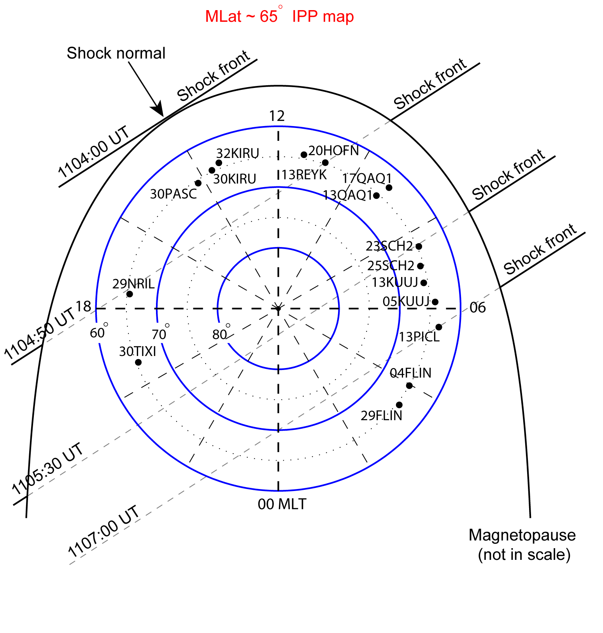
In general, the TEC background is ~10 TECU during night; on dayside in the auroral ionosphere, the background is higher than the nightside and varies in15 - 20 TECU. The shock can elevate TEC by ~10 to 20% or even more.
Shock normal at (-0.75, -0.56, -0.37) in GSE based on Geotail that was at (13, 9, 6 Re) in GSE at 1101 UT .
(Shock aurora related TEC on March 8, 2012, Jin et al., GRL 2016.)
Notes:
Q: As to the background level (including the instrument biases), it is necessary to at least know the percentage of the TEC increase to the background. So one can know how significant the enhancement is.
A: The TEC background can be obtained from the MIT mardrigal website (http://madrigal.haystack.mit.edu/cgi-bin/madrigal/madExperiment.cgi?exp=experiments/2012/gps/24jan12&displayLevel=0&expTitle=World-wide%20Vertical%20Total%20Electron%20Content) or from the vriginia tech website (http://vt.superdarn.org/tiki-index.php?page=DaViT+TEC+Movie).
However, their TEC value is always lower than my expectation and the value from our GPS receiver, I am not quite sure about it. From my experience, the TEC background is ~10 TECU during night at the region we are interested in (higher to 15 or 20 TECU at daytime). A movie can be seen TEC above 60 deg of north.
C:\Users\xyzhou\AppData\Local\Microsoft\Windows\Temporary Internet Files\Content.Outlook\DAVTUXGU\20120124.gif

Slide 21
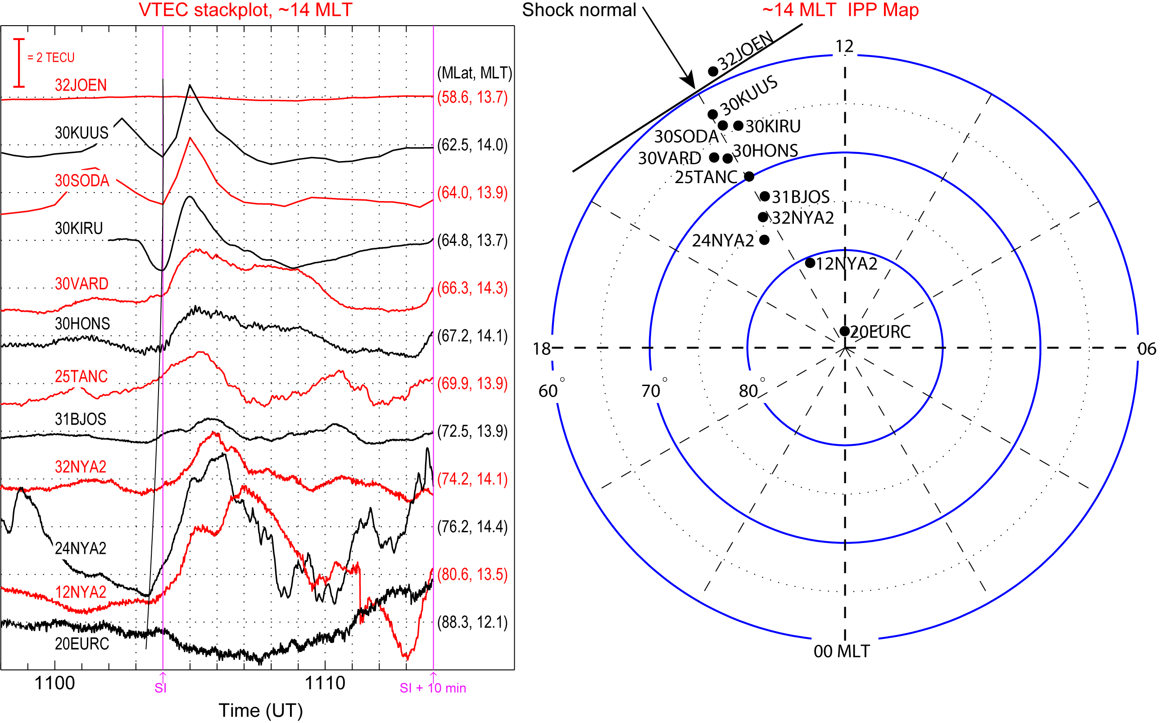
The latitudinal TEC variation at the shock impact location ~14 MLT.
No large time lag from high to low latitudes except the ~30 sec delay from 12NYA2 to 30KIRU;
TECs above ~66° MLAT were more disturbed than those near or below 65° MLAT.
There seems a cutoff between 30KUUs and 32JOEN, suggesting the boundary of plasmapause?
(Shock aurora related TEC on March 8, 2012, Jin et al., GRL 2016.)
Notes:
there are two striking differences. One is that there is no large time lag in the TEC enhancements. Instead, the start point at high latitude, such as station 12NYA2 (~1103:30 UT), was ~30 s earlier than that at 30KIRU at 1103:58 UT. A line is drawn roughly along the start points of the TEC enhancements to highlight this TEC equatorward expansion that was at a very high speed of ~45 km/s. The propagation
direction was consistent with the shock compression that pushed the subsolar magnetopause from ~9 to 7 RE (calculated based on Shue’s model [Shue et al., 1997]). The other difference is that TECs above ~66° MLAT were more disturbed than those near or below 65° MLAT. The TEC impulses at high latitudes either lasted longer than 3 min (such as at 30HONS) or become multiple (such as at 25TANC or 24NYA2).

Slide 22
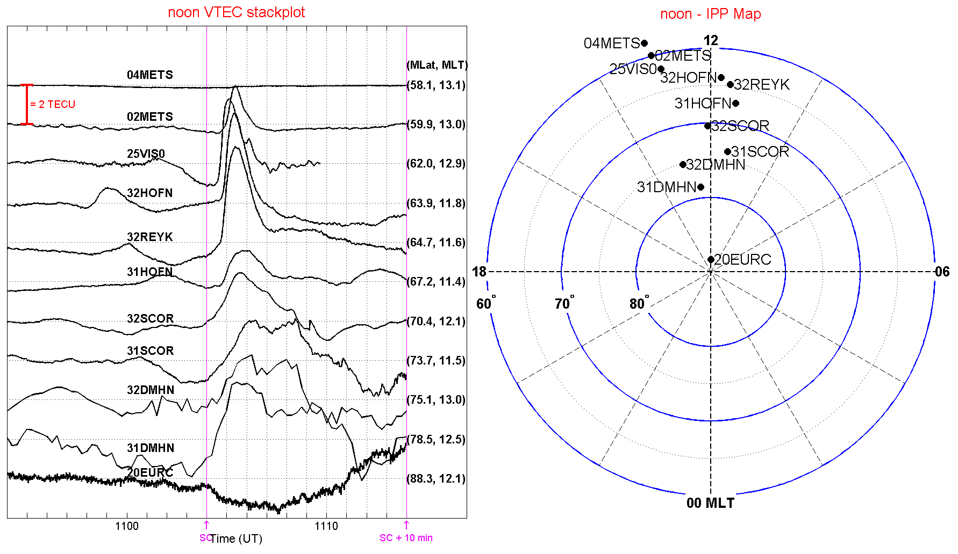
The longitudinal propagation seen in the latitudinal chains
(Shock aurora related TEC on March 8, 2012, Jin et al., GRL 2016.)

Slide 23
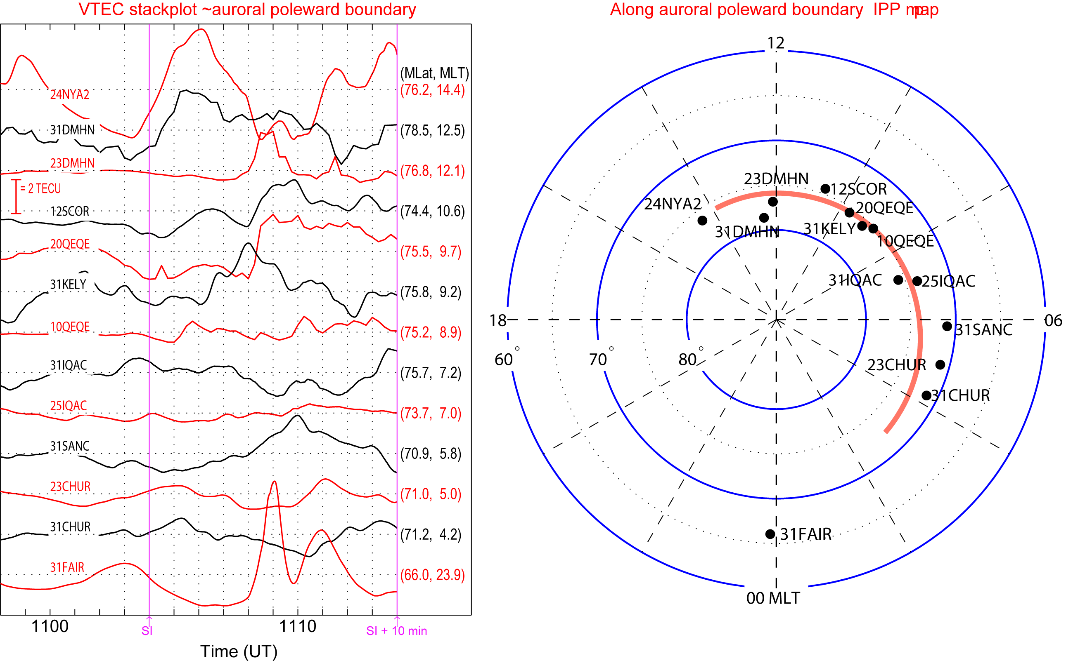
The chain of TEC pierce points along the poleward boundary of the oval
High-latitude chain along foot prints between open&close field lines
(Shock aurora related TEC on March 8, 2012, Jin et al., GRL 2016.)

Slide 24
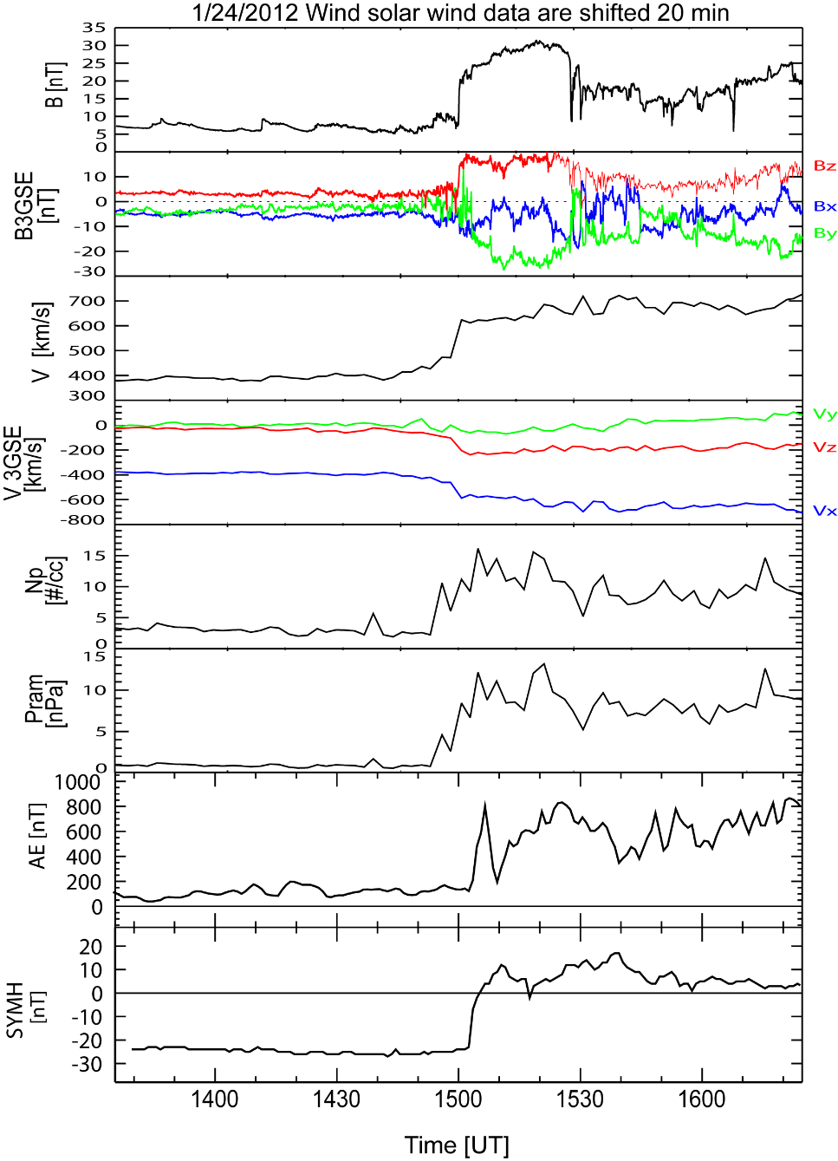
Shock normal at (-0.92, -0.21,- 0.32) in GSE by ARTEMIS/THB at (57, 15, 5 Re) in GSE
Shock normal at (-0.92, -0.01, -0.26) in GSE by Wind at (197,-42,-14Re) in GSE
Shock M = 3.2
Notes:
The Finns have calculated the shock normal at ipshocks.fi which is [-0.68, -0.40, -0.61]

Slide 25
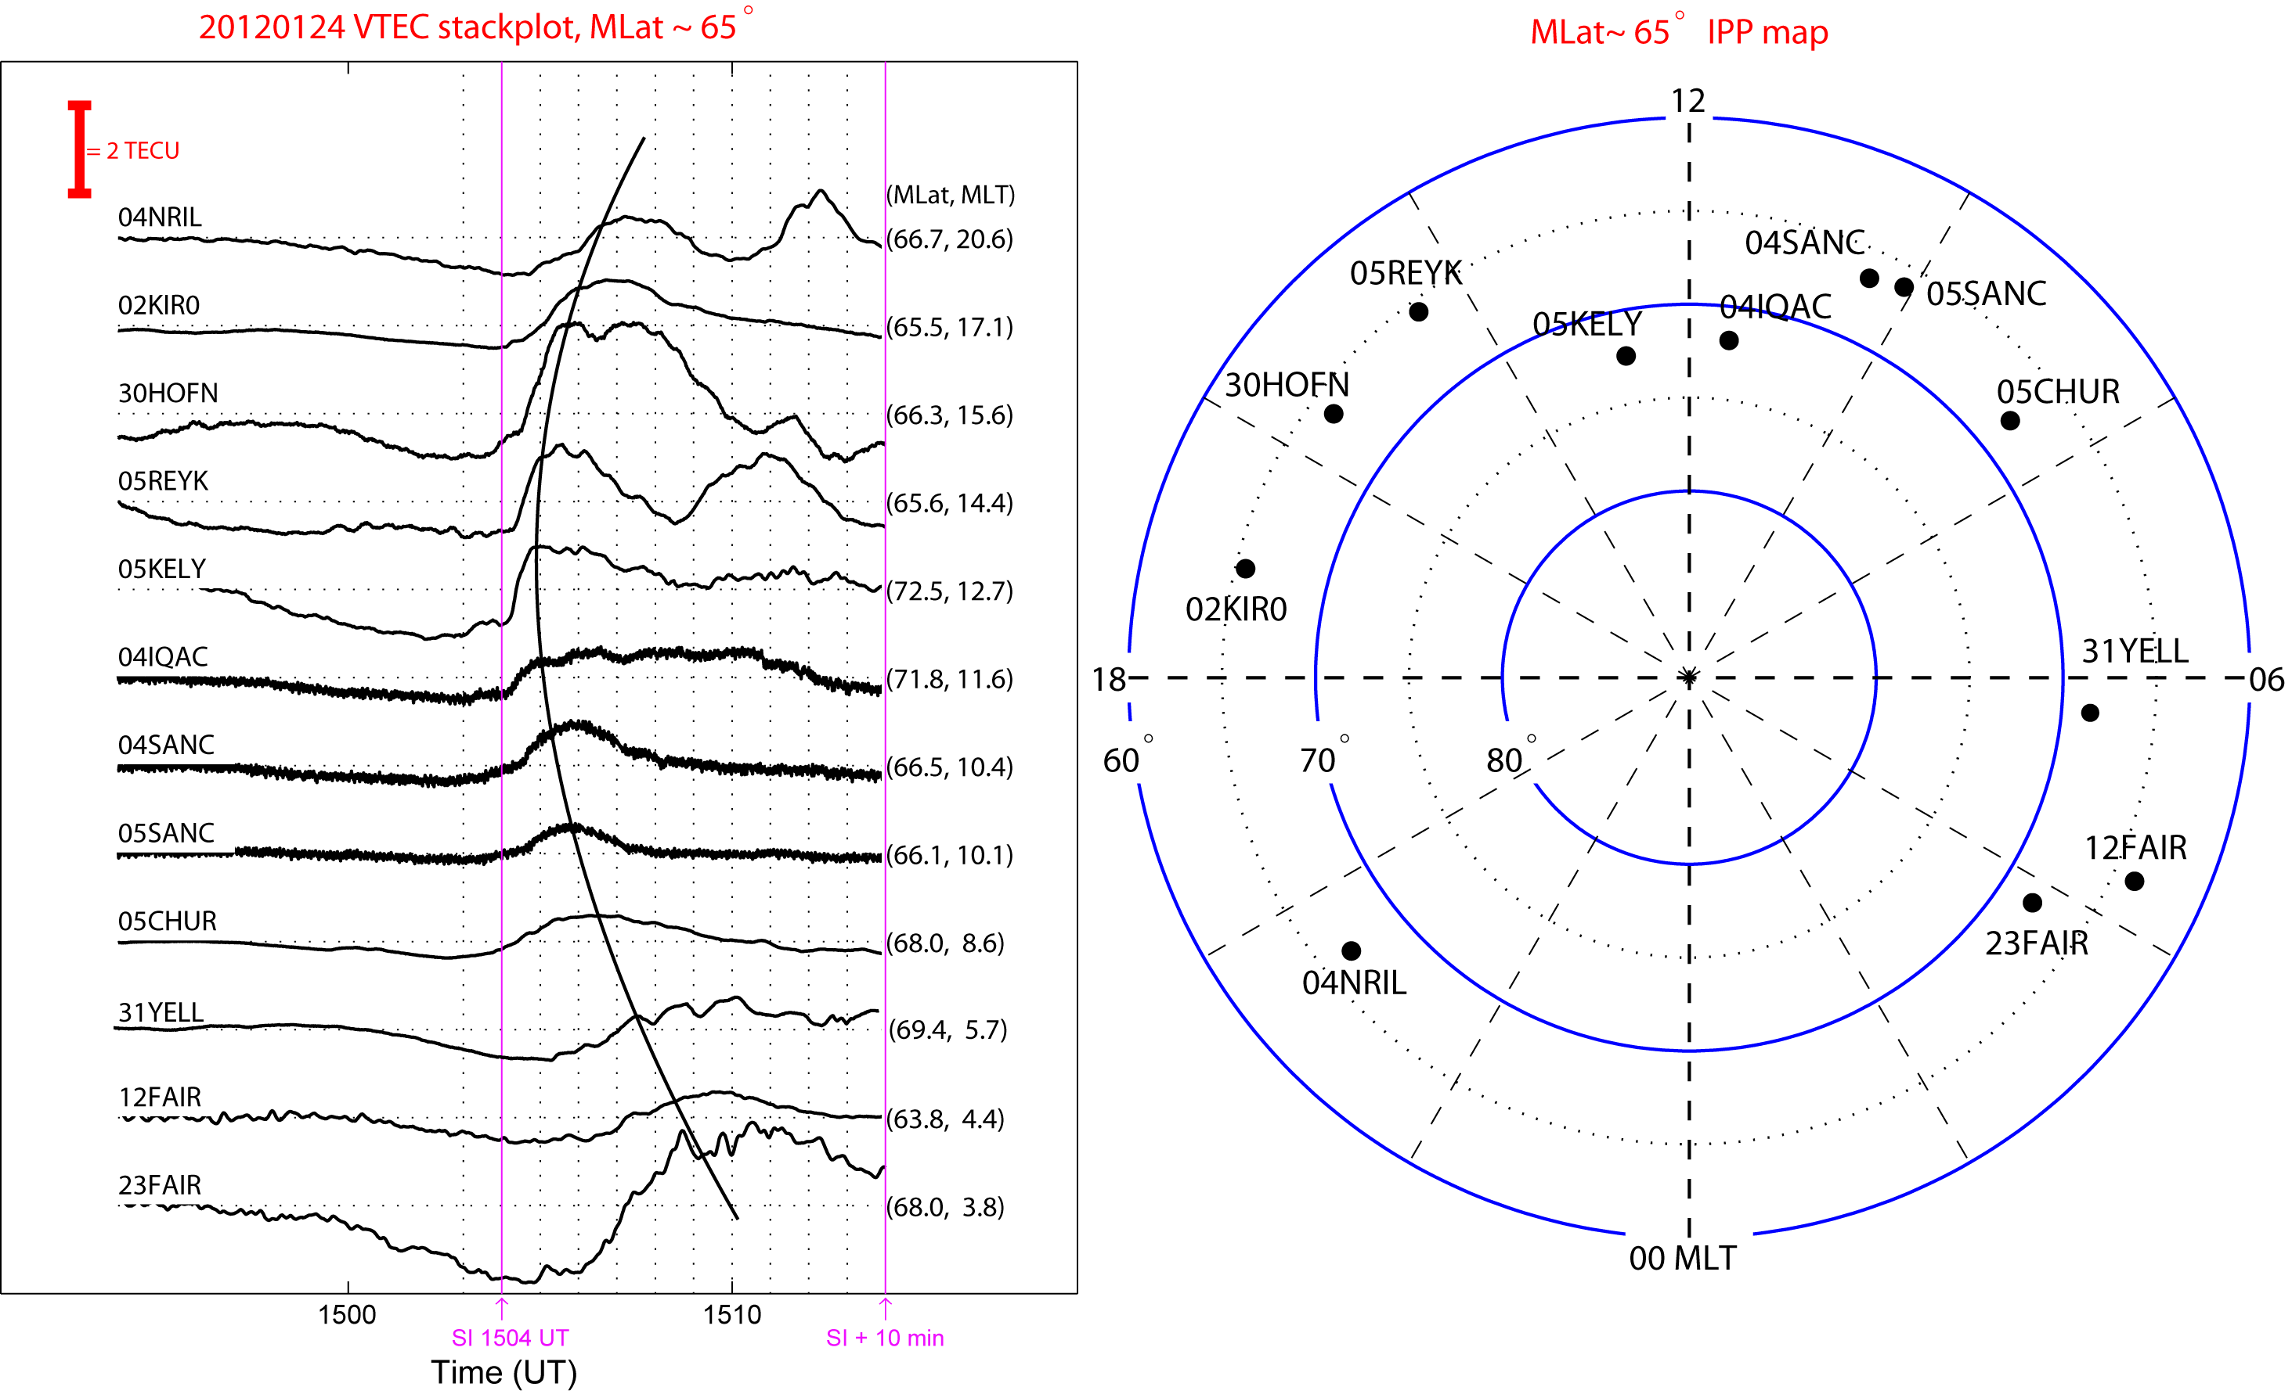
(Shock aurora related TEC on January 24, 2012.)

Slide 26
(Shock aurora related TEC on January 24, 2012.)

Slide 27
Preliminary statistical results
Date | Bz (nT) | ΔV (km/s) by WIND | Δsym-H (nT) at SI | SI (UT) | ΔTEC@ 65 MLAT | ΔTEC@ 10-15LT | ΔPsw (nPa)
20120124 | Bz>0 | 181 | 35 | 1504 | YES | YES | 10
20120308* | Bz>0 | 219 | 59 | 1104 | YES | YES | 13
20120312 | Bz ~ 0, to N | 133 | 73 | 0914 | YES | YES | 6
20120616 | Bz>0 | 104 | 25 | 0956 | NO | YES | 2
20130317 | Bz ~ 0 | 199 | 40 | 0600 | NO | YES | 8
20140912 | Bz>0 | 228 | 43 | 1554 | YES | YES | 9
20150317 | Bz~7 in 1 day | 109 | 48 | 0445 | NO | YES | 5
20150815 | Bz>0 | 81 | 39 | 0830 | NO | YES | 5
20150920 | Bz>0, to S | 92 | 27 | 0605 | NO | YES | 5
* The event studied in Jin et al., GRL2016.
There are always TEC variations, but when the shock is weak, the TEC variations doesn’t clearly and globally show at low latitude (e.g., ~65 MLAT).
Notes:
Q: When selecting shock events, you only use those with northward Bz in the upstream of the shock. Could you explain the reason?
A: when Bz <0, we always see expanded convection cell and large convection velocity which can transport the F region plasma and form large-scale plasma structures (such as polar cap patches). I want to avoid this since they are not auroral processes. I am not sure whether we can see the TEC propagation during negative Bz. This can be leave to future work.

Slide 28
Conclusions
Shock-generated-TEC variation is a “duplication” of the shock aurora from the auroral forms to their global dynamics.
The TEC first enhanced at the shock impact location.
The TEC intensification propagated away from the impact location at ~14 km/s that matched the shock propagation in the solar wind at 450 km/s
The low-lat chain showed the propagation, high-lat didn’t because different aurorae.
What has TEC revealed more?
The equatorward expansion suggested that the impact braking time is ~30 s for this particular event, during that time a new pressure balance was established.
Single TEC impulse lasted 2–3 min at each pierce point, indicating short-life time driver in deeper magnetosphere.
This study opens the door for the TEC to be an important tool to understand the solar wind and geospace coupling, especially on dayside.
Good spatial coverage and high time resolution
Less affected by the weather, season, and Rayleigh scattering comparing to the available auroral imaging tools

Slide 29
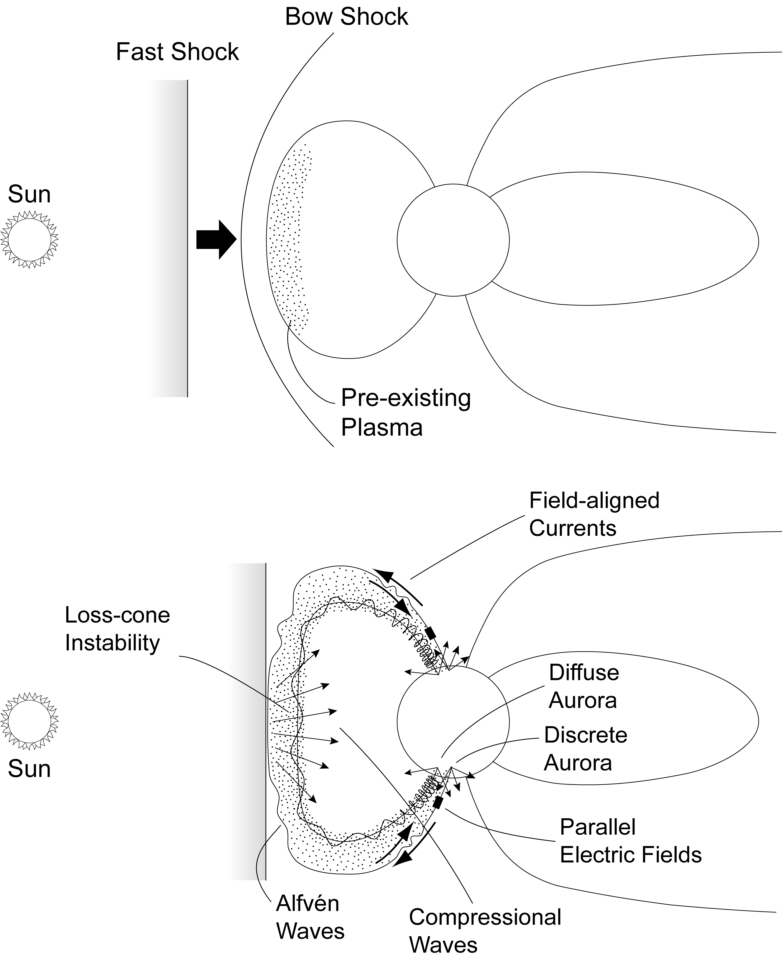
Zhou et al., JGR, 2003
The developed instabilities include whistler, electrostatic, & z modes. The whistler mode requires the smallest anisotropy threshold, but the z mode requires a large
temperature anisotropy.
With growing instability, wave particle interactions lead to an enhancement of pitch angle
scattering. Isotropic particles become profuse. As a result,
diffuse aurora in the ionosphere occurs or becomes more intense.
Chaston et al.(2005) showed the consistence between the observed E to B ratio and theoretical drift-kinetic Alfvén waves, & confirmed magnetic reconnection as a source of the drift-kinetic Alfven waves that power the red discrete aurora.
Notes:
Zhou et al, 2003 Figure 9. A schematic of possible phenomena in the dayside magnetosphere and ionosphere, which are generated by interplanetary shock/pressure pulse compression.
The interplanetary shock normal is along the Sun-Earth connection line. This figure shows that an intense impact of an interplanetary shock may generate Alfvén waves as well as loss-cone instability, which may lead to two types of precipitations of particles pre-existing in the outer magnetospheric region creating diffuse and discrete auroras as shown in Figure 9b.
Yahnina et al. (JGR 2008), using ground-based magnetometer for pulsations related to EMIC; Zhang et al. (JGR 2008), Polar magnetometer data; EMIC-electromagnetic ion cyclotron.

Slide 30
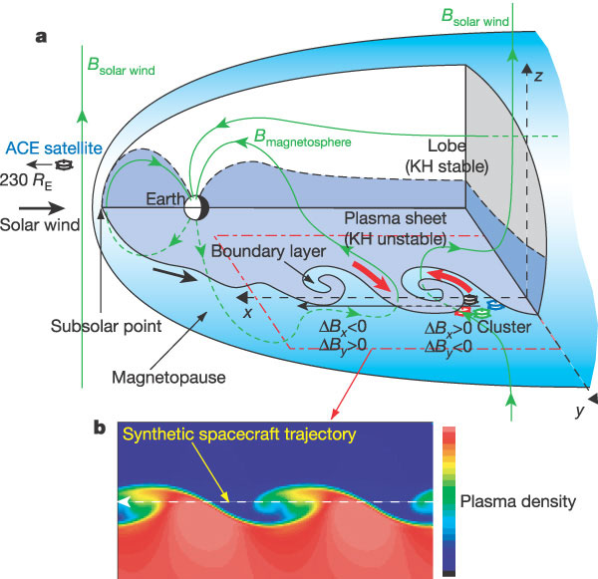
(Nishino et al., PSS2011)
KHI induces vortical structures on the magnetopause, which play an important role in plasma transport.
Hasegawa et al. [2004]: Transport of solar wind into Earth's magnetosphere through rolled-up KH vortices
Notes:
Hasegawa et al. [2004] Transport of solar wind into Earth's magnetosphere through rolled-up Kelvin–Helmholtz vortices, Nature, 2004
FIGURE 1. Three-dimensional (3D) cutaway view of Earth's magnetosphere, showing signatures of Kelvin–Helmholtz instability (KHI).a, View of the magnetosphere, showing the KH vortices at the duskside magnetopause. The velocity gradient across the magnetopause increases with distance from the subsolar point. The KHI occurs at the interface between the solar wind and the plasma sheet because the plasma energy dominates in both regions, whereas it does not occur at the surface of the lobes where the magnetic energy dominates and the magnetic tension prevents it from deforming the magnetopause. Consequently, the KH vortices evolve only along the low-latitude magnetopause and only low-latitude portions of the magnetospheric and solar-wind field lines are entrained into the vortices, inducing characteristic field perturbations in regions off the equatorial plane where the Cluster spacecraft were located. The satellites were situated at (x, y, z) (- 3, 19, -3) Earth radii (R_{E}) in GSM (geocentric solar magnetospheric) coordinates, and were separated by 2,000 km from each other. The coordinate system in the figures is defined such that -x is in the direction of motion of the vortex structure which was sliding anti-sunward in the spacecraft frame, y points outward along the magnetopause normal, and z points to the north. b, Vortex structure resulting from a 3D numerical simulation of the magnetohydrodynamic KHI under a magnetosphere-like geometry, with the plasma sheet sandwiched between the two lobes. Colour-coded is the plasma density (minimum, 0 cm⁻³; maximum, 5.0 cm⁻³) in an x-y cross-section cut below the equatorial plane. The density, velocity and magnetic field variations expected when a synthetic satellite passes through the centre of the KH vortices to the left are shown in Fig. 2.

Slide 31
Nonlinear wave structures or vortices are formed by a balance between mechanical momentum flux absorbed from the external flow and magnetic shear stresses on the inside, which can be described using a simple balance equation:
The magnetic shear stresses are propagated in the Alfvén mode along the internal field and a field-aligned sheet current arises from the divergence of
Finally, the field-aligned current density for an effective cross-section of ~20 km in the ionosphere turns out to be 8.8x10⁻⁶ A/m². The corresponding field-aligned potential drop is ~4.6 kV.
An important finding is that the spatial scales used in the above analysis are about one order of magnitude smaller than the vortices derived from Cluster measurements by Hasegawa et al. [2004].
The streaks are obviously of very different nature than the vortices observed by Cluster. Our interpretation implies a viscous interaction between dawnside magnetosheath flow and magnetosphere of the kind discussed by Miura [1992] and by Sonnerup [1980] for the low-latitude boundary layer.
Notes:
Rho_msh is the density in the magnetosheath and V_{msh} the flow velocity. α << 1 [Miura, 1992] is a constant representing the effective viscosity responsible for the nonlinear growth of the surface waves and the related momentum transfer to the magnetosphere. j_perp and B_{MP} are the current and magnetic field of the Lorentz force acting against the transferred mechanical stress at the magnetopause, and s_{b} is the braking length of the flow generated inside the nonlinear structure. Figure 7 provides a simple illustration. One notices the opposing direction of transverse current and electric field in the figure, indicating the generation of balanced upward and downward currents. The mechanical stress is applied over a latitudinal extent, 2 . We consider solely the momentum transfer without touching on the difficult problem of reconnection to the external field.
An important finding is that the spatial scales used in the above analysis are about one order of magnitude smaller than the vortices derived from Cluster measurements by Hasegawa et al. [2004]. This follows from the typical separation of two adjacent streaks, if identified as images of nonlinear KH waves. The separation length, observed to range between 80 and 170 km, would map into a typical separation of ~0.5-1.0 R_{E} at the magnetopause. Using the common ratio of 8 between KH wavelength and width of the shear layer, the latter would range between 400 and 800 km. This is consistent with the typical width of the magnetopause [Paschmann et al. 2005], and if projected into the ionosphere, corresponds to the widths of the observed streaks at ~10-20 km. These widths are quantitatively consistent with observations shown in Figure 3. The auroral streaks are therefore nonlinear structures inside the dawn magnetopause. They are obviously of very different nature than the vortices observed by Cluster. Our interpretation implies a viscous interaction between magnetosheath flow and magnetosphere of the kind discussed by Miura [1992] and by Sonnerup [1980] for the low-latitude boundary layer.

Slide 32
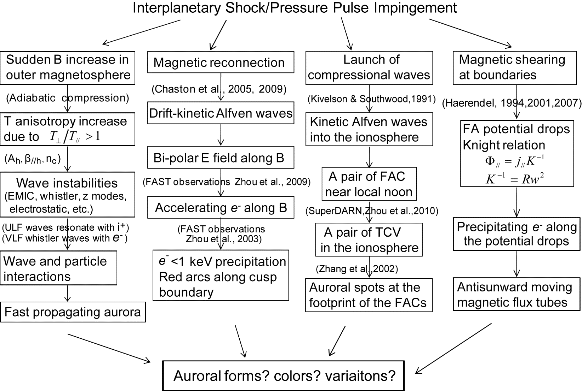
Shock-Aurora in Four Perspectives
To verify the hypothesis of the auroral mechanisms, we conducted a series of studies following the traces of the particle and wave precipitations at different local times from the out magnetosphere to the ionosphere with a distance stretched to 10-15 Re.
Zhou et al., 2016
Notes:
Instead of reviewing a list of my recent work, let me start with an ongoing study that is a child/continuation of our previous works on auroral dynamics and solar wind-magnetosphere coupling and that very well summarizes the five aspects in the beginning slide.
Generated by interplanetary shocks or solar wind pressure pulses, shock-aurora has transient, global, and dynamic significances and provides a direct manifestation of the solar wind – magnetosphere – ionosphere coupling. The aurora first appears around local noon, then propagates antisunward along the oval at a very high ionosphere speed in 6-11 km/s. This global dynamic picture was first captured by the space-based UVI images. To verify the hypothesis of the mechanisms, we conducted studies following the traces of the partial acceleration from the out magnetosphere to the ionosphere with a distance stretched to 10-15 Re. Shocks touch down on the dayside magnetopause several processes happen, but with distinguishable manifestation and corresponding auroral activity. Four processes are identified as summarized here based recent studies, each one has been documented by publications except the most right one, which is the paper we are working on.

Slide 33
Shock-Aurora in Four Perspectives
To verify the hypothesis of the auroral mechanisms, we conducted a series of studies following the traces of the particle and wave precipitations at different local times from the out magnetosphere to the ionosphere with a distance stretched to 10-15 Re.
Zhou et al., 2016
Notes:
Instead of reviewing a list of my recent work, let me start with an ongoing study that is a child/continuation of our previous works on auroral dynamics and solar wind-magnetosphere coupling and that very well summarizes the five aspects in the beginning slide.
Generated by interplanetary shocks or solar wind pressure pulses, shock-aurora has transient, global, and dynamic significances and provides a direct manifestation of the solar wind – magnetosphere – ionosphere coupling. The aurora first appears around local noon, then propagates antisunward along the oval at a very high ionosphere speed in 6-11 km/s. This global dynamic picture was first captured by the space-based UVI images. To verify the hypothesis of the mechanisms, we conducted studies following the traces of the partial acceleration from the out magnetosphere to the ionosphere with a distance stretched to 10-15 Re. Shocks touch down on the dayside magnetopause several processes happen, but with distinguishable manifestation and corresponding auroral activity. Four processes are identified as summarized here based recent studies, each one has been documented by publications except the most right one, which is the paper we are working on.

Slide 34
Shock-Aurora in Four Perspectives
To verify the hypothesis of the auroral mechanisms, we conducted a series of studies following the traces of the particle and wave precipitations at different local times from the out magnetosphere to the ionosphere with a distance stretched to 10-15 Re.
Zhou et al., 2016
Notes:
Instead of reviewing a list of my recent work, let me start with an ongoing study that is a child/continuation of our previous works on auroral dynamics and solar wind-magnetosphere coupling and that very well summarizes the five aspects in the beginning slide.
Generated by interplanetary shocks or solar wind pressure pulses, shock-aurora has transient, global, and dynamic significances and provides a direct manifestation of the solar wind – magnetosphere – ionosphere coupling. The aurora first appears around local noon, then propagates antisunward along the oval at a very high ionosphere speed in 6-11 km/s. This global dynamic picture was first captured by the space-based UVI images. To verify the hypothesis of the mechanisms, we conducted studies following the traces of the partial acceleration from the out magnetosphere to the ionosphere with a distance stretched to 10-15 Re. Shocks touch down on the dayside magnetopause several processes happen, but with distinguishable manifestation and corresponding auroral activity. Four processes are identified as summarized here based recent studies, each one has been documented by publications except the most right one, which is the paper we are working on.

Slide 35
Low-latitude chain
Low-latitude chain along close field lines foot prints
(Shock aurora related TEC on March 8, 2012, Jin et al., GRL 2016.)
Notes:
Proton aurora does not enhance ionospheric TEC because the aurora is generated via charge exchange.
My basic selection criteria are 1) select the most clear variation; 2) higher elevation angle; sometimes the data show the more or less the same result, then I try to keep a better coverage (i.e., farther away from previous data points).
To remove the background trend due to the GPS satellite motion, a 15 min period filter is applied in this study. The instrumental biases of the satellites and receivers are not subtracted because only relative changes in TEC are important in this study.
In the stack plot from top to bottom, the measurements were from ~19 to 03 MLT clockwise. Each pierce point’s MLAT and MLT are listed at the right end of each TEC curve.

Slide 36
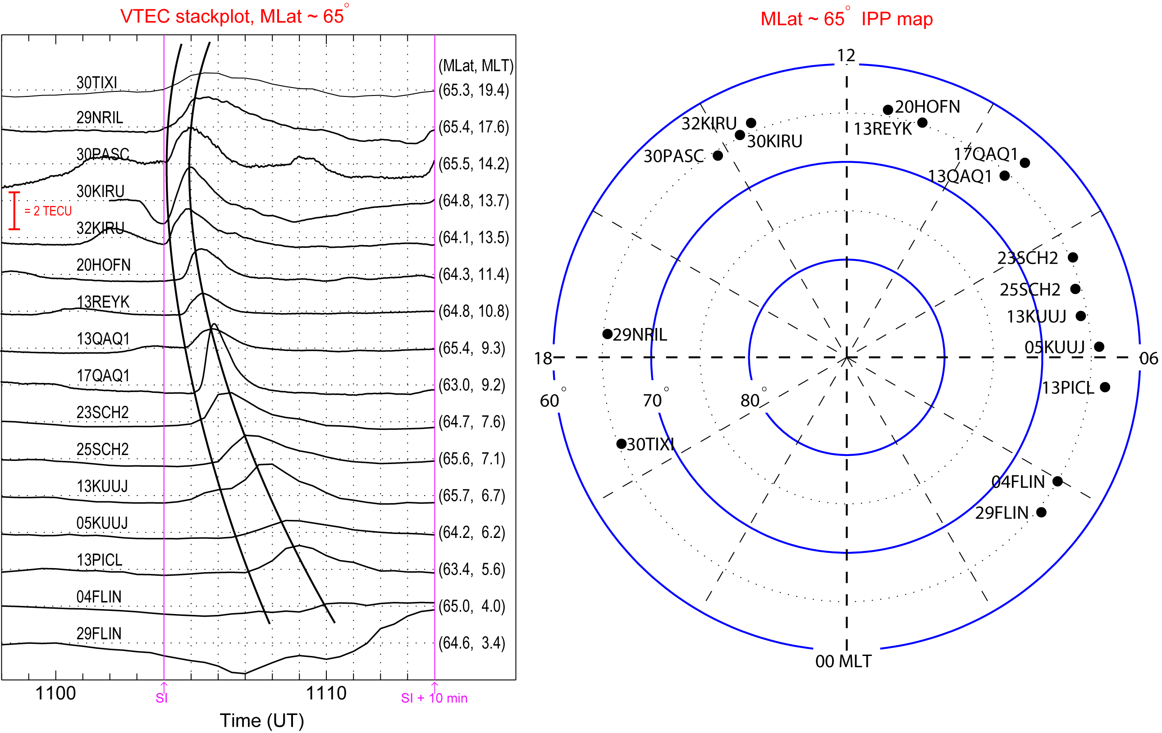
Low-latitude chain
Low-latitude chain along close field lines foot prints
The farther from the impact location, the larger the enhancement slope is.
(Shock aurora related TEC on March 8, 2012, Jin et al., GRL 2016.)

Slide 37
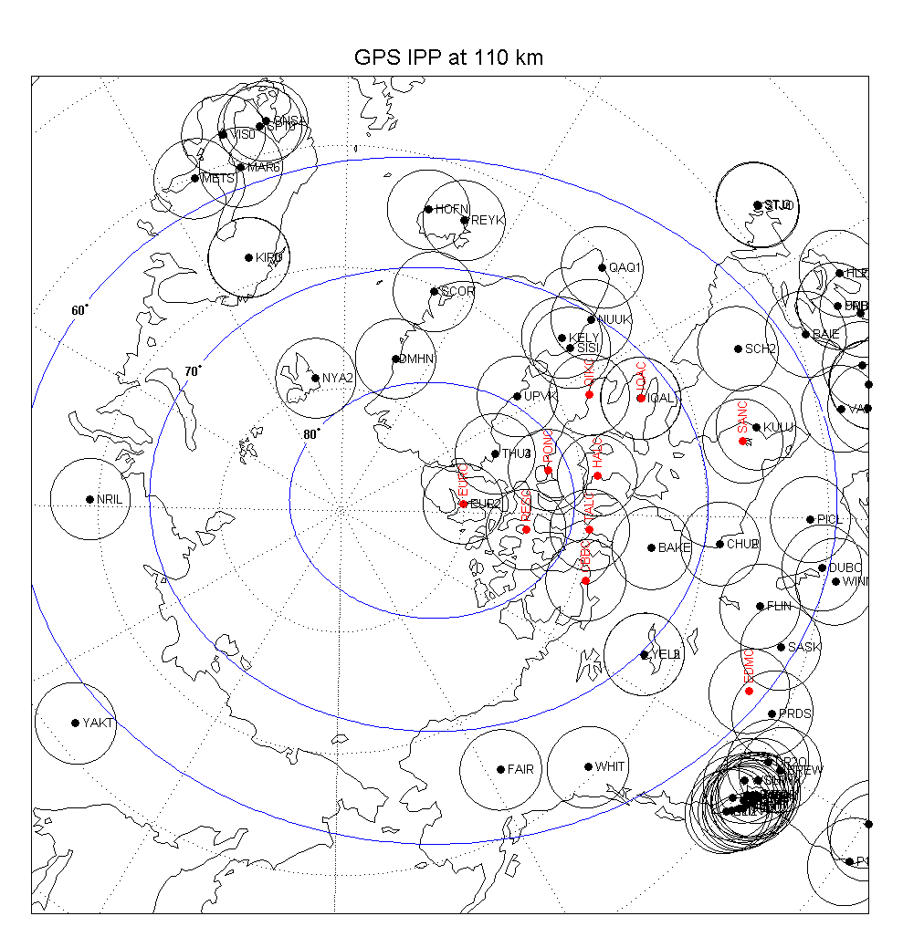
Possible available stations:
For 1 Hz GPS data
Large blue circles are magnetic latitudes (60, 70, and 80 degrees).
Red vertical line shows approximately noon-midnight meridian.
12 MLT

Slide 38
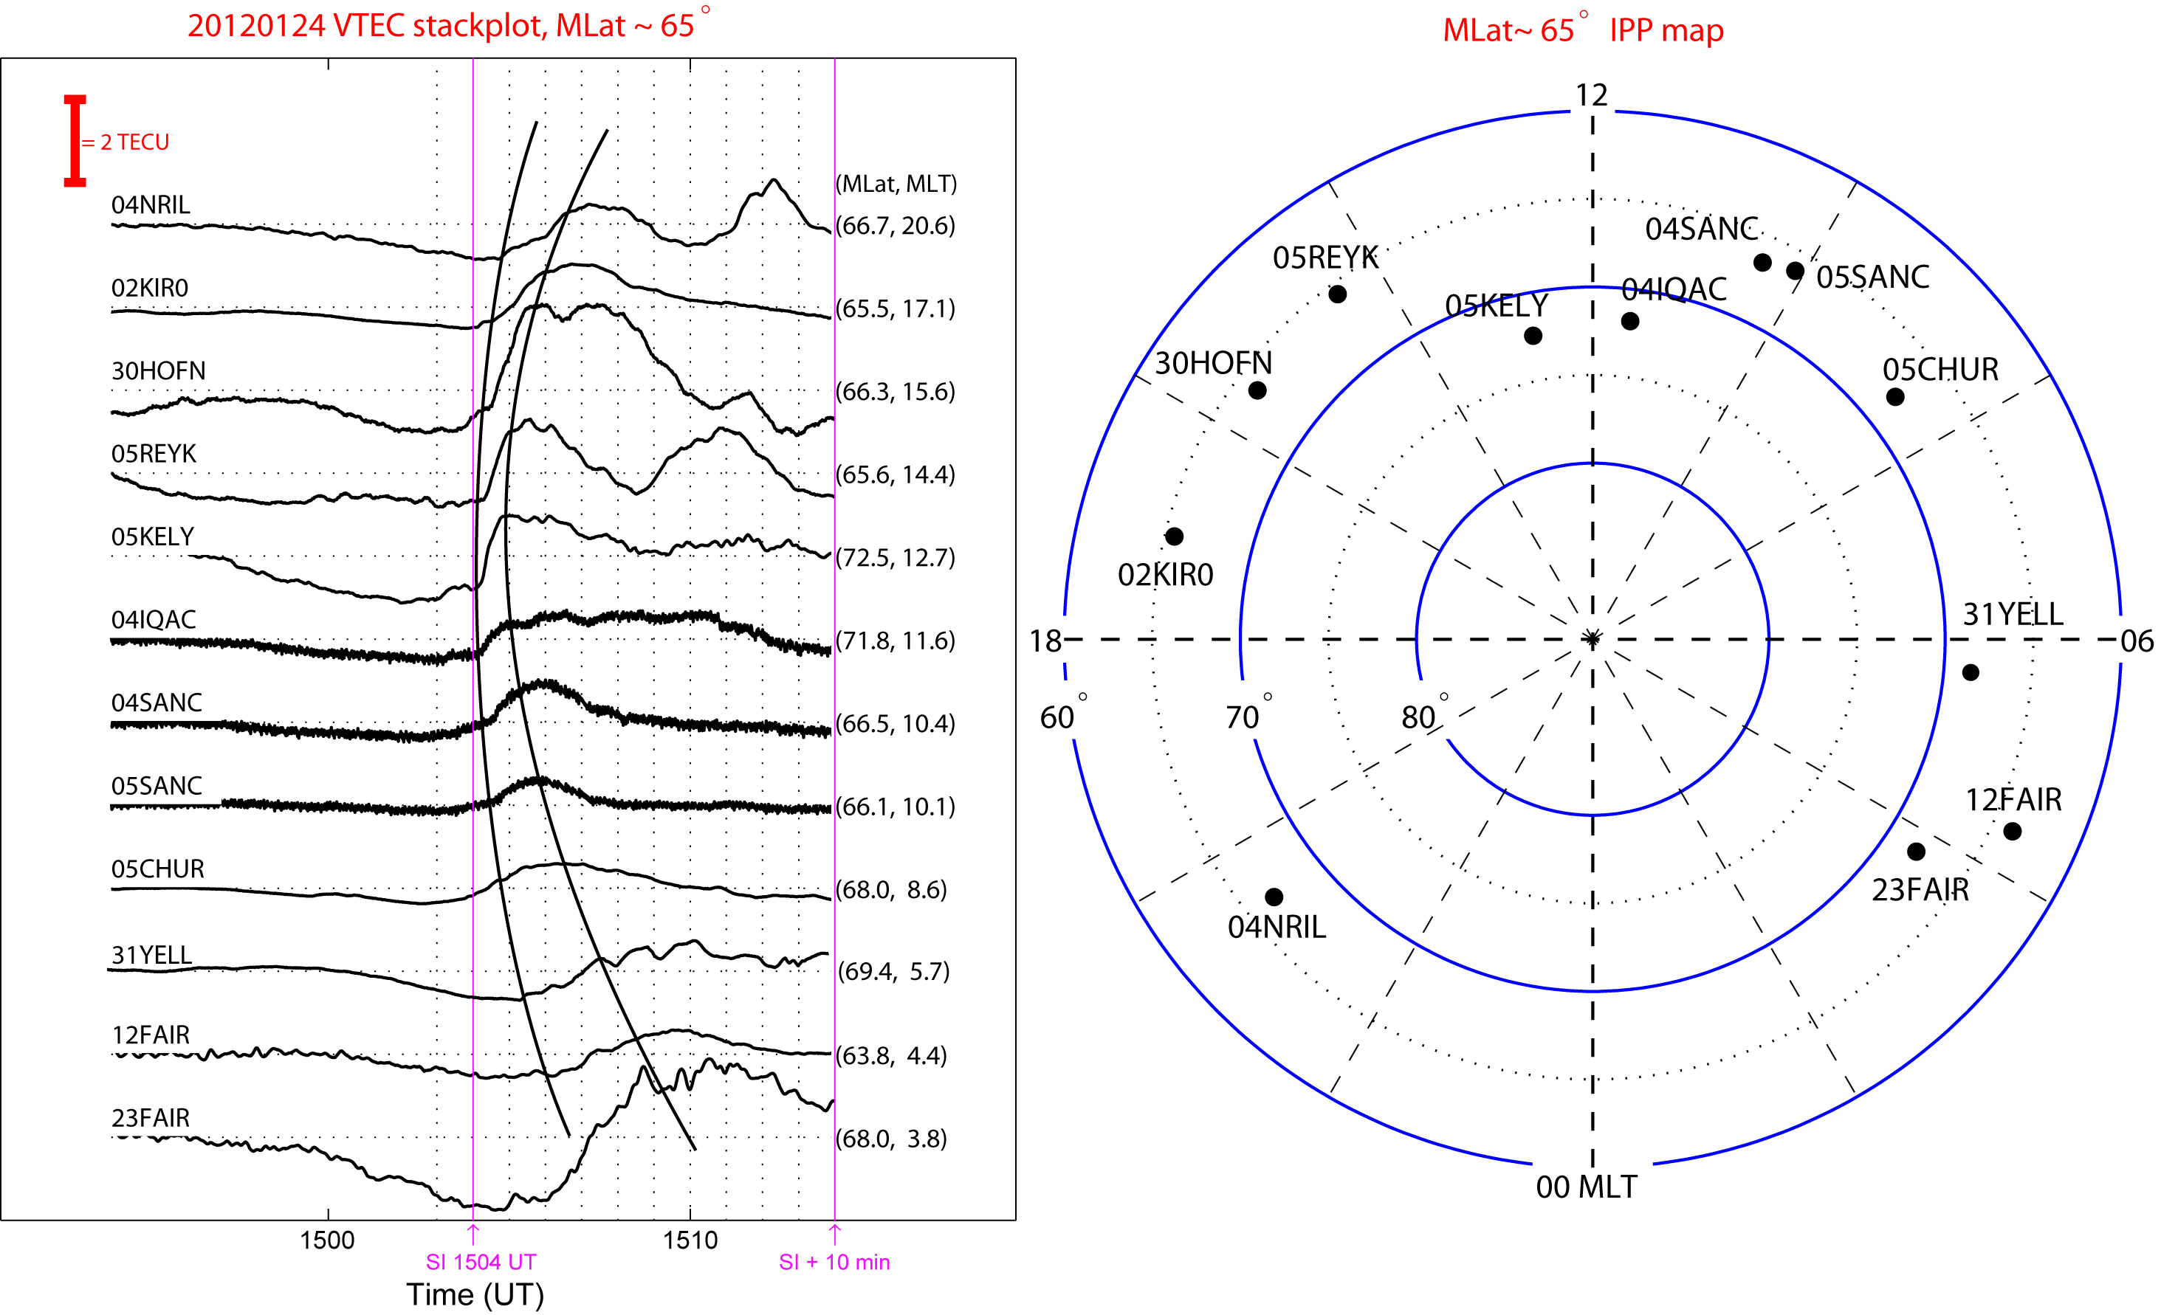
(Shock aurora related TEC on January 24, 2012.)
Notes:
Add THB for sw plot and calculate IS normal. latitudinal plot, no high latitude chain plot because the poor LT coverage.

