Slide 1
CoDR 2016-2017
MIT Rocket Team
Propulsion
Structures
Avionics
Recovery
Payload
Exec

Slide 2
Propulsion System - Propellant
Estimated Impulse Required
10,000 Ns
Estimated Mass of Propellant
5.2 kg
Propellant Formulation
R-45M HTPB: 13.5%
Isocyanate MDI: 2.4%
Isodecyl Pelargonate: 4.5%
Copper Chromite: 1.5%
Copper Oxychloride: 3%
HX-752: .28%
Ammonium Perchlorate: 67.6%
Atomized Aluminum: 7.12%
Castor Oil: 0.3%
Polydimethylsiloxane: 1 drop/500g
Triton X-100: 1 drop/500g
Propulsion
Structures
Avionics
Recovery
Payload
Exec

Slide 3
Propulsion System - Motor Hardware
Motor Case Dimensions:
Length 31” (∓2”); OD 4.01”; ID 3.61”
Motor Case Mass Estimate:
5 kg, depending on nozzle
Motor Case Material Choice
7075-T6 Aluminum
6061-T6 Aluminum
Nozzle Dimensions:
Exit Pressure: 0.8 atm
Geometry: Conical Con-Di
Nozzle Material Choice
Graphite
Propulsion
Structures
Avionics
Recovery
Payload
Exec

Slide 4
Propulsion System - Flight Qualification
Strand Burner Propellant Characterization: through mid September
54 mm motor tests: through mid October.
98mm 1 grain tests: through Thanksgiving
Flight Motor tests: through February. The initial flight motor static fire should be before Christmas.
Flight Tests start in March. Any acceleration to the schedule is encouraged, though we are limited by training and member availability.
Propulsion
Structures
Avionics
Recovery
Payload
Exec

Slide 5
Structures
Tube Dimensions:
6in ID; 6.25in OD
Nose cone:
Built in house using female mold
Material system:
8-harness satin weave S-glass
West Systems 105 Resin
New system with ≤ 300F cure temp. for oven
Propulsion
Structures
Avionics
Recovery
Payload
Exec

Slide 6
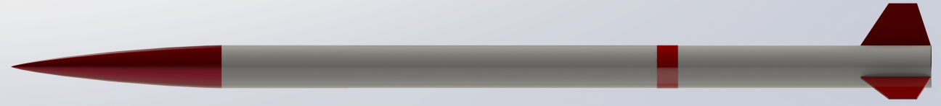
Structures
Rocket mass:
~25 kg (55 lbs) dry
Rocket length:
12.5 ft
Propulsion
Structures
Avionics
Recovery
Payload
Exec

Slide 7
Avionics
Pyxida
Our custom flight computer that handles parachute deployment and recovery tracking. It is based on an ARM microcontroller and is programmed using the Arduino development environment. The PCB is designed and assembled by the team.
Sensors
Barometer - Altitude, Apogee detection
GPS - Location, backup altitude
IMU - Orientation, Apogee detection,
Accelerometer - Thrust calculation
Propulsion
Structures
Avionics
Recovery
Payload
Exec

Slide 8
Avionics
Pyxida Outputs
Radio
  Pyxida has an XBee radio that is used to command the rocket and receive telemetry for tracking.
Pyro Channels
  The board will have 8 configurable pyro channels for triggering events.
Auxiliary outputs
  It can also be connected to other devices, which it streams data and radio commands to.
Propulsion
Structures
Avionics
Recovery
Payload
Exec

Slide 9
Avionics
Avionics bay
New shell based design
Telemetrum
Proved itself to be a capable backup system last year
Propulsion
Structures
Avionics
Recovery
Payload
Exec

Slide 10
Recovery: CO₂ Deployment Mechanism
CO₂ deployment mechanism using COTS valves and canisters
Drogue housed in deployment bag connected to Payload
  Pulled out upon the ejection of Payload at 10,000 ft / apogee via CO₂ system
  Redundancy in CO₂ deployment with two independent system housed at the intersection of Recovery and Avionics
Payload
Dro
Recovery
Main
CO₂ Deploy Sys.
Avionics
Propulsion
Structures
Avionics
Recovery
Payload
Exec

Slide 11
Recovery: Parachute Requirements
Drogue deploys at 10,000 ft / Apogee
  Potential to upscope to ballute after development of CO₂ deployment system (contingent upon altitude)
  For 30 m/s descent rate (within ESRA recommendations) and semi-ellipsoidal shape, currently estimating 2.4 ft diameter.
Main parachute deploys at <= 1500 ft
  For 5 m/s landing rate and semi-ellipsoidal shape, currently estimating 11.6 ft diameter
  Main parachute to be housed in coupler held in place by 2-4 solenoid pins
    Pins will release the coupler and the chute at the desired altitude.
Propulsion
Structures
Avionics
Recovery
Payload
Exec

Slide 12
Recovery: Functional Requirements of Mechanisms
CO₂ Deployment Mechanism
  Must meet the requirements of the competition. For reference: ESRA 2016 IREC Advanced sections 5.1 and 5.2.
    5.1: the system should have both Safed and Armed statuses (two steps to deployment vs. one)
    5.2: the system should be rated for much higher pressures than what will actually be used
Main Parachute Retention Mechanism
    Solenoid pin holding mechanism must be able to withstand opening shock loads of drogue
    External “Remove Before Flight” pin to prevent the coupler from displacement prior to electronic pin engagement
Propulsion
Structures
Avionics
Recovery
Payload
Exec

Slide 13
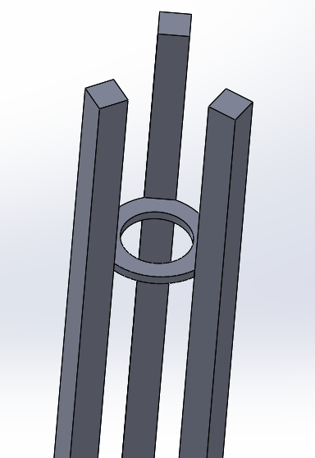
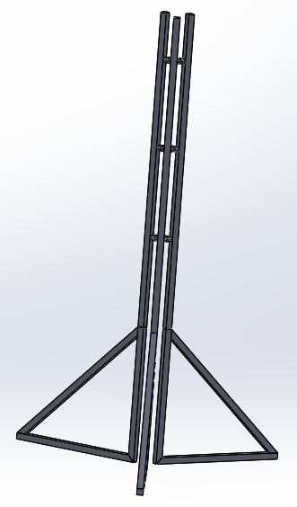
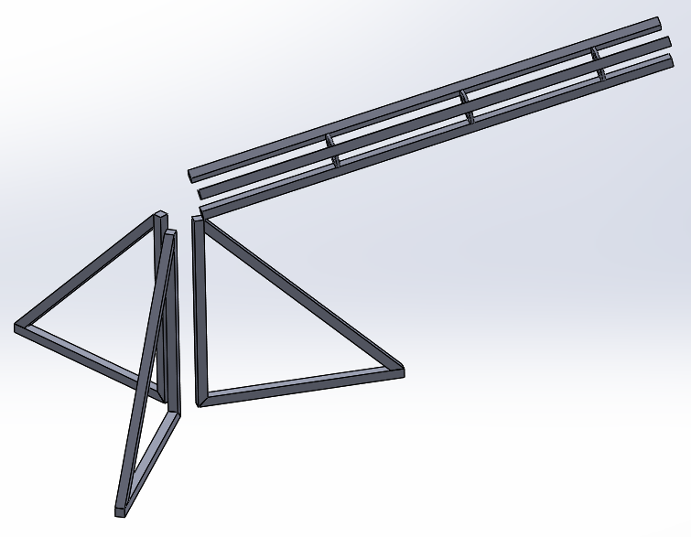
Ground Support Equipment
Conceptual Design of Test Stand:
Based on functionality of launch rail
Made of unistrut

Slide 14
Ground Support Equipment
Possible Test Locations:
New Hampshire location
Race tracks, abandoned runways
Existing launch sites (URRG, MDRA, etc.)

Slide 15
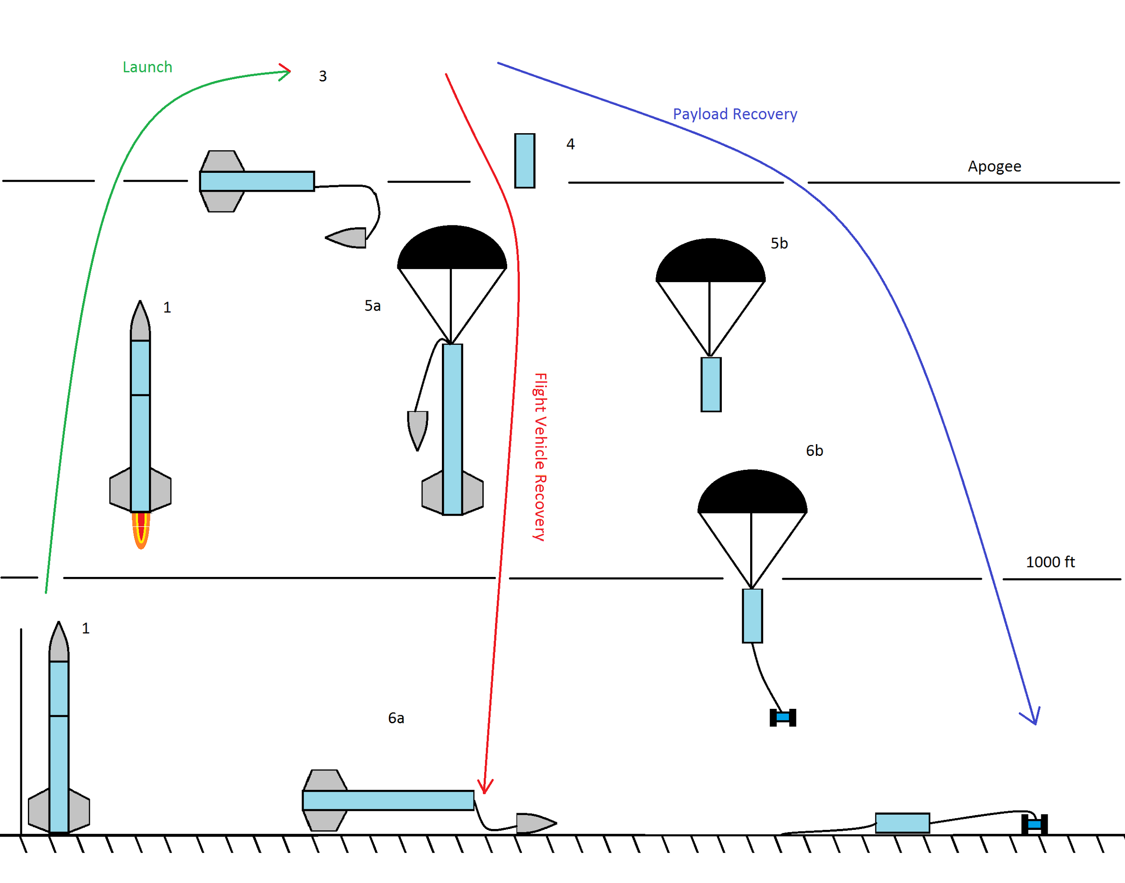
Mission: Rover Deployment
The rocket’s payload is a rover. The rover shall:
separate from the rest of the rocket at apogee
arrest its velocity and land under a parachute
detach itself from the landing assembly
drive autonomously
conduct an independent “science” mission
Propulsion
Structures
Avionics
Recovery
Payload
Exec

Slide 16
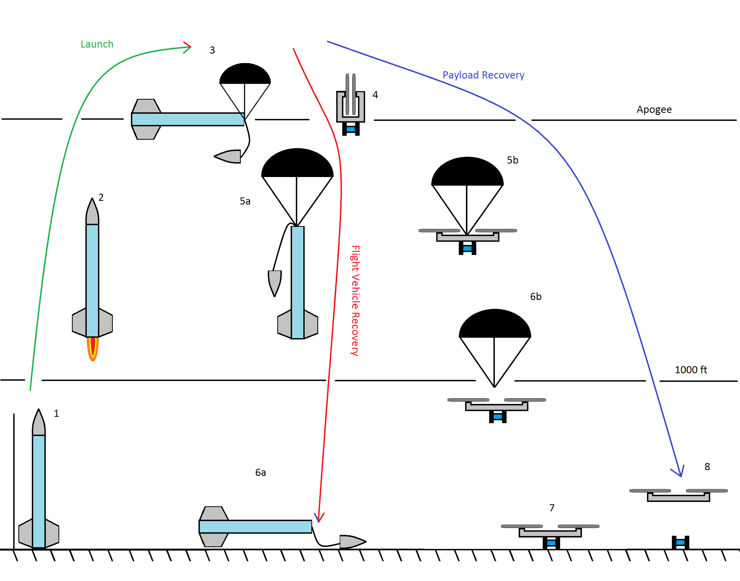
Mission Upscope: Quadcopter
If the rover project goes well, we will be upscoping the mission by adding a quadcopter to the mission. The quadcopter shall:
deploy from the payload tube
fly the rover to a landing location
deposit the rover and fly away
potentially incorporate computer vision or its own mission
Propulsion
Structures
Avionics
Recovery
Payload
Exec

Slide 17
Milestones
Best | OK | Worst | Milestone
Oct 31 | Oct 31 | Nov 30 | Send proposal to ESRA, with altitude and mission
Jan 31 | Mar 30 | Apr 31 | Component testing completed and reviewed Full-size motor static test completed Flight test 1 completed
Mar 30 | Apr 31 |  | Flight test 2 completed
Apr 31 |  |  | Flight test 3 completed
Propulsion
Structures
Avionics
Recovery
Payload
Exec

Slide 18
Key Project Risks
Finding a test location for static fires
Mixing large batches of propellant
Not enough testing for payload

