Slide 1
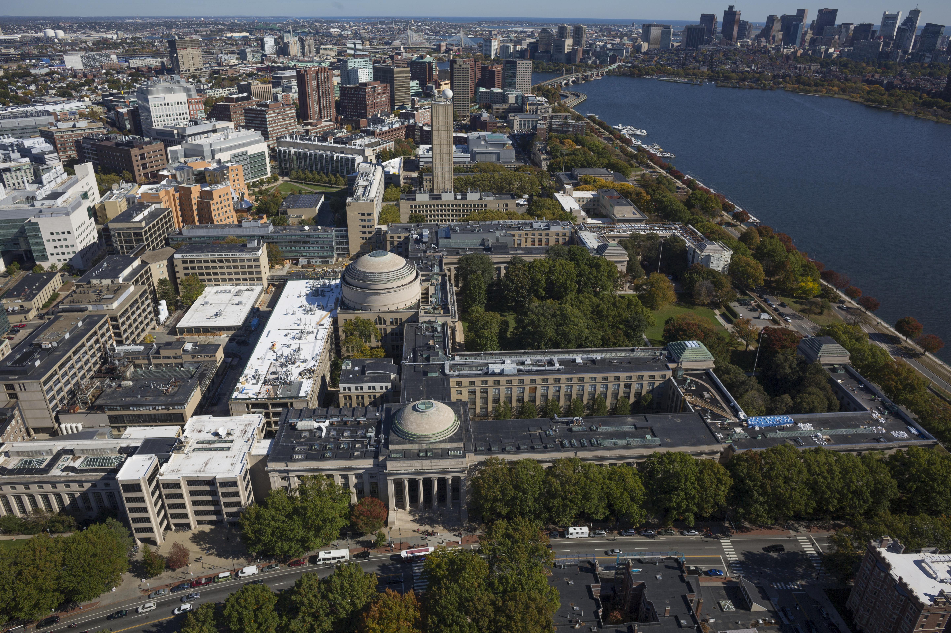
e-Builder
Project Definition (PD) and MPBE
Bob Brosseau
e-Builder Trainer
e-Builder Training| May 2017

Slide 2
Project Definition Form Creation
Started by the CC Planner, CC Planning Manager, eB admin, Project Manager, R&M Manager, or UTILITIES Program Manager.
If the CC Planner does not start the PD Form process the first step will go to the CC Planner.
The Project Manager Review step is “touch” step for the PM.
The approval workflow culminates in a Merge step that creates the PD Form.
The MPEB (03.01) process is spawned following PD Merge step.
The final PD Form is created following CC planning Mgr approval.

Slide 3
Process Output
Three key functions of the PD Form process.
Routes immediately to the CC Planner if the process is started by someone else.
Creates a draft PD form and a Final PD Form.
Spawns the 3.01 Milestone Project Estimate process. It appears in the Project Manager’s court for completion.

Slide 4
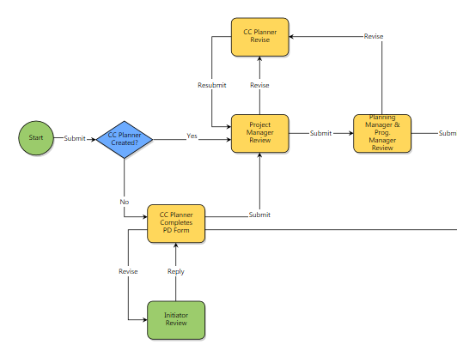
PD Form, Initial Step Sequence
This is the first sequence of steps for creating the PD form.
If the CC Planner does not start the process the first step routes to that role.
The CC Planner and Project Manager can engage in a Submit and Revise loop to complete work on the PD form content.
The Project Manager’s submission will go to the Planning Manager and Program Manager for review/approval.

Slide 5
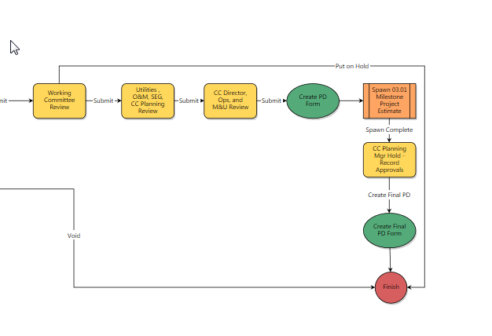
PD Form – Remaining Steps
Assuming the form is not voided this sequence begins with Working Committee Review.
Other reviews and approvals take place prior to the draft PD form being created.
The 3.01 MPEB process is spawned.
The final PD Form is printed in the final process step.

Slide 6
Processes:
Helpful Skills to Know
Filtering to view a process
Using Submit and Revise steps (revise allows for a reviewer to request a correction or ask questions)
Comments – making and requesting
Attaching documents to processes
Print merge template (Current View and Merge Templates)
Show History, Current Actors, Workflow Diagram

