Slide 1
CRSP Screening Kickoff - 2
e-Builder training

Slide 2
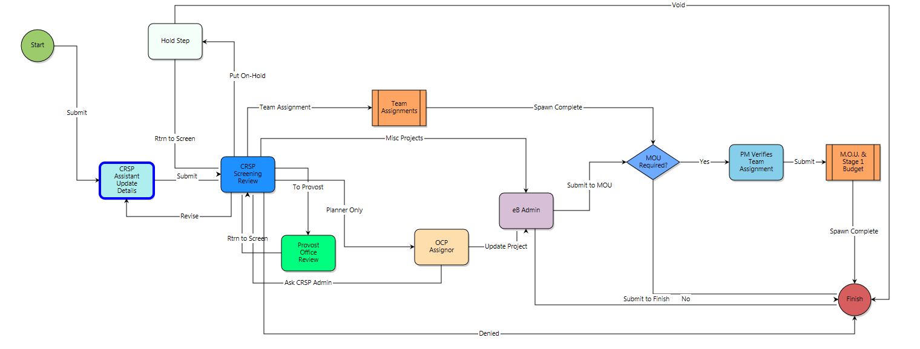
Process

Slide 3
Project Details

Slide 4
PM Verifies Team Assignment

