Slide 1

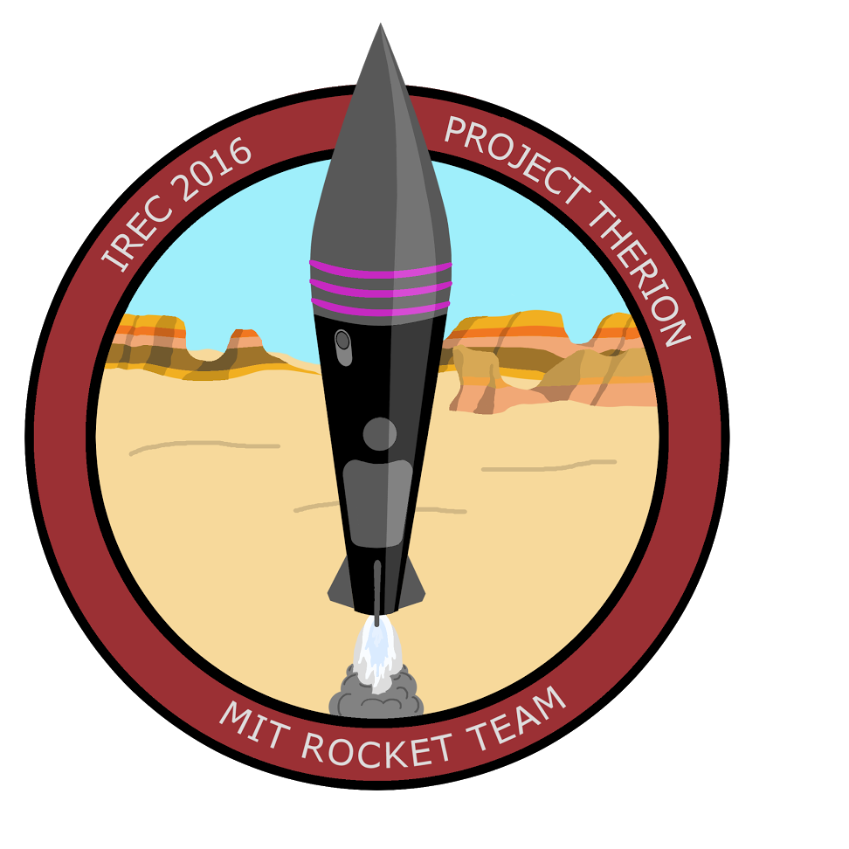

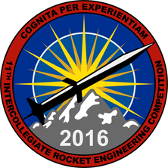
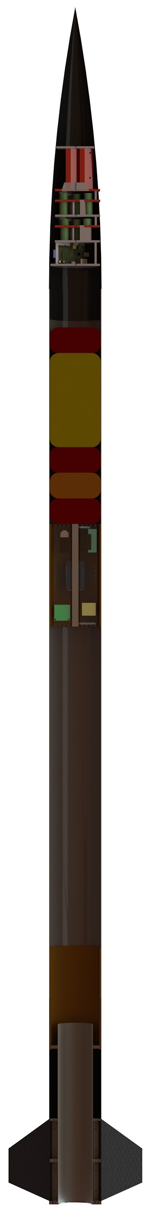
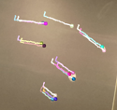
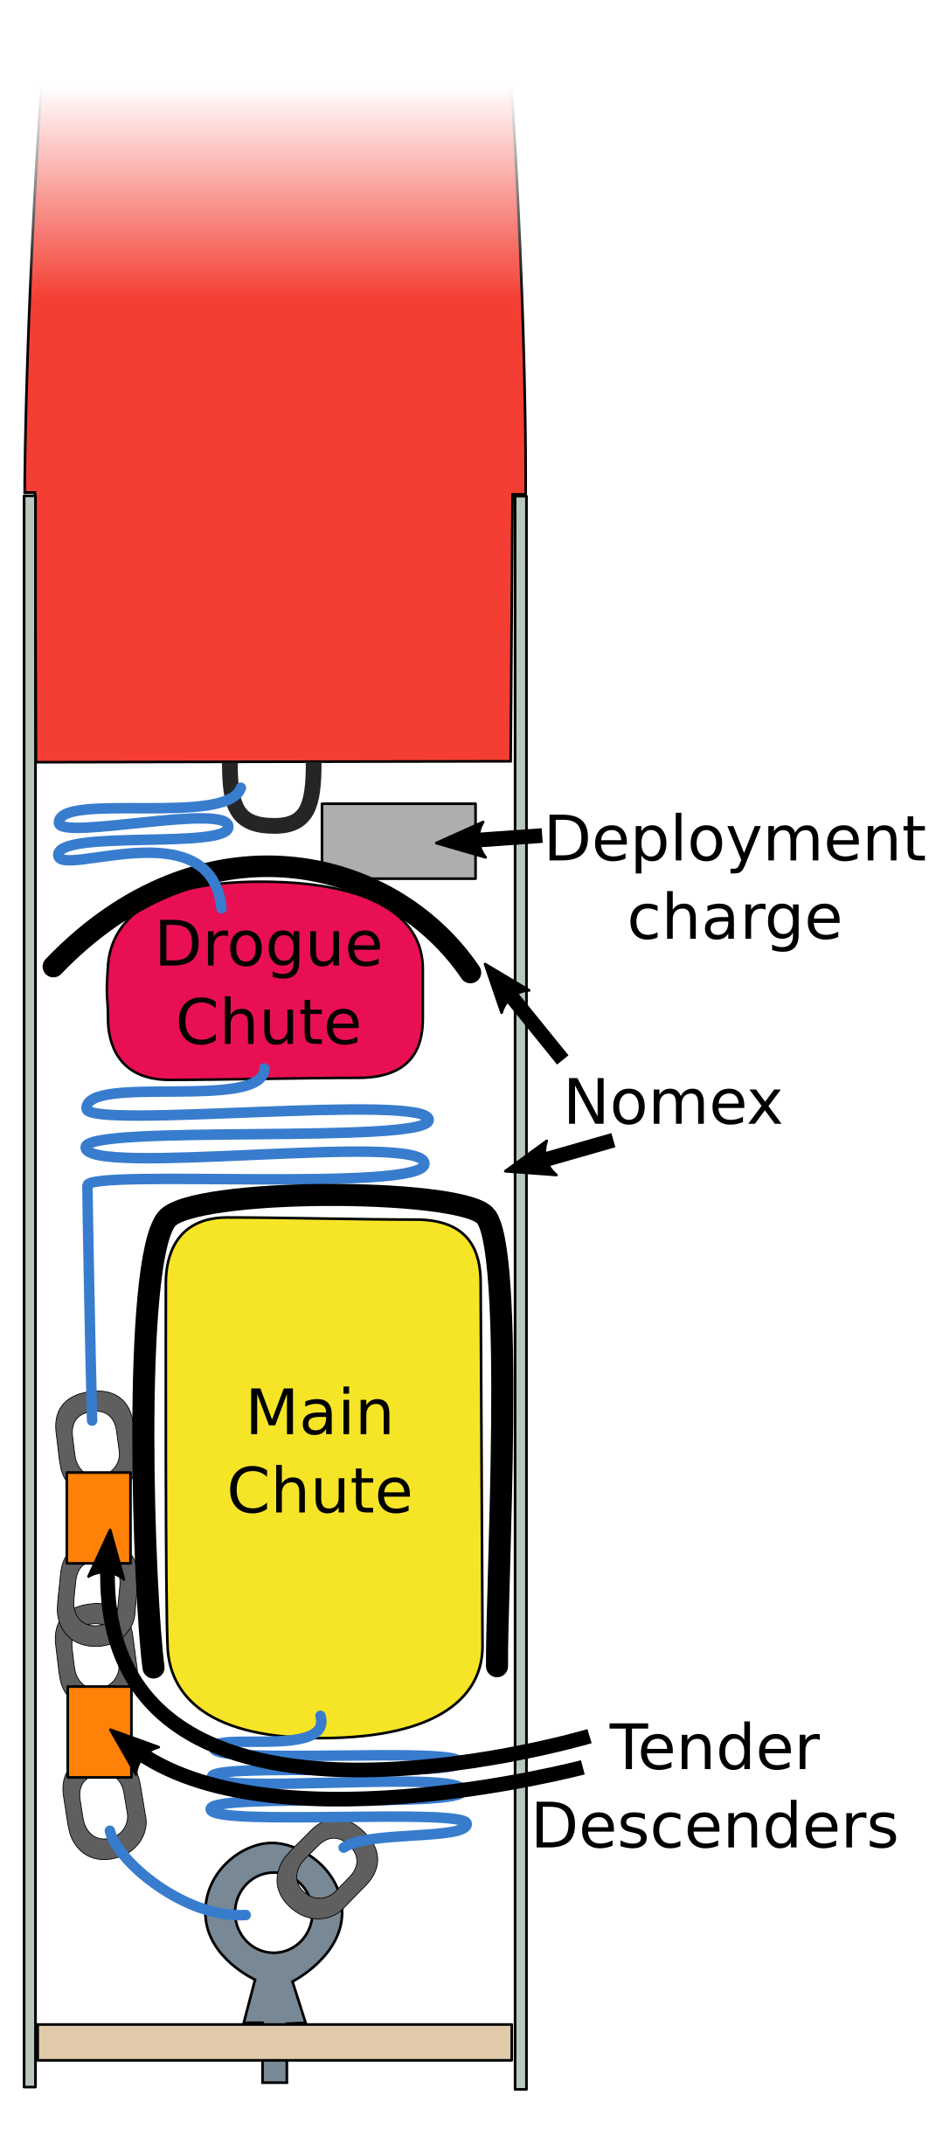
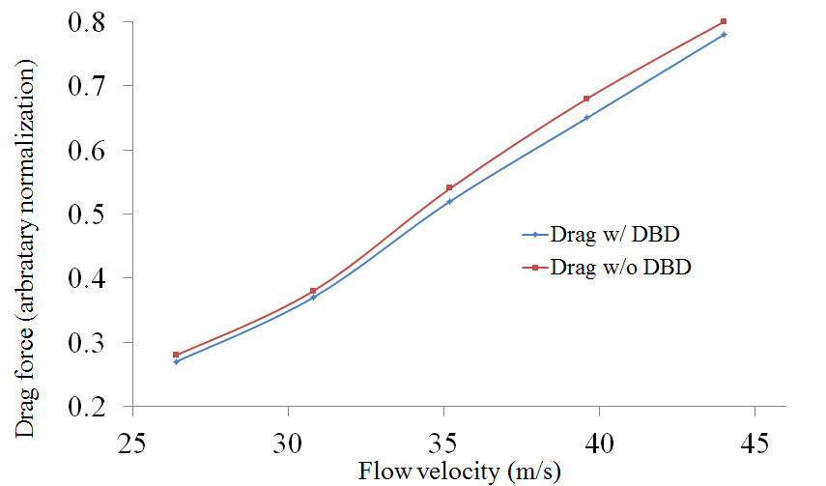
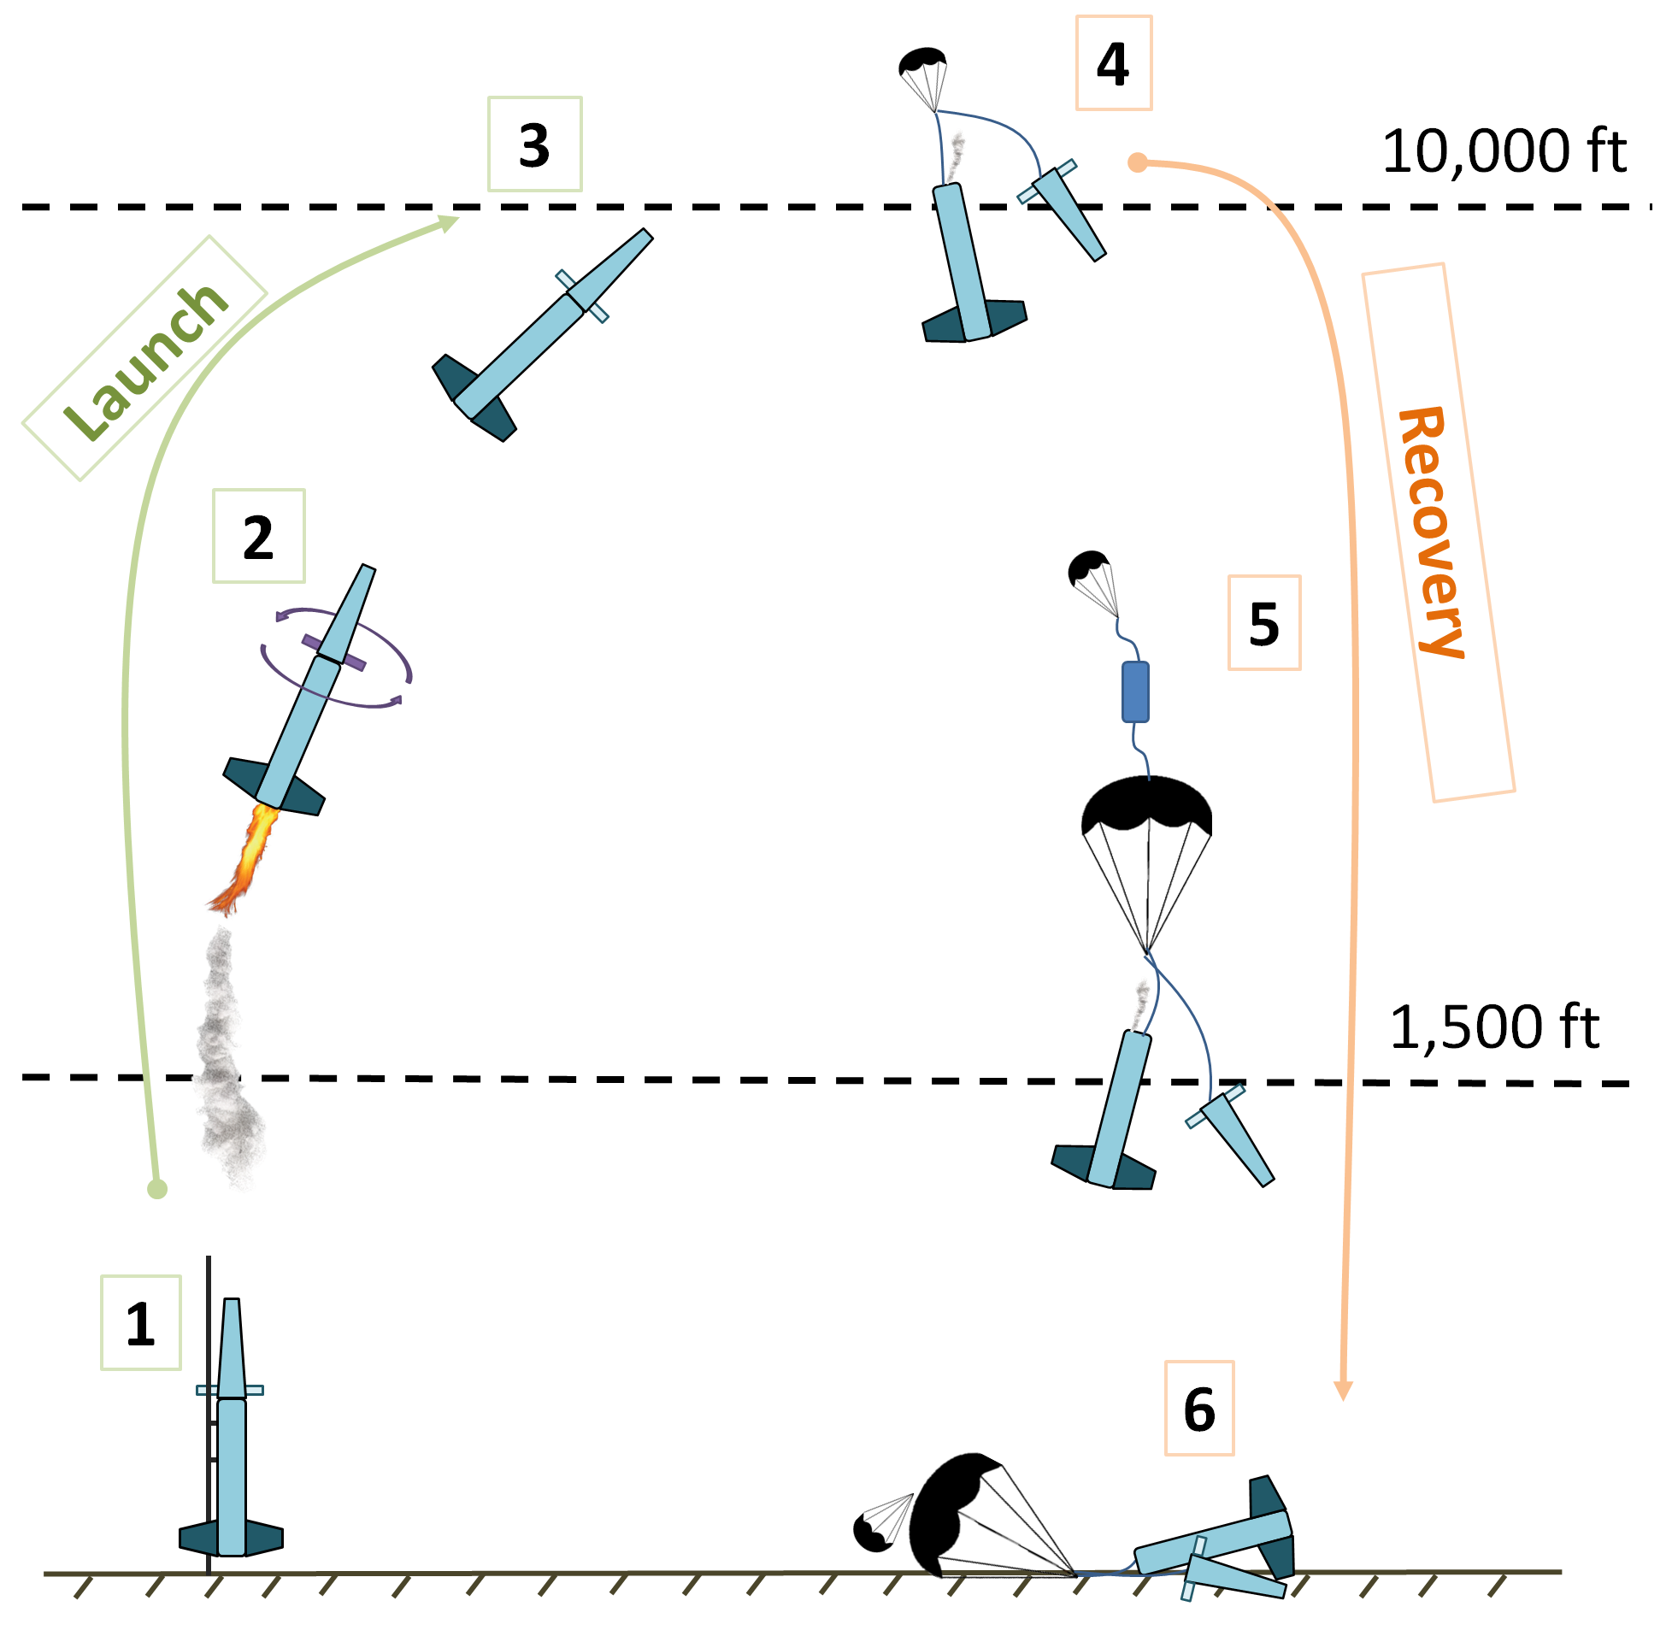
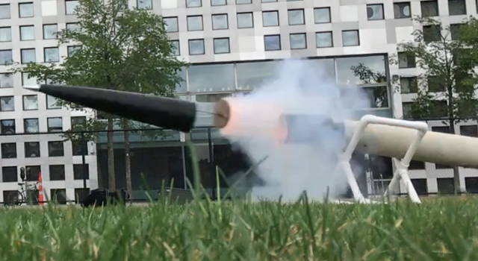
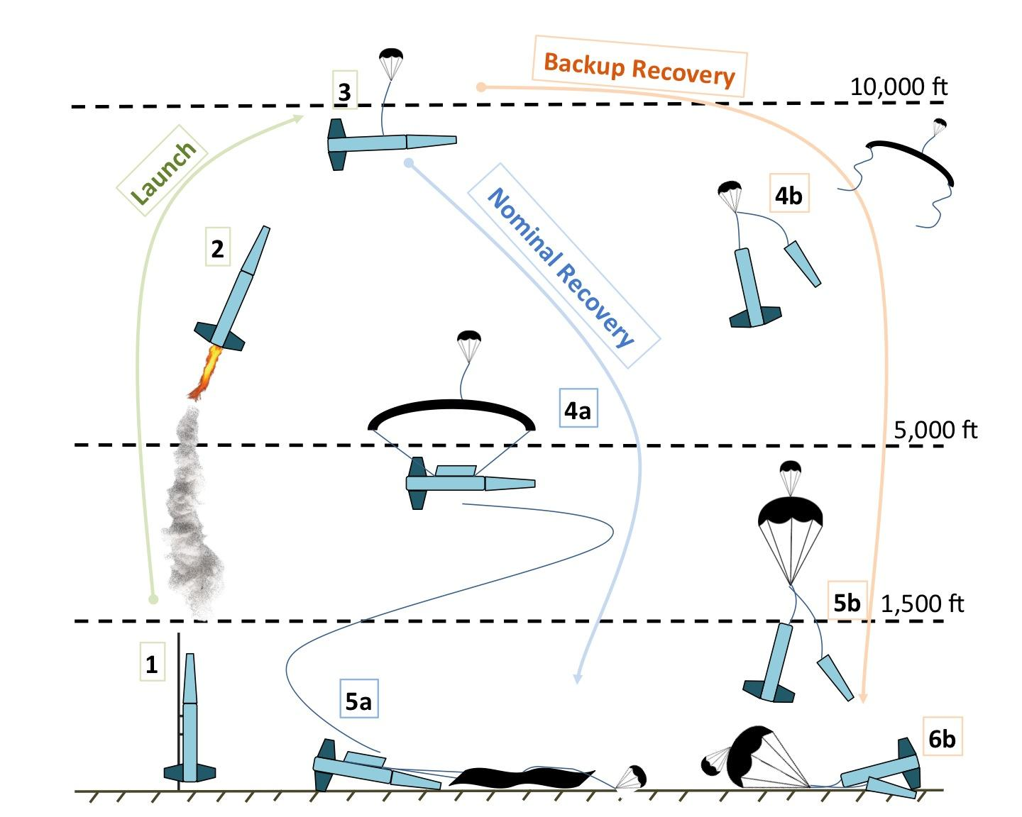
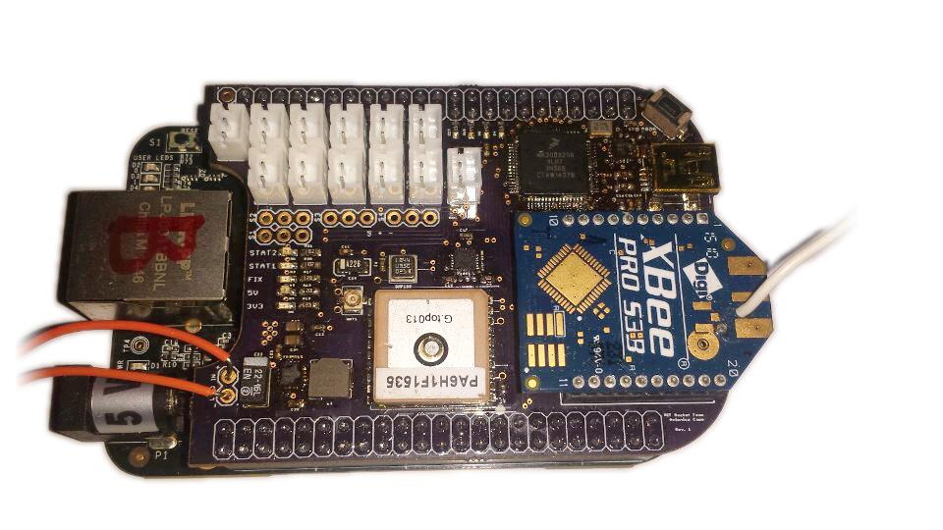
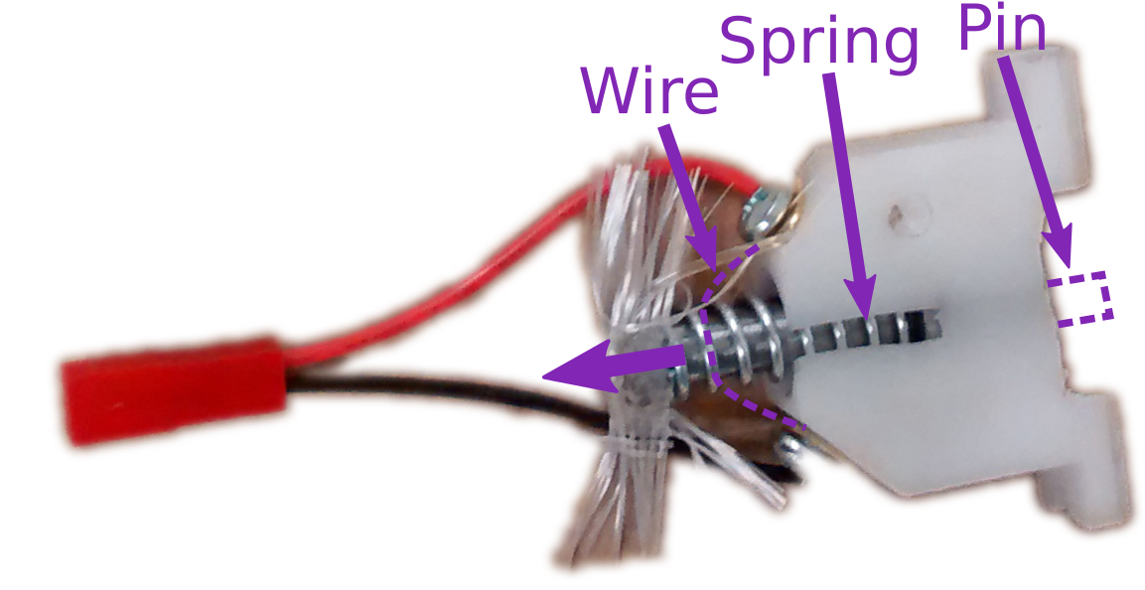
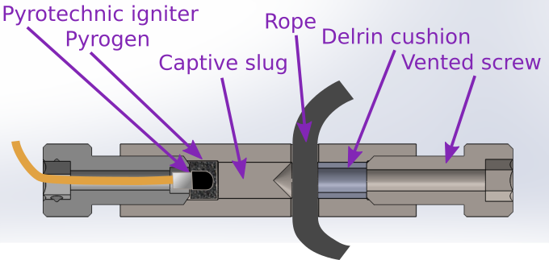
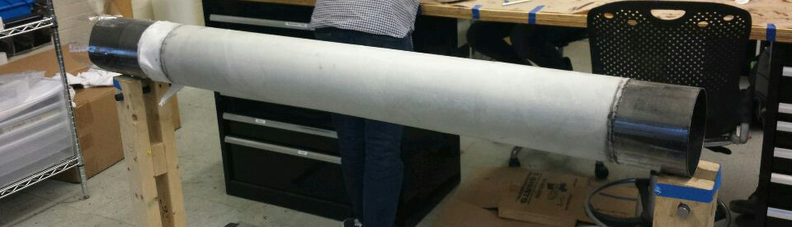
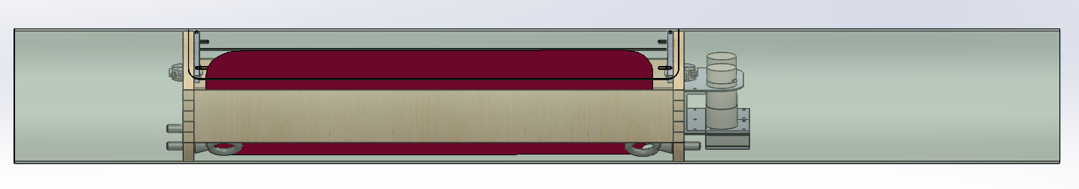
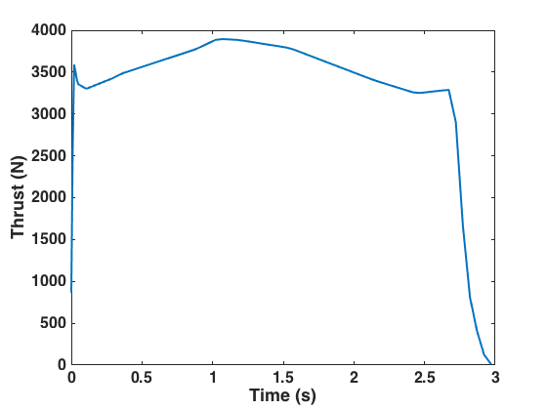
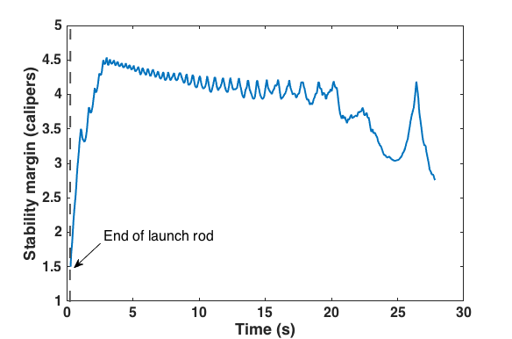


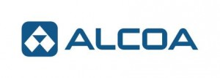







Therion III
The Optical Flow Experiment estimates the attitude of the rocket to supplement inertial measurements. A PlayStation Eye camera mounted in the nosecone feeds live video to a Raspberry Pi. The software then tracks Therion's flight path by tracking the motion of feature points between frames.
The recovery system is a single-separation dual-deployment system. A pyrotechnic charge ejects the nosecone at apogee, pulling the drogue chute out the rocket body. The main parachute is released from the rocket at 1,500ft by redundant Tender Descenders. We have ground tested this system several times to choose the size of our ejection charge.
The parachutes were student-designed and sewn in-house. The parachute gores are ripstop nylon and seams are reinforced with nylon tape.
Launch
Plasma Experiment
Coast to Apogee
Drogue Deploy
Main Deploy
Landing
Pyxida is the avionics system that we developed this year. It consists of a Beaglebone Black and a student designed and assembled PCB with a GPS, IMU, barometer, and XBee radio for telemetry. Pyxida records data from its sensors, triggers flight events, and transmits its data to a ground station for tracking
For backup, the rocket has a Telemetrum and a StratoLogger onboard that can deploy parachutes and provide tracking information in case Pyxida fails to do so.
Team Overview
Optical Flow Tracking
Payload
40 members representing 5 majors
6 subteams: Structures, Recovery, Propulsion, Avionics, Payload, and Special Operations. The team aims to accomplish 2 overarching goals:
Establish and contribute to the rocketry community and engage in outreach
Hands on engineering practice
Goals accomplished this year:
Ready for next year advanced
Custom, redundant avionics and live telemetry
Rapid integration
30 personal rocket flights and 11 Certs
The dielectric barrier discharge payload (DBD payload) is designed to study the impact of DBD electrohydrodynamic actuators on the behavior of transonic airflow around the rocket. DBD devices are a form of plasma based aerodynamic actuator capable of producing high velocity surface flow without the use of moving parts. These actuators can be used to influence flow behavior by adding momentum to the boundary layer, which can be used to reattach flow or to interfere with laminar-turbulent transition. The system on Therion uses circumferential rings of DBD electrodes and high angle of attack canards to observe changes in skin drag and flow attachment.
Recovery
Quick Facts
Size | 11ft 8in long; ⌀ 6in
Mass | 56lbs dry
Motor | CTI M3400
Materials | Fiberglass, carbon fiber
CONOPS
Drag-velocity profile with one DBD-equipped canard on a 4” mock-up
Avionics
Structures
The recovery and inert sections are 6in, 11-ply E-glass tubes. The fin can section is a 6in carbon fiber tube for increased strength, with student-machined aluminum thrust and centering rings.
All body tubes are student-fabricated to achieve longer sections than we can buy. The nosecone is COTS and the couplers are COTS and student reinforced.
The bulkheads are sandwich panels with ½” plywood and 1 layer of fiberglass or carbon fiber.
Parafoil Experiment
An experimental recovery system will fly on a second, non-competition flight. It deploys and steers a skydiving parafoil.
Pin Release
Rope Cutter
Fins and Stability
Steering winches
The fins are foam core carbon fiber sandwich panels. The fins are removable to allow for quick replacement; each is secured by 4 threaded inserts bolted directly to the fin can.
Acknowledgements
Thank you to our faculty adviser Prof. Paulo Lozano, Prof. Woody Hoburg, our corporate sponsors, and our dedicated team members, without whom this project would not have been possible.
Propulsion
The motor is a 98mm, 4 grain Pro98 M3400 from CTI, with White Thunder propellant.

