Slide 1
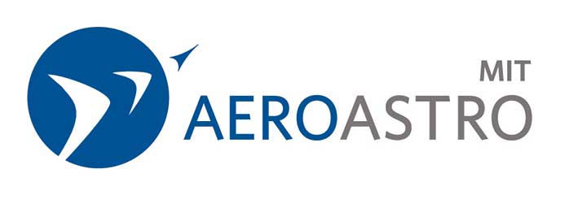

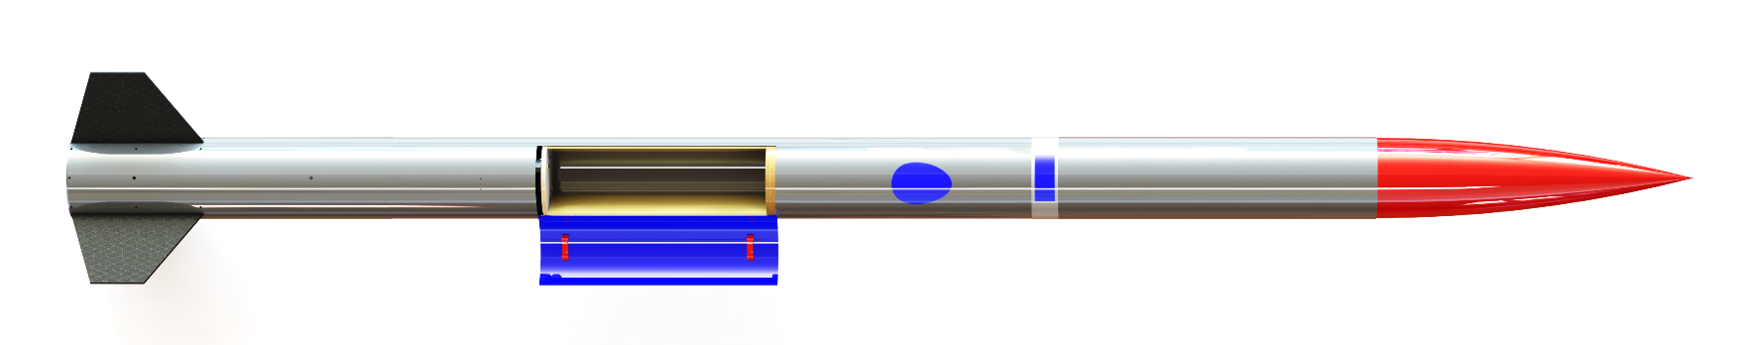
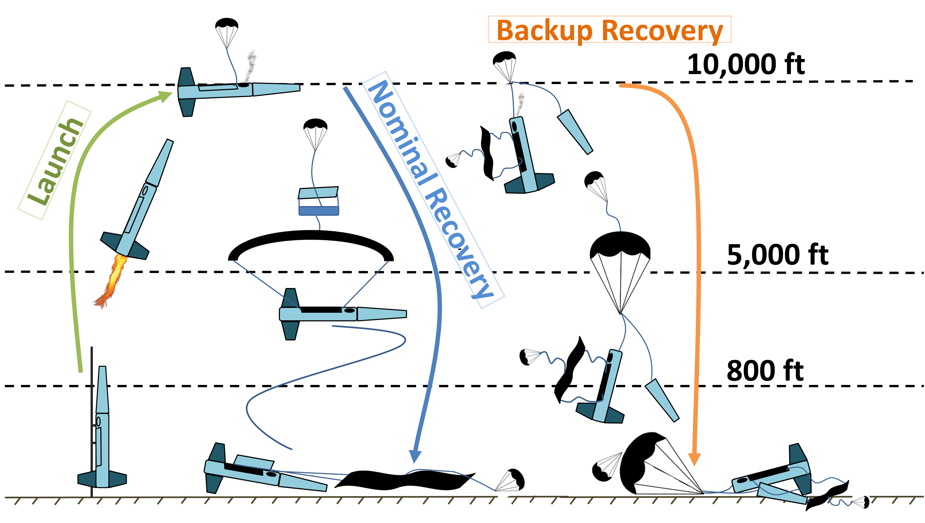
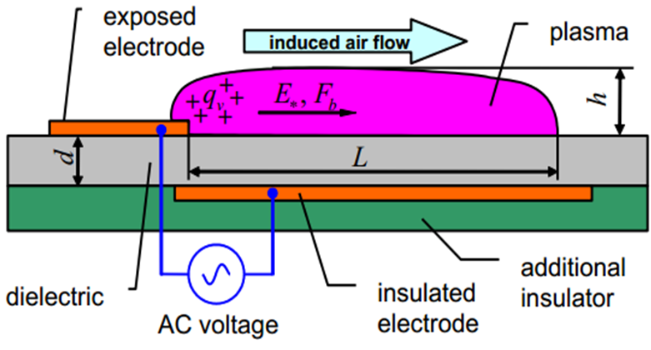
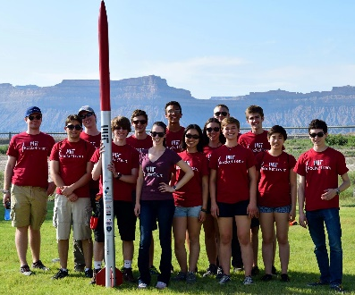
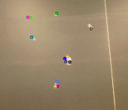
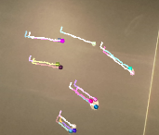
Project Therion
MIT Rocket Team’s entry in the Experimental Sounding Rocket Association’s
(ESRA) Intercollegiate Rocket Engineering Competition (IREC)
Competition Overview
IREC will be held June 2016 in Green River Utah. The team is competing in the Basic category. Points are awarded for minimum delta from 10,000ft apogee, ability to carry 10lbs of payload, payload scientific value, full recovery of the system, and a poster presentation.
Fin Can
Parafoil
Backup Recovery
Payloads
Rocket Specifications
Recovery Concept of Operations
Length: 10ft 2in
Diameter: 6in
Structure: Fiberglass, Carbon Fiber
Liftoff Mass: 57.3lbs (Dry: 46.7lbs)
Propulsion: COTS solid M3400
Max Acceleration: 14.9 G’s
Nominal guided recovery
  Deploy pilot chute at apogee
  Pyro rope cutters open hatch at 5000ft
  Parafoil is deployed
  Actuators control glide direction
  System lands in predetermined target location
Backup recovery
  Deploys if primary recovery failure
  Drogue deploy with nosecone separation
  Main parachute deploy at 800ft
Plasma Science Experiment
- Located on nosecone
- Operation during launch
- Dielectric barrier discharge
- Promote flow attachment
- 10% drag reduction potential
- 1-10kHz signal up to 20kV
OpenCV Optical Flow Experiment
Operation during glide
Camera faces the ground
Raspberry pi determines rotation rate
Team Overview
50 MIT affiliates (43 undergrad)
5 Subteams (Payload, Recovery, Structures, Avionics, Propulsion)
Lab provided by MIT AeroAstro

