Slide 1




Arecibo ISR Observations on March 17-19, 2015
Shunrong Zhang, Phil Erickson
MIT Haystack Observatory
Mike Sulzer
Arecibo Observatory

Slide 2
Outline
Dynamics: drifts, winds, and density
Diffusive equilibrium
ISR-TEC: topside and bottomside contributions
Light ions

Slide 3
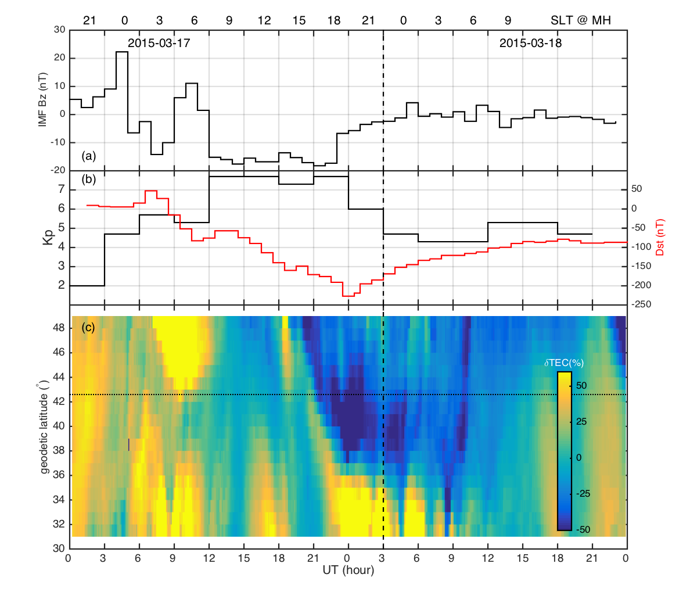
Zhang et al. (2015)

Slide 4
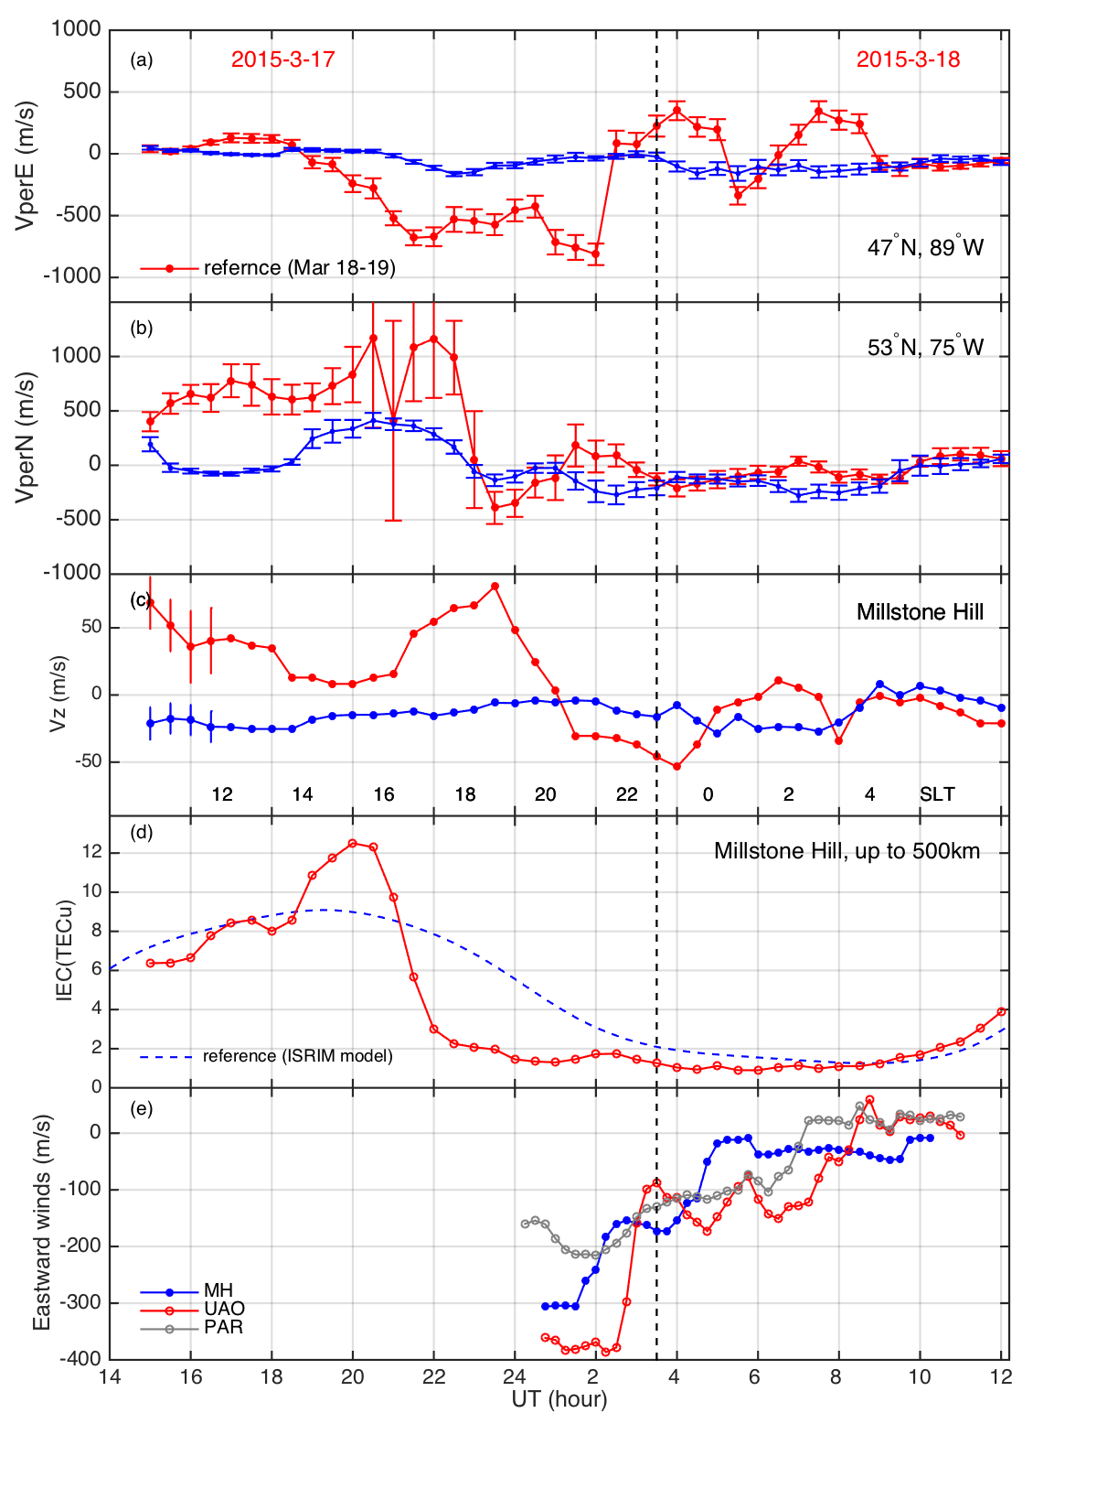
Millstone Hill ISR
Ion drifts
Vz
Vpar
VperN
horizon
VperE
B
Zhang et al. (2015)

Slide 5
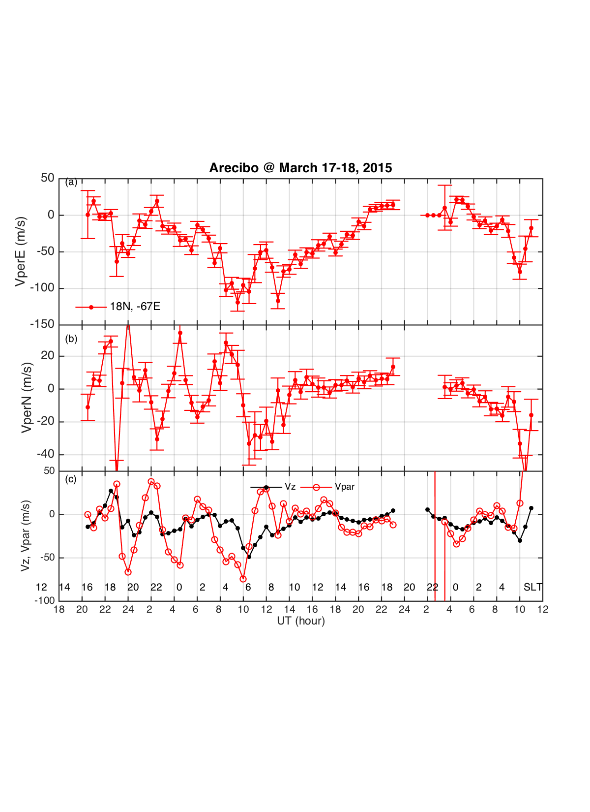
Vectors at 400km
Vz
VperN
horizon
VperE
B

Slide 6
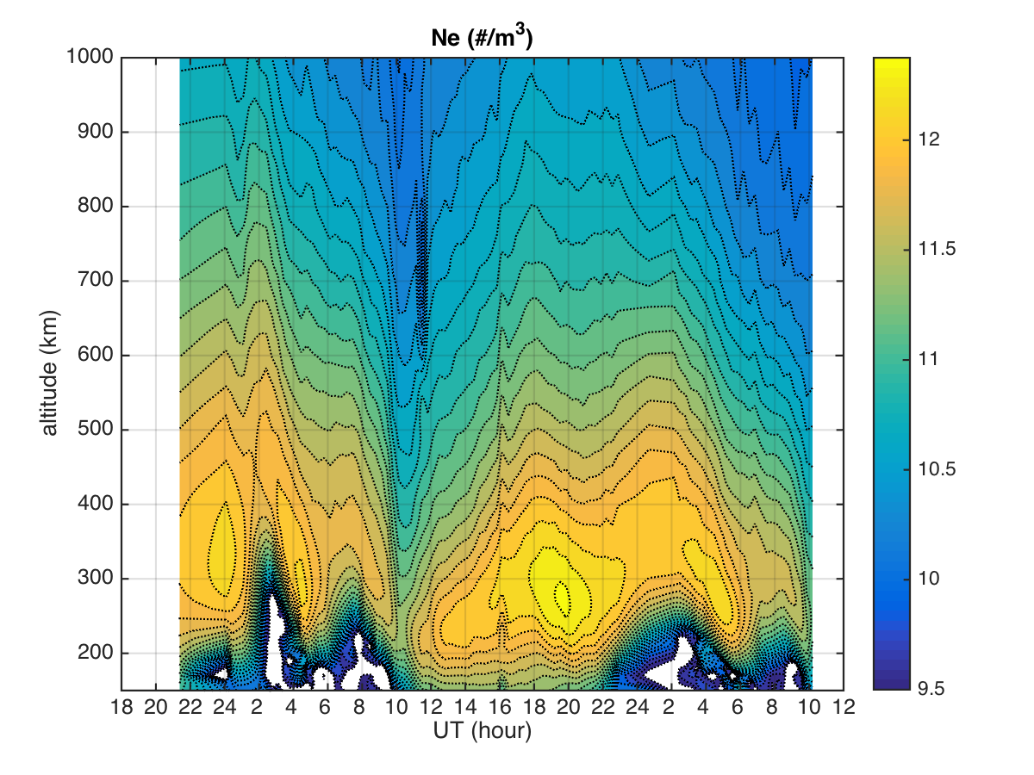

Slide 7
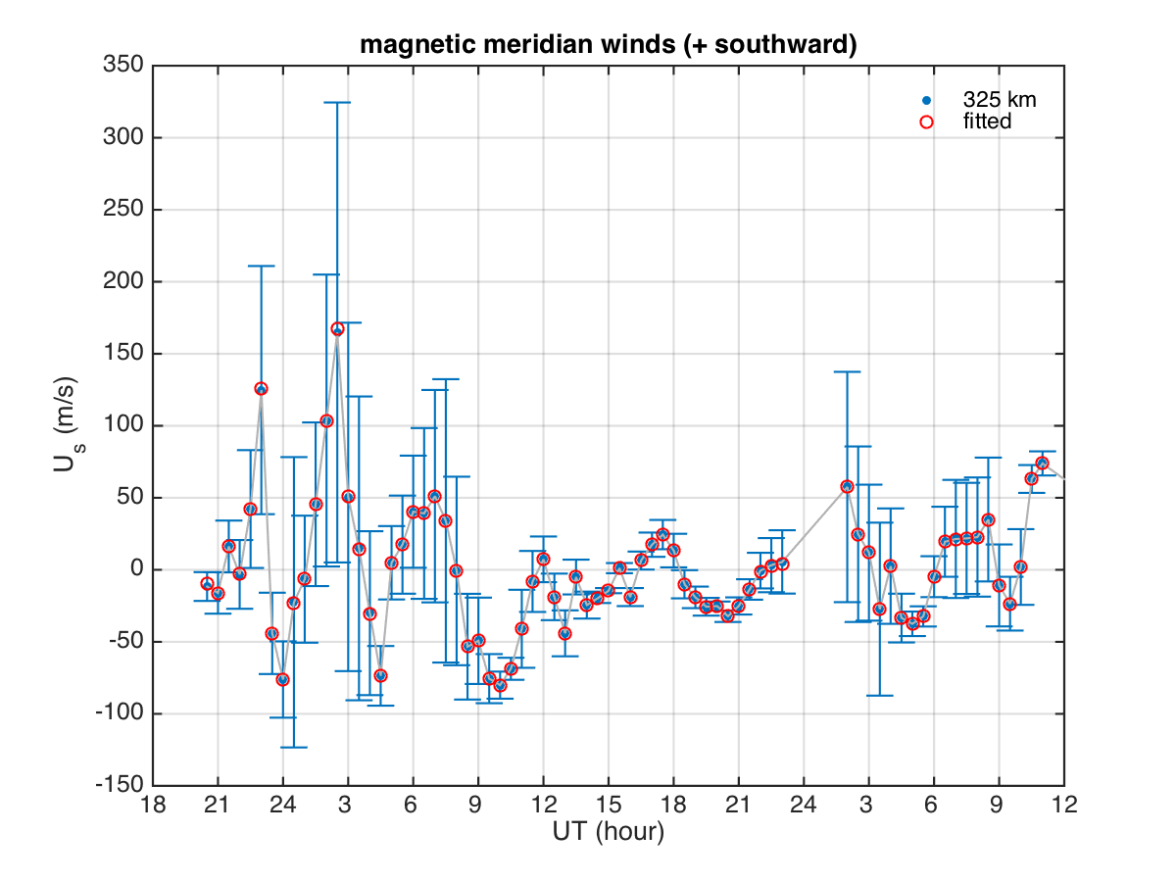
ISR based Meridional Winds (Southward +)

Slide 8
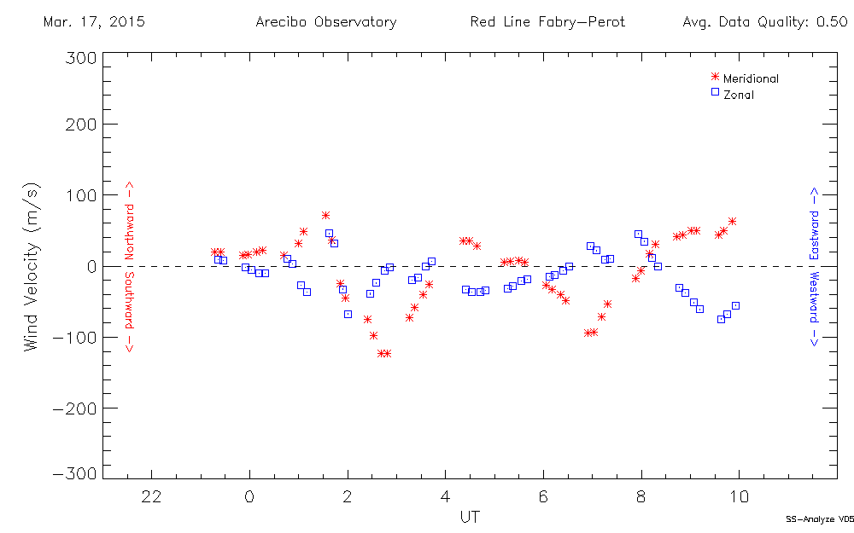
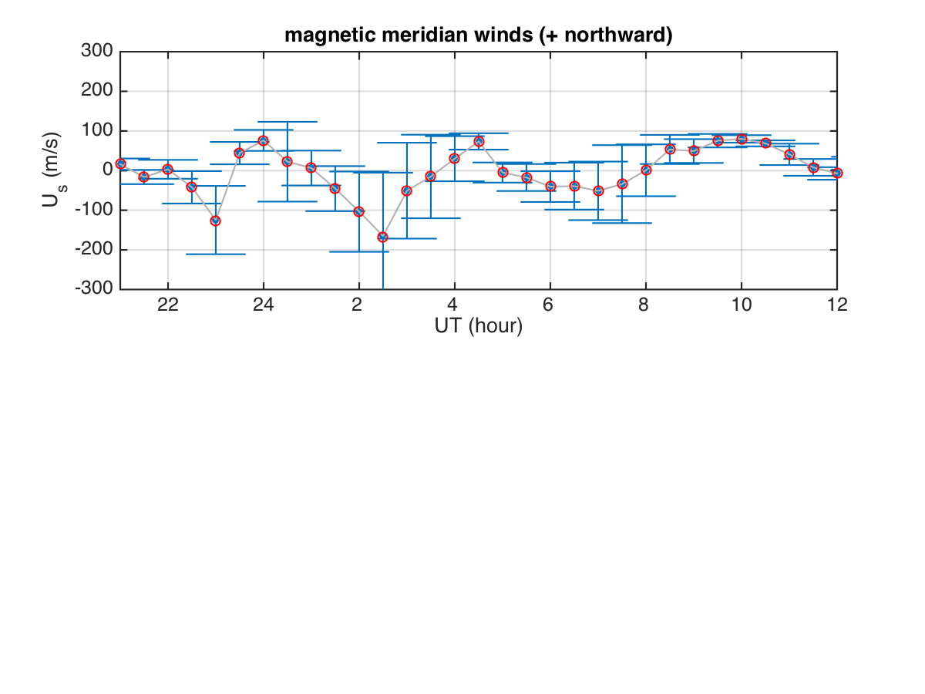

Slide 9
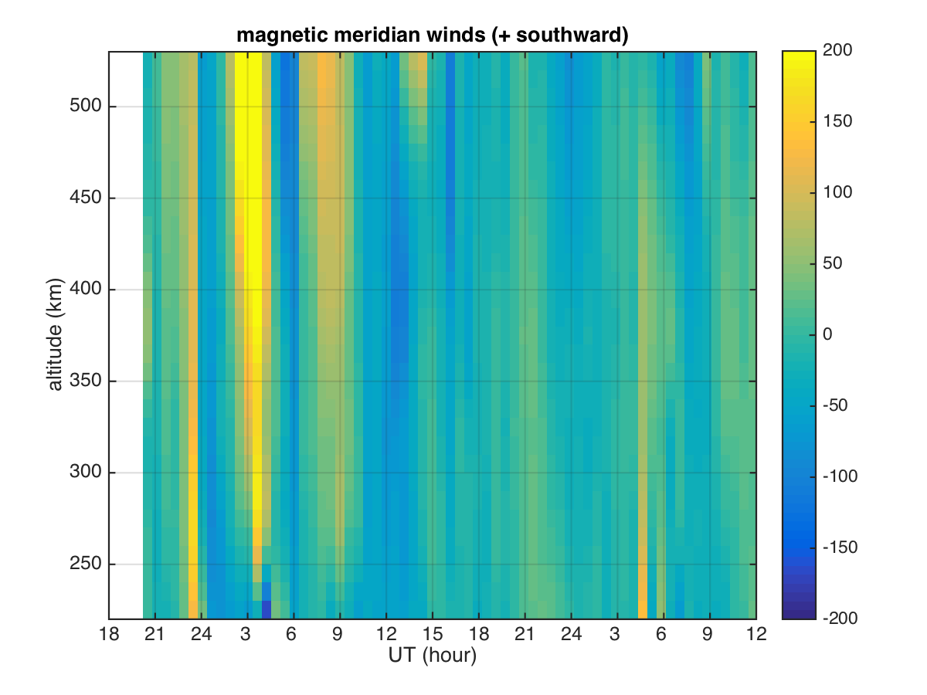

Slide 11
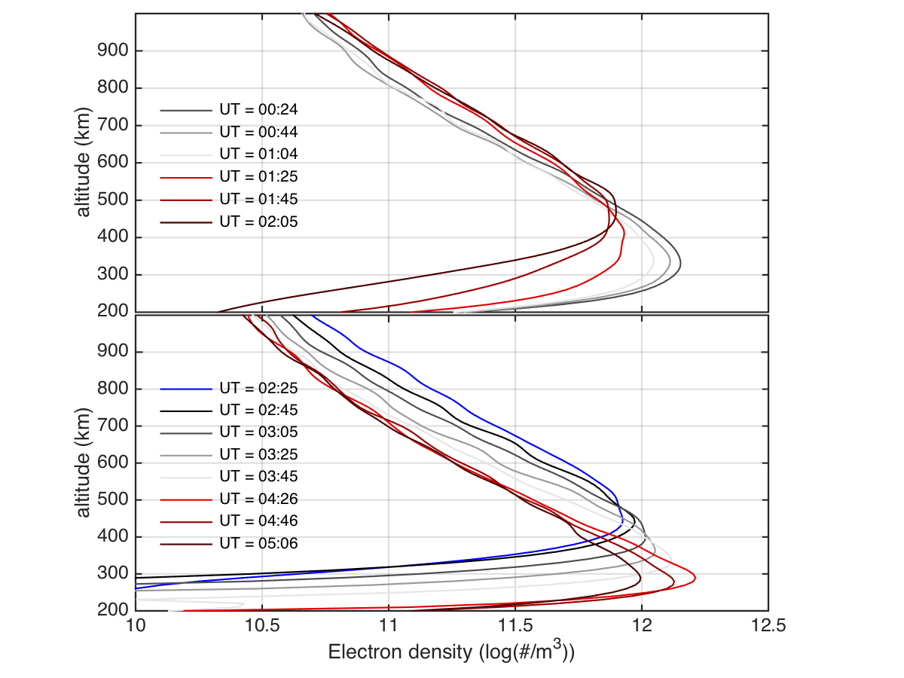
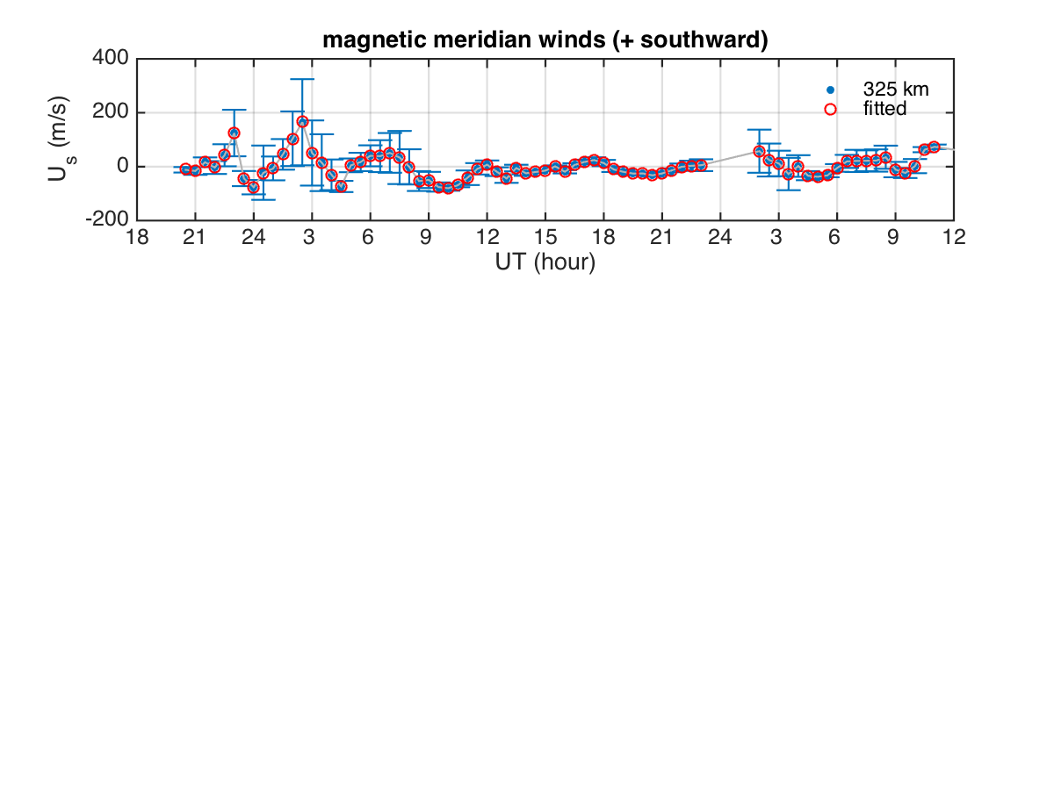
Winds & Ne Oscillations

Slide 12
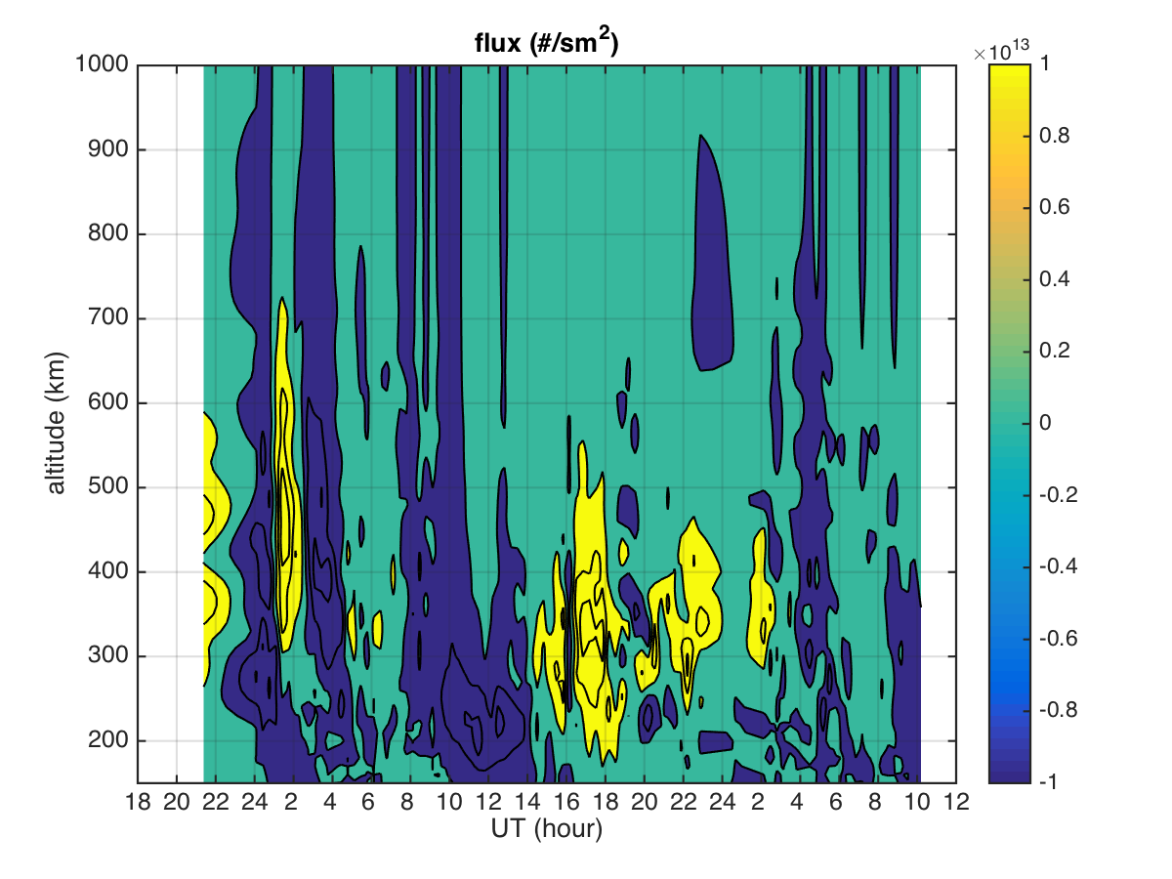

Slide 13
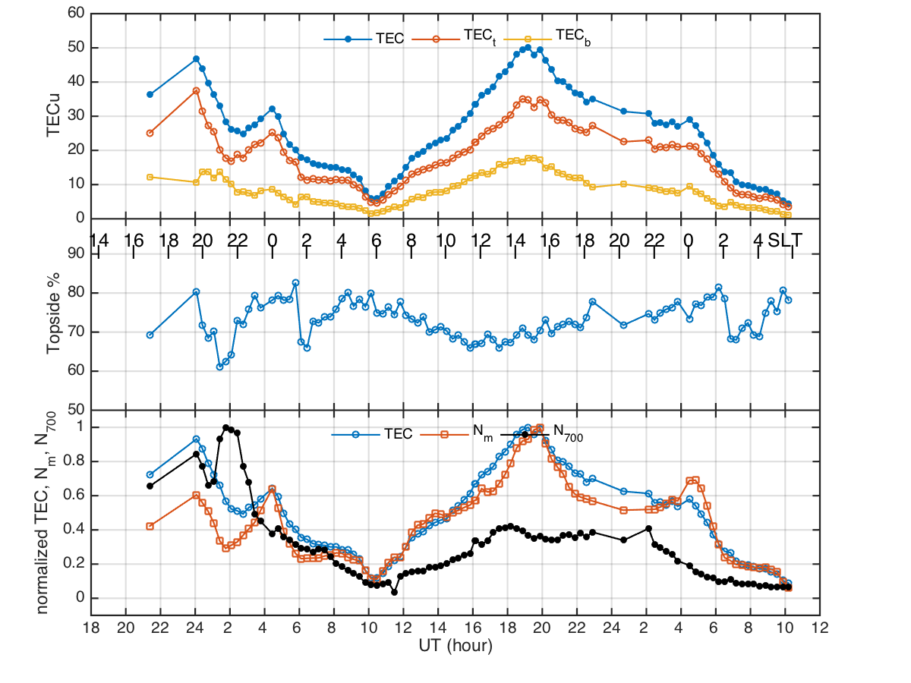

Slide 14
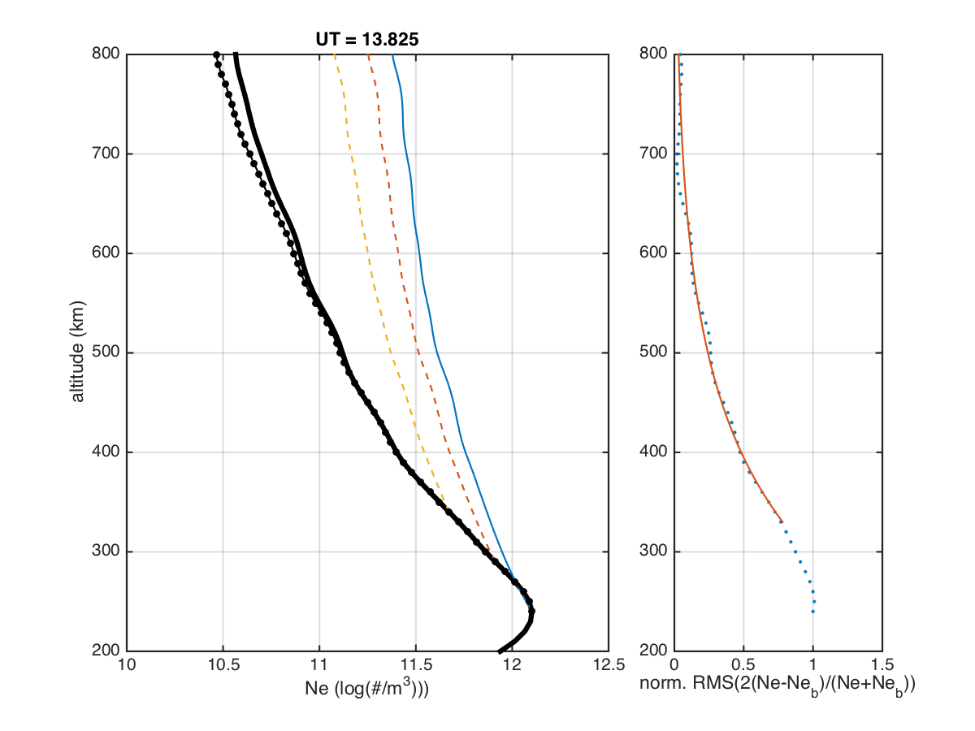
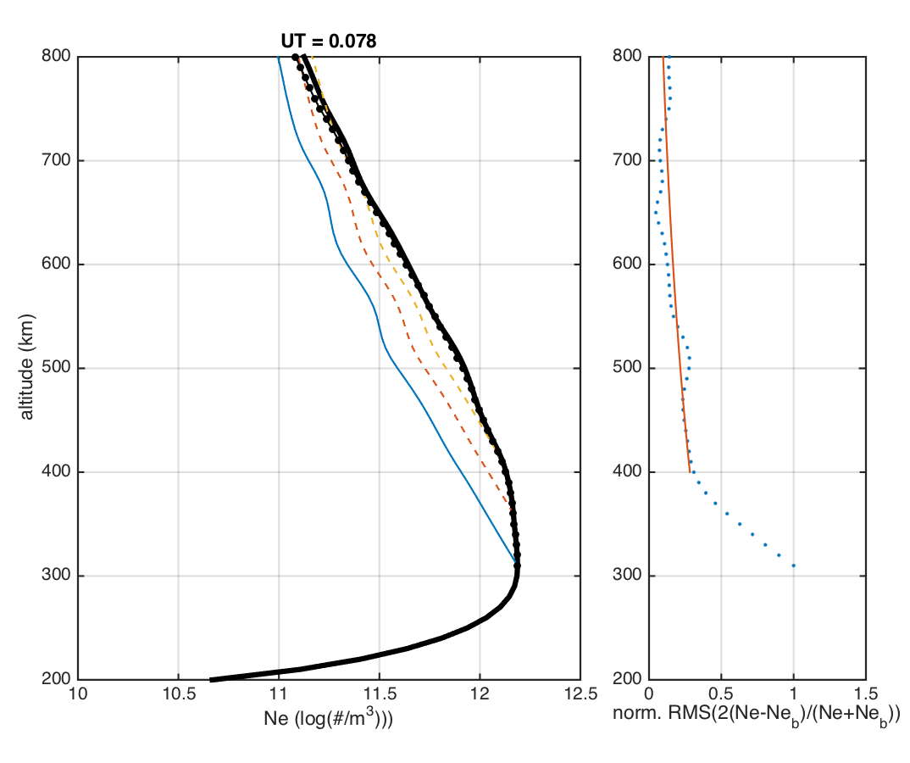

Diffusive equilibrium
N_{e} = N_{m} exp[-(z-z_{m})/H]
V_{d} ←→ Ne

Slide 15
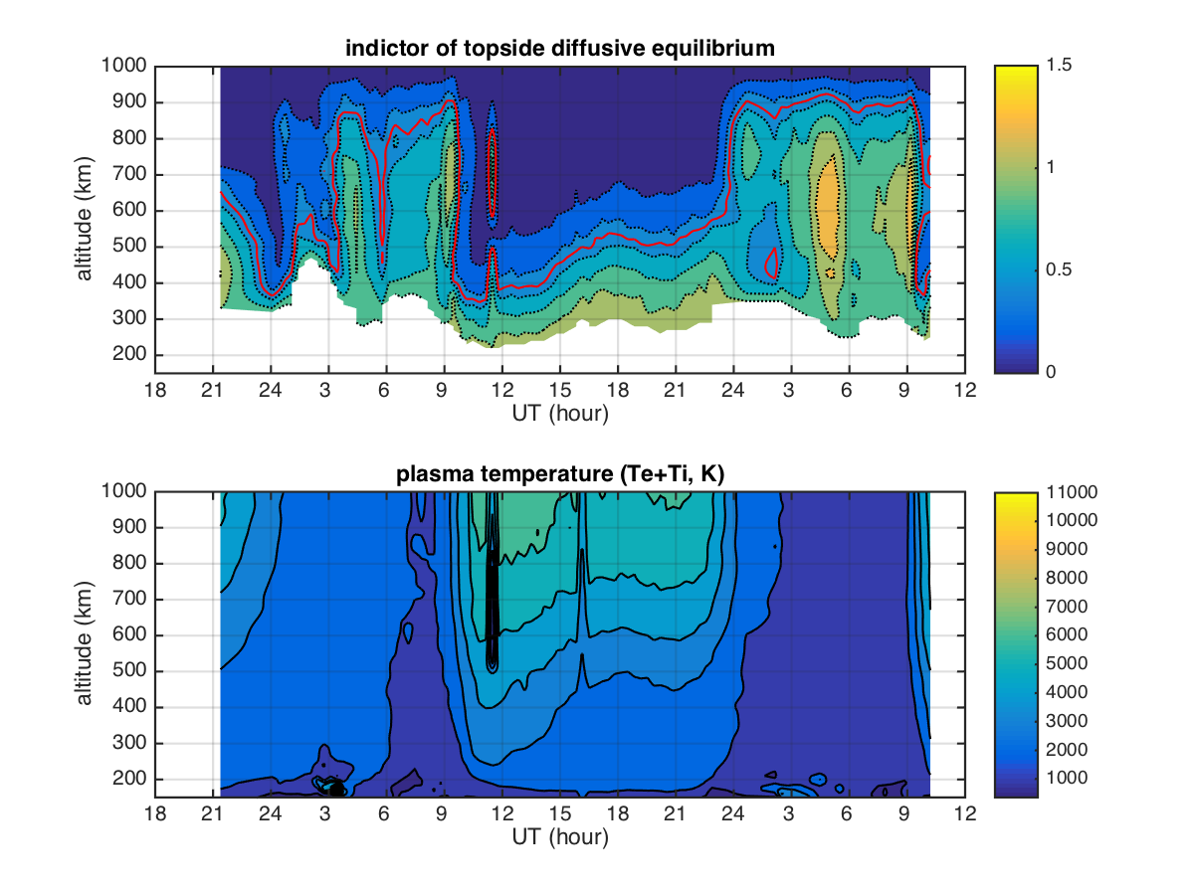

Slide 17
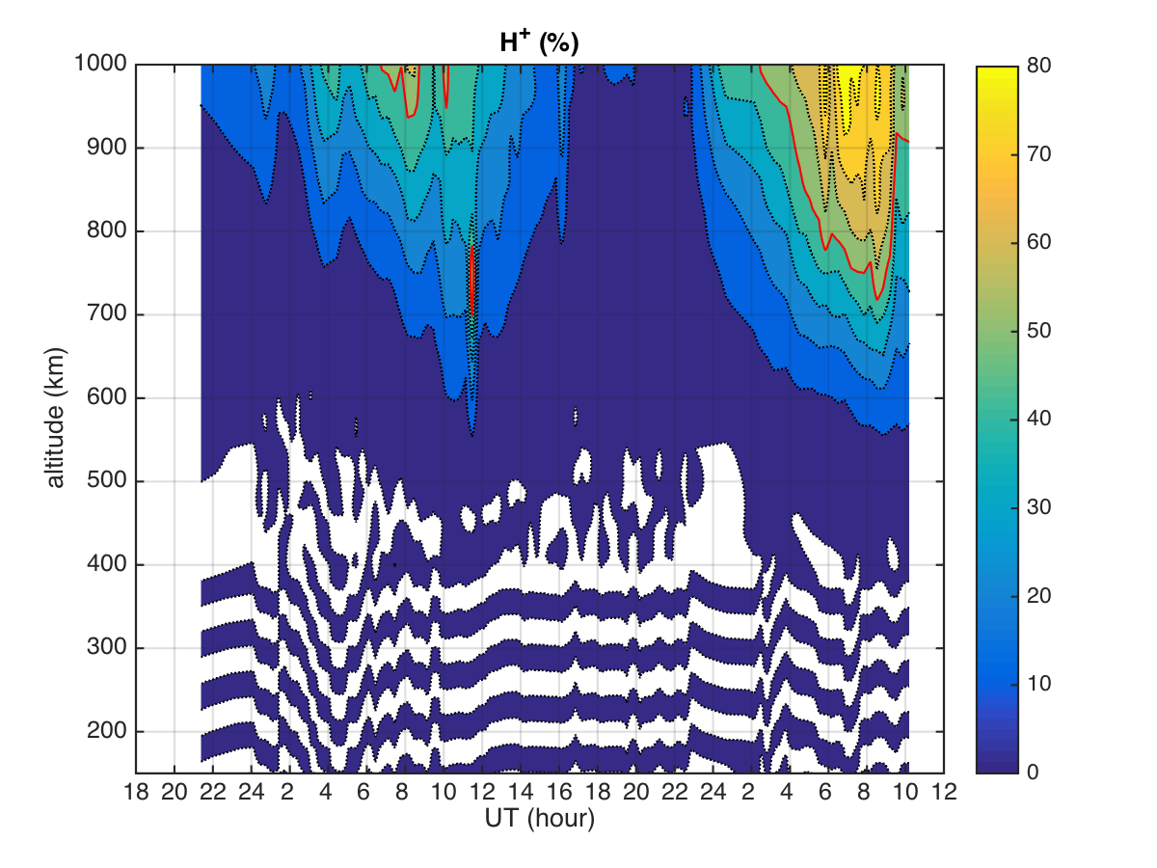

Slide 19
