Slide 1




SAPS influences on the subauroral ionosphere during the March 17-18, 2015 geomagnetic storm
Shunrong Zhang and Phil Erickson
MIT Haystack Observatory

Slide 2
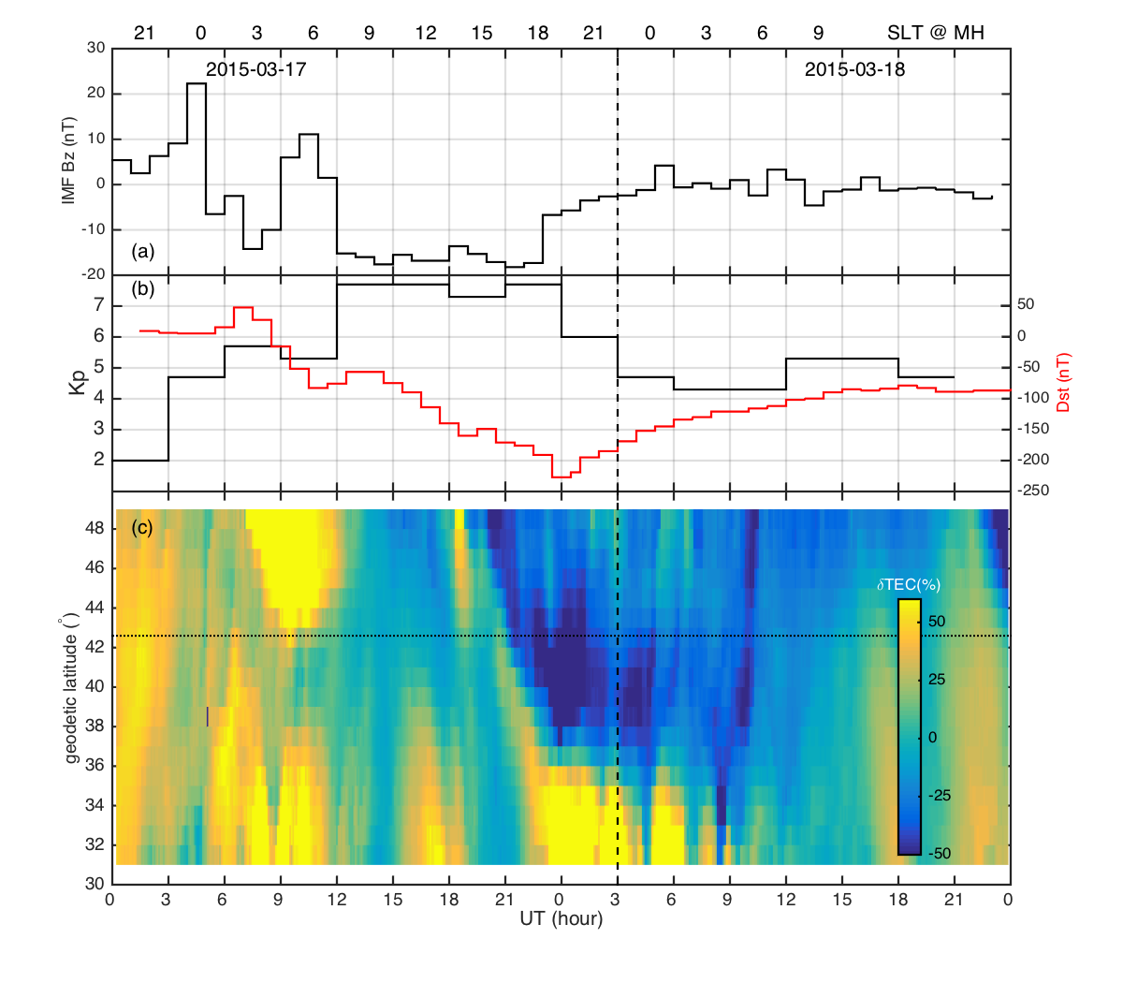
Zhang et al. (2015)

Slide 3
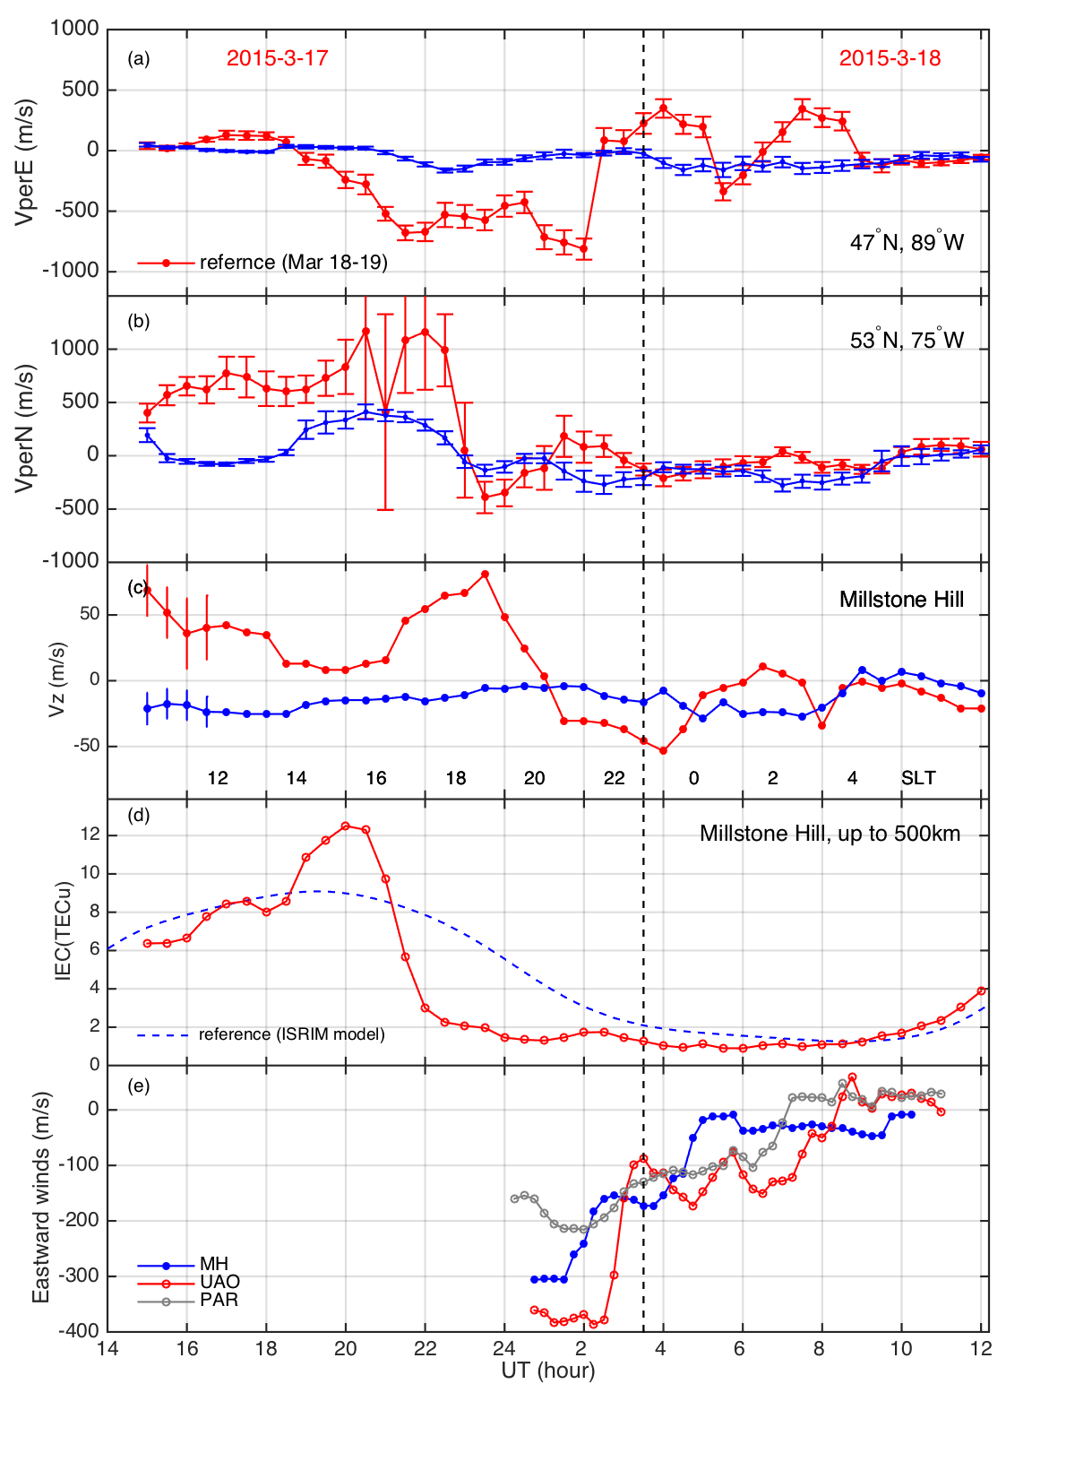
Millstone Hill ISR
Ion drifts

Slide 4
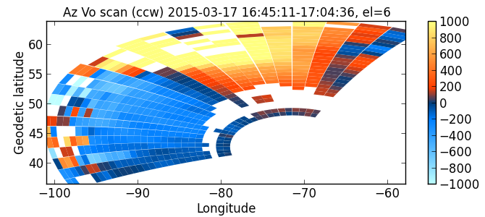
MH ISR Azimuth Scans

Slide 5
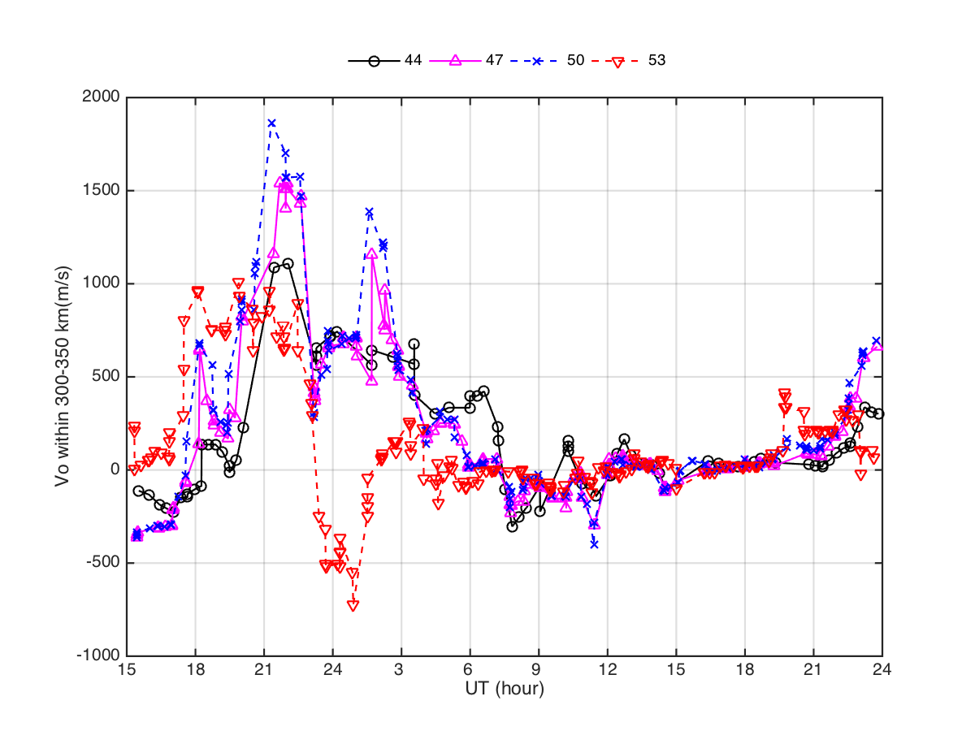
ISR LOS in SAPS (F2-region)

Slide 6
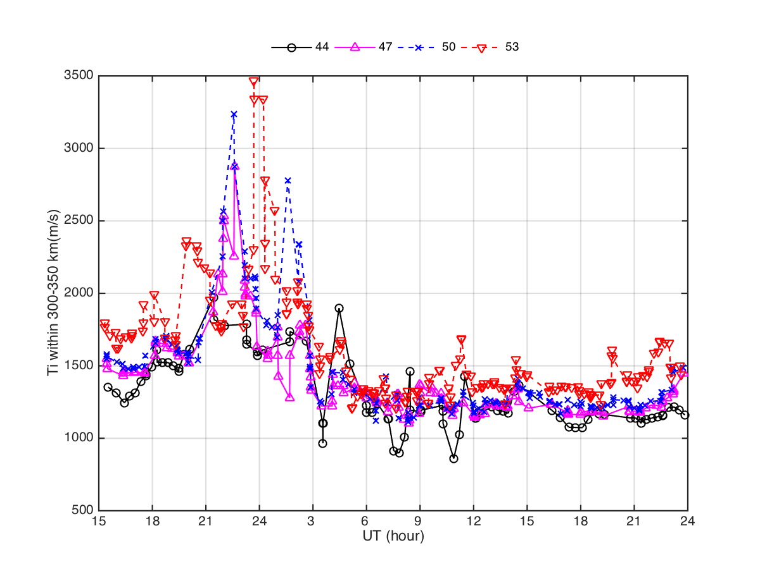
ISR Ti in SAPS (F region)

Slide 7
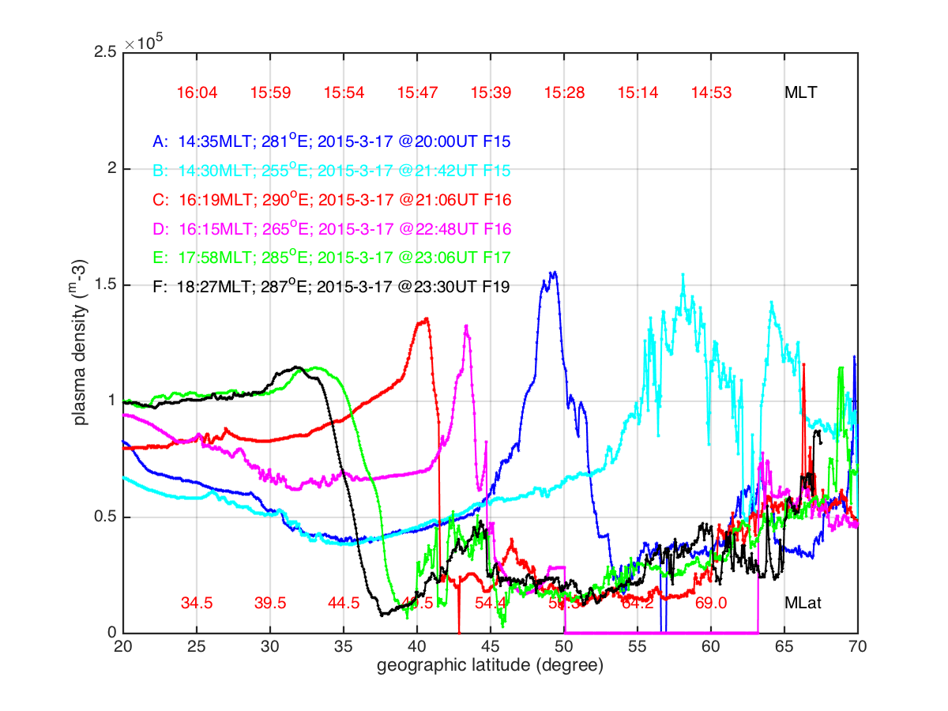
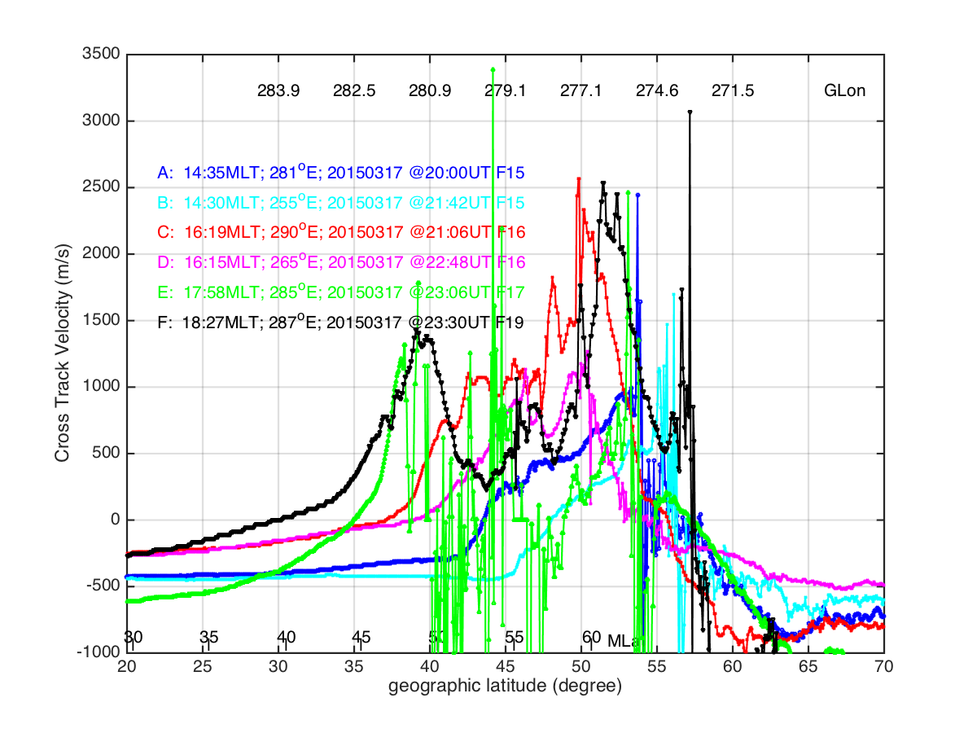

Slide 8
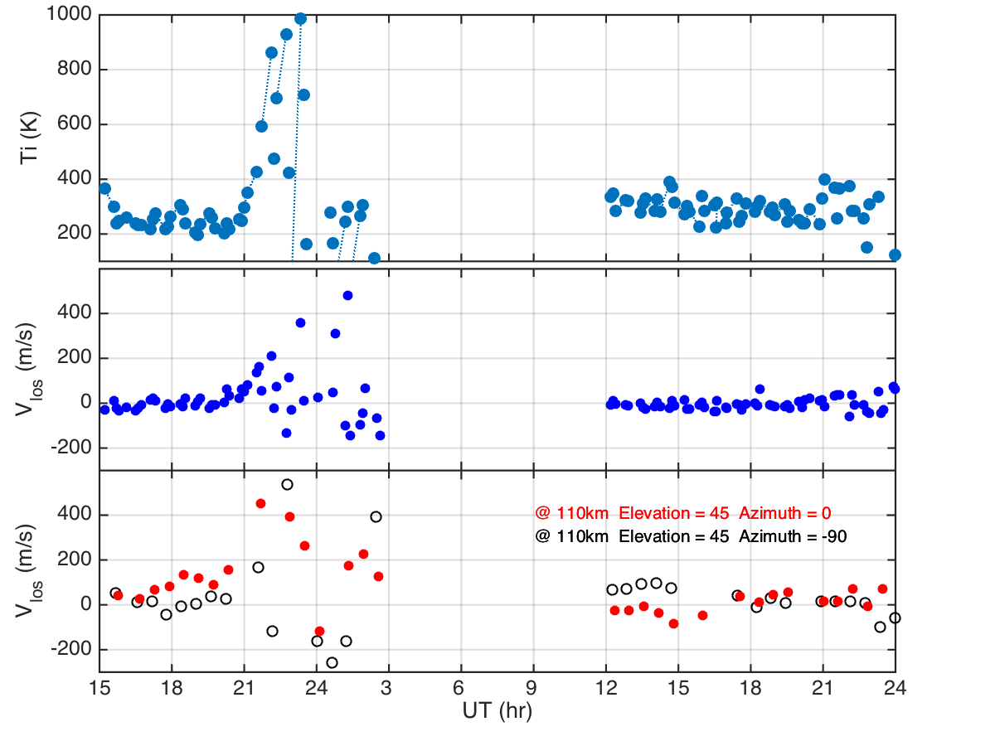
@110 km heating

Slide 9
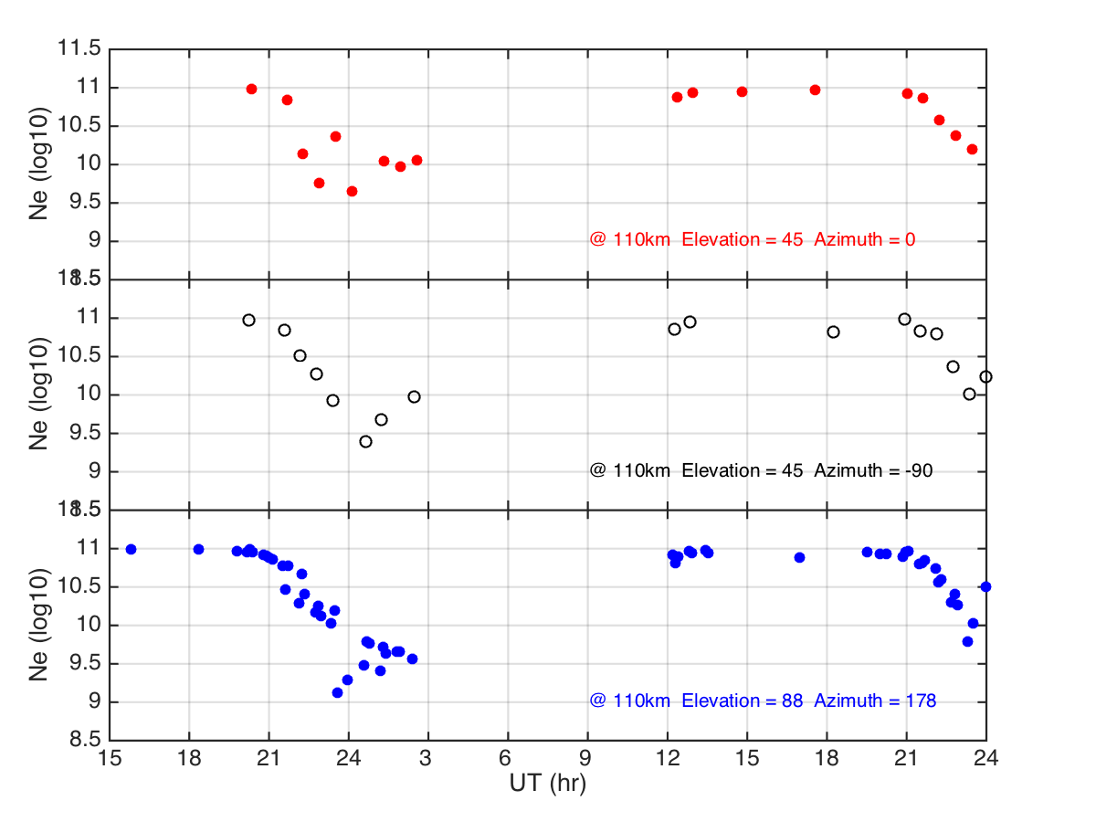
Ne @ 110 km

Slide 10
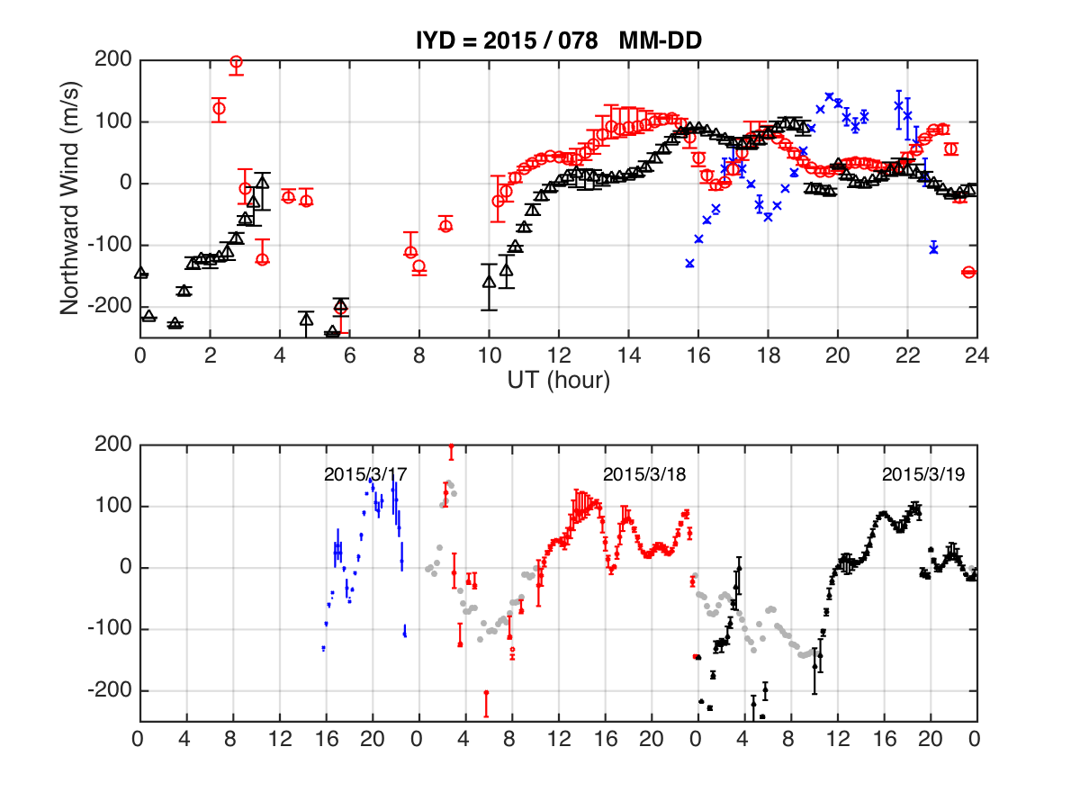
Millstone Hill Merdional Winds (+ northward)
Dayside Northward
Dayside southward

Slide 11
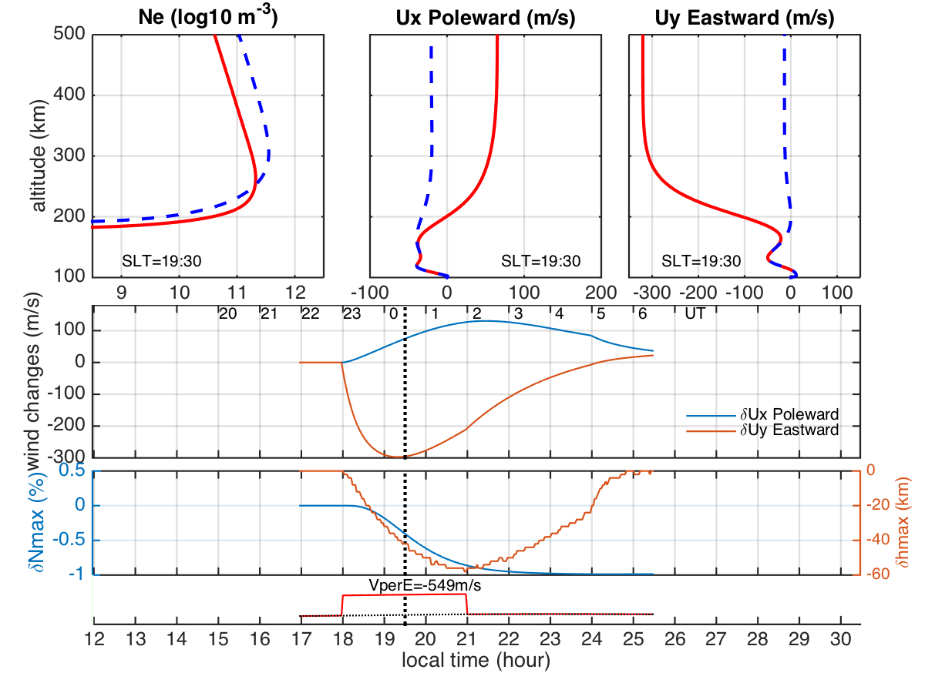

Slide 12
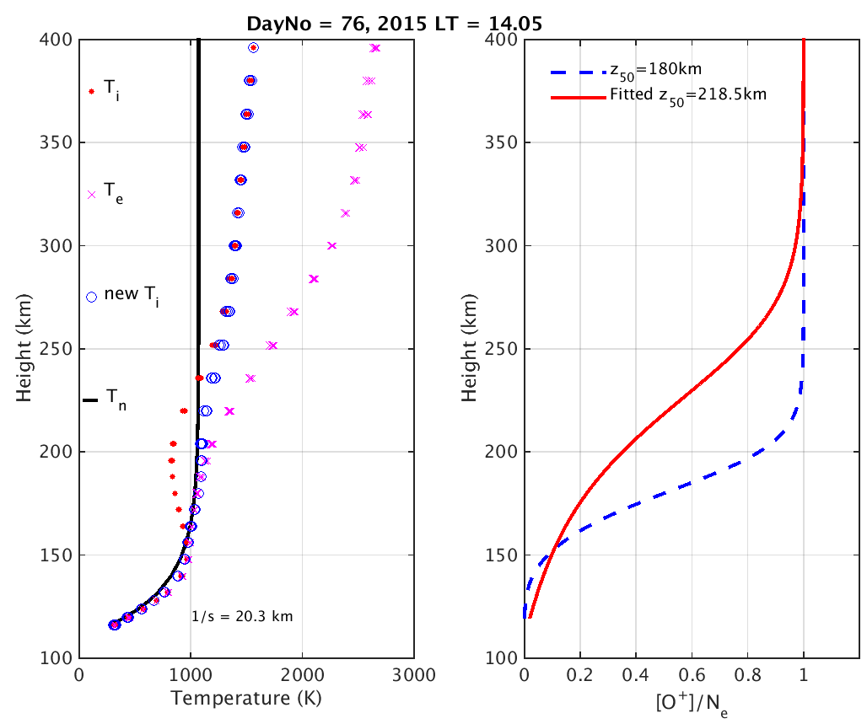
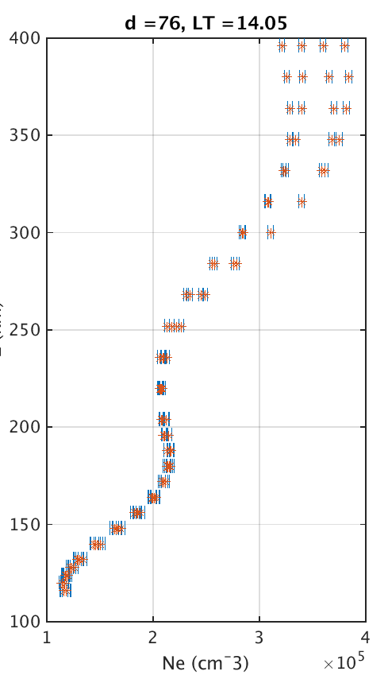
F1-region composition

Slide 13
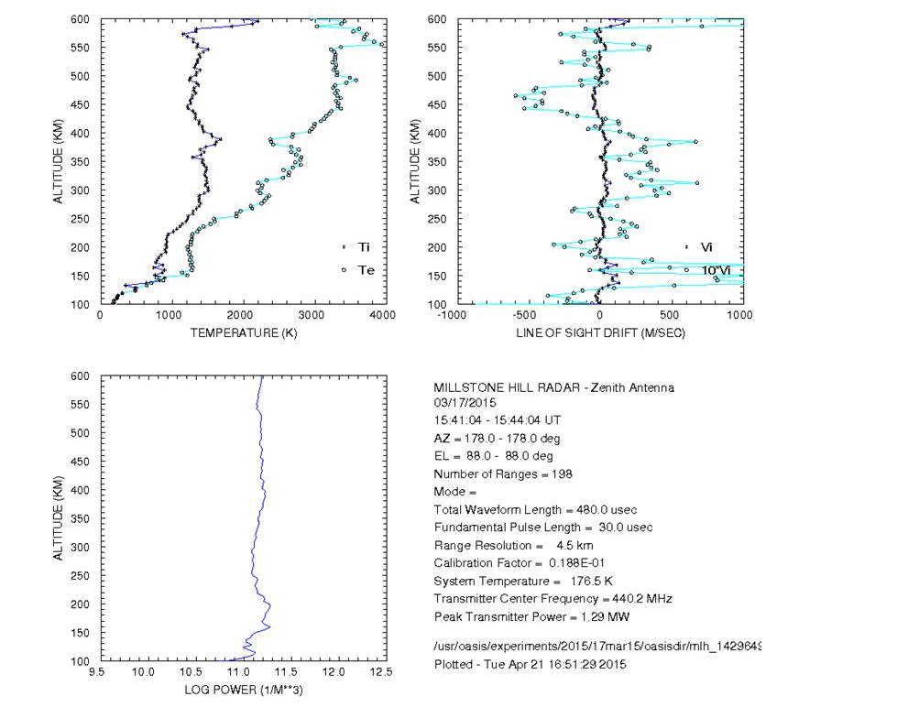
The G-condition

Slide 14
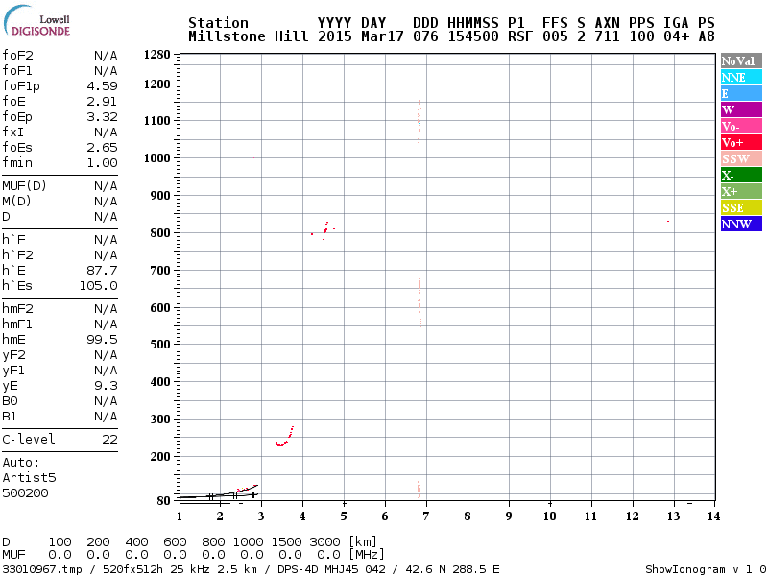

Slide 15
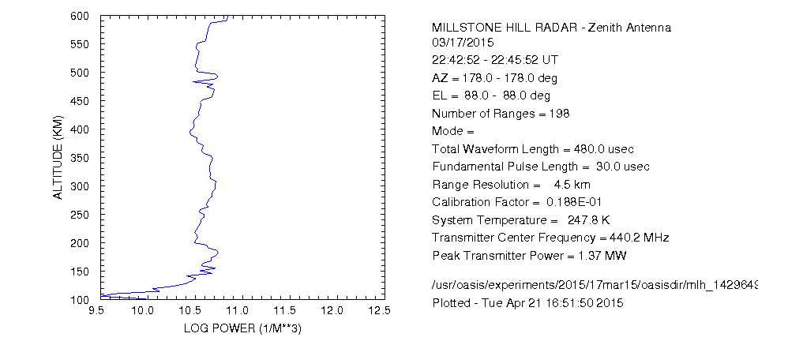
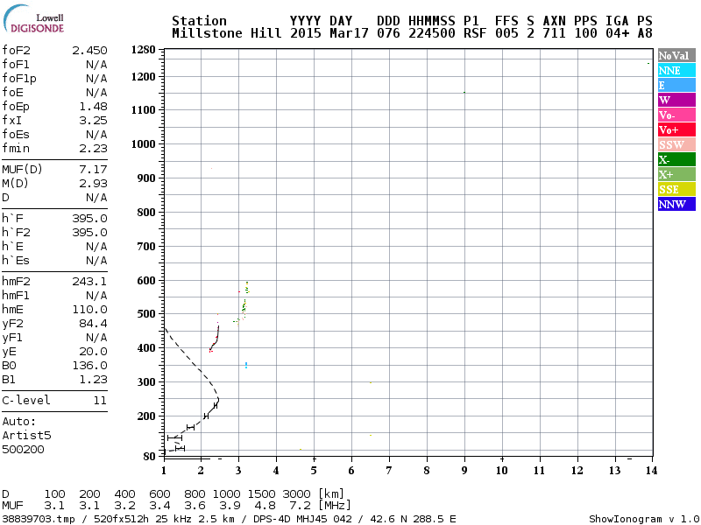

Slide 16
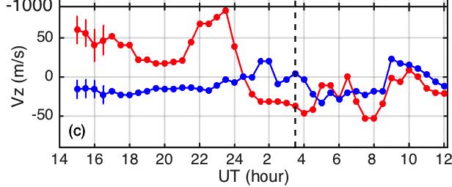
Ion drift at 200 km
March 17

