Slide 1


Slide 2
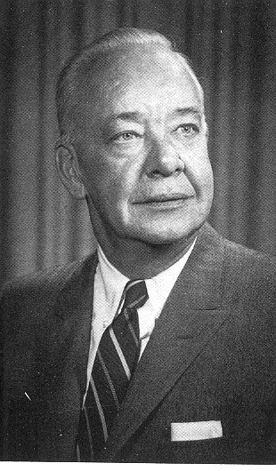
The Wulff Lecture honors the late Professor John Wulff, a skilled and provocative teacher who originated the popular subject 3.091 (Introduction to Solid State Chemistry).
Professor Wulff was an educator renowned for his ability to entertain while inspiring and educating.
Professor John Wulff

Slide 3
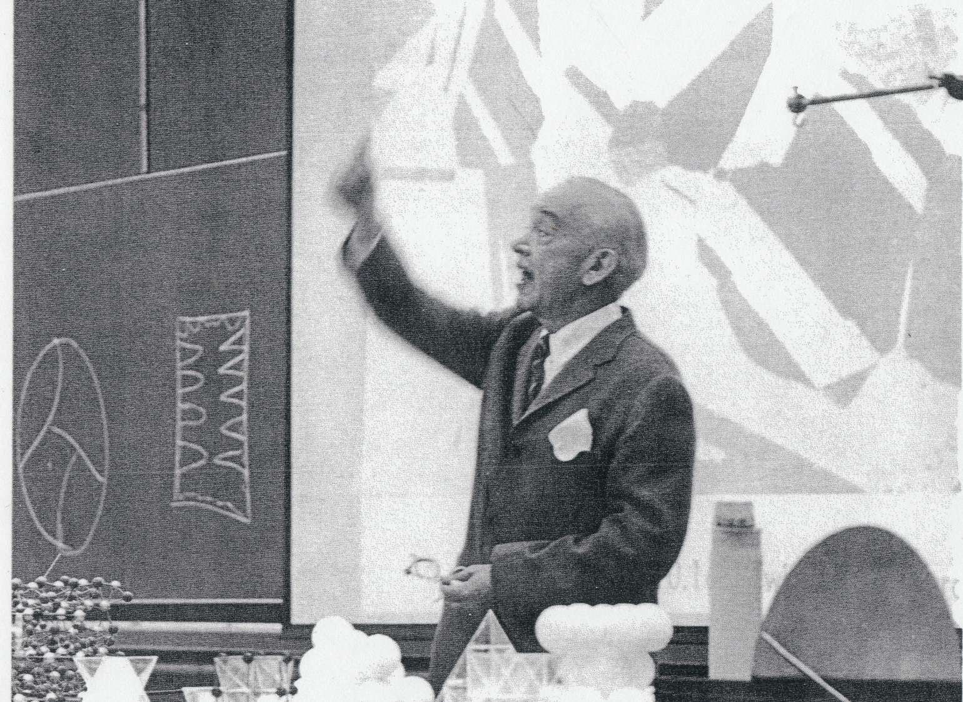
Prof. Wulff lecturing on solidification in 3.091
The mission of the Wulff Lecture is to engage the imagination of the next generation of Materials Scientists in the same way that Professor Wulff inspired his own students.

Slide 4
“Builders of Solid Matter”
Our medium is atoms, molecules
Our product is solid matter with desirable properties
Our applications include all the most pressing areas of human endeavor:
energy, nanotech, biotech, health, sustainability
Learn how to:
“vertically integrate” science and engineering
Master all methods of building with atoms: physics, chemistry, biology
Society
Properties
Structure
Processing
Science
Engineering

Slide 5
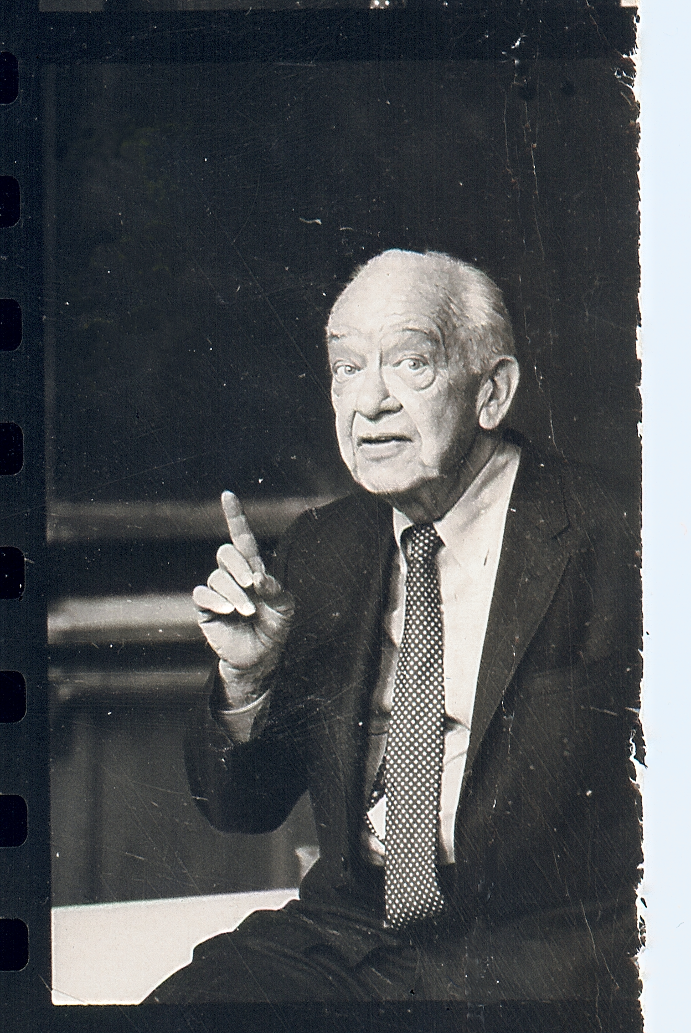
The first Wulff Lecturer — May 5, 1977

