Slide 1
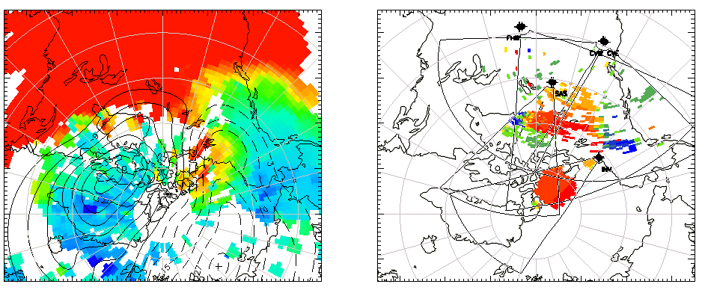
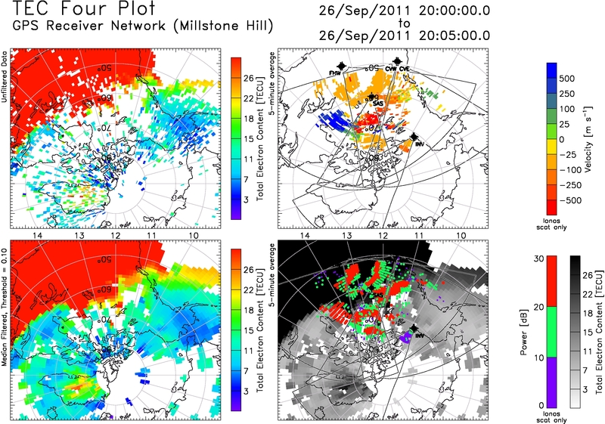
Relationship of Electric Fields to SED/TOI
Sep. 26th, 2011
19:00 UT
(solar noon)
(solar noon)
Tongue of ionization (TOI) seen entering dayside polar cap as channel of enhanced total electron content (TEC) during a strong geomagnetic storm on Sep. 26th 2011.
Strong anti-sunward flows measured by SuperDARN radars within the region of enhanced TEC at both middle and polar latitudes.

Slide 2
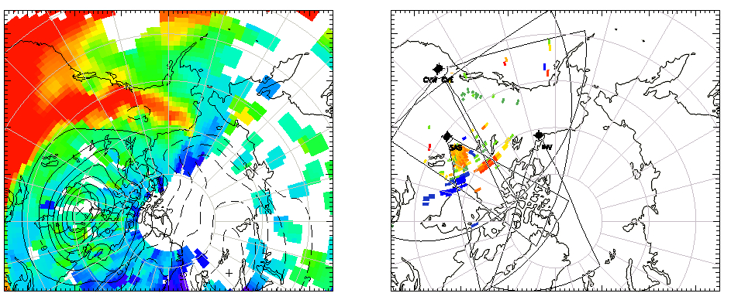
Relationship of Electric Fields to SED/TOI
Sep. 26th, 2011
23:00 UT
(solar noon)
(solar noon)
Convection electric fields no longer extend into middle latitudes to actively draw plasma from the dense source region at lower latitudes.
Plume of high TEC associated with storm enhanced density is no longer capable of forming a TOI, but co-rotates with the Earth at a near-constant latitude as a “fossil” plume as it persists for several hours.

