Slide 1
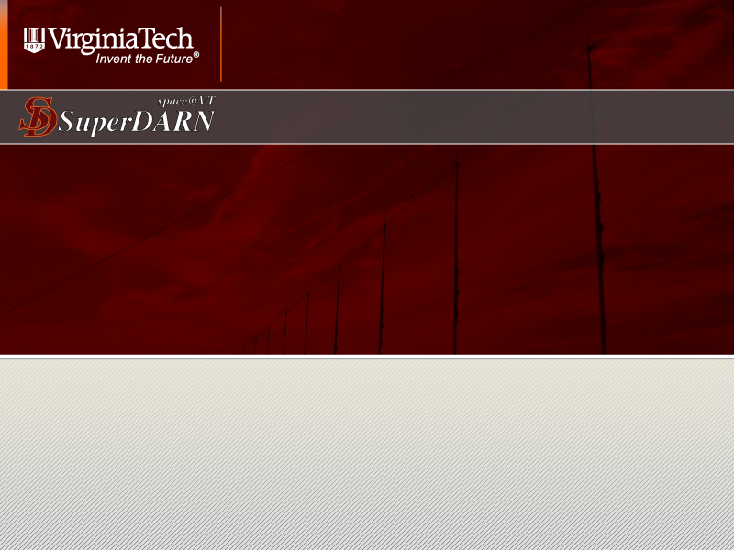
Recent Geospace Storms:
A SuperDARN Perspective
2012 CEDAR Workshop, June 24 – 29
Santa Fe, New Mexico
J. Michael Ruohoniemi, Sebastien de Larquier, A J Riberio and Evan Thomas
Virginia Tech, Blacksburg, Virginia, USA

Slide 2
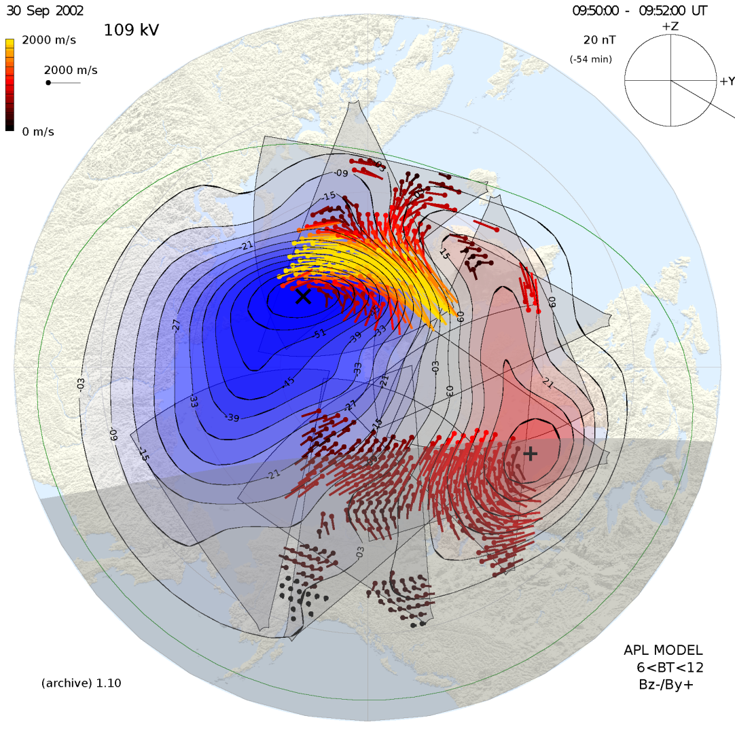
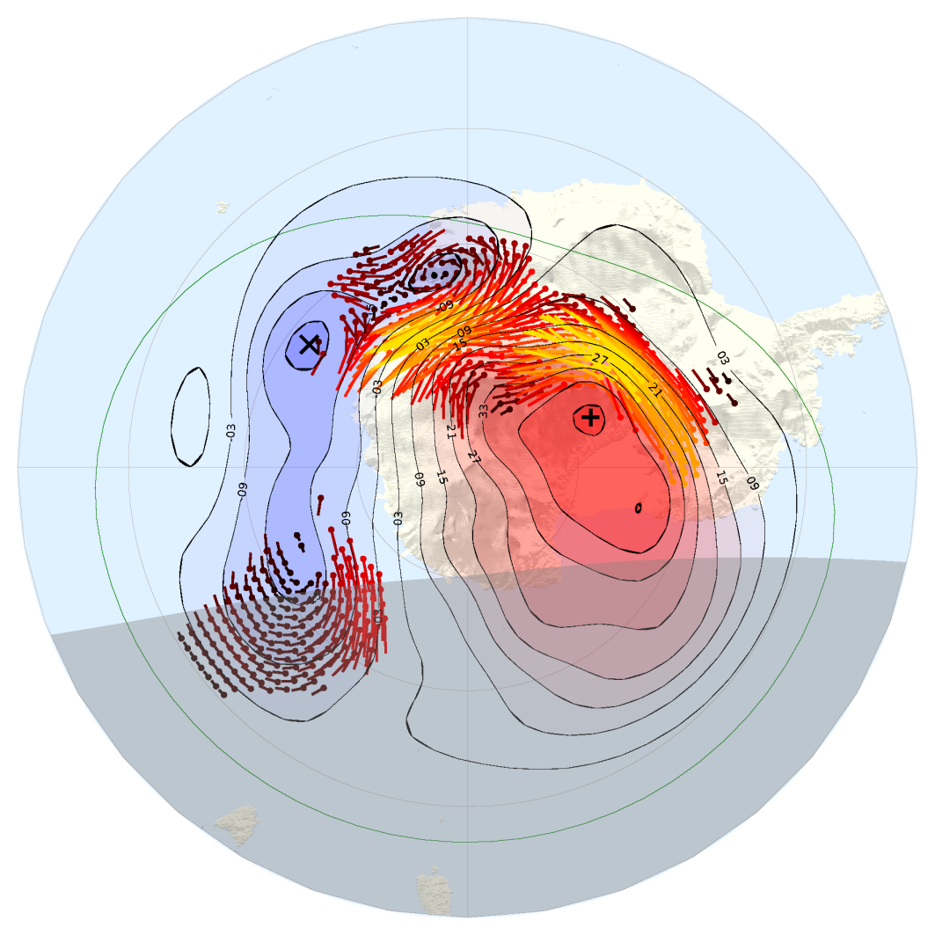
Simultaneous conjugate convection patterns
SD Radars in China
September 30, 2002: 09:50 – 09:52 UT
Northern Hemisphere
Southern Hemisphere

Slide 3
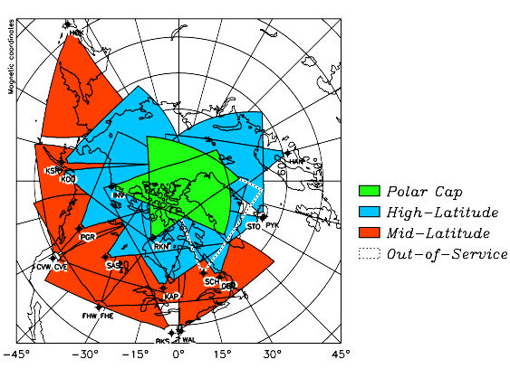
SuperDARN – Northern Hemisphere
SD Radars in China

Slide 4
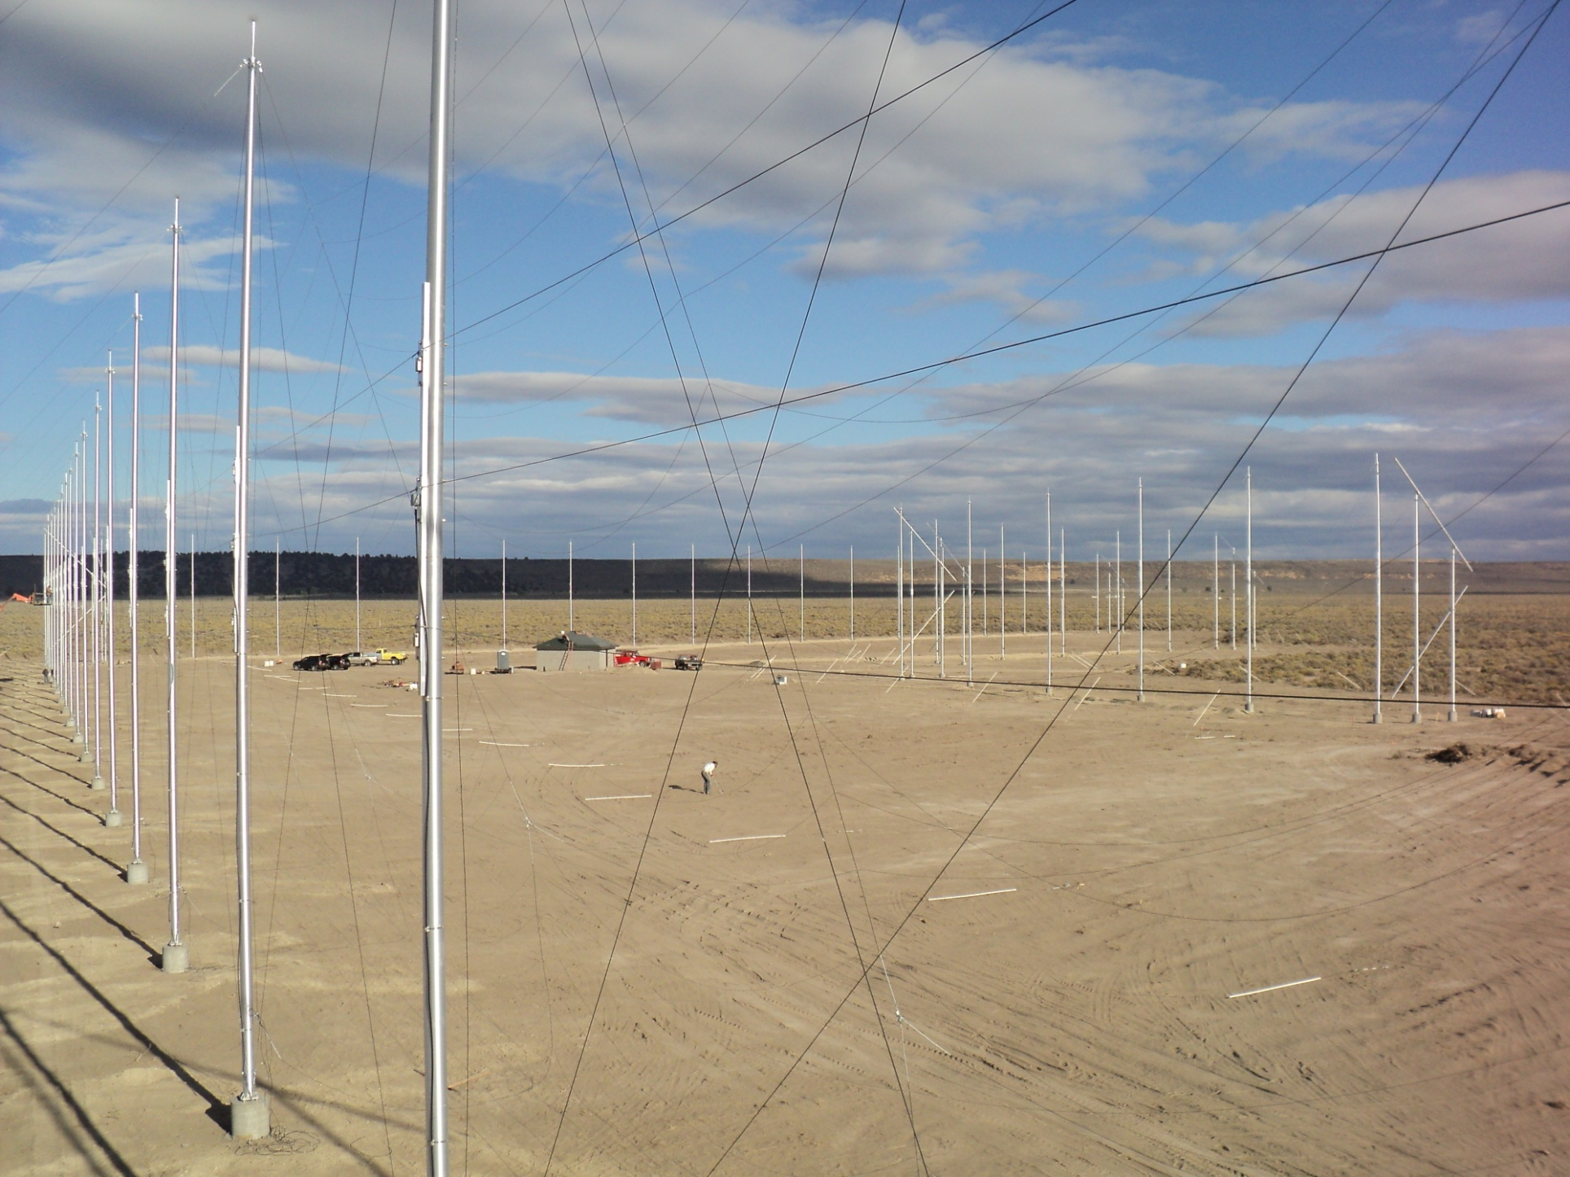
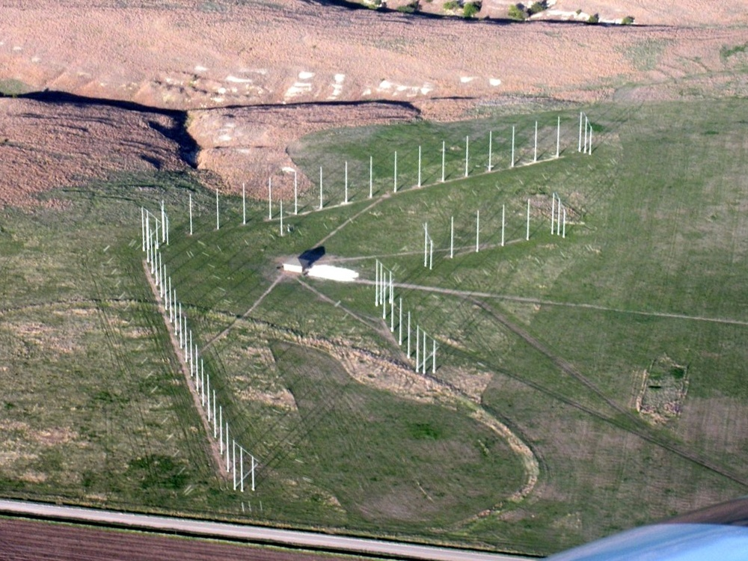
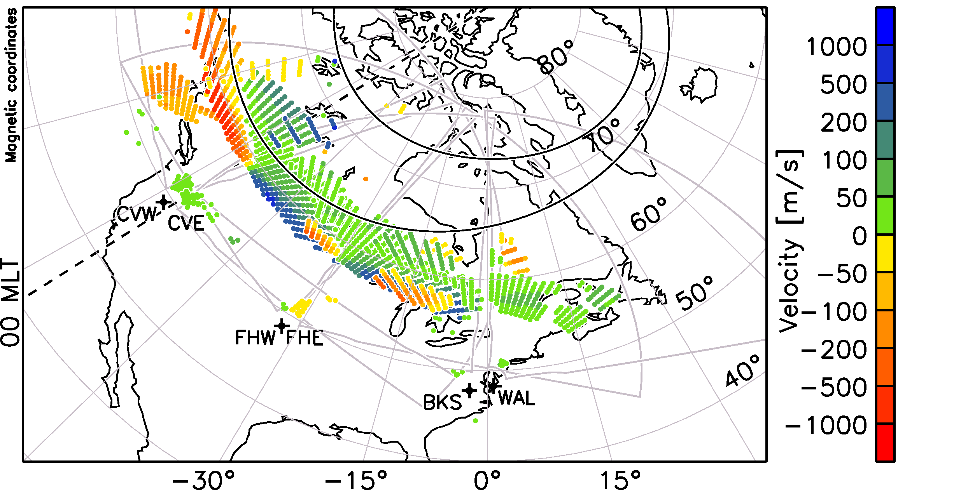
NSF MSI SuperDARN
Storm–time example:
Extended, Instantaneous Imaging of a SAPS Flow Channel
Christmas Valley, OR
Hays, KS
First extended, instantaneous image of a SAPS event recorded on March 9th, 2011 at 08:40 UT. Line-of-sight velocities are shown.
Map of Line-of-Sight Velocities for 08:40 UT, March 9th, 2011

Slide 5
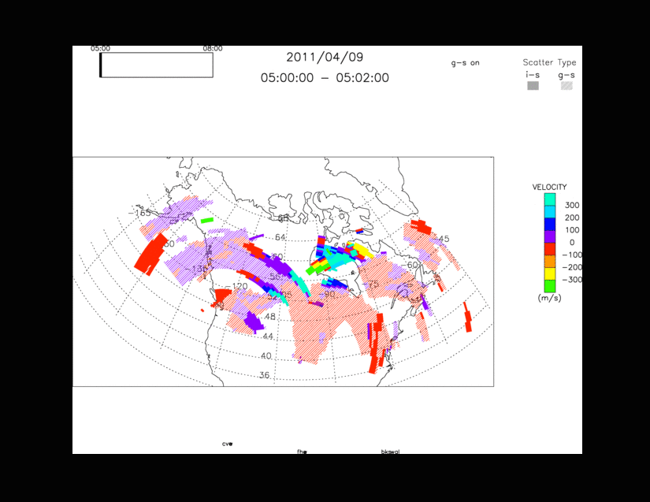
Onset of a geomagnetic storm and SAPS event
SD Radars in China

Slide 6
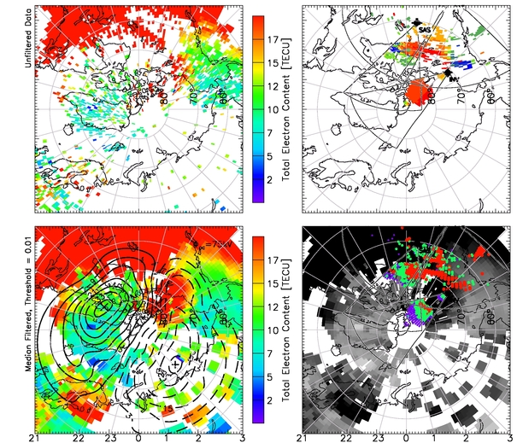
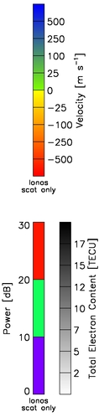
Relationship of Electric Fields to SED/TOI
SD Radars in China
Sep. 26th, 2011
19:00 UT
Tongue of ionization (TOI) seen entering dayside polar cap as channel of enhanced total electron content (TEC).
Strong anti-sunward flows measured by SuperDARN radars within the region of enhanced TEC at both middle and polar latitudes.

Slide 7
SuperDARN: New Capabilities
SD Radars in China
With the build of the MSI chain of mid-latitude SuperDARN radars, now able to image storm effects from the pole to mid-latitudes in the North American sector
Recent storm periods have been productive in generating continental-scale observations of SAPS lasting many hours
Other notable observations of storm effects at mid-latitudes include:
  the formation of SEDS and TOIs
  sudden vertical motion of the ionosphere

Slide 8
Geospace Storms: Research directions?
SD Radars in China
Exploit the expanded instrument coverage over North America to study geospace storms ITM effects through the current solar cycle maximum
Identify a research theme or themes that make best use of the instrumentation and coordinate observations
Convene a CEDAR ‘Geospace Storms’ working group to plan experiments and to convene CEDAR workshops through the current cycle
Explore connections (Systems Science) to GEM RBSP, etc.

