Slide 1

Significance of the altitudinal distribution of magnetospheric energy inputs to the upper atmosphere
Yue Deng, Arthur Richmond, Delores Knipp, Jeffrey Thayer
CEDAR, June 2012

Slide 2
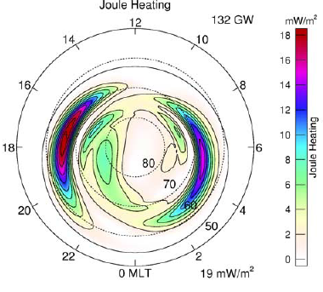
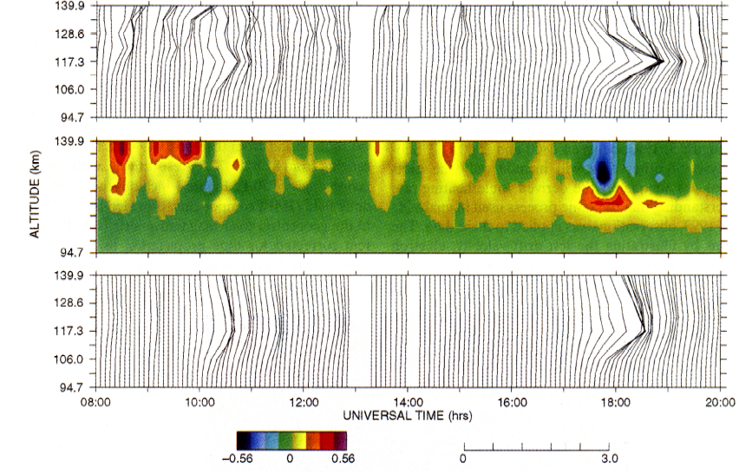
Motivation: 3-D distribution
[Weimer, 2005]
[Thayer, 1998]
The studies of magnetospheric energy inputs have been devised primarily in 2-D (e.g. the altitude-integrated Joule heating)
Attention has been paid to the altitude resolved Joule heating at E-region altitudes

Slide 3
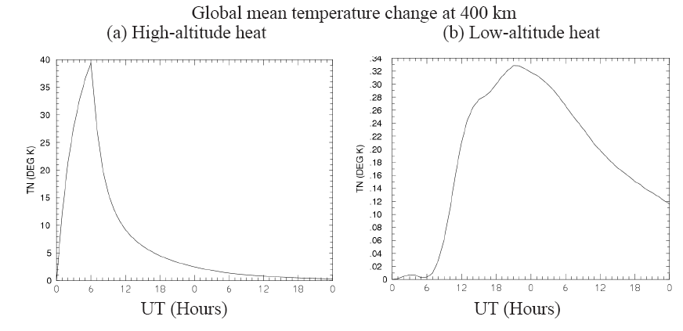
Tn response (TIEGCM)
Courtesy of Arthur Richmond.
Global-mean temperature change at 400 km altitude for two TIE-GCM runs with identical total Joule heating between 0 and 6 UT.
(a) heating input at heights 225-325 km; (b) 108-138 km.

Slide 4
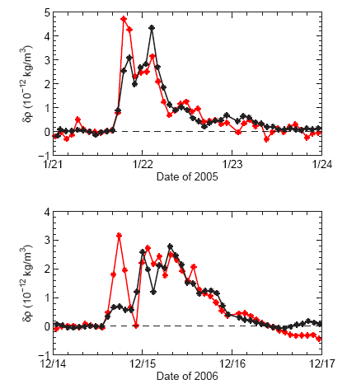
Neutral density (CHAMP)
[Thayer, 2010]
Density from CHAMP for Jan 21 2005 and Dec 14 2006 storms
high latitude (MLat > 60⁰) orbit-averaged density for local summer (Red) and winter (Winter).

Slide 5
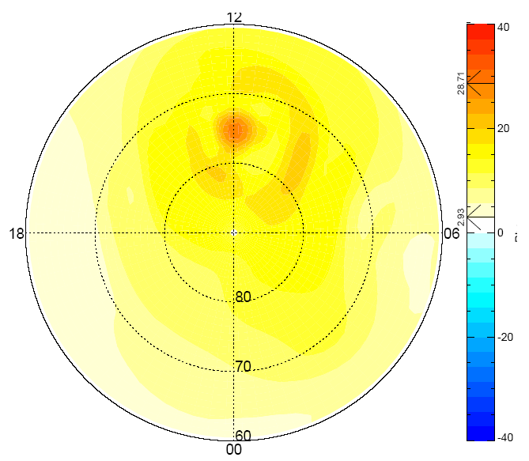
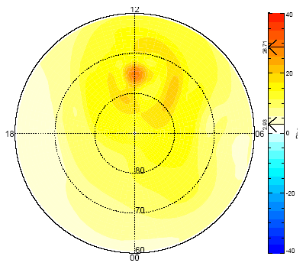
% increase of Rho @ 400 km (GITM)
Soft electrons in the cusp: (100 eV, 2 mw/m²)
[Deng et. al., 2012]
% difference between with and without soft electrons in the cusp
Rho at 400km increases by 29% even with the same amount of Joule heating

Slide 6
Yanshi Huang et. al., Wavelength dependence of Solar Flare and its influence on the thermosphere, poster, Tuesday.
Cheng Sheng et. al., Height-Integrated Pedersen Conductivity of Ionosphere from COSMIC Observations, poster, Tuesday.

