Slide 1
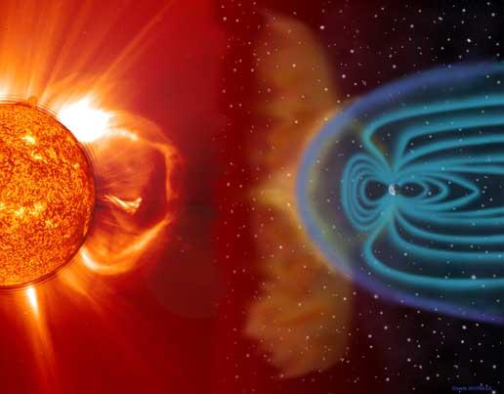
Exploring Ionospheric Response to a Sudden Decrease in Solar Activity
ISR Radar School 2014
Arecibo, Puerto Rico
Yolián Amaro-Rivera
Meghan Burleigh
Roberto Colón Quiñones
Joseph Jensen
Robert Sorbello
Travis Swenson

Slide 2
Outline
Solar activity and our unique window
Ionosphere impact
Experimental setup
Previous solar max & min data
Results
Conclusions & discussion

Slide 3
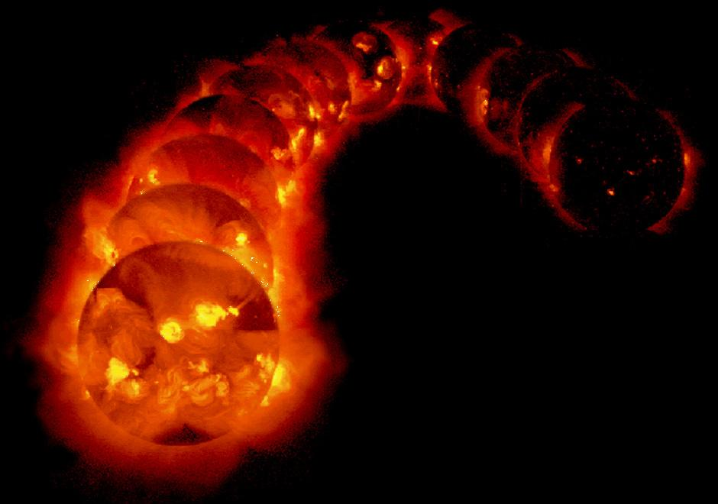
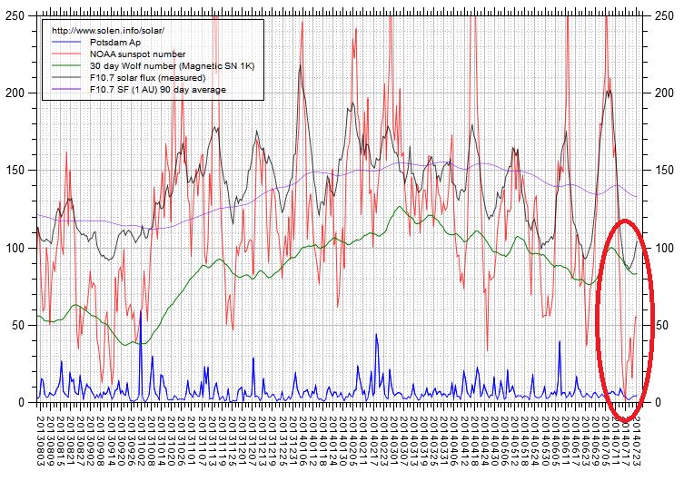
Solar Activity
The sun, and its cycle(s), directly affects the earth's ionosphere.
What if it behaves oddly?

Slide 4
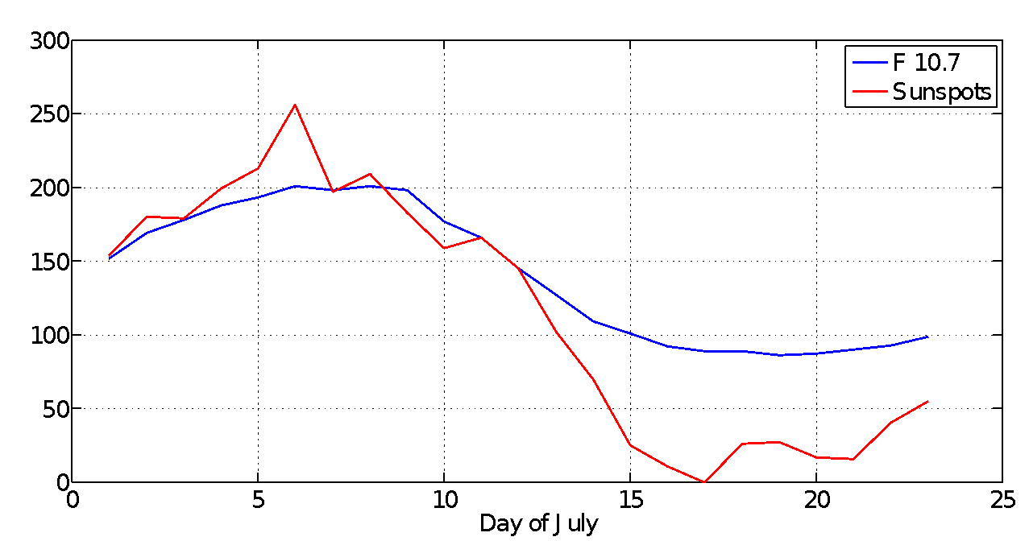
Dip in recent solar activity
Very large dip in solar activity during solar max
What is the ionospheric response?

Slide 5
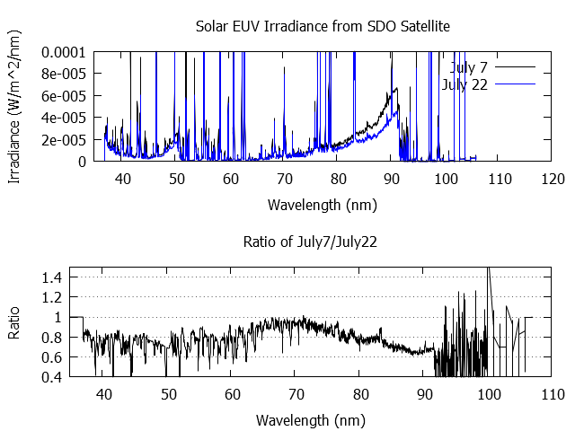
EUV Radiation: July 7 vs July 22
Decreased solar EUV radiation on July 22nd
Notes:
More solar EUV -> greater photoionization -> larger densities, elevated temperatures
Less solar EUV -> less photoionization -> smaller densities, cooler temperatures, settled light ions

Slide 6
EUV Radiation Ratio
EUV radiation is about 70 to 80% of July 22nd’s

Slide 7
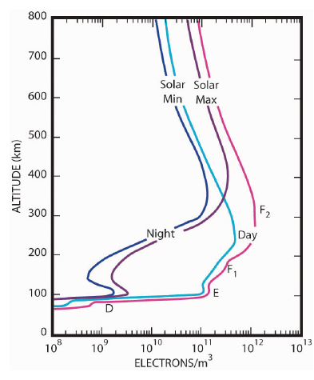
Ionospheric response to solar cycle
Parameters of Interest
Electron Temperature (Te)
Ion Temperature (Ti)
Electron Density (Ne)
Ion Composition (H+)
Possible Other Variations
Seasonal
Day-night
Spatial
Notes:
here we should give a quick mention that we have been considering the other possible variations in the ionosphere (seasonal variations, day night variations ) and say that it is very hard to definitively say that the ionosphere looks like a solar min ionosphere with just 2 hours of data!
The ionosphere undergoes photoionization in response to solar EUV. This acts to increase local ion densities and temperatures. At night the ionosphere experiences more recombination than photoionization resulting in the ionosphere decreasing in density. This day-night “breathing” is a direct response the influence of the sun.

Slide 8
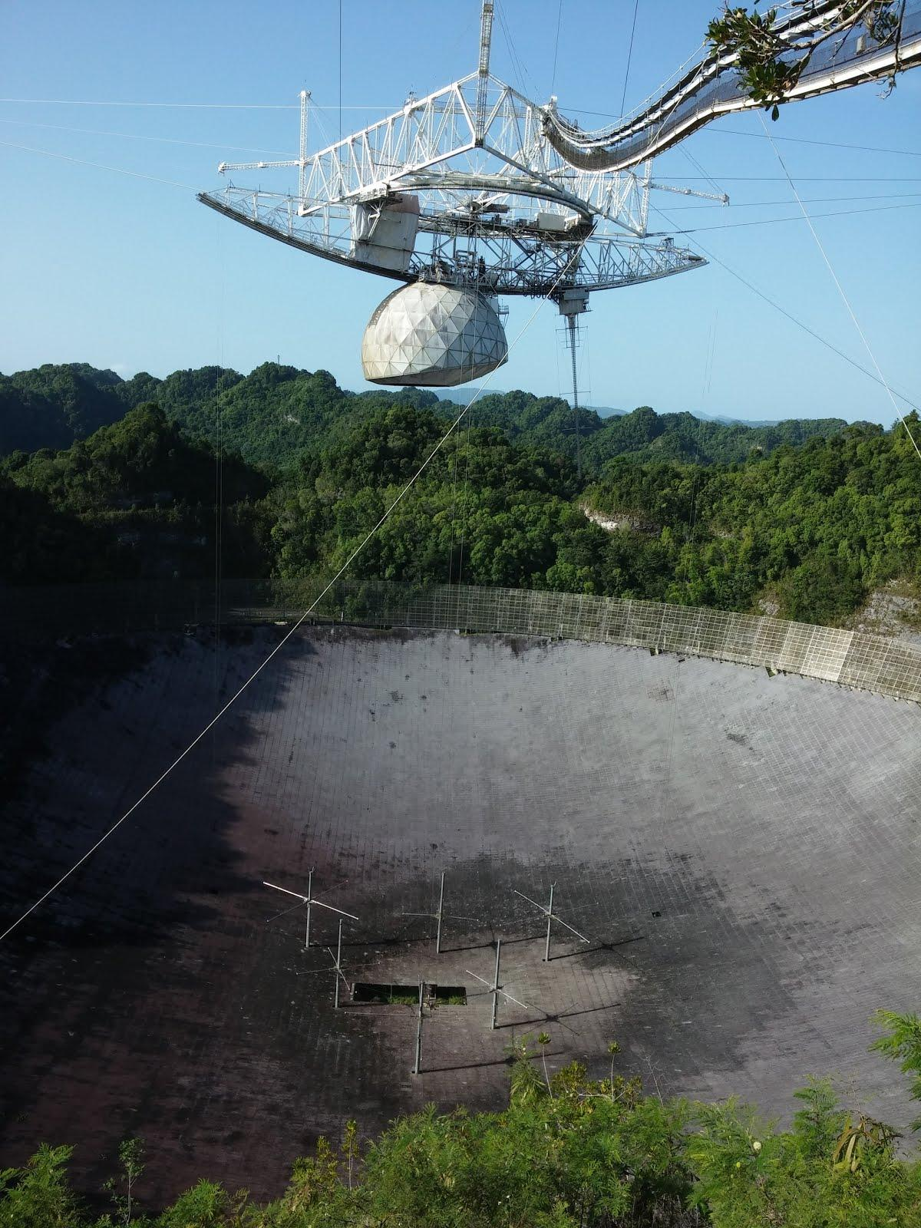
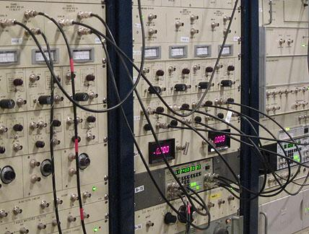
Radar Setup
1:00-3:00 LT (5:00-7:00 UT)
Linefeed only (90 elv – constant)
MRACF
40 second integration time
Notes:
Linefeed makes a more efficient use of the main dish when pointed vertically and its radiation pattern fills the available aperture

Slide 9
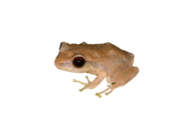
Multiple Radar Autocorrelation Function (MRACF)
Transmits 7 frequencies simultaneously within a 250 kHz bandwidth and a 30 kHz spacing between each frequency
Normally, MRACF altitude range extends from 140 to 680 km
Electron densities and ion compositions can normally be obtained with accuracies of 1 or 2%
308μs pulse transmitted every 10ms & the backscatter is sampled every 4μs
Notes:
Transmittter duty cycle is approximately 3%
Range gates calculated every 38 km but fundamental range resolution as determined by the transmitted pulse is 46km
7 freqs to exploit the large SNR
MRACF gathers ion line data for use in computing ionospheric plasma parameters
As altitude increases SNR becomes comparable to 1 and the advantage of 7 freqs is lost
By dividing the tx power on several channels, the signal can be used to obtain statistically independent samples which can be averaged to improve statistical errors by a factor equal to the square root of the relative increase in the number of independent samples

Slide 10
Solar max/min night time ionosphere
 | Solar Max | Solar Min
Te | 1083 K | 753 K
Ti | 977 K | 636 K
h_{m}f2 | 350 km | 300 km
N_{m}f2 | 11.54 | 11.0
Average night time ionosphere parameters
Used to characterize current state of ionosphere
Sharma et. al (2008) Lei et.al (2005)
Notes:
nmf2= number density at the peak of the f2 layer
hmf2=height of the peak of the f2 layer

Slide 11
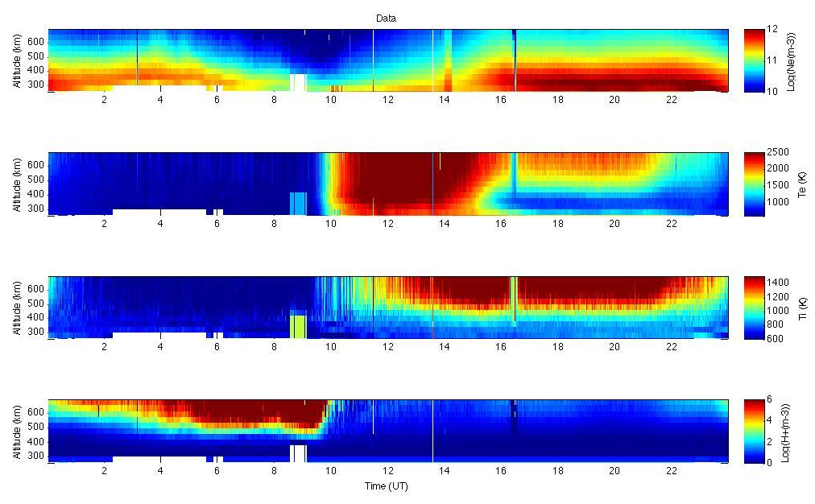
Solar minimum (May 13, 2009)

Slide 12
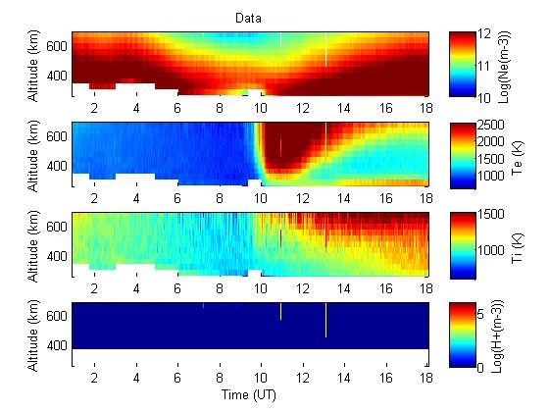
Solar maximum (April 6, 2014)

Slide 13
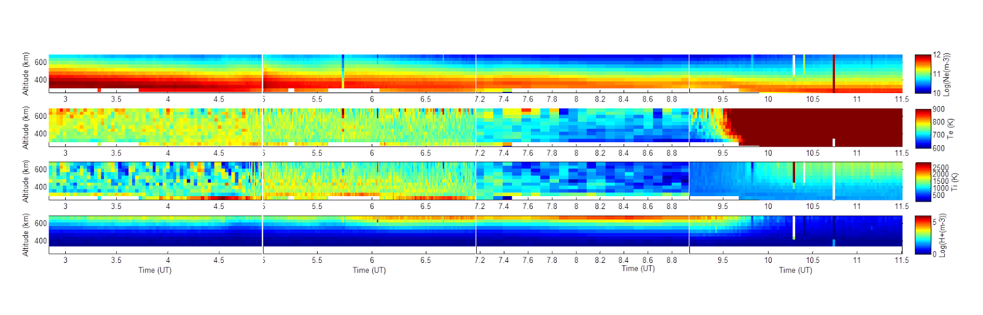
Experimental data (Jul 23, 2014)

Slide 14
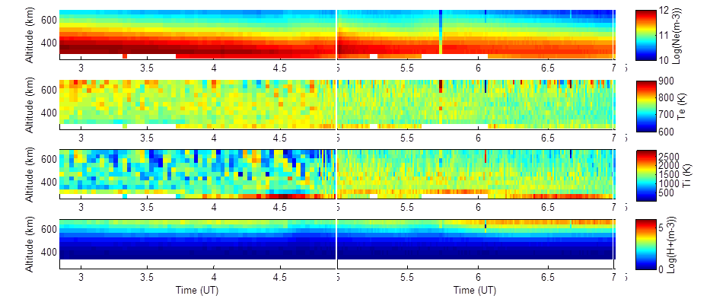
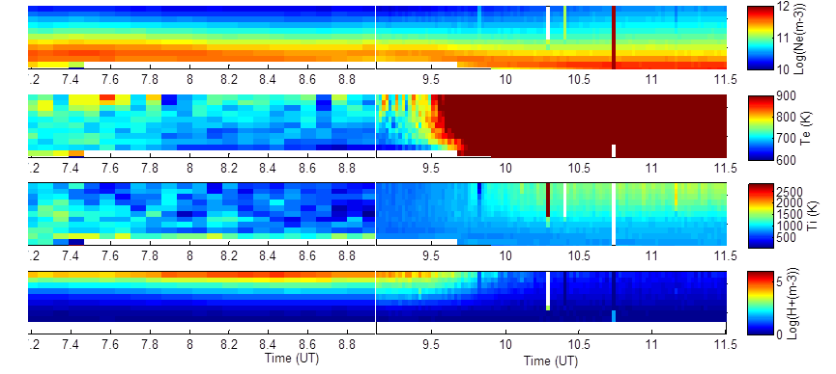

Slide 15
Comparison of our data
 | Solar min (2009) | Arecibo (22 July) | Solar max (2014)
Te (K) | 680 | 704.3 | 991
Ti (K) | 623 | 682.4 | 986
N_{m}f2 (log10(m-3)) | 10.533 | 11.431 | 12.093
h_{m}f2 (km) | 380.4 | 342 | 342
Notes:
Solar Min
Min of Max Time = 08:31
Min of Max Range = 380.4 km
Min of Max Ne = 10.533
Min of Max Te = 1144K
Min of Max Ti = 1103K
Mean Te = 680.3 K
Mean Ti = 623.7 K
Solar Max
Min of Max Time = 09.35 UT
Min of Max Range = 342 km
Min of Max Ne = 12.093 log10 m-3
Min of Max Te = 913 K
Min of Max Ti = 916 K
Mean Te = 991 K
Mean Ti = 986 K
nmf2= number density at the peak of the f2 layer
hmf2=height of the peak of the f2 layer

Slide 16
Discussion & conclusion
yes, the ionosphere looks exactly like a min
or
nope, the ionosphere is still very maxy
or
it is somewhere in between and inconclusive!

Slide 17
Future work
MORE DATA !!!!
Use the other ISR data to get a better global snapshot of the ionosphere

Slide 18
Summary
We had a unique window to look at ionospheric response
Initial data suggests the ionosphere responds at least within 10 days, approaching solar min conditions
Further studies are needed, here and at other ISR facilities, to draw firm conclusions

Slide 19
Questions?

Slide 20
References
Isham, B., C. A. Tepley, M. P. Sulzer, Q. H. Zhou, M. C. Kelley, J. S. Friedman, and S. A. González (2000), Upper atmospheric observations at the Arecibo Observatory: Examples obtained using new capabilities, J. Geophys. Res., 105(A8), 18609–18637, doi:10.1029/1999JA900315.
Sharma (effect of solar activity on ionospheric temperature in F2 region) 2008 indian radar and space science (Te and Ti satellite data)
Lei, J., L. Liu, W. Wan, and S.-R. Zhang (2005), Variations of electron density based on long-term incoherent scatter radar and ionosonde measurements over Millstone Hill, Radio Sci., 40, RS2008, doi:10.1029/2004RS003106.
J. Klenzing et. al. (2011) Topside equatorial ionospheric density and composition during and after extreme solar minimum (solar min scale height)
http://www.solen.info/solar

Slide 21
BACKUP Slides

Slide 22
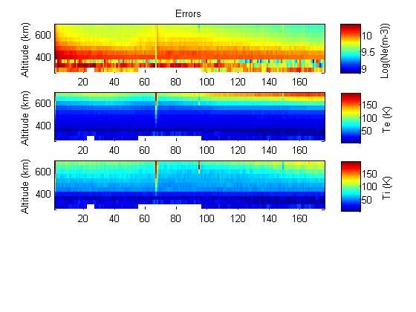
Our Data

Slide 23
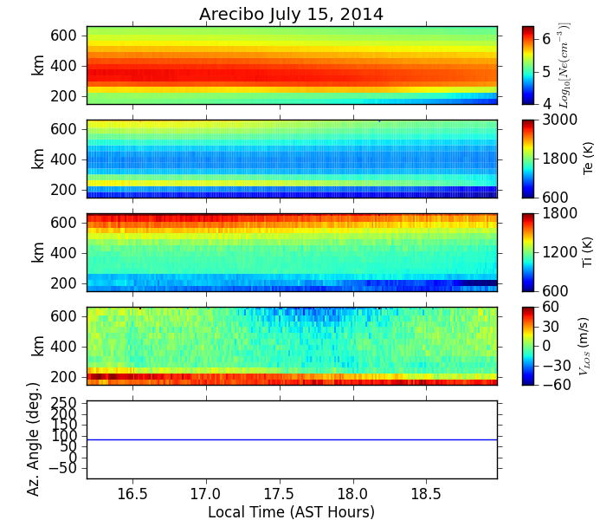

Slide 24
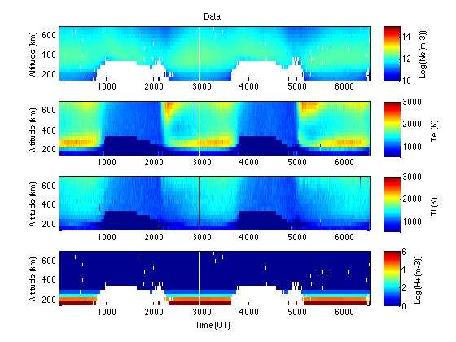
here are some examples of previous solar maxes (Apr 11 - Apr 13, 2000)
15:37:30 - 22:51:40

Slide 25
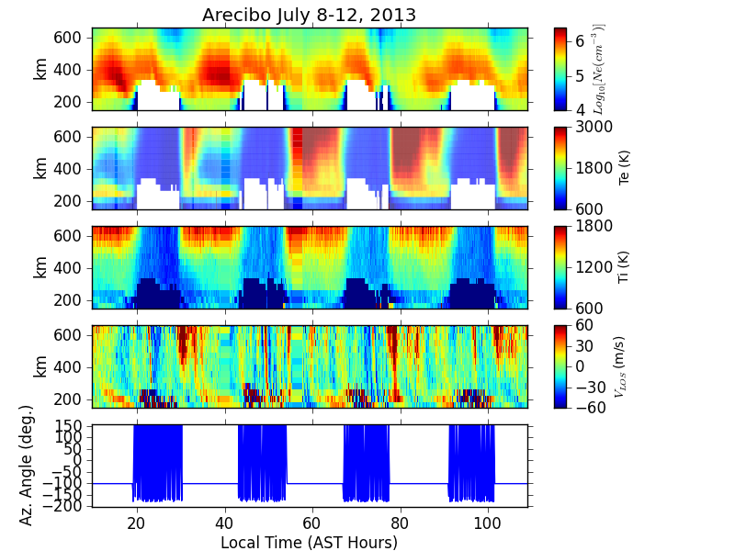
ONE YEAR AGO AT ARECIBO

Slide 26
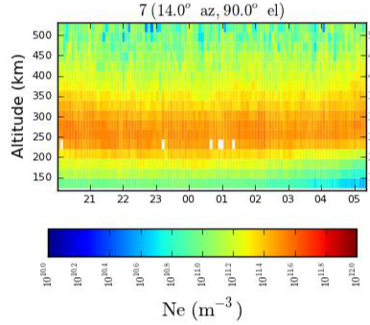
Poker Flat Electron Density

Slide 27
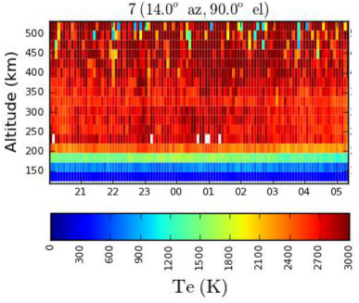
Poker Flat Electron Temperature

Slide 28
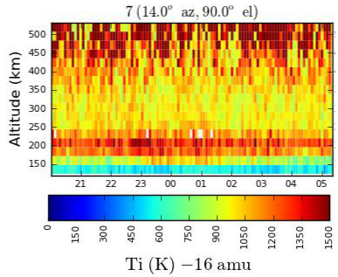
Poker Flat Ion Temperature

Slide 29
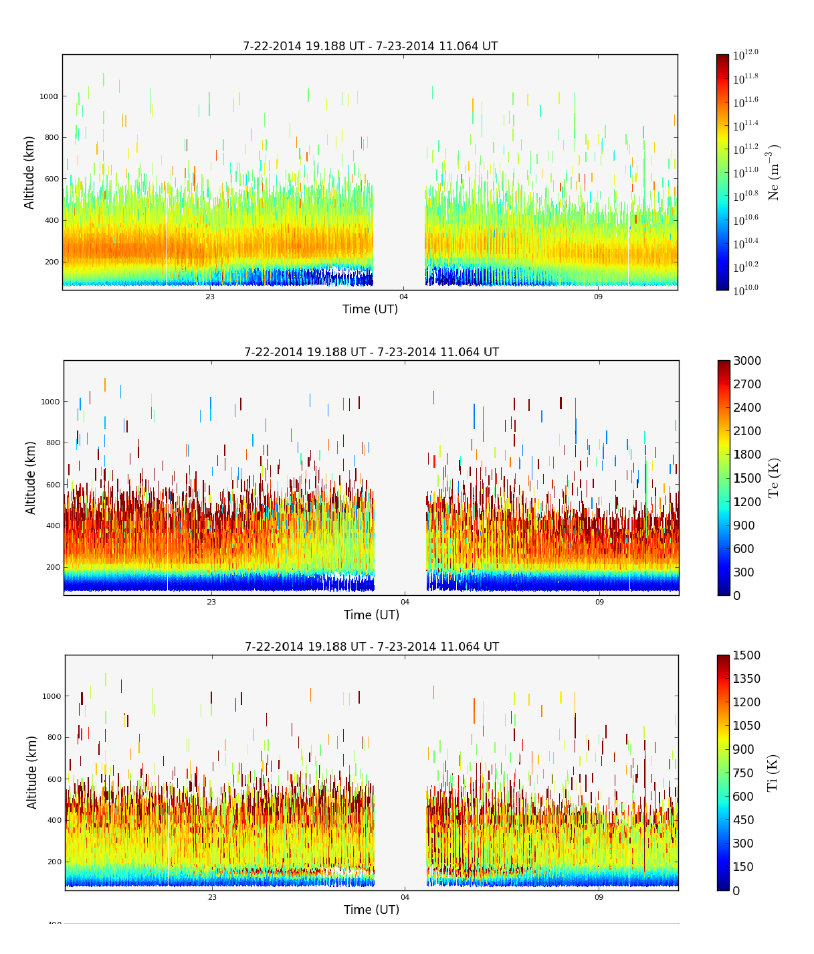
Sondrestrom

Slide 30
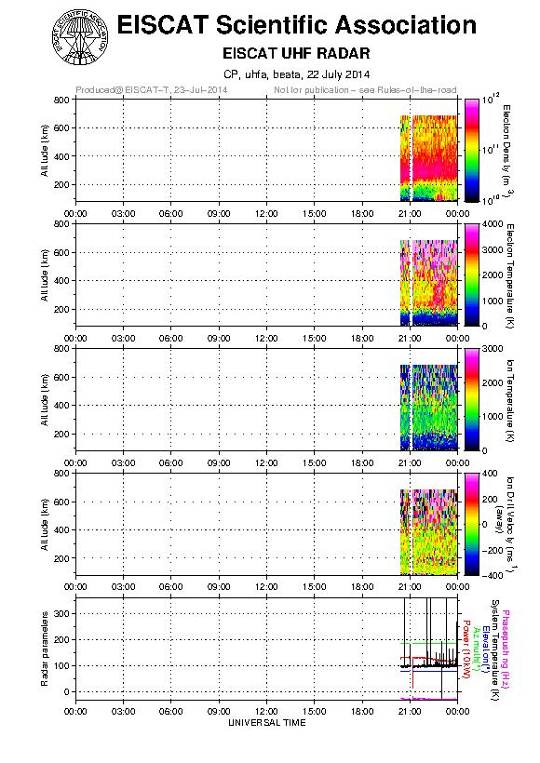
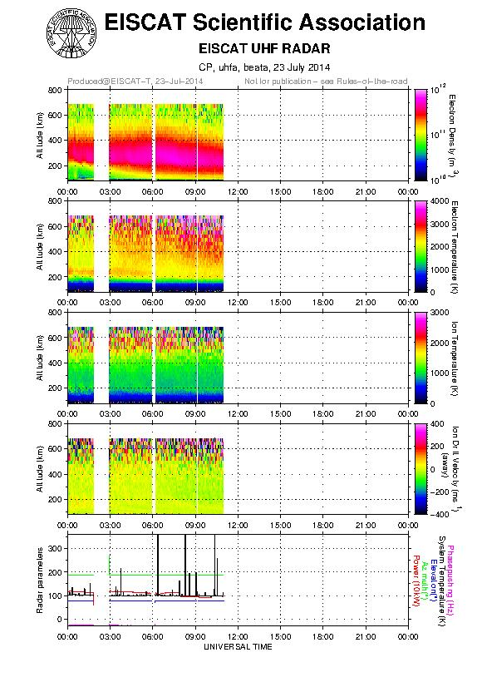
EISCAT

