Slide 1
ISR SUMMER SCHOOL
Group Experiment
Group 4
Garima Malhotra
David Themens
Takuo Tsuda
Yamazaki Yosuke
Chhavi Goenka

Slide 2
Our goal : Comparison of geophysical data (temperatures, velocities, compositions, electron density) from different radars to understand global variation of the ionosphere.
Modes used at Arecibo : Topside and MRACF
  Linefeed and Gregorian – 20 seconds Topside alternating with 10 second MRACF
  Linefeed pointing towards zenith
  Gregorian rotating 360◦ in azimuth and with elevation of 75◦
Radars compared : Millstone Hill, Arecibo, EISCAT, PFISR
We ended up with more than we expected. So Brace yourselves! ☺

Slide 3
First we will show you what we promised…

Slide 4
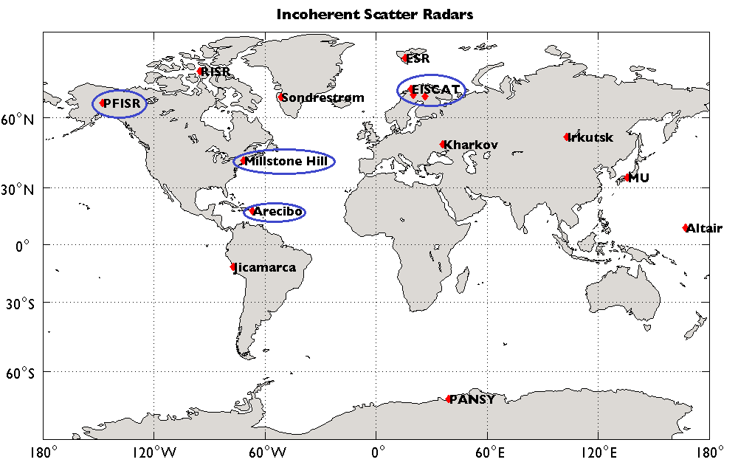

Slide 5
Electron Density Profiles (3:00-4:00 UT)
Lat: 42N
LT: 11pm-12am
Vertical
Lat: 69N
LT: 5am-6am
Field-aligned
Lat: 18N
LT: 11pm-12am
Vertical
Lat: 65N
LT: 7pm-8pm
Av. Vertical
Why is the electron density at Arecibo so high? Are the data correct?

Slide 6
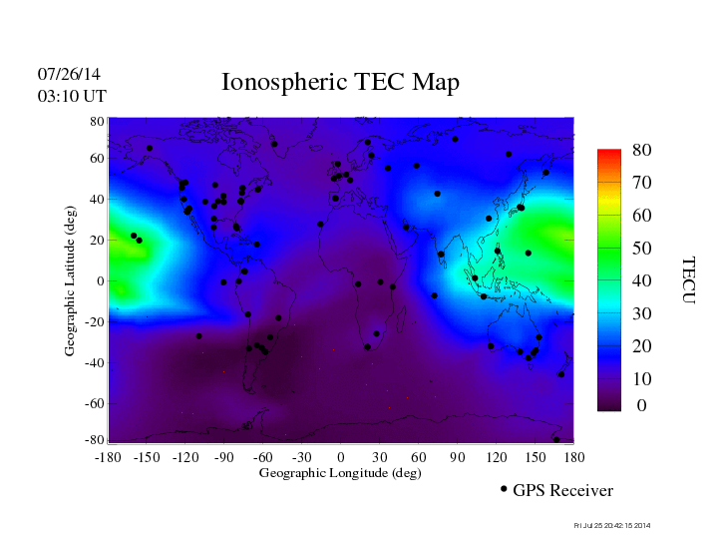
(by Jet Propulsion Lab.)
Arecibo is in the tail of the equatorial ionospheric anomaly

Slide 7
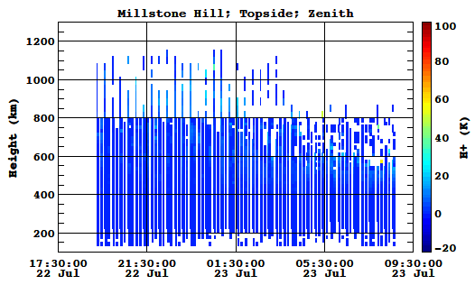
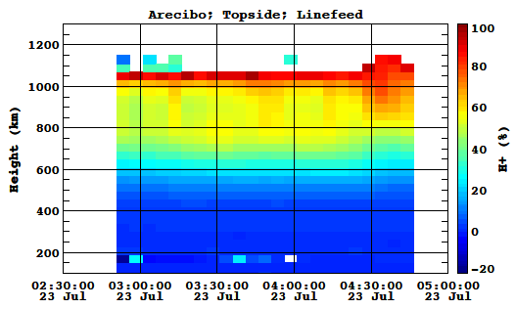
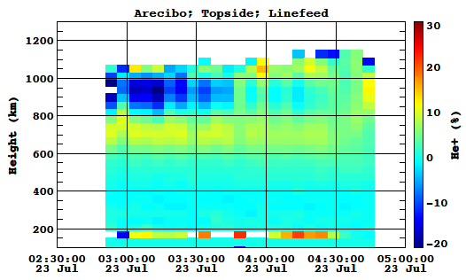
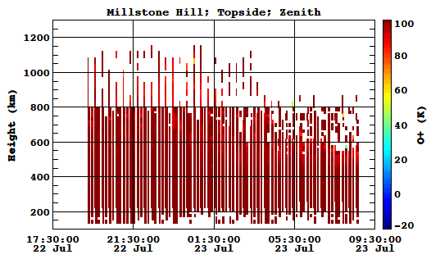
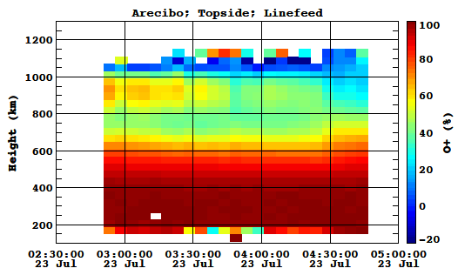
Ion composition in the topside ionosphere
Millstone Hill
Arecibo
Why?
H⁺ (%)
H⁺ (%)
Negative
He⁺ (%)
Why?
O⁺ (%)
O⁺ (%)
Why?

Slide 8
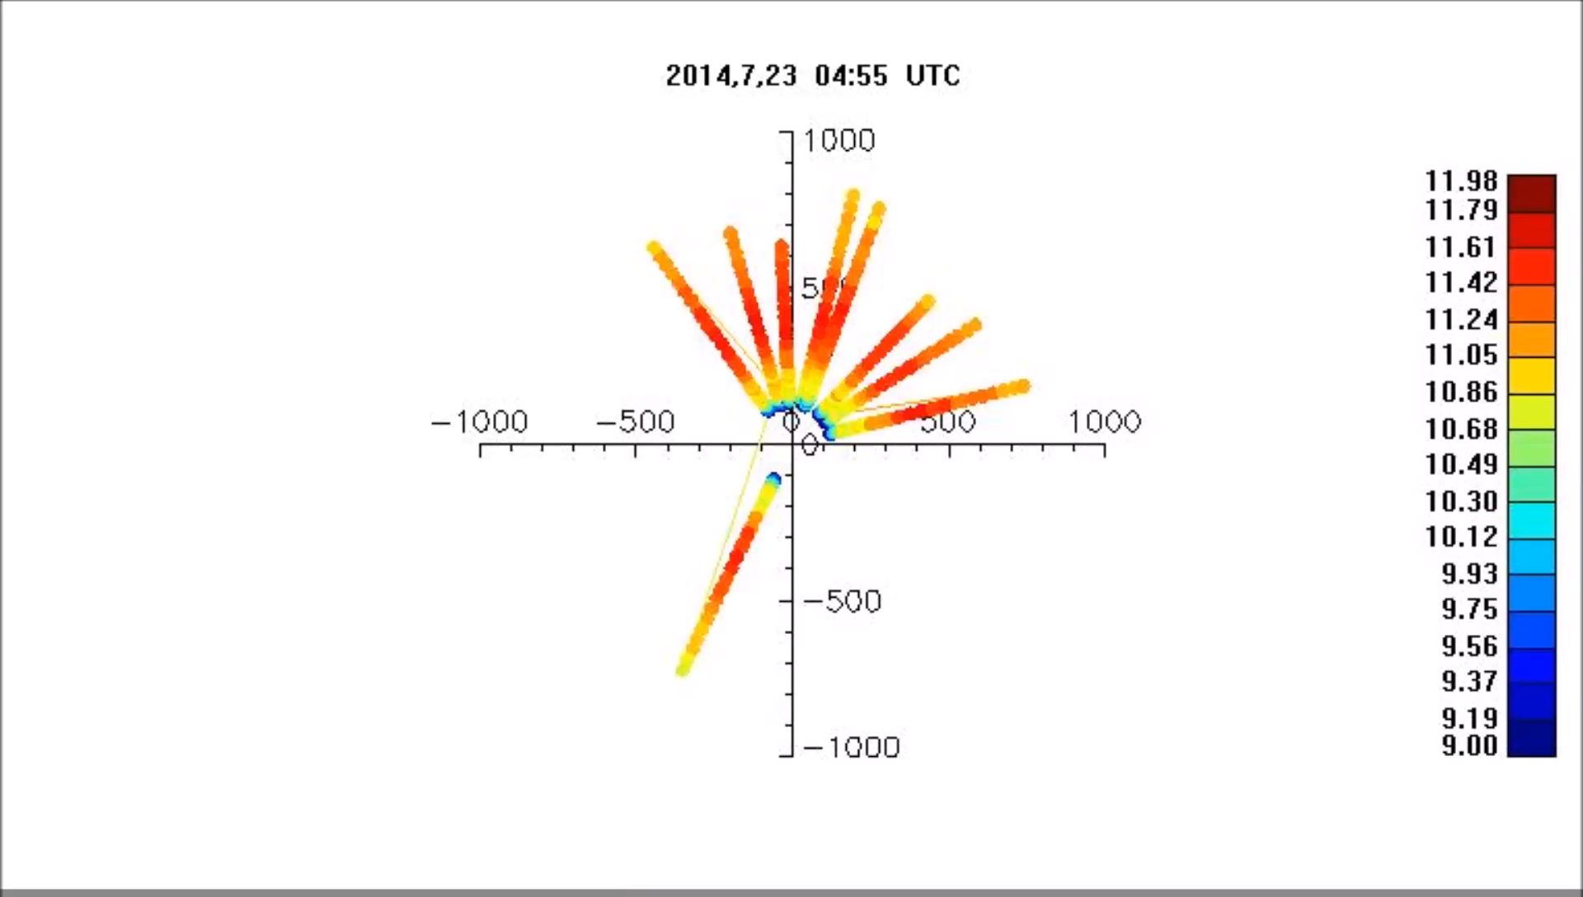
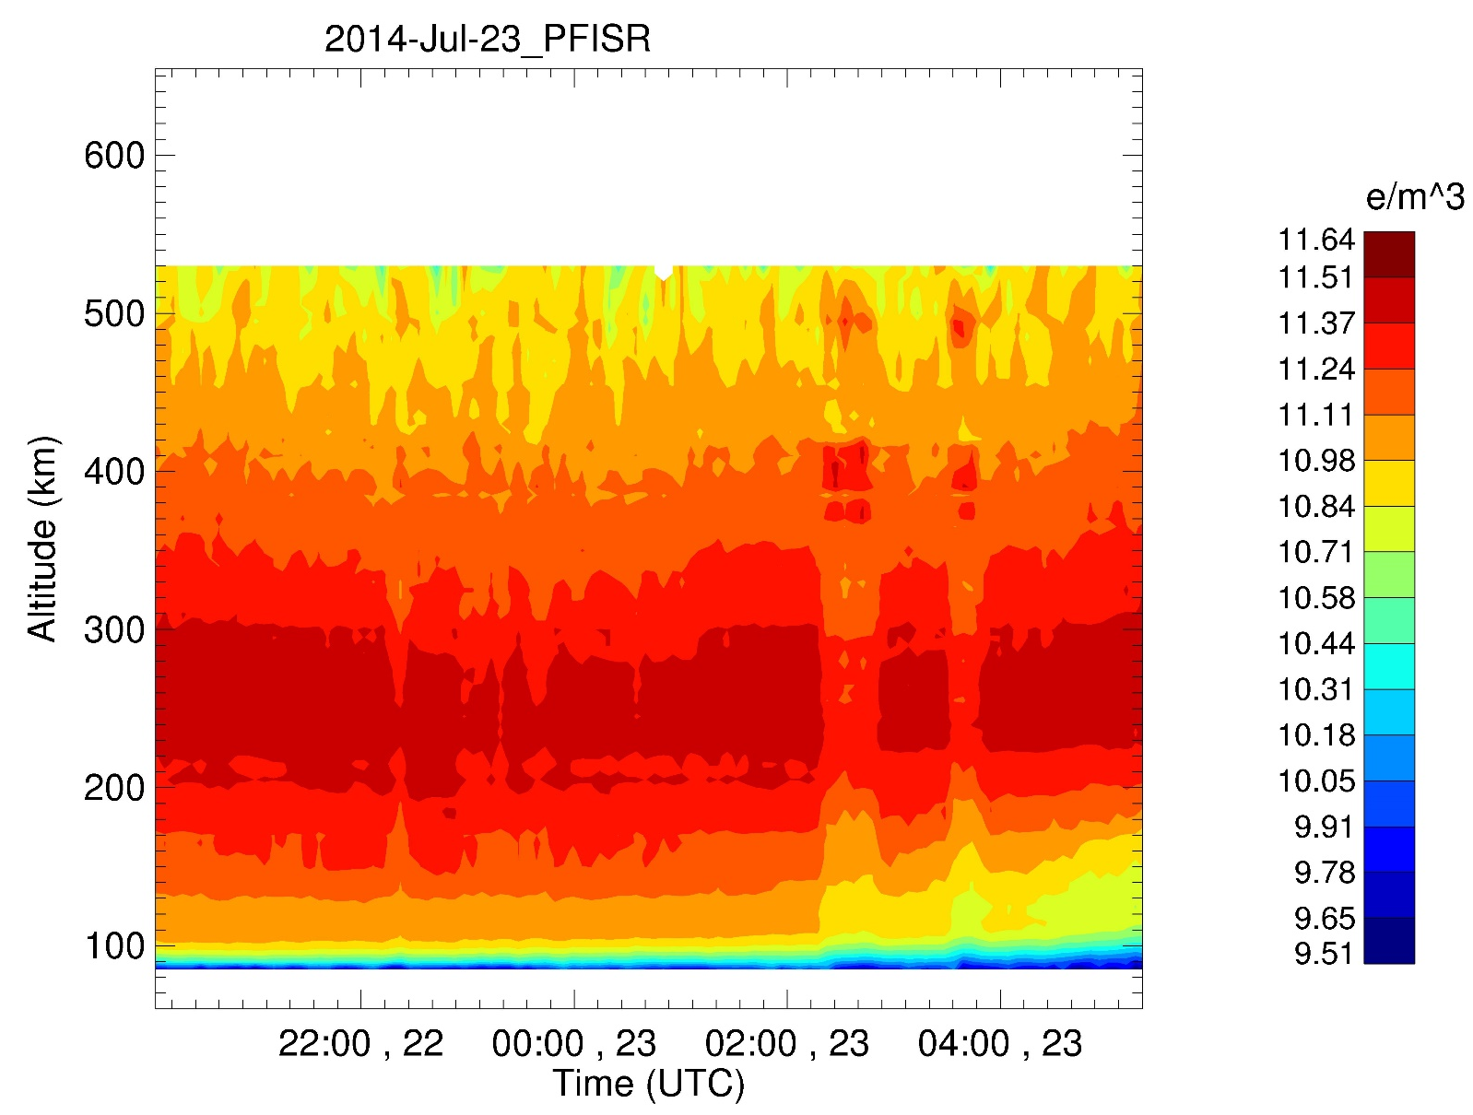
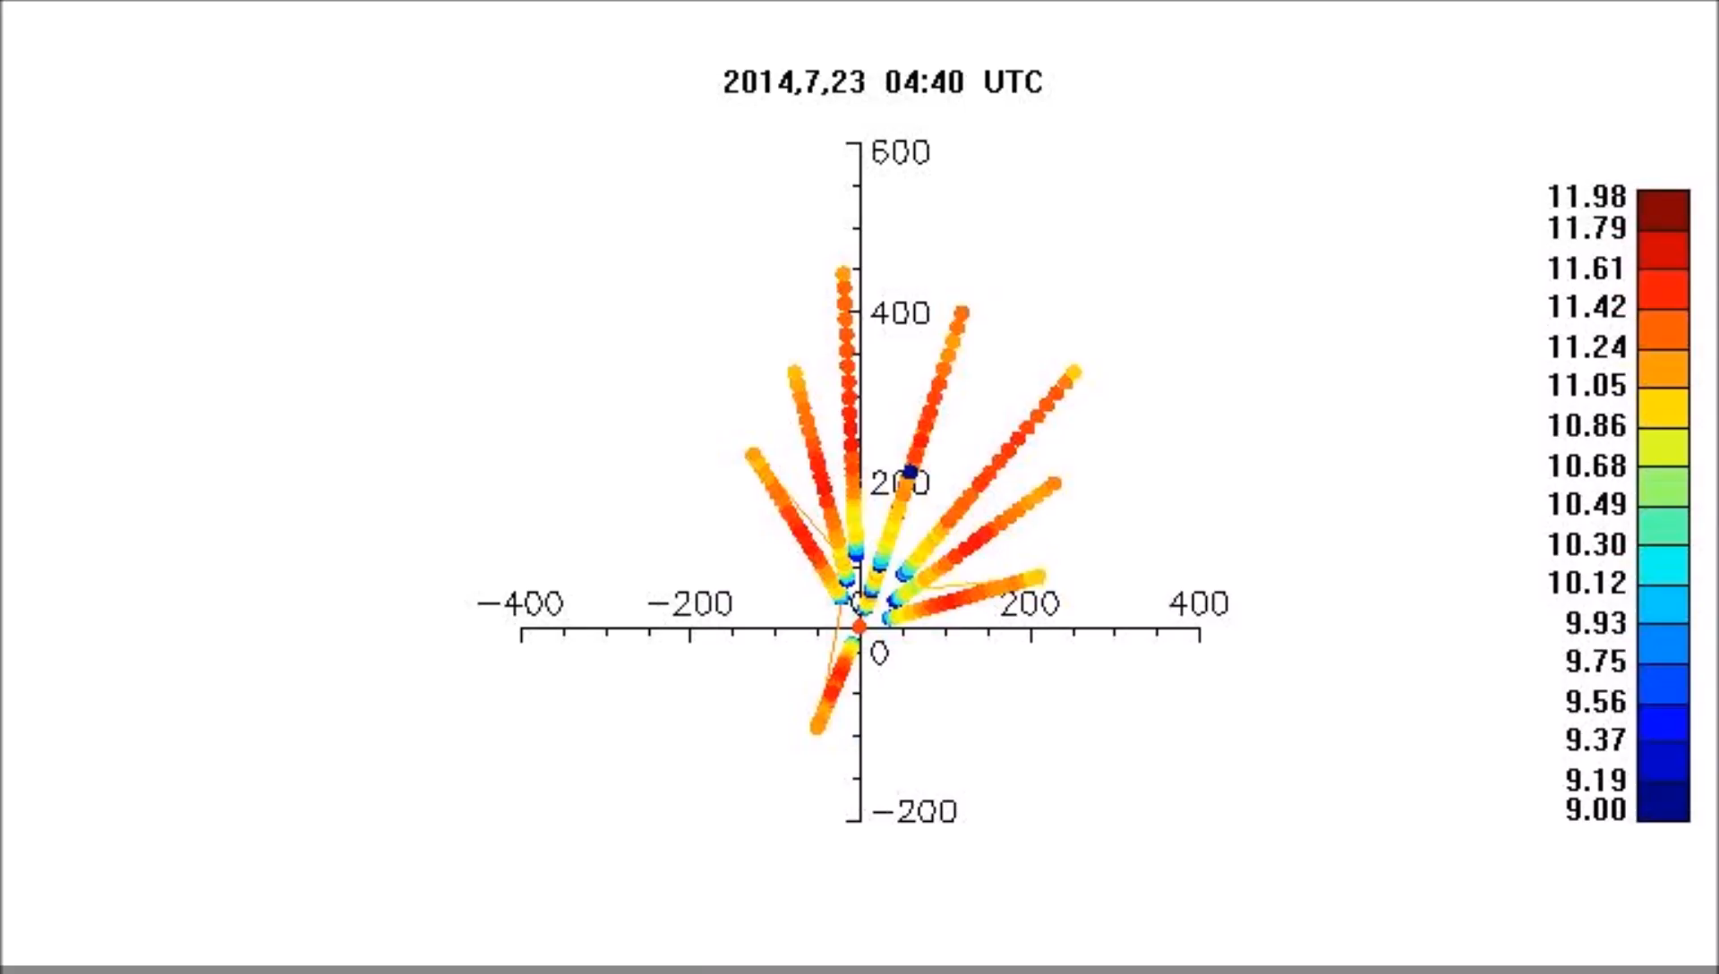
PFISR

Slide 9
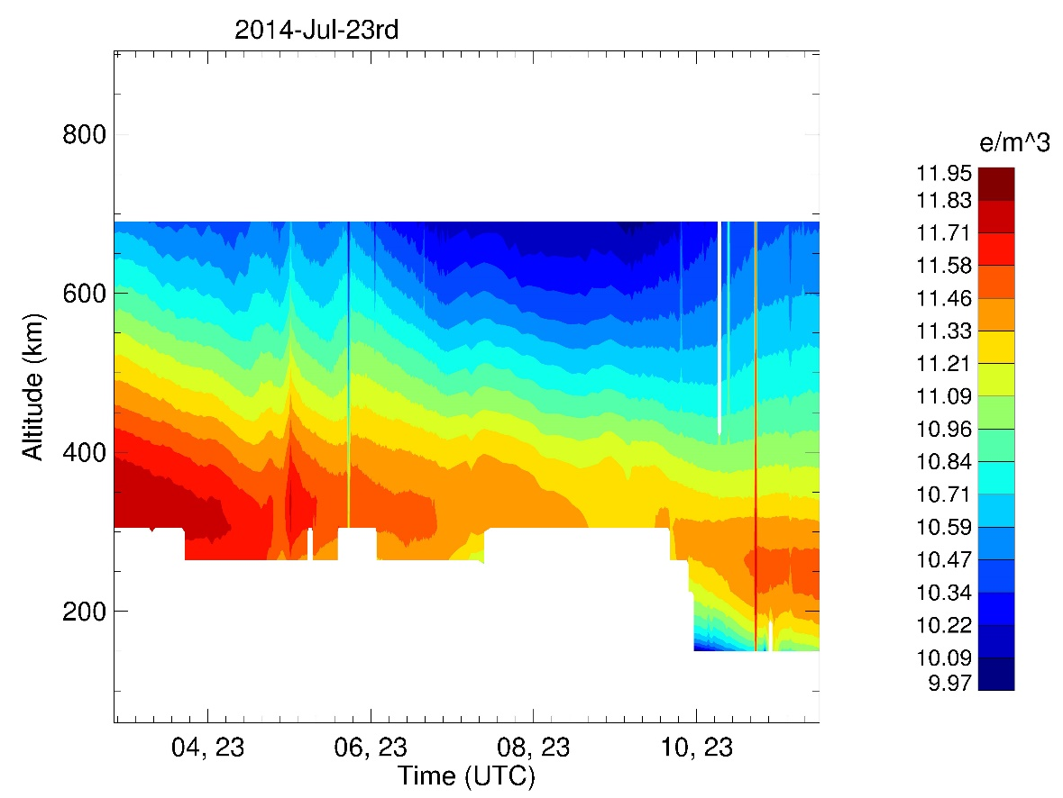
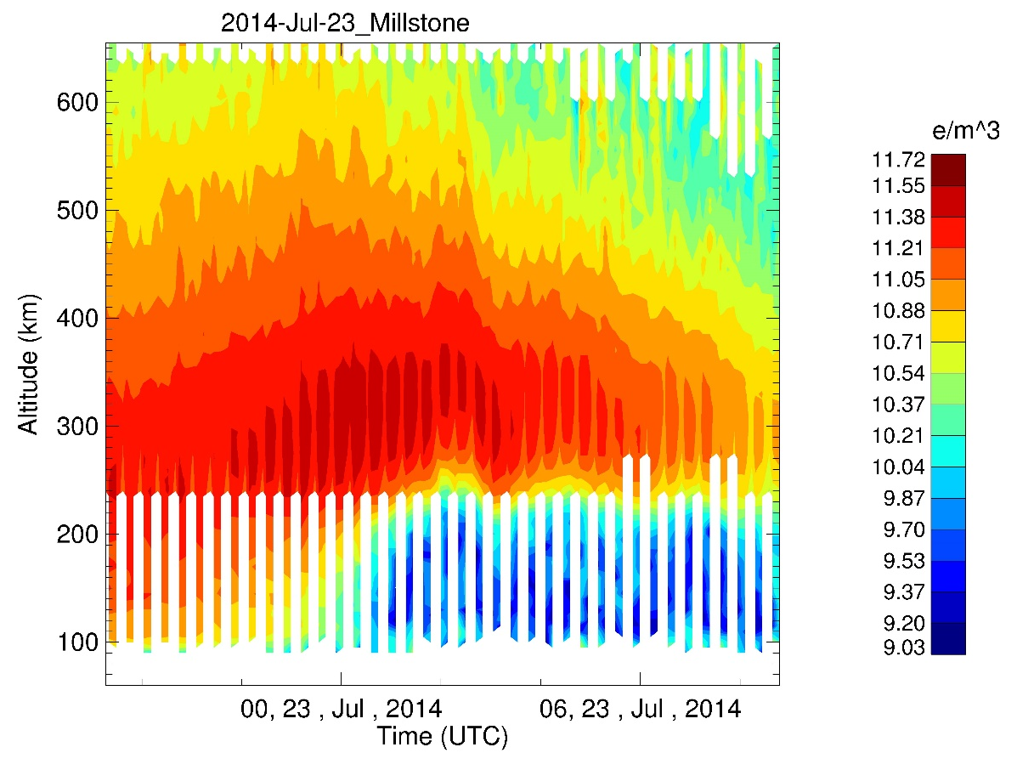
Arecibo

Slide 10
We were just about to compare temperatures..
But.. we got distracted by something more interesting!

Slide 11
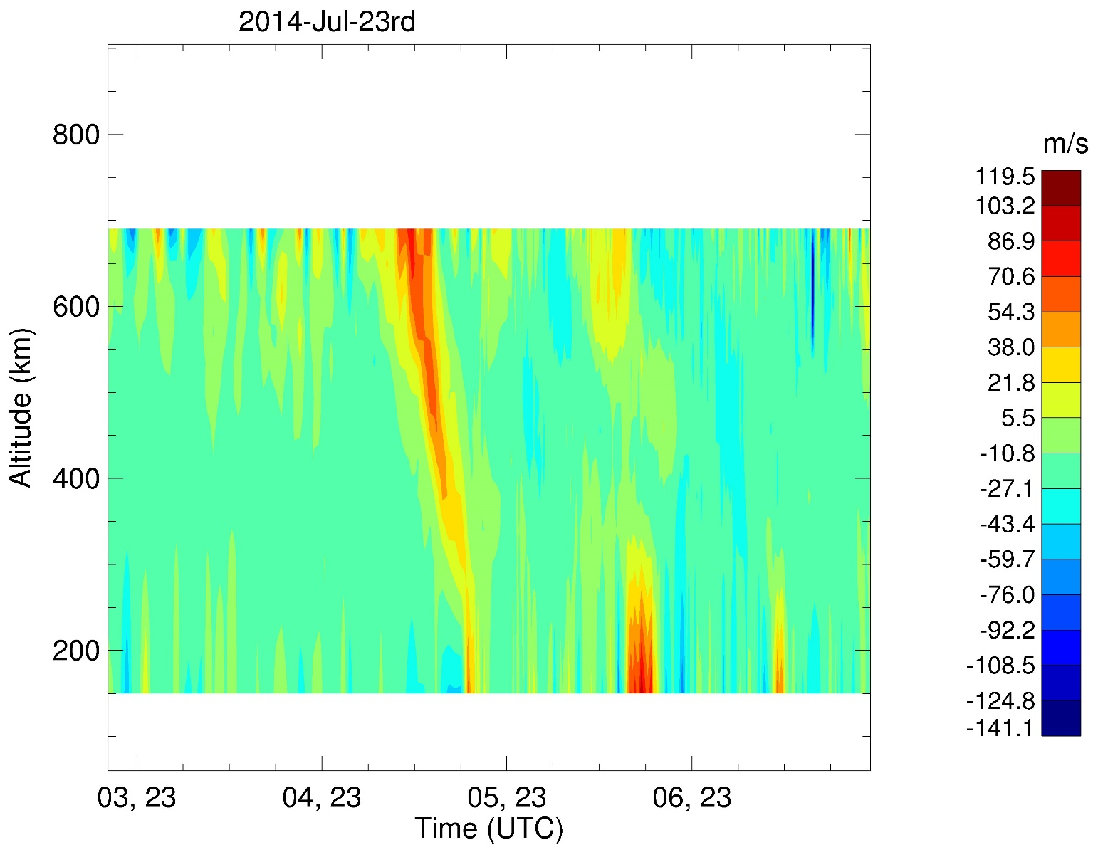
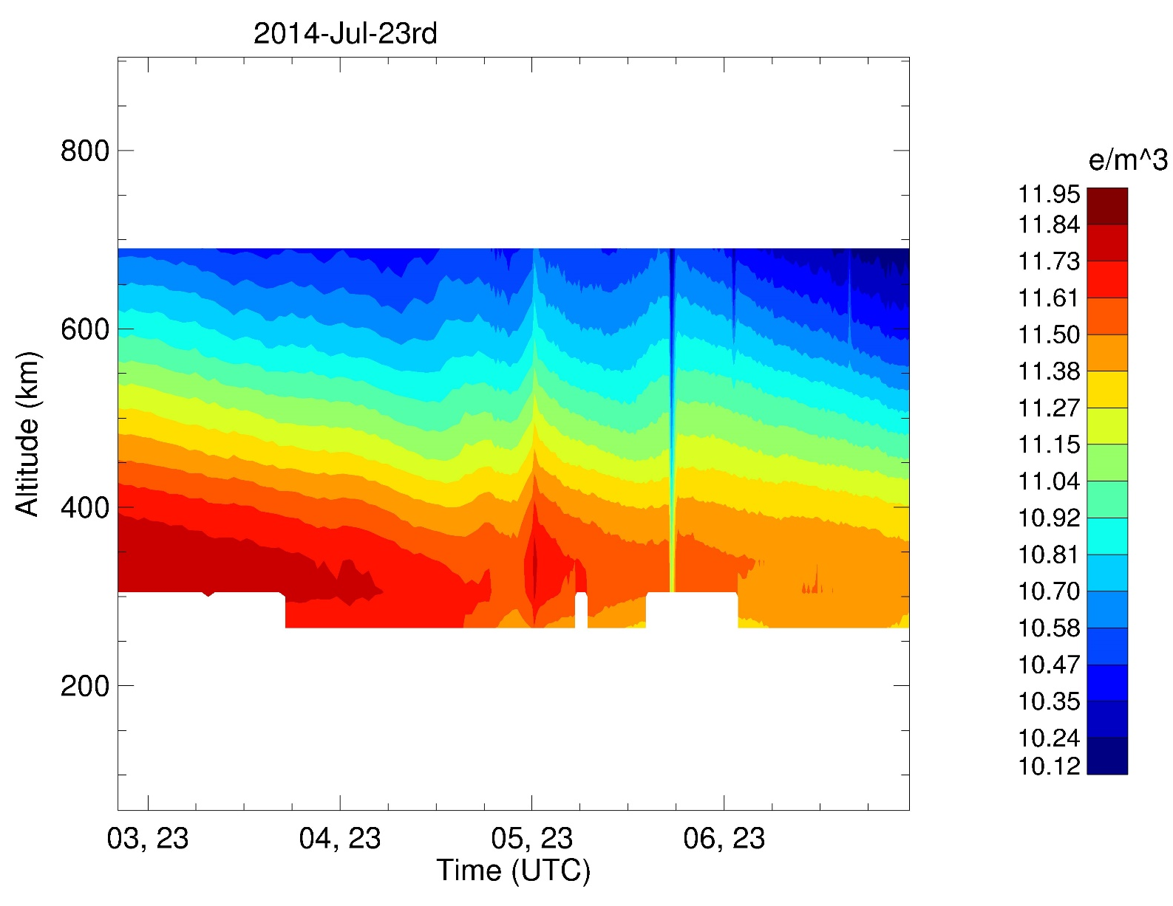
Surprise!

Slide 12
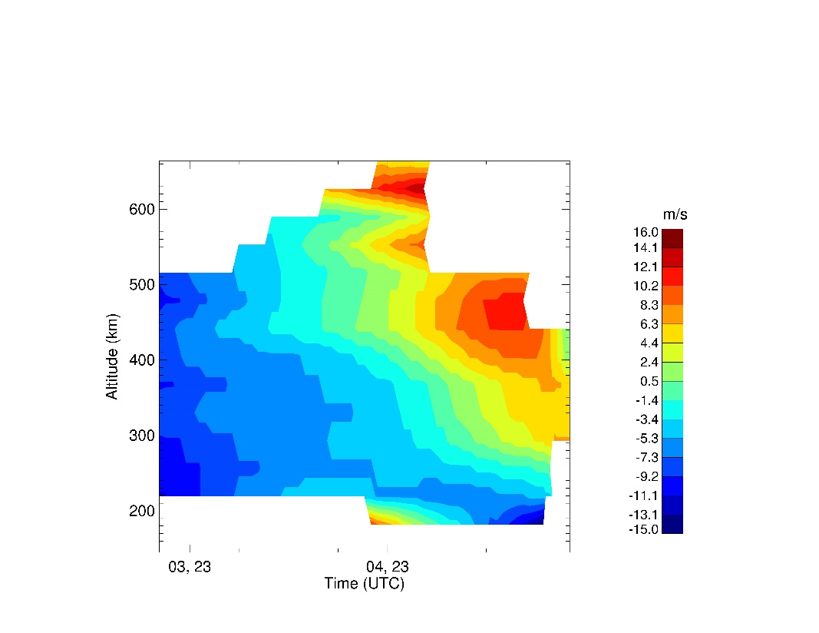
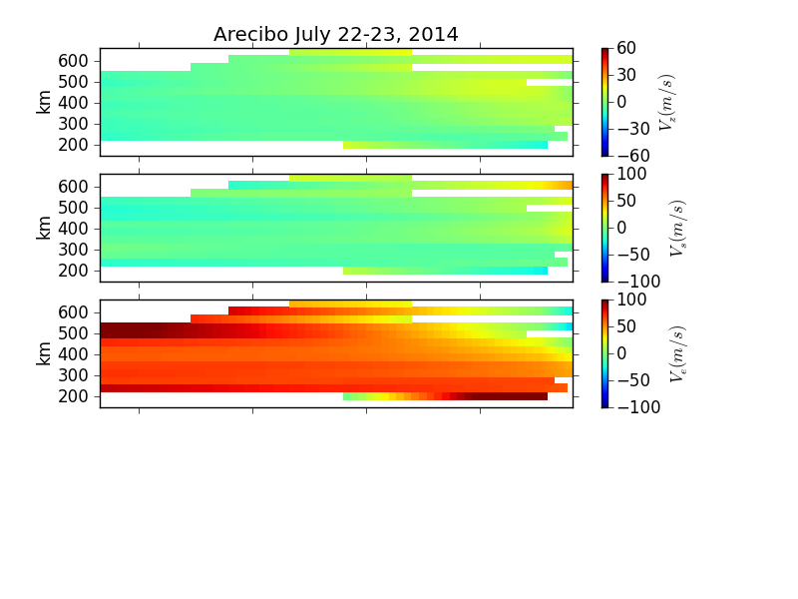
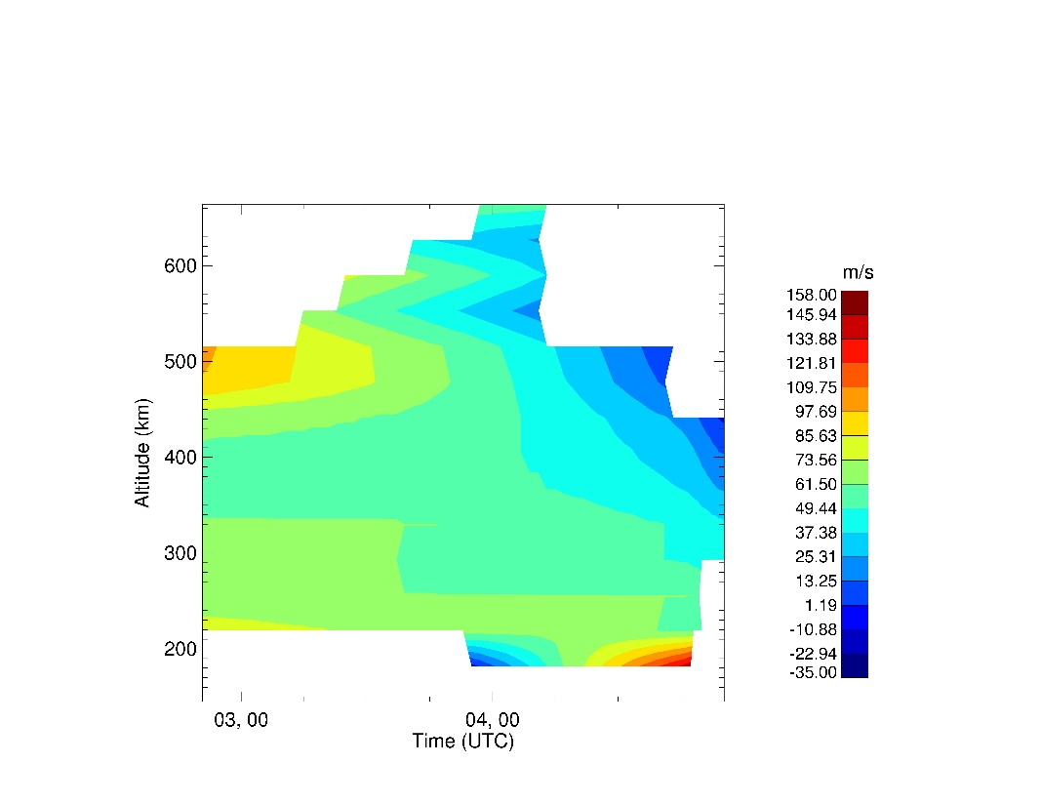
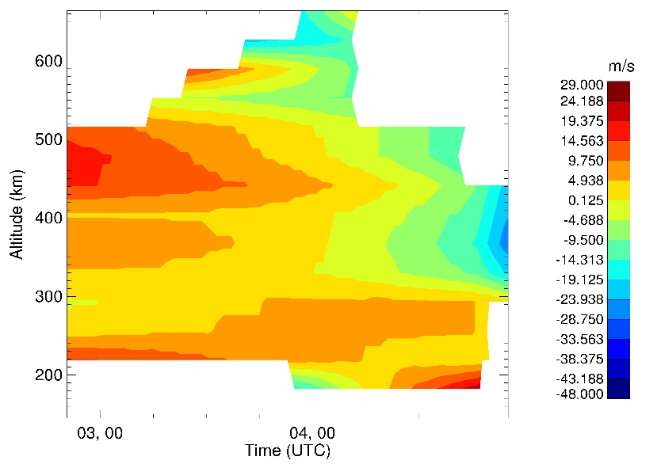
What about the Gregorian?
Vz
Ve
Vs

Slide 13
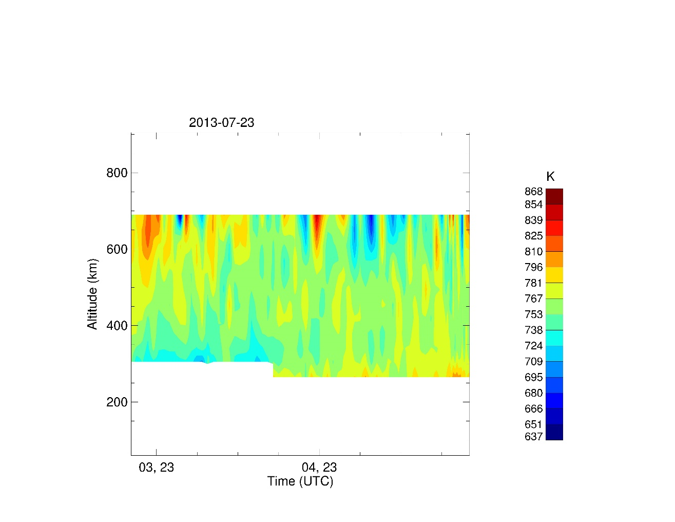
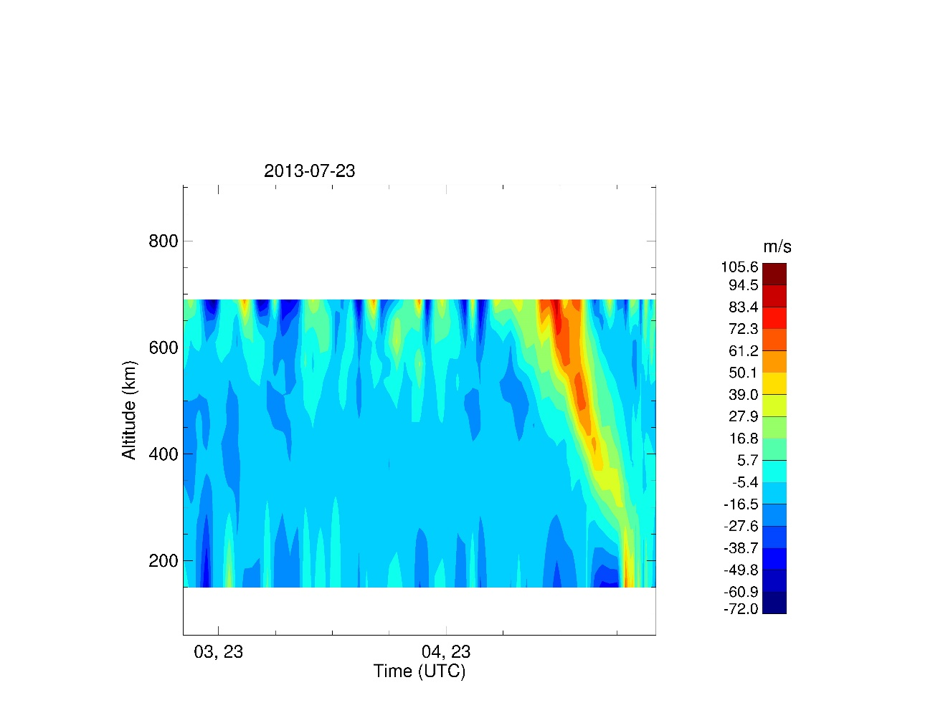
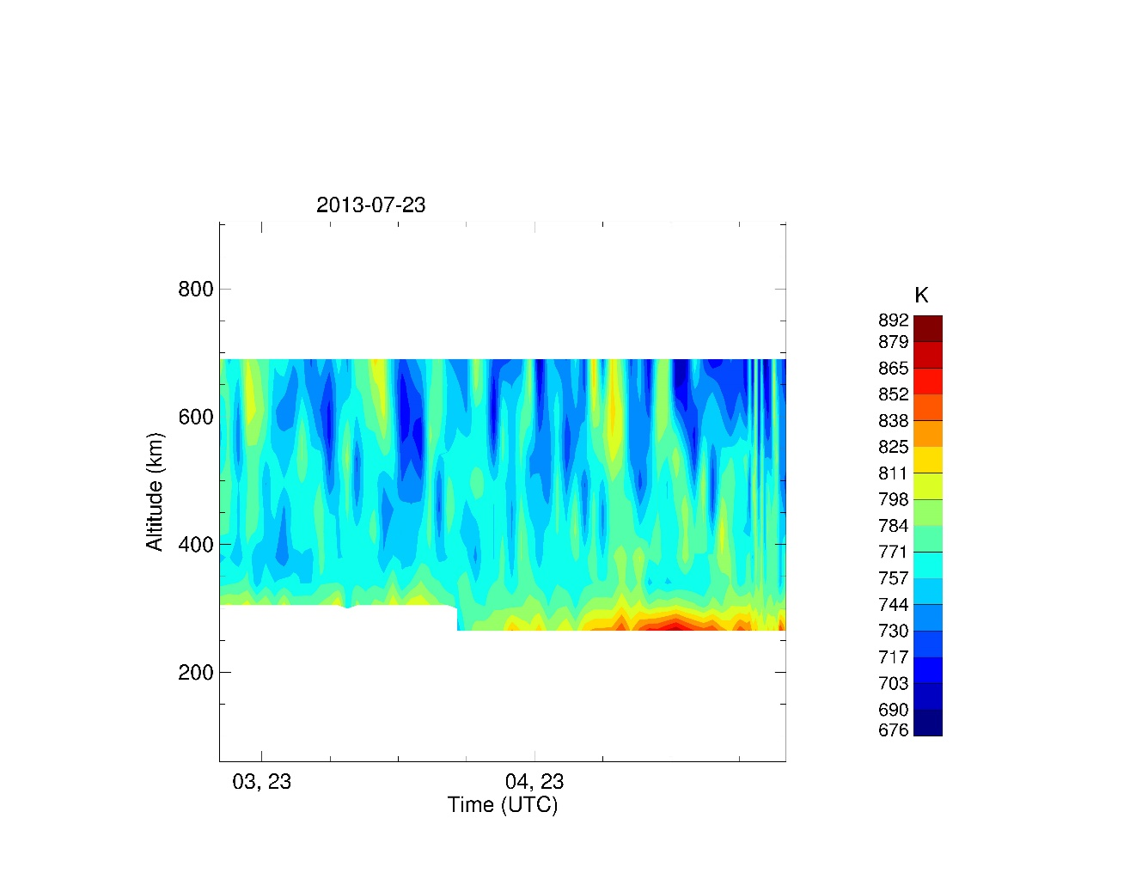
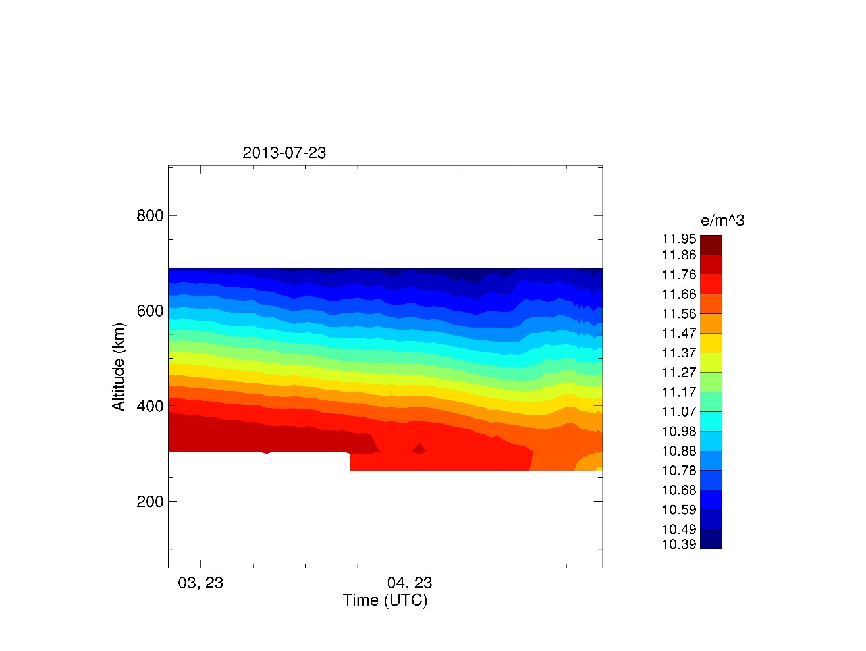
Te
Vo
Ti
Ne

Slide 14
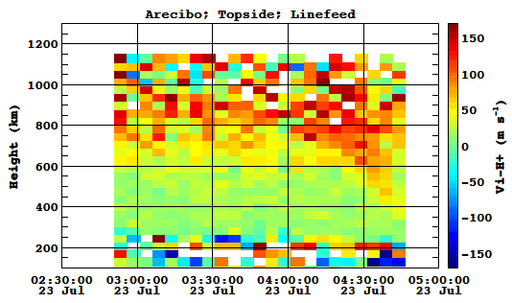
Ion composition in the topside ionosphere
Millstone Hill
Arecibo
Why?
H⁺ (%)
H⁺ (%)
Negative
He⁺ (%)
Why?
Vi (H⁺) (m/s)
O⁺ (%)
O⁺ (%)
Upward lifting!
Why?

Slide 15
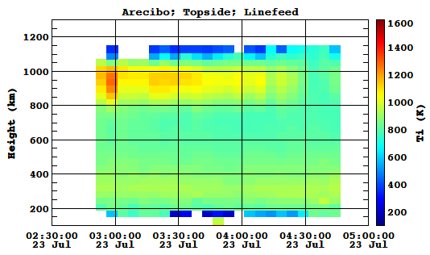
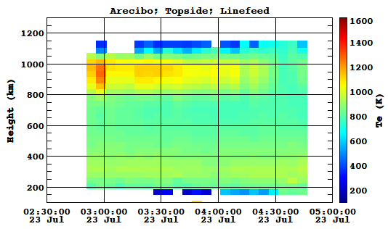
Ion composition in the topside ionosphere
Ti (K)
Te (K)
Arecibo
Cooling?
Cooling?
Why?
H⁺ (%)
Negative
He⁺ (%)
Why?
Vi (H⁺) (m/s)
O⁺ (%)
Upward lifting!
Why?

Slide 16
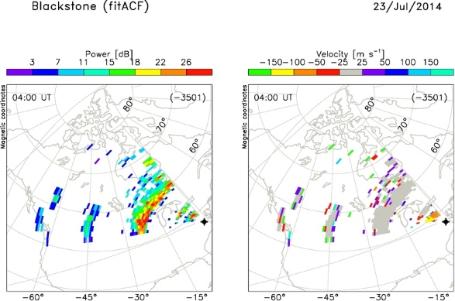
Observations from SuperDARN Radars
Blackstone Radar

Slide 17
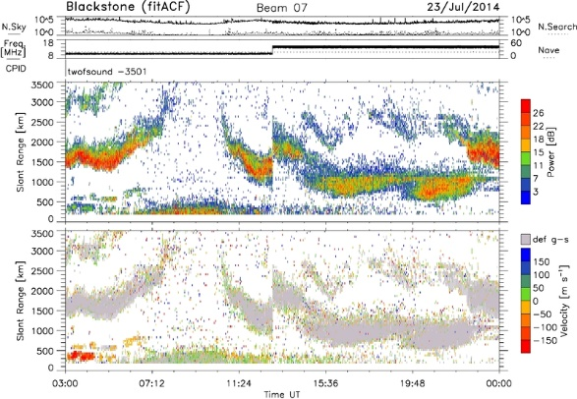
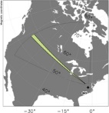
Blackstone RTI Plot

Slide 18
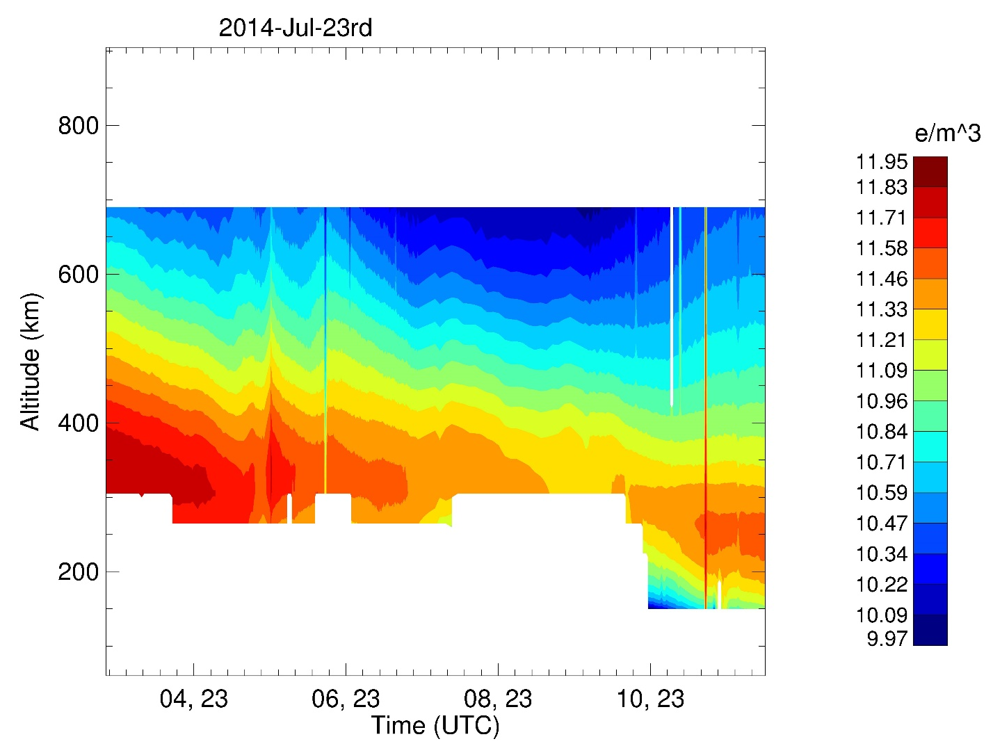
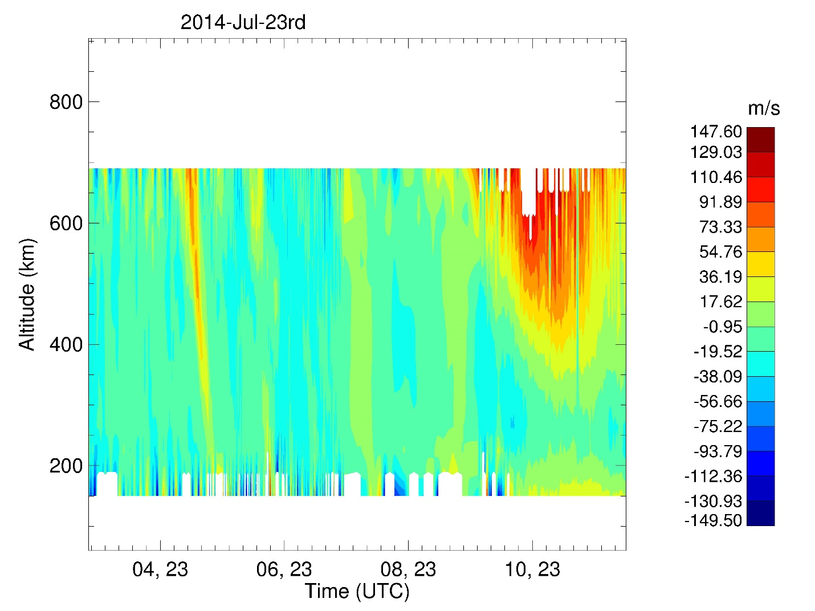
Waves? Travelling Ionospheric Disturbance?

Slide 19

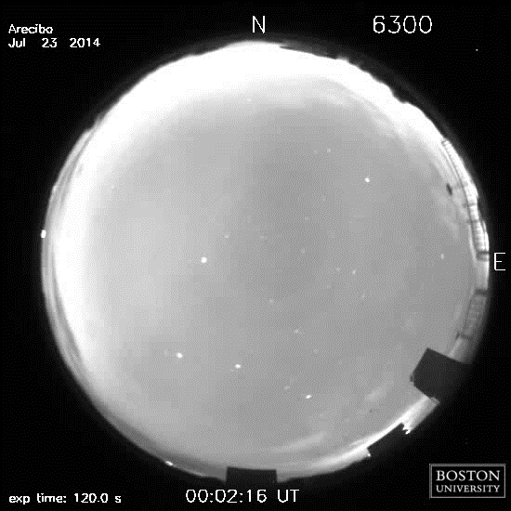
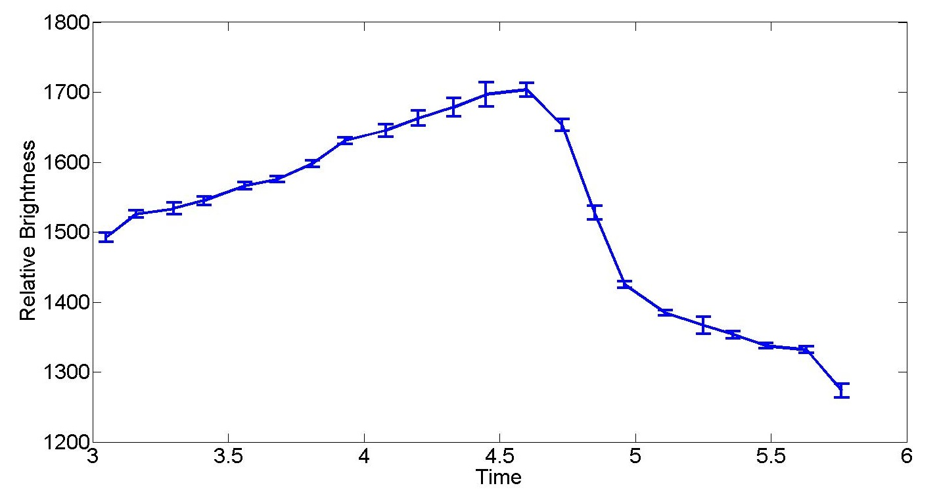
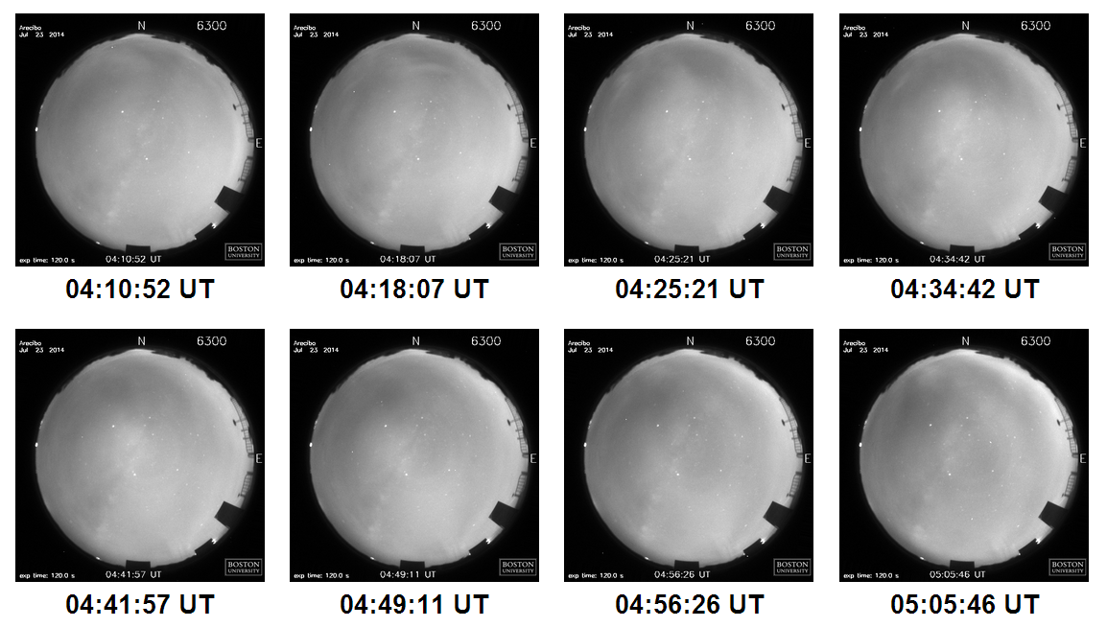
We also see it in Arecibo (Puerto Rico) 6300 Å All-Sky Imager Data

Slide 20
Geomagnetic Field during the Velocity Enhancement
?
?
Strange geomagnetic perturbations are observed.

Slide 21
Geomagnetic Pulsations
High Pc4 activity during the velocity enhancement. No Pc3 activity.

Slide 22
We are not responsible for any assertions based on this data!

Slide 23
But here’s what we know
Unusually strong upwelling over a 15 minute period (possibly repeating)
Strong east-west vector wind convergence in that region
An associate electron density depletion in the F region
Possible high altitude proton ratio enhancement
Possible advection-induced high altitude cooling
Coincident pc4 magnetic pulsations
Possible 400 km wavelength wave
Observed in the 6300 Å imager
It might be….
An electric-field related Traveling Ionospheric Disturbance (TID)

