Slide 1
Observations of a pre-reversal enhancement in the evening zonal electric field during June solstice at Arecibo
Group2
Jessica Smith
Andrew Kiene
Tetsuro Ishida
Laurianne Palin
Alexander Karlsson
Jul 26, 2014

Slide 2
Contents
Background
Motivation
Observation
Result
Discussion
Summary

Slide 3
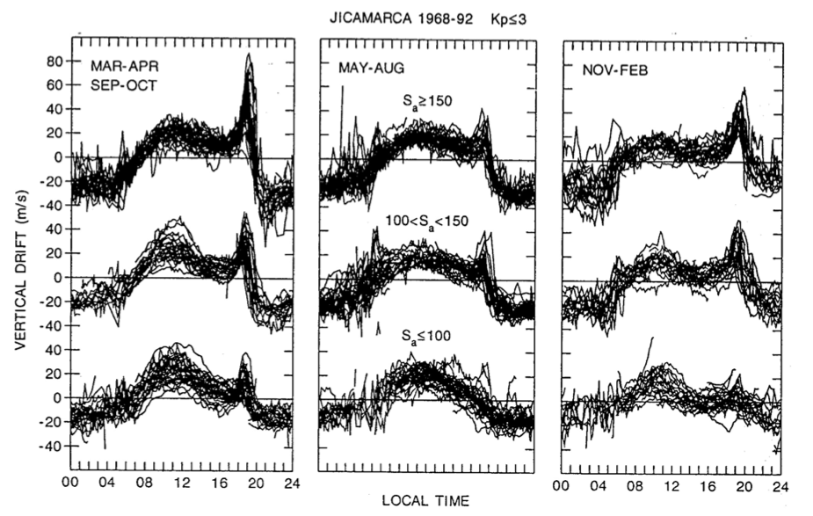

Pre-Reversal Enhancement (PRE)
1. Background
The pre-reversal enhancement
Scherliess and Fejer, J. Geophys. Res., 104, 6829, 1999.
Notes:
The pre-reversal enhancement is an enhancement in the zonal electric field in the evening. The vertical drifts are a direct measure of the zonal electric field based on the E x B equation. This equation is valid in the topside. This is a plot of observed Jicamarca vertical drifts organized by season and solar flux conditions and every day they had in the data set was plotted one on top of the other. So the drifts are normally upwards during the day (corresponding to an eastward E field), and downward at night (corresponding to a westward E field). But before the drifts reverse downwards around sunset, there is an enhancement which is called the PRE. I should enforce that the PRE is an equatorial effect.

Slide 4
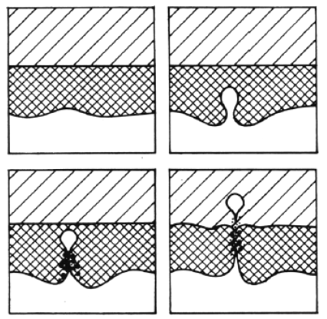
1. Background
The PRE is one factor that can trigger the growth of ionospheric irregularities.
The signature of ionospheric irregularities in the equatorial region is known as equatorial spread F (ESF).
ESF is important for space weather.
ESF, in particular, large-scale strucures can cause large disruptions in communications and navigation systems.
Upper panels show the development of the ESF [Woodman and LaHoz, 1976].
Notes:
Say first sentence.
This is typically how an equatorial irregularity forms. The electrodynamics of this phenomenon is very complicated but basically the ionosphere is unstable at night. The upward density gradient becomes very sharp at night, which in turn makes the ionosphere very susceptible to plasma depletions forming.
The general term for the signatures of these irregularities are known collectively as equatorial spread F.
These structures can cause scintillations in transionospheric radio waves and other disturbances.

Slide 5
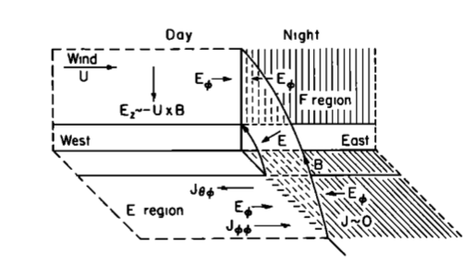
1. Background
Theory of the Pre-Reversal Enhancement
Farley et al., J. Geophys. Res, 91, 1986.
Notes:
There are three different theories of the PRE. The most cited theory was proposed by Farley et al. in 1986.

Slide 6
1. Background
Seasonal and Solar activity variation of the PRE
The seasonal variation of the PRE depends on the alignment of the magnetic meridian and sunset terminator (Abdu et al., 1992).
Scherliess and Fejer, J. Geophys. Res., 104, 6829, 1999.
Notes:
It’s been found that the better the alignment, the more of a PRE you have. Reference figure. So, for the equinoxes and december solstice, you should have a larger PRE and in june solstice a smaller PRE.
So, in other words, as solar activity changes, conductivity gradients change, and thus you have a larger PRE for higher solar flux conditions.

Slide 7
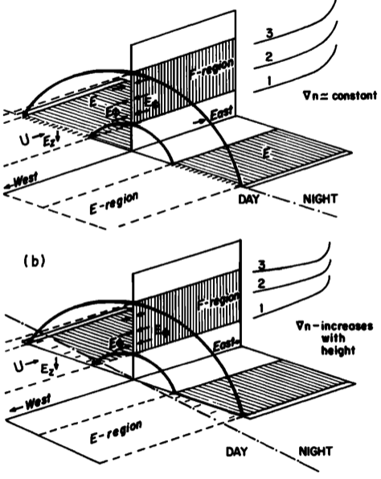
1. Background
Seasonal and Solar activity variation of the PRE
The seasonal variation of the PRE depends on the alignment of the magnetic meridian and sunset terminator (Abdu et al., 1992).
Scherliess and Fejer, J. Geophys. Res., 104, 6829, 1999.
Notes:
Just so you have a visual, here is what the magnetic meridian and sunset terminator look like when perfectly aligned and less than perfectly aligned.

Slide 8
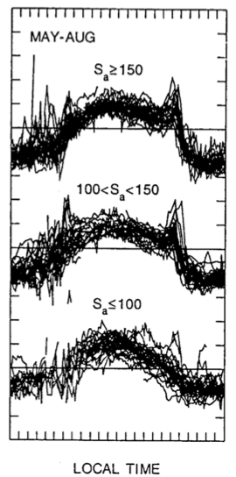

1. Background
Seasonal and Solar activity variation of the PRE
The increase in the PRE with solar activity is due to the differences in conductivity gradients across the terminator, as well as increased zonal wind velocity, as solar activity changes (Heelis et al., 1974).
Notes:
So, in other words, as solar activity increases, conductivity gradients increase (high conductivity/vacuum)(higher conductivity/vacuum), and thus you have a larger PRE for higher solar flux conditions.
Also there is more solar heating, thus creating larger pressure gradients, making the winds larger. Where the winds induce the currents that generate the localized E x B drift that is the PRE.

Slide 9
2. Motivation
The pre-reversal enhancement is believed to the main driver of the manifestation of ionospheric irregularities at equatorial latitudes (Fejer et al., 1996).
However, there have been a number of studies to observe ionospheric irregularities at middle latitudes (Mid-Latitude Spread F) (e.g., Swartz et al., 2000; Earle et al., 2010).

Slide 10
2. Motivation
Science question
Can we observe a PRE at mid-latitudes?
  During summer solstice, the PRE is expected to small at equatorial latitudes.
  On the other hand, the PRE may not be too small, since we are experiencing solar maximum conditions.
What will we observe at mid-latitudes?
Notes:
We thought it would be interesting to look for a PRE at mid-latitudes, especially during this time period.
During summer solstice when the PRE is expected to be small at equitorial latitudes, but maybe not too small since we are in solar max period.
At mid-latitudes, we may or may not oberserve a tiny PRE.

Slide 11
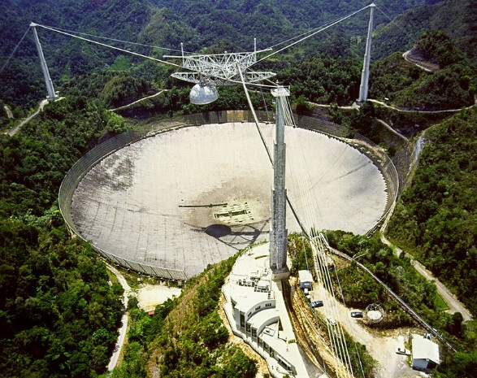
3. Observation
What: The enhancement of the eastward electric field.
How: By observing the E x B drifts, we can determine the electric field.
Overview of the Arecibo incoherent scatter radar.
Notes:
Our goal is to obtain an ion velocity vector every 8 minutes. Because the PRE is believed to occur over a long period of time, about 30 minutes, we believe 8 minutes is a good time resolution.

Slide 12
3. Observation
Time
7pm – 9pm LT :
post-sunset hours

Slide 13
3. Observation
Time
Mode
7pm – 9pm LT :
post-sunset hours
Multi-frequency mode (multiple radar autocorrelation function: MRACF)
  H+ Concentrations
  He+ Concentrations
  Electron Densities
  Ion Temperatures
  Electron Temperatures
  Line of Sight Velocities
  Vector Velocities (Geographic and Geomagnetic coordinates)

Slide 14
3. Observation
Operation - MRACF
In Freq domain
1
2
3
4
5
6
7
In Time domain
Decreasing noise by integrating seven ACFs in time domain
(= Increasing the accuracy of the IS spectrum in freq domain)
1
2
3
4
5
6
7
Integration

Slide 15
3. Observation
Time
Mode
7pm – 9pm LT :
post-sunset hours
Multi-frequency mode (multiple radar autocorrelation function: MRACF)
  H+ Concentrations
  He+ Concentrations
  Electron Densities
  Ion Temperatures
  Electron Temperatures
  Line of Sight Velocities
  Vector Velocities (Geographic and Geomagnetic coordinates)
Pointing direction
Gregorian at 15 degrees off-zenith
Azimuthal 360 degrees – constant rotation

Slide 16
3. Observation
Beam
Ion velocity vector
Measuring velocity with a non moving dish :
You can measure the velocity only in 1D.
Measured ion velocity
But velocity vector is described in 3D
Rotation to get the full vector

Slide 17
3. Observation
Linefeed :
Only vertical velocity
Very good resolution
Gregorian :
Rotation of 360° in 16 min
=> full vector every 4 min
Linefeed + Gregorian :
Assumptions :
  Velocity stable within 4 min
  Wind doesn’t change inside cone.
  => Velocity vector every 10 secondes !
15°
gregorian
linefeed

Slide 18
3. Observation
Field line
V⊥ East
V⊥ North
Earth
N
V antipar
E
up

Slide 19
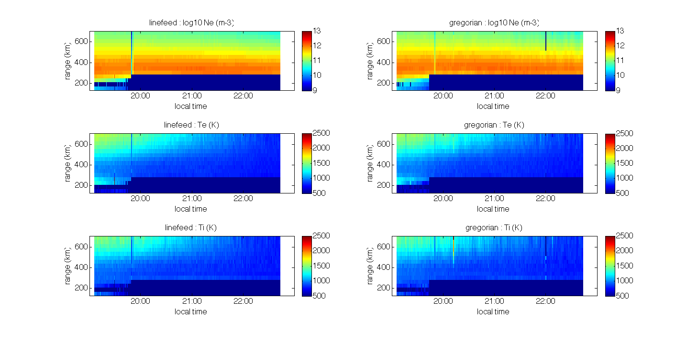
linefeed
4. Results
Ne
Same general trend but Ne is not the same in every direction

Slide 20
linefeed
4. Results
Ne
Same general trend but Ne is not the same in every direction

Slide 21
linefeed
4. Results
Ne
Same general trend but Ne is not the same in every direction

Slide 22
linefeed
4. Results
Ne
Same general trend but Ne is not the same in every direction

Slide 23
4. Results
linefeed
Ne
Te
Same general trend but Ne is not the same in every direction

Slide 24
4. Results
linefeed
Ne
Te
Ti
Same general trend but Ne is not the same in every direction

Slide 25
linefeed
4. Results
gregorian
Ne
Te
Ti
Same general trend but Ne is not the same in every direction

Slide 26
4. Results
linefeed
gregorian
Ne
Te
Ti
Same general trend but Ne is not the same in every direction

Slide 27
4. Results
linefeed
gregorian
Ne
Te
Ti
Same general trend but Ne is not the same in every direction

Slide 28
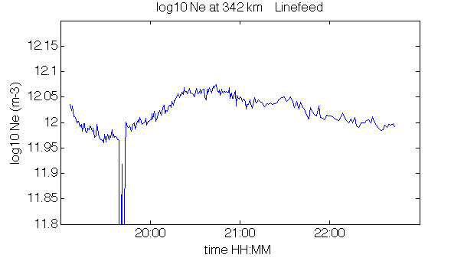
linefeed
4. Results
gregorian
Ne
Same general trend but Ne is not the same in every direction

Slide 29
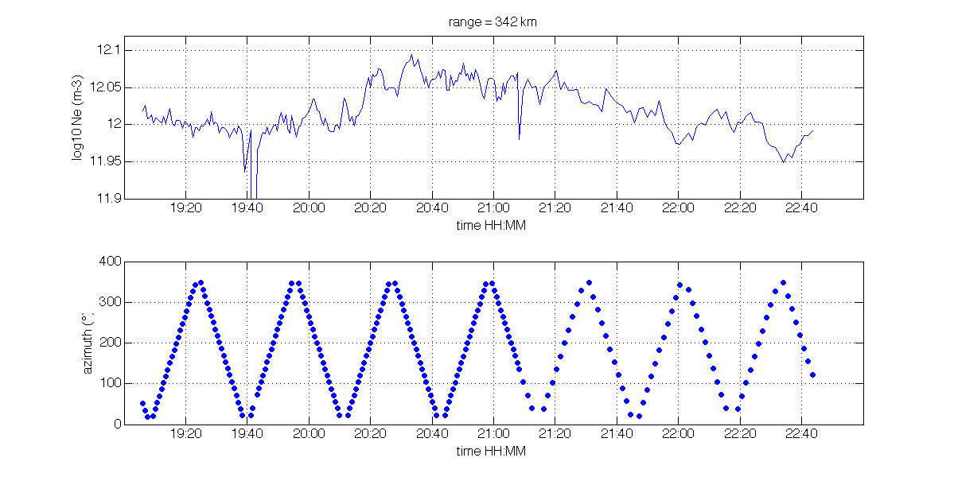
linefeed
4. Results
gregorian
Same general trend but Ne is not the same in every direction

Slide 30
Ne vs azimuth
4. Results

Slide 31
Ne vs azimuth
4. Results

Slide 32
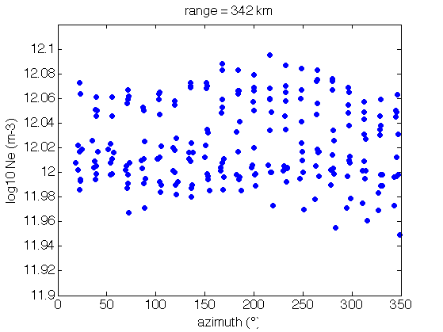
Ne vs azimuth
4. Results

Slide 33
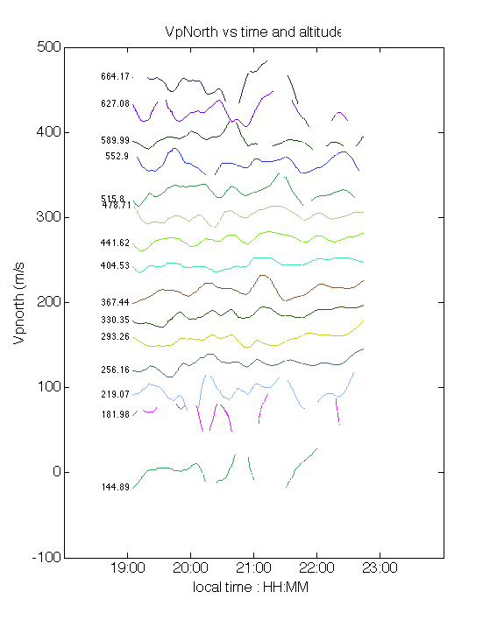
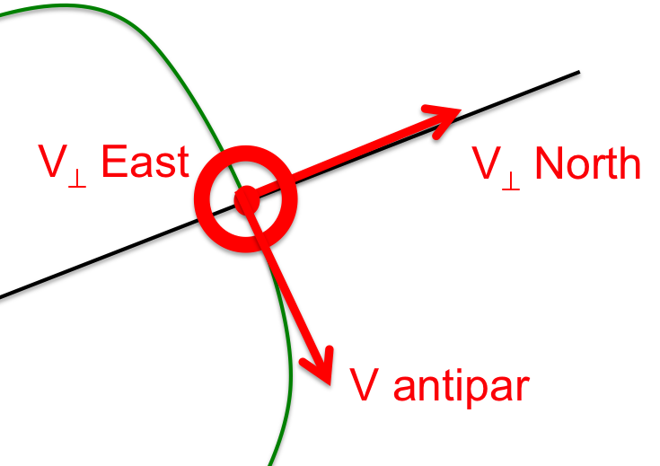
V⊥ north
4. Results

Slide 34
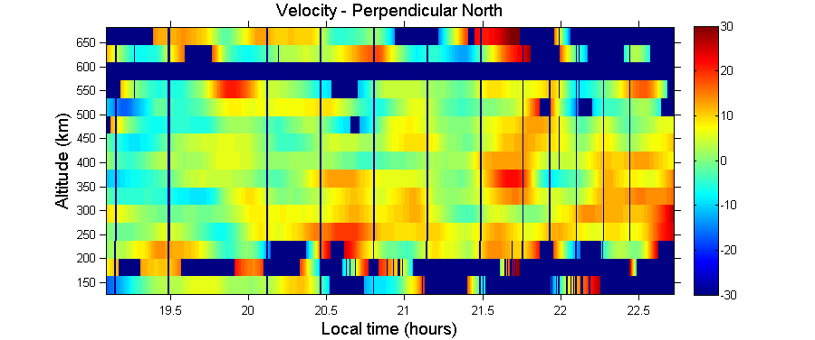
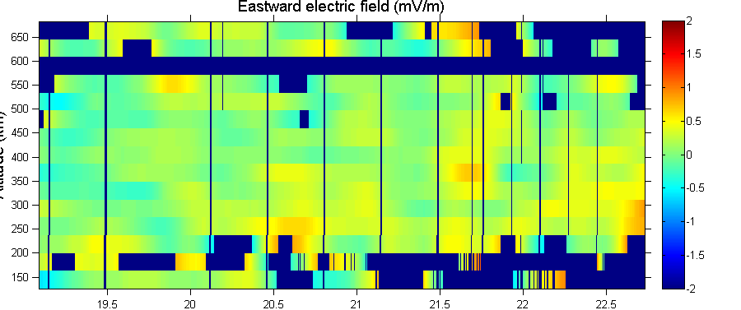
4. Results

Slide 35
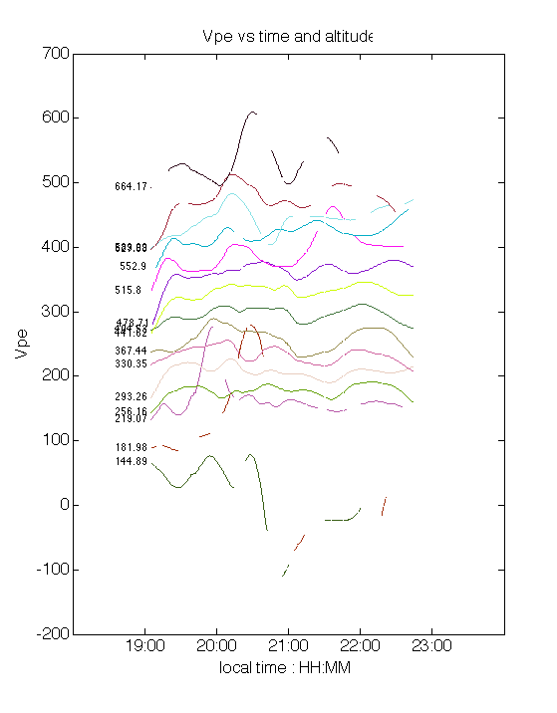
4. Results
V⊥ east

Slide 36
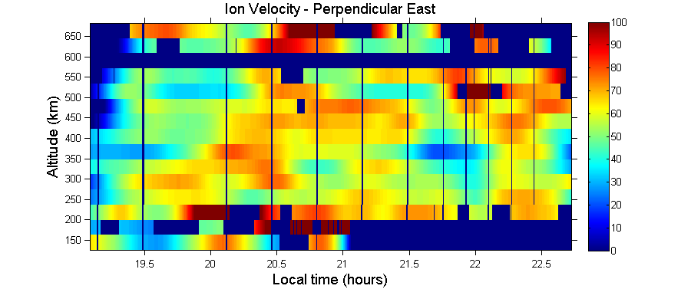
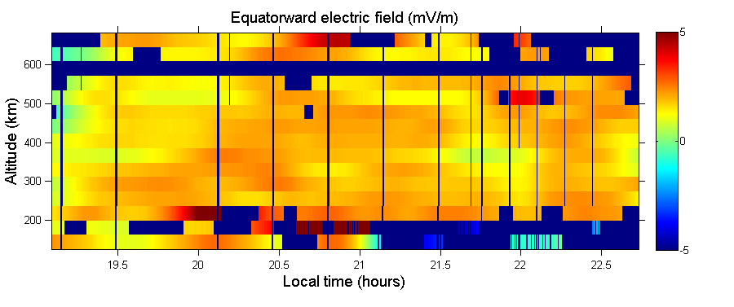
4. Results

Slide 37
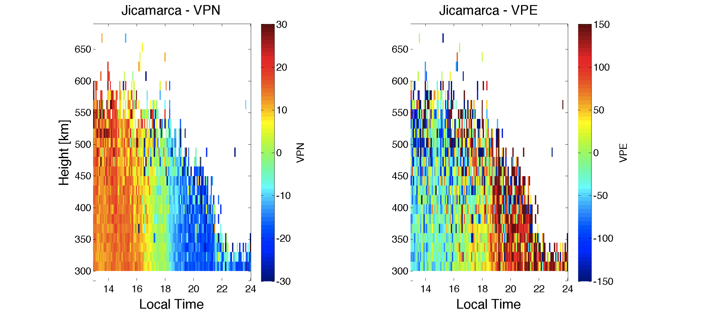
4. Results

Slide 38
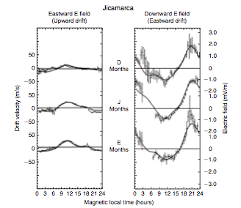
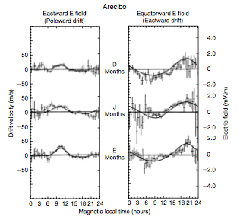
5. Discussion
Seasonally averaged quiet-day drifts and electric fields (points with error bars) and model drifts (solid lines) perpendicular to the geomagnetic field at 300 km for Jicamarca (left) and Arecibo (right) (Kelley, 2008).

Slide 39
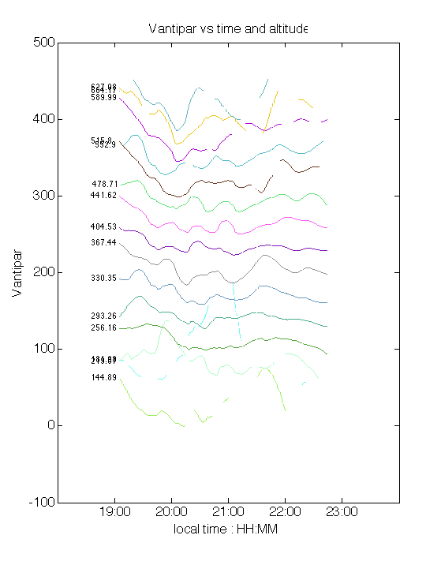
Vantipar
4. Results
Notes:
We see some kind of wave-like in the velocity along magnetic field at almost every altitude.

Slide 40
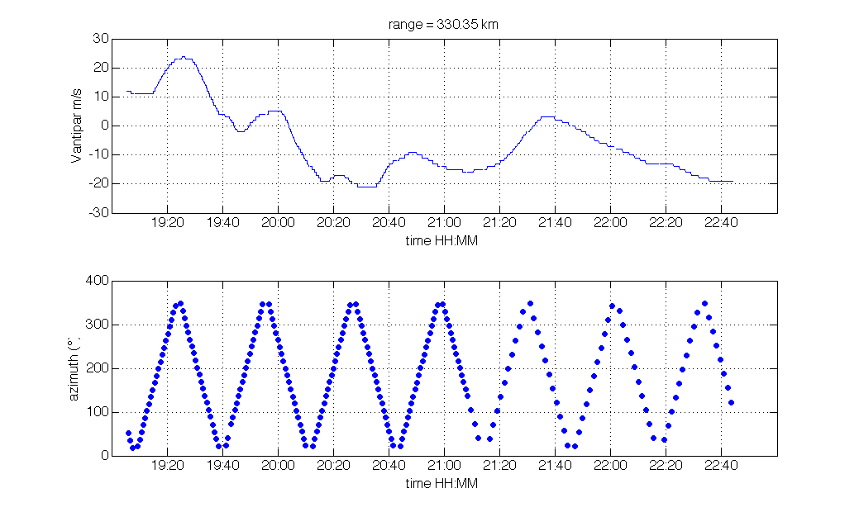
Vantipar vs azimuth
4. Results
Notes:
At a fixed altitude of about 330 km, we see some correlation with the azimuth of the gregorian before 9 pm. But after, there is little correlation. After 9, the experiment was changed, which could have something to do with the change in correlation.

Slide 41
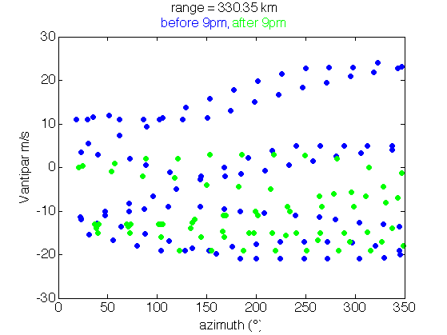
Vantipar vs azimuth
4. Results

Slide 42
6. Summary
Experiment:
  MRACF alternating between rotating Gregorian and Linefeed
Results:
  No significant PRE over Arecibo during June solstice (July 22, 2014 19:00 – 23:00 LT)
  Strange enhancement in VperpEast starting at low altitudes around 20:00 LT and increasing in altitude with time.
  Typical features (Ne, Te, Ti) at sunset, but slightly perturbed Ne, perhaps by atmospheric gravity waves.

