Slide 1

GPS Observations of CARE
(Quick Look)
MIT Haystack Observatory
15 December 2008
Eileen MacKenzie¹, Keith Groves², Charles Carrano¹, Dean Anneser²
¹Institute for Space Research
Boston College
²Space Vehicles Directorate
Air Force Research Laboratory

Slide 2
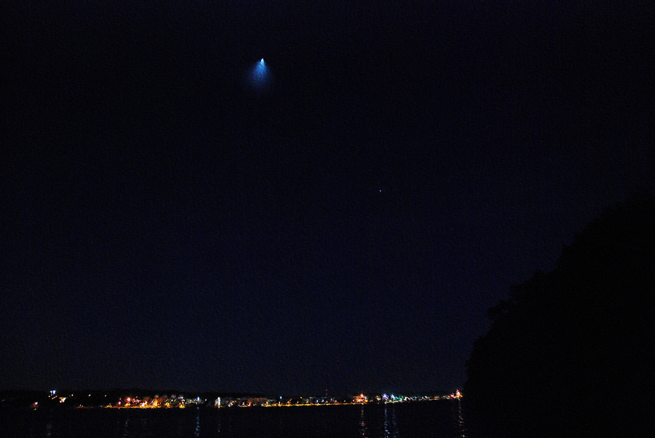
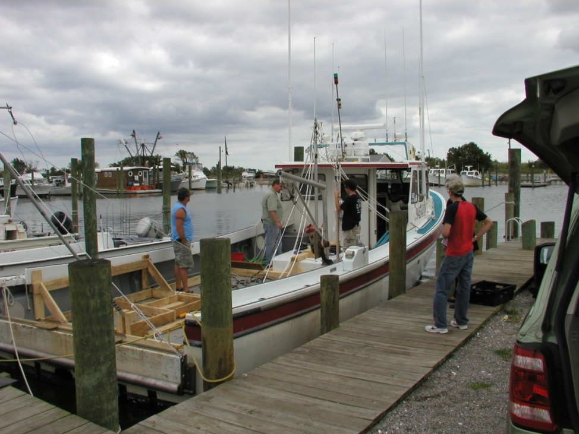
Contributing members of the cast….
Jake Quinn Randy Cicale Justin Cowley Mike Verlinden Ben Heruska

Slide 3
Outline
Boat-based GPS Observations
Land-based Observations
  CORS stations (1-Hz data rate)
  AFRL sensors (50-Hz data rate)
Summary
Note: These are preliminary results. AFRL has a limited
amount of data back from its deployed receivers

Slide 4
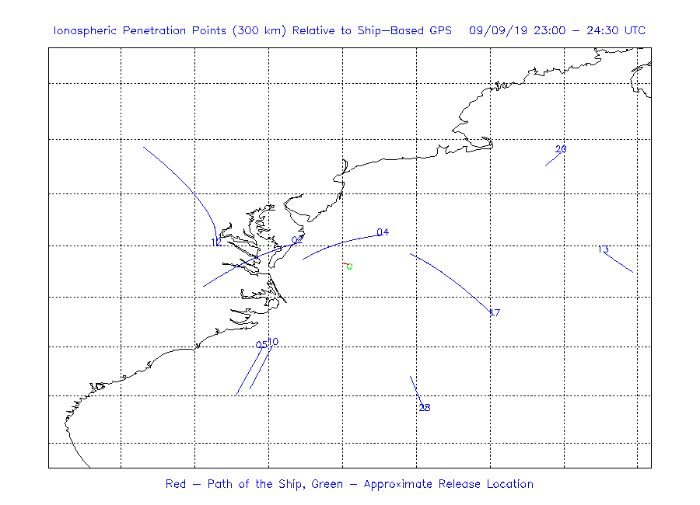
GPS Geometry from the Boat
Best Geometry at Ignition
GPS IPP at ignition
Elev angle = 71°
+
Boat
Burn
Available GPS ray paths do not pass closer than ~100 km from burn location
No clear CARE-related signatures observed; bounds spatial extent of hole

Slide 5
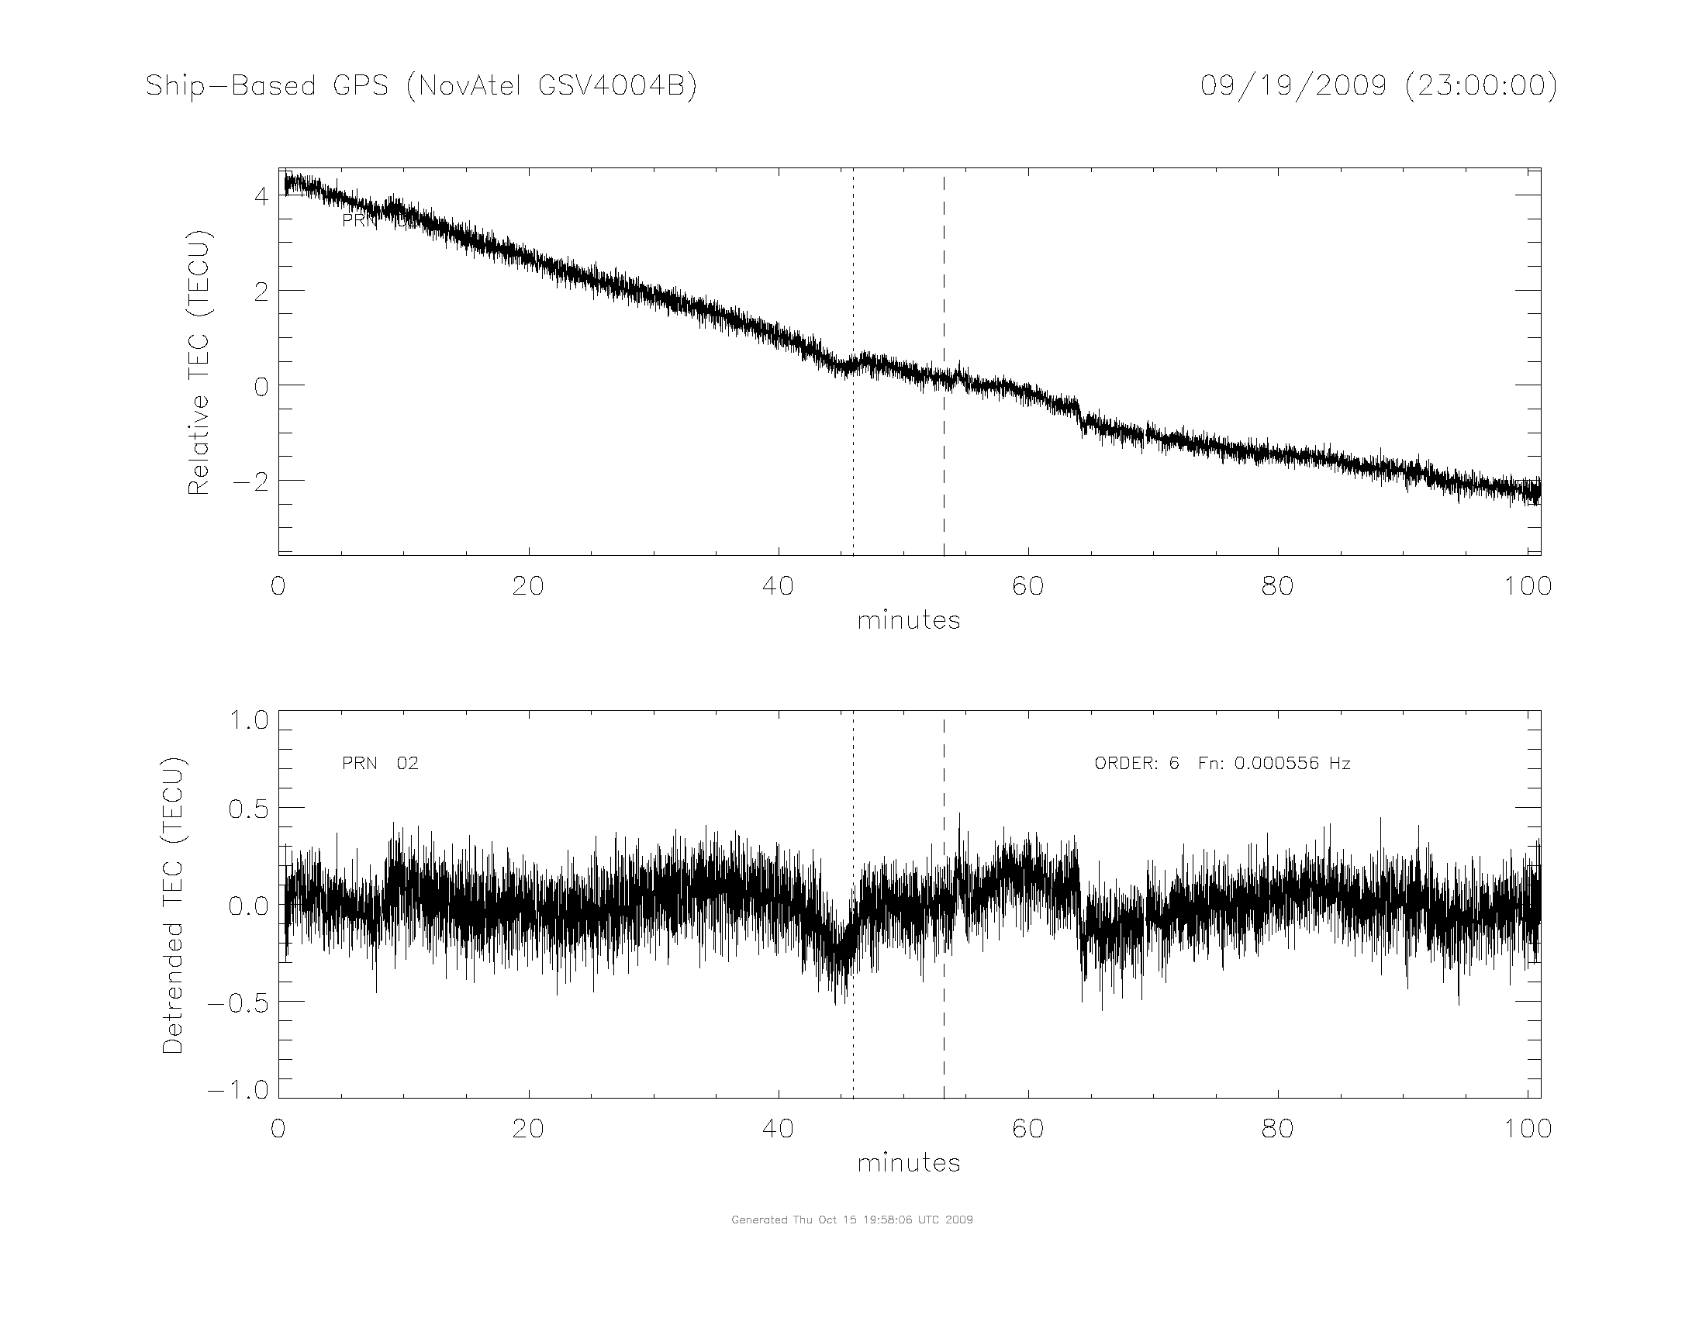
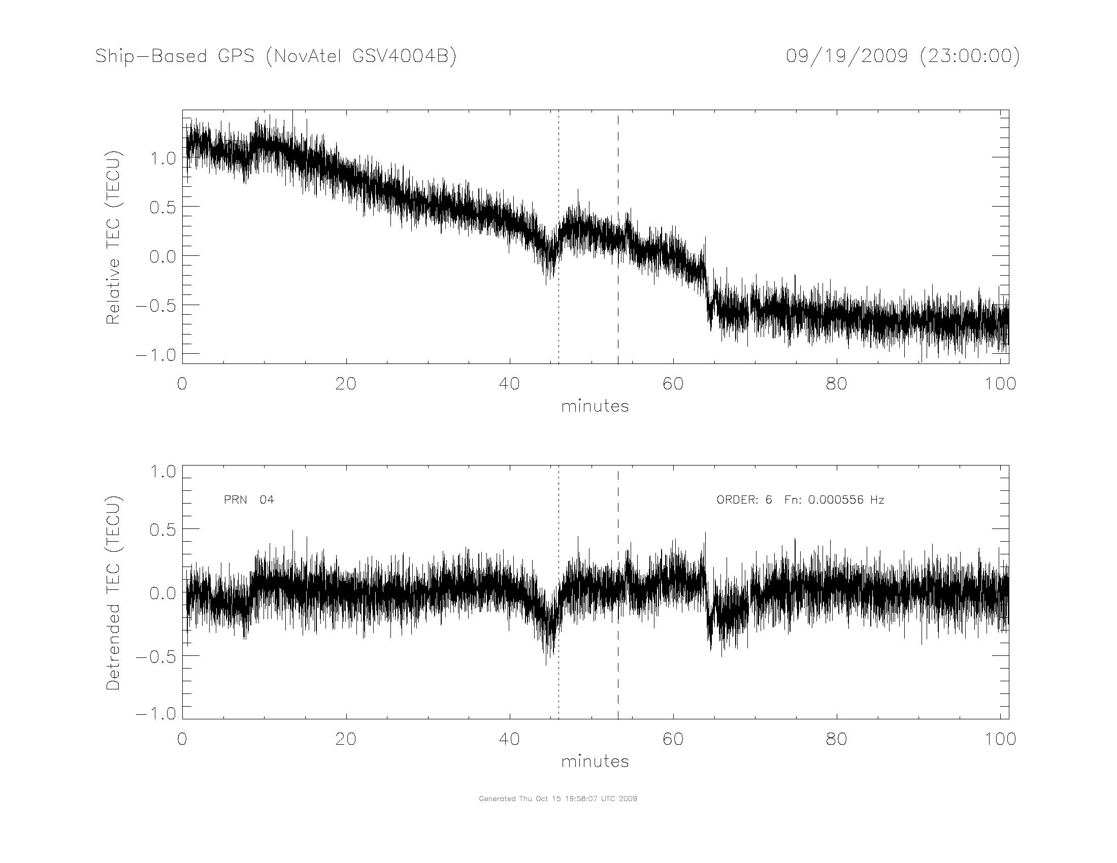
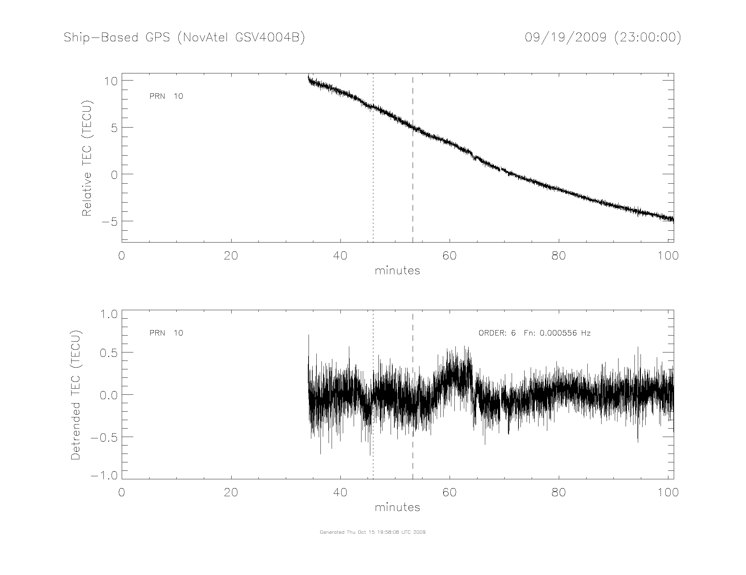
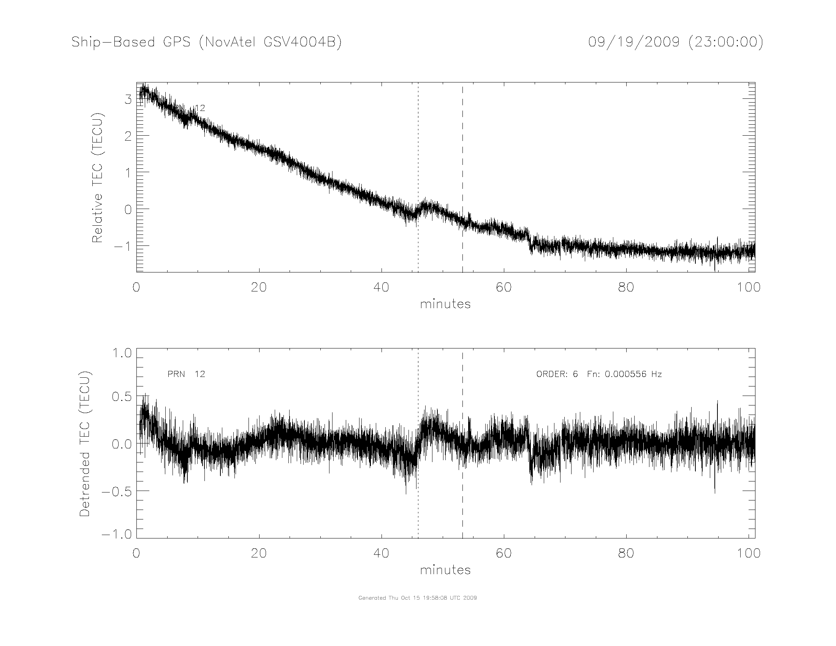
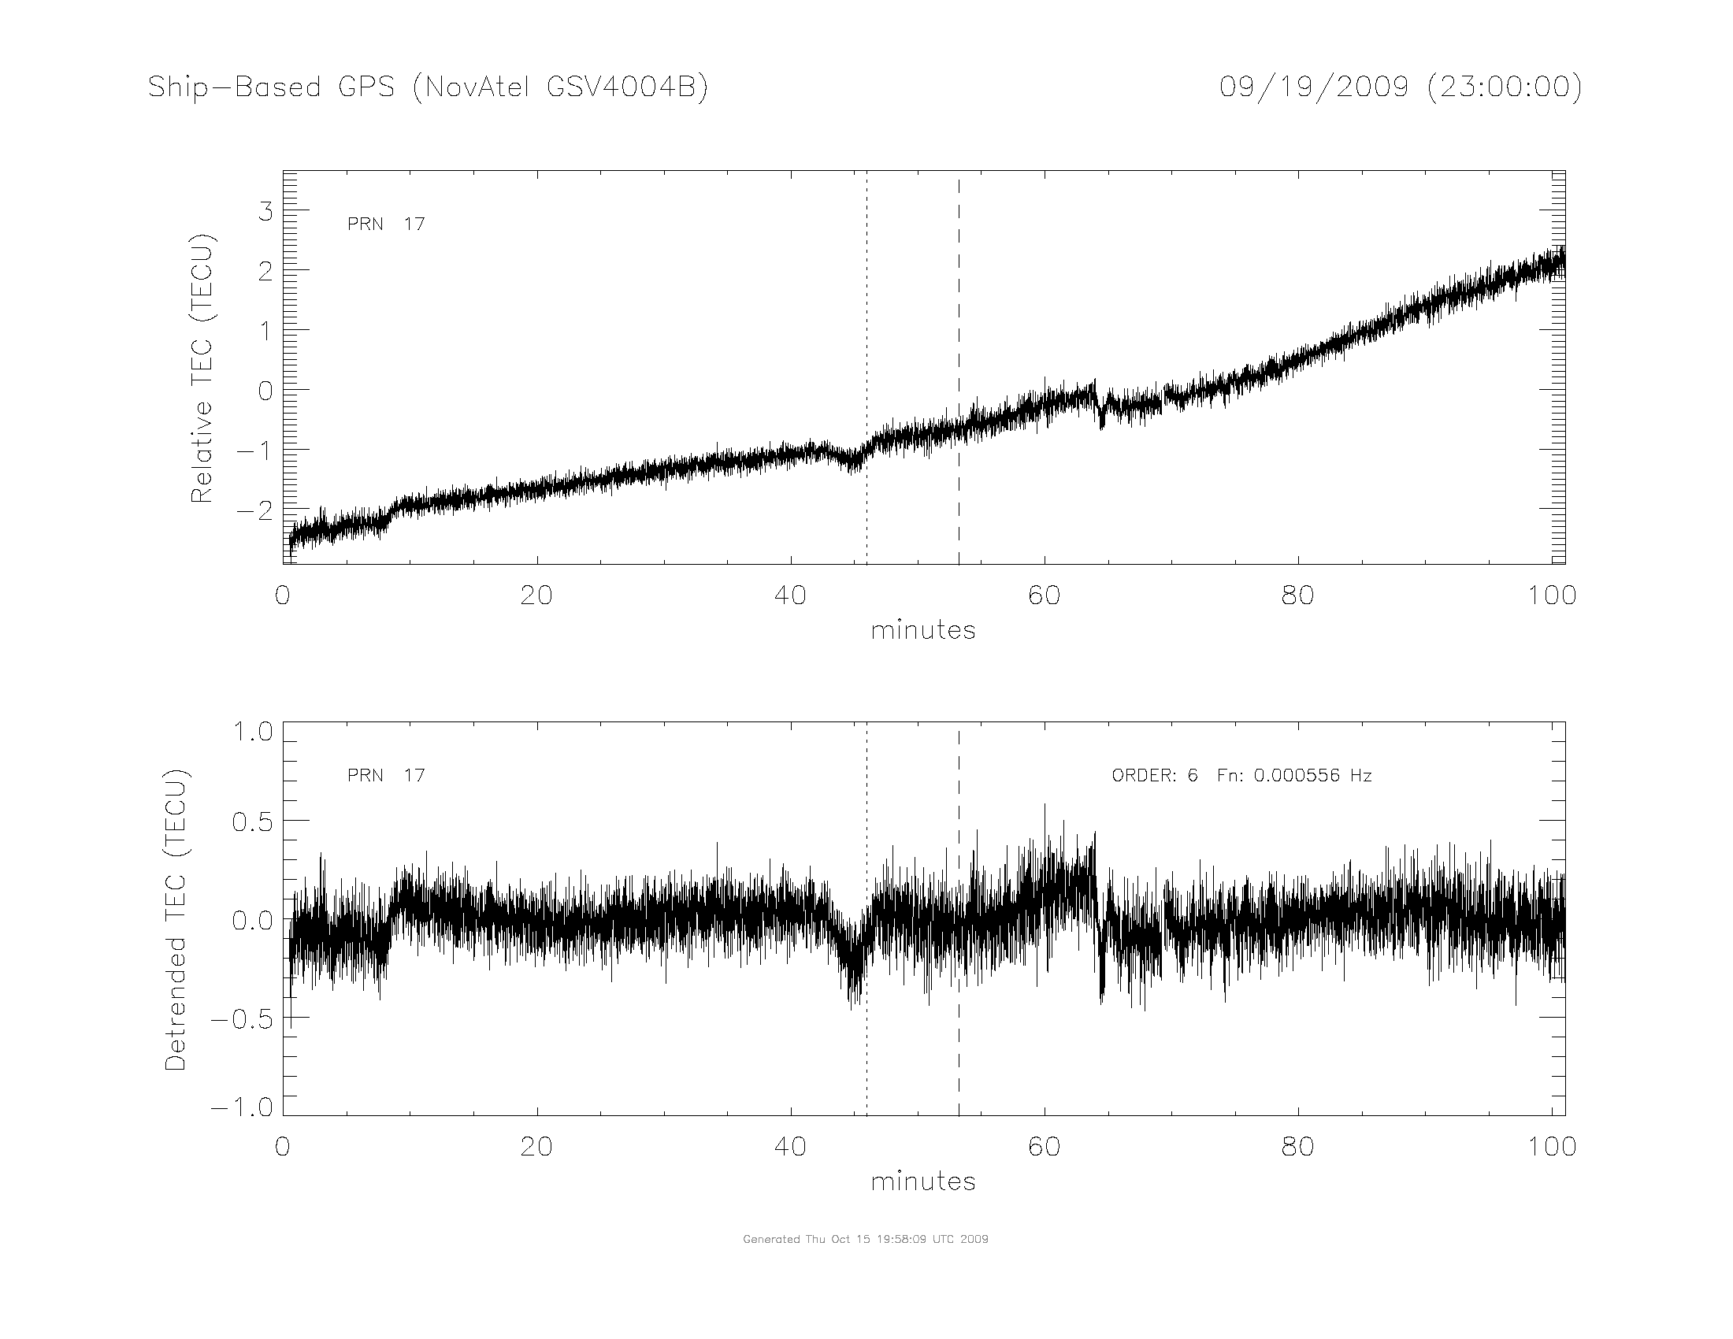
GPS Boat-based Artifacts?
PRN 04
Correlated dip in TEC observed on several PRNS simultaneously; geographic locations unrelated
IMPORTANT: PRN 04 observations bound northern extent of depletion

Slide 6
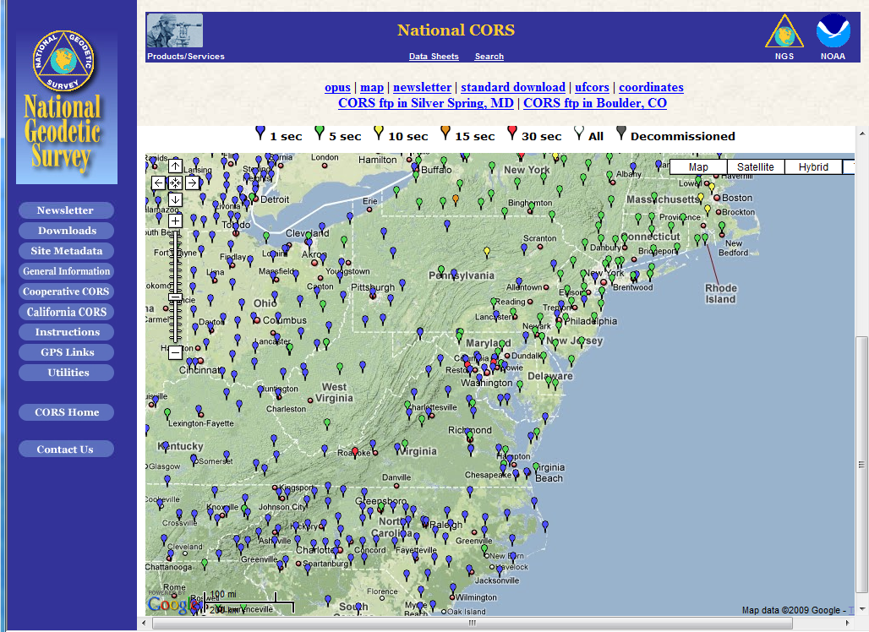
Land-based GPS Sensor Locations
Data from 5 sites presented in this quick report
LOYF
LOYM
MDSI
VAWI
LOYW

Slide 7
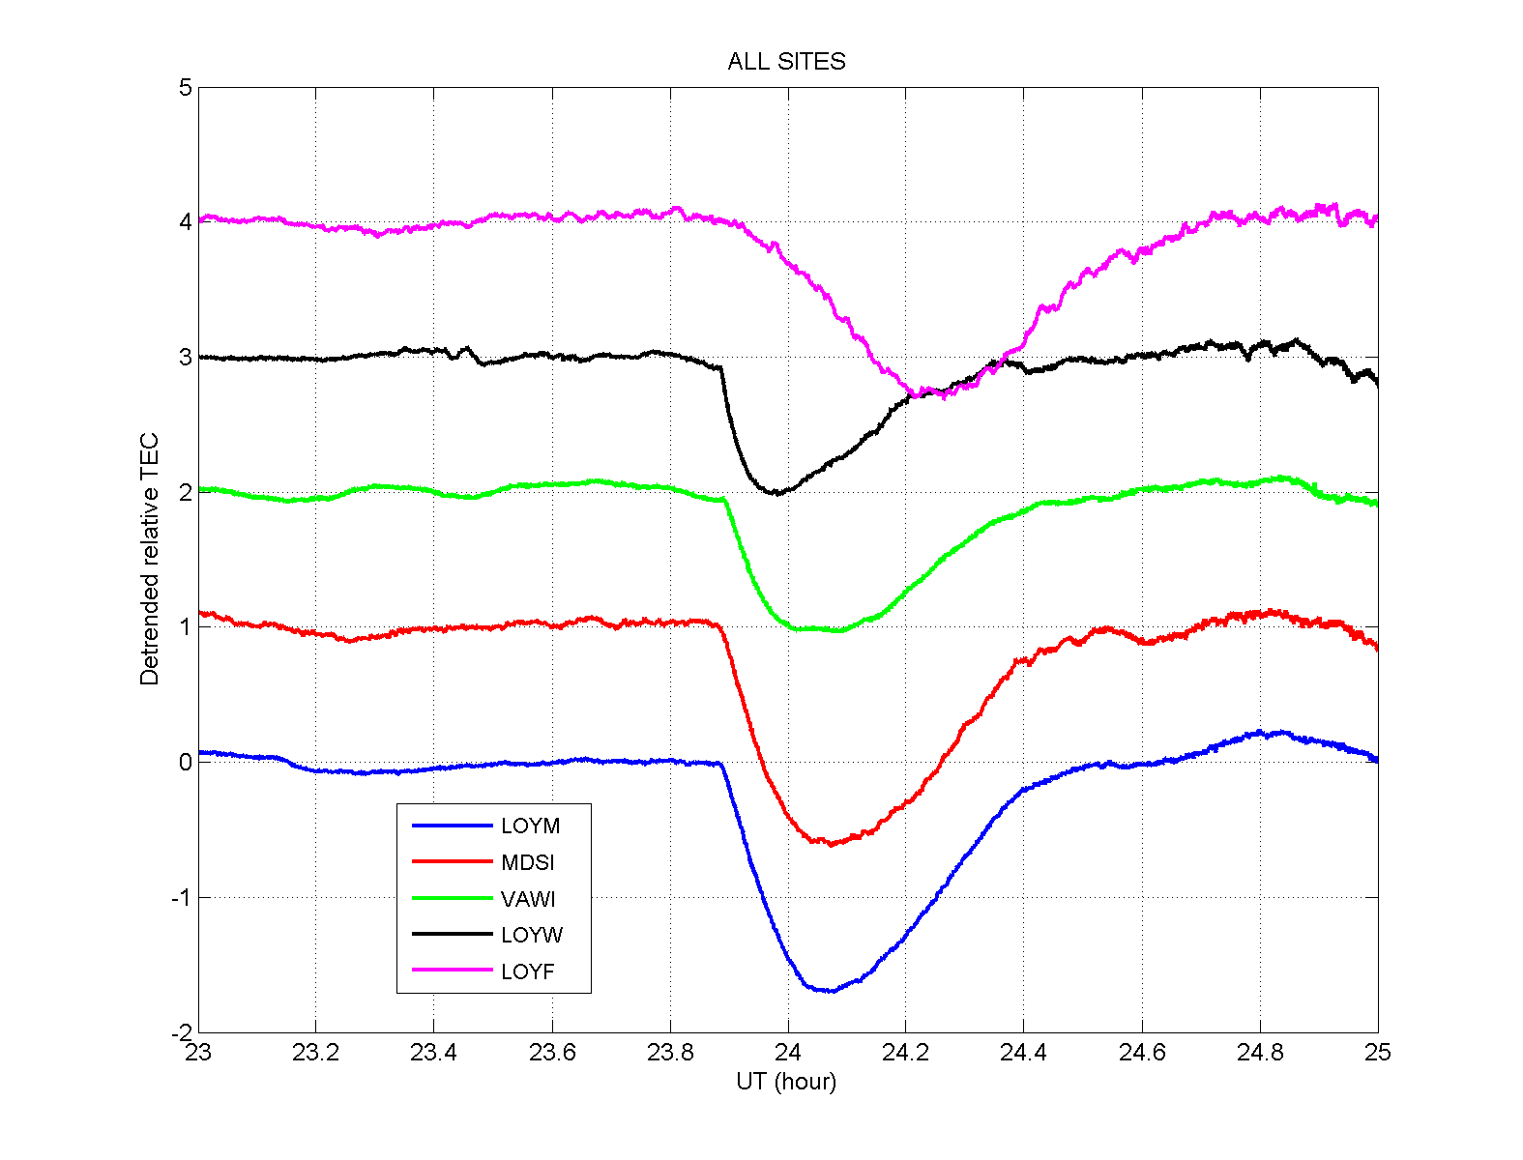
CARE TEC Perturbations
E
D
C
B
A

Slide 8
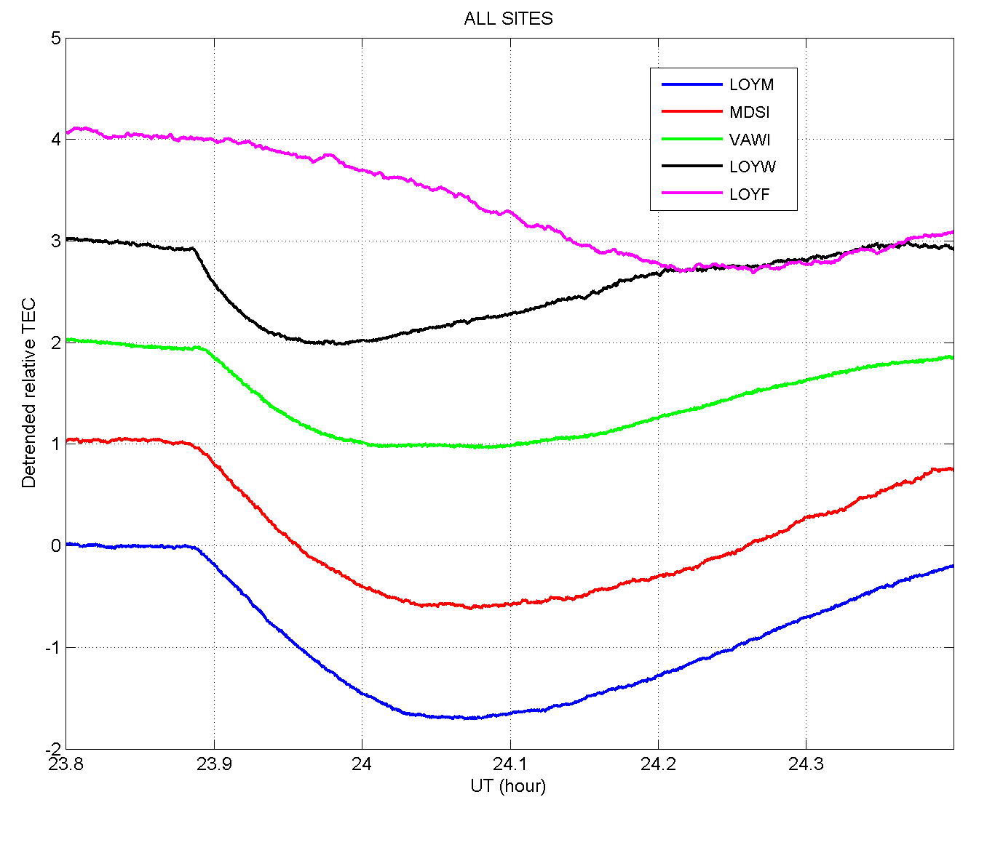
Hole Onset Period Expanded View
A & B are closest to sub-motor location at time of ignition and record largest perturbation
Onset time is nearly the same on all links, but small differences may yield information on formation and expansion rates
Track E detects the center of depletion approximately 20 minutes later than the other sites and shows lesser gradients; effects are probably occurring at higher altitude on this link; the IPP for this link is nearly identical to PRN 04 as observed from the boat which detected no signature
E
D
C
B
A

Slide 9
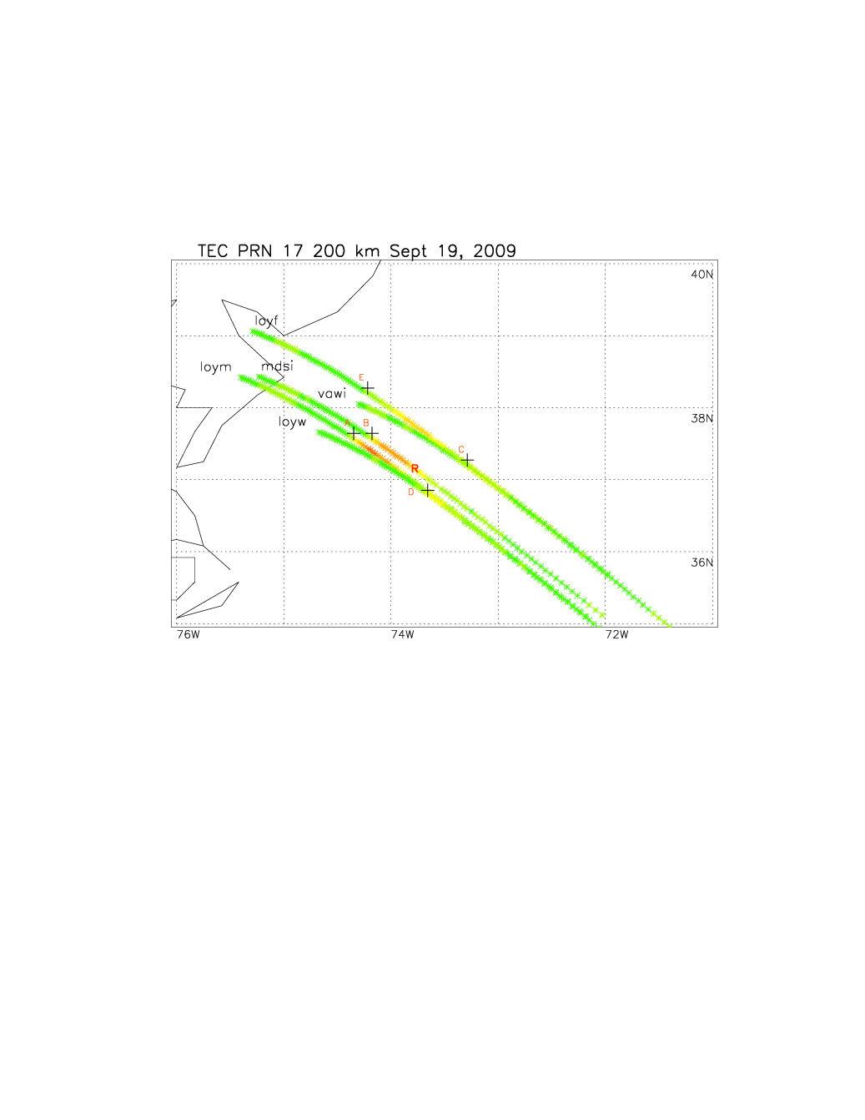
Mapping the Perturbation with GPS
The map shows the track of GPS IPPs from 23-25 UT; color corresponds to relative TEC
Location of the GPS IPPs at time of ignition is indicated with a ‘+’ symbol
From the digisonde the bottom of the F-region lies near 200 km altitude, the lowest altitude at which a depletion could be observed
IPP = 200 km
IPP location at time of ignition
TEC is an integrated quantity so the signatures actually come from a range of altitudes; elevation angles for the links shown range from 43°-45°

Slide 10
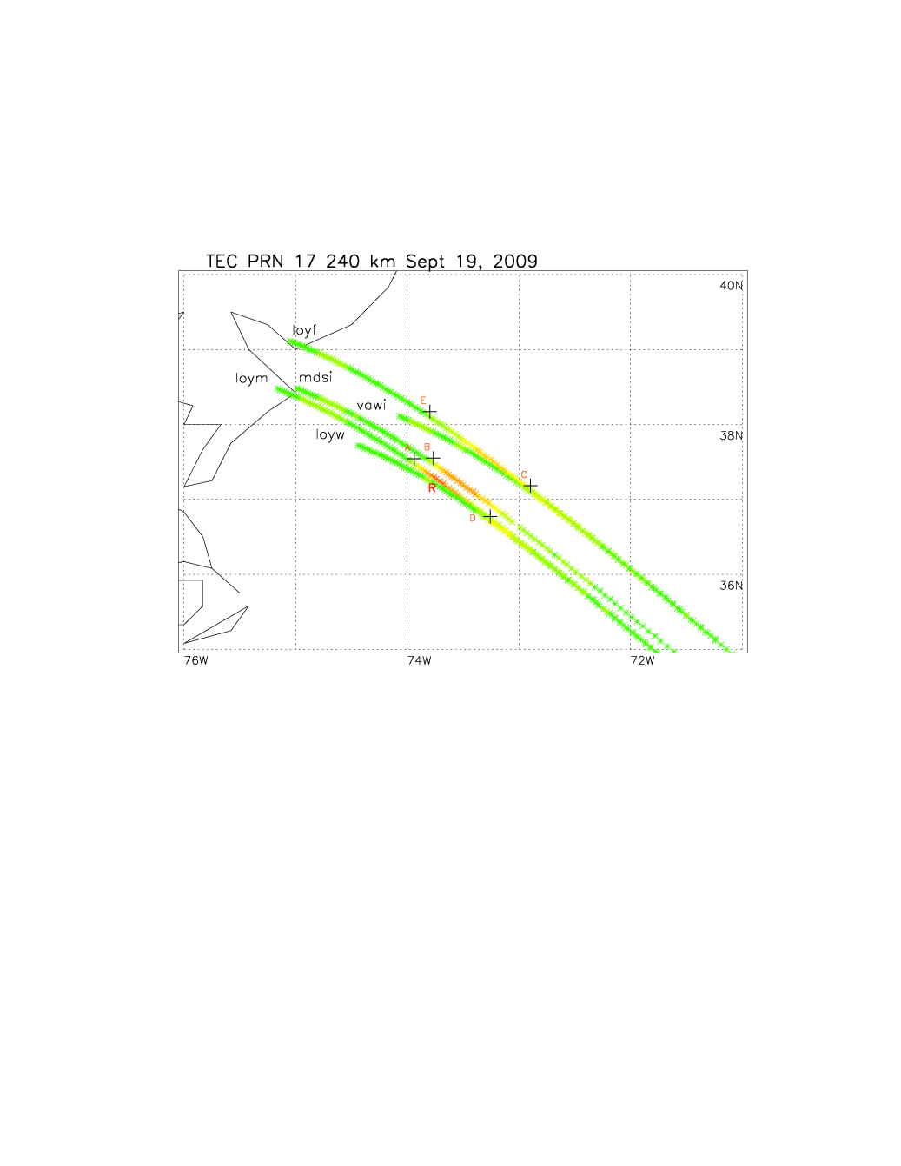
Mapping the Perturbation with GPS
240 km IPP places strongest perturbations observed closest to center of the release (Tracks A, B)
Tracks C & D are closer to the release location for lower IPPs
Higher IPP is required to account for depletion detection from Track E; the IPP as shown is nearly identical to the IPP from PRN 04 as observed at a very high elevation angle from the boat
IPP = 240 km
More thorough analysis can yield information on the vertical and horizontal characteristics of the perturbation

Slide 11
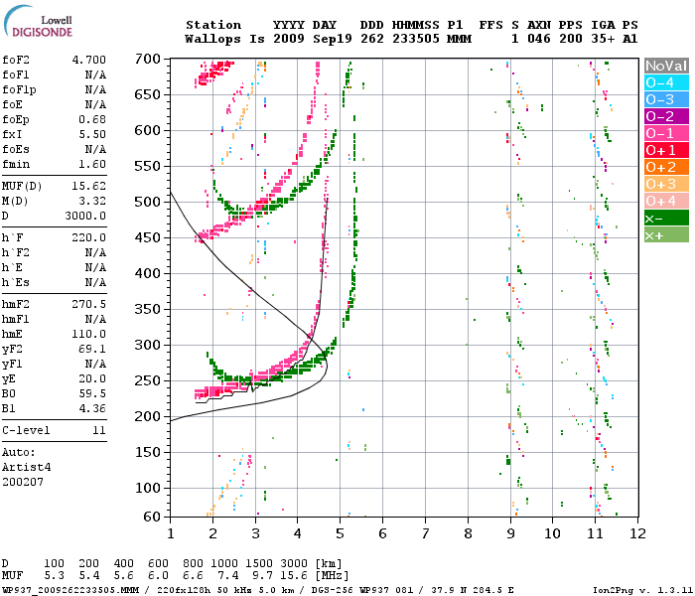
Pre-Launch Digisonde Profile
Digisonde indicates background peak density is too low for L-band scintillations
Bottom-side limits minimum height for observing the Ne perturbation to approximately 200 km
Upper bound is ~300 km based on rocket motor altitude at time of burn

Slide 12
Summary & Plans
CARE release produced significant ionospheric perturbation detected by GPS
  Depletion of ~1.8 TECU observed approximately 50 km in diameter
  Closest proximity of GPS ionospheric pierce points to release location was about 10 km
No scintillations were observed associated with the release
  FOF2 below 5 MHz suggests the density was too low even if irregularities were present
  AFRL data from Wallops Island has not been available for analysis yet; it should confirm results from CORS receiver (VAWI) and provide more detail on potential irregularities
More complete analysis of CORS data sets could be accomplished to perform 3-D tomographic analysis of the CARE perturbation

