Slide 1
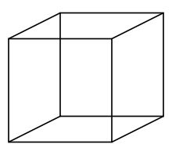
Syk
CD79 C
CD79 N

