Slide 1

Cost Savings Ideas and Realization (CSIR) Update
Rob Smyser

Slide 2
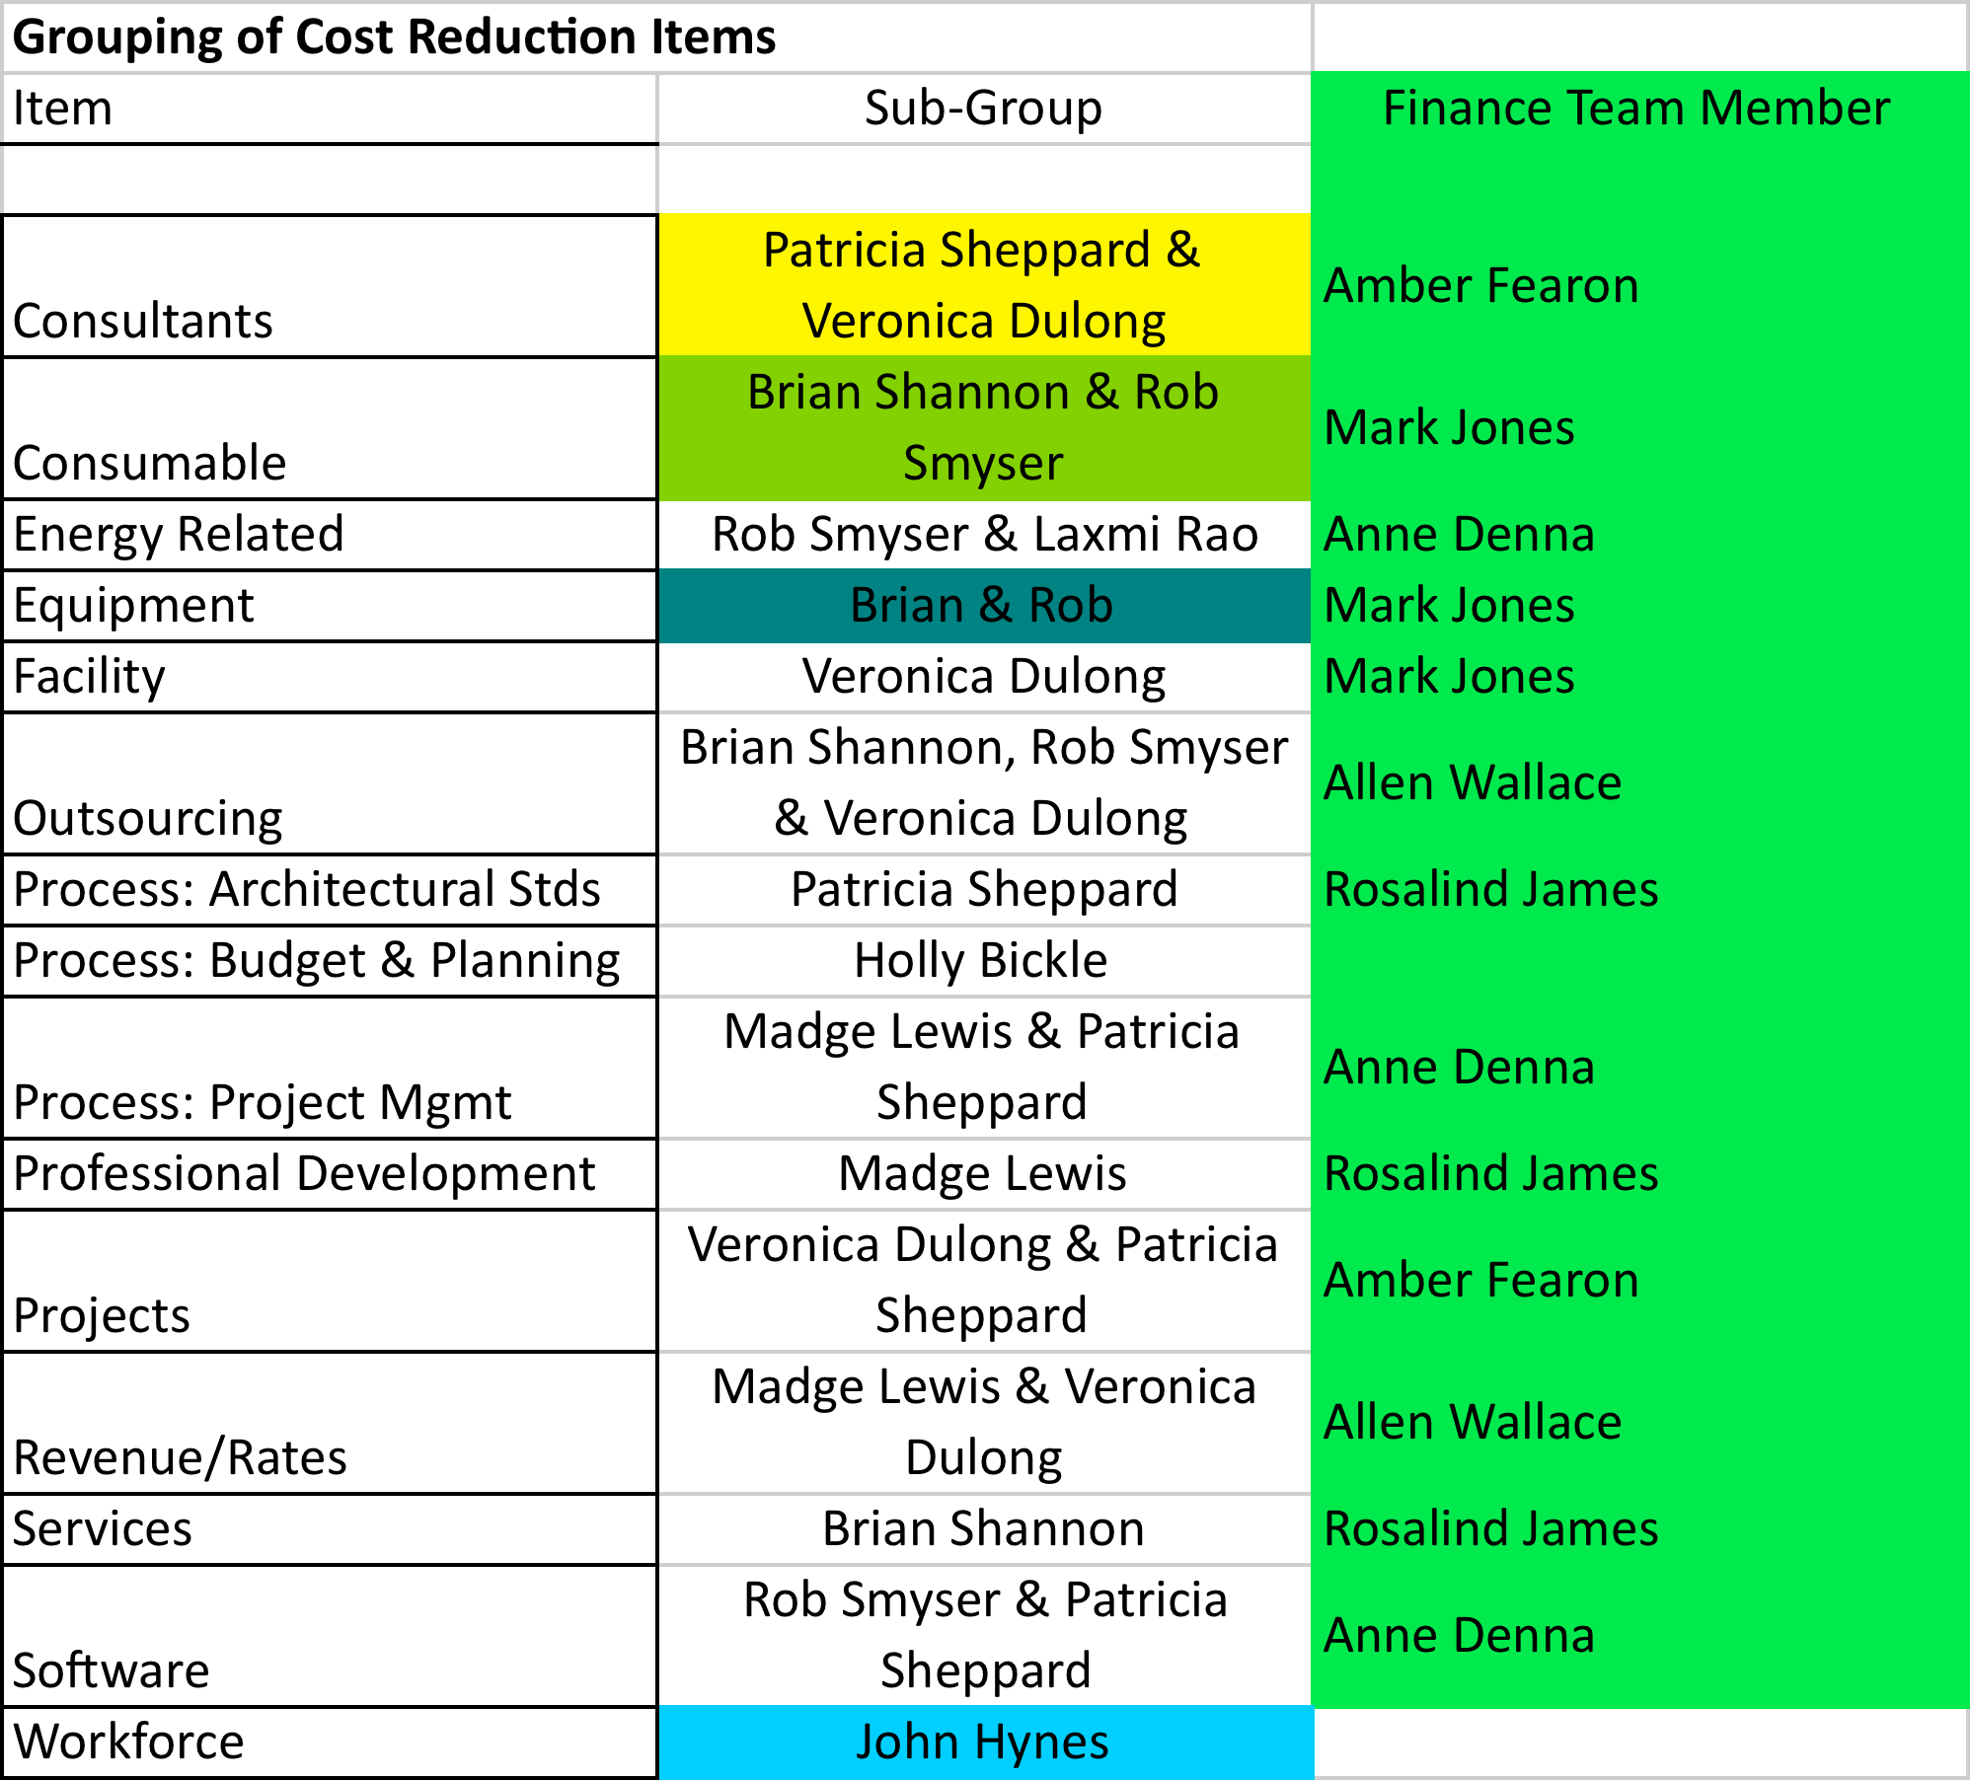
Sub-team Assignments

Slide 3
Work Process of CSIR
CSIR team member(s)
CSIR team
VP Staff
VP Staff
Interesting
Ideas
Good
Ideas
Great
Idea$
Ideas

Slide 4
Pipeline / Portfolio Management
Interesting
Ideas
Good
Ideas
Great Idea$
Ideas
Cost
to Do
Time

Slide 5
Idea Stage
Idea is collected with Item Number, Category, Item description, Impact, What’s needed to make it happen (and possibly rough SWAG of original potential savings estimates)
CSIR team members are assigned to appropriate sub-group(s)
Subgroup clarifies and consolidates/streamlines with other similar ideas
Subgroup looks at the idea to see if it is interesting enough
Exit criteria (to move from Idea to Interesting Idea)
  Consensus by the CSIR Team
  Documentation on Item along with responsible person (at least for the next phase of the idea)

Slide 6
Interesting Idea Stage
Interesting Idea is reviewed by responsible person(s).
Idea may need to be discussed by subgroup and/or relevant subject matter expert(s). Is there any there there?
Business Case template needs to be filled out with necessary modifications
Responsible person(s) bring the Interesting Idea to the CSIR Team with recommendation
If the CSIR Team agrees that the item is a Good Idea
Exit Criteria (to move from Interesting Idea to Good Idea)
  Approval of VP Staff to proceed, Business case documentation, Plan and resource assignment

Slide 7
Good Idea Stage
Project Team for the Idea launches
Communicate the launch of the effort broadly
Project Leader reports the progress to the CSIR Team based on agreed upon milestone points
Validate potential savings and report actual savings
Finance Team ‘recognize’ and report savings to the CSIR Team
CSIR Team reports to VP Staff on progress

Slide 8
Great Idea Stage
Once savings are on track, share the details on the Idea with broader audience
Continue to monitor the work and the progress of savings
Systematize as needed
Ensure proper documentation of the work

Slide 9
Pipeline Snapshot (as of 2/19)
250+
Ideas
Interesting
Ideas
Good
Ideas
6
12
Great
Idea$
10
101

Slide 10
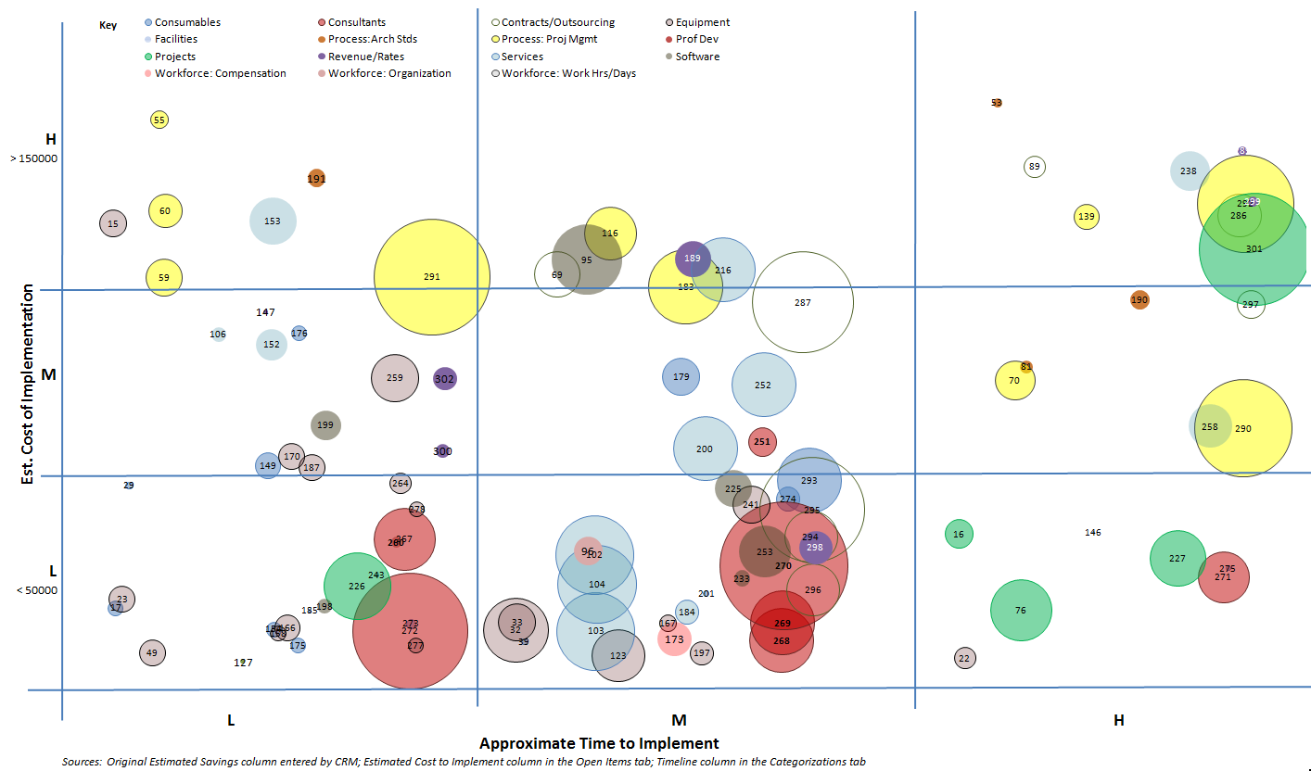

Slide 11
Some Completed Items
Consultants
  Renegotiated contract rates for upcoming year.
  Utilize internal resources instead of external consultants for VoIP transition work and insideMIT portal development,
  HR/Payroll and OIS projects
Travel and Professional Development
  Reduction on spend for FY09
Projects
  Reduction of FY09 Capital Plan Spend
Equipment
  Cell phone carrier consolidation and minute pooling
Hardware
  Deferred the SAP Hardware Renewal.
  Decommissioned servers and repurposed hardware
Software
  Renegotiated Genuitec (MyEclipse) software license

Slide 12
Interesting Ideas proposed to be Good Ideas
(reviewed Thursday 2/26 and 3/5)
#165: TSM Energy Savings Tool
  Create a software package for Macintosh and Windows that performs the necessary tweaks to registries and settings such that a machine that is “asleep” can wake up unattended to perform a scheduled TSM backup, then go back to sleep when finished.
# 276: Food and Beverage Restrictions
# 280: Reduce Travel and Professional Development

Slide 13
Summary
Savings so far…
  $2.1M for FY09, $1.1 for FY10, $341K for FY11 & beyond
IS&T CSIR Team logistics
  Weekly CSIR Team meetings
  Multiple subgroup work streams, w/ outsourcing to IS&T SMEs
  Weekly VP Staff reviews
Communication
  IS&T Inside and web site – https://web.mit.edu/ist/about/orgreview_costsavings/ and https://web.mit.edu/ist/about/orgreview_costsavings/pipeline.html
Community-Wide Initiatives
  ideabank.mit.edu
  http://web.mit.edu/instituteplanning

Slide 14

CSIR Team utilizes process that continues to evolve
Ideas
Interesting Ideas
Good Ideas
Great Ideas
Collect ideas
Assign category/theme
Assign to subgroup
Clarify ideas
Consolidate ideas
Evaluate ideas
Document potential savings, impact
Subgroup recommends to CSIR Team
Analyze idea
Develop range of savings vetted by FBC
Develop implementation plan
May involve SME
Identify assumptions
Subgroup recommends to CSIR Team
Launch project team for the idea
Progress to the CSIR Team based on agreed upon milestone points
Validate potential savings and report actual savings
CSIR Team reports to VP Staff on progress
Share the details on the Idea with broader audience
Continue to monitor the work and the progress of savings
Systematize as needed
Ensure proper documentation of the work
Activities
CSIR Team per subgroup’s recommendation
VP Staff per CSIR Team’s recommendation
VP Staff per CSIR Team’s updates
VP Staff per CSIR Team’s updates
Decision
Refined description
Impact statement
Rough saving estimate
Rationale
Responsible person for next phase
Business case documentation
Plan and resource assignment
Select communication
Savings realized
Broad communication
Savings realized
Best practice examples
General communication
Deliverables

