Slide 1
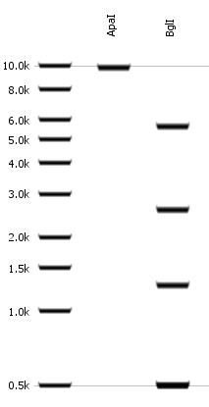
(1) Hef1a: BACE1-YFP and (2) Hef1a: YFP-BACE1

Slide 2

(3) Hef1a: YFP-BACE2

Slide 3

(4) TRE: YFP-BACE2

